Slide 1
Today’s Class
Housekeeping:
Midterm Project due by 11:59PM on Sunday, 1 Nov. 2020
6:00PM – 7:30PM: dplyr part one (data manipulation)
7:45PM – 8:45PM: tidyr functions for data reshaping
9:00PM – 9:50PM: MBTA group challenge

Slide 2

DON’T FORGET!
Go to the course website to download today’s Week 3 material.
Leverage the .R scripts so you don’t have to type everything!
Take notes by commenting in the scripts!

Slide 3
data
transformation
Visualize
Get
Clean
Transform
Communicate
Model
Understand
Program
☨A modified version of Hadley Wickham’s analytic process

Slide 4

INTRO TO THE TIDYVERSE

Slide 5
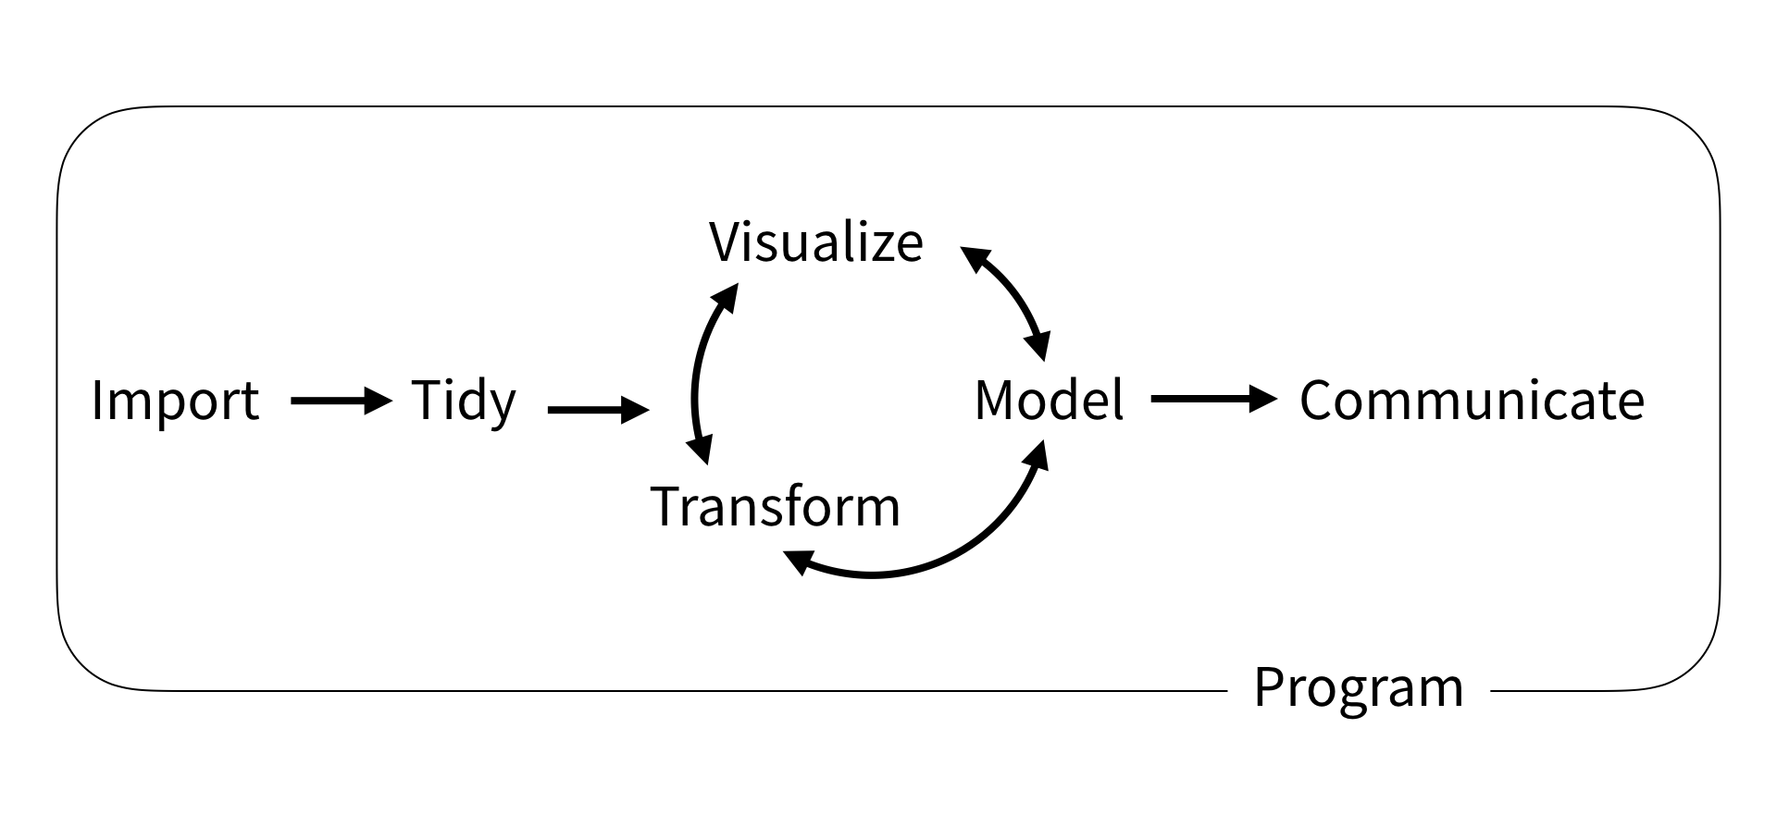
Typical Data Science Workflow

Slide 6

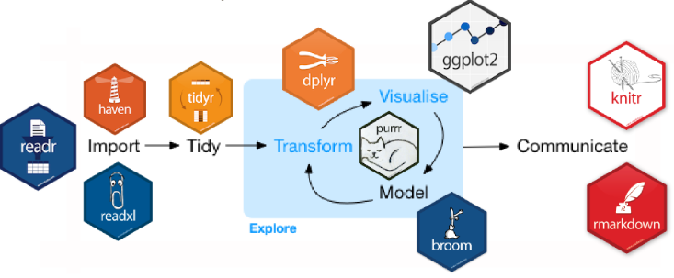
What Is the Tidyverse?
An opinionated collection of packages…
designed to simplify data analysis.

Slide 7
Installing/Loading Core Tidyverse Packages
install.packages(“tidyverse”)
does the equivalent of…
install.packages(“dplyr”)
install.packages(“ggplot2”)
install.packages(“tidyr”)
install.packages(“tibble”)
install.packages(“readr”)
install.packages(“purrr”)
install.packages(“stringr”)
install.packages(“forcats”)
library(tidyverse)
does the equivalent of…
library(dplyr)
library(ggplot2)
library(tidyr)
library(tibble)
library(readr)
library(purrr)
library(stringr)
library(forcats)

Slide 8
Other Tidyverse Packages not Automatically Loaded
The Tidyverse also includes many other packages that are not automatically loaded with library(tidyverse).
Use library() to load each package and leverage its more specialized capabilities.
# load core tidyverse packages
library(tidyverse)
# load other non-core tidyverse packages
# these aren’t the only non-core tidyverse packages
library(readxl) # reading excel spreadsheets
library(lubridate) # working with dates and datetimes
library(magrittr) # additional pipe operators
library(glue) # an alternative to paste

Slide 9
prerequisite

Slide 10
package prerequisite
library(nycflights13)
library(tidyverse)
#> Loading tidyverse: ggplot2
#> Loading tidyverse: tibble
#> Loading tidyverse: tidyr
#> Loading tidyverse: readr
#> Loading tidyverse: purrr
#> Loading tidyverse: dplyr
#> Conflicts with tidy packages ----------------------------------------------
#> filter(): dplyr, stats
#> lag(): dplyr, stats

Slide 11
data prerequisite
flights
# A tibble: 336,776 × 19
year month day dep_time sched_dep_time dep_delay arr_time sched_arr_time arr_delay carrier flight
<int> <int> <int> <int> <int> <dbl> <int> <int> <dbl> <chr> <int>
1 2013 1 1 517 515 2 830 819 11 UA 1545
2 2013 1 1 533 529 4 850 830 20 UA 1714
3 2013 1 1 542 540 2 923 850 33 AA 1141
4 2013 1 1 544 545 -1 1004 1022 -18 B6 725
5 2013 1 1 554 600 -6 812 837 -25 DL 461
6 2013 1 1 554 558 -4 740 728 12 UA 1696
7 2013 1 1 555 600 -5 913 854 19 B6 507
8 2013 1 1 557 600 -3 709 723 -14 EV 5708
9 2013 1 1 557 600 -3 838 846 -8 B6 79
10 2013 1 1 558 600 -2 753 745 8 AA 301
# ... with 336,766 more rows, and 8 more variables: tailnum <chr>, origin <chr>, dest <chr>,
# air_time <dbl>, distance <dbl>, hour <dbl>, minute <dbl>, time_hour <dttm>

Slide 12
Your turn!
Are there vignettes for the dplyr package?
Can you find additional documentation explaining the flights data set?

Slide 13
Solution
# are there vignettes for the dplyr package —> yes, 5 of them
vignette(package = "dplyr")
browseVignettes(package = "dplyr") # shows hyperlinks in browser
# additional documentation for the mpg data set
?flights

Slide 14

dplyr
We will learn six key dplyr functions that allow you to solve the vast majority of your data manipulation challenges. What do each do?
filter:
arrange:
select:
mutate:
summarize:
group_by:

Slide 15

filter
Filter values based on defined conditions

Slide 16
basic filtering
Filter based on one or more variables
filter(flights, month == 1)
# A tibble: 27,004 × 19
year month day dep_time sched_dep_time dep_delay arr_time sched_arr_time arr_delay
<int> <int> <int> <int> <int> <dbl> <int> <int> <dbl>
1 2013 1 1 517 515 2 830 819 11
2 2013 1 1 533 529 4 850 830 20
3 2013 1 1 542 540 2 923 850 33
4 2013 1 1 544 545 -1 1004 1022 -18
5 2013 1 1 554 600 -6 812 837 -25
6 2013 1 1 554 558 -4 740 728 12
7 2013 1 1 555 600 -5 913 854 19
8 2013 1 1 557 600 -3 709 723 -14
9 2013 1 1 557 600 -3 838 846 -8
10 2013 1 1 558 600 -2 753 745 8
# ... with 26,994 more rows, and 10 more variables: carrier <chr>, flight <int>,
# tailnum <chr>, origin <chr>, dest <chr>, air_time <dbl>, distance <dbl>, hour <dbl>,
# minute <dbl>, time_hour <dttm>

Slide 17
basic filtering
Filter based on one or more variables
filter(flights, month == 1, day == 1)
# A tibble: 842 × 19
year month day dep_time sched_dep_time dep_delay arr_time sched_arr_time arr_delay
<int> <int> <int> <int> <int> <dbl> <int> <int> <dbl>
1 2013 1 1 517 515 2 830 819 11
2 2013 1 1 533 529 4 850 830 20
3 2013 1 1 542 540 2 923 850 33
4 2013 1 1 544 545 -1 1004 1022 -18
5 2013 1 1 554 600 -6 812 837 -25
6 2013 1 1 554 558 -4 740 728 12
7 2013 1 1 555 600 -5 913 854 19
8 2013 1 1 557 600 -3 709 723 -14
9 2013 1 1 557 600 -3 838 846 -8
10 2013 1 1 558 600 -2 753 745 8
# ... with 832 more rows, and 10 more variables: carrier <chr>, flight <int>, tailnum <chr>,
# origin <chr>, dest <chr>, air_time <dbl>, distance <dbl>, hour <dbl>, minute <dbl>,
# time_hour <dttm>

Slide 18
basic filtering
Filter based on one or more variables
filter(flights, month == 1, day == 1, dep_delay > 0)
# A tibble: 352 × 19
year month day dep_time sched_dep_time dep_delay arr_time sched_arr_time arr_delay
<int> <int> <int> <int> <int> <dbl> <int> <int> <dbl>
1 2013 1 1 517 515 2 830 819 11
2 2013 1 1 533 529 4 850 830 20
3 2013 1 1 542 540 2 923 850 33
4 2013 1 1 601 600 1 844 850 -6
5 2013 1 1 608 600 8 807 735 32
6 2013 1 1 611 600 11 945 931 14
7 2013 1 1 613 610 3 925 921 4
8 2013 1 1 623 610 13 920 915 5
9 2013 1 1 632 608 24 740 728 12
10 2013 1 1 644 636 8 931 940 -9
# ... with 342 more rows, and 10 more variables: carrier <chr>, flight <int>, tailnum <chr>,
# origin <chr>, dest <chr>, air_time <dbl>, distance <dbl>, hour <dbl>, minute <dbl>,
# time_hour <dttm>

Slide 19
save new data frame
Save filter data frame using assignment operator (<-)
Save and view filtered data frame by wrapping entire function with ()
jan1 <- filter(flights, month == 1, day == 1)
(dec25 <- filter(flights, month == 12, day == 25))
# A tibble: 719 × 19
year month day dep_time sched_dep_time dep_delay arr_time sched_arr_time arr_delay
<int> <int> <int> <int> <int> <dbl> <int> <int> <dbl>
1 2013 12 25 456 500 -4 649 651 -2
2 2013 12 25 524 515 9 805 814 -9
3 2013 12 25 542 540 2 832 850 -18
4 2013 12 25 546 550 -4 1022 1027 -5
5 2013 12 25 556 600 -4 730 745 -15
6 2013 12 25 557 600 -3 743 752 -9
7 2013 12 25 557 600 -3 818 831 -13
8 2013 12 25 559 600 -1 855 856 -1
9 2013 12 25 559 600 -1 849 855 -6
10 2013 12 25 600 600 0 850 846 4
# ... with 709 more rows, and 10 more variables: carrier <chr>, flight <int>, tailnum <chr>,
# origin <chr>, dest <chr>, air_time <dbl>, distance <dbl>, hour <dbl>, minute <dbl>,
# time_hour <dttm>

Slide 20
logical tests
?Comparison
12 == 12
[1] TRUE
12 <= c(12, 11)
[1] TRUE FALSE
12 %in% c(12, 11, 8)
[1] TRUE
x <- c(12, NA, 11, NA, 8)
is.na(x)
[1] FALSE TRUE FALSE TRUE FALSE
< | Less than
> | Greater than
== | Equal to
<= | Less than or equal to
>= | Greater than or equal to
!= | Not equal to
%in% | Group membership
is.na | Is NA
!is.na | Is not NA

Slide 21
comparison
What will these operations produce?
filter(flights, month == 12)
filter(flights, month != 12)
filter(flights, month %in% c(11, 12))
filter(flights, arr_delay <= 120)
filter(flights, !(arr_delay <= 120))
filter(flights, is.na(tailnum))

Slide 22
comparison
What will these operations produce?
filter(flights, month == 12) # flights in December only
filter(flights, month != 12) # flights not in December
filter(flights, month %in% c(11, 12)) # November/December flights
filter(flights, arr_delay <= 120) # flights with arr. delays less than 120
filter(flights, !(arr_delay <= 120)) # flights with arr. Delays more than 120
filter(flights, is.na(tailnum)) # flights with missing tail numbers

Slide 23
multiple logical tests
12 == 12 & 12 < 14
[1] TRUE
12 == 12 & 12 < 10
[1] FALSE
12 == 12 | 12 < 10
[1] TRUE
any(12 == 12, 12 < 10)
[1] TRUE
all(12 == 12, 12 < 10)
[1] FALSE
?base::Logic
& | boolean and
| | boolean or
xor | exclusively x or y
! | not
any | any true
all | all true

Slide 24
multiple comparisons
Using comma is same as using &
filter(flights, month == 12, day == 25)
filter(flights, month == 12 & day == 25)
Use %in% as a shortcut for |
filter(flights, month == 11 | month == 12)
filter(flights, month %in% c(11, 12))
Are these the same????
filter(flights, !(arr_delay > 120 | dep_delay > 120))
filter(flights, arr_delay <= 120, dep_delay <= 120)

Slide 25
Your turn!
Find the number of flights that
Had an arrival delay of two or more hours
Flew to Houston (IAH or HOU)
Arrived more than two hours late, but didn’t leave late

Slide 26
Solution
# Had an arrival delay of two or more hours
filter(flights, arr_delay >= 120)
# Flew to Houston (IAH or HOU)
filter(flights, dest %in% c("IAH", "HOU"))
# Arrived more than two hours late, but didn’t leave late
filter(flights, arr_delay > 120, dep_delay <= 0)

Slide 27

arrange
Reorder data

Slide 28
ordering your data
Order data based on one or more variables
arrange(flights, dep_delay)
# A tibble: 336,776 × 19
year month day dep_time sched_dep_time dep_delay arr_time sched_arr_time arr_delay carrier flight
<int> <int> <int> <int> <int> <dbl> <int> <int> <dbl> <chr> <int>
1 2013 12 7 2040 2123 -43 40 2352 48 B6 97
2 2013 2 3 2022 2055 -33 2240 2338 -58 DL 1715
3 2013 11 10 1408 1440 -32 1549 1559 -10 EV 5713
4 2013 1 11 1900 1930 -30 2233 2243 -10 DL 1435
5 2013 1 29 1703 1730 -27 1947 1957 -10 F9 837
6 2013 8 9 729 755 -26 1002 955 7 MQ 3478
7 2013 10 23 1907 1932 -25 2143 2143 0 EV 4361
8 2013 3 30 2030 2055 -25 2213 2250 -37 MQ 4573
9 2013 3 2 1431 1455 -24 1601 1631 -30 9E 3318
10 2013 5 5 934 958 -24 1225 1309 -44 B6 375
# ... with 336,766 more rows, and 8 more variables: tailnum <chr>, origin <chr>, dest <chr>, air_time <dbl>,
# distance <dbl>, hour <dbl>, minute <dbl>, time_hour <dttm>

Slide 29
ordering your data
Order data based on one or more variables
arrange(flights, dep_delay, arr_delay)
# A tibble: 336,776 × 19
year month day dep_time sched_dep_time dep_delay arr_time sched_arr_time arr_delay carrier flight
<int> <int> <int> <int> <int> <dbl> <int> <int> <dbl> <chr> <int>
1 2013 12 7 2040 2123 -43 40 2352 48 B6 97
2 2013 2 3 2022 2055 -33 2240 2338 -58 DL 1715
3 2013 11 10 1408 1440 -32 1549 1559 -10 EV 5713
4 2013 1 11 1900 1930 -30 2233 2243 -10 DL 1435
5 2013 1 29 1703 1730 -27 1947 1957 -10 F9 837
6 2013 8 9 729 755 -26 1002 955 7 MQ 3478
7 2013 3 30 2030 2055 -25 2213 2250 -37 MQ 4573
8 2013 10 23 1907 1932 -25 2143 2143 0 EV 4361
9 2013 5 5 934 958 -24 1225 1309 -44 B6 375
10 2013 9 18 1631 1655 -24 1812 1845 -33 AA 2223
# ... with 336,766 more rows, and 8 more variables: tailnum <chr>, origin <chr>, dest <chr>, air_time <dbl>,
# distance <dbl>, hour <dbl>, minute <dbl>, time_hour <dttm>

Slide 30
ordering your data
Reverse the order by using desc()
arrange(flights, desc(dep_delay))
# A tibble: 336,776 × 19
year month day dep_time sched_dep_time dep_delay arr_time sched_arr_time arr_delay carrier flight
<int> <int> <int> <int> <int> <dbl> <int> <int> <dbl> <chr> <int>
1 2013 1 9 641 900 1301 1242 1530 1272 HA 51
2 2013 6 15 1432 1935 1137 1607 2120 1127 MQ 3535
3 2013 1 10 1121 1635 1126 1239 1810 1109 MQ 3695
4 2013 9 20 1139 1845 1014 1457 2210 1007 AA 177
5 2013 7 22 845 1600 1005 1044 1815 989 MQ 3075
6 2013 4 10 1100 1900 960 1342 2211 931 DL 2391
7 2013 3 17 2321 810 911 135 1020 915 DL 2119
8 2013 6 27 959 1900 899 1236 2226 850 DL 2007
9 2013 7 22 2257 759 898 121 1026 895 DL 2047
10 2013 12 5 756 1700 896 1058 2020 878 AA 172
# ... with 336,766 more rows, and 8 more variables: tailnum <chr>, origin <chr>, dest <chr>, air_time <dbl>,
# distance <dbl>, hour <dbl>, minute <dbl>, time_hour <dttm>

Slide 31
ordering your data
Note that missing values are always sorted at the end:
df <- tibble(x = c(5, 2, 5, NA))
# A tibble: 4 × 1
x
<dbl>
1 5
2 2
3 5
4 NA
arrange(df, x)
# A tibble: 4 × 1
x
<dbl>
1 2
2 5
3 5
4 NA
arrange(df, desc(x))
# A tibble: 4 × 1
x
<dbl>
1 5
2 5
3 2
4 NA

Slide 32
Your turn!
Sort flights to find those with largest departure delays
Find the flights that left earliest based on departure time
Which flights traveled the longest distance?
Which traveled the shortest?

Slide 33
Solution
# Sort flights to find those with largest departure delays
arrange(flights, desc(dep_delay))
# Find the flights that left earliest
arrange(flights, dep_time)
# Which flights travelled the longest?
arrange(flights, desc(distance))
# Which travelled the shortest?
arrange(flights, distance)

Slide 34

select
Select variables of concern

Slide 35
selecting variables
Select one or more variables
select(flights, year, month, day)
# A tibble: 336,776 × 3
year month day
<int> <int> <int>
1 2013 1 1
2 2013 1 1
3 2013 1 1
4 2013 1 1
5 2013 1 1
6 2013 1 1
7 2013 1 1
8 2013 1 1
9 2013 1 1
10 2013 1 1
# ... with 336,766 more rows
select(flights, year:day)
# A tibble: 336,776 × 3
year month day
<int> <int> <int>
1 2013 1 1
2 2013 1 1
3 2013 1 1
4 2013 1 1
5 2013 1 1
6 2013 1 1
7 2013 1 1
8 2013 1 1
9 2013 1 1
10 2013 1 1
# ... with 336,766 more rows
Same
Results

Slide 36
selecting variables
Deselect one or more variables
select(flights, -(year:day))
# A tibble: 336,776 × 16
dep_time sched_dep_time dep_delay arr_time sched_arr_time arr_delay carrier flight
<int> <int> <dbl> <int> <int> <dbl> <chr> <int>
1 517 515 2 830 819 11 UA 1545
2 533 529 4 850 830 20 UA 1714
3 542 540 2 923 850 33 AA 1141
4 544 545 -1 1004 1022 -18 B6 725
5 554 600 -6 812 837 -25 DL 461
6 554 558 -4 740 728 12 UA 1696
7 555 600 -5 913 854 19 B6 507
8 557 600 -3 709 723 -14 EV 5708
9 557 600 -3 838 846 -8 B6 79
10 558 600 -2 753 745 8 AA 301
# ... with 336,766 more rows, and 8 more variables: tailnum <chr>, origin <chr>,
# dest <chr>, air_time <dbl>, distance <dbl>, hour <dbl>, minute <dbl>,
# time_hour <dttm>

Slide 37
useful select functions
* Blue functions come in dplyr
- | Select everything but
: | Select range
contains() | Select columns whose name contains a character string
starts_with() | Select columns whose name starts with a character string
ends_with() | Select columns whose name ends with a string
everything() | Select every column
matches() | Select columns whose name matches a regular expression
num_range() | Select columns named x1, x2, x3, x4, x5
one_of()/any_of | Select columns whose names are in a group of names

Slide 38
selecting variables
Select variables based on name patterns
select(flights, ends_with("time"))
# A tibble: 336,776 × 5
dep_time sched_dep_time arr_time sched_arr_time air_time
<int> <int> <int> <int> <dbl>
1 517 515 830 819 227
2 533 529 850 830 227
3 542 540 923 850 160
4 544 545 1004 1022 183
5 554 600 812 837 116
6 554 558 740 728 150
7 555 600 913 854 158
8 557 600 709 723 53
9 557 600 838 846 140
10 558 600 753 745 138
# ... with 336,766 more rows

Slide 39
selecting variables
Select variables based on multiple name patterns
select(flights, c(carrier, ends_with("time"), contains("delay")))
# A tibble: 336,776 × 8
carrier dep_time sched_dep_time arr_time sched_arr_time air_time dep_delay arr_delay
<chr> <int> <int> <int> <int> <dbl> <dbl> <dbl>
1 UA 517 515 830 819 227 2 11
2 UA 533 529 850 830 227 4 20
3 AA 542 540 923 850 160 2 33
4 B6 544 545 1004 1022 183 -1 -18
5 DL 554 600 812 837 116 -6 -25
6 UA 554 558 740 728 150 -4 12
7 B6 555 600 913 854 158 -5 19
8 EV 557 600 709 723 53 -3 -14
9 B6 557 600 838 846 140 -3 -8
10 AA 558 600 753 745 138 -2 8
# ... with 336,766 more rows

Slide 40
variable placement
Sometimes we just want to change the order of variables
select(flights, time_hour, air_time, everything())
# A tibble: 336,776 × 19
time_hour air_time year month day dep_time sched_dep_time dep_delay arr_time
<dttm> <dbl> <int> <int> <int> <int> <int> <dbl> <int>
1 2013-01-01 05:00:00 227 2013 1 1 517 515 2 830
2 2013-01-01 05:00:00 227 2013 1 1 533 529 4 850
3 2013-01-01 05:00:00 160 2013 1 1 542 540 2 923
4 2013-01-01 05:00:00 183 2013 1 1 544 545 -1 1004
5 2013-01-01 06:00:00 116 2013 1 1 554 600 -6 812
6 2013-01-01 05:00:00 150 2013 1 1 554 558 -4 740
7 2013-01-01 06:00:00 158 2013 1 1 555 600 -5 913
8 2013-01-01 06:00:00 53 2013 1 1 557 600 -3 709
9 2013-01-01 06:00:00 140 2013 1 1 557 600 -3 838
10 2013-01-01 06:00:00 138 2013 1 1 558 600 -2 753
# ... with 336,766 more rows, and 10 more variables: sched_arr_time <int>, arr_delay <dbl>,
# carrier <chr>, flight <int>, tailnum <chr>, origin <chr>, dest <chr>, distance <dbl>,
# hour <dbl>, minute <dbl>

Slide 41
renaming variables
Other times we just want to rename our variables:
rename(flights, ANNOYING = dep_delay)
# A tibble: 336,776 × 19
year month day dep_time sched_dep_time ANNOYING arr_time sched_arr_time arr_delay
<int> <int> <int> <int> <int> <dbl> <int> <int> <dbl>
1 2013 1 1 517 515 2 830 819 11
2 2013 1 1 533 529 4 850 830 20
3 2013 1 1 542 540 2 923 850 33
4 2013 1 1 544 545 -1 1004 1022 -18
5 2013 1 1 554 600 -6 812 837 -25
6 2013 1 1 554 558 -4 740 728 12
7 2013 1 1 555 600 -5 913 854 19
8 2013 1 1 557 600 -3 709 723 -14
9 2013 1 1 557 600 -3 838 846 -8
10 2013 1 1 558 600 -2 753 745 8
# ... with 336,766 more rows, and 10 more variables: carrier <chr>, flight <int>,
# tailnum <chr>, origin <chr>, dest <chr>, air_time <dbl>, distance <dbl>,
# hour <dbl>, minute <dbl>, time_hour <dttm>

Slide 42
Your turn!
What happens if you include the name of a variable multiple times in a select() call?
What does the one_of() function do? Why might it be helpful in conjunction with this vector?
vars <- c("MONTH", "month", "day", "dep_delay", "arr_delay")
Does the result of running the following code surprise you? How do the select helpers deal with case by default? How can you change that default?
select(flights, contains("TIME"))

Slide 43
Solution
# 1. what happens if you call a variable multiple times in select()
select(flights, month, month)
# A tibble: 336,776 × 1
month
<int>
1 1
2 1
3 1
4 1
5 1
6 1
7 1
8 1
9 1
10 1
# ... with 336,766 more rows

Slide 44
Solution
# 2. what does one_of() do?
vars <- c("MONTH", “month", "day", "dep_delay", "arr_delay")
select(flights, one_of(vars))
# A tibble: 336,776 × 4
month day dep_delay arr_delay
<int> <int> <dbl> <dbl>
1 1 1 2 11
2 1 1 4 20
3 1 1 2 33
4 1 1 -1 -18
5 1 1 -6 -25
6 1 1 -4 12
7 1 1 -5 19
8 1 1 -3 -14
9 1 1 -3 -8
10 1 1 -2 8
# ... with 336,766 more rows
Warning message:
In one_of(vars) : Unknown variables: `MONTH`

Slide 45
Solution
# 3. Default for select helpers?
?select
starts_with(match, ignore.case = TRUE, vars = current_vars())
ends_with(match, ignore.case = TRUE, vars = current_vars())
contains(match, ignore.case = TRUE, vars = current_vars())
matches(match, ignore.case = TRUE, vars = current_vars())

Slide 46

mutate
Create new variables with functions of existing variables

Slide 47
reduce our data
Lets work with a smaller data set
flights_sml <- select(flights,
year:day,
ends_with("delay"),
distance,
air_time
)
flights_sml
# A tibble: 336,776 × 7
year month day dep_delay arr_delay distance air_time
<int> <int> <int> <dbl> <dbl> <dbl> <dbl>
1 2013 1 1 2 11 1400 227
2 2013 1 1 4 20 1416 227
3 2013 1 1 2 33 1089 160
4 2013 1 1 -1 -18 1576 183
5 2013 1 1 -6 -25 762 116
6 2013 1 1 -4 12 719 150
7 2013 1 1 -5 19 1065 158
8 2013 1 1 -3 -14 229 53
9 2013 1 1 -3 -8 944 140
10 2013 1 1 -2 8 733 138
# ... with 336,766 more rows

Slide 48
create new variables
mutate() creates new variables with functions of existing variables:
mutate(flights_sml,
gain = arr_delay - dep_delay,
speed = distance / air_time * 60
)
# A tibble: 336,776 × 9
year month day dep_delay arr_delay distance air_time gain speed
<int> <int> <int> <dbl> <dbl> <dbl> <dbl> <dbl> <dbl>
1 2013 1 1 2 11 1400 227 9 370.0441
2 2013 1 1 4 20 1416 227 16 374.2731
3 2013 1 1 2 33 1089 160 31 408.3750
4 2013 1 1 -1 -18 1576 183 -17 516.7213
5 2013 1 1 -6 -25 762 116 -19 394.1379
6 2013 1 1 -4 12 719 150 16 287.6000
7 2013 1 1 -5 19 1065 158 24 404.4304
8 2013 1 1 -3 -14 229 53 -11 259.2453
9 2013 1 1 -3 -8 944 140 -5 404.5714
10 2013 1 1 -2 8 733 138 10 318.6957
# ... with 336,766 more rows
Does flights_sml changed?

Slide 49
create new variables
Note: you can create variables based on columns that you’ve just created:
mutate(flights_sml,
gain = arr_delay - dep_delay,
hours = air_time / 60,
gain_per_hour = gain / hours
)
# A tibble: 336,776 × 10
year month day dep_delay arr_delay distance air_time gain hours gain_per_hour
<int> <int> <int> <dbl> <dbl> <dbl> <dbl> <dbl> <dbl> <dbl>
1 2013 1 1 2 11 1400 227 9 3.7833333 2.378855
2 2013 1 1 4 20 1416 227 16 3.7833333 4.229075
3 2013 1 1 2 33 1089 160 31 2.6666667 11.625000
4 2013 1 1 -1 -18 1576 183 -17 3.0500000 -5.573770
5 2013 1 1 -6 -25 762 116 -19 1.9333333 -9.827586
6 2013 1 1 -4 12 719 150 16 2.5000000 6.400000
7 2013 1 1 -5 19 1065 158 24 2.6333333 9.113924
8 2013 1 1 -3 -14 229 53 -11 0.8833333 -12.452830
9 2013 1 1 -3 -8 944 140 -5 2.3333333 -2.142857
10 2013 1 1 -2 8 733 138 10 2.3000000 4.347826
# ... with 336,766 more rows

Slide 50
create new variables
If you only want to keep the new variables use transmute():
transmute(flights,
gain = arr_delay - dep_delay,
hours = air_time / 60,
gain_per_hour = gain / hours
)
# A tibble: 336,776 × 3
gain hours gain_per_hour
<dbl> <dbl> <dbl>
1 9 3.7833333 2.378855
2 16 3.7833333 4.229075
3 31 2.6666667 11.625000
4 -17 3.0500000 -5.573770
5 -19 1.9333333 -9.827586
6 16 2.5000000 6.400000
7 24 2.6333333 9.113924
8 -11 0.8833333 -12.452830
9 -5 2.3333333 -2.142857
10 10 2.3000000 4.347826
# ... with 336,766 more rows

Slide 51
many useful creation functions
Functions | Description
+, -, *, /, ^ | arithmetic
x / sum(x) | arithmetic w/aggregate functions
%/%, %% | modular arithmetic
log, exp, sqrt | transformations
lag, lead | offsets
cumsum, cumprod, cum… | cum/rolling aggregates
>, >=, <, <=, !=, == | logical comparisons
min_rank, dense_rank, etc | ranking
between | are values between a and b?
ntile | bin values into buckets
There are a wide variety of functions you can use with mutate()

Slide 52
create new variables
Functions | Description
+, -, *, /, ^ | arithmetic
x / sum(x) | arithmetic w/aggregate functions
%/%, %% | modular arithmetic
log, exp, sqrt | transformations
lag, lead | offsets
cumsum, cumprod, cum… | cum/rolling aggregates
>, >=, <, <=, !=, == | logical comparisons
min_rank, dense_rank, etc | ranking
between | are values between a and b?
ntile | bin values into buckets
transmute(flights,
normalized_delay = dep_delay / (mean(dep_delay, na.rm = TRUE)))
# A tibble: 336,776 × 1
normalized_delay
<dbl>
1 0.15823949
2 0.31647898
3 0.15823949
4 -0.07911974
5 -0.47471846
6 -0.31647898
7 -0.39559872
8 -0.23735923
9 -0.23735923
10 -0.15823949
# ... with 336,766 more rows

Slide 53
create new variables
Functions | Description
+, -, *, /, ^ | arithmetic
x / sum(x) | arithmetic w/aggregate functions
%/%, %% | modular arithmetic
log, exp, sqrt | transformations
lag, lead | offsets
cumsum, cumprod, cum… | cum/rolling aggregates
>, >=, <, <=, !=, == | logical comparisons
min_rank, dense_rank, etc | ranking
between | are values between a and b?
ntile | bin values into buckets
transmute(flights,
log_air_time = log2(air_time),
exp_delay = exp(dep_delay))
# A tibble: 336,776 × 2
log_air_time exp_delay
<dbl> <dbl>
1 7.826548 7.389056099
2 7.826548 54.598150033
3 7.321928 7.389056099
4 7.515700 0.367879441
5 6.857981 0.002478752
6 7.228819 0.018315639
7 7.303781 0.006737947
8 5.727920 0.049787068
9 7.129283 0.049787068
10 7.108524 0.135335283
# ... with 336,766 more rows

Slide 54
create new variables
Functions | Description
+, -, *, /, ^ | arithmetic
x / sum(x) | arithmetic w/aggregate functions
%/%, %% | modular arithmetic
log, exp, sqrt | transformations
lag, lead | offsets
cumsum, cumprod, cum… | cum/rolling aggregates
>, >=, <, <=, !=, == | logical comparisons
min_rank, dense_rank, etc | ranking
between | are values between a and b?
ntile | bin values into buckets
transmute(flights,
dep_delay = dep_delay,
lag_delay = lag(dep_delay),
sum_delay = cumsum(dep_delay))
# A tibble: 336,776 × 3
dep_delay lag_delay sum_delay
<dbl> <dbl> <dbl>
1 2 NA 2
2 4 2 6
3 2 4 8
4 -1 2 7
5 -6 -1 1
6 -4 -6 -3
7 -5 -4 -8
8 -3 -5 -11
9 -3 -3 -14
10 -2 -3 -16
# ... with 336,766 more rows

Slide 55
create new variables
Functions | Description
+, -, *, /, ^ | arithmetic
x / sum(x) | arithmetic w/aggregate functions
%/%, %% | modular arithmetic
log, exp, sqrt | transformations
lag, lead | offsets
cumsum, cumprod, cum… | cum/rolling aggregates
>, >=, <, <=, !=, == | logical comparisons
min_rank, dense_rank, etc | ranking
between | are values between a and b?
ntile | bin values into buckets
transmute(flights,
arr_delay = arr_delay,
bucket = ntile(arr_delay, 10))
# A tibble: 336,776 × 2
arr_delay bucket
<dbl> <int>
1 11 8
2 20 8
3 33 9
4 -18 3
5 -25 2
6 12 8
7 19 8
8 -14 3
9 -8 5
10 8 7
# ... with 336,766 more rows

Slide 56
Your turn!
Create a new variable distance_km that converts distance in miles to kilometers
Create a time_per_km variable based on air_time and distance_km.

Slide 57
Solution
transmute(flights,
distance_km = distance * 1.60934,
time_per_km = air_time / distance_km)
# A tibble: 336,776 × 2
distance_km time_per_km
<dbl> <dbl>
1 2253.0760 0.10075115
2 2278.8254 0.09961272
3 1752.5713 0.09129443
4 2536.3198 0.07215178
5 1226.3171 0.09459218
6 1157.1155 0.12963270
7 1713.9471 0.09218488
8 368.5389 0.14381116
9 1519.2170 0.09215274
10 1179.6462 0.11698423
# ... with 336,766 more rows

Slide 58

summarise
Collapse many values down to a single summary statistic

Slide 59
summarizing our data
We can create summary statistics of one or more variables:
summarise(flights, dep_delay_mean = mean(dep_delay, na.rm = TRUE))
# A tibble: 1 × 1
dep_delay_mean
<dbl>
1 12.63907
Important: try this without na.rm = TRUE and see what happens. Why does this happen?

Slide 60
summarizing our data
We can create summary statistics of one or more variables:
summarise(flights,
dep_delay_mean = mean(dep_delay, na.rm = TRUE),
dep_delay_sd = sd(dep_delay, na.rm = TRUE))
# A tibble: 1 × 2
dep_delay_mean dep_delay_sd
<dbl> <dbl>
1 12.63907 40.21006

Slide 61
summarizing our data
We can create summary statistics of one or more variables:
summarise(flights,
dep_delay_mean = mean(dep_delay, na.rm = TRUE),
dep_delay_sd = sd(dep_delay, na.rm = TRUE),
n = n())
# A tibble: 1 × 3
dep_delay_mean dep_delay_sd n
<dbl> <dbl> <int>
1 12.63907 40.21006 336776

Slide 62
summary functions
* All take a vector of values and return a single
value
** Blue functions come in dplyr
min(), max() | Minimum and maximum values
mean() | Mean value
median() | Median value
sum() | Sum of values
var, sd() | Variance and standard deviation of a vector
first() | First value in a vector
last() | Last value in a vector
nth() | Nth value in a vector
n() | The number of values in a vector
n_distinct() | The number of distinct values in a vector
sum()

Slide 63
summary functions
* All take a vector of values and return a single value
min(), max() | Minimum and maximum values
mean() | Mean value
median() | Median value
sum() | Sum of values
var, sd() | Variance and standard deviation of a vector
first() | First value in a vector
last() | Last value in a vector
nth() | Nth value in a vector
n() | The number of values in a vector
n_distinct() | The number of distinct values in a vector
1
2
3
4
5
6
21
sum()

Slide 64
summarizing grouped data
Summary statistics become more powerful when we can compare groups:
by_day <- group_by(flights, year, month, day)
summarise(by_day, delay = mean(dep_delay, na.rm = TRUE))
Source: local data frame [365 x 4]
Groups: year, month [?]
year month day delay
<int> <int> <int> <dbl>
1 2013 1 1 11.548926
2 2013 1 2 13.858824
3 2013 1 3 10.987832
4 2013 1 4 8.951595
5 2013 1 5 5.732218
6 2013 1 6 7.148014
7 2013 1 7 5.417204
8 2013 1 8 2.553073
9 2013 1 9 2.276477
10 2013 1 10 2.844995
# ... with 355 more rows

Slide 65
summarizing grouped data
country | year | sex | cases
Afghanistan | 1999 | female | 1
Afghanistan | 1999 | male | 1
Afghanistan | 2000 | female | 1
Afghanistan | 2000 | male | 1
Brazil | 1999 | female | 2
Brazil | 1999 | male | 2
Brazil | 2000 | female | 2
Brazil | 2000 | male | 2
China | 1999 | female | 3
China | 1999 | male | 3
China | 2000 | female | 3
China | 2000 | male | 3
country | year | sex | cases
Afghanistan | 1999 | female | 1
Afghanistan | 1999 | male | 1
Afghanistan | 2000 | female | 1
Afghanistan | 2000 | male | 1
Brazil | 1999 | female | 2
Brazil | 1999 | male | 2
Brazil | 2000 | female | 2
Brazil | 2000 | male | 2
China | 1999 | female | 3
China | 1999 | male | 3
China | 2000 | female | 3
China | 2000 | male | 3
group_by(data, country)

Slide 66
summarizing grouped data
country | year | sex | cases
Afghanistan | 1999 | female | 1
Afghanistan | 1999 | male | 1
Afghanistan | 2000 | female | 1
Afghanistan | 2000 | male | 1
Brazil | 1999 | female | 2
Brazil | 1999 | male | 2
Brazil | 2000 | female | 2
Brazil | 2000 | male | 2
China | 1999 | female | 3
China | 1999 | male | 3
China | 2000 | female | 3
China | 2000 | male | 3
country | year | sex | cases
Afghanistan | 1999 | female | 1
Afghanistan | 1999 | male | 1
Afghanistan | 2000 | female | 1
Afghanistan | 2000 | male | 1
Brazil | 1999 | female | 2
Brazil | 1999 | male | 2
Brazil | 2000 | female | 2
Brazil | 2000 | male | 2
China | 1999 | female | 3
China | 1999 | male | 3
China | 2000 | female | 3
China | 2000 | male | 3
country | year | sex | cases
Afghanistan | 1999 | female | 1
Afghanistan | 1999 | male | 1
Afghanistan | 2000 | female | 1
Afghanistan | 2000 | male | 1
Brazil | 1999 | female | 2
Brazil | 1999 | male | 2
Brazil | 2000 | female | 2
Brazil | 2000 | male | 2
China | 1999 | female | 3
China | 1999 | male | 3
China | 2000 | female | 3
China | 2000 | male | 3
group_by(data, country, year)

Slide 67
summarizing grouped data
country | year | sex | cases
Afghanistan | 1999 | female | 1
Afghanistan | 1999 | male | 1
Afghanistan | 2000 | female | 1
Afghanistan | 2000 | male | 1
Brazil | 1999 | female | 2
Brazil | 1999 | male | 2
Brazil | 2000 | female | 2
Brazil | 2000 | male | 2
China | 1999 | female | 3
China | 1999 | male | 3
China | 2000 | female | 3
China | 2000 | male | 3
country | year | sex | cases
Afghanistan | 1999 | female | 1
Afghanistan | 1999 | male | 1
Afghanistan | 2000 | female | 1
Afghanistan | 2000 | male | 1
Brazil | 1999 | female | 2
Brazil | 1999 | male | 2
Brazil | 2000 | female | 2
Brazil | 2000 | male | 2
China | 1999 | female | 3
China | 1999 | male | 3
China | 2000 | female | 3
China | 2000 | male | 3
country | year | sex | cases
Afghanistan | 1999 | female | 1
Afghanistan | 1999 | male | 1
Afghanistan | 2000 | female | 1
Afghanistan | 2000 | male | 1
Brazil | 1999 | female | 2
Brazil | 1999 | male | 2
Brazil | 2000 | female | 2
Brazil | 2000 | male | 2
China | 1999 | female | 3
China | 1999 | male | 3
China | 2000 | female | 3
China | 2000 | male | 3
country | year | sex | cases
Afghanistan | 1999 | female | 1
Afghanistan | 1999 | male | 1
Afghanistan | 2000 | female | 1
Afghanistan | 2000 | male | 1
Brazil | 1999 | female | 2
Brazil | 1999 | male | 2
Brazil | 2000 | female | 2
Brazil | 2000 | male | 2
China | 1999 | female | 3
China | 1999 | male | 3
China | 2000 | female | 3
China | 2000 | male | 3
ungroup(data)

Slide 68
Your turn!
Which carrier had the largest mean departure delay? Smallest?
Which carrier had the largest difference between their max and min departure delay?
Which month has the largest standard deviation for arrival delays?

Slide 69
Solution
# Which carrier had the largest mean departure delay? Smallest?
by_carrier <- group_by(flights, carrier)
summarise(by_carrier, delay = mean(dep_delay, na.rm = TRUE))
# Which carrier had the largest difference between their max and min departure delay?
summarise(by_carrier,
max = max(dep_delay, na.rm = TRUE),
min = min(dep_delay, na.rm = TRUE),
delta = max - min)
# Which month has the largest variance for arrival delays?
by_month <- group_by(flights, month)
summarise(by_month, delay = sd(arr_delay, na.rm = TRUE))

Slide 70
pipe operator
%>%
Chaining functions together with the pipe operator

Slide 71
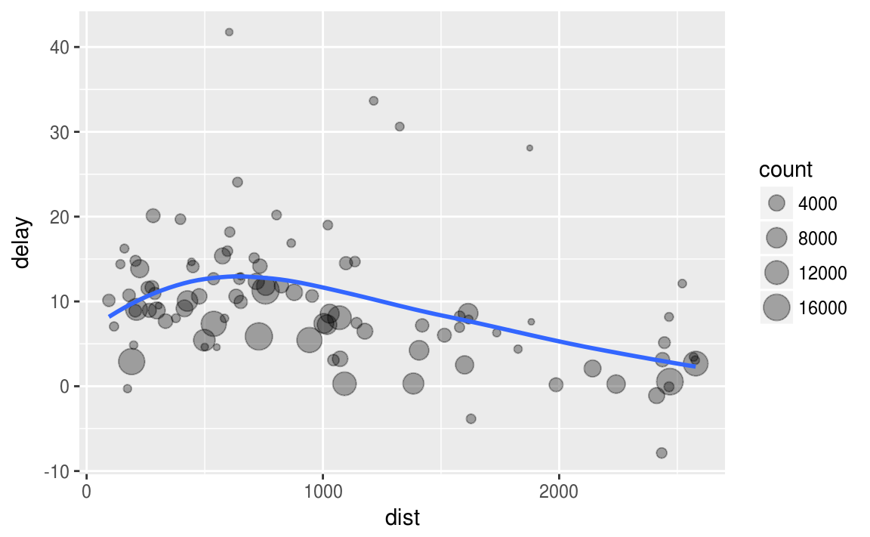
streamlining our analysis
Imagine that we want to explore the relationship between the distance and average delay for each location.
Using what you know about dplyr and ggplot, you might write code like this:
by_dest <- group_by(flights, dest)
delay <- summarise(by_dest,
count = n(),
dist = mean(distance, na.rm = TRUE),
delay = mean(arr_delay, na.rm = TRUE)
)
delay <- filter(delay, count > 20, dest != “HNL")
ggplot(data = delay, mapping = aes(x = dist, y = delay)) +
geom_point(aes(size = count), alpha = 1/3) +
geom_smooth(se = FALSE)

Slide 72
streamlining our analysis
Imagine that we want to explore the relationship between the distance and average delay for each location.
Using what you know about dplyr and ggplot, you might write code like this:
by_dest <- group_by(flights, dest)
delay <- summarise(by_dest,
count = n(),
dist = mean(distance, na.rm = TRUE),
delay = mean(arr_delay, na.rm = TRUE)
)
delay <- filter(delay, count > 20, dest != “HNL")
ggplot(data = delay, mapping = aes(x = dist, y = delay)) +
geom_point(aes(size = count), alpha = 1/3) +
geom_smooth(se = FALSE)
This code does four things:
?
?
?
?

Slide 73
streamlining our analysis
Imagine that we want to explore the relationship between the distance and average delay for each location.
Using what you know about dplyr and ggplot, you might write code like this:
by_dest <- group_by(flights, dest)
delay <- summarise(by_dest,
count = n(),
dist = mean(distance, na.rm = TRUE),
delay = mean(arr_delay, na.rm = TRUE)
)
delay <- filter(delay, count > 20, dest != “HNL")
ggplot(data = delay, mapping = aes(x = dist, y = delay)) +
geom_point(aes(size = count), alpha = 1/3) +
geom_smooth(se = FALSE)
This code does four things:
grouping by destination
summarizing count, distance, and delay
filtering out low counts and Honolulu
creating a plot

Slide 74
streamlining our analysis
We can streamline our code to make it more efficient and legible
library(magrittr)
x <- 1:15
sum(x)
x %>% sum()
These do the
same thing
Try it!
%>%
x sum( )

Slide 75
streamlining our analysis
Let's re-write our code using the pipe (%>%) operator:
flights %>%
group_by(dest) %>%
summarise(count = n(),
dist = mean(distance, na.rm = TRUE),
delay = mean(arr_delay, na.rm = TRUE)) %>%
filter(count > 20, dest != "HNL") %>%
ggplot(aes(x = dist, y = delay)) +
geom_point(aes(size = count), alpha = 1/3) +
geom_smooth(se = FALSE)
This code does four things in a very efficient & readable manner:
grouping by destination
summarizing count, distance, and delay
filtering out low counts and Honolulu
creating a plot

Slide 76

streamlining our analysis
Let's re-write our code using the pipe (%>%) operator:
flights %>%
group_by(dest) %>%
summarise(count = n(),
dist = mean(distance, na.rm = TRUE),
delay = mean(arr_delay, na.rm = TRUE)) %>%
filter(count > 20, dest != "HNL") %>%
ggplot(aes(x = dist, y = delay)) +
geom_point(aes(size = count), alpha = 1/3) +
geom_smooth(se = FALSE)

Slide 77
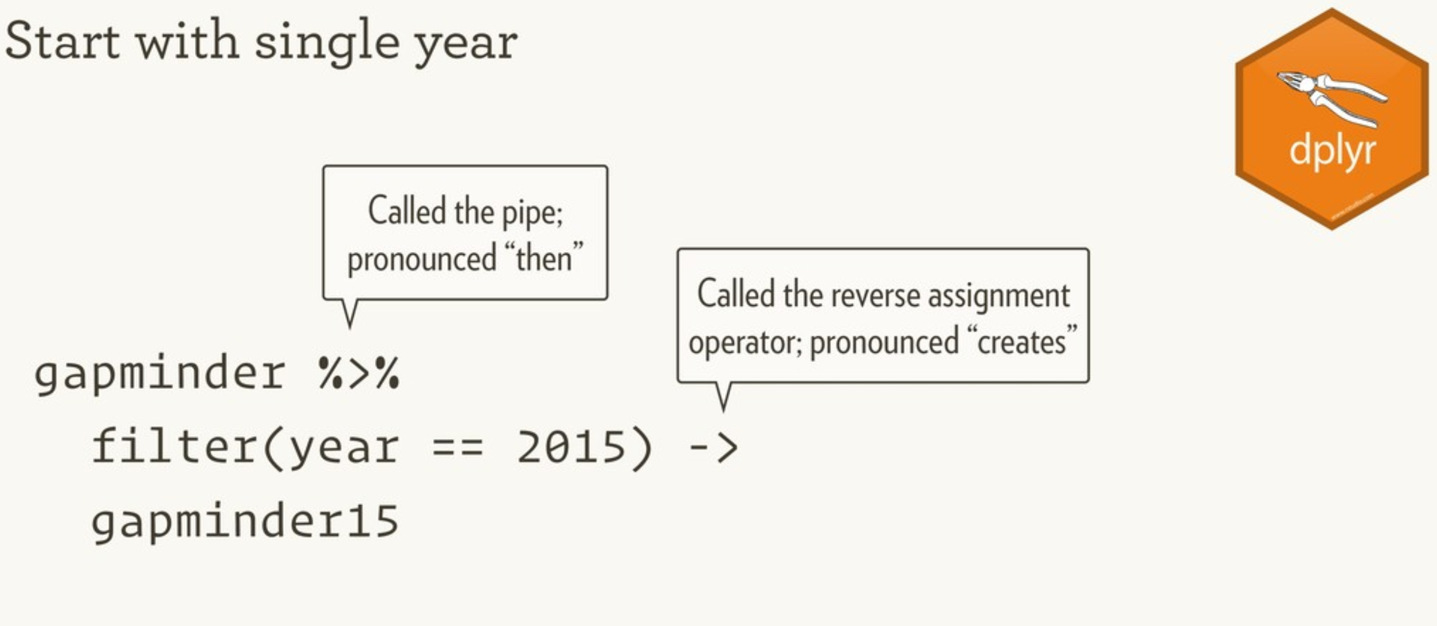
Communicate WITH the TIDYVERSE

Slide 78
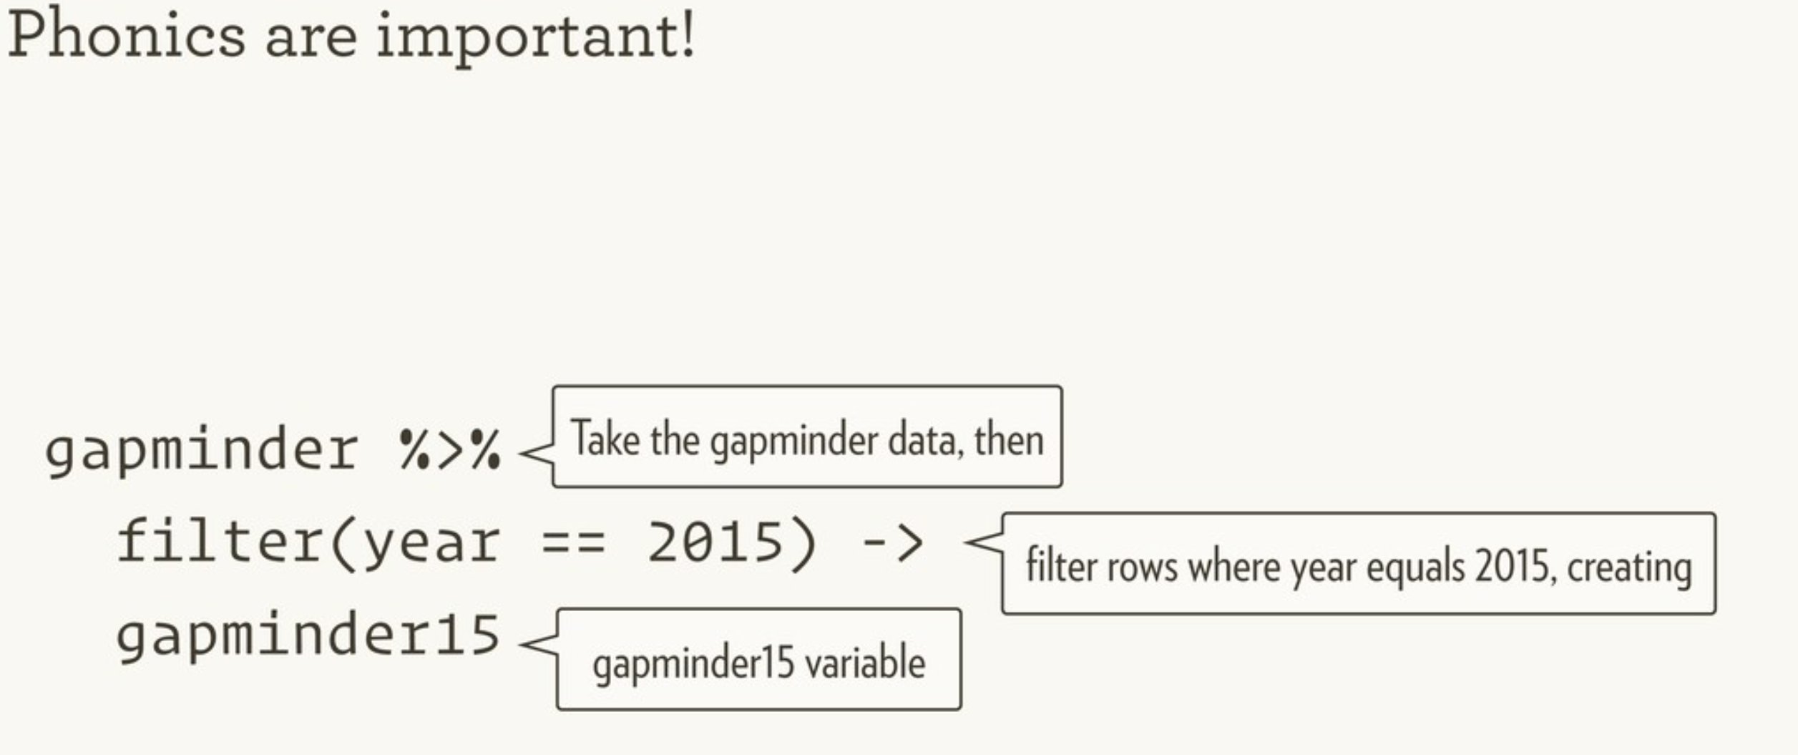
Source from Hadley Wickham, February 2019: https://speakerdeck.com/hadley/welcome-to-the-tidyverse
Reverse assignment operator

Slide 79
PIPE OPERATOR KEYBOARD SHORTCUT
Ctrl + Shift + M

Slide 80
Your turn!
Using the pipe operator follow these steps with the flight data:
filter out missing values that exist in the tail number variable
group the data by tail number
calculate the average arrival delay and the number of observations by tail number
arrange the average delays in descending order

Slide 81
Solution
flights %>%
filter(!is.na(tailnum)) %>%
group_by(tailnum) %>%
summarise(
delay = mean(arr_delay, na.rm = TRUE),
n = n()) %>%
arrange(desc(delay))
# A tibble: 4,043 x 3
tailnum delay n
<chr> <dbl> <int>
1 N844MH 320.0000 1
2 N911DA 294.0000 1
3 N922EV 276.0000 1
4 N587NW 264.0000 1
5 N851NW 219.0000 1
6 N928DN 201.0000 1
7 N7715E 188.0000 1
8 N654UA 185.0000 1
9 N665MQ 174.6667 6
10 N427SW 157.0000 1
# ... with 4,033 more rows

Slide 82
Your turn!
See if you can use the pipe operator and dplyr functions to answer this question:
In which month do most carriers experience their greatest arrival delays?

Slide 83
Solution
flights %>%
group_by(carrier, month) %>%
summarise(max_delay = max(arr_delay, na.rm = TRUE)) %>%
mutate(rank_delay = rank(desc(max_delay))) %>%
group_by(month) %>%
summarize(avg_rank = mean(rank_delay)) %>%
arrange(desc(avg_rank))
# A tibble: 12 x 2
month avg_rank
<int> <dbl>
1 10 9.200000
2 2 7.800000
3 11 7.562500
4 8 6.718750
5 9 6.593750
6 12 6.466667
7 3 6.333333
8 5 6.266667
9 1 6.062500
10 4 5.800000
11 6 4.437500
12 7 3.666667

Slide 84

what to remember

Slide 85
functions to remember
Operator/Function | Description
filter | pick observations based on their values
>, >=, <, <=, !=, == | comparison operators
is.na | identify missing values
arrange | re-order rows
desc | order in descending order
select | select variables
starts_with, ends_with, contains, etc. | select variables based on patterns
rename | rename select variables
mutate, transmute | create new variables
summarise | summarize data
group_by, ungroup | group/ungroup based on categorical variables
%>% | pipe operator to chain together functions

Slide 86
important
This aligns to standards 4.1, 7.2 & 7.3 and certainly %>% into standards 4.2, 4.3, 4.4, 4.5.

Slide 87


Slide 88
dplyr
You learned six key dplyr functions that allow you to solve the vast majority of your data manipulation challenges. What do each do?
filter:
arrange:
select:
mutate:
summarize:
group_by:

Slide 89
dplyr
You learned six key dplyr functions that allow you to solve the vast majority of your data manipulation challenges. What do each do?
filter: pick observations based on values
arrange: reorder data
select: pick variables
mutate: create new variables
summarize: summarize data by functions of choice
group_by: group data by categorical levels

