Slide 1
Today’s Class
6:00PM – 7:45PM: Leveraging the Tidyverse to Simplify Data Wrangling
8:00PM – 9:00PM: Joining data (Not with SQL! In R!)
9:00PM – 9:50PM: Work on your mid-term, the session 4 in-class coding exercise.

Slide 2
relational
data
Visualize
Get
Clean
Transform
Communicate
Model
Understand
Program
☨A modified version of Hadley Wickham’s analytic process

Slide 3
“It’s rare that a data analysis involves only a single table of data. Typically you have many tables of data, and you must combine them to answer the questions that you’re interested in.”
- Garrett Grolemund & Hadley Wickham

Slide 4
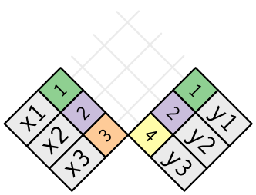
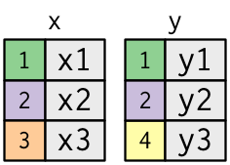
what is relational data?

Slide 5
what is relational data?

Slide 6

verbs
To work with relational data you need verbs that work with pairs of tables. There are three families of verbs designed to work with relational data:
Mutating joins: add new variables to one data frame by matching observations in another.
Filter joins: filter observations from one data frame based on whether or not they match an observation in the other table.
Set operations: treat observations as if they were set elements

Slide 7
verbs
To work with relational data you need verbs that work with pairs of tables. There are three families of verbs designed to work with relational data:
Mutating joins: add new variables to one data frame by matching observations in another.
Filter joins: filter observations from one data frame based on whether or not they match an observation in the other table.
Set operations: treat observations as if they were set elements

Slide 8

prerequisites

Slide 9
package prerequisite
library(nycflights13)
library(tidyverse)
#> Loading tidyverse: ggplot2
#> Loading tidyverse: tibble
#> Loading tidyverse: tidyr
#> Loading tidyverse: readr
#> Loading tidyverse: purrr
#> Loading tidyverse: dplyr
#> Conflicts with tidy packages ----------------------------------------------
#> filter(): dplyr, stats
#> lag(): dplyr, stats

Slide 10
example data prerequisite
x <- tribble(
~key, ~val_x,
1, "x1",
2, "x2",
3, "x3"
)
y <- tribble(
~key, ~val_y,
1, "y1",
2, "y2",
4, "y3"
)

Slide 11
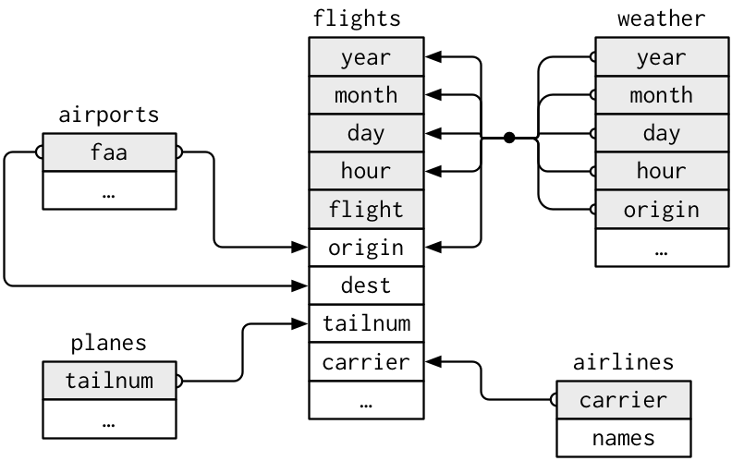
exercise data prerequisite
For nycflights13:
flights connects to planes via tailnum
flights connects to airlines via carrier
flights connects to airports via origin & dest
flights connects to weather via origin, year, month, day, & hour

Slide 12

mutating joins
Adding variables

Slide 13
inner join
Simplest type of join
matches pairs of observations whenever their keys are equal
keys are variables that connect pairs of tables

Slide 14
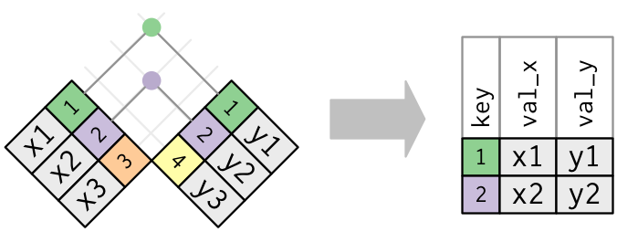
inner join
use by to tell dplyr which variable is the key
unmatched rows are not included in the result
x %>% inner_join(y, by = "key")
# A tibble: 2 × 3
key val_x val_y
<dbl> <chr> <chr>
1 1 x1 y1
2 2 x2 y2

Slide 15
outer joins
Outer joins keep observations that appear in at least one of the tables
There are 3 types of outer joins:

Slide 16
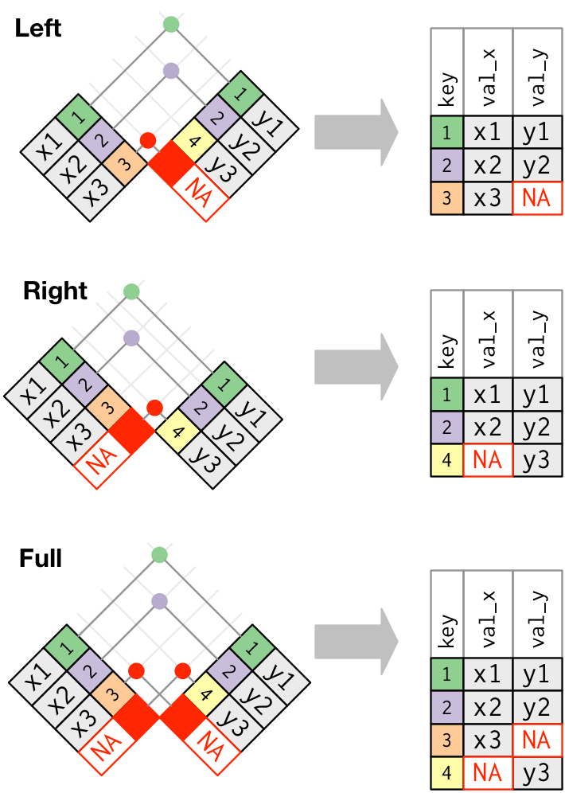
outer joins
Outer joins keep observations that appear in at least one of the tables
There are 3 types of outer joins:
left join: keeps all observations in x
x %>% left_join(y, by = "key")
# A tibble: 3 × 3
key val_x val_y
<dbl> <chr> <chr>
1 1 x1 y1
2 2 x2 y2
3 3 x3 <NA>
Note how missing values get filled in with NA

Slide 17
outer joins
Outer joins keep observations that appear in at least one of the tables
There are 3 types of outer joins:
left join: keeps all observations in x
right join: keeps all observations in y
x %>% right_join(y, by = "key")
# A tibble: 3 × 3
key val_x val_y
<dbl> <chr> <chr>
1 1 x1 y1
2 2 x2 y2
3 4 <NA> y3

Slide 18
outer joins
Outer joins keep observations that appear in at least one of the tables
There are 3 types of outer joins:
left join: keeps all observations in x
right join: keeps all observations in y
full join: keeps all observations in x and y
x %>% full_join(y, by = "key")
# A tibble: 4 × 3
key val_x val_y
<dbl> <chr> <chr>
1 1 x1 y1
2 2 x2 y2
3 3 x3 <NA>
4 4 <NA> y3

Slide 19
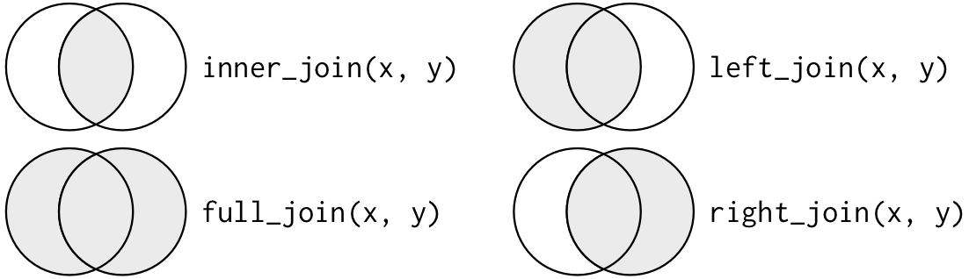
comparing joins

Slide 20
defining keys
What if our key names don’t match?
x <- tribble(
~key1, ~val_x,
1, "x1",
2, "x2",
3, "x3"
)
y <- tribble(
~key2, ~val_y,
1, "y1",
2, "y2",
4, "y3"
)

Slide 21
defining keys
What if our keys don’t match?
x %>% inner_join(y, by = c("key1" = “key2”))
# A tibble: 2 × 3
key1 val_x val_y
<dbl> <chr> <chr>
1 1 x1 y1
2 2 x2 y2

Slide 22
Your turn!
take the flights data and then
left join airlines data
filter for “Virgin America”
group by time_hour
summarise data by computing the mean dep_delay
identify the top 10 date-times with the highest mean dep_delay
Can you figure out how to add the location of the origin and destination (i.e. the lat and lon) from airports to flights data? Hint: use two consecutive left_joins.

Slide 23
Solution
# problem 1
flights %>%
left_join(airlines) %>%
filter(name == "Virgin America") %>%
group_by(time_hour) %>%
summarise(delay = mean(dep_delay, na.rm = TRUE)) %>%
top_n(10, wt = delay) %>%
arrange(desc(delay))

Slide 24
Solution
# problem 2
flights %>%
left_join(airports, by = c("origin" = "faa")) %>%
left_join(airports, by = c("dest" = "faa")) %>%
select(dest,
origin,
origin_lat = lat.x,
origin_lon = lon.x,
dest_lat = lat.y,
dest_lon = lon.y,
arr_delay)

Slide 25

filtering joins
A
B
C
D
E
F
G
0
1
1
0
1
0
1
A
B
C
D
E
F
G
1
0
0
0
1
1
1
Filtering variables based on another data set

Slide 26
filtering joins
Filtering joins affect the observations rather than adding variables
There are 2 types of filtering joins:

Slide 27
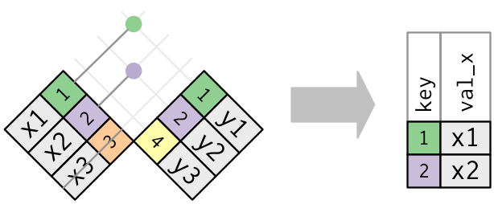
filtering joins
Filtering joins affect the observations rather than adding variables
There are 2 types of filtering joins:
semi join: keeps all observations in x that have a match in y
x %>% semi_join(y, by = "key")
# A tibble: 2 × 2
key val_x
<dbl> <chr>
1 1 x1
2 2 x2

Slide 28
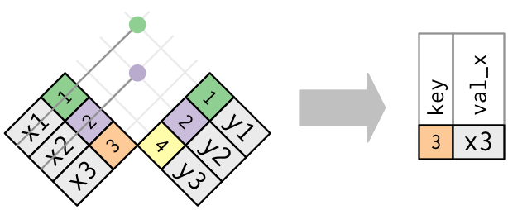
filtering joins
Filtering joins affect the observations rather than adding variables
There are 2 types of filtering joins:
semi join: keeps all observations in x that have a match in y
anti join: drops all observations in x that have a match in y
x %>% anti_join(y, by = "key")
# A tibble: 1 × 2
key val_x
<dbl> <chr>
1 3 x3

Slide 29
Your turn!
How many flights in the flights data have matching planes metadata (tailnum is your key)? How many do not? Hint: use tally() after your joining functions.
Filter the airports data for those airports that do not have matching destination values in the flights data (faa and dest are your keys). How many unique airports do you find? Hint: use the distinct() and tally() functions after your joining function.

Slide 30
Solution
# problem 1a ——> 284,170
flights %>%
semi_join(planes, by = "tailnum") %>%
tally()
# problem 1b ——> 52,606
flights %>%
anti_join(planes, by = "tailnum") %>%
tally()
# problem 2 —-> 1,357
airports %>%
anti_join(flights, by = c("faa" = "dest")) %>%
distinct(faa) %>%
tally()

Slide 31

set operations
Treat observations as set elements

Slide 32
set operations
I use these least frequently
Compares entire row in each data set

Slide 33
set operations
I use these least frequently
Compares entire row in each data set
intersect(x, y): return only observations in both x and y.
union(x, y): return unique observations in x and y.
setdiff(x, y): return observations in x, but not in y
Illustrate with these two data sets
df1 <- tribble(
~x, ~y,
1, 1,
2, 1
)
df2 <- tribble(
~x, ~y,
1, 1,
1, 2
)

Slide 34
set operations
I use these least frequently
Compares entire row in each data set
intersect(x, y): return only observations in both x and y.
union(x, y): return unique observations in x and y.
setdiff(x, y): return observations in x, but not in y
Illustrate with these two data sets
df1 <- tribble(
~x, ~y,
1, 1,
2, 1
)
df2 <- tribble(
~x, ~y,
1, 1,
1, 2
)
intersect(df1, df2)
# A tibble: 1 × 2
x y
<dbl> <dbl>
1 1 1

Slide 35
set operations
I use these least frequently
Compares entire row in each data set
intersect(x, y): return only observations in both x and y.
union(x, y): return unique observations in x and y.
setdiff(x, y): return observations in x, but not in y
Illustrate with these two data sets
df1 <- tribble(
~x, ~y,
1, 1,
2, 1
)
df2 <- tribble(
~x, ~y,
1, 1,
1, 2
)
union(df1, df2)
# A tibble: 3 × 2
x y
<dbl> <dbl>
1 1 2
2 2 1
3 1 1

Slide 36
set operations
I use these least frequently
Compares entire row in each data set
intersect(x, y): return only observations in both x and y.
union(x, y): return unique observations in x and y.
setdiff(x, y): return observations in x, but not in y
Illustrate with these two data sets
df1 <- tribble(
~x, ~y,
1, 1,
2, 1
)
df2 <- tribble(
~x, ~y,
1, 1,
1, 2
)
setdiff(df1, df2)
# A tibble: 1 × 2
x y
<dbl> <dbl>
1 2 1

Slide 37

challenge

Slide 38
compute costs & end strength
Question: In 2014, what was the average O&S costs and end strength numbers for all aircraft and missiles systems at Minot AFB?
Steps:
Import the ws-programmatics.csv and ws-categorization.csv files in the data folder:
left join ws-categorization data to ws-programmatics data using Base and MD as the keys
Filter Base for only MINOT AFB (ND)
Filter System for only Aircraft or Missile systems
Group the data by the System variable
Compute the mean summary statistic for Total_O.S and End_Strength

Slide 39
Solution
library(tidyverse)
ws_programmatics <- read_csv("data/ws-programmatics.csv")
ws_categorizations <- read_csv("data/ws-categorization.csv")
ws_programmatics %>%
left_join(ws_categorizations) %>%
filter(Base == "MINOT AFB (ND)",
System == "AIRCRAFT" | System == "MISSILES" ) %>%
group_by(System) %>%
summarise(Total_O.S = mean(Total_O.S, na.rm = TRUE),
End_Strength = mean(End_Strength, na.rm = TRUE))
# A tibble: 2 × 3
System Total_O.S End_Strength
<chr> <dbl> <dbl>
1 AIRCRAFT 36056921 313.0851
2 MISSILES 48838881 689.1800

Slide 40

what to remember

Slide 41
functions to remember
Operator/Function | Description
inner_join, left_join, right_join, full_join | mutating join: add new variables to one data frame by matching observations in another.
semi_join, anti_join | filtering joins: filter observations from one data frame based on whether or not they match an observation in the other table
intersect, union, setdiff | set operations: treat observations as if they were set elements

Slide 42


Slide 43
For the rest of today…
Spend rest of today’s class session working through the Session 4 Midterm Project .pdf file with your mid-term reviewer or group members. Submit your plan via slack to me by the end of today (no need to be very complete).

