Slide 1
Early AMY Preprocessing
Megan Hagenauer, Ph.D., University of Michigan
Contact Info: hagenaue@umich.edu, 734-709-7204
Note: These slides illustrate the major output/graphs/etc. for the early preprocessing of this brain region (i.e. everything up until the linear regression models that were designed to analyze the effects of diagnosis). These slides were meant to be viewed after reading the more detailed overview of how the preprocessing was approached for the entire Pritzker 960 dataset: "2 IMPORTANT Summary of Preprocessing.ppt"
How to read and interpret the output presented here is discussed in this earlier general .ppt. (i.e., there is no overarching narrative here, only output/graphs specific to the brain region).

Slide 2
Raw Data Sources:
"Sample Info.txt"
"Pritzker960DeathInfoForR.csv"
"EarlyLateCohortForR_UMvsUCDforR.csv"
"AMY_AVG_Signal.txt"
"AMY_Detection_Pval.txt"
**lumi output was also analyzed, but found to be almost identical to raw output (shifted minimum values)

Slide 3
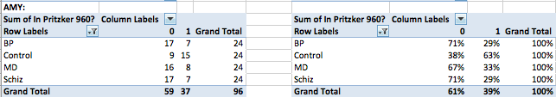
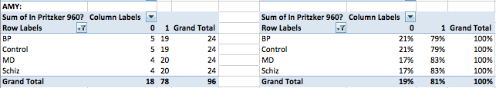
Subject overlap with previous Pritzker Microarray datasets:
Overlap with Affy:
(0=Pritzker 960 subject not included in Affy for brain region, 1= Included in Affy):
Overlap with Freeze3:
(0=Pritzker 960 subject not included in Freeze3 for brain region, 1= Included in Freeze3):

Slide 4
Initial steps
Making sure the data:
1) is the proper length,
2) is numerical,
3) has an order that matches the subject info
4) has 3561 renamed as 3651
[1] "Check Dimensions"
[1] 46971 96

Slide 5
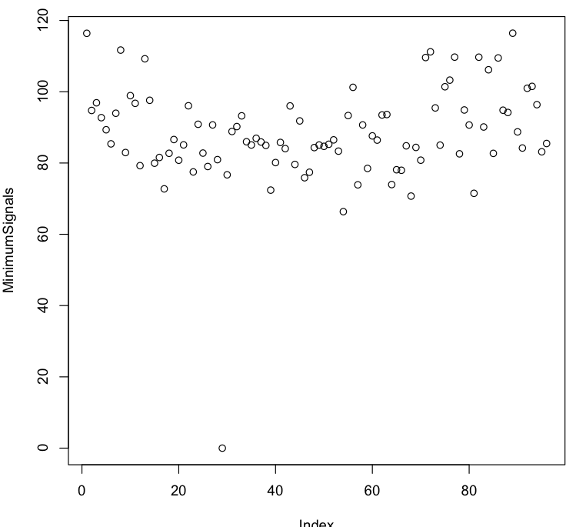
Minimum Signal Values:

Slide 6
Output of Log(base2) Signal:
[1] "What is the lowest signal value?"
[1] 0
[1] "The values in the signal matrix may have been corrected to always be larger than 0"
1834 1881 2248 2292 2311
ILMN_1762337 138.0398 136.2609 122.9048 118.9457 115.8343
ILMN_2055271 201.8043 147.0200 172.9627 139.9968 151.6846
ILMN_1736007 191.3755 131.0271 141.1785 118.5999 123.6884
ILMN_2383229 151.1261 117.3715 144.7872 120.6288 128.3831
ILMN_1806310 163.3018 126.8303 133.9233 132.9037 121.6624
[1] "A logged version of this corrected signal matrix:"
1834 1881 2248 2292 2311
ILMN_1762337 7.108940 7.090228 6.941397 6.894159 6.855919
ILMN_2055271 7.656813 7.199869 7.434317 7.129250 7.244931
ILMN_1736007 7.580262 7.033721 7.141377 6.889959 6.950566
ILMN_2383229 7.239609 6.874938 7.177790 6.914431 7.004311
ILMN_1806310 7.351397 6.986756 7.065263 7.054237 6.926740
[1] "Use dataset log.avg96 now"

Slide 7
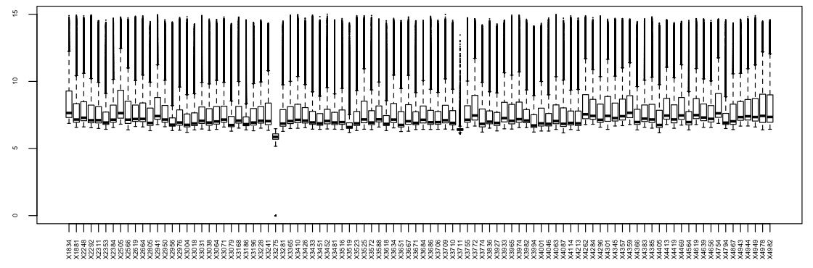
Boxplots showing the distribution of log-transformed gene expression values for each sample.
Getting the column index for the bad sample:
which("3275"==colnames(log.avg96))
[1] 29
which("3711"==colnames(log.avg96))
[1] 54

Slide 8
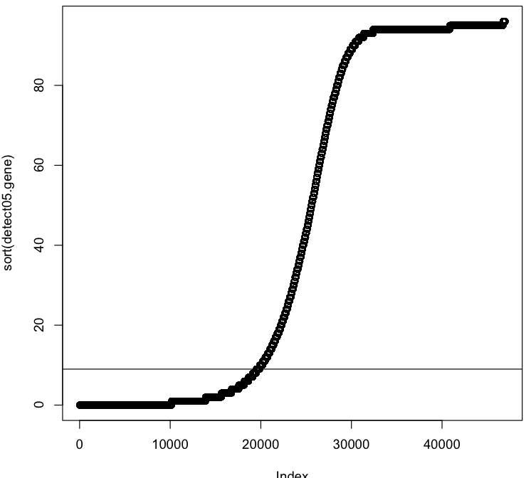
Jun chose a cut-off that a gene needed to be significantly expressed (detection p-value of <0.05) on 9 chips (10%, rounded down?). That means that ~20,000 genes should be thrown out for lack of significant detection

Slide 9
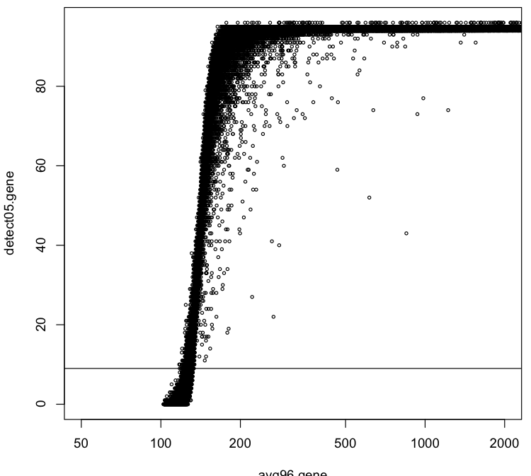
All genes below the “significantly detected in at least 9 chips” cut-off seem to have very low average expression values.

Slide 10
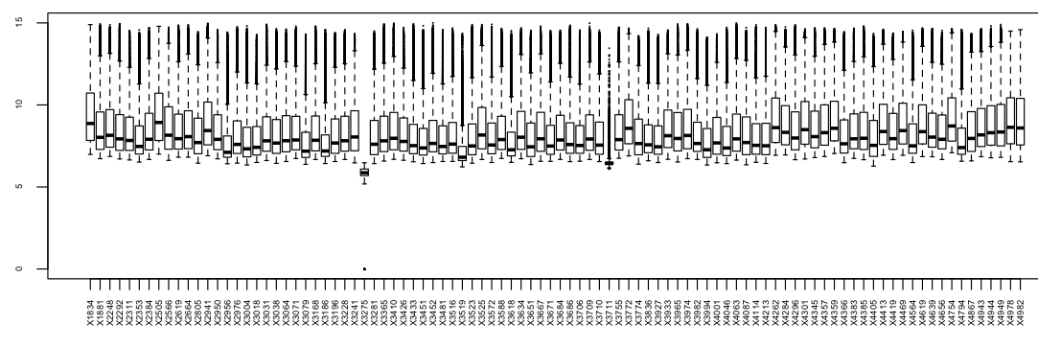
Genes that made the cut: New boxplot of log-transformed expression values:
Filtering out genes with low levels of detection: Code
[1] "Dimensions of the Matrix of Filtered Genes:"
[1] 27097 96

Slide 11
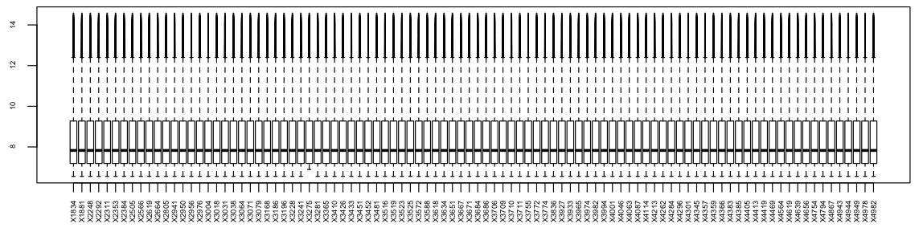
Quantile normalized, log-transformed values

Slide 12
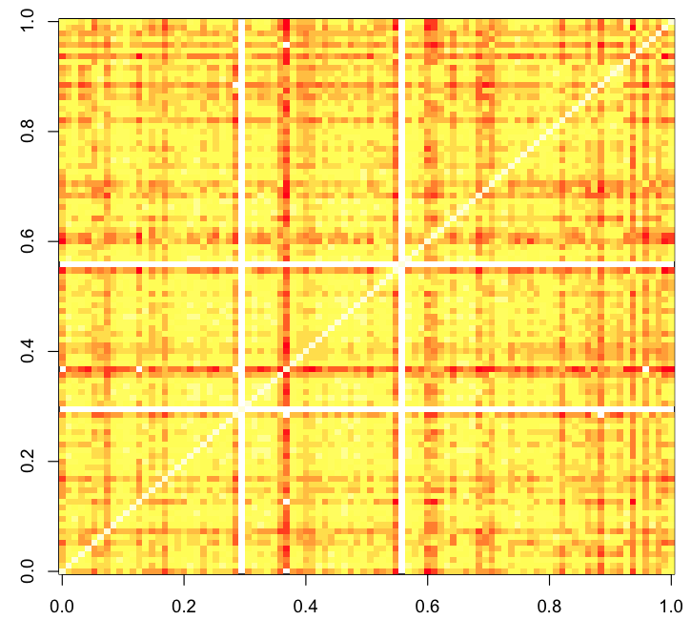
Visualizing the strength of the correlations between individual samples:
Replotted with different limits for the Z-axis: zlim=c(0.92, 1))

Slide 13
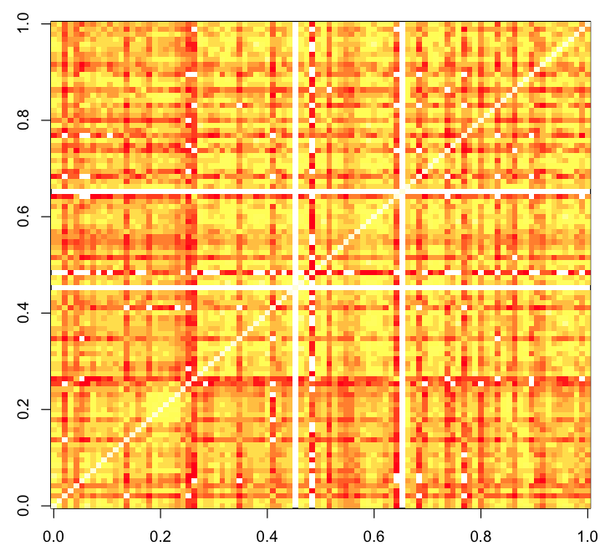
Cohort effects in the subject-subject correlations (block 1 = cohorts 7-10, block 2=earlier cohorts)
image(cor(norm96.orderedbyCohort), zlim=c(0.94, 1))

Slide 14
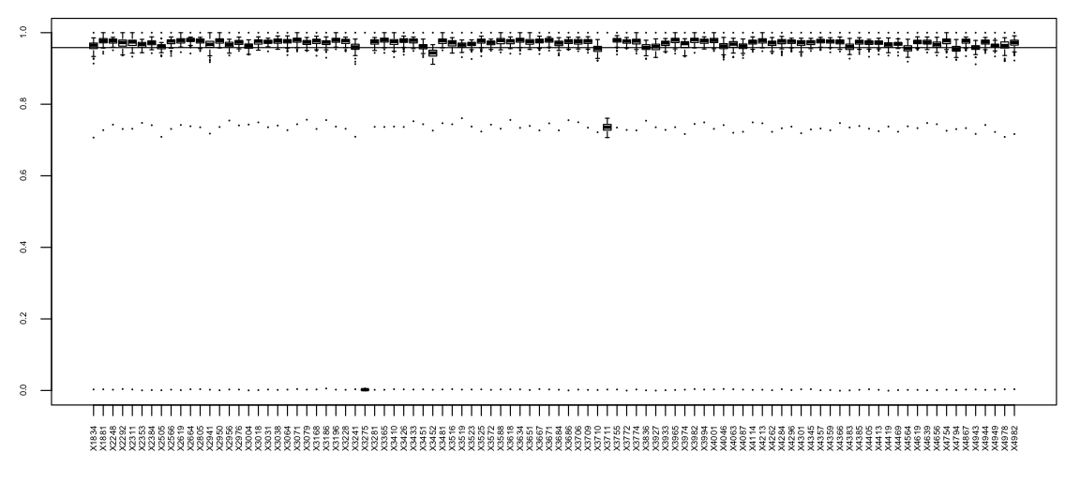
Visualizing how well the samples correlate with each other:
Wow... talk about outliers! Those two samples are horrible!
Plots the median Pearson correlation coefficient (with all samples). The two ‘hinges’ are versions of the first and third quartile, the whiskers extend to the most extreme data point which is no more than 1.5 times the interquartile range from the box.
The line represents the median .10 quantile for the Pearson sample-sample correlation coefficients.
I am going to consider any sample that has whiskers that don't overlap with the median .10 quantile to be outliers.

Slide 15
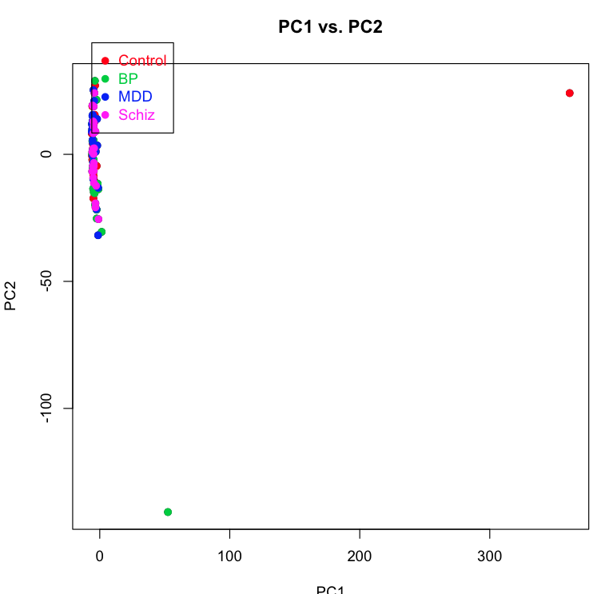
Principal Components Analysis: PC1 vs. PC2

Slide 16
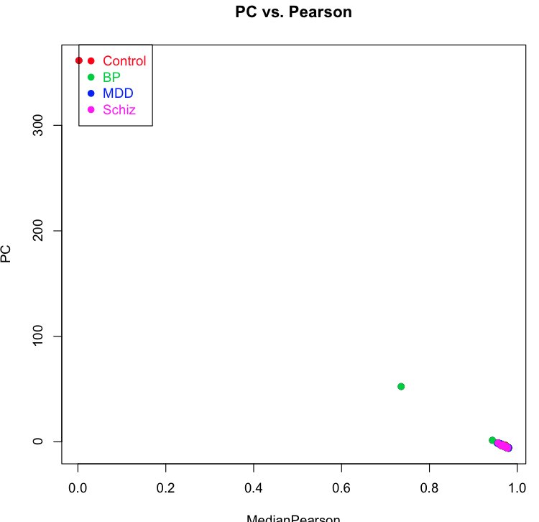
PC1 vs. Median Pearson Correlation Index:

Slide 17
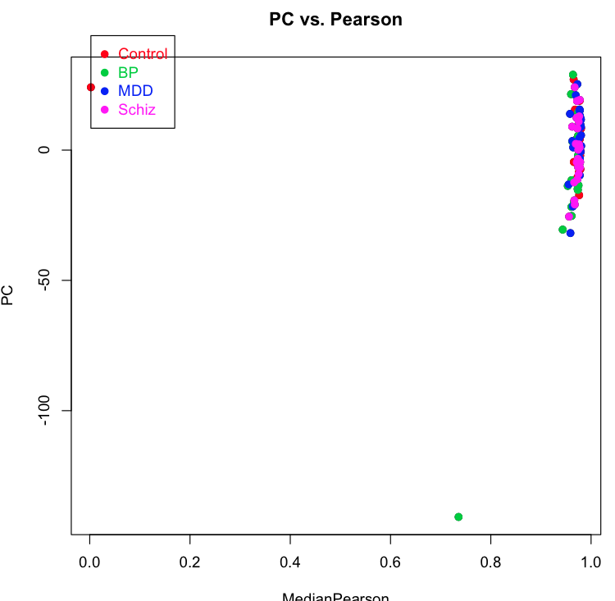
PC2 vs. Median Pearson Correlation Index

Slide 18
Removing Outliers from the Original Data

Slide 19
Cutting out the funky samples and re-running quantile normalization:
Actual sample names for each of the samples that were removed:
"3275"==29
"3711"==54
QuantileNormNoOutliers(log.avg96.filtered[,c(-29, -54)])
[1] "Check dimensions on quantile normalized data with outliers removed"
[1] 27097 94

Slide 20
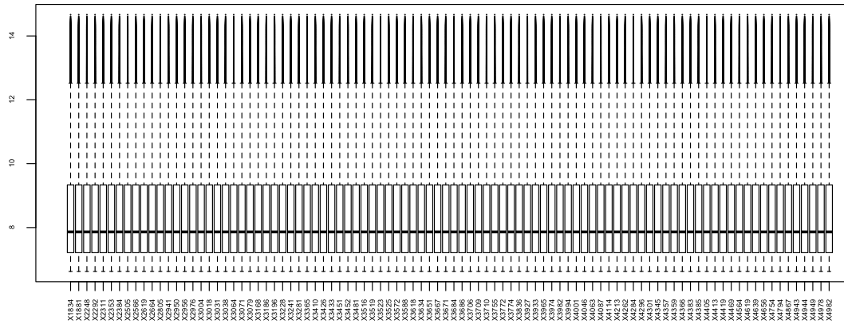
Boxplot of quantile normalized data w/o outliers:

Slide 21
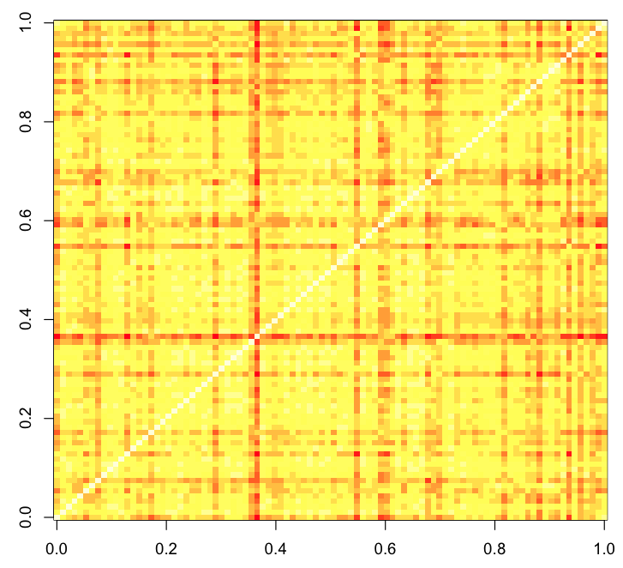
Visualizing the strength of the correlations between individual samples (no outliers):

Slide 22
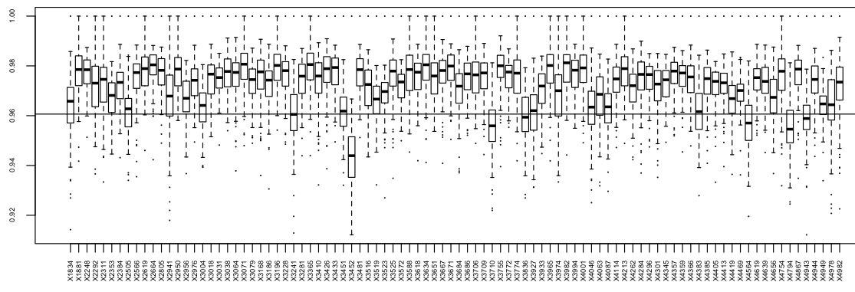
Visualizing how well the samples correlate with each other (no outliers):
Plots the median Pearson correlation coefficient (with all samples). The two ‘hinges’ are versions of the first and third quartile, the whiskers extend to the most extreme data point which is no more than 1.5 times the interquartile range from the box.
The line represents the median .10 quantile for the Pearson sample-sample correlation coefficients.

Slide 23
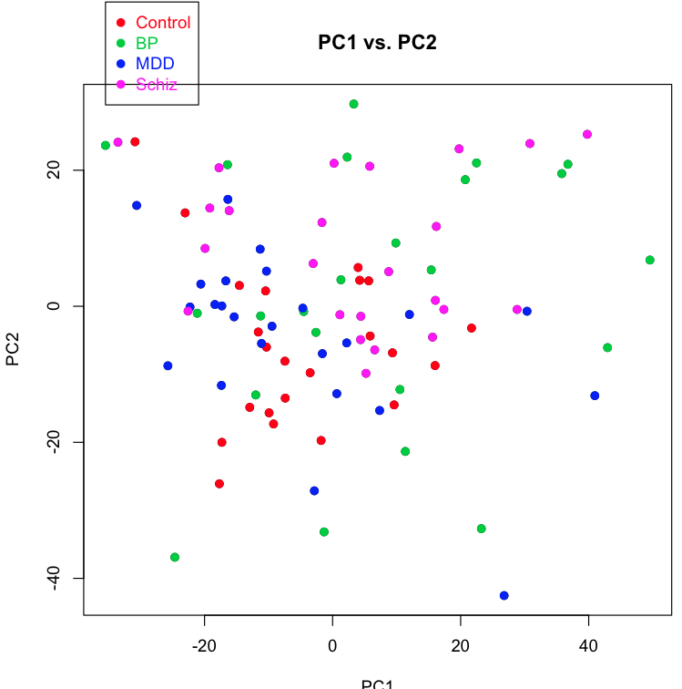
PC1 vs. PC2 for data w/o outliers:

Slide 24
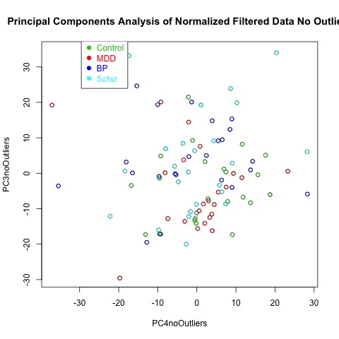
PC3 vs. PC4 (colored by diagnosis)

Slide 25
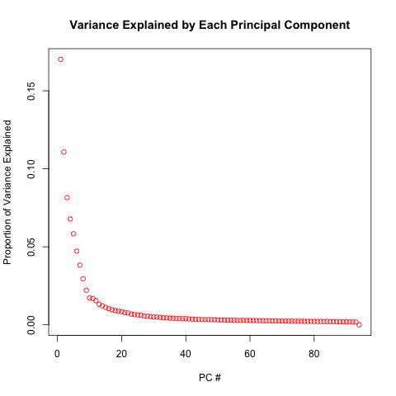
Scree Plots:

Slide 26
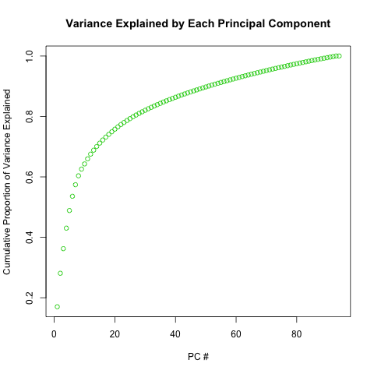
Scree Plots:

Slide 27
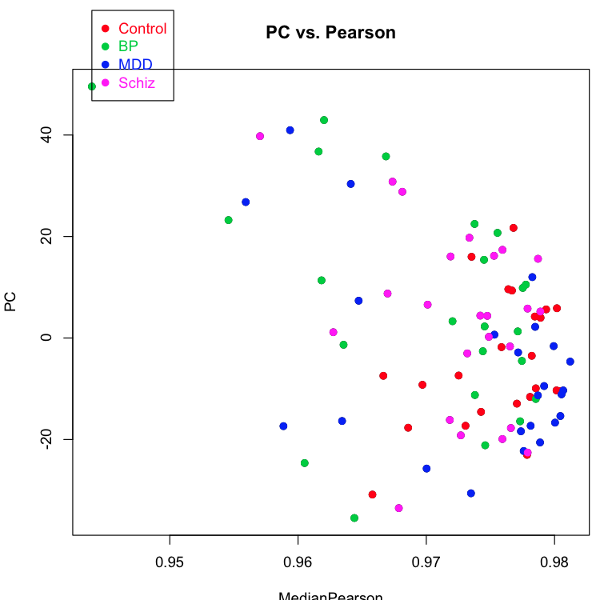
What is the relationship between PC1 and subject-subject correlations?

Slide 28
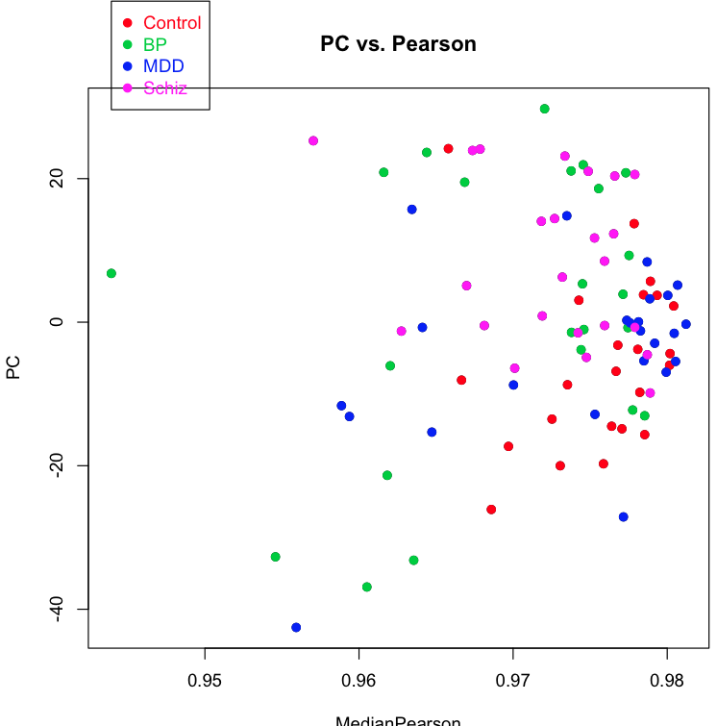
What is the relationship between PC2 and subject-subject correlations?

Slide 29
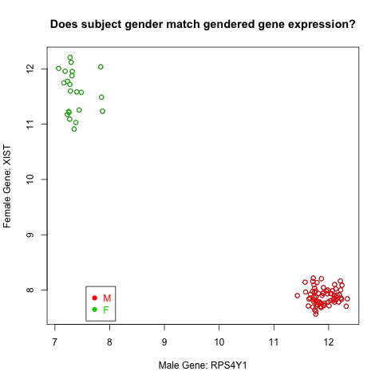
Gender Check: Looks good!

Slide 30
Identifying Potential Confounds and Sources of Noise

Slide 31
Flagged Relationships Between Subject Variables
[1] "HoursColdNoOutliers vs HoursIceNoOutliers p-value= 5.6415005437666e-10"
[1] "HoursColdNoOutliers vs HoursFinalNoOutliers p-value= 0.00575048032179101"
[1] "HoursColdNoOutliers vs HospitalizedAtTODNoOutliers p-value= 0.0289566410228675"
[1] "HoursIceNoOutliers vs HoursColdNoOutliers p-value= 5.64150054376682e-10"
[1] "HoursIceNoOutliers vs HoursFinalNoOutliers p-value= 1.42141384444634e-09"
[1] "HoursIceNoOutliers vs SuicideNoOutliers p-value= 0.00664781168134233"****************
[1] "HoursIceNoOutliers vs HospitalizedAtTODNoOutliers p-value= 0.00418152705472416"
[1] "HoursIceNoOutliers vs EarlyLateCohortNoOutliers p-value= 0.00537808215791572"
[1] "HoursFinalNoOutliers vs HoursColdNoOutliers p-value= 0.00575048032179104"
[1] "HoursFinalNoOutliers vs HoursIceNoOutliers p-value= 1.42141384444635e-09"
[1] "HoursFinalNoOutliers vs HospitalizedAtTODNoOutliers p-value= 0.0215146213622211"
[1] "HoursFinalNoOutliers vs EarlyLateCohortNoOutliers p-value= 0.0186723724701199"
[1] "AgeNoOutliersCentered vs SuicideNoOutliers p-value= 0.000613925401671034"
[1] "AgeNoOutliersCentered vs GenderNoOutliers p-value= 0.03976032363128"
[1] "pHNoOutliers vs EarlyLateCohortNoOutliers p-value= 9.68375585220929e-07"
[1] "DiagnosisNoOutliers vs SuicideNoOutliers p-value= 6.16946356249206e-07"
[1] "DiagnosisNoOutliers vs HospitalizedAtTODNoOutliers p-value= 0.000617029647878301"***********
[1] "DiagnosisNoOutliers vs EarlyLateCohortNoOutliers p-value= 0.00206215572975633"***********
[1] "SuicideNoOutliers vs DiagnosisNoOutliers p-value= 6.16946356249206e-07"
[1] "SuicideNoOutliers vs HospitalizedAtTODNoOutliers p-value= 0.00319756858806163"***********
[1] "HospitalizedAtTODNoOutliers vs DiagnosisNoOutliers p-value= 0.000617029647878301"***********
[1] "HospitalizedAtTODNoOutliers vs SuicideNoOutliers p-value= 0.00319756858806163"
[1] "EarlyLateCohortNoOutliers vs DiagnosisNoOutliers p-value= 0.00206215572975633"***********

Slide 32
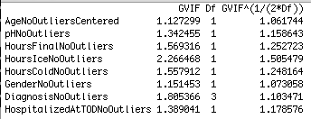
Analysis of multicollinearity between subject variables:

Slide 33
More details and graphs can be found within folder: "14 Confounding Relationships for Subject Variables"
Stats output:
"14 Cross Tabs between Subject Factors.txt"
"14 Statistical Relationships between Subject Variables. txt"

Slide 34
Flagged Relationships Between Subject Variables and PCA:
[1] "PC1noOutliers vs pHNoOutliers p-value= 0.0002821252400249"
[1] "PC1noOutliers vs GenderNoOutliers p-value= 0.0439702216575596"
[1] "PC2noOutliers vs AgeNoOutliersCentered p-value= 0.0367661078894021"
[1] "PC2noOutliers vs pHNoOutliers p-value= 0.00458602798239353"
[1] "PC2noOutliers vs DiagnosisNoOutliers p-value= 0.00695321010933398"
[1] "PC2noOutliers vs EarlyLateCohortNoOutliers p-value= 7.30640107603012e-10" *******
[1] "PC3noOutliers vs pHNoOutliers p-value= 0.00168436465205053"
[1] "PC3noOutliers vs HoursIceNoOutliers p-value= 0.0140529159879407"
[1] "PC3noOutliers vs HoursFinalNoOutliers p-value= 0.000105056466663883"
[1] "PC3noOutliers vs EarlyLateCohortNoOutliers p-value= 9.72464848420599e-12"********
[1] "PC4noOutliers vs HoursIceNoOutliers p-value= 0.0424253963696896"
[1] "PC4noOutliers vs HoursFinalNoOutliers p-value= 0.0064481323426249"
[1] "PC4noOutliers vs SuicideNoOutliers p-value= 0.0124703157200232"
[1] "PC4noOutliers vs EarlyLateCohortNoOutliers p-value= 0.00746374253040345"

Slide 35
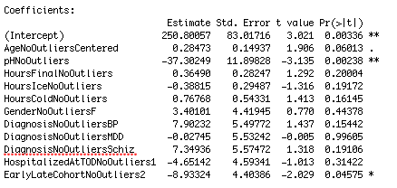
PC1 vs. All Subject Variables (one regression model)

Slide 36
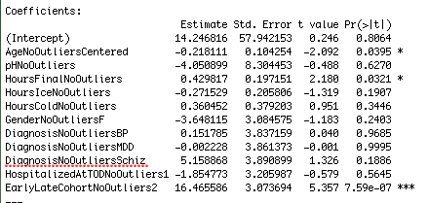
PC2 vs. All Subject Variables (one regression model)

Slide 37
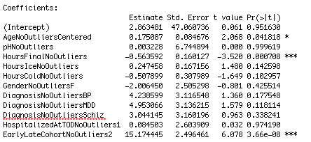
PC3 vs. All Subject Variables (one regression model)

Slide 38
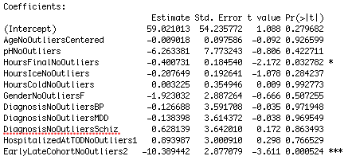
PC4 vs. All Subject Variables (one regression model)

Slide 39
More details and graphs can be found within folder: "15 PCA for potential sources of noise"
Stats output:
""15 Statistical Relationships between Subject Variables and PCA"

