Slide 1
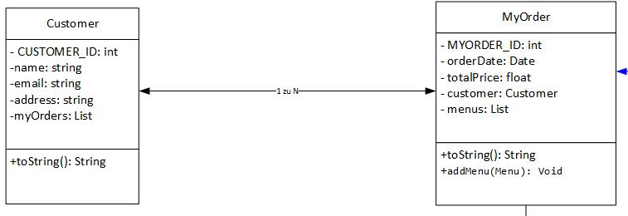

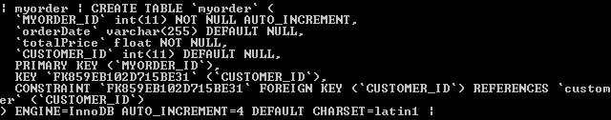
Customer.hbm.xml
<set name="myOrders" inverse="true" cascade="save-update, delete, delete-orphan">
<key column="CUSTOMER_ID" />
<one-to-many class="dbt.online.delivery.MyOrder" />
</set>
Myorder.hbm.xml
<many-to-one name="customer" column="CUSTOMER_ID"
class="dbt.online.delivery.Customer" />

Slide 2
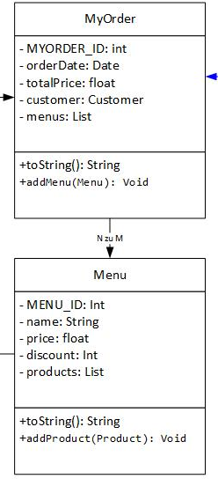
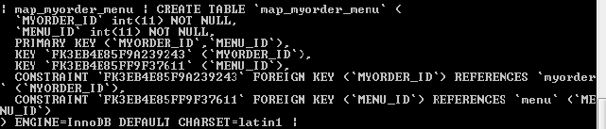

Myorder.hbm.xml
<set name="menus" table="map_myorder_menu" cascade="save-update, delete, delete-orphan">
<key column="MYORDER_ID"/>
<many-to-many class="dbt.online.delivery.Menu" column="MENU_ID" /> </set>

Slide 3
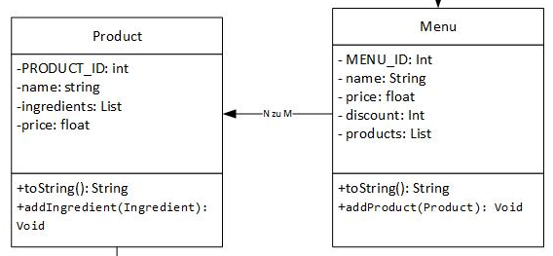
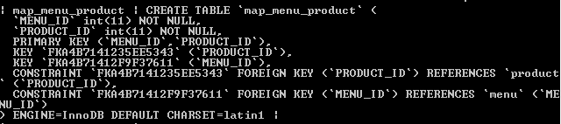

Menu.hbm.xml
<set name="products" table="map_menu_product" cascade="save-update, delete, delete-orphan">
<key column="MENU_ID"/>
<many-to-many class="dbt.online.delivery.Product" column="PRODUCT_ID" /> </set>

Slide 4
