Slide 1
UK RAILWAY DATASET
End-to-End Data
Analysis Project
From raw CSV to interactive dashboards, Python, SQL, Excel & Power BI
• Final Team Discussion

Slide 2
01 • PROJECT BRIEF
What this project is about
An end-to-end analysis of a UK railway transactions dataset, moving from raw, inconsistent data to clean insights that support operational and business decisions.
31,653
18
4
0
Ticket
transactions
Original
columns
Tools used
end-to-end
Missing values
after cleaning
Railway Dataset • End-to-End Analysis • Hager
2 / 14

Slide 3
02 • OBJECTIVES
What we set out to do
1
Assess
2
Explore
Identify and resolve missing values, duplicates and inconsistent categories.
Uncover patterns in journey performance, revenue, delays and passenger behaviour.
3
Enrich
4
Query
Build metrics, delay time, booking lead days, refund eligibility.
Answer business questions in SQL on route, delay and revenue performance.
5
Model
6
Visualise
Star schema with Fact + Dimension tables for scalable reporting.
Interactive Excel dashboard and 3-page Power BI report.
Railway Dataset • End-to-End Analysis • Hager
3 / 14

Slide 4
03 • THE DATASET
railway.csv — what's inside
Transaction
AT A GLANCE
ID • Date & Time of Purchase • Purchase Type • Payment Method
31,653
Ticket
Railcard • Class • Type • Price
ticket transactions
Journey
Departure & Arrival Station • Date • Scheduled & Actual Times
18 original columns covering pricing, route, scheduling, delay cause and refund behaviour across multiple UK stations.
Outcome
Journey Status • Reason for Delay • Refund Request
Railway Dataset • End-to-End Analysis • Hager
4 / 14

Slide 5
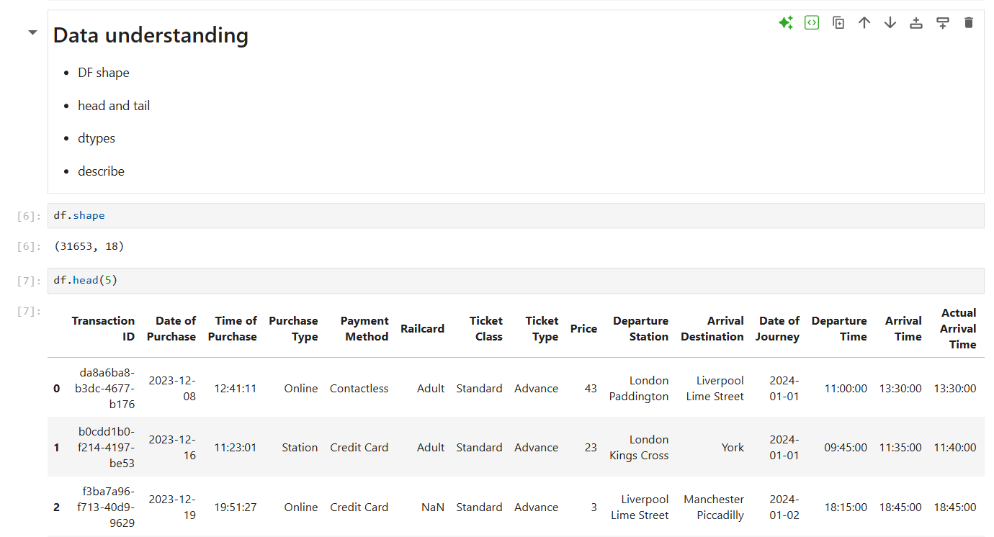
04 • PYTHON • DATA UNDERSTANDING
Getting to know the data
✓
.shape
Dataset dimensions — 31,653 × 18
✓
.head() / .tail()
Preview first and last rows
✓
.columns
All column names
✓
.dtypes
Data type inspection
✓
.describe()
Summary statistics
Railway Dataset • End-to-End Analysis • Hager
5 / 14

Slide 6
05 • PYTHON • DATA CLEANING
From messy to clean
Missing values — handled with logic, not guesses
Column
Missing
Action
Railcard
20,918 (66%)
Filled with “No Railcard” — absence is meaningful
Reason for Delay
27,481 (87%)
On Time → “No Delay”; Delayed/Cancelled → “Unknown”
Actual Arrival Time
1,880 (6%)
Cancelled → “Cancelled”; else → “Unknown”
Type fixes
Duplicates
Standardised
Date of Purchase &
Date of Journey → datetime64
0 fully duplicate rows found
Weather Conditions→Weather,
Signal failure→Signal Failure,
Staff Shortage→Staffing
Railway Dataset • End-to-End Analysis • Hager
6 / 14

Slide 7
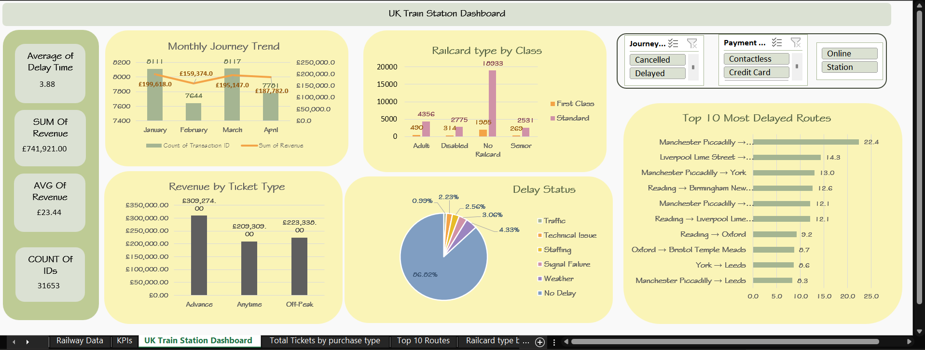
07 • EXCEL • UK TRAIN STATION DASHBOARD
Interactive Excel dashboard
6 charts • 4 KPI cards • 3 connected slicers
3.88 min
AVG Delay Time
£741,921
Total Revenue
£23.44
AVG Ticket Price
31,653
Total Journeys
Railway Dataset • End-to-End Analysis • Hager
8 / 14

Slide 8
08 • EXCEL • CHARTS & SLICERS
What each visual answers
Monthly Journey Trend
Revenue by Ticket Type
Combo chart — journeys (bars) + revenue (line), Jan–Apr 2024.
Advance leads at £309,274.
Railcard × Class
Delay Status
No-Railcard Standard dominates at 18,933.
Pie — 86.82% no delay.
Top 10 Delayed Routes
Slicers
Manchester Piccadilly → London St Pancras at 22.4 min.
Journey Status • Payment Method • Purchase Type.
Railway Dataset • End-to-End Analysis • Hager
9 / 14

Slide 9
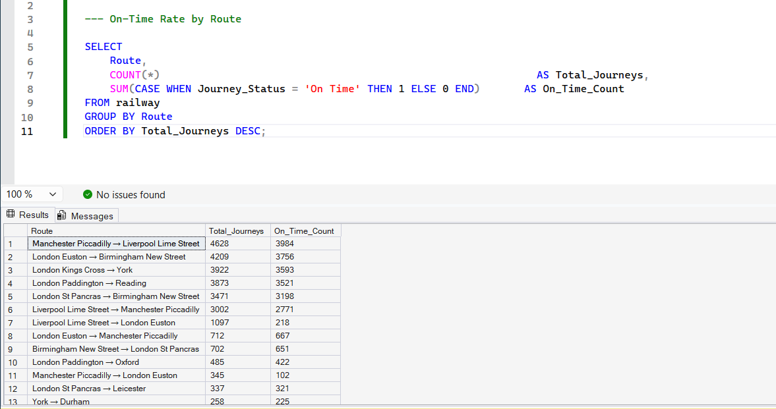
09 • SQL SERVER • BUSINESS QUERIES
Five queries, five answers
Data imported from Excel into a clean SQL Server .
Q1
On-Time Rate by Route
Q2
Avg & Max Delay by Reason
Q3
Monthly Revenue Trend
Q4
Refunds by Journey Status
Q5
Top 5 Most Delayed Routes
Railway Dataset • End-to-End Analysis • Hager
10 / 14

Slide 10
10 • SQL • QUERY SPOTLIGHT
Top 5 most delayed routes
query_5.sql
INSIGHT
SELECT TOP 5
Route,
COUNT(*) AS Total_Delayed,
ROUND(AVG([ Delay_Time]),2) AS Avg_Delay_Mins
FROM Railway
WHERE Journey_Status = 'Delayed'
GROUP BY Route
ORDER BY Total_Delayed DESC;
A handful of routes drive most of the delay volume — perfect targets for operational focus.
Combined with Q2 (delay reasons), these routes become a prioritised remediation backlog.
Railway Dataset • End-to-End Analysis • Hager
11 / 14

Slide 11
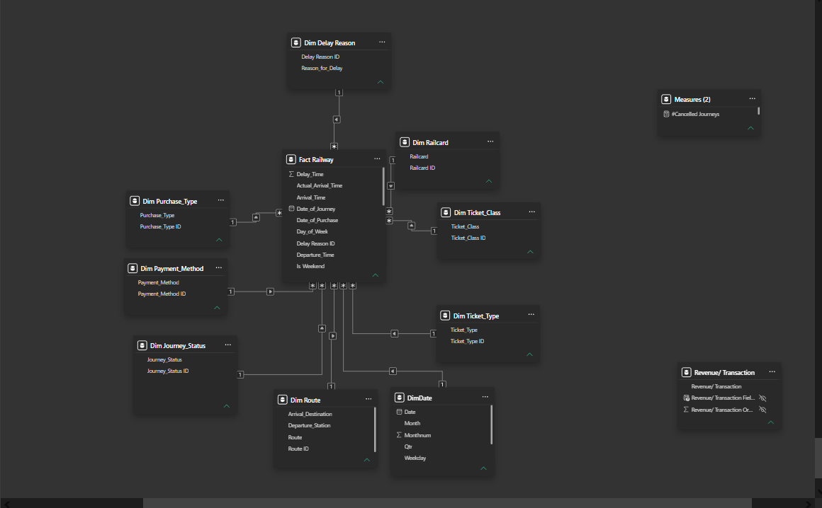
11 • POWER BI • STAR SCHEMA
Dim Date
Dim Journey Status
Dim Station
4 dimensions × 1 fact — efficient, intuitive filtering across every report page.
12 / 14

Slide 12
12 • POWER BI • THREE-PAGE REPORT
Overview · Revenue · Performance
01 OVERVIEW
02 REVENUE
03 PERFORMANCE
KPIs
KPIs
KPIs
Transactions, AVG Delay, Net Revenue, AVG Ticket Price
Total Revenue, Expenses, Net Revenue, Refund Gauge
On-Time, Delayed, Cancelled gauges + delay analysis
INSIGHT
INSIGHT
INSIGHT
Credit Card leads payments (61.29%). Top crowded route: Manchester Piccadilly → Liverpool (1,110).
Advance tickets highest at £309,274. Refund rate 3.47% — above 2% target.
On-time 87.03% (vs 90% target). Weather worst in April at 32.93 min.
13 / 14

Slide 13
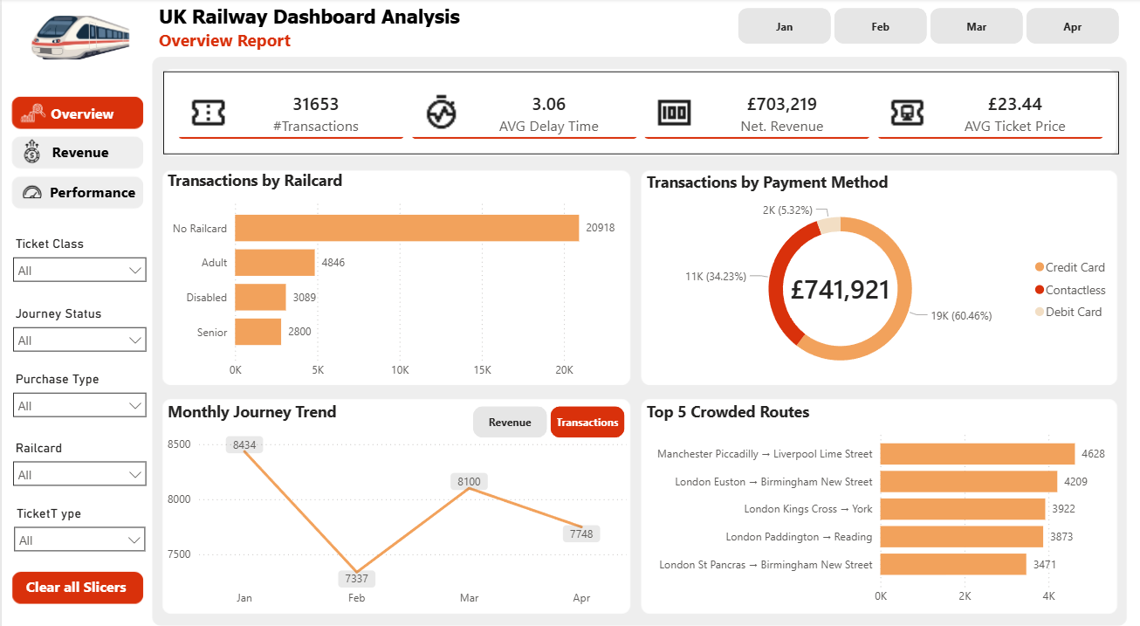
13 • POWER BI •
Overview
01 OVERVIEW
KPIs
Transactions, AVG Delay, Net Revenue, AVG Ticket Price
INSIGHT
Credit Card leads payments (61.29%). Top crowded route: Manchester Piccadilly → Liverpool (1,110).
13 / 14

Slide 14
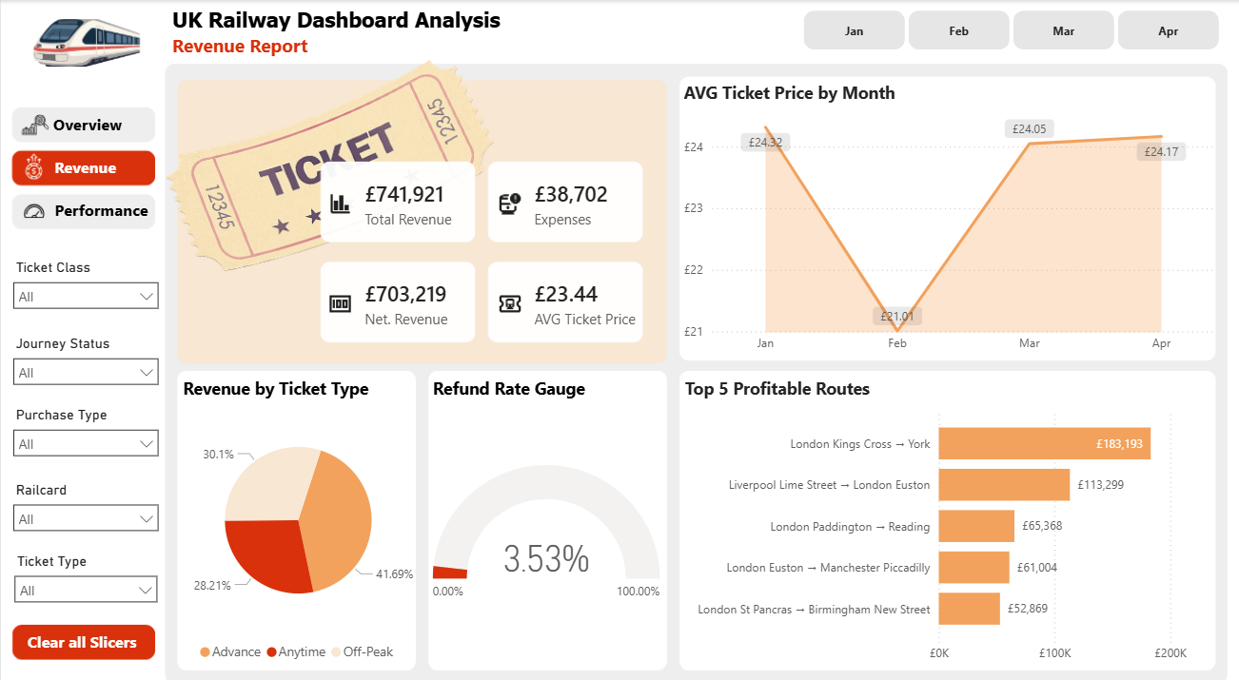
14 • POWER BI •
Revenue
02 REVENUE
KPIs
Total Revenue, Expenses, Net Revenue, Refund Gauge
INSIGHT
Advance tickets highest at £309,274. Refund rate 3.47% — above 2% target.
13 / 14

Slide 15
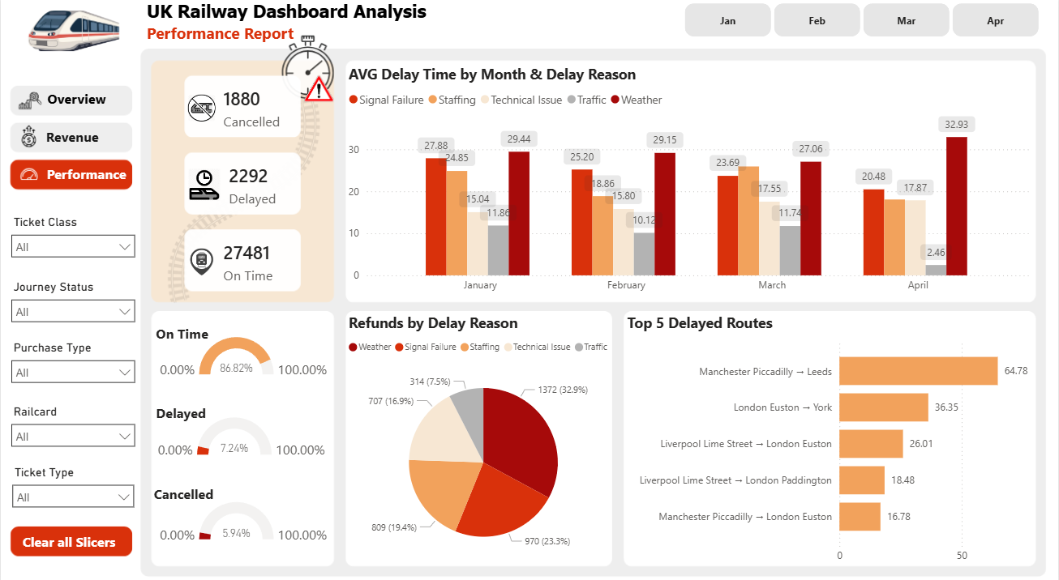
15 • POWER BI •
Performance
03 PERFORMANCE
KPIs
On-Time, Delayed, Cancelled gauges + delay analysis
INSIGHT
On-time 87.03% (vs 90% target). Weather worst in April at 32.93 min.
13 / 14

Slide 16
16 • POWER BI • GAUGES VS BENCHMARKS
How we measure success
KPI
Current
Target
Status
On-Time Rate
87.03%
90%
On target
Refund Rate
3.47%
Below 2%
Above
Cancelled Rate
6.16%
Below 3%
Above
AVG Delay Time
3.88 min
Below 5 min
On target
According to the Industry Benchmark for train stations: the on-Time rate should be from 85–90%"
Railway Dataset • End-to-End Analysis • Hager
14 / 14

