Slide 1
COVID-19 Data Analysis Report
Python cleaning, a Power BI dashboard, findings and recommendations
187 countries · snapshot of 27 July 2020 · Prepared by Hager Naser
Notes:
Opening: this report answers the two requirement parts first, then shows the dashboard, explains every chart, and ends with insights and recommendations. All figures come from the country_wise_latest sheet (187 countries, snapshot of 27 July 2020).

Slide 2
Overall statistical analysis
DIRECT ANSWER · PART 1
Category | Total | Average | Maximum | Max country
Active | 6,358,362 | 34,001.94 | 2,816,444 | US
Confirmed | 16,480,485 | 88,130.94 | 4,290,259 | US
Deaths | 654,036 | 3,497.52 | 148,011 | US
Recovered | 9,468,087 | 50,631.48 | 1,846,641 | Brazil
Average = mean of all 187 countries
The US holds the maximum in 3 of 4
Not filtered by any selection, so it matches the dashboard cards.
Brazil leads Recovered; the US is second with 1,325,804.
Source: country_wise_latest · 187 countries · snapshot of 27 Jul 2020
Notes:
Part 1 answer. Total, average and maximum for Active, Confirmed, Deaths and Recovered. The average is the mean across all 187 countries. The maximum is the highest single-country value: the US for Active, Confirmed and Deaths, Brazil for Recovered.

Slide 3
Countries above the average
DIRECT ANSWER · PART 2
Category | Average | Countries above | Share of 187 | Highest country
Active | 34,002 | 24 | 12.8% | US · 2,816,444
Confirmed | 88,131 | 25 | 13.4% | US · 4,290,259
Deaths | 3,498 | 26 | 13.9% | US · 148,011
Recovered | 50,631 | 28 | 15.0% | Brazil · 1,846,641
“Overactive” means “above average”
The requirements define no separate threshold, so a country is flagged whenever its value is greater than the average of that category. The next four slides list every flagged country; the full 187-country tables are in the dashboard.
Source: country_wise_latest · 187 countries · snapshot of 27 Jul 2020
Notes:
Part 2 summary. For each category we compared every country with that category's average. Between 24 and 28 countries exceed the average, roughly one country in seven. The note in the requirements says overactive and above average are the same condition unless a separate threshold is given, and none is given.

Slide 4
Active: 24 countries above 34,002
DIRECT ANSWER · PART 2 · ACTIVE
24 of 187 countries (12.8%) together hold 89.3% of all active cases
# | Country | Active
1 | US | 2,816,444
2 | Brazil | 508,116
3 | India | 495,499
4 | United Kingdom | 254,427
5 | Russia | 201,097
6 | South Africa | 170,537
7 | Colombia | 117,163
8 | France | 108,928
# | Country | Active
9 | Canada | 107,514
10 | Peru | 98,752
11 | Bangladesh | 97,577
12 | Spain | 93,613
13 | Argentina | 91,782
14 | Sweden | 73,695
15 | Philippines | 53,649
16 | Egypt | 52,992
# | Country | Active
17 | Mexico | 47,657
18 | Netherlands | 47,064
19 | Bolivia | 47,056
20 | Saudi Arabia | 43,238
21 | Ecuador | 40,733
22 | Belgium | 39,154
23 | Indonesia | 37,292
24 | Israel | 36,378
Source: country_wise_latest · 187 countries · snapshot of 27 Jul 2020
Notes:
Every country whose active cases exceed the average of 34,002. The US alone is 44% of the world's active cases. Some countries here (for example the UK, Canada, Sweden, Netherlands) report almost no recoveries, which inflates their active count; see the data-quality slide.

Slide 5
Confirmed: 25 countries above 88,131
DIRECT ANSWER · PART 2 · CONFIRMED
25 of 187 countries (13.4%) together hold 85.6% of all confirmed cases
# | Country | Confirmed
1 | US | 4,290,259
2 | Brazil | 2,442,375
3 | India | 1,480,073
4 | Russia | 816,680
5 | South Africa | 452,529
6 | Mexico | 395,489
7 | Peru | 389,717
8 | Chile | 347,923
9 | United Kingdom | 301,708
# | Country | Confirmed
10 | Iran | 293,606
11 | Pakistan | 274,289
12 | Spain | 272,421
13 | Saudi Arabia | 268,934
14 | Colombia | 257,101
15 | Italy | 246,286
16 | Turkey | 227,019
17 | Bangladesh | 226,225
# | Country | Confirmed
18 | France | 220,352
19 | Germany | 207,112
20 | Argentina | 167,416
21 | Canada | 116,458
22 | Iraq | 112,585
23 | Qatar | 109,597
24 | Indonesia | 100,303
25 | Egypt | 92,482
Source: country_wise_latest · 187 countries · snapshot of 27 Jul 2020
Notes:
Every country whose confirmed cases exceed the average of 88,131. The first ten countries alone hold 68% of the world's confirmed cases.

Slide 6
Deaths: 26 countries above 3,498
DIRECT ANSWER · PART 2 · DEATHS
26 of 187 countries (13.9%) together hold 91.8% of all deaths
# | Country | Deaths
1 | US | 148,011
2 | Brazil | 87,618
3 | United Kingdom | 45,844
4 | Mexico | 44,022
5 | Italy | 35,112
6 | India | 33,408
7 | France | 30,212
8 | Spain | 28,432
9 | Peru | 18,418
# | Country | Deaths
10 | Iran | 15,912
11 | Russia | 13,334
12 | Belgium | 9,822
13 | Chile | 9,187
14 | Germany | 9,125
15 | Canada | 8,944
16 | Colombia | 8,777
17 | South Africa | 7,067
18 | Netherlands | 6,160
# | Country | Deaths
19 | Pakistan | 5,842
20 | Sweden | 5,700
21 | Turkey | 5,630
22 | Ecuador | 5,532
23 | Indonesia | 4,838
24 | China | 4,656
25 | Egypt | 4,652
26 | Iraq | 4,458
Source: country_wise_latest · 187 countries · snapshot of 27 Jul 2020
Notes:
Every country whose deaths exceed the average of 3,498. The median country has 108 deaths, and 17 countries report zero.

Slide 7
Recovered: 28 countries above 50,631
DIRECT ANSWER · PART 2 · RECOVERED
28 of 187 countries (15.0%) together hold 88.5% of all recovered cases
# | Country | Recovered
1 | Brazil | 1,846,641
2 | US | 1,325,804
3 | India | 951,166
4 | Russia | 602,249
5 | Chile | 319,954
6 | Mexico | 303,810
7 | South Africa | 274,925
8 | Peru | 272,547
9 | Iran | 255,144
10 | Pakistan | 241,026
# | Country | Recovered
11 | Saudi Arabia | 222,936
12 | Turkey | 210,469
13 | Italy | 198,593
14 | Germany | 190,314
15 | Spain | 150,376
16 | Colombia | 131,161
17 | Bangladesh | 125,683
18 | Qatar | 106,328
19 | France | 81,212
# | Country | Recovered
20 | China | 78,869
21 | Iraq | 77,144
22 | Argentina | 72,575
23 | Belarus | 60,492
24 | Indonesia | 58,173
25 | Oman | 57,028
26 | Kuwait | 55,057
27 | Kazakhstan | 54,404
28 | UAE | 52,510
Source: country_wise_latest · 187 countries · snapshot of 27 Jul 2020 · UAE = United Arab Emirates
Notes:
Every country whose recovered cases exceed the average of 50,631. Brazil is first, ahead of the US. Six countries report zero recoveries: Canada, Mozambique, Serbia, Sweden, Syria and Timor-Leste.

Slide 8
Data preparation in Python
METHOD
STEP 1
STEP 2
STEP 3
STEP 4
Load
Clean
Validate
Prepare
Read the country_wise_latest sheet: 187 countries, one row per country.
Dropped two stray columns (Unnamed: 15 and 16). Their only value, 4,290,259, is the US confirmed total.
No missing values, duplicates or negatives.
Added an Above_Avg flag per category, saved each requirement as a table and exported the clean file to Power BI.
Country names were kept as in the source
For example Taiwan* and Congo (Kinshasa). Each country appears once, so no grouping was needed before comparing with the average.
Source: country_wise_latest · 187 countries · snapshot of 27 Jul 2020
Notes:
Method in four steps: load, clean, validate, prepare. The identity Confirmed = Deaths + Recovered + Active held in every row, which gives confidence in the source. The stray column value 4,290,259 equals the US confirmed total, so it was a leftover note, not data.

Slide 9
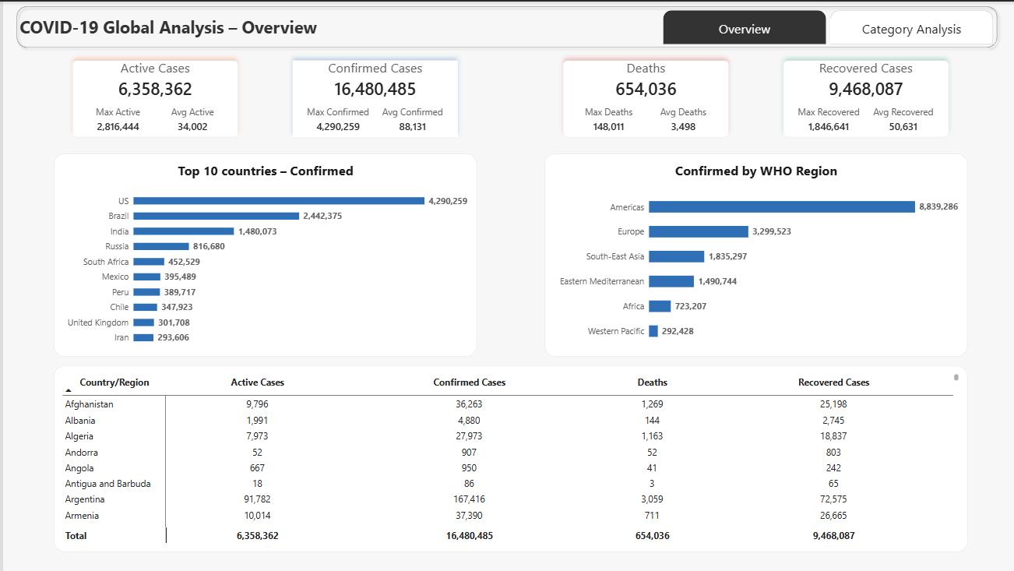
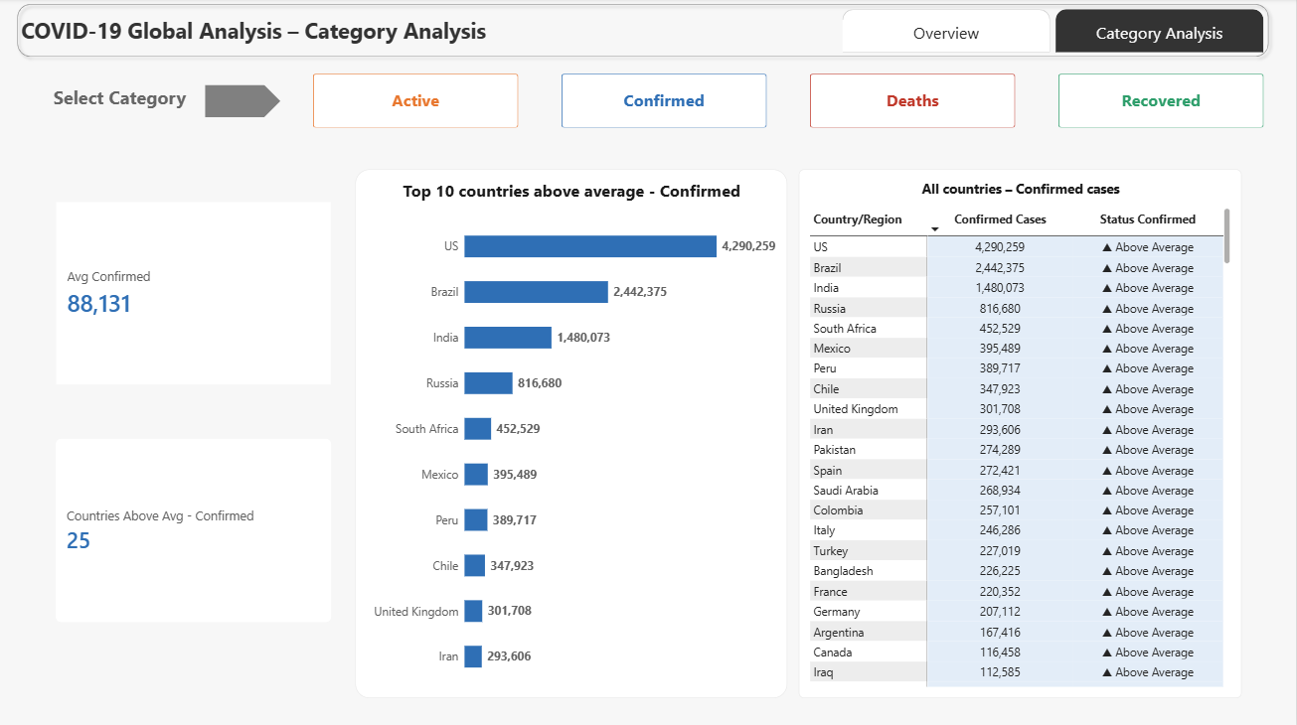
The Power BI dashboard
DASHBOARD
Page 1 · Overview
Page 2 · Category Analysis
Part 1: totals, maximum and average
Part 2: one category at a time, chosen with the buttons
Built in Power BI from the cleaned Python export · colours are fixed per category across the report
Notes:
The complete dashboard. Page 1 answers Part 1 and gives the global picture. Page 2 answers Part 2: the four buttons switch the cards, the Top 10 chart and the all-countries table between Active, Confirmed, Deaths and Recovered. Each category keeps its own colour on every visual.

Slide 10
KPI cards: totals, maximum, average
CHART 1 · OVERVIEW PAGE
What it shows
What we learn
One card per category with the world total, the highest single-country value (Max) and the per-country average (Avg). It answers Part 1 at a glance.
Of 16.5M confirmed cases, 57.5% recovered, 38.6% are still active and 4.0% died.
The top country dwarfs the average: US confirmed is 49× the average, US active 83×, US deaths 42×, Brazil recovered 37×.
Source: Power BI dashboard, Overview page · rates computed from the world totals
Notes:
The cards are the direct answer to Part 1 inside the dashboard. The ratio of maximum to average shows how uneven the distribution is: one country can be dozens of times the average.

Slide 11
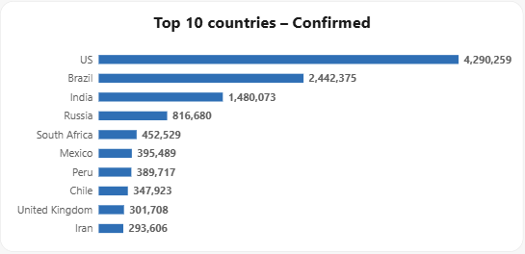
Top 10 countries by confirmed cases
CHART 2 · OVERVIEW PAGE
What it shows
The ten countries with the most confirmed cases, ranked from the largest.
What we learn
The US (4.29M) and Brazil (2.44M) alone are 40.9% of all confirmed cases.
The ten countries together hold 68.0% of the world total.
Even the tenth, Iran with 293,606, is 3.3× the average.
Source: Power BI dashboard, Overview page · shares computed from the world total of 16,480,485
Notes:
Concentration is the main message: a very small group of countries accounts for most cases, so averages and rankings are driven by them.

Slide 12
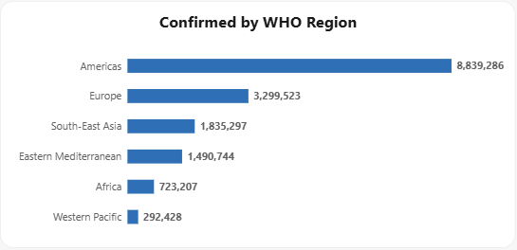
Confirmed cases by WHO region
CHART 3 · OVERVIEW PAGE
What it shows
Total confirmed cases for each of the six WHO regions.
What we learn
The Americas hold 8.84M cases, 53.6% of the world total.
With Europe (3.30M, 20.0%) they make up 73.7% of all cases.
The Western Pacific is smallest: 292,428 cases, 1.8%.
These are raw counts, not adjusted for population.
Source: Power BI dashboard, Overview page · shares computed from the world total of 16,480,485
Notes:
Regional view. More than half of all confirmed cases are in the Americas. Because regions differ greatly in population, this view shows where the volume is, not where the risk per person is highest.

Slide 13
How the category page works
CHARTS 4 TO 7 · CATEGORY ANALYSIS PAGE
1 · Choose a category
Four buttons switch every visual: Active, Confirmed, Deaths, Recovered.
2 · Read the cards
The category average and how many countries are above it.
3 · Rank and check
The bar chart ranks the leading countries above average. The table lists all 187 countries with a status, and above-average rows are shaded.
Source: Power BI dashboard, Category Analysis page (Confirmed view shown)
Notes:
This page answers Part 2. The next four slides take the categories one by one. In each, the left picture is the Top 10 chart, the middle picture is the all-countries table, and the right column explains what we learn.

Slide 14
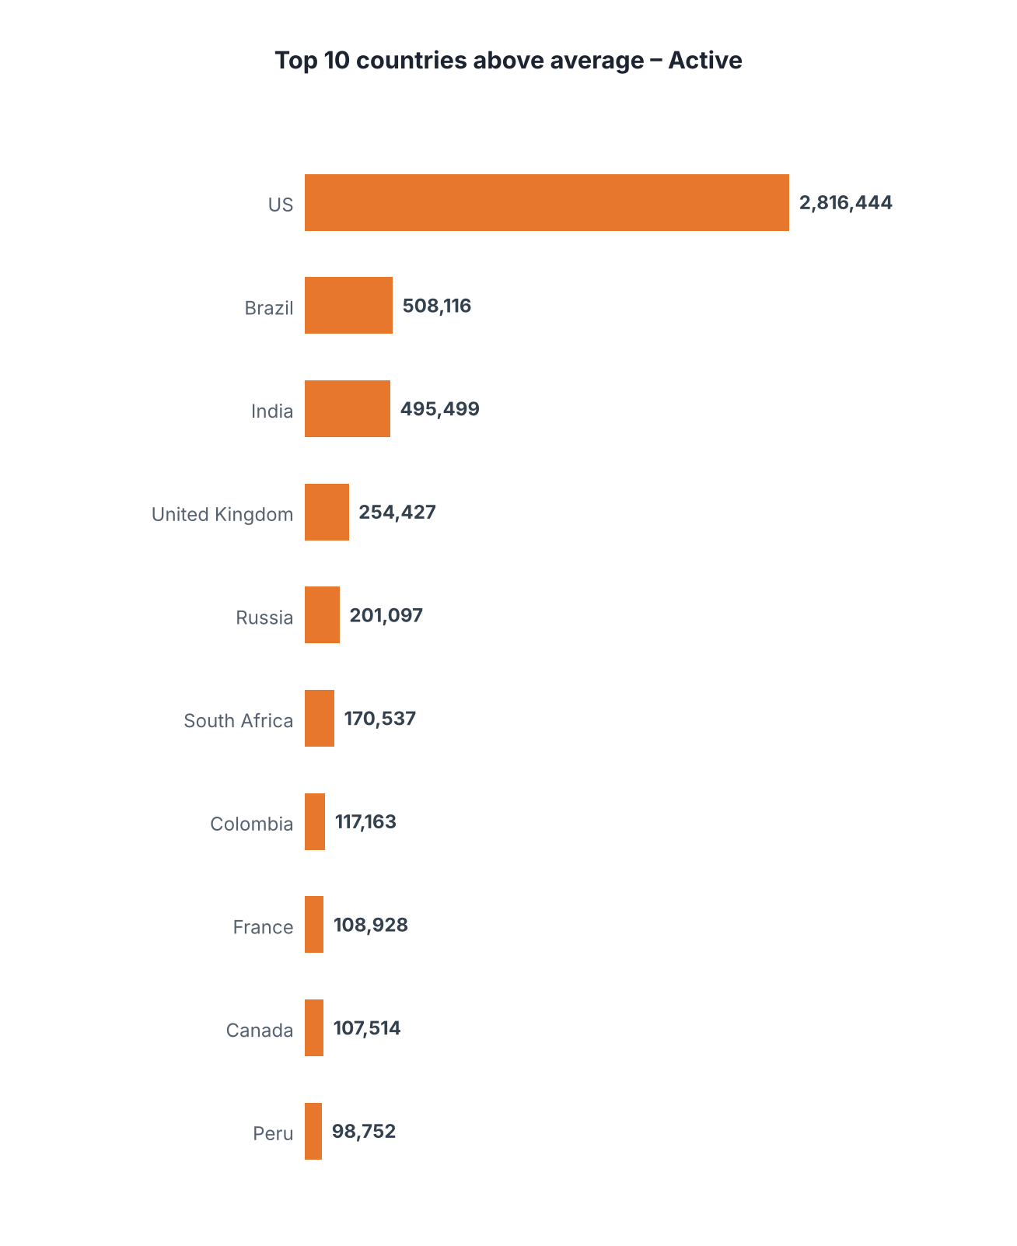
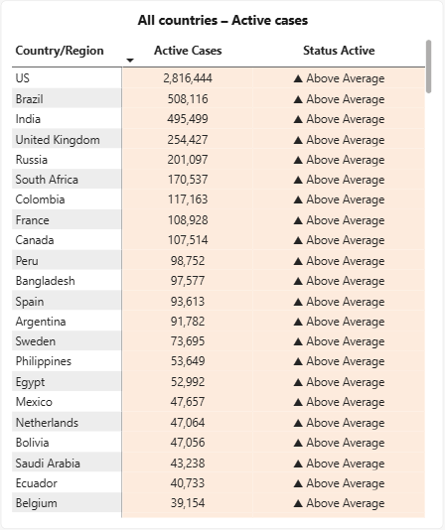
Active: the US holds 44% of cases
CHART 4 · CATEGORY ANALYSIS · ACTIVE
What it shows
The top 10 countries above the 34,002 average, and the table of all 187 countries with their status.
What we learn
US: 2.82M active cases, 44.3% of the world total.
The top five countries hold 67.2% of all active cases.
The median is only 1,600, far below the average.
UK and Canada report almost no recoveries, which inflates their active counts.
Source: Power BI dashboard, Category Analysis page · shares computed from the world active total of 6,358,362
Notes:
Active cases. Replace the left picture with a screenshot of your own Power BI Top 10 chart after setting its Top N filter to rank by Active; the picture here is redrawn from the data to show the corrected ranking (US, Brazil, India, UK, Russia, South Africa, Colombia, France, Canada, Peru).

Slide 15
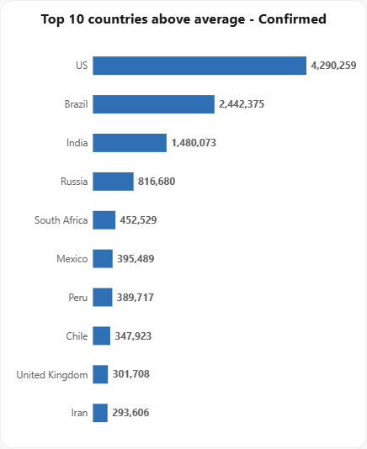
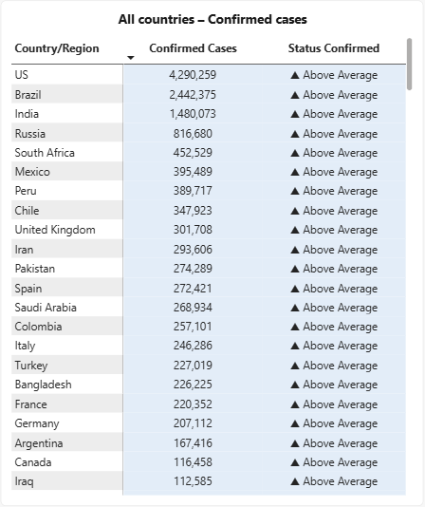
Confirmed: 25 countries above 88,131
CHART 5 · CATEGORY ANALYSIS · CONFIRMED
What it shows
The top 10 countries above the 88,131 average, and the table of all 187 countries with their status.
What we learn
25 countries hold 85.6% of all confirmed cases.
US: 4.29M cases, 26.0% of the world; Brazil follows with 2.44M.
The top five countries hold 57.5% of all cases.
The median is 5,059, so the average is 17× a typical country.
Source: Power BI dashboard, Category Analysis page · shares computed from the world confirmed total of 16,480,485
Notes:
Confirmed cases. The ranking here is the same as the Overview chart, restricted to countries above the average. Only 13.4% of countries are flagged, yet they carry more than 85% of all cases.

Slide 16
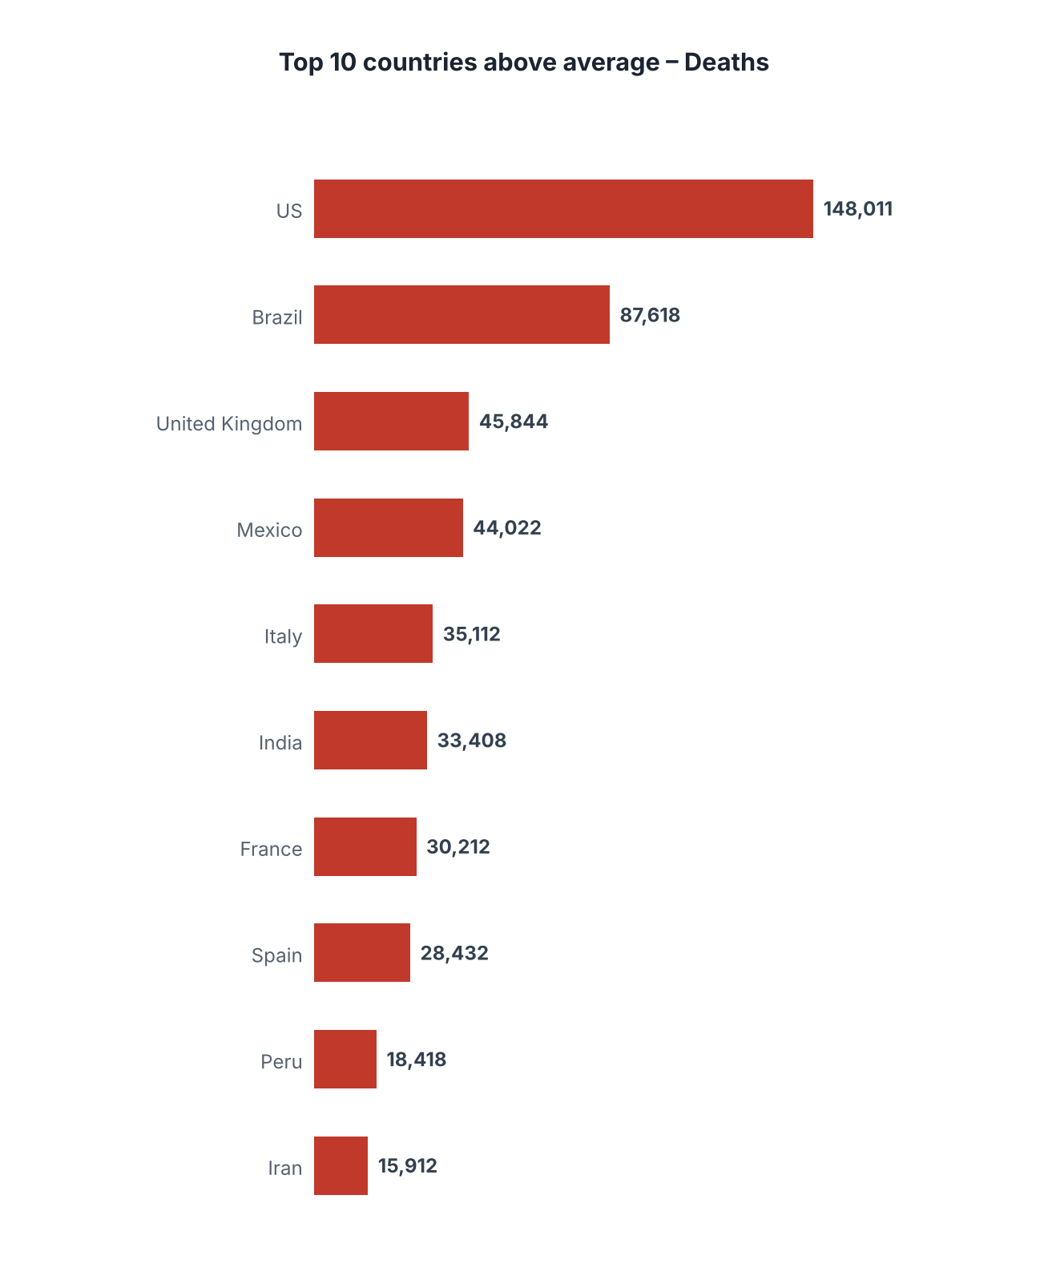
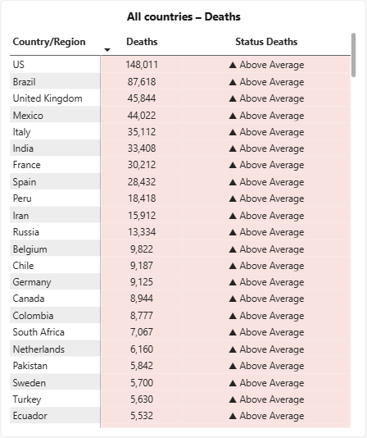
Deaths: 26 countries hold 91.8%
CHART 6 · CATEGORY ANALYSIS · DEATHS
What it shows
The top 10 countries above the 3,498 average, and the table of all 187 countries with their status.
What we learn
US: 148,011 deaths (22.6%), then Brazil 87,618 and the UK 45,844.
The top five countries hold 55.1% of all deaths.
17 countries report zero deaths; the median is 108.
The UK (301,708 cases) has more deaths than India (1,480,073 cases).
Source: Power BI dashboard, Category Analysis page · shares computed from the world deaths total of 654,036
Notes:
Deaths. Replace the left picture with a screenshot of your own Power BI Top 10 chart after fixing it: the bars must show Deaths and the Top N filter must rank by Deaths. The picture here is redrawn from the data (US, Brazil, UK, Mexico, Italy, India, France, Spain, Peru, Iran).

Slide 17
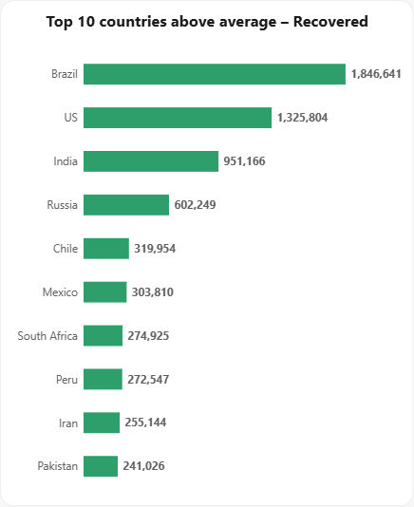
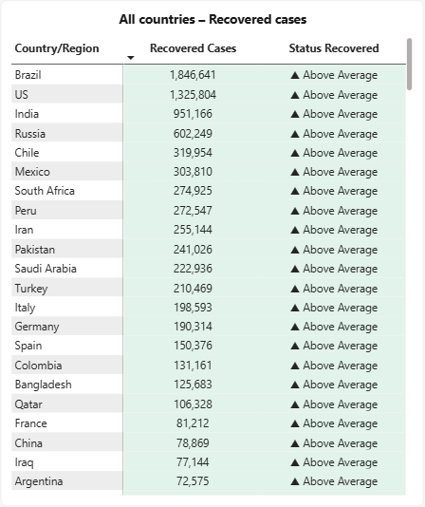
Recovered: Brazil leads, ahead of the US
CHART 7 · CATEGORY ANALYSIS · RECOVERED
What it shows
The top 10 countries above the 50,631 average, and the table of all 187 countries with their status.
What we learn
Brazil (1.85M) is first and the US (1.33M) second, the only category the US does not lead.
28 countries hold 88.5% of all recoveries; the top five hold 53.3%.
Six countries report zero recoveries, including Canada, Sweden and Serbia.
Source: Power BI dashboard, Category Analysis page · shares computed from the world recovered total of 9,468,087
Notes:
Recovered cases. Brazil leads. The zero values are mostly reporting gaps rather than real zero recoveries: the zero-recovery countries are Canada, Mozambique, Serbia, Sweden, Syria and Timor-Leste.

Slide 18
A few countries carry most cases
INSIGHT 1 · CONCENTRATION
Active
Confirmed
Deaths
Recovered
89.3%
85.6%
91.8%
88.5%
of active cases sit in 24 countries (12.8%)
of confirmed cases sit in 25 countries (13.4%)
of deaths sit in 26 countries (13.9%)
of recoveries sit in 28 countries (15.0%)
About one country in seven carries 86% to 92% of every category
The top five countries alone hold 67.2% of Active, 57.5% of Confirmed, 55.1% of Deaths and 53.3% of Recovered.
Source: computed from country_wise_latest · share of each world total held by the countries above that category's average
Notes:
Insight 1. The above-average group is small but accounts for almost all of the volume in each category. Interventions or monitoring focused on these countries cover most of the burden.

Slide 19
The average is far above a typical country
INSIGHT 2 · AVERAGE VS MEDIAN
Category | Average | Median | Average ÷ median
Active | 34,002 | 1,600 | 21×
Confirmed | 88,131 | 5,059 | 17×
Deaths | 3,498 | 108 | 32×
Recovered | 50,631 | 2,815 | 18×
Why it matters
A handful of very large outbreaks pull the mean up. So “above average” isolates the heavy hitters, 13% to 15% of countries, not simply the countries with a problem. Reporting the median next to the mean shows the typical country.
Source: computed from country_wise_latest · 187 countries · snapshot of 27 Jul 2020
Notes:
Insight 2. Half of all countries have fewer than 1,600 active cases or 108 deaths, while the averages are 34,002 and 3,498. The distribution is heavily right-skewed, which is why the above-average group is so small.

Slide 20
Regions and outcome rates
INSIGHT 3 · REGIONS
WHO region | Share of confirmed | Deaths per 100 cases | Recovered per 100 cases
Americas | 53.6% | 3.9 | 50.6
Europe | 20.0% | 6.4 | 60.4
South-East Asia | 11.1% | 2.3 | 63.0
Eastern Mediterranean | 9.0% | 2.6 | 80.6
Africa | 4.4% | 1.7 | 60.9
Western Pacific | 1.8% | 2.8 | 70.7
World | 100% | 4.0 | 57.5
What we learn
Europe has the highest death rate: 6.4 per 100 cases against 4.0 worldwide.
The UK, Belgium, Italy and France are all above 13 deaths per 100 cases.
Eastern Mediterranean has the highest recovery rate: 80.6 per 100 cases.
Rates use reported cases, and testing differs by country.
Source: computed from country_wise_latest · country rates for countries with 10,000+ confirmed cases
Notes:
Insight 3. The Americas carry the volume, but Europe has the highest share of cases ending in death. Deaths per 100 cases is a crude rate: it depends on how many mild cases were tested and reported.

Slide 21
Data flags that change the reading
INSIGHT 4 · CAVEATS
Recoveries are under-reported
Overlap across categories
Counts, not rates
11 countries are above average in all four categories: Brazil, Colombia, France, India, Indonesia, Mexico, Peru, Russia, South Africa, Spain and the US. 38 countries are above average in at least one.
The data has no population or testing figures, so large countries rank high by size alone. It is also one snapshot, 27 July 2020, with no trend inside the country table.
Canada, Serbia and Sweden report zero recovered; the UK (1,437) and the Netherlands (189) report almost none. Active = Confirmed − Deaths − Recovered, so their active counts are overstated. UK active of 254,427 ranks fourth.
Source: computed from country_wise_latest · 187 countries · snapshot of 27 Jul 2020
Notes:
Three limits to keep in mind. First, missing recovery reports make the Active column unreliable for a few countries. Second, many countries repeat across the four above-average lists. Third, the table has no population, so rankings reflect size as well as severity.

Slide 22
Prioritizing Public Health Response
RECOMMENDATIONS · 1 OF 2
1 · Prioritize healthcare resource allocation
2 · Strengthen Mortality Reduction Efforts
Assess healthcare resource needs in countries with the highest case burden, including medical supplies and hospital capacity.
.
.
Identify opportunities to improve critical care capacity and timely access to treatment in high-mortality countries.
3 · Develop Targeted Regional Response Strategies
4 · Investigate Regional Differences in Mortality
Prioritize the Americas and Europe, which account for 73.7% of confirmed cases, through region-specific response strategies.
Examine potential factors contributing to Europe's higher reported death rate of 6.4 per 100 confirmed cases, compared with 4.0 globally.
Evidence: concentration, average vs median and regional slides
Notes:
Recommendations grounded in the numbers. 1 is about method, 2 and 3 are about where to focus, and 4 is a question the data raises but cannot answer by itself.

Slide 23
Supporting Public Health Decision-Making
RECOMMENDATIONS · 2 OF 2
5 · Strengthen Healthcare System Preparedness
6 · Strengthen Surveillance and Early Detection
Assess hospital capacity, ICU availability, medical staffing, and essential supplies in high-burden countries.
Improve testing, case reporting, and epidemiological surveillance to support timely outbreak detection and response..
7 · Enhance Access to Critical Care
8 · Establish Continuous Monitoring
Evaluate access to timely medical care and critical care services in countries with high reported mortality.
Track key public health indicators over time to identify changes and evaluate response effectiveness.
9 · Support Evidence-Based Country-Level Interventions
Combine case data with population and healthcare information to develop targeted interventions based on each country's needs.
Evidence: concentration, average vs median and regional slides
Notes:
Recommendations grounded in the numbers. 1 is about method, 2 and 3 are about where to focus, and 4 is a question the data raises but cannot answer by itself.

