Slide 1
Java
se
Diploma
lecture
7
operation
© 2016 Ahmed Ashraf Abdelmonem. All rights reserved
1-1

Slide 2
Prepared By:
•
Eng : Ahmed Ashraf Abdelmonem
▪
Phone : 01144277723 – 01027400068
▪
Email :
eng.ahmadashrafabdelmonem@gmail.com
▪
hours:
Tuesdays and Thursdays
Or by appointment
3pm-6pm
© 2016 Ahmed Ashraf Abdelmonem. All rights reserved
1-2

Slide 3
Today’s Agenda
•
Operation
•
Type of operation
•
Arithmetic Operators
•
Relational Operators
•
Logical Operators
•
Bitwise Operators
•
Assignment Operators
•
Conditional or Misc
Operators
•
Precedence
© 2016 Ahmed Ashraf Abdelmonem. All rights reserved
1-3

Slide 4
Operation
•
In
of
all computer languages,
components:
expressions
consist
of
two
types
1
–
operands.
2
-
operator.
3
–
returned value
after operation.
•
Operands are the objects that are manipulated
•
Operator is a special symbol that tells the compiler
perform specific mathematical or logical Operation
to
© 2016 Ahmed Ashraf Abdelmonem. All rights reserved
1-4

Slide 5
Type of operation
•
Unary
is an operator that
Binary
is an operator that
Ternary
takes only one value
for its operation.
•
takes only two values for its operation.
•
is an operator that takes only one value
for its operation.
•
Except for the assignment operators, all binary
are left-associative
operators
•
The assignment operators and the
conditional operator (?:) are right-associative
© 2016 Ahmed Ashraf Abdelmonem. All rights reserved
1-5

Slide 6
Operators type
•
We can divide all the Java
groups:
operators
into
the
following
1.
Arithmetic Operators
2.
Relational Operators
3.
Bitwise Operators
4.
Logical Operators
5.
Assignment Operators
6.
Misc Operators
© 2016 Ahmed Ashraf Abdelmonem. All rights reserved
1-6

Slide 7
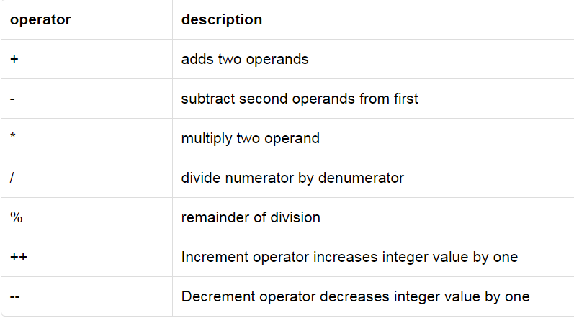
Arithmetic Operation
•
Arithmetic operators are used in mathematical
expressions
in the same way that they are used
in
algebra.
The
following
table
lists
the
arithmetic
operators
© 2016 Ahmed Ashraf Abdelmonem. All rights reserved
1-7

Slide 8
Increment and decrement
•
++var preincrement The expression (++var) increments var
by 1 and evaluates to the new value in var after the increment.
•
var++ postincrement The expression (var++) evaluates
the original value in var and increments var by 1.
to
•
--var predecrement The expression (--var) decrements
by 1 and evaluates to the new value in var after the decrement.
var
•
var-- postdecrement The expression
original value in var and decrements
(var--)
var by
evaluates
1.
to the
© 2016 Ahmed Ashraf Abdelmonem. All rights reserved
1-8

Slide 9
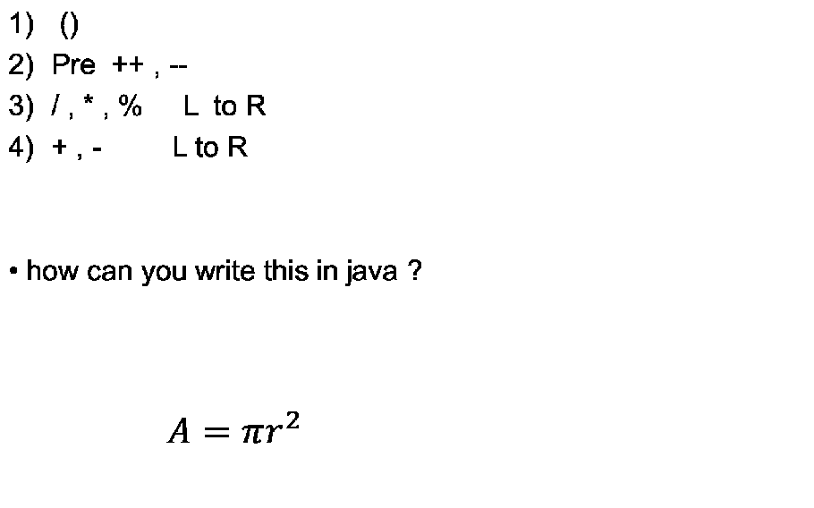
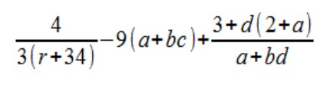
Precedence
© 2016 Ahmed Ashraf Abdelmonem. All rights reserved
1-9

Slide 10
Notes
When performing a binary operation involving two operands of different types, Java automatically converts the operand based on the following rules:
1.
If one of the operands is double, the other is converted
double.
into
2.
Otherwise, if one of the
converted into float
operands
is
float,
the
other
is
3
Otherwise, if one of the
converted into long.
operands
is
long,
the
other
is
4.
Otherwise, both operands are converted into
int.
© 2016 Ahmed Ashraf Abdelmonem. All rights reserved
1-10

Slide 11
Arithmetic Operation
•
powers is the iteration of multiplication process
•
Division operator / if used on integers
(without rounding) or exception
returns
integer
7/3.0f
// Evaluates
to 2.333333f
7/0
// Throws an
ArithmeticException
7/0.0
// Evaluates
to positive infinity
0.0/0.0
// Evaluates to NaN
© 2016 Ahmed Ashraf Abdelmonem. All rights reserved
1-11

Slide 12
Exercise 1 :
public class Ahmad {
public static void main (String[] args){
int result = 1 + 2;
result = result - 1;
result = result * 2;
result = result / 2;
result = result + 8;
result = result % 7;
System.out.println(result);
}
}
© 2016 Ahmed Ashraf Abdelmonem. All rights reserved
1-12

Slide 13
Exercise 2 :
class Ahmad{
public static void main(String[] args) {
int i = 3;
System.out.println(i);
i++;
System.out.println(i);
++i;
System.out.println(i);
System.out.println(i);
System.out.println(++i);
System.out.println(i++);
System.out.println(i);
}
}
© 2016 Ahmed Ashraf Abdelmonem. All rights reserved
1-13

Slide 14
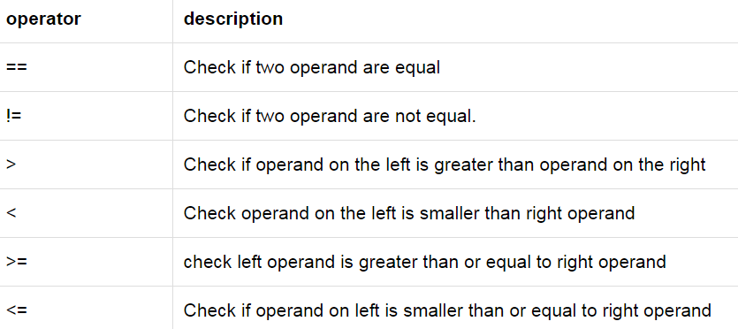
Relational
Operation
© 2016 Ahmed Ashraf Abdelmonem. All rights reserved
1-14

Slide 15
Exercise:
public class Ahmad{
public static void main(String args[]) {
int a = 10;
int b = 20;
System.out.println("a == b = " + (a == b) );
System.out.println("a != b = " + (a != b) );
System.out.println("a > b = " + (a > b) );
System.out.println("a < b = " + (a < b) );
System.out.println("b >= a = " + (b >= a) );
System.out.println("b <= a = " + (b <= a) );
}
}
© 2016 Ahmed Ashraf Abdelmonem. All rights reserved
1-15

Slide 16
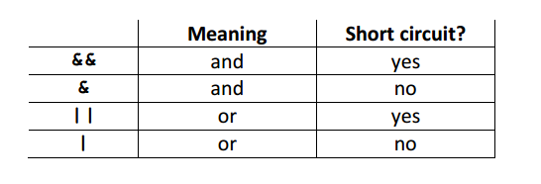
Logical
operators
© 2016 Ahmed Ashraf Abdelmonem. All rights reserved
1-16

Slide 17
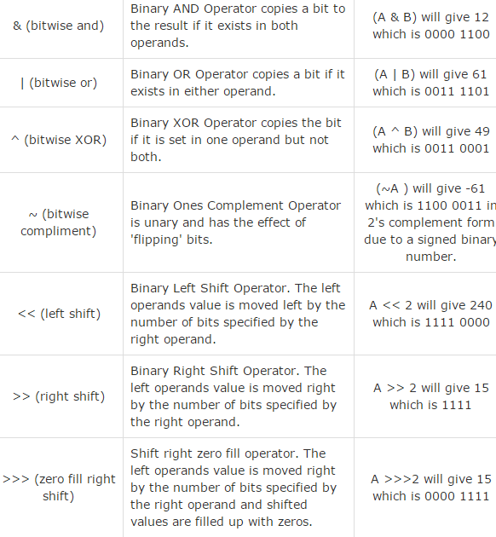
Bitwise
operators
© 2016 Ahmed Ashraf Abdelmonem. All rights reserved
1-17

Slide 18
Example :
•
Java defines several bitwise operators, which can be applied to
the integer types, long, int, short, char, and byte.
•
Bitwise operator works on bits and performs bit-by-bit operation
•
Assume if a = 60 and
follows −
b
=
13;
now
in
binary
format
they
will
be
as
a = 0011 1100
b = 0000 1101
-----------------
a&b = 0000 1100
a|b = 0011 1101
a^b = 0011 0001
~a = 1100 0011
© 2016 Ahmed Ashraf Abdelmonem. All rights reserved
1-18

Slide 19
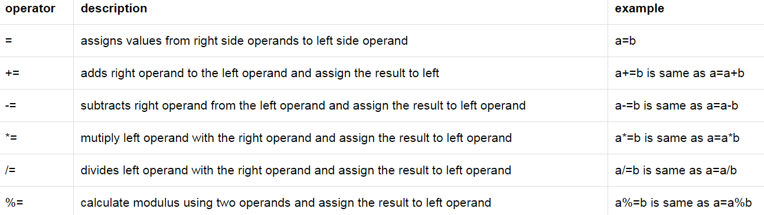
Assignment
Operators
© 2016 Ahmed Ashraf Abdelmonem. All rights reserved
1-19

Slide 20
Conditional or Misc
Operators
•
It can be represented with " ?: “
•
This operator consists of three operands and is used to
evaluate Boolean expressions. The goal of the operator is to
decide, which value should be assigned to
operator is written as
the
variable.
The
variable x
= (expression)
?
True
:
false
;
© 2016 Ahmed Ashraf Abdelmonem. All rights reserved
1-20

Slide 21
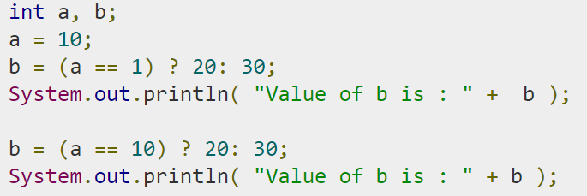
Example
© 2016 Ahmed Ashraf Abdelmonem. All rights reserved
1-21

Slide 22
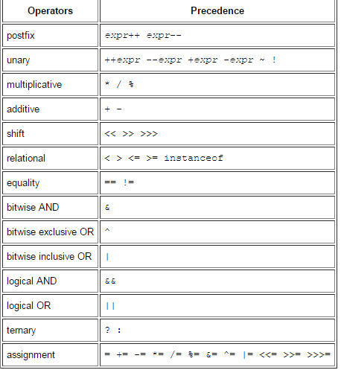
© 2016 Ahmed Ashraf Abdelmonem. All rights reserved
1-22

