Slide 1
Java se Diploma lecture 6 variables

Slide 2
Prepared By:
Eng : Ahmed Ashraf Abdelmonem
Phone : 01144277723 – 01027400068
Email : eng.ahmadashrafabdelmonem@gmail.com
hours: Tuesdays and Thursdays 3pm-6pm
Or by appointment

Slide 3
Today’s Agenda
data types
Number system
Scientific Notation
Variable
Variable naming
Declaring then initializing
Literal & unliteral
Variable Types
Derived Datatypes

Slide 4
Data Type in Java
is a special keyword used to allocate sufficient memory space for the data, in other words Data type is used for representing the data in main memory (RAM) of the computer.
In general every programming language is containing three categories of data types. They are
1 - Fundamental or primitive data types 2 – reference data type
a - Derived data types
b - User defined data types

Slide 5
Primitive Vs Reference
Variables of Primitive data types store the actual value
Variables of Reference data types store the reference
(= address) of the memory cells where the actual values are stored

Slide 6
Primitive data types
Primitive data types are those whose variables allows us to store only one value but they never allows us to store multiple values of same type. This is a data type whose variable can hold maximum one value at a time.
There are eight primitive types in Java :
Four of them are integer types .
two are floating-point number types .
one is the character type .
and one is a Boolean type for truth values.

Slide 7
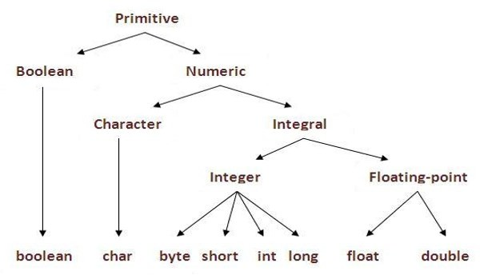
FIRST Primitive data types

Slide 8
Integer
Integers : is any number not have a decimal point whatever
positive or negative.
Java provides four reserved word (byte - short – int – long)
These four words are similar in functionality, but differ in space in memory was be reserved .

Slide 9
byte
Byte data type is a 8-bit signed two's complement integer.
Minimum value is (-2^7) = - 128 .
Maximum value is (2^7 -1) = 127
Byte from -128 to 127 any number out this range error
Byte data type is used to save space in large arrays,
mainly in place of integers, since a byte is four times
smaller than an int .
If you don’t write the value the value will be Default value is 0
example byte x = 5 ; byte x = -5 ;

Slide 10
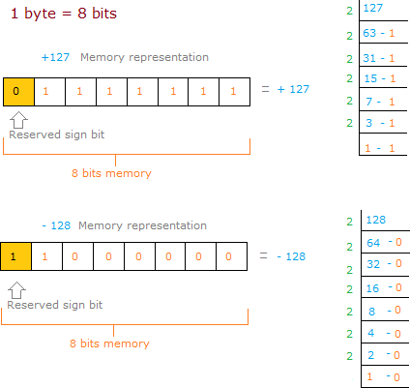
byte

Slide 11
short
Short data type is a 16-bit signed two's complement integer.
Minimum value is (-2^15) = - 32,768 .
Maximum value is (2^15 -1) = 32,767 .
Short from - 32,768 to 32,767 any number out this range
error
.
If you don’t write the value the value will be Default value is 0
Example : short s= 10000 , short r = -20000

Slide 12
int
int data type is a 32-bit signed two's complement integer.
Minimum value is (-2^31) = - 2,147,483,648
Maximum value is (-2^31-1) = 2,147,483,647
int from - 2,147,483,648 to 2,147,483,647
int is generally used as the default data type for integral
values unless there is a concern about memory.
If you don’t write the value the value will be Default value 0
Example : int a = 100000, int b = -200000

Slide 13
long
Long data type is a 64-bit signed two's complement integer.
Minimum value is (-2^63) = -9,223,372,036,854,775,808 .
Maximum value is (2^63 -1) = 9,223,372,036,854,775,807
.
Long from -9,223,372,036,854,775,808 to
9,223,372,036,854,775,807
This type is used when a wider range than int is needed.
If you don’t write the value the value will be Default value 0
Example : int a = 100000L, int b = -200000L

Slide 14
How to represent Number system in java
There are four number system
binary 0,1 base 2 .
2) octal 0,1,2,3,4,5,6,7 base 8 .
3) decimal 0,1,2,3,4,5,6,7,8,9 base 10 .
4) hexadecimal 0,1,2,3,4,5,6,7,8,9,A,B,C,D,E,F base 16 .
int binaryNumber = 0b010101 ; must 0 or 1 only .
int octalNumber = 01247; between 0 and 7 only can not write 8 int decimalNummer = 10; between 0 and 9 only .
int hexadecimalNumber = 0x10abcdef ; between 0 and 9 , A and F

Slide 15
notes
Under Java, the ranges of the integer types do not depend on the machine on which you will be running.

Slide 16
Real Number
numbers with fractional parts.
Java provides two reserved word ( float – double )
These two words are similar in functionality, but differ in space in memory was be reserved

Slide 17
float
Float data type is a single-precision 32-bit 64-bit IEEE 754 floating point..
Float is mainly used to save memory in large arrays of floating point numbers.
Default value is 0.0f.
Float data type is never used for precise values such as currency.
Example : float f1 = 234.5f

Slide 18
double
double data type is a double-precision 64-bit IEEE 754 floating point.
This data type is generally used as the default data type for decimal values. generally the default choice.
Double data type should never be used for precise values such as currency.
Default value is 0.0d.
Example : double d1 = 123.4

Slide 19
Special float number
are three special floating-point values to denote overflows and errors:
Positive infinity
the result of dividing a positive number by 0 is positive infinity.
Negative infinity
NaN (not a number)
0/0 or the square root of a negative number yields NaN.

Slide 20
Scientific Notation
Floating-point literals can also be specified in scientific notation, for example, 1.23456e+2, same as 1.23456e2, is equivalent to 123.456, and 1.23456e-2 is equivalent to 0.0123456. E (or e) represents an exponent and it can be either in lowercase or uppercase

Slide 21
char
char data type is a single 16-bit Unicode character.
Minimum value is '\u0000' (or 0).
Maximum value is '\uffff' (or 65,535 inclusive).
Char data type is used to store any character.
Example . char letter ='A‘ ;
enclosed within single quotes
Java is case sensitive A not equaL a

Slide 22
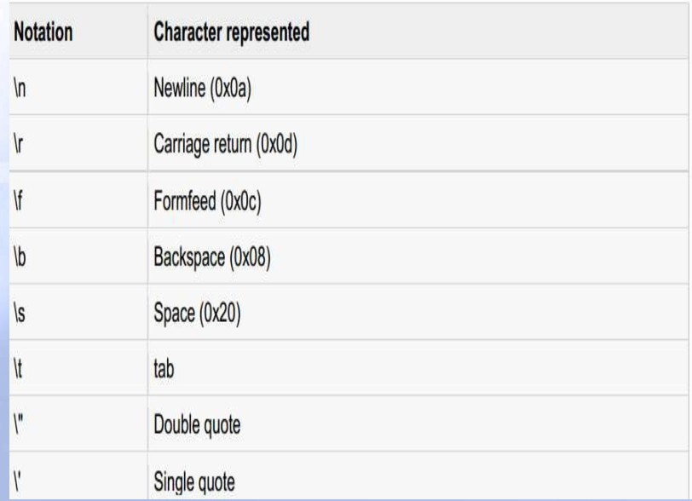
Special character

Slide 23
boolean
boolean data type represents one bit of information.
There are only two possible values : true and false.
This data type is used for simple flags that track true/false conditions .
It is used for evaluating logical conditions
Default value is false.
Example : boolean one = true ;

Slide 24
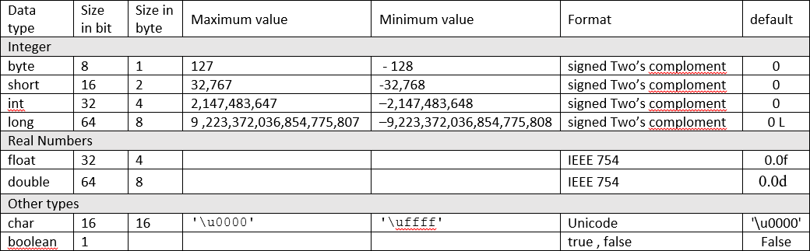
Summary

Slide 25
Why Java take 2 byte of memory for store character ?
java support more than 18 international languages so java take 2 byte for characters, because for 18 international language 1 byte of memory is not sufficient for storing all characters and symbols present in 18 languages. Java supports Unicode but c support ascii code. In ascii code only English language are present, so for storing all English latter and symbols 1 byte is sufficient. Unicode character set is one which contains all the characters which are available in 18 international languages and it contains 65536 characters

Slide 26
Why Boolean data types take zero byte of memory ?
Boolean data type takes zero bytes of main memory space because Boolean data type of java implemented by Sun Micro System with a concept of flip - flop. A flip - flop is a general purpose register which stores one bit of information (one true and zero false).
Note: In C, C++ (Turbo) Boolean data type is not available for representing true false values but a true value can be treated as non-zero value and false values can be represented by zero

Slide 27
User defined data types
User defined data types are those which are developed by programmers by making use of appropriate features of the language.
User defined data types related variables allows us to store multiple values either of same type or different type or both. This is a data type whose variable can hold more than one value of dissimilar type, in java it is achieved using class concept.
In C language, user defined data types can be developed by using struct, union, enum etc. In java programming user defined datatype can be developed by using the features of classes and interfaces.

Slide 28

Derived Datatypes
Derived data types are those whose variables allow us to store multiple values of same type. But they never allows to store multiple values of different types. These are the data type whose variable can hold more than one value of similar type. In general derived data type can be achieve using array.

Slide 29
Variable
Variable is an identifier which holds data or another one
variable is an identifier whose value can be changed at the execution time of program. Variable is an identifier which can be used to identify input data in a program.

Slide 30
Variable naming
Every variable name should start with either alphabets or underscore ( _ ) or dollar ( $ ) symbol also can start with ¥,¢, or any other currency sign..
After the first character in a Java variable name, the name can also contain numbers
No space are allowed in the variable declarations.
No keywords should access variable name.

Slide 31
Variable naming
Except underscore ( _ ) no special symbol are allowed in the middle of variable declaration
Variable name always should exist in the left hand side of assignment operators.
Maximum length of variable is 64 characters.
No keywords should access variable name.
Choose meaningful and descriptive names.

Slide 32
Variable naming
java variable names are case sensitive.
Variable names are written in lowercase
If variable names consist of multiple words, each word after the first word has its first letter written in uppercase.
Static final fields (constants) are named in all uppercase, typically using an _ to separate the words in the name.

Slide 33
Declaring then initializing
int x ; x = 1 ;
// Declare x to be an integer variable
// Assign 1 to x
General form :
data type identifier ; identifier = value ;
In Java, it is considered good style to declare variables as closely as possible to the point where they are first used.

Slide 34
Declaring and Initializing in One Step
int x = 1 ;
Form
data type identifier = value ; char letter = ‘c’ ;
boolen result = false ;
Semicolon mean end of line .

Slide 35
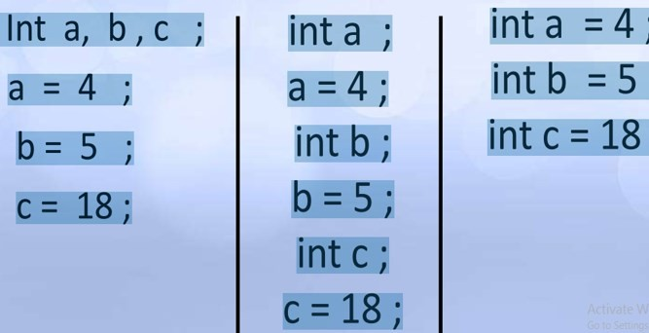
Different images perform the same function

Slide 36
Literals
A literal is a source code representation of a fixed value. They are represented directly in the code without any computation.
example int x = 50 ;

Slide 37
UNLiterals
They are represented in the code with computation.
example
int x = 50 + a ;

Slide 38
Java Variable Types
In Java there are four types of variables:
Non-static fields
Static fields
Local variables
Parameters

Slide 39
local variable
Local variables are declared in methods, constructors, or blocks.
Local variables are created when the method, constructor or block is entered and the variable will be destroyed once it exits the method, constructor, or block.
Access modifiers cannot be used for local variables.
Local variables are visible only within the declared method, constructor, or block.

Slide 40
local variable
Local variables are implemented at stack level internally.
There is no default value for local variables, so local variables should be declared and an initial value should be assigned before the first use.

