Slide 1
Technology-Driven Development:
Using Automation and
Development Techniques
to Grow an Agile Culture
Jul/29/2014
Hiroyuki Ito
Development Process Optimization Department, Rakuten, Inc.
http://www.rakuten.co.jp/
Notes:
Hello everyone.
In this session, I’d like to talk about “Technology-Driven Development”.

Slide 2
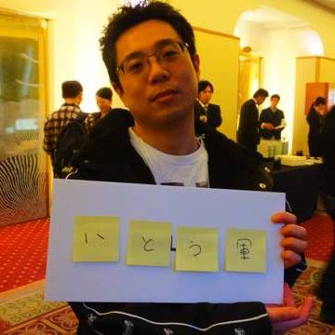
About me
Hiroyuki Ito
(The Hiro)
@hageyahhoo
Test-Driven
Development Group
Notes:
My name is Hiroyuki Ito.
Please call me “The Hiro”.
I’m from Rakuten, in Japan.
I belong to “Test-Driven Development Group”!
I have 2 certifications of Scrum.
Now I’m working as an Agile Coach.

Slide 3
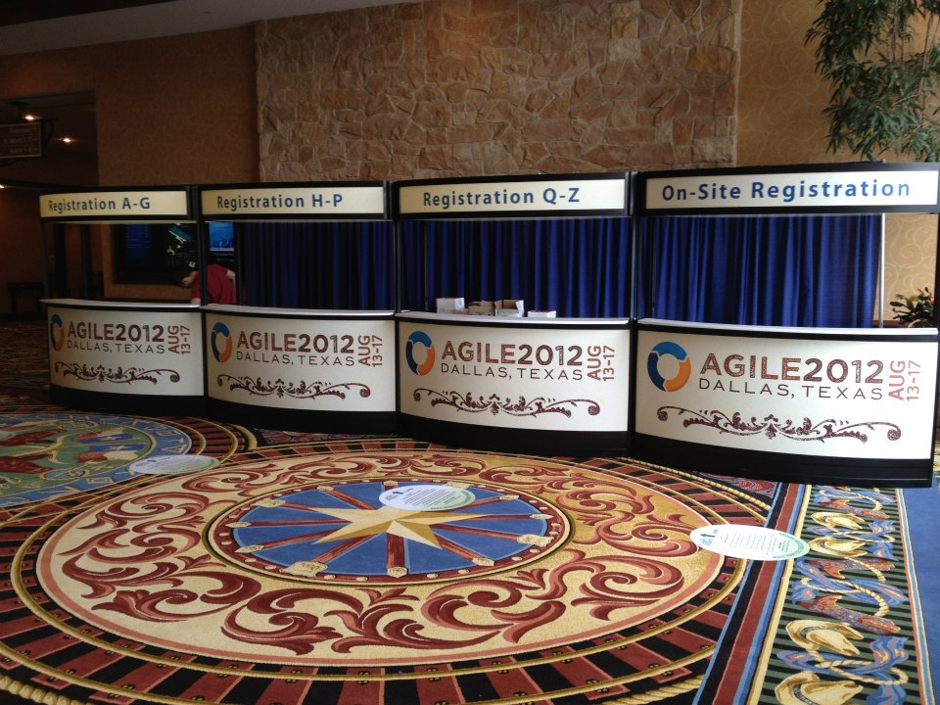
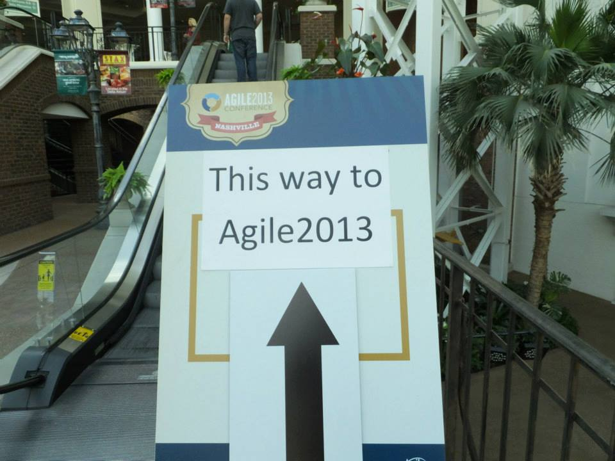
It’s my 3rd time to be here!
Agile2014 : as a Speaker
Notes:
Today, I’m here as a speaker.

Slide 4
This session’s theme
Technology-
Driven
Development
Notes:
As you may know, this session’s theme is “Technology-Driven Development”.
Of course, this name is derived from “Test-Driven Development”.
Anyway, what is “Technology-Driven Development”?

Slide 5
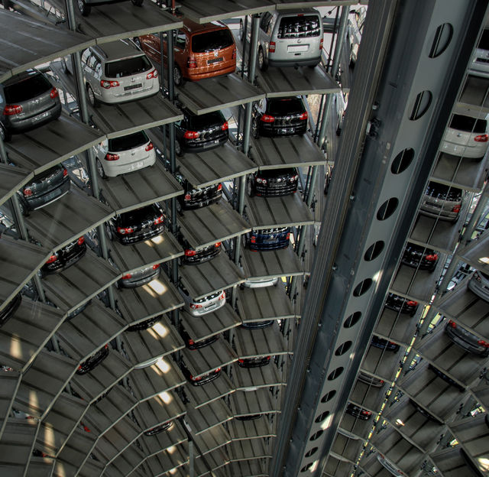
Additional possibilities of automation
Notes:
It means the new possibilities of Automation.

Slide 6
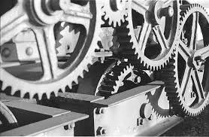
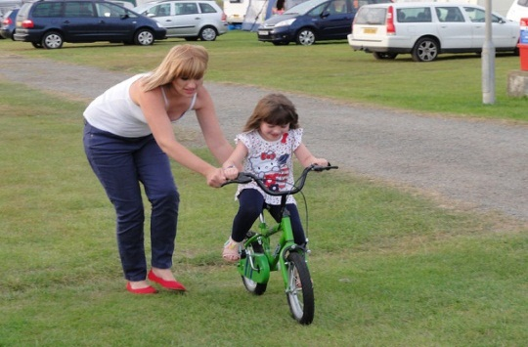

Three purposes
Efficiency
Learning
Collaboration
Notes:
“Technology-Driven Development” stands for 3 purposes.

Slide 7

Three approaches
CI/CD
TDD
BDD
Notes:
I used these approaches to achieve those purposes.

Slide 8





Three approaches by
CI/CD
TDD
BDD
Notes:
From the tool’s aspect.
I’ll talk the details later.

Slide 9
Agenda
1. Conditions and Challenges
2. CI/CD
3. TDD
4. BDD
5. Results, Problems, Possibility and Future
6. Conclusions
Notes:
Here is this session’s agenda.
At first, I will talk about the conditions and the challenges of my project.
Next, I will explain the concrete approaches, CI/CD, TDD, and BDD.
After that, I will talk about the results, problems, possibilities, and the future of Technology-Driven Development.
At last I will conclude this report.

Slide 10
1. Conditions and Challenges
2. CI/CD
3. TDD
4. BDD
5. Results, Problems, Possibility and Future
6. Conclusions
Notes:
At first, conditions and the challenges of my project.

Slide 11
At the end of April 2013
HELP!
Developers
Business
Analyst
UI/UX
Designers
Agile Coach
(The Hiro)

Slide 12

Our target application is

Slide 13
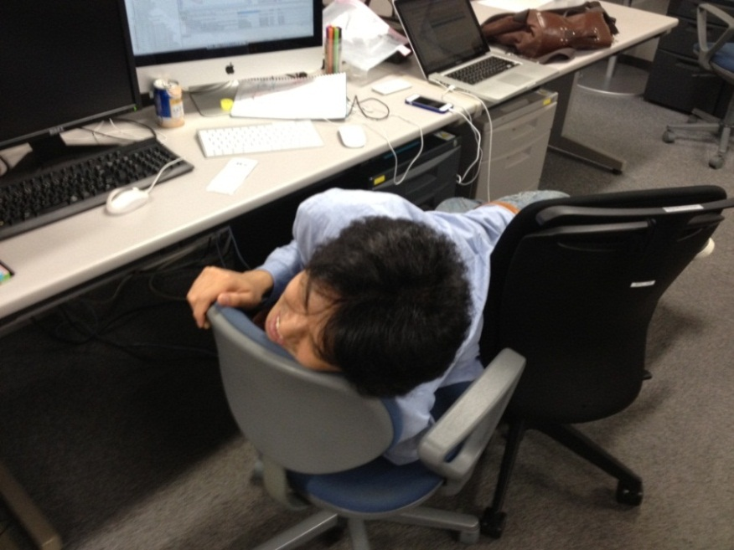
Conditions and Challenges
None of the team members had
any experience with agile
There had been
many manual operations
Most of the team members
were young and immature
Notes:
These are top 3 challenges.

Slide 14
What do you think?
Notes:
If you are in the same position.

Slide 15
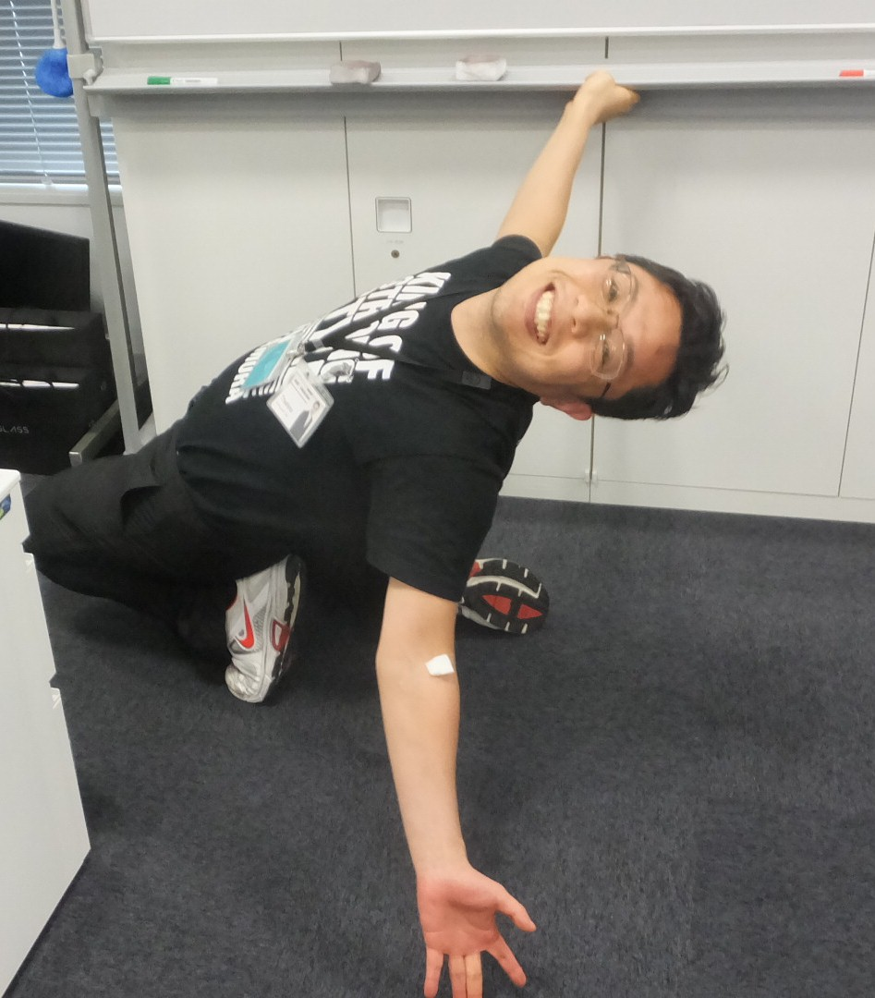
I was so much excited!
Notes:
In Japanese, YeaOh!

Slide 16
WHY?
I can
achieve anything through such a challenging project!
Notes:
Therefore, I was highly-motivated!

Slide 17
Three approaches
CI/CD
TDD
BDD
Notes:
So, I tried to improve the project with these three approaches.

Slide 18
1. Conditions and Challenges
2. CI/CD
3. TDD
4. BDD
5. Results, Problems, Possibility and Future
6. Conclusions
Notes:
Next, about CI/CD.

Slide 19
Challenges
Low performance
So many manual tasks
Going in circles
No clear vision and no requirements
No timely progress information
Notes:
At first, we tried to get over these challenges.

Slide 20
Before CI/CD
13.5 hours/week
Change requests : 3 times/week
Regression testing : 4 hours/change
Need to retry if we find bugs…
Install applications : 0.5 hour/change
5-minite work for 6 persons
Notes:
We tried to measure the current status like this.

Slide 21

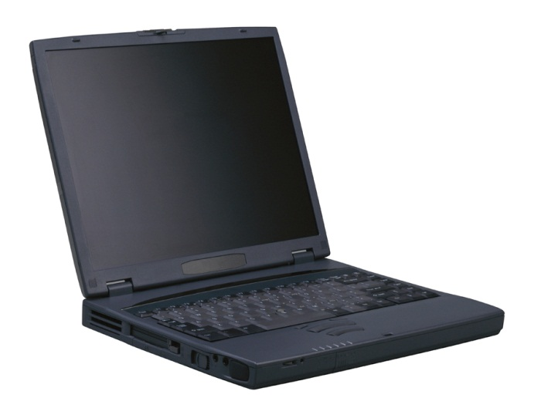

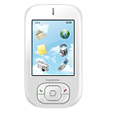
The Implementation of CI/CD in our project
Check-in build (hourly)
My PC
Deliver to
all team members
automatically
Build applications
and run regression tests automatically
We demonstrate latest application
to the business analyst and managers
in every daily scrum

Slide 22
Shared understanding by the working software
Developers
Business
Analyst
Know about
the progress
Get fast feedback
UI/UX
Designers

Slide 23
After CI/CD
15 minutes/week
1/54 !
Change requests : 3 times/week
Regression testing : 3 minutes/change
Install applications : 2 minutes/change

Slide 24
1. Conditions and Challenges
2. CI/CD
3. TDD
4. BDD
5. Results, Problems, Possibility and Future
6. Conclusions
Notes:
Next, TDD.

Slide 25
Challenges
Lack of skill and knowledge of Android
the architecture of Android
how to develop the Android application
how to access the database on the device
how to implement the UI
Notes:
Our challenge is very simple : we did not have enough skill and knowledge of Android at that time.

Slide 26
Before TDD
Dao
DB
Model
Controller
Dao
DB
Activity
Dao
DB
Could not test after we implemented all components
(Debug Later Programming)
It took five days to implement one activity set

Slide 27

Too difficult to use Android JUnit 😐
java.lang.RuntimeException: Stub! (ﾟДﾟ)
Why we need an emulator or a device? :-o
Please don’t start a heavy lifecycle of Android for each test case :-<

Slide 28
Solution to do TDD on Android
Robolectric : Do all unit testing only on JVM
http://robolectric.org/
Without any emulator or device!
Mockito : Can use the “Test Double”
http://code.google.com/p/mockito/
Notes:
Finally, we adopted the new test harness for Android.

Slide 29
Image of Unit testing for Dao by using Robolectric
@Before
public void setUp() {
Create database for Test;
Insert test data;
}
@Test
public void findXxx() {
Assertions;
}
@After
public void tearDown() {
Drop Database for Test;
}
It takes only about
0.5 seconds
to run each test case.

Slide 30
After TDD
Dao
DB
Model
Controller
Dao
DB
Activity
Dao
DB
Can test each component independently and separately
It takes one day to implement one activity set (five times faster than at the start of the project)

Slide 31
1. Conditions and Challenges
2. CI/CD
3. TDD
4. BDD
5. Results, Problems, Possibility and Future
6. Conclusions
Notes:
Next, I will explain the 3 approaches, CI/CD, TDD, and BDD.
After that, I will talk about the problems, possibilities, and the future of Technology-Driven Development.
At last I will conclude this report.

Slide 32
Challenges
Avoid feature creep
Detect bugs and regressions
on use-cases
Learn domain knowledge effectively
Notes:
So, I tried to improve the project with these three approaches.

Slide 33
Example of feature creep
DONE!
Need discipline!
Developers
Business
Analyst
NUUN ☹
MORE!
MORE! MORE!
MORE!
MORE! MORE!
UI/UX
Designers

Slide 34
Calabash-android: improve the discipline
The wrapper of Cucumber for Android
As an executable specification
As a communication tool
Specifying collaboratively with
business analyst, designers and developers
By specification with examples

Slide 35
Example of BDD test scenario with Calabash-Android
Feature : name of all cases
Scenario : name of each case
Feature: Input
Scenario: Input today’s data
Given I kick drumroll
And drumroll show today
When press next
Then I should see ”xxx" screen
When I press keys and calculator should show like this:
| 2 | 2 |
| 0 | 20 |
| 0 | 200 |
| * | 200 |
| 3 | 3 |
| = | 600 |
Then take photo
…
These statements are
RUNNABLE!
We can write data
with table style like this
Notes:
ちなみに、こちらが ATDD のテストケースの例です。
私たちは、Cucumber というツールを活用して、受入テストの自動化を実現しました。

Slide 36
Process of BDD
Developers
Business
Analyst
We want to…
We want to…
UI/UX
Designers

Slide 37
Process of BDD
GIVEN …
WHEN …
THEN …
Developers
Business
Analyst
Is that right?
MORE!
MORE! MORE!
We want to…
UI/UX
Designers

Slide 38
Process of BDD
GIVEN …
WHEN …
THEN …
Developers
Business
Analyst
Is that right?
MORE!
MORE! MORE!
OK, go ahead!
UI/UX
Designers

Slide 39
Process of BDD
GIVEN …
WHEN …
THEN …
Developers
Business
Analyst
Is it OK?
UI/UX
Designers

Slide 40
Process of BDD
GIVEN …
WHEN …
THEN …
Developers
Business
Analyst
Is it OK?
MORE!
MORE! MORE!
Sure!
UI/UX
Designers

Slide 41
Process of BDD
GIVEN …
WHEN …
THEN …
Developers
Business
Analyst
Expired of the
deadline
Sure!
MORE!
UI/UX
Designers

Slide 42
After BDD
Bugs : -67%
Change requests : -70%
Improved!
Regressions : -60%
Notes:
例によって、これらの施策の効果を１月後に計測してみたところ…
このような数値が出ました。
まず、バグの報告件数が、他の機能と同程度になりました。
これは、ATDD による自動回帰テストを整備した成果であると考えています。
次に、機能追加／修正の頻度が、５倍から１．５倍に一気に減りました。
この数値を見ると、変更要望に歯止めをかけたことに成果があったことが分かります。
そして、デグレードの頻度も、５倍から２倍に減りました。
デグレード自体は撲滅できていないものの、デグレードを検知して対応し終わるまでの時間を計測してみたところ、対応前の１／５程度にまで減っていることも分かりました。
つまり、デグレード自体の影響度が以前よりもはるかに減ったと言えると思います。

Slide 43
1. Conditions and Challenges
2. CI/CD
3. TDD
4. BDD
5. Results, Problems, Possibility and Future
6. Conclusions
Notes:
Next, I will talk about the problems, possibilities, and the future of Technology-Driven Development.

Slide 44
Results
Notes:
Of course, we achieved the target!

Slide 45
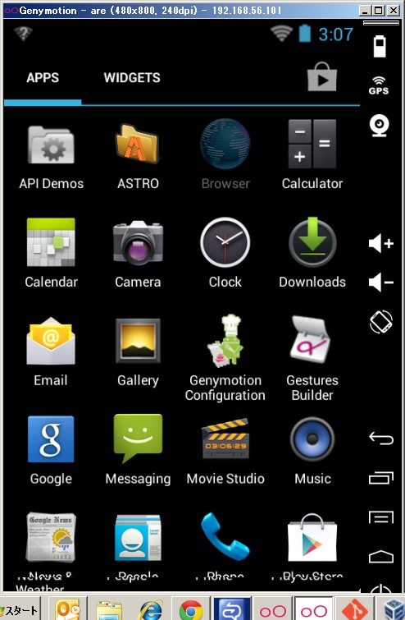
Example of collaborative culture
Got some slack time!
How about
Genymotion?
Developers
Too slow
emulator…
Over 10 times faster
Can run via Calabash-Android
Notes:
I’d like to share the example of the collaborative culture by Technology-Driven Development in our team.
Automation nurtures the team members.

Slide 46
[Problem] Changing scope
No!
Do all we planned
at first!
Developers
Business
Analyst
Please change scope!
Please change scope!
Please change scope!
UI/UX
Designers
Agile Coach
(The Hiro)

Slide 47
[Problem] Changing scope
It’s impossible
to change the scope
within our company…
Developers
Business
Analyst
Belong to
another (subsidiary) company
UI/UX
Designers
Agile Coach
(The Hiro)

Slide 48
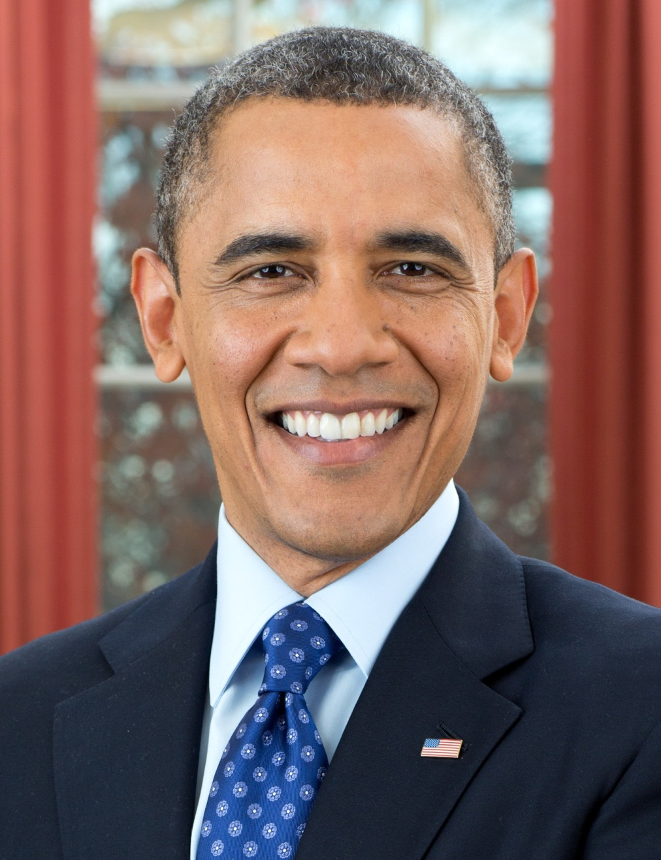
Asked for one executive
YES, YOU CAN!
We changed scope!

Slide 49
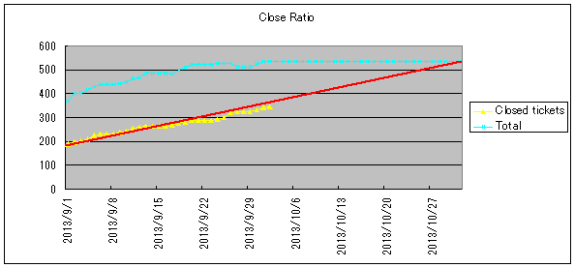
[Possibility] Enhance by numerical measurement
[e.g.]
Change requests : 3 times/week
Regression testing : 3 minutes/change
Install applications : 2 minutes/change

Slide 50
[Future] As a measure for total optimization
Developers
Executive
Business
Analyst
Agile Coach
(The Hiro)
UI/UX
Designers
Manager
Over barriers/silos

Slide 51

Don’t lose the whole picture!

Slide 52
“Technology-Driven Development”
has the possibility
to grow an agile culture
Can achieve short-term results easily
Short-term effects are not sustainable
Necessary to grow the team continuously
for making effects long-lasting
Improving the practice continuously by itself
is useful
Notes:
We tried to measure the current status like this.

Slide 53
1. Conditions and Challenges
2. CI/CD
3. TDD
4. BDD
5. Results, Problems, Possibility and Future
6. Conclusions
Notes:
At last, conclusion of this report.

Slide 54
Three purposes
Efficiency
Learning
Collaboration
Notes:
“Technology-Driven Development” has 3 purposes.

Slide 55
Three approaches
CI/CD
TDD
BDD
Notes:
I used these approaches to achieve those purposes.

Slide 56
Three approaches by
CI/CD
TDD
BDD
Notes:
From the tool’s aspect.

Slide 57
We found this practice
through the project
with passionate members
with a lot of trial and error
Notes:
ここまでお話させていただいた内容は、
いずれも私たちが現場の日々の現実に向き合い、
試行錯誤を繰り返し、
ようやく見つけた答えの１つです。
すなわち、答えは現場にあります。

Slide 58
Experience from Gemba
現場主義
Notes:
この現場実践主義こそが、私が考える「リーン開発」であり「アジャイル」です。

Slide 59
Find your answer
by yourself
through your experience
Notes:
是非皆さんには、
現場で試行錯誤を繰り返しながら、
自分の「リーン開発」と「アジャイル」を、そして自分の答えを見つけていただきたいと考えています。

Slide 60

Find your treasure!
Notes:
It will be your treasure!

