Slide 1


Introduction To SQL Joins

Slide 2

CONTENTS
01.
Primary Keys
02.
Referential Integrity
03.
Joins
04.
SQL queries

Slide 3

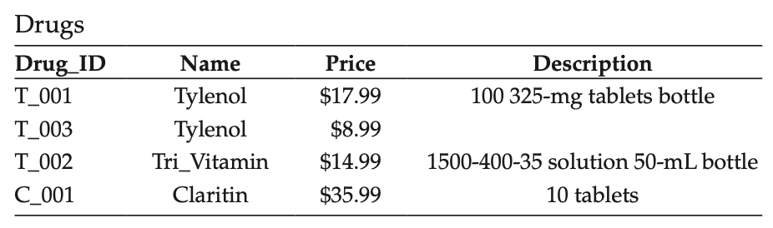
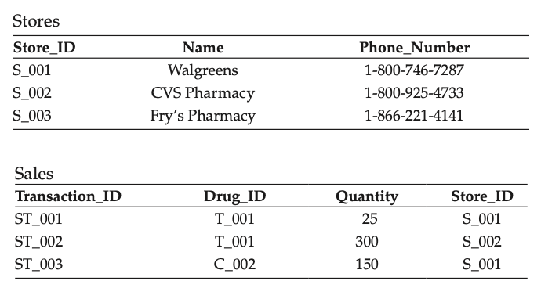
Primary & Foreign Keys
Primary Keys
Foreign Keys

Slide 4
Data Integrity Constraints
Entity Integrity Constraint
IT requires that every relation in a relational database model must have the primary key and that a value of the primary key cannot be NULL
i.e. every table in a database must have a primary key that uniquely identifies that record
Entity
Domain
Referential
Domain Integrity Constraint
It requires that all the values of an attribute must be from the same domain
i.e. In a column, all values must be of the same data type
Referential Integrity Constraint
requires that a foreign key must take either one of the values that its primary key has or the NULL value
i.e. the foreign key cannot take a value that is not defined already as a primary key in the table where it is referenced from

Slide 5
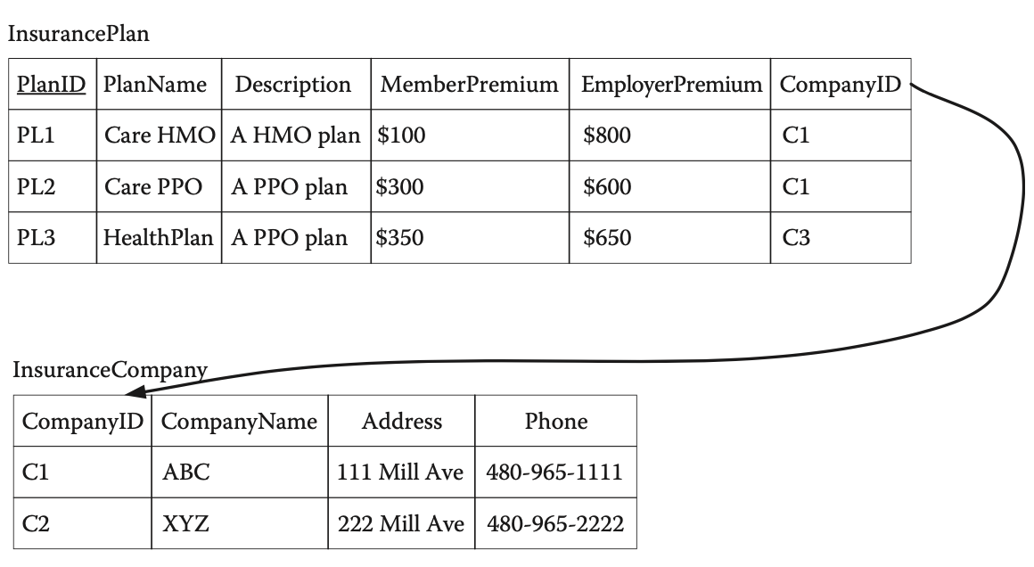
Data Integrity Constraints
Referential
Integrity
Constraint

Slide 6
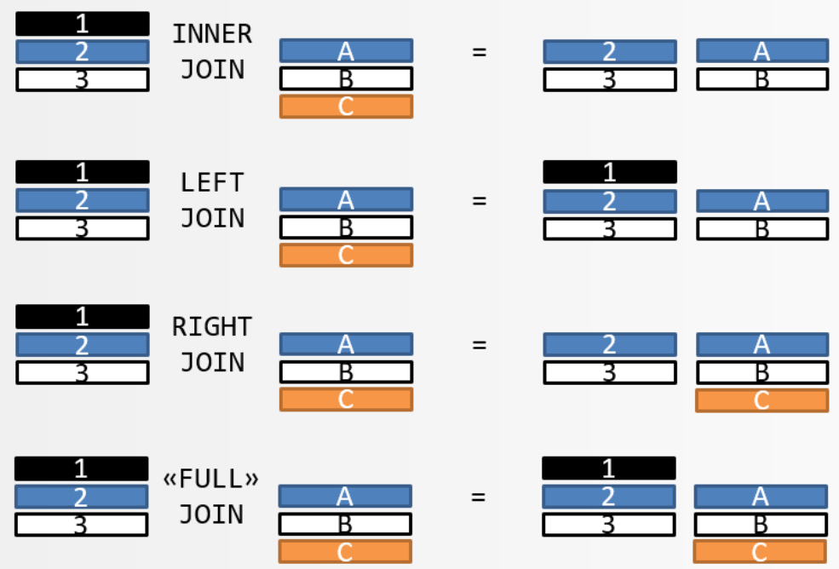
SQL Joins
Types
Of
Joins

Slide 7
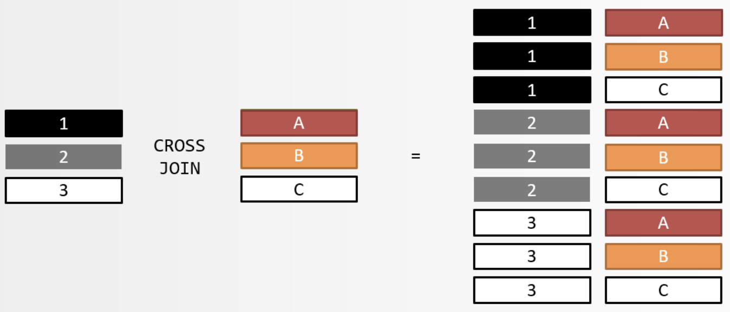
SQL Joins
Types
Of
Joins

Slide 8
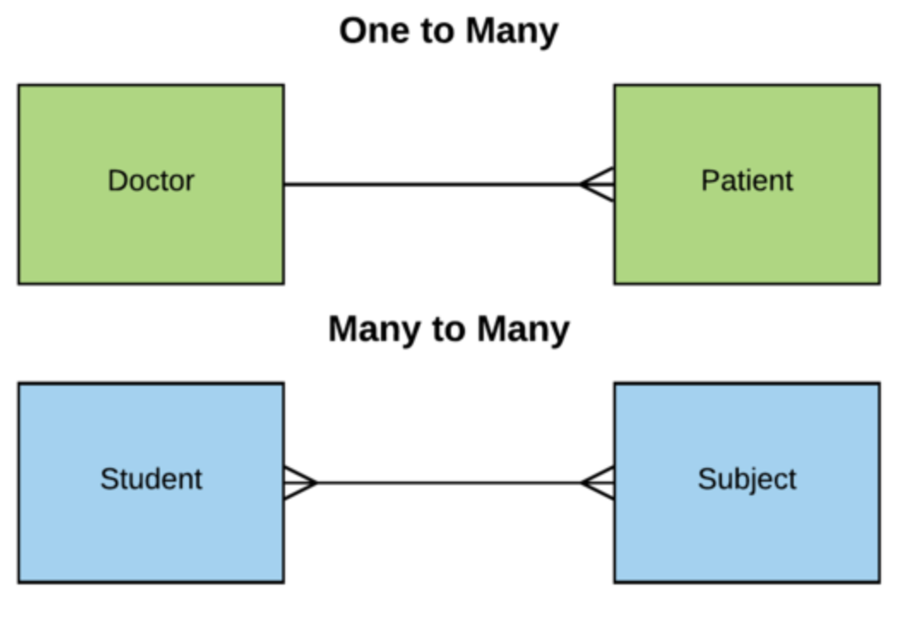
SQL Relationships
One to One
One to One
One to Many
Many to Many

Slide 9
SQL Joins
Multiple
Joins in
SQL

