Slide 1


Naïve Bayes Algorithm

Slide 2

Logistic Regression Overview

Slide 3
One of the base line models for binomial and multinomial classification
Has four important components:
1. Feature representation of the input [x1,x2,...,xn]
2. The sigmoid and softmax tools as classification functions
3. Cross-entropy loss function as the objective function for learning, involving minimizing error on training data
4. Stochastic gradient descent algorithm for optimizing the objective function

Slide 4
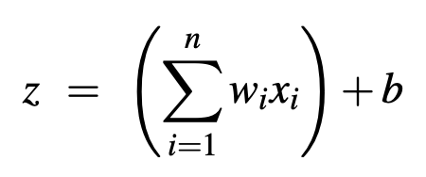
Given a vector x [x1,x2,...,xn]
We want to know:
The probability P(y = 1|x) that this observation is a member of the class
The probability P(y = 0|x) that this observation is not a member of the class
Logistic regression solves this task by learning, from a training set, a vector of weights (one for each feature) and a bias term.
The weight represents how important that input feature is to the classification decision

Slide 5
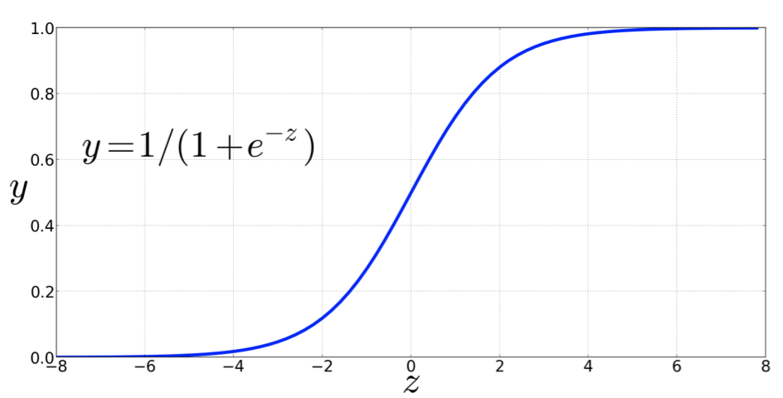
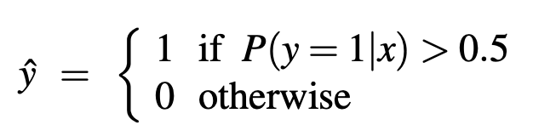
Decision Boundary 0.5

Slide 6
How does Logistic Regression Model Learn
Optimizing the loss function (just the same way as we do in linear regression)
Loss function used is cross-entropy loss
The algorithm used to achieve this is Stochastic Gradient Descent
Key idea is to learn the weights that maximize the the probability of the correct label p(y|x).

Slide 7
Naïve Bayes
&
Multinomial Naïve Bayes

Slide 8
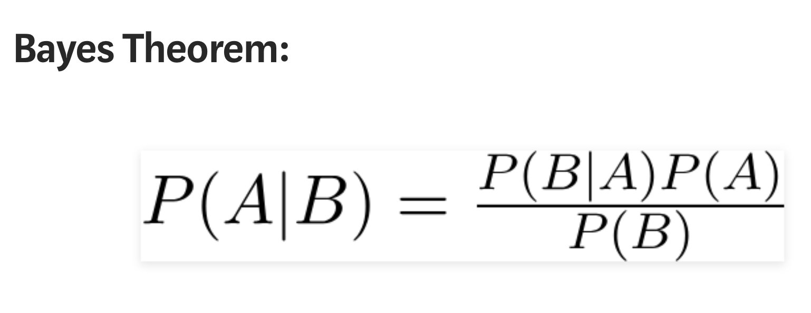

Slide 9
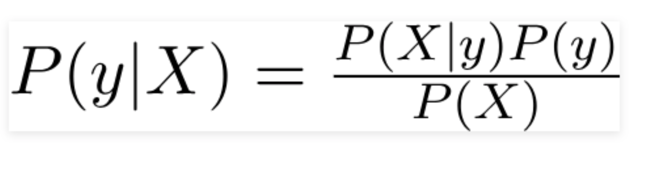

Slide 10
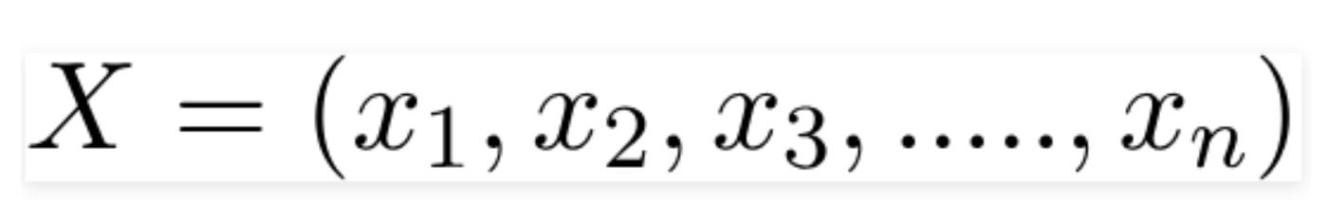

Slide 11
