Slide 1


Natural Language Processing

Slide 2

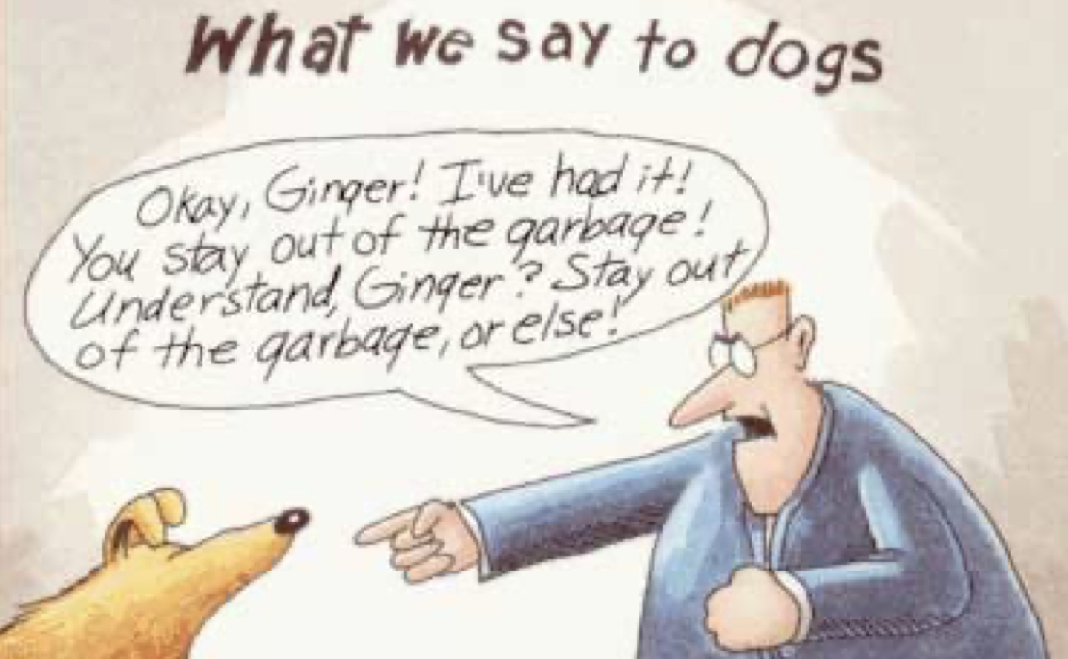
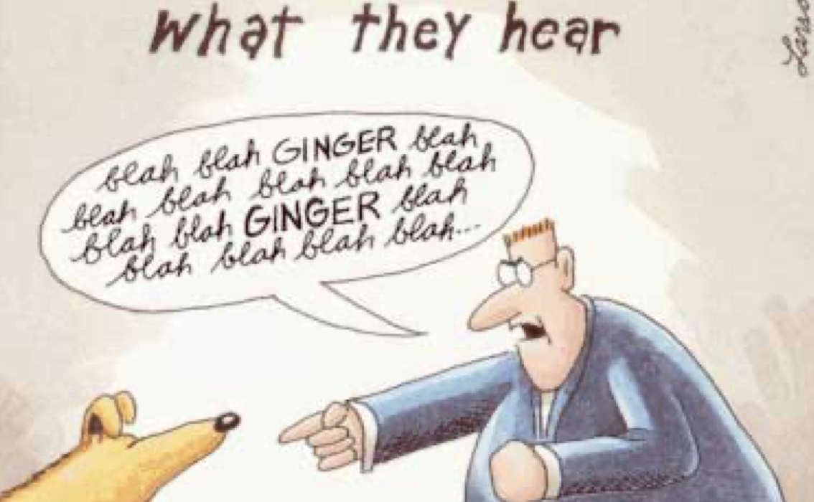

Slide 3
CS + AI + Linguistics
Some of the applications are:
Sentiment Analysis
Spam filtering
Speech Recognition – Chatbots
Text auto complete , spell checks
Question answering AI -> Siri, Alexa, Google Assistant
Performing tasks such as making appointments etc.
Machine Translation

Slide 4
NLP is different than other analysis because human language behaves very differently than just numbers. It is discrete and symbolic
Why is it hard?
Large vocabulary
Symbolic encoding of words
Human language is ambiguous
Depends a lot on interpretation and common sense
Very Context based

Slide 5
Some important terms in NLP
Corpus – Collection of documents
Document – Collection of terms
Tokens / Terms - Individual words in a document
Tokenization – Process of converting sentences into tokens
Bag of Words – All the words/tokens put together

Slide 6
Data Pre-processing
Data cleaning
Stop Words Removal
Stemming
Lemmatization

Slide 7
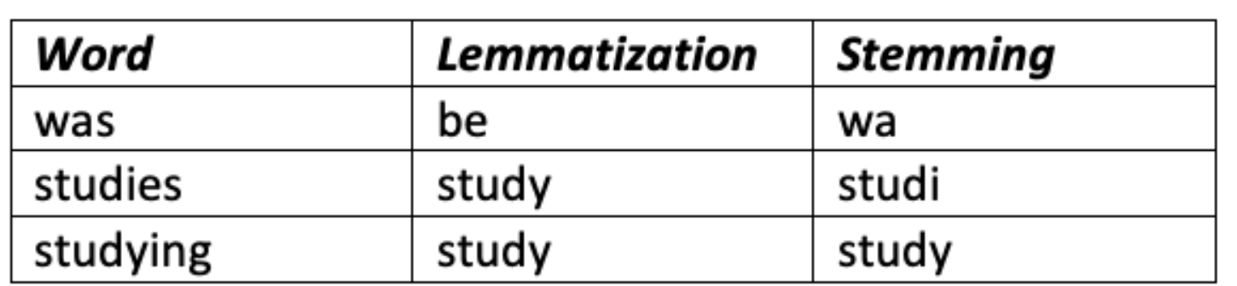
Stemming and Lemmatization
The objective of these processes is to reduce inflectional forms and derivationally related forms of a word to a common base form
Stemming: It is a crude heuristic process that chops off the ends of words to achieve this goal correctly
Lemmatization: It uses vocabulary and morphological analysis of words, aiming to remove inflectional endings only and to return the base or dictionary form of a word, which is known as the lemma

Slide 8
Vector Representation of Text
The idea is that every word, every phrase, and every logical expression is a vector
In vector space terms , this is a vector with 1’s and 0’s just like a one hot encoded matrix

Slide 9
Count Vectorizer
text = ['My name is himanshu’,
'let us learn NLP’]
['himanshu', 'is', 'learn', 'let', 'my', 'name', 'nlp', 'us’]
array([[1, 1, 0, 0, 1, 1, 0, 0],
[0, 0, 1, 1, 0, 0, 1, 1]])

Slide 10
TF-IDF
TF-IDF: term frequency-inverse document frequency
TF: Term Frequency measures how frequently a term occurs in a document
TF(t) = Number of times term t appears in a document / Total number of terms in the document
IDF: Inverse Document Frequency measures how important a term is
IDF(t) = log_e(Total number of documents / Number of documents with term t in it)
For every term in the document, the product of TD and IDF is calculated. The importance increases proportionally to the number of times a word appears in the document but is offset by the frequency of the word in the corpus

