Slide 1
Fault Trees, SLOs and Monitoring with Datadog
A Systems Engineering Approach

Slide 2
Failure Rate
A system is only as good as it’s components
A system’s reliability is a combination of the serial and parallel paths among its components

Slide 3
Didya Know?
Õ means failure?

Slide 4
Serial Paths
Always lower a system’s reliability
Failure probabilities are added together
A
B
Notes:
Show a basic equation with reliability in serial
Get some laTex with lambda1=0.90, lambda2=0.99, lambdasys= lambda1 * lambda2 = 0.89

Slide 5
Parallel Paths
Effectively increase a segment’s reliability
Failure probabilities are multiplied together
A
B
Notes:
need to look at the right way to categorize failure rates of tech components: degraded == failed ?
how to view self-healing systems? Admittedly more reliable over time, explore concept of duty cycle and recovery time, method
Caveat: if parallel elements have a common root cause then they do not increase relability

Slide 6
Fault Trees
Define the whole system’s reliability
Summation of all the underlying components’ reliabilities
Cannot exceed a desired (or required!) top level failure probability
Notes:
“Required” when there’s regulation involved

Slide 7
Service Level Objectives
Specific measures of a system’s performance… as measured by the end user!
For example, our Artifactory service claims 99% availability
Probability of service being down is 1%
Notes:
How does AWS do it? They take credit for a massively parallel architecture, with failovers and automated repair and recovery
Synthetics are very useful here
Blackbox vs Whitebox monitoring
Suggestion is that end user, potentially synthetic, blackbox monitoring be prioritized as most real and urgent to resolve

Slide 8
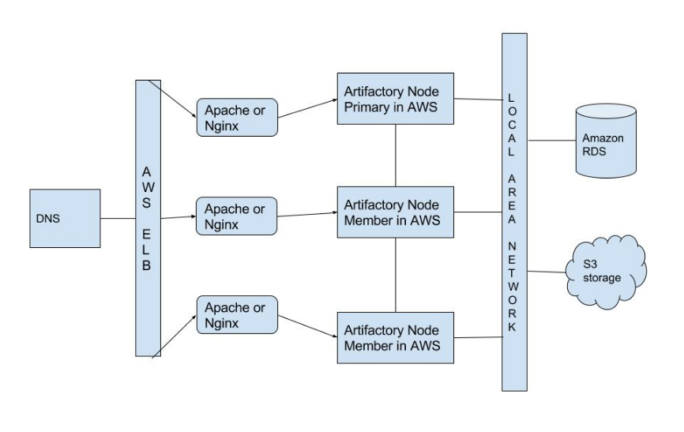
Sample Architecture

Slide 9
Uptime Target
Given the system design
And setting an overall target availability of 99%

Slide 10
Frailty of Single Point of Failure
A single server needs to be 99% up

Slide 11
Robustness from Parallelization
Expanding the server branch in parallel fashion
With N = 2, each server needs to be 90% up
With 3 replicas, each app can be down 20% of the time!

Slide 12
Monitoring
Trigger when a system, branch or component metric exceeds its SLO
Mixture of black box monitoring and white box monitoring
Notes:
Each component, branch should be identified and targed by different levels of monitors in a tiered composite manner
If you have 3 reverse proxies serving up content from behind a load balancer, you should be able to create a monitor for an aggregate measurement of the group of RPs (with a lower failure rate and consequently higher SLO target) and each individual RP (with a higher failure rate and lower SLO target)

Slide 13
Uptime
With some HA setups, you can achieve an uptime better than each individual node
Health check monitor hooked up to SLO widget
Health check monitors -> composite “AND” monitor

Slide 14
Service Design Doc
Basis for claiming a SLO
Template for observability
Production service should match engineering specifications

Slide 15
Complexity and Limitations
Getting failure rates and reliability numbers can be time intensive
Plus what we deploy is constantly evolving
Use services with SLAs, multi-zone & multi-region parallelization, to minimize all possible factors
Set a goal for the unknowns, measure and iterate

Slide 16
Suggestions
Use business objectives to craft an SLO for your service
Reference dependency SLAs, if available
Estimate remaining components, then measure, refine, retarget
Reduce failure of infra by using Infra as Code with integration testing

Slide 17
New Ideas
Complex monitors, wide and deep composition
Monitor notification suppression to simplify situational awareness, or even better...
Monitor hierarchy visualization

Slide 18
Datadog Composite Monitors
Logical construction of several sub-monitors
Limited by 10 monitors
Cannot stack composite monitors

Slide 19
Averages of Averages
Tempting to perform percentile calculations on groups of sampled data
Inherently flawed when populations aren’t common between members
Datadog has global distributions
HdrHistogram can be statistically combined

Slide 20
Citations
https://pdfs.semanticscholar.org/0eaf/7918b321bb1be779e6243044858c868c1c4c.pdf
https://reliabilityanalyticstoolkit.appspot.com/

Slide 21
This work is licensed under a Creative Commons Attribution-ShareAlike 3.0 Unported License.
It makes use of the works of Mateus Machado Luna.

