Slide 1
Microdata service
Research database

Slide 2
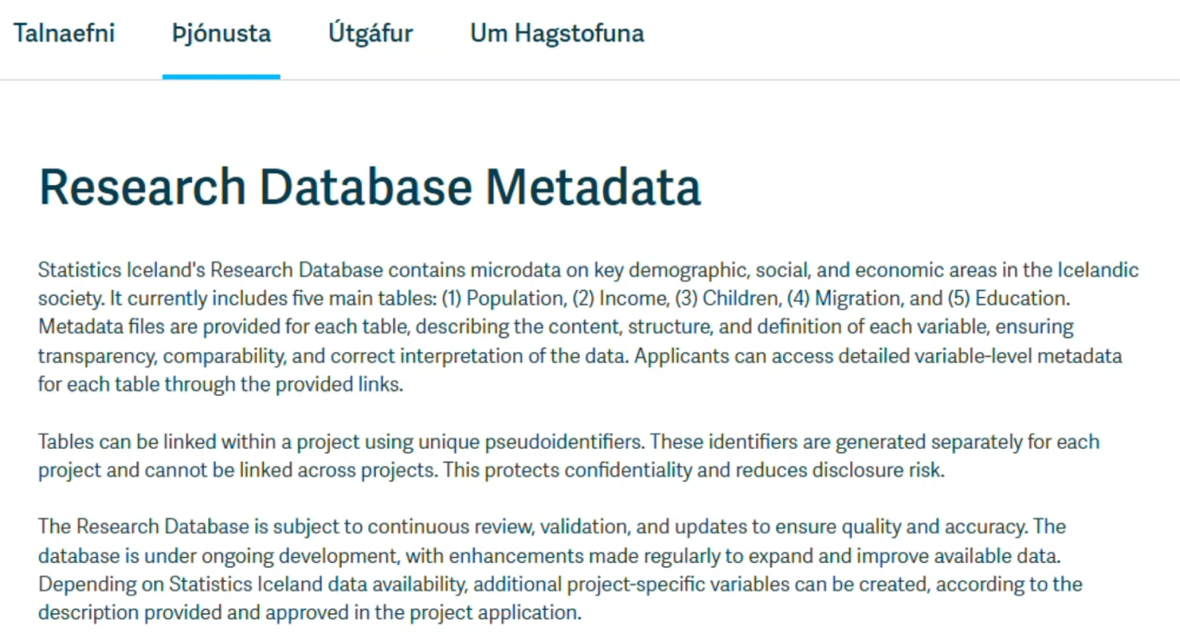

Slide 3
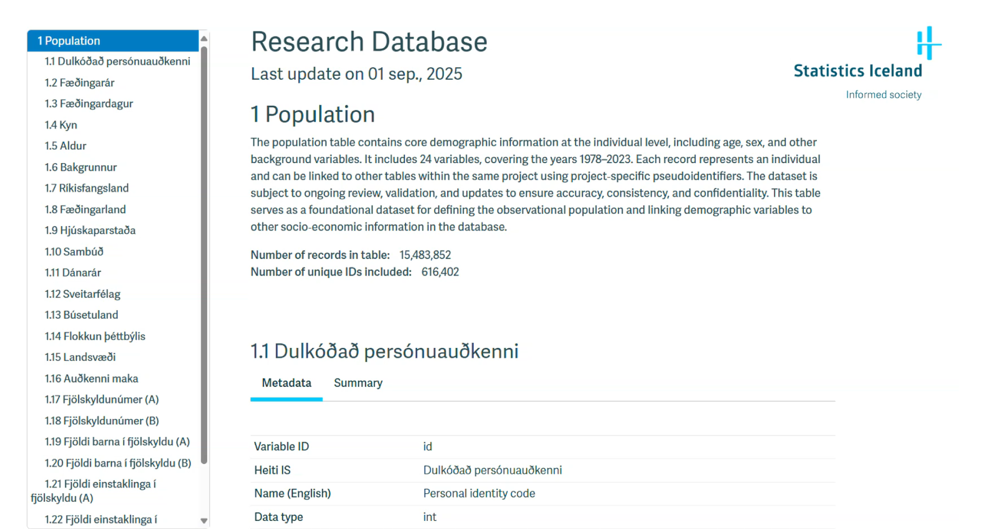

Slide 4
How does it work?
Research Proposal
Submission
Proposal Processing
Data Preparation
Cost Estimation
Data Transfer
Access Granted
Output Request
Project
Completion
Research Undertaken
Output Delivery

Slide 5

Output checking
Tests and thresholds for:
Frequency tables
Magnitude tables
Descriptive statistics
Analysis results
Code

Slide 6
Microdata examples

Slide 7
Example 1
A dataset on unemployed university graduates in a region is released in two versions.
Both versions: age, gender, field of study, applications in last 3 months
Version 1: adds marital status
Version 2: adds information on whether the graduate lives in a large city or not
Different versions aim to meet user needs while protecting confidentiality. No full file is released, and versions can’t be matched by ID. However, combinations of variables may still allow disclosure.
The following tables show data for unemployed male graduates aged 28. An employment officer with Version 1 notices an unmarried chemist with one application. He also has an external file (names, age, gender, marital status, field of study, and place of living). With Version 1 alone, he cannot identify the chemist uniquely.
Is there any risk if the officer get access to Version 2?

Slide 8
Version 1
Age (in years) | Gender | Marital status | Field of study | Number of applications during the last three months
28 | male | married | chemistry | 6
28 | male | married | chemistry | 7
28 | male | unmarried | chemistry | 7
28 | male | unmarried | chemistry | 5
28 | male | married | law | 5
28 | male | unmarried | chemistry | 1
28 | male | married | chemistry | 8
28 | male | married | law | 6

Slide 9
Version 2
Age (in years) | Gender | Living in a large city? | Field of study | Number of applications during the last three months
28 | male | No | law | 5
28 | male | Yes | chemistry | 7
28 | male | Yes | chemistry | 6
28 | male | Yes | chemistry | 7
28 | male | No | chemistry | 8
28 | male | Yes | chemistry | 5
28 | male | No | law | 6
28 | male | No | chemistry | 1

Slide 10
Example 2
A common SDC technique is suppressing rare value combinations.
But users with knowledge of the data and method may reconstruct suppressed values.
In the following table, education has 3 levels (low, intermediate, high) and ethnicity 2 (Dutch, foreign).
Task:
Use your knowledge to restore suppressed values, considering that at the province level, combinations quickly narrow down groups.
Also check if the unsuppressed data were suitable for release.

Slide 11
Occupation | Gender | Education | Ethnicity | Province of dwelling
Crane driver | × | Intermediate | Dutch | Drenthe
Teacher | Male | High | Dutch | South Holland
Shop assistant | Female | Low | Dutch | South Holland
Surgeon | Female | High | × | Gelderland
Hotel keeper | Male | High | Dutch | Utrecht
System analyst | Female | × | × | Zealand
Taxi driver | Male | × | Dutch | Drenthe
Hospital director | × | × | Dutch | Friesland
Painter | × | High | × | ×
Family doctor | Female | High | Dutch | Limburg
Member of Parliament | Male | × | × | ×
Train guard | Female | Intermediate | Dutch | Groningen

