Slide 2
Privacy, disclosure and SDC
Peter-Paul de Wolf (Statistics Netherlands ) pp.dewolf@cbs.nl
September 2025

Slide 3
Tabulated data (tables)

Slide 4
Sex
Region | Male | Female | Total
North | 859,645 | 862,667 | 1,722,312
East | 1,804,460 | 1,818,814 | 3,623,274
South | 1,821,037 | 1,824,447 | 3,645,484
West | 4,041899 | 4,148,115 | 8,190,014
Total | 8,527,041 | 8,654,043 | 17,181,084
Tabular data / tables
Tables in the sense of statistics
Aggregated information
Frequency count tables
Magnitude tables
Number of inhabitants
Region
Type | A | B | C | D | Total
Harps | 58 | 47 | 36 | 89 | 230
Organs | 71 | 124 | 24 | 31 | 250
Pianos | 92 | 157 | 59 | 28 | 336
Other | 800 | 934 | 651 | 742 | 3127
Total | 1021 | 1262 | 770 | 890 | 3943
Turnover (M€) of instrument producing companies

Slide 5
Frequency count tables

Slide 6
Frequency count tables
Each cell represents the number of units that satisfy the category of the spanning variable.
I.e., cell values are counts that in themselves are not “sensitive”
Spanning variables can be “sensitive” and/or “identifying” attributes
Age-class
Gender
Health status
Criminal history

Slide 7
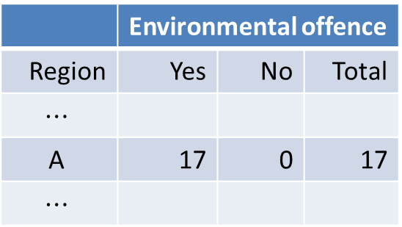
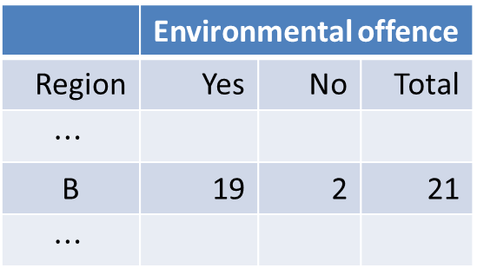
Frequency count tables
Number of shipowners
 | Environmental offence
Region | Yes | No | Total
$$⋯$$
$$\text{A}$$ | 17 | 0 | 17
$$⋯$$
 | Environmental offence
Region | Yes | No | Total
$$⋯$$
B | 19 | 2 | 21
$$⋯$$
(Almost) all shipowners commited offence => high probability

Slide 8
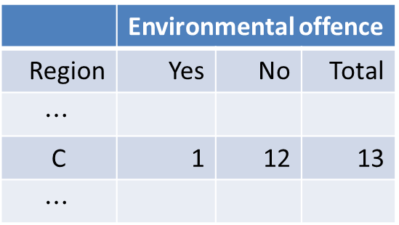
Frequency count tables
Number of shipowners
 | Environmental offence
Region | Yes | No | Total
$$⋯$$
C | 1 | 12 | 13
$$⋯$$

Slide 9
Frequency count tables
‘Summary’:
scores should be sufficiently spread
over all categories
Cells with one or two, not necessarily unsafe!
But beware!

Slide 10
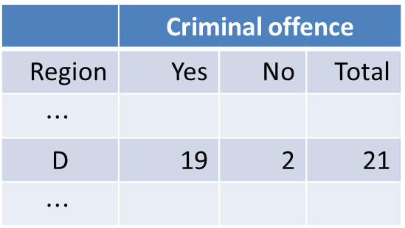
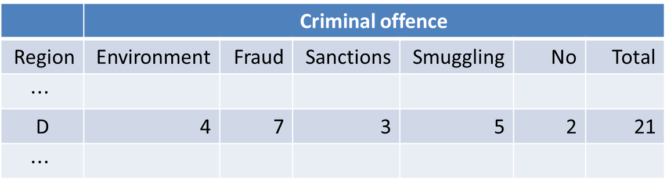
Frequency count tables
Number of shipowners
 | Criminal offence
Region | Environment | Fraud | Sanctions | Smuggling | No | Total
$$⋯$$
D | 4 | 7 | 3 | 5 | 2 | 21
$$⋯$$
 | Criminal offence
Region | Yes | No | Total
$$⋯$$
D | 19 | 2 | 21
$$⋯$$

Slide 11
Magnitude tables

Slide 12
Magnitude tables
each cell-value represents the sum of the score of the units that fall into that cell
Region
 | A |  | B |  | C |  |  | D |  | Total
Harps | 58 |  | 47 |  | 36 |  |  | 89 |  | 230
Organs | 71 |  | 124 |  | 24 |  |  | 31 |  | 250
Pianos | 92 |  | 157 |  | 59 |  |  | 28 |  | 336
Other | 800 |  | 934 |  | 651 |  |  | 742 |  | 3127
Total | 1021 |  | 1262 |  | 770 |  |  | 890 |  | 3943
Region |  |  |  |  |  | number of respondents
 | A |  | B |  | C |  |  | D |  | Total
Harps | 58 | 151 | 47 | 2 | 36 |  | 98 | 89 | 23 | 230 | 274
Organs | 71 | 16 | 124 | 21 | 24 |  | 9 | 31 | 8 | 250 | 54
Pianos | 92 | 5 | 157 | 12 | 59 |  | 7 | 28 | 1 | 336 | 25
Other | 800 | 302 | 934 | 362 | 651 |  | 287 | 742 | 227 | 3127 | 1178
Total | 1021 | 474 | 1262 | 397 | 770 |  | 401 | 890 | 259 | 3943 | 1531
Turnover (M€) of instrument producing companies

Slide 13
Magnitude tables
each cell-value represents the sum of the score of the units that fall into that cell
Region |  |  |  |  |  | number of respondents
 | A |  | B |  | C |  |  | D |  | Total
Harps | 58 | 151 | 47 | 2 | 36 |  | 98 | 89 | 23 | 230 | 274
Organs | 71 | 16 | 124 | 21 | 24 |  | 9 | 31 | 8 | 250 | 54
Pianos | 92 | 5 | 157 | 12 | 59 |  | 7 | 28 | 1 | 336 | 25
Other | 800 | 302 | 934 | 362 | 651 |  | 287 | 742 | 227 | 3127 | 1178
Total | 1021 | 474 | 1262 | 397 | 770 |  | 401 | 890 | 259 | 3943 | 1531
?
Turnover (M€) of instrument producing companies

Slide 14
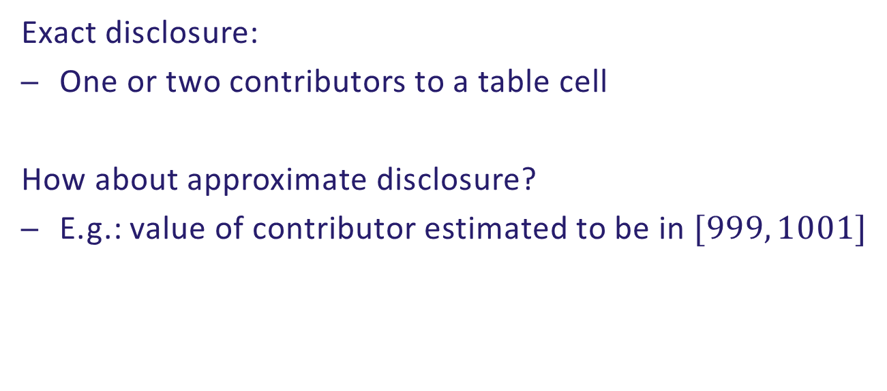
Magnitude tables
Exact disclosure:
One or two contributors to a table cell
How about approximate disclosure?
E.g.: value of contributor estimated to be in $[999, 1001]$

Slide 15
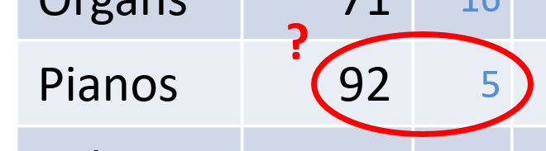
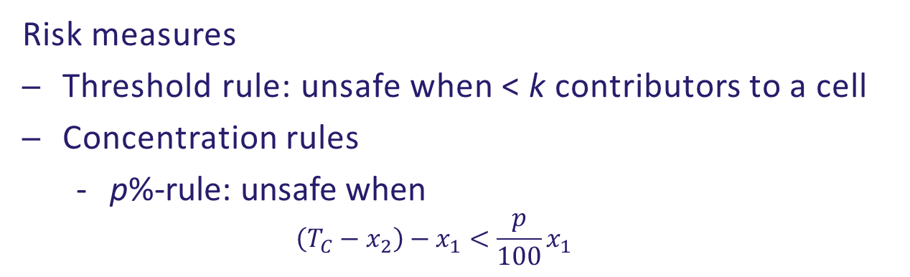

Magnitude tables
Risk measures
Threshold rule: unsafe when < k contributors to a cell
Concentration rules
  p%-rule: unsafe when
  $\left(T_{C}−x_{2}\right)−x_{1}<\frac{p}{100}x_{1}$
or
$$\frac{\left(T_{C}−x_{2}\right)−x_{1}}{x_{1}}<\frac{p}{100}$$
x₁ = 81 M€, x₂ = 8 M€, x₃ = x₄ = x₅ = 1 M€
10%-rule:
(92 – 8) – 81 < 0.10*81
3 < 8.1 Unsafe!

Slide 16
Magnitude tables
Other concentration rules:
Dominance rule or (n, k)-rule
  Largest n should not contribute more than k% to the cell total
p/q-rule (prior/posterior rule)
  Same as p%-rule, but with prior knowledge up to q%

Slide 17


Magnitude tables
Concentration rules only make sense if the size of the variable is ‘identifying’!
I.e., if ‘intruders’ know who the largest respondents are.
Example:
Profit
Turnover

Slide 18
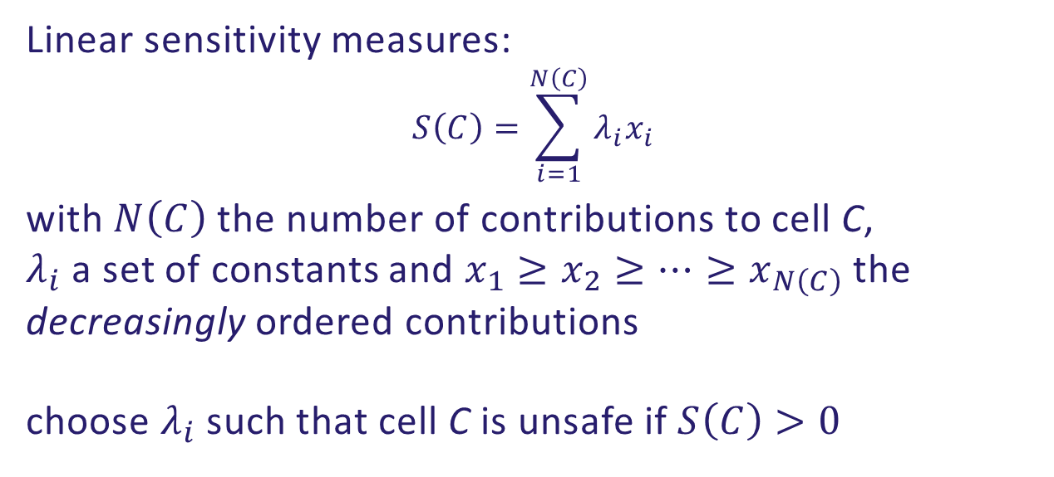
Magnitude tables
Linear sensitivity measures:
$$S\left(C\right)=\sum_{i=1}^{N\left(C\right)}{λ_{i}x_{i}}$$
with $N\left(C\right)$ the number of contributions to cell C,
$λ_{i}$ a set of constants and $x_{1}≥x_{2}≥…≥x_{N\left(C\right)}$ the decreasingly ordered contributions
choose $λ_{i}$ such that cell C is unsafe if $S\left(C\right)>0$

Slide 19
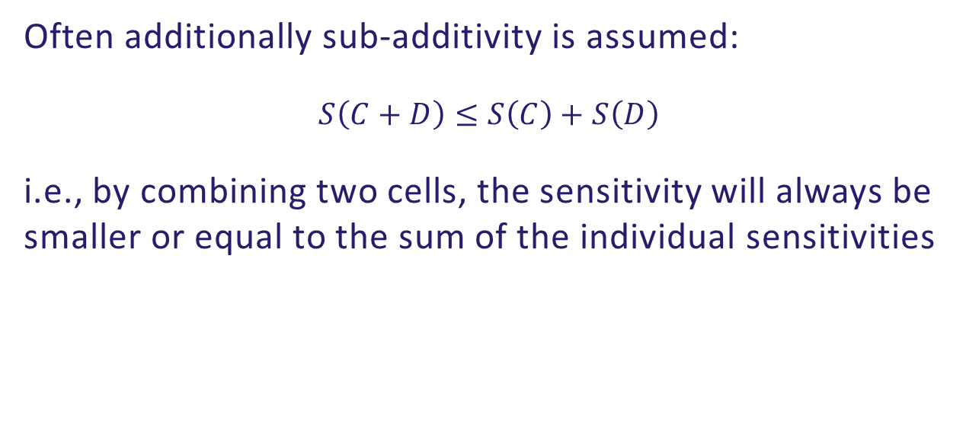
Magnitude tables
Often additionally sub-additivity is assumed:
$$S\left(C+D\right)≤S\left(C\right)+S\left(D\right)$$
i.e., by combining two cells, the sensitivity will always be smaller or equal to the sum of the individual sensitivities

Slide 20
Magnitude tables
Holdings/branches/offices:
companies contributing to more than one cell
NB: In marginal combined to one contribution when checking sensitivity!

Slide 21
Magnitude tables
Example: p% rule with p = 10
Region
Type | A |  | B |  | C |  | D |  | Total
…
Violins | 620 |  | 160 |  | 30 |  | 0 |  | 810
…
600, |  | 90, |  | 10, |  | - | 600, 90,
10, |  | 60, |  | 10, |  | - | 60,
10, |  | 10, |  | 10, |  | - | 6 x 10,
((810 – 90) – 600)/600 = 20% => Safe

Slide 22
Magnitude tables
Example: p% rule with p = 10
Region
Type | A |  | B |  | C |  | D |  | Total
…
Violins | 620 |  | 160 |  | 30 |  | 0 |  | 810
…
600, |  | 90, |  | 10, |  | - | 690,
10, |  | 60, |  | 10, |  | - | 60,
10, |  | 10, |  | 10, |  | - | 6 x 10,
((810 – 60) – 690)/690 = 8.7% => Unsafe

Slide 23
Some special tables

Slide 24
Survey based tables
So far assumed:
population tables (complete enumeration)
Often (weighted) tables based on sample
Response knowledge?
Yes? Treat like complete enumeration
No? …

Slide 25
Survey based tables
  relax rules
  adjust rules e.g., use weights to construct
  ‘virtually completely enumerated’ cells
      E.g., Contributor 1: 100, weight 1
      Contributor 2: 50, weight 4
      Contributor 3: 20, weight 2
Non-integer weights: several possibilities
Contributor 1: 100
Contributor 2: 50
Contributor 3: 50
Contributor 4: 50
Contributor 5: 50
Contributor 6: 20
Contributor 7: 20

Slide 26
Linked tables
Tables sharing cells
Parts of higher dimensional table
Hierarchically linked spanning variables
Some shared spanning variable(s)

Slide 27
Linked tables
Number of booksellers
: Gender × Region × Criminal record
Table 1
Table 2
Table 3
 | Amsterdam | Rotterdam | Total
Male | 21 | 12 | 33
Female | 16 | 19 | 35
Total | 37 | 31 | 68
Criminal record | Yes | No | Total
Male | 23 | 10 | 33
Female | 8 | 27 | 35
Total | 31 | 37 | 68
Criminal record | Yes | No | Total
Amsterdam | 11 | 26 | 37
Rotterdam | 20 | 11 | 31
Total | 31 | 37 | 68

Slide 28
Linked tables
Equations following from Table 1:
x_{MAmY} + x_{MAmN} = 21
x_{MRoY} + x_{MRoN} = 12
x_{FAmY} + x_{FAmN} = 16
x_{FRoY} + x_{FRoN} = 19
Equations following from Table 2:
x_{MAmY} + x_{MRoY} = 23
x_{FAmY} + x_{FRoY} = 8
x_{MAmN} + x_{MRoN} = 10
x_{FAmN} + x_{FRoN} = 27
Equations following from Table 3:
x_{MAmY} + x_{FAmY} = 11
x_{MAmN} + x_{FAmN} = 26
x_{MRoY} + x_{FRoY} = 20
x_{MRoN} + x_{FRoN} = 11
 | Amsterdam | Rotterdam | Total
Male | 21 | 12 | 33
Female | 16 | 19 | 35
Total | 37 | 31 | 68
Criminal record | Yes | No | Total
Male | 23 | 10 | 33
Female | 8 | 27 | 35
Total | 31 | 37 | 68
Criminal record | Yes | No | Total
Amsterdam | 11 | 26 | 37
Rotterdam | 20 | 11 | 31
Total | 31 | 37 | 68

Slide 29
Linked tables
Solving these equations with assumptions
x_{GRC} ≥ 0
x_{GRC} integer
we get
 | Yes | No | Total
Male, Am | 11 | 10 | 21
Male, Ro | 12 | 0 | 12
Male, Total | 23 | 10 | 33
Female, Am | 0 | 16 | 16
Female, Ro | 8 | 11 | 19
Female, Total | 8 | 27 | 35
Total | 31 | 37 | 68
 | Yes | No | Total
Male, Am | 11 | 10 | 21
Male, Ro | 12 | 0 | 12
Male, Total | 23 | 10 | 33
Female, Am | 0 | 16 | 16
Female, Ro | 8 | 11 | 19
Female, Total | 8 | 27 | 35
Total | 31 | 37 | 68

Slide 30
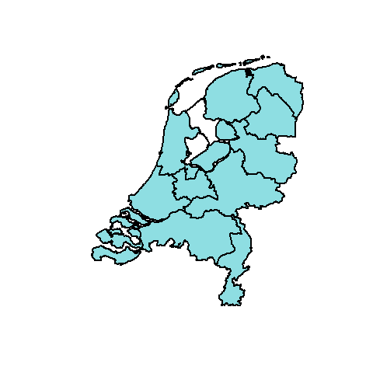
Linked tables
Region | Something sensitive
North | 63
East | 80
South | 83
West | 191
Total | 417
Region | Something sensitive
Groningen | 21
Friesland | X
Drenthe | 23
Overijssel | 27
Gelderland | 41
Flevoland | X
Utrecht | 32
Noord-Holland | 54
Zuid-Holland | 67
Zeeland | 38
Noord-Brabant | 44
Limburg | 39
Total | 417

Slide 31
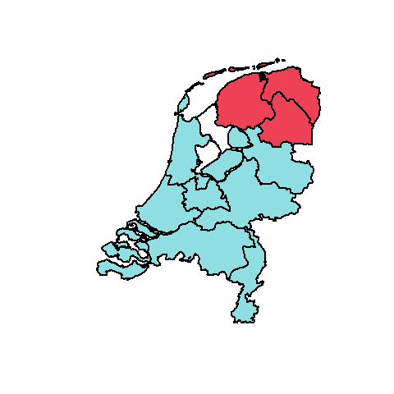
Linked tables
Region | Something sensitive
North | 63
East | 80
South | 83
West | 191
Total | 417
Region | Something sensitive
Groningen | 21
Friesland | X
Drenthe | 23
Overijssel | 27
Gelderland | 41
Flevoland | X
Utrecht | 32
Noord-Holland | 54
Zuid-Holland | 67
Zeeland | 38
Noord-Brabant | 44
Limburg | 39
Total | 417

Slide 32
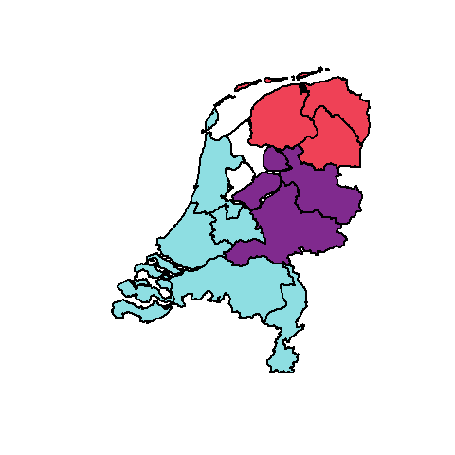
Linked tables
Region | Something sensitive
North | 63
East | 80
South | 83
West | 191
Total | 417
Region | Something sensitive
Groningen | 21
Friesland | 19
Drenthe | 23
Overijssel | 27
Gelderland | 41
Flevoland | X
Utrecht | 32
Noord-Holland | 54
Zuid-Holland | 67
Zeeland | 38
Noord-Brabant | 44
Limburg | 39
Total | 417

Slide 33
Linked tables
Region | Something sensitive
North | 63
East | 80
South | 83
West | 191
Total | 417
Region | Something sensitive
Groningen | 21
Friesland | 19
Drenthe | 23
Overijssel | 27
Gelderland | 41
Flevoland | 12
Utrecht | 32
Noord-Holland | 54
Zuid-Holland | 67
Zeeland | 38
Noord-Brabant | 44
Limburg | 39
Total | 417

Slide 34
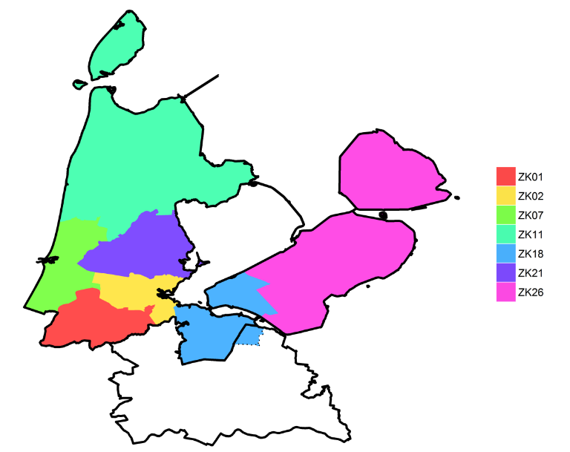
Linked tables
In practice often many classifications of same variable
Even: non-nested classifications!
Beware of differencing!
Coloured areas: Care facility areas
Eemnes (municipality)

Slide 35
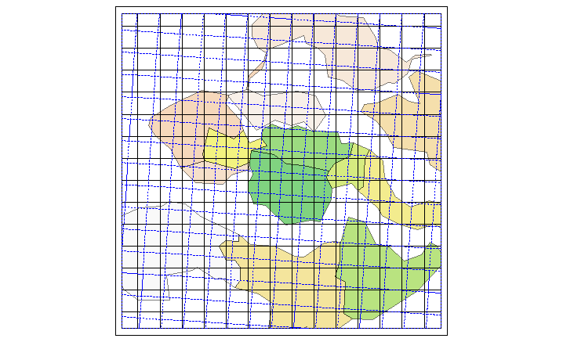
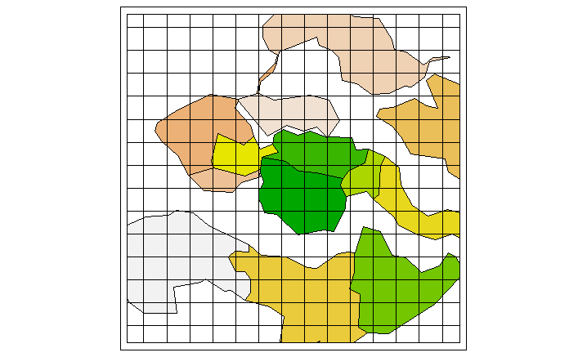
Linked tables
Grid squares and administrative areas in Census

Slide 36
Tables methods

Slide 37
Tables
Redesign: combine rows and/or columns to increase the number of units that fall into cells
Region |  |  |  |  |  | Number of companies
Type | A |  | B |  | C |  | D |  | Total
Harps | 58 | 151 | 47 | 2 | 36 | 98 | 89 | 23 | 230 | 274
Organs | 71 | 16 | 124 | 21 | 24 | 9 | 31 | 8 | 250 | 54
Pianos | 92 | 5 | 157 | 12 | 59 | 7 | 28 | 1 | 336 | 25
Other | 800 | 302 | 934 | 362 | 651 | 287 | 742 | 227 | 3127 | 1178
Total | 1021 | 474 | 1262 | 397 | 770 | 401 | 890 | 259 | 3943 | 1531

Slide 38
Tables
Redesign: combine rows and/or columns to increase the number of units that fall into cells
Region |  |  |  | Number of companies
Type | A |  | B + C |  | D |  | Total
Harps | 58 | 151 | 83 | 100 | 89 | 23 | 230 | 274
Organs + Pianos | 163 | 21 | 364 | 49 | 59 | 9 | 586 | 79
Other | 800 | 302 | 1585 | 649 | 742 | 227 | 3127 | 1178
Total | 1021 | 474 | 2032 | 798 | 890 | 259 | 3943 | 1531

Slide 39
Tables
Primary suppressions
suppress cells that are sensitive according to used measure
Region
Type | A | B | C | D | Total
Harps | 58 | X | 36 | 89 | 230
Organs | 71 | 124 | 24 | 31 | 250
Pianos | 92 | 157 | 59 | X | 336
Other | 800 | 934 | 651 | 742 | 3127
Total | 1021 | 1262 | 770 | 890 | 3943
Region
Type | A | B | C | D | Total
Harps | 58 | 47 | 36 | 89 | 230
Organs | 71 | 124 | 24 | 31 | 250
Pianos | 92 | 157 | 59 | 28 | 336
Other | 800 | 934 | 651 | 742 | 3127
Total | 1021 | 1262 | 770 | 890 | 3943

Slide 40
Tables
Secondary suppressions
suppress additional (safe) cells to prevent recalculation
Region
Type | A | B | C | D | Total
Harps | 58 | X | 36 | 89 | 230
Organs | 71 | 124 | 24 | 31 | 250
Pianos | 92 | 157 | 59 | X | 336
Other | 800 | 934 | 651 | 742 | 3127
Total | 1021 | 1262 | 770 | 890 | 3943
Region
Type | A | B | C | D | Total
Harps | 58 | X | 36 | 89 | 230
Organs | 71 | 124 | 24 | 31 | 250
Pianos | 92 | 157 | 59 | X | 336
Other | 800 | X | 651 | X | 3127
Total | 1021 | 1262 | 770 | 890 | 3943
Region
Type | A | B | C | D | Total
Harps | X | X | X | 89 | 230
Organs | X | 124 | X | 31 | 250
Pianos | 92 | X | 59 | X | 336
Other | 800 | X | 651 | X | 3127
Total | 1021 | 1262 | 770 | 890 | 3943

Slide 41
Tables
BEWARE: Two (or more) suppressions per row/column not necessarily enough!
Can still be recalculated
Region
Type | A | B | C | D | Total
Harps | X | X | X | 89 | 230
Organs | X | 124 | X | 31 | 250
Pianos | 92 | X | 59 | X | 336
Other | 800 | X | 651 | X | 3127
Total | 1021 | 1262 | 770 | 890 | 3943

Slide 42
Tables
Always:
using a-priori information (e.g., T_{C} ≥ 0) possible to obtain interval for each T_{C}
Feasibility interval
[T_{C} − L_{C}, T_{C} + U_{C}] with L_{C} , U_{C} ≥ 0
Sometimes L_{C} = U_{C} = 0 (exact recalculation)
or bounds within p% of T_{C}

Slide 43
Tables
How to obtain feasibility interval, given the suppressions?
General approach (two LP problems):
  maximise T_{C}
  under sum-restrictions of table and T_{C} ≥ 0
  minimise T_{C}
  under sum-restrictions of table and T_{C} ≥ 0

Slide 44
Tables
Feasibility intervals for primary unsafe cells should be sufficiently wide
Possible rule:
Require minimum feasibility interval,
i.e., require safety ranges, for each primary unsafe cell
Safety range a.k.a. protection interval

Slide 45
Tables
Threshold rule: fixed percentage/absolute value
Concentration rules: sensitivity determines the size
More sensitive
more protection
larger safety range

Slide 46
Tables
  Protection standards:
  Protection against exact disclosure
  It is not possible to disclose the exact value of a sensitive cell if no additional knowledge is considered (like singletons)
  Protection against interval disclosure
  Safety ranges of a sensitive cell are satisfied if no additional knowledge is considered (like singletons)
  Protection against singleton disclosure
  A suppression pattern with only two suppressed cells within a row (or column) of a table is not feasible if each one of the two corresponds to a single respondent

Slide 47
Tables
(Commercial)
LP solver
 | Modular | Optimal | Network | HyperCube
Exact or interval disclosure | Interval (subtable scenario) | Interval | Interval | Interval (subtable scenario)
Singleton disclosure | Yes (row/column scenario) | Yes (row/column scenario) | No | Yes

Slide 48
Tables
Rounding
Basic idea:
  Replace each cell value by integer multiple of rounding base b
  Larger b implies more protection
  Choose b according to used sensitivity measure
  Provides feasibility interval
  (can be smaller than +/- rounding base)

Slide 49
Tables
Conventional rounding (e.g., rounding base b = 5):
 |  | Region
 | A | B | C | Total
Books | 20 | 50 | 10 | 80
Papers | 8 | 19 | 22 | 49
Pens | 17 | 32 | 12 | 61
Total | 45 | 101 | 44 | 190
 |  | Region
 | A | B | C | Total
Books | 20 | 50 | 10 | 80
Papers | 10 | 20 | 20 | 50
Pens | 15 | 30 | 10 | 60
Total | 45 | 100 | 45 | 190
 |  | Region
 | A | B | C | Total
Books | 20 | 50 | 10 | 80
Papers | 10 | 20 | 20 | 50
Pens | 15 | 30 | 10 | 60
Total | 45 | 100 | 45 | 190

Slide 50
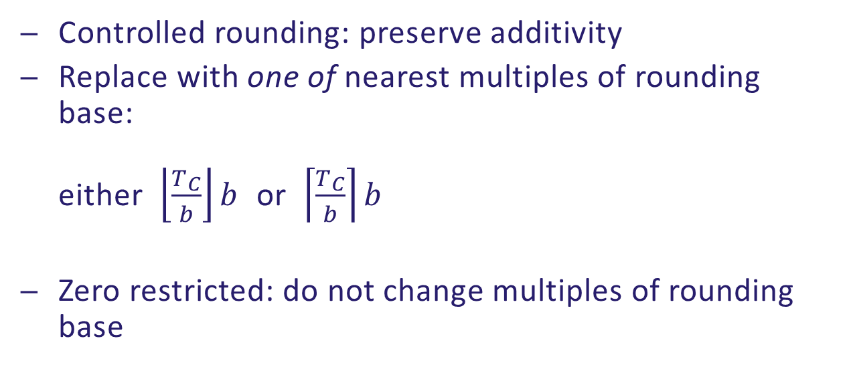
Tables
Controlled rounding: preserve additivity
Replace with one of nearest multiples of rounding base:
either $\left\lfloor \frac{T_{C}}{b}\right\rfloor b$ or $\left\lceil \frac{T_{C}}{b}\right\rceil b$
Zero restricted: do not change multiples of rounding base

Slide 51
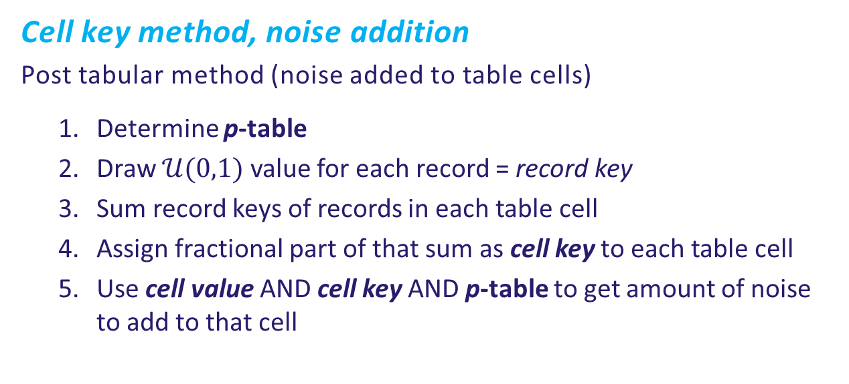
Tables
Cell key method, noise addition
Post tabular method (noise added to table cells)
  Determine p-table
  Draw $𝒰(0,1)$ value for each record = record key
  Sum record keys of records in each table cell
  Assign fractional part of that sum as cell key to each table cell
  Use cell value AND cell key AND p-table to get amount of noise to add to that cell

Slide 52
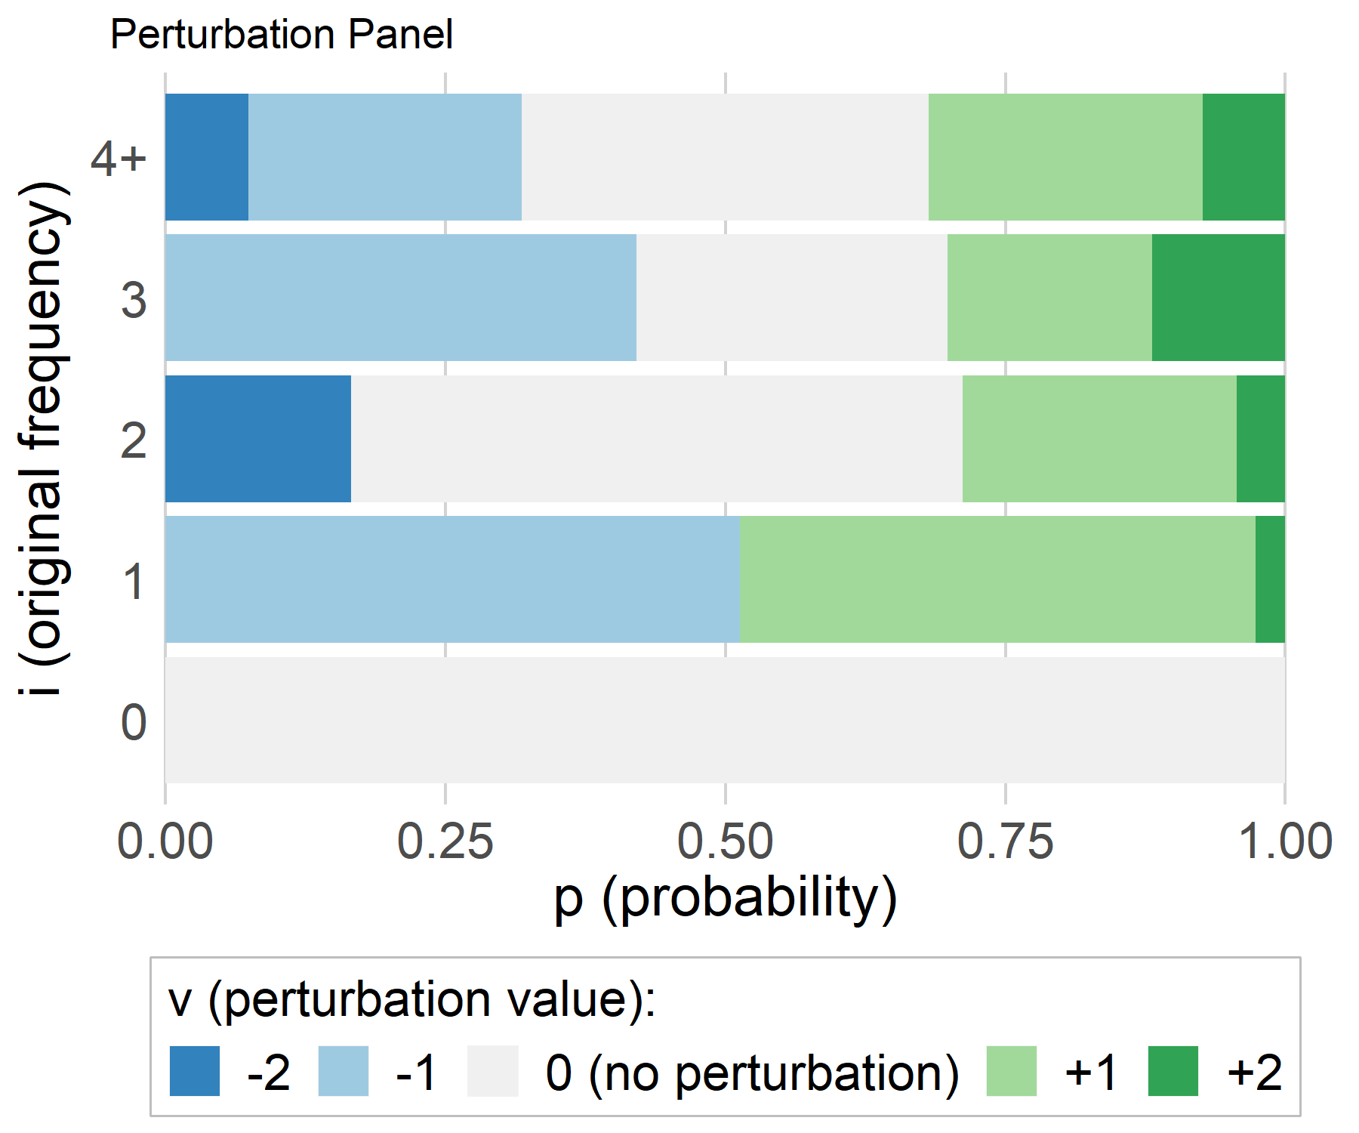
Tables
  p-table: Transition probabilities (R-package ptable)
  p_{ij} = P(cell value i is changed into value j)
  E.g., probabilities
  Cumulative
_{i} ^{j} | 0 | 1 | 2 | 3 | 4 | 5 | 6
0 | 1 | 0 | 0 | 0 | 0 | 0 | 0
1 | 0.5133 | 0 | 0.4600 | 0.0267 | 0 | 0 | 0
2 | 0.1656 | 0 | 0.5463 | 0.2449 | 0.0432 | 0 | 0
3 | 0 | 0 | 0.4208 | 0.2776 | 0.1824 | 0.1192 | 0
4 | 0 | 0 | 0.0739 | 0.2442 | 0.3637 | 0.2442 | 0.0739
v = j – i :

Slide 53
Tables
ID | Sex | Age | Record Key
1 | M | A | 0.34582249
2 | F | B | 0.68438579
3 | F | B | 0.95880618
4 | F | C | 0.62902289
5 | M | B | 0.86598721
6 | F | C | 0.36307981
7 | M | A | 0.91420393
8 | M | A | 0.69629390
9 | M | B | 0.53460054
10 | F | B | 0.68511663
11 | F | B | 0.03426370
12 | M | B | 0.33696811
13 | F | B | 0.11181613
14 | F | A | 0.56526973
15 | M | A | 0.01047942
Sex | Age | i | Cell Key
T | T | 15 | 0.73611646
T | A | 5 | 0.53206947
T | B | 8 | 0.21194429
T | C | 2 | 0.99210270
M | T | 7 | 0.70435560
M | A | 4 | 0.96679974
M | B | 3 | 0.73755586
M | C | 0 | 0
F | T | 8 | 0.03176086
F | A | 1 | 0.56526973
F | B | 5 | 0.47438843
F | C | 2 | 0.99210270
Sum=1.73755586

Slide 54
Tables
  Cumulative
Sex | Age | i | Cell Key
T | T | 15 | 0.73611646
T | A | 5 | 0.53206947
T | B | 8 | 0.21194429
T | C | 2 | 0.99210270
M | T | 7 | 0.70435560
M | A | 4 | 0.96679974
M | B | 3 | 0.73755586
M | C | 0 | 0
F | T | 8 | 0.03176086
F | A | 1 | 0.56526973
F | B | 5 | 0.47438843
F | C | 2 | 0.99210270
v = j – i :
(M, B): i = 3
(M, B): j = i + 1 = 4

Slide 55
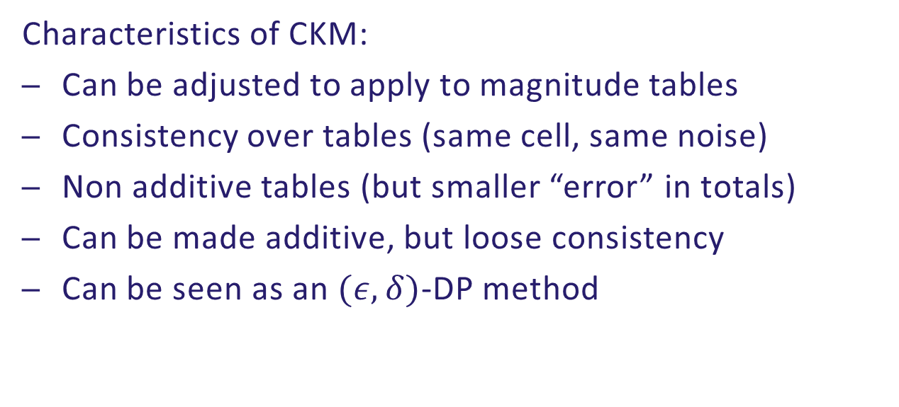
Tables
Characteristics of CKM:
Can be adjusted to apply to magnitude tables
Consistency over tables (same cell, same noise)
Non additive tables (but smaller “error” in totals)
Can be made additive, but loose consistency
Can be seen as an $(ε,δ)$-DP method

Slide 56


Tables
To check risk measures and apply methods:
τ-argus (stand alone software)
sdcTable (R-package)
rtauargus (R-package)
GaussSuppression (R-package)
https://github.com/sdctools

Slide 57
Output checking

Slide 58

Output checking
Check results that leave the NSI
On-site: intermediate and final
Remote access: (intermediate and) final

Slide 59

Output checking
Output of OS/RA can be everything…
Traditional output (tables)
Descriptive statistics
Output of many analyses, e.g.,
  (Non)-linear regression
  Factor analysis
  Correspondence analysis
  …
Graphics
Set of rules that covers every possible output?

Slide 60
Output checking
Examples of “problems”
Extreme values (max, min)
  Often extremes belong to (unique) identifiable units
  Extremes are very visible
Mean
  Single respondent?
  Two respondents?
  Dominating respondent?
  Group disclosure?

Slide 61
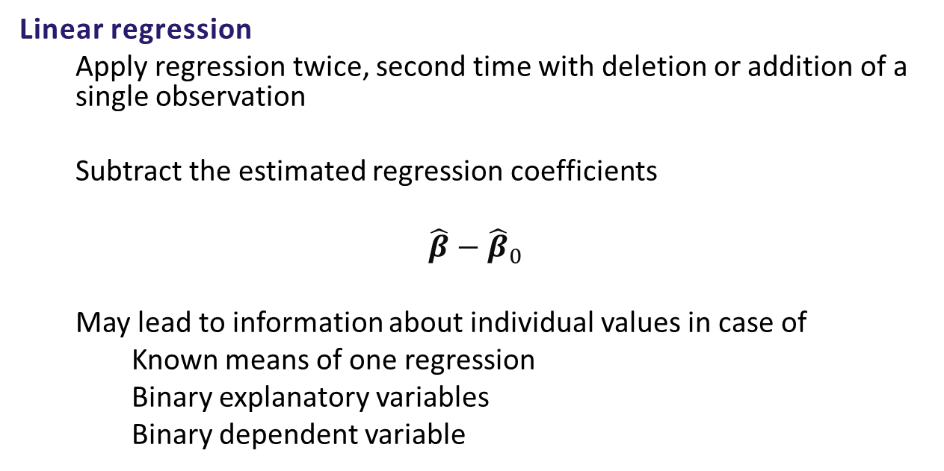
Output checking
Linear regression
  Apply regression twice, second time with deletion or addition of a single observation
  Subtract the estimated regression coefficients
$$\hat{β}−{\hat{β}}_{0}$$
  May lead to information about individual values in case of
  Known means of one regression
  Binary explanatory variables
  Binary dependent variable

Slide 62
Output checking
Graphics
  Possible to identify individual respondent?
  Outliers present?
  Is underlying data safe?
  Does picture have “data embedded”?

Slide 63
Output checking
Guidelines
Started as deliverable of
ESSnet on common tools and harmonised methodology for SDC in the ESS
Included in Wiley book
Statistical Disclosure Control
Improved upon and extended in FP7
Data without Boundaries

Slide 64
Output checking
Types of error with output checking:
Releasing disclosive output
Not releasing safe output

Slide 65



Output checking
Two model approach:
Rule-of-thumb
(simple rules that make a first distinction between
safe output and potentially unsafe output)
Principle Based
(further check potentially unsafe output)

Slide 66
Output checking
Practical issues
SDC awareness of researcher
Joint responsibility of researcher and NSI
Output checking is context specific
  Check by SDC-expert and context-expert
Consistency between checkers
Costs and time-limits

Slide 67
Output checking
Output checking is labour intensive!
Possibilities:
  Researcher facilitates NSI for checking
  Check sample of outputs
  Put price on checking of output
  Facilitate writing of reports at safe setting

Slide 68
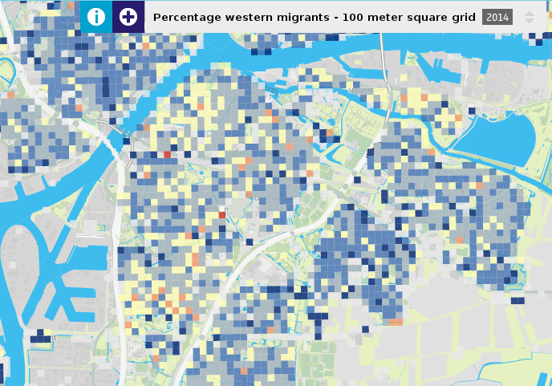

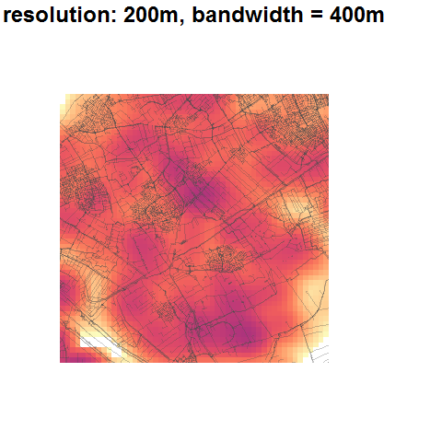

Challenges SDC
“New” types of data and output
  Networks
  Geo-spatial
  Unstructured
  (AI/ML) models

Slide 70
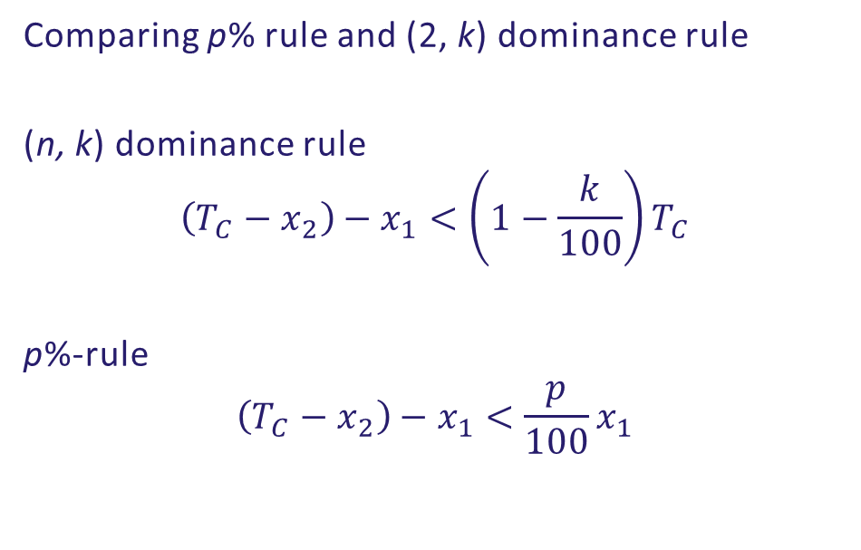
Magnitude tables
Comparing p% rule and (2, k) dominance rule
(n, k) dominance rule
$$\left(T_{C}−x_{2}\right)−x_{1}<\left(1−\frac{k}{100}\right)T_{C}$$
p%-rule
$$\left(T_{C}−x_{2}\right)−x_{1}<\frac{p}{100}x_{1}$$
More natural

Slide 71
Magnitude tables
Example:
(3,85) dominance rule
Cell X: 25 + 19 + 13 + 8 + 2 = 67
Cell Y: 25 + 19 + 12 + 8 + 2 = 66
X is unsafe: (25+19+13)/67 = 0.851
Y is safe: (25+19+12)/66 = 0.848
But:
Estimating x₁: 67 - (19+13) = 35 = 1.4 x₁
Estimating y₁: 66 - (19+12) = 35 = 1.4 y₁
Same relative error!

Slide 72
Magnitude tables
Example:
(3,85) dominance rule
Cell C: 41 + 40 + 40 + 20 + 1 = 142
Cell T: 81 + 20 + 20 + 20 + 1 = 142
C is unsafe: (41+40+40)/142 = 0.852
T is unsafe: (81+20+20)/142 = 0.852
But:
Estimating x₁: 142 - (40+40) = 62 = 1.51 x₁
Estimating y₁: 142 - (20+20) = 102 = 1.26 y₁
Very different relative error!

