Slide 1
CAS CS 460/660
Introduction to Database Systems
Indexing: Hashing

Slide 2
Introduction
Hash-based indexes are best for equality selections. Cannot support range searches.
Static and dynamic hashing techniques exist; trade-offs similar to ISAM vs. B+ trees.
Recall, 3 alternatives for data entries k*:
  Data record with key value k
  <k, rid of data record with search key value k>
  <k, list of rids of data records w/search key k>
  Choice is orthogonal to the indexing technique
Notes:
2

Slide 3
Static Hashing
# primary pages fixed, allocated sequentially, never de-allocated; overflow pages if needed.
A simple hash function (for N buckets):
  h(k) = k MOD N
  is bucket # where data entry with key k belongs.
h(key)
0
1
key
h
N-1
Primary bucket pages
Overflow pages
Notes:
3

Slide 4
Static Hashing (Contd.)
Buckets contain data entries.
Hash fn works on search key field of record r. Use MOD N to distribute values over range 0 ... N-1.
  h(key) = key MOD N works well for uniformly distributed data.
    better: h(key) = (A*key MOD P) mod N, where P is a prime number
  various ways to tune h for non-uniform (checksums, crypto, etc.).
As with any static structure: Long overflow chains can develop and degrade performance.
  Extendible and Linear Hashing: Dynamic techniques to fix this problem.
Notes:
4

Slide 5
Extendible Hashing
Situation: Bucket (primary page) becomes full.
  Want to avoid overflow pages
Add more buckets (i.e., increase “N”)?
  Okay, but need a new hash function!
Doubling # of buckets makes this easier
  Say N values are powers of 2: how to do “mod N”?
  What happens to hash function when double “N”?
Problems with Doubling
  Don’t want to have to double the size of the file.
  Don’t want to have to move all the data.
Notes:
5

Slide 6
Extendible Hashing (cont)
Idea: Add a level of indirection!
Use directory of pointers to buckets,
Double # of buckets by doubling the directory
  Directory much smaller than file, so doubling it is much cheaper.
Split only the bucket that just overflowed!
  No overflow pages!
  Trick lies in how hash function is adjusted!
Notes:
5

Slide 7
How it Works
Directory is array of size 4, so 2 bits needed.
Bucket for record r has entry with index = `global depth’ least significant bits of h(r);
  If h(r) = 5 = binary 101, it is in bucket pointed to by 01.
  If h(r) = 7 = binary 111, it is in bucket pointed to by 11.
LOCAL DEPTH
2
4*
12*
32*
16*
Bucket A
GLOBAL DEPTH
2
1
00
1*
5*
7*
13*
Bucket B
01
10
2
11
10*
Bucket C
DIRECTORY

Slide 8
Handling Inserts
Find bucket where record belongs.
If there’s room, put it there.
Else, if bucket is full, split it:
  increment local depth of original page
  allocate new page with new local depth
  re-distribute records from original page.
  add entry for the new page to the directory

Slide 9
Example: Insert 21,19, 15
21 = 10101
19 = 10011
15 = 01111
LOCAL DEPTH
2
4*
12*
32*
16*
Bucket A
GLOBAL DEPTH
2
2
1
00
1*
5*
7*
13*
Bucket B
21*
01
10
2
11
10*
Bucket C
DIRECTORY
2
7*
19*
15*
Bucket D
  we denote key r by h(r).
DATA PAGES
Notes:
6

Slide 10
Insert h(r)=20 (Causes Doubling)
LOCAL DEPTH
3
LOCAL DEPTH
3
2
Bucket A
GLOBAL DEPTH
32*
16*
32*
16*
Bucket A
4*
12*
32*
16*
GLOBAL DEPTH
2
2
3
2
00
1*
5*
21*
13*
Bucket B
1*
5*
21*
13*
000
Bucket B
01
001
10
2
010
2
11
10*
Bucket C
011
10*
Bucket C
2
100
Bucket D
101
2
15*
7*
19*
15*
7*
19*
Bucket D
110
3
111
Bucket A2
3
4*
12*
20*
(`split image'
4*
12*
20*
Bucket A2
of Bucket A)
(`split image'
of Bucket A)
Notes:
7

Slide 11
Points to Note
20 = binary 10100. Last 2 bits (00) tell us r in either A or A2. Last 3 bits needed to tell which.
  Global depth of directory: Max # of bits needed to tell which bucket an entry belongs to.
  Local depth of a bucket: # of bits used to determine if an entry belongs to this bucket.
When does split cause directory doubling?
  Before insert, local depth of bucket = global depth. Insert causes local depth to become > global depth; directory is doubled by copying it over and `fixing’ pointer to split image page.
Notes:
8

Slide 12
Directory Doubling
Why use least significant bits in directory
(instead of the most significant ones)?
  Allows for doubling by copying the
  directory and appending the new copy
  to the original.
1
2
1
2
1
1
1
0, 2
00
0, 2
1
00
0, 1
0, 1
0
01
0
01
1
1
1
1
1
10
1
10
1, 3
1, 3
2, 3
2, 3
11
11
Least Significant
vs.
Most Significant

Slide 13
Comments on Extendible Hashing
If directory fits in memory, equality search answered with one disk access; else two.
  100MB file, 100 bytes/rec, 4K pages contains 1,000,000 records (as data entries) and 25,000 directory elements; chances are high that directory will fit in memory.
  Directory grows in spurts, and, if the distribution of hash values is skewed, directory can grow large.
  Multiple entries with same hash value cause problems!
Notes:
9

Slide 14
Comments on Extendible Hashing
Delete:
If removal of data entry makes bucket empty, can be merged with `split image’
If each directory element points to same bucket as its split image, can halve directory.
Notes:
9

Slide 15
Linear Hashing
A dynamic hashing scheme that handles the problem of long overflow chains without using a directory.
Directory avoided in LH by using temporary overflow pages, and choosing the bucket to split in a round-robin fashion.
When any bucket overflows split the bucket that is currently pointed to by the “Next” pointer and then increment that pointer to the next bucket.
Notes:
10

Slide 16
Linear Hashing – The Main Idea
Use a family of hash functions h₀, h₁, h₂, ...
h_{i}(key) = h(key) mod(2^{i}N)
  N = initial # buckets
  h is some hash function
h_{i+1} doubles the range of h_{i} (similar to directory doubling)

Slide 17
Linear Hashing (Contd.)
Algorithm proceeds in `rounds’. Current round number is “Level”.
There are N_{Level} (= N * 2^{Level}) buckets at the beginning of a round
Buckets 0 to Next-1 have been split; Next to N_{Level} have not been split yet this round.
Round ends when all initial buckets have been split (i.e. Next = N_{Level}).
To start next round:
  Level++;
  Next = 0;
Notes:
11

Slide 18
Linear Hashing - Insert
Find appropriate bucket
If bucket to insert into is full:
  Add overflow page and insert data entry.
  Split Next bucket and increment Next.
    Note: This is likely NOT the bucket being inserted to!!!
    to split a bucket, create a new bucket and use h_{Level+1} to re-distribute entries.
Since buckets are split round-robin, long overflow chains don’t develop!
Notes:
12

Slide 19
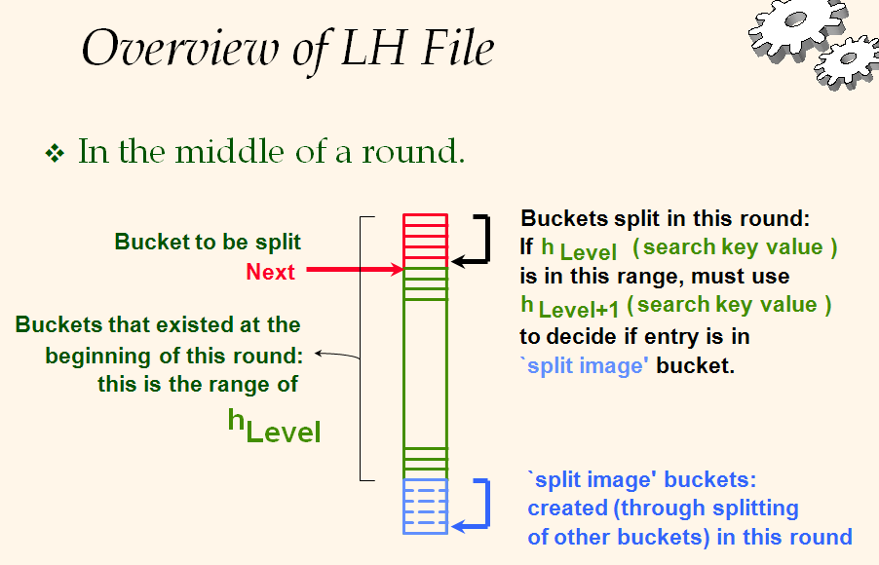
Notes:
11

Slide 20
Example: Insert 43 (101011)
Level=0, N=4
h
h
1
0
Next=0
000
00
32*
44*
36*
Level=0
001
01
9*
25*
5*
Next=1
h
h
PRIMARY
OVERFLOW
010
10
14*
18*
10*
30*
1
0
PAGES
PAGES
011
31*
35*
7*
11*
000
00
32*
11
PRIMARY
001
01
9*
25*
5*
(This info
is for illustration
only!)
PAGES
010
10
14*
18*
10*
30*
(This info
is for illustration
only!)
31*
35*
7*
11*
43*
011
11
100
00
44*
36*
Notes:
13

Slide 21
Example: End of a Round
Level=1, Next = 0
Insert 50 (110010)
PRIMARY
OVERFLOW
h
h
PAGES
1
0
PAGES
Level=0, Next = 3
Next=0
000
00
32*
PRIMARY
OVERFLOW
h
h
PAGES
PAGES
1
0
001
01
9*
25*
000
00
32*
010
10
66*
18*
10*
34*
50*
001
01
9*
25*
011
11
43*
35*
11*
010
10
66*
18*
10*
34*
Next=3
100
00
44*
36*
31*
7*
11*
43*
011
11
35*
44*
101
11
5*
37*
29*
100
00
36*
101
01
5*
37*
29*
110
10
14*
30*
22*
14*
30*
110
10
22*
111
11
31*
7*
Notes:
14

Slide 22
LH Search Algorithm
To find bucket for data entry r, find h_{Level}(r):
  If h_{Level}(r) >= Next (i.e., h_{Level}(r) is a bucket that hasn’t been involved in a split this round) then r belongs in that bucket for sure.
  Else, r could belong to bucket h_{Level}(r) or bucket h_{Level}(r) + N_{Level} must apply h_{Level+1}(r) to find out.

Slide 23
Example: Search 44 (11100), 9 (01001)
Level=0, Next=0, N=4
h
h
1
0
000
00
32*
44*
36*
001
01
9*
25*
5*
010
10
14*
18*
10*
30*
011
11
31*
35*
7*
11*
(This info
is for illustration
only!)
PRIMARY
PAGES
Notes:
13

Slide 24
Example: Search 44 (11100), 9 (01001)
Level=0, Next = 1, N=4
h
h
PRIMARY
OVERFLOW
1
0
PAGES
PAGES
000
00
32*
001
01
9*
25*
5*
010
10
14*
18*
10*
30*
(This info
is for illustration
only!)
31*
35*
7*
11*
43*
011
11
100
00
44*
36*
Notes:
13

Slide 25
Summary
Hash-based indexes: best for equality searches, cannot support range searches.
Static Hashing can have long overflow chains.
Extendible Hashing avoids overflow pages by splitting a full bucket when a new data entry is to be added to it. (Duplicates may require overflow pages.)
  Directory to keep track of buckets, doubles periodically.
  Can get large with skewed data; additional I/O if this does not fit in main memory.
Notes:
16

