Slide 1
Last time: search strategies
Uninformed: Use only information available in the problem formulation
Breadth-first
Uniform-cost
Depth-first
Depth-limited
Iterative deepening
Informed: Use heuristics to guide the search
Best first:
Greedy search – queue first nodes that maximize heuristic “desirability” based on estimated path cost from current node to goal;
A* search – queue first nodes that maximize sum of path cost so far and estimated path cost to goal.
Iterative improvement – keep no memory of path; work on a single current state and iteratively improve its “value.”
Hill climbing – select as new current state the successor state which maximizes value.
Simulated annealing – refinement on hill climbing by which “bad moves” are permitted, but with decreasing size and frequency. Will find global extremum.

Slide 2
Exercise: Search Algorithms
The following figure shows a portion of a partially expanded search tree. Each arc between nodes is labeled with the cost of the corresponding operator, and the leaves are labeled with the value of the heuristic function, h.
Which node (use the node’s letter) will be expanded next by each of the following search algorithms?
(a) Depth-first search
(b) Breadth-first search
(c) Uniform-cost search
(d) Greedy search
(e) A* search
A
h=20
3
5
B
19
h=14
C
D
6
h=18
h=15
4
5
5
E
F
G
H
h=10
h=12
h=8
h=10

Slide 3
Depth-first search
Node queue: initialization
# state depth path cost parent #
1 A 0 0 --

Slide 4
Depth-first search
Node queue: add successors to queue front; empty queue from top
# state depth path cost parent #
2 B 1 3 1
3 C 1 19 1
4 D 1 5 1
1 A 0 0 --

Slide 5
Depth-first search
Node queue: add successors to queue front; empty queue from top
# state depth path cost parent #
5 E 2 7 2
6 F 2 8 2
7 G 2 8 2
8 H 2 9 2
2 B 1 3 1
3 C 1 19 1
4 D 1 5 1
1 A 0 0 --

Slide 6
Depth-first search
Node queue: add successors to queue front; empty queue from top
# state depth path cost parent #
5 E 2 7 2
6 F 2 8 2
7 G 2 8 2
8 H 2 9 2
2 B 1 3 1
3 C 1 19 1
4 D 1 5 1
1 A 0 0 --

Slide 7
Exercise: Search Algorithms
The following figure shows a portion of a partially expanded search tree. Each arc between nodes is labeled with the cost of the corresponding operator, and the leaves are labeled with the value of the heuristic function, h.
Which node (use the node’s letter) will be expanded next by each of the following search algorithms?
(a) Depth-first search
(b) Breadth-first search
(c) Uniform-cost search
(d) Greedy search
(e) A* search
A
h=20
3
5
B
19
h=14
C
D
6
h=18
h=15
4
5
5
E
F
G
H
h=10
h=12
h=8
h=10

Slide 8
Breadth-first search
Node queue: initialization
# state depth path cost parent #
1 A 0 0 --

Slide 9
Breadth-first search
Node queue: add successors to queue end; empty queue from top
# state depth path cost parent #
1 A 0 0 --
2 B 1 3 1
3 C 1 19 1
4 D 1 5 1

Slide 10
Breadth-first search
Node queue: add successors to queue end; empty queue from top
# state depth path cost parent #
1 A 0 0 --
2 B 1 3 1
3 C 1 19 1
4 D 1 5 1
5 E 2 7 2
6 F 2 8 2
7 G 2 8 2
8 H 2 9 2

Slide 11
Breadth-first search
Node queue: add successors to queue end; empty queue from top
# state depth path cost parent #
1 A 0 0 --
2 B 1 3 1
3 C 1 19 1
4 D 1 5 1
5 E 2 7 2
6 F 2 8 2
7 G 2 8 2
8 H 2 9 2

Slide 12
Exercise: Search Algorithms
The following figure shows a portion of a partially expanded search tree. Each arc between nodes is labeled with the cost of the corresponding operator, and the leaves are labeled with the value of the heuristic function, h.
Which node (use the node’s letter) will be expanded next by each of the following search algorithms?
(a) Depth-first search
(b) Breadth-first search
(c) Uniform-cost search
(d) Greedy search
(e) A* search
A
h=20
3
5
B
19
h=14
C
D
6
h=18
h=15
4
5
5
E
F
G
H
h=10
h=12
h=8
h=10

Slide 13
Uniform-cost search
Node queue: initialization
# state depth path cost parent #
1 A 0 0 --

Slide 14
Uniform-cost search
Node queue: add successors to queue so that entire queue is sorted by path cost so far; empty queue from top
# state depth path cost parent #
1 A 0 0 --
2 B 1 3 1
3 D 1 5 1
4 C 1 19 1

Slide 15
Uniform-cost search
Node queue: add successors to queue so that entire queue is sorted by path cost so far; empty queue from top
# state depth path cost parent #
1 A 0 0 --
2 B 1 3 1
3 D 1 5 1
5 E 2 7 2
6 F 2 8 2
7 G 2 8 2
8 H 2 9 2
4 C 1 19 1

Slide 16
Uniform-cost search
Node queue: add successors to queue so that entire queue is sorted by path cost so far; empty queue from top
# state depth path cost parent #
1 A 0 0 --
2 B 1 3 1
3 D 1 5 1
5 E 2 7 2
6 F 2 8 2
7 G 2 8 2
8 H 2 9 2
4 C 1 19 1

Slide 17
Exercise: Search Algorithms
The following figure shows a portion of a partially expanded search tree. Each arc between nodes is labeled with the cost of the corresponding operator, and the leaves are labeled with the value of the heuristic function, h.
Which node (use the node’s letter) will be expanded next by each of the following search algorithms?
(a) Depth-first search
(b) Breadth-first search
(c) Uniform-cost search
(d) Greedy search
(e) A* search
A
h=20
3
5
B
19
h=14
C
D
6
h=18
h=15
4
5
5
E
F
G
H
h=10
h=12
h=8
h=10

Slide 18
Greedy search
Node queue: initialization
# state depth path cost total parent #
cost to goal cost
1 A 0 0 20 20 --

Slide 19
Greedy search
Node queue: Add successors to queue, sorted by cost to goal.
# state depth path cost total parent #
cost to goal cost
1 A 0 0 20 20 --
2 B 1 3 14 17 1
3 D 1 5 15 20 1
4 C 1 19 18 37 1
Sort key

Slide 20
Greedy search
Node queue: Add successors to queue, sorted by cost to goal.
# state depth path cost total parent #
cost to goal cost
1 A 0 0 20 20 --
2 B 1 3 14 17 1
5 G 2 8 8 16 2
7 E 2 7 10 17 2
6 H 2 9 10 19 2
8 F 2 8 12 20 2
3 D 1 5 15 20 1
4 C 1 19 18 37 1

Slide 21
Greedy search
Node queue: Add successors to queue, sorted by cost to goal.
# state depth path cost total parent #
cost to goal cost
1 A 0 0 20 20 --
2 B 1 3 14 17 1
5 G 2 8 8 16 2
7 E 2 7 10 17 2
6 H 2 9 10 19 2
8 F 2 8 12 20 2
3 D 1 5 15 20 1
4 C 1 19 18 37 1

Slide 22
Exercise: Search Algorithms
The following figure shows a portion of a partially expanded search tree. Each arc between nodes is labeled with the cost of the corresponding operator, and the leaves are labeled with the value of the heuristic function, h.
Which node (use the node’s letter) will be expanded next by each of the following search algorithms?
(a) Depth-first search
(b) Breadth-first search
(c) Uniform-cost search
(d) Greedy search
(e) A* search
A
h=20
3
5
B
19
h=14
C
D
6
h=18
h=15
4
5
5
E
F
G
H
h=10
h=12
h=8
h=10

Slide 23
A* search
Node queue: initialization
# state depth path cost total parent #
cost to goal cost
1 A 0 0 20 20 --

Slide 24
A* search
Node queue: Add successors to queue, sorted by total cost.
# state depth path cost total parent #
cost to goal cost
1 A 0 0 20 20 --
2 B 1 3 14 17 1
3 D 1 5 15 20 1
4 C 1 19 18 37 1
Sort key

Slide 25
A* search
Node queue: Add successors to queue front, sorted by total cost.
# state depth path cost total parent #
cost to goal cost
1 A 0 0 20 20 --
2 B 1 3 14 17 1
5 G 2 8 8 16 2
6 E 2 7 10 17 2
7 H 2 9 10 19 2
3 D 1 5 15 20 1
8 F 2 8 12 20 2
4 C 1 19 18 37 1

Slide 26
A* search
Node queue: Add successors to queue front, sorted by total cost.
# state depth path cost total parent #
cost to goal cost
1 A 0 0 20 20 --
2 B 1 3 14 17 1
5 G 2 8 8 16 2
6 E 2 7 10 17 2
7 H 2 9 10 19 2
3 D 1 5 15 20 1
8 F 2 8 12 20 2
4 C 1 19 18 37 1

Slide 27
Exercise: Search Algorithms
The following figure shows a portion of a partially expanded search tree. Each arc between nodes is labeled with the cost of the corresponding operator, and the leaves are labeled with the value of the heuristic function, h.
Which node (use the node’s letter) will be expanded next by each of the following search algorithms?
(a) Depth-first search
(b) Breadth-first search
(c) Uniform-cost search
(d) Greedy search
(e) A* search
A
h=20
3
5
B
19
h=14
C
D
6
h=18
h=15
4
5
5
E
F
G
H
h=10
h=12
h=8
h=10

Slide 28
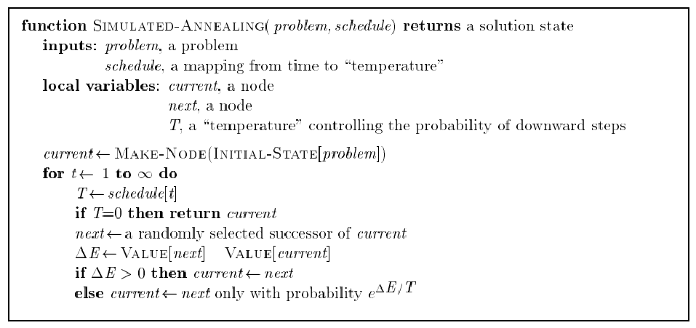
Last time: Simulated annealing algorithm
Idea: Escape local extrema by allowing “bad moves,” but gradually decrease their size and frequency.
Note: goal here is to
maximize E.
-

Slide 29
Last time: Simulated annealing algorithm
Idea: Escape local extrema by allowing “bad moves,” but gradually decrease their size and frequency.
Algorithm when goal
is to minimize E.
-
<
-

Slide 30
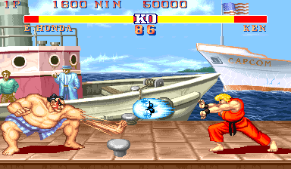
This time: Outline
Game playing
The minimax algorithm
Resource limitations
alpha-beta pruning
Elements of chance

Slide 31
What kind of games?
Abstraction: To describe a game we must capture every relevant aspect of the game. Such as:
Chess
Tic-tac-toe
…
Accessible environments: Such games are characterized by perfect information
Search: game-playing then consists of a search through possible game positions
Unpredictable opponent: introduces uncertainty thus game-playing must deal with contingency problems

Slide 32
Searching for the next move
Complexity: many games have a huge search space
Chess: b = 35, m=100 ⇒ nodes = 35 ¹⁰⁰ if each node takes about 1 ns to explore then each move will take about 10 ⁵⁰ millennia to calculate.
Resource (e.g., time, memory) limit: optimal solution not feasible/possible, thus must approximate
Pruning: makes the search more efficient by discarding portions of the search tree that cannot improve quality result.
Evaluation functions: heuristics to evaluate utility of a state without exhaustive search.

Slide 33
Two-player games
A game formulated as a search problem:
Initial state: ?
Operators: ?
Terminal state: ?
Utility function: ?

Slide 34
Two-player games
A game formulated as a search problem:
Initial state: board position and turn
Operators: definition of legal moves
Terminal state: conditions for when game is over
Utility function: a numeric value that describes the outcome of the game. E.g., -1, 0, 1 for loss, draw, win. (AKA payoff function)

Slide 35
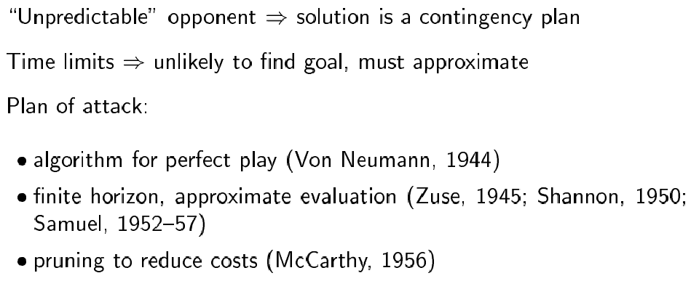
Game vs. search problem

Slide 36
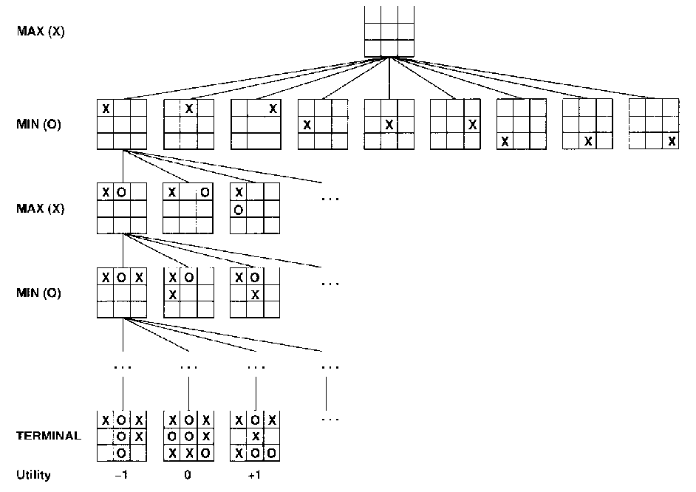
Example: Tic-Tac-Toe

Slide 37
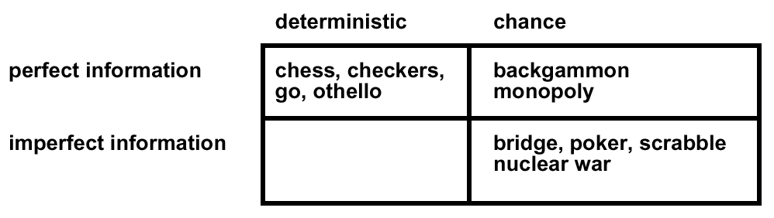
Type of games

Slide 38
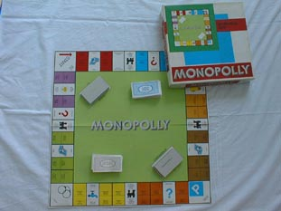
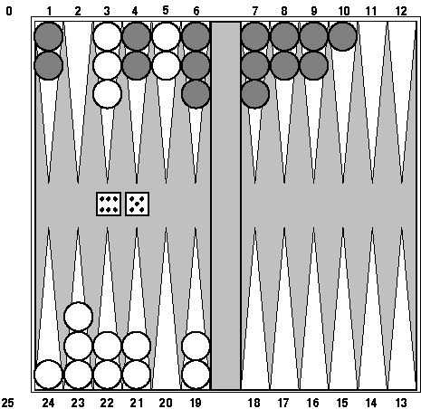
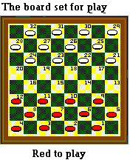
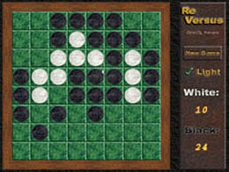


Type of games

Slide 39
The minimax algorithm
Perfect play for deterministic environments with perfect information
Basic idea: choose move with highest minimax value = best achievable payoff against best play
Algorithm:
Generate game tree completely
Determine utility of each terminal state
Propagate the utility values upward in the three by applying MIN and MAX operators on the nodes in the current level
At the root node use minimax decision to select the move with the max (of the min) utility value
Steps 2 and 3 in the algorithm assume that the opponent will play perfectly.

Slide 40
Generate Game Tree

Slide 41
Generate Game Tree
x
 | x
x
 |  | x

Slide 42
Generate Game Tree
 | x
 | x | o
o | x
 | x
 | o
 | x
o

Slide 43
Generate Game Tree
 | x
1 ply
1 move
 | x | o
o | x
 | x
 | o
 | x
o

Slide 44
A subtree
x
o
x
o
x
o
win
lose
x
o
x
x
o
x
x
o
x
draw
x
o
x
o
x
o
x
o
x
o
x
o
x
o
x
x
o
x
x
o
x
x
o
x
x
o
x
x
o
x
x
o
x
x
o
x
o
o
x
o
x
o
o
x
o
x
o
o
o
o
x
o
x
o
o
x
o
o
x
o
x
o
x
x
o
x
x
o
x
x
o
x
x
o
x
o
o
x
o
o
x
x
o
x
o
x
o
x
x
o
x
x
o
o
x
o

Slide 45
What is a good move?
x
o
x
o
x
o
win
lose
x
o
x
x
o
x
x
o
x
draw
x
o
x
o
x
o
x
o
x
o
x
o
x
o
x
x
o
x
x
o
x
x
o
x
x
o
x
x
o
x
x
o
x
x
o
x
o
o
x
o
x
o
o
x
o
x
o
o
o
o
x
o
x
o
o
x
o
o
x
o
x
o
x
x
o
x
x
o
x
x
o
x
x
o
x
o
o
x
o
o
x
x
o
x
o
x
o
x
x
o
x
x
o
o
x
o

Slide 46
Minimax
3
12
8
2
4
6
14
5
2
Minimize opponent’s chance
Maximize your chance

Slide 47
Minimax
3
2
2
MIN
3
12
8
2
4
6
14
5
2
Minimize opponent’s chance
Maximize your chance

Slide 48
Minimax
3
MAX
3
2
2
MIN
3
12
8
2
4
6
14
5
2
Minimize opponent’s chance
Maximize your chance

Slide 49
Minimax
3
MAX
3
2
2
MIN
3
12
8
2
4
6
14
5
2
Minimize opponent’s chance
Maximize your chance

Slide 50
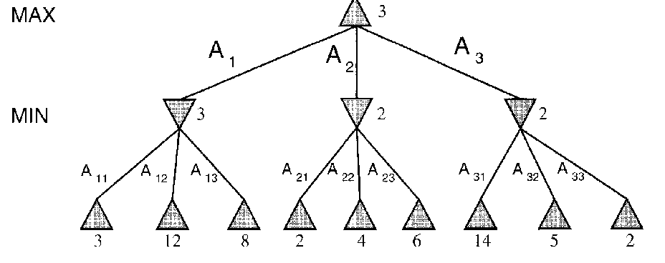
minimax = maximum of the minimum
1st ply
2nd ply

Slide 51
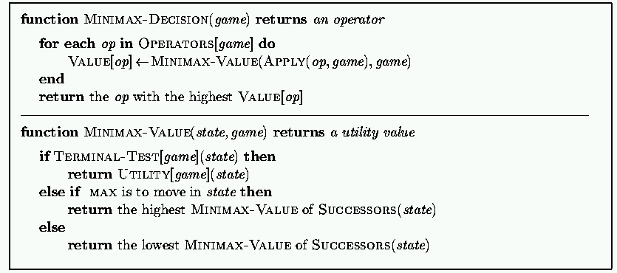
Minimax: Recursive implementation
Complete: ? Optimal: ?
Time complexity: ? Space complexity: ?

Slide 52
Minimax: Recursive implementation
Complete: Yes, for finite state-space Optimal: Yes
Time complexity: O(b^{m}) Space complexity: O(bm) (= DFS Does not keep all nodes in memory.)

Slide 53
1. Move evaluation without complete search
Complete search is too complex and impractical
Evaluation function: evaluates value of state using heuristics and cuts off search
New MINIMAX:
CUTOFF-TEST: cutoff test to replace the termination condition (e.g., deadline, depth-limit, etc.)
EVAL: evaluation function to replace utility function (e.g., number of chess pieces taken)

Slide 54
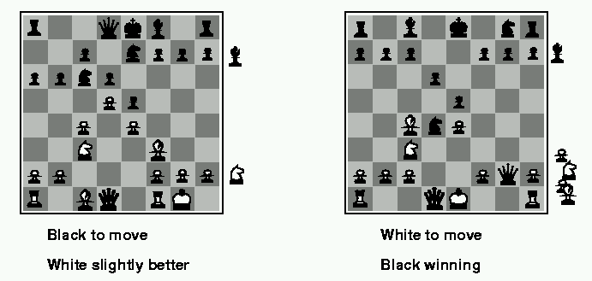
Evaluation functions
Weighted linear evaluation function: to combine n heuristics f = w₁f₁ ₊ w₂f_{2 + … +} w_{n}f_{n}
E.g, w’s could be the values of pieces (1 for prawn, 3 for bishop etc.) f’s could be the number of type of pieces on the board

Slide 55
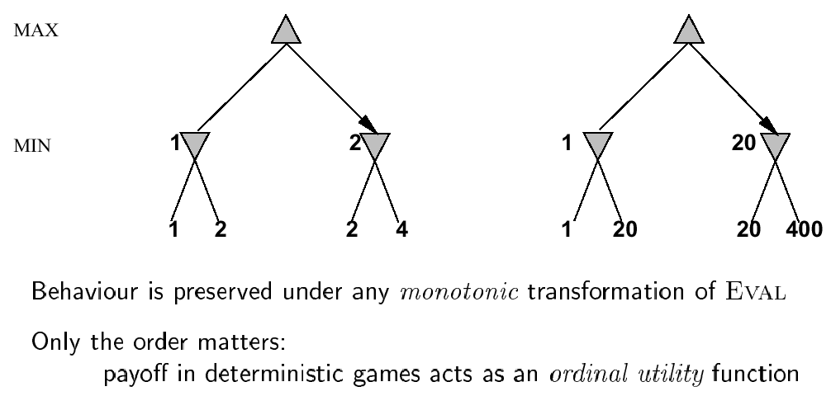
Note: exact values do not matter

Slide 56
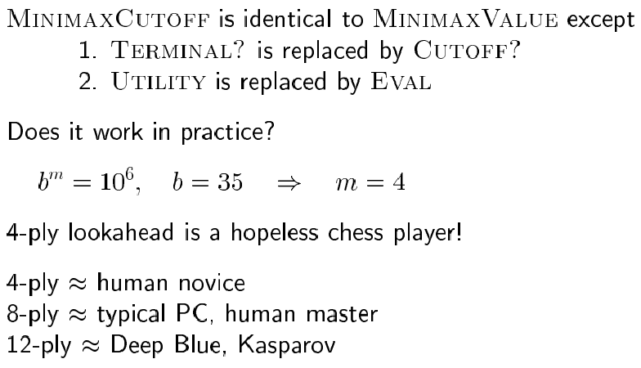
Minimax with cutoff: viable algorithm?
Assume we have 100 seconds, evaluate 10⁴ nodes/s; can evaluate 10⁶ nodes/move

Slide 57
2. α-β pruning: search cutoff
Pruning: eliminating a branch of the search tree from consideration without exhaustive examination of each node
α-β pruning: the basic idea is to prune portions of the search tree that cannot improve the utility value of the max or min node, by just considering the values of nodes seen so far.
Does it work? Yes, in roughly cuts the branching factor from b to √b resulting in double as far look-ahead than pure minimax

Slide 58
α-β pruning: example
≥ 6
MAX
MIN
6
6
12
8

Slide 59
α-β pruning: example
≥ 6
MAX
MIN
6
≤ 2
6
12
8
2

Slide 60
α-β pruning: example
≥ 6
MAX
MIN
6
≤ 2
≤ 5
6
12
8
2
5

Slide 61
α-β pruning: example
≥ 6
MAX
Selected move
MIN
6
≤ 2
≤ 5
6
12
8
2
5

Slide 62
α-β pruning: general principle
Player
m
α
Opponent
If α > v then MAX will chose m so prune tree under n
Similar for β for MIN
Player
Opponent
n
v

Slide 63
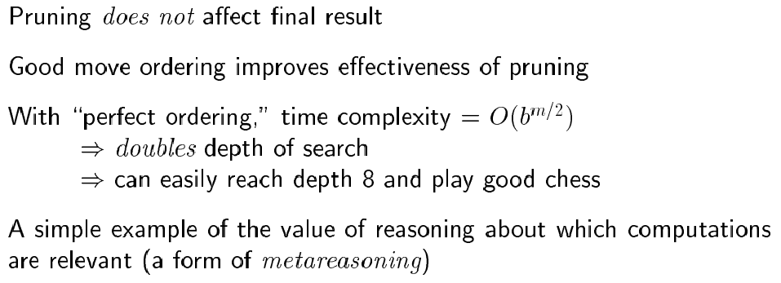
Properties of α-β

Slide 64
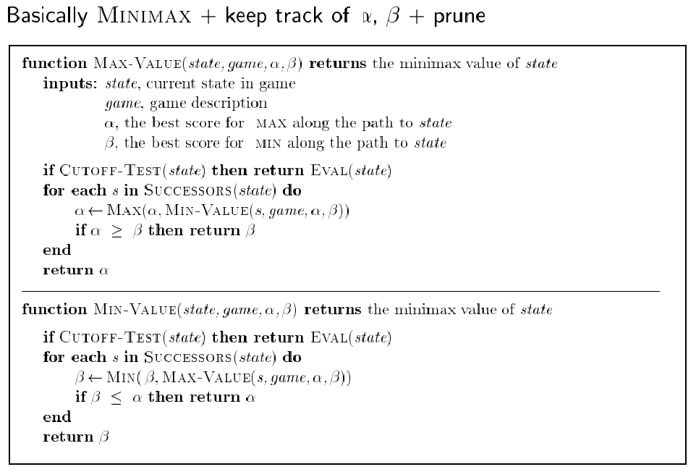
The α-β algorithm:

Slide 65
More on the α-β algorithm
Same basic idea as minimax, but prune (cut away) branches of the tree that we know will not contain the solution.

Slide 66
More on the α-β algorithm: start from Minimax

Slide 67
Remember: Minimax: Recursive implementation
Complete: Yes, for finite state-space Optimal: Yes
Time complexity: O(b^{m}) Space complexity: O(bm) (= DFS Does not keep all nodes in memory.)

Slide 68
More on the α-β algorithm
Same basic idea as minimax, but prune (cut away) branches of the tree that we know will not contain the solution.
Because minimax is depth-first, let’s consider nodes along a given path in the tree. Then, as we go along this path, we keep track of:
α : Best choice so far for MAX
β : Best choice so far for MIN

Slide 69
More on the α-β algorithm: start from Minimax
Note: These are both
Local variables. At the
Start of the algorithm,
We initialize them to
α = -∞ and β = +∞

Slide 70
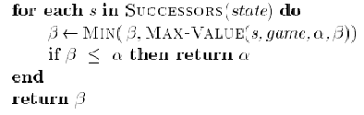
More on the α-β algorithm
In Min-Value:
α = -∞
β = +∞
MAX
Max-Value loops
over these
…
Min-Value loops
over these
MIN
5 10 6 2 8 7
α = -∞
β = 5
α = -∞
β = 5
α = -∞
β = 5

Slide 71
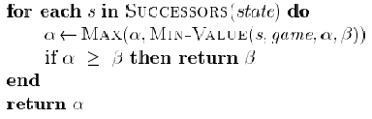
More on the α-β algorithm
In Max-Value:
MAX
Max-Value loops
over these
α = 5
β = +∞
MIN
…
MAX
5 10 6 2 8 7
α = -∞
β = 5
α = -∞
β = 5
α = -∞
β = 5

Slide 72
More on the α-β algorithm
In Min-Value:
MAX
α = 5
β = +∞
MIN
…
Min-Value loops
over these
MAX
5 10 6 2 8 7
α = -∞
β = 5
α = -∞
β = 5
α = -∞
β = 5
α = 5
β = 2
End loop and return 5

Slide 73
More on the α-β algorithm
In Max-Value:
MAX
Max-Value loops
over these
α = 5
β = +∞
α = 5
β = +∞
MIN
…
MAX
5 10 6 2 8 7
α = -∞
β = 5
α = -∞
β = 5
α = -∞
β = 5
α = 5
β = 2
End loop and return 5

Slide 74
Another way to understand the algorithm
From:
http://yoda.cis.temple.edu:8080/UGAIWWW/lectures95/search/alpha-beta.html
For a given node N,
α is the value of N to MAX
β is the value of N to MIN

Slide 75
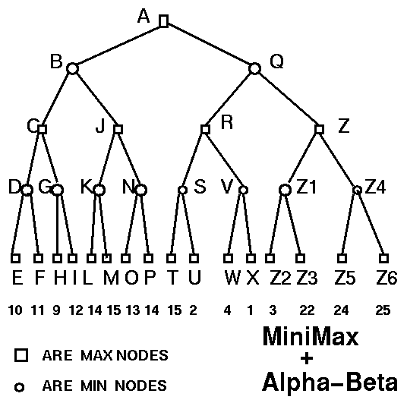
Example

Slide 76
α-β algorithm:

Slide 77
Solution
NODE TYPE ALPHA BETA SCORE
A MAX -Inf Inf
B MIN -Inf Inf
C MAX -Inf Inf
D MIN -Inf Inf
E MAX 10 10 10
D MIN -Inf 10
F MAX 11 11 11
D MIN -Inf 10 10
C MAX 10 Inf
G MIN 10 Inf
H MAX 9 9 9
G MIN 10 9 9
C MAX 10 Inf 10
B MIN -Inf 10
J MAX -Inf 10
K MIN -Inf 10
L MAX 14 14 14
K MIN -Inf 10
M MAX 15 15 15
K MIN -Inf 10 10
…
NODE TYPE ALPHA BETA SCORE
…
J MAX 10 10 10
B MIN -Inf 10 10
A MAX 10 Inf
Q MIN 10 Inf
R MAX 10 Inf
S MIN 10 Inf
T MAX 15 15 15
S MIN 10 15
U MAX 2 2 2
S MIN 10 2 2
R MAX 10 Inf
V MIN 10 Inf
W MAX 4 4 4
V MIN 10 4 4
R MAX 10 Inf 10
Q MIN 10 10 10
A MAX 10 Inf 10

Slide 78
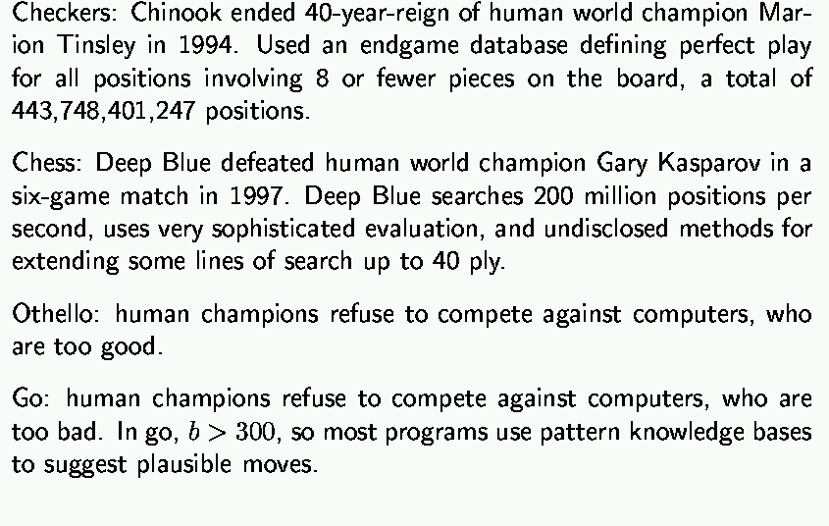
State-of-the-art for deterministic games

Slide 79
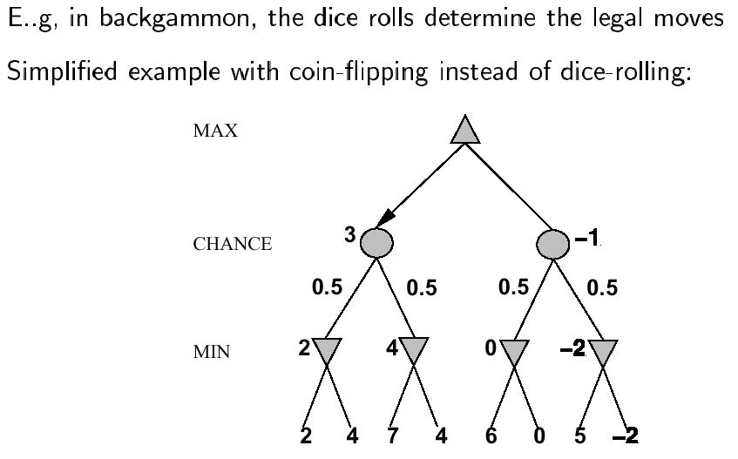
Nondeterministic games

Slide 80
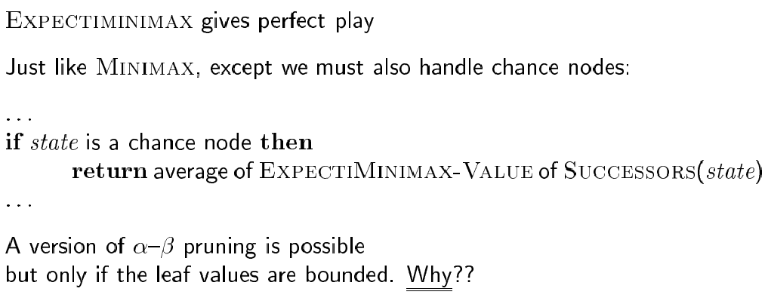
Algorithm for nondeterministic games

Slide 81
Remember: Minimax algorithm

Slide 82
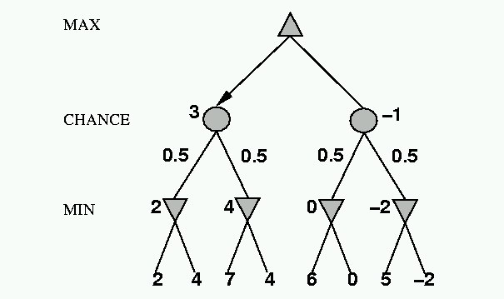
Nondeterministic games: the element of chance
expectimax and expectimin, expected values over all possible outcomes
CHANCE
?
0.5
0.5
3
?
?
8
17
8

Slide 83
Nondeterministic games: the element of chance
4 = 0.5*3 + 0.5*5
Expectimax
CHANCE
0.5
0.5
5
3
5
Expectimin
8
17
8

Slide 84
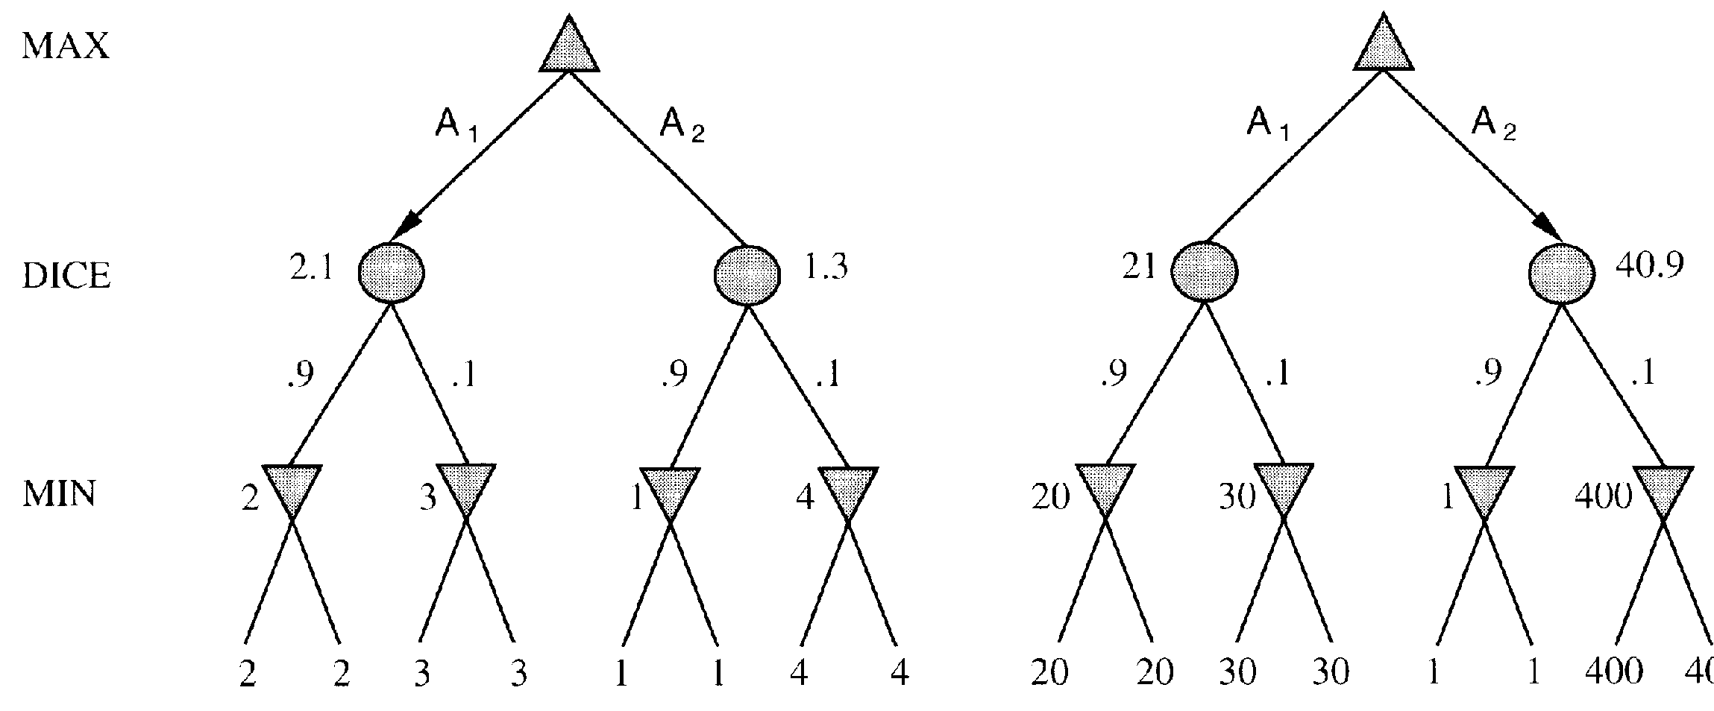
Evaluation functions: Exact values DO matter
Order-preserving transformation do not necessarily behave the same!

Slide 85
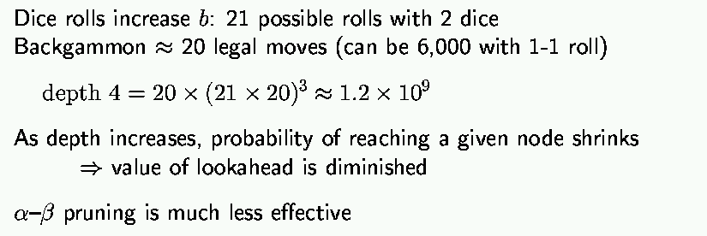
State-of-the-art for nondeterministic games

Slide 86
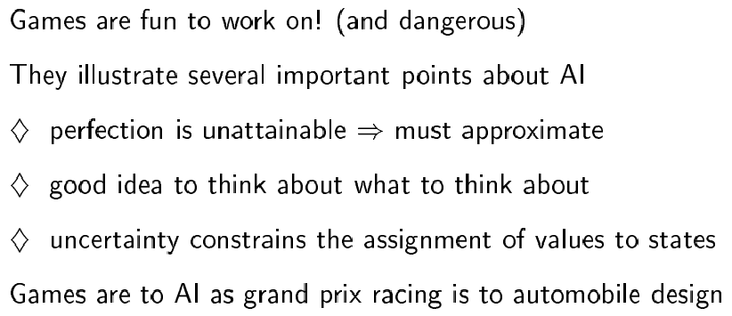
Summary

Slide 87
Exercise: Game Playing
Consider the following game tree in which the evaluation function values are shown below each leaf node. Assume that the root node corresponds to the maximizing player. Assume the search always visits children left-to-right.
(a) Compute the backed-up values computed by the minimax algorithm. Show your answer by writing values at the appropriate nodes in the above tree.
(b) Compute the backed-up values computed by the alpha-beta algorithm. What nodes will not be examined by the alpha-beta pruning algorithm?
(c) What move should Max choose once the values have been backed-up all the way?
A
Max
B
C
Min
D
E
F
G
H
I
J
K
Max
Min
L
M
N
O
P
Q
R
S
T
U
V
W
X
Y
2
3
8
5
7
6
0
1
5
2
8
4
10
2

