Slide 1
CAS CS 460/660
Introduction to Database Systems
Disks, Buffer Manager, Files

Slide 2
DBMS architecture
Database app
Query Optimization
and Execution
Relational Operators
These layers
must consider
concurrency
control and
recovery
Access Methods
Buffer Management
Disk Space Management
Student Records stored on disk

Slide 3
Why Not Store It All in Main Memory?
Costs too much. $100 will buy you either
~16 GB of RAM or around 2000 GB (2 TB) of disk today.
  High-end Databases today can be in the Petabyte (1000TB) range.
  Approx 60% of the cost of a production system is in the disks.
Main memory is volatile. We want data to be saved between runs. (Obviously!)
Note, some specialized systems do store entire database in main memory.
  Vendors claim 10x speed up vs. traditional DBMS running in main memory.

Slide 4
The Storage Hierarchy
Main memory (RAM) for currently used data.
Disk for main database (secondary storage).
Tapes for archive, maybe
(tertiary storage).
The role of Flash (SSD)
still unclear
Registers
Small, Fast
On-chip Cache
On-Board Cache
RAM
SSD
Disk
Big, Slow
Tape

Slide 5
Economics
For $1000, you can get:
  ~180GB of RAM
  ~2.5TB of Solid State Disk
  ~30TB of Magnetic Disk
Notes:
SSD today about $100/250GB
HDDD 3TB Barracuda $90
DRAM 8GB about $20

Slide 6
Disks and Files
Today: Most data is stored on magnetic disks.
  Disks are a mechanical anachronism!
Major implications!
  No “pointer derefs”. Instead, an API:
    READ: transfer “page” of data from disk to RAM.
    WRITE: transfer “page” of data from RAM to disk.
  Both API calls expensive
    Plan carefully!
  An explicit API can be a good thing
    Minimizes the kind of pointer errors you see in C

Slide 7
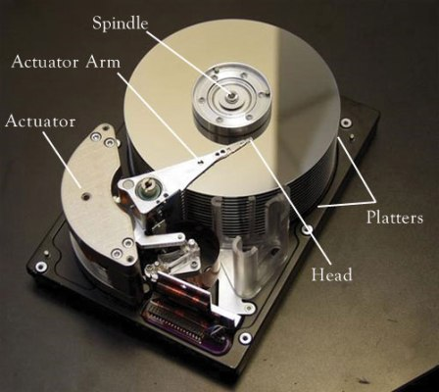


Slide 8
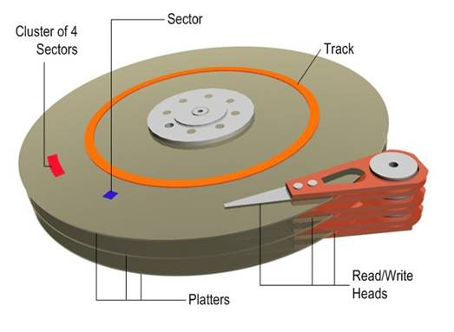
Anatomy of a Disk
The platters spin
The arm assembly is moved in or out to position a head on a desired track. Tracks under heads make a cylinder (imaginary!).
Only one head reads/writes at any one time.
Block size is a multiple of sector size (which is fixed)
Notes:
sector size: 512 bytes to new HDD 4KB (AF)
Block size: 4KB to 32KB

Slide 9
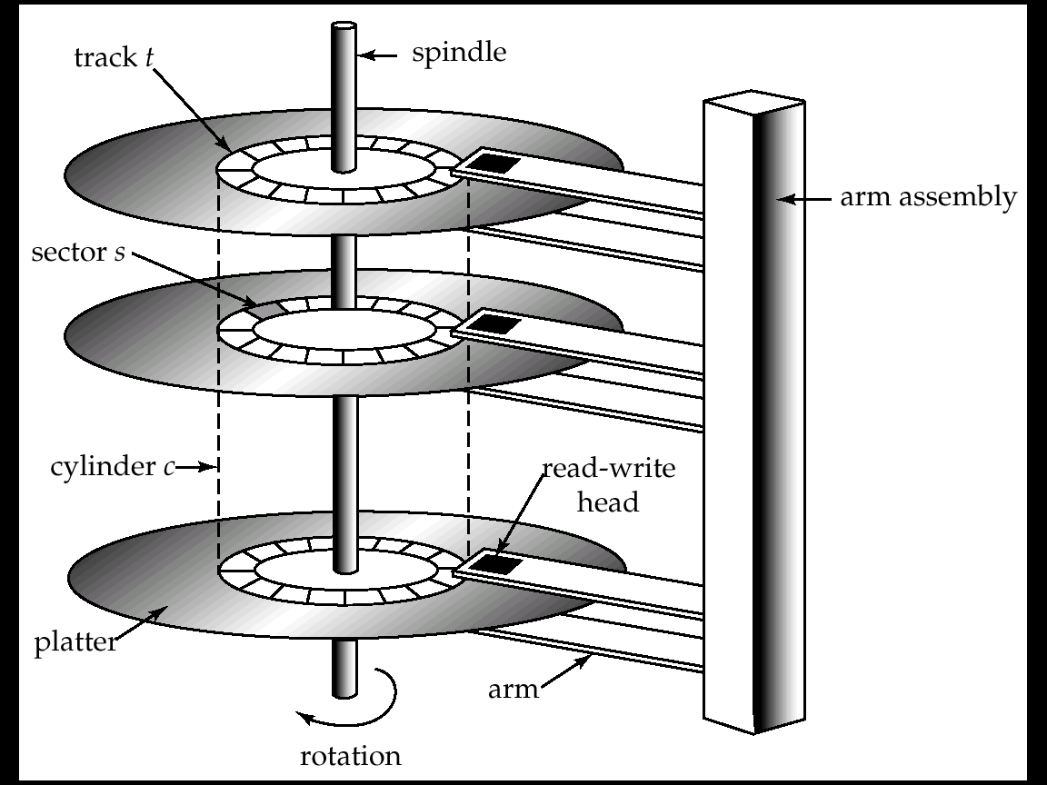

Slide 10
Accessing a Disk Page
Time to access (read/write) a disk block:
  seek time (moving arms to position disk head on track)
  rotational delay (waiting for block to rotate under head)
  transfer time (actually moving data to/from disk surface)
Seek time and rotational delay dominate.
  Seek time varies from about 1 to 15msec (full stroke)
  Rotational delay varies from 0 to 8msec (7200rpm)
  Transfer rate is < 0.1msec per 8KB block
Key to lower I/O cost:
  reduce seek/rotation delays! Hardware vs. software solutions?
Also note: For shared disks most time spent waiting in queue for access to arm/controller
Wait
Transfer
Transfer
Rotate
Rotate
Seek
Seek

Slide 11
Arranging Pages on Disk
`Next’ block concept:
  blocks on same track, followed by
  blocks on same cylinder, followed by
  blocks on adjacent cylinder
Arrange file pages sequentially on disk
  minimize seek and rotational delay.
For a sequential scan, pre-fetch
  several pages at a time!
We use Block/Page interchangeably!!

Slide 12
From the DB Administrator’s View
Modern disk structures are so complex even industry experts refer to them as “black boxes”. Today there is no alignment to physical disk sectors, no matter what we believe. Disks do not map sectors to physical regions in a way that we can understand from outside the box; the simplistic “geometry” reported by the device is an artifice.
from Microsoft’s “Disk Partition Alignment Best Practices for SQL Server”

Slide 13
Disk Space Management
Lowest layer of DBMS software manages space on disk (using OS file system or not?).
Higher levels call upon this layer to:
  allocate/de-allocate a page
  read/write a page
Best if a request for a sequence of pages is satisfied by pages stored sequentially on disk! Higher levels don’t need to know if/how this is done, or how free space is managed.

Slide 14
Notes on Flash (SSD)
Various technologies, we focus on NAND
  suited for volume data storage
  alternative: NOR Flash
Read is random access and fast
  E.g. 512 Bytes at a time
Write is coarser grained and slower
  E.g. 16-512 KBytes at a time.
  Can get slower over time
Some concern about write endurance
  100K cycle lifetimes?
Still changing quickly

Slide 15
CPU
Typical
Computer
...
...
M
C
Secondary
Storage

Slide 16
Buffer Management in a DBMS
Page Requests from Higher Levels
BUFFER POOL
disk page
free frame
MAIN MEMORY
choice of frame dictated
by replacement policy
DISK
DB
Data must be in RAM for DBMS to operate on it!
  The query processor refers to data using virtual memory addresses.
Buffer Mgr hides the fact that not all data is in RAM

Slide 17
Some Terminology…
Disk Page – the unit of transfer between the disk and memory (or Block)
  Typically set as a config parameter for the DBMS.
  Typical value between 4 KBytes to 32 KBytes.
Frame – a unit of memory
  Typically the same size as the Disk Page Size
Buffer Pool – a collection of frames used by the DBMS to temporarily keep data for use by the query processor (CPU).
  note: We will sometime use the term “buffer” and “frame” synonymously.

Slide 18
When a Page is Requested ...
If requested page IS in the pool:
  Pin the page and return its address.
Else, if requested page IS NOT in the pool:
  If a free frame exists, choose it, Else:
    Choose a frame for replacement (only un-pinned pages are candidates)
    If chosen frame is “dirty”, write it to disk
  Read requested page into chosen frame
  Pin the page and return its address.
Q: What information about buffers and their contents must the system maintain?

Slide 19
Buffer Control Blocks (BCBs):
<frame#, pageid, pin_count, dirty>
A page may be requested many times, so
  a pin count is used.
  To pin a page, pin_count++
  A page is a candidate for replacement iff pin_count == 0 (“unpinned”)
Requestor of page must eventually unpin it.
  pin_count--
Must also indicate if page has been modified:
  dirty bit is used for this.
  Q: Why is this important?
Q: How should BCB’s be organized?

Slide 20
Additional Buffer Mgr Notes
BCB’s are hash indexed by pageID
Concurrency Control & Recovery may entail additional I/O when a frame is chosen for replacement.
(Write-Ahead Log protocol; more later.)
If requests can be predicted (e.g., sequential scans) pages can be pre-fetched several pages at a time.

Slide 21
Buffer Replacement Policy
Frame is chosen for replacement by a replacement policy:
  Least-recently-used (LRU), MRU, Clock, etc.
This policy can have big impact on the number of disk reads and writes.
  Remember, these are slooooooooooow.
BIG IDEA – throw out the page that you are least likely to need in the future.
  Q: How do you predict the future?

Slide 22
LRU Replacement Policy
Least Recently Used (LRU)
for each page in buffer pool, keep track of time last unpinned
2)Replace the frame that has the oldest (earliest) time
  Most common policy: intuitive and simple
    Based on notion of “Temporal Locality”
    Works well to keep “working set” in buffers.
  Implemented through doubly linked list of BCBs
    Requires list manipulation on unpin

Slide 23
“Clock” Replacement Policy
A(1)
An approximation of LRU
Arrange frames into a cycle, store one reference bit per frame
  Can think of this as the 2nd chance bit
When pin count reduces to 0, turn on ref. bit
When replacement necessary
do for each page in cycle {
if (pincount == 0 && ref bit is on)
turn off ref bit;
else if (pincount == 0 && ref bit is off)
choose this page for replacement;
} until a page is chosen;
B(p)
D(1)
C(1)

Slide 24
Some issues with LRU
Problem: Sequential flooding
  LRU + repeated sequential scans.
  # buffer frames < # pages in file means each page request causes an I/O. MRU much better in this situation (but not in all situations, of course).
Problem: “cold” pages can hang around a long time before they are replaced.

Slide 25
“2Q” Replacement Policy
One Queue (A1) has pages that have been referenced only once.
  new pages enter here
A second, LRU Queue (Am) has pages that have been referenced (pinned) multiple times.
  pages get promoted from A1 to here
Replacement victims are usually taken from A1
  Q: Why????

Slide 26
DBMS vs. OS File System
OS does disk space & buffer mgmt: why not let OS manage these tasks?
Some limitations, e.g., files can’t span disks.
  Note, this is changing --- OS File systems are getting smarter (i.e., more like databases!)
Buffer management in DBMS requires ability to:
  pin a page in buffer pool, force a page to disk & order writes (important for implementing CC & recovery)
  adjust replacement policy, and pre-fetch pages based on access patterns in typical DB operations.

Slide 27
Storage Pragmatics & Trends
Many significant DBs are not that big.
  Daily weather, round the globe, 1929-2009: 20GB
  2000 US Census: 200GB
  2009 English Wikipedia: 14GB
  NYC Taxi Rides (~20GB per year)
But data sizes grow faster than Moore’s Law
What is the role of disk, flash, RAM?
  The subject of much debate/concern!

Slide 28
Files of Records
Disk blocks are the interface for I/O, but…
Higher levels of DBMS operate on records, and files of records.
FILE: A collection of pages, each containing a number of records. The File API must support:
  insert/delete/modify record
  fetch a particular record (specified by record id)
  scan all records (possibly with some conditions on the records to be retrieved)
Typically: file page size = disk block size = buffer frame size

Slide 29
“MetaData” - System Catalogs
How to impose structure on all those bytes??
MetaData: “Data about Data”
For each relation:
  name, file location, file structure (e.g., Heap file)
  attribute name and type, for each attribute
  index name, for each index
  integrity constraints
For each index:
  structure (e.g., B+ tree) and search key fields
For each view: view name and definition
Plus statistics, authorization, buffer pool size, etc.
Notes:
Q: But how to store the catalogs????

Slide 30
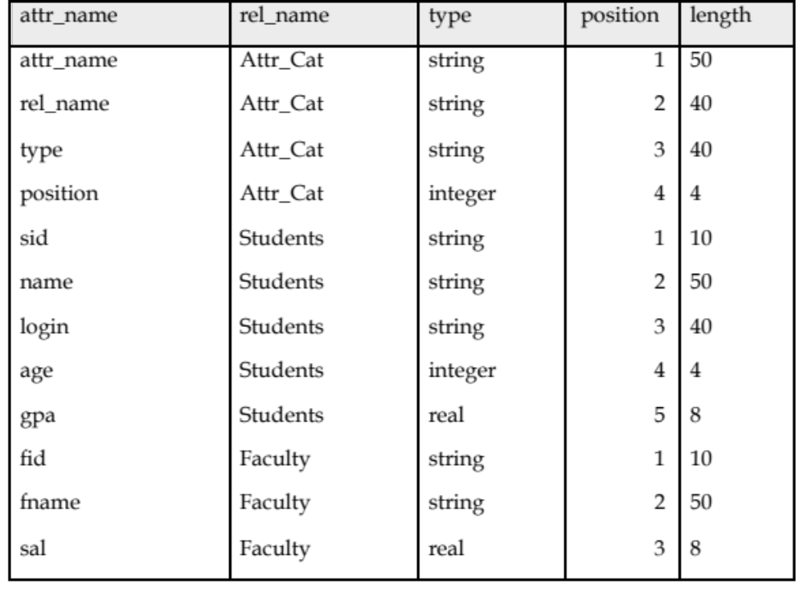
Catalogs are Stored as Relations!
Attr_Cat(attr_name, rel_name, type, position, length)

Slide 31
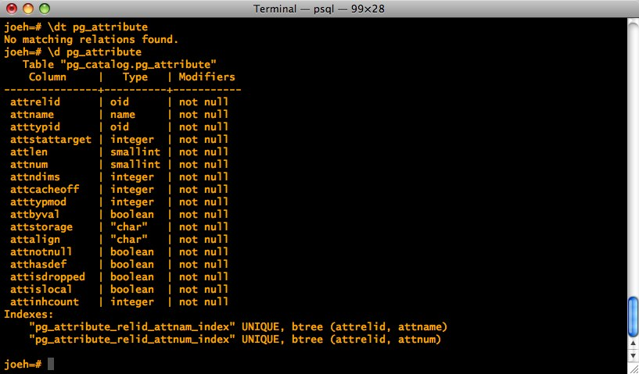
It’s a bit more complicated…

Slide 32
Record Formats: Fixed Length
F1
F2
F3
F4
L1
L2
L3
L4
Base address (B)
Address = B+L1+L2
Information about field types same for all records in a file; stored in system catalogs.
Finding i’th field done via arithmetics.

Slide 33
Record Formats:Variable Length
Two alternative formats (# fields is fixed):
F1 F2 F3 F4
$
$
$
$
Fields Delimited by Special Symbols
F1 F2 F3 F4
Array of Field Offsets
Second offers direct access to i’th field, efficient storage
of nulls (special don’t know value); some directory overhead.

Slide 34
How to Identify a Record?
The Relational Model doesn’t expose “pointers”, but that doesn’t mean that the DBMS doesn’t use them internally.
Q: Can we use memory addresses to permanently “point” to records?
Systems instead use a “Record ID” or “RecID”
Typically: Record ID = <page id, slot #>

Slide 35
Page Formats: Fixed Length Records
Slot 0
record
Slot 0
record
Slot 1
record
Slot 1
record
record
. . .
. . .
Free
Space
Slot N-1
record
record
Free
Space
Slot M-1
Slot M-1
record
N
1
0
0
1
. . .
1
0
1
M
number
of records
M-1 … 2 1 0
number
of slots
PACKED
UNPACKED, BITMAP
In first alternative, free space management requires record movement.
Changes RIds - may not be acceptable.

Slide 36
“Slotted Page” for Variable Length Records
Rid = <i,1>
Page i
Data
Area
Rid = <i,2>
Rid = <i,0>
Free Space
Offset
to start
of free
space
[28,16]
[4,20]
[64,28]
3
92
2 1 0
# slots
SLOT ARRAY
Slot contains: [offset (from start of page), length]
  both in bytes
Record id = <page id, slot #>
Page is full when data space and slot array meet.

Slide 37
Slotted Page (continued)
When need to allocate:
  If enough room in free space, use it and update free space pointer.
  Else, try to compact data area, if successful, use the freed space.
  Else, tell caller that page is full.
Advantages:
  Can move records around in page without changing their record ID
  Allows lazy space management within the page, with opportunity for clean up later

Slide 38
Slotted page (continued)
0 |  |  |  |  |  |  |  | 8 |  |  |  |  |  |  | 15
Pointer
to start
of free
space
 |  |  |  |  |  |  |  |  |  |  |  | 8 | 9 | 0 | 4 | 2 | 17
Slot directory
# of slots
What’s the biggest record you can add to the above page without compacting?
  Need 2 bytes for slot: [offset, length] plus record.

Slide 39
Slotted page (continued)
0 |  |  |  |  |  |  |  | 8 |  |  |  |  |  |  | 15
Pointer
to start
of free
space
 |  |  |  |  |  |  |  |  |  | 17 | 9 | 8 | 9 | 0 | 4 | 3 | X
Slot directory
# of slots
What’s the biggest record you can add to the above page without compacting?
  Need 2 bytes for slot: [offset, length] plus record.

Slide 40
Slotted page (continued)
0 |  |  |  |  |  |  |  | 8 |  |  |  |  |  |  | 15
Pointer
to start
of free
space
 |  |  |  |  |  |  |  |  |  |  |  | 8 | 9 | 0 | 4 | 2 | 17
Slot directory
# of slots
What’s the biggest record you can add to the above page with compacting?
  Need 2 bytes for slot: [offset, length] plus record.

Slide 41
Slotted page (continued)
0 |  |  |  |  |  |  |  | 8 |  |  |  |  |  |  | 15
Pointer
to start
of free
space
 |  |  |  |  |  |  |  |  |  | 13 | 13 | 4 | 9 | 0 | 4 | 3 | X
Slot directory
# of slots
What do you do if a record needs to move to a different page?
  Leave a special “tombstone” object in place of record, pointing to new page & slot.
    Record id remains unchanged
What if it needs to move again?
  Update the original tombstone – so one hop max.

Slide 42
So far we’ve organized:
Fields into Records (fixed and variable length)
Records into Pages (fixed and variable length)
Now we need to organize Pages into Files

Slide 43
Alternative File Organizations
Many alternatives exist, each good for some situations, and not so good in others:
Heap files: Unordered. Fine for file scan retrieving all records. Easy to maintain.
Sorted Files: Best for retrieval in search key order, or if only a `range’ of records is needed. Expensive to maintain.
Clustered Files (with Indexes): A compromise between the above two extremes.

Slide 44
Unordered (Heap) Files
Simplest file structure contains records in no particular order.
As file grows and shrinks, pages are allocated and de-allocated.
To support record level operations, we must:
  keep track of the pages in a file
  keep track of free space on pages
  keep track of the records on a page
Can organize as a list, as a directory, a tree, …

Slide 45
Heap File Implemented as a List
Data
Page
Data
Page
Data
Page
Full Pages
Header
Page
Data
Page
Data
Page
Data
Page
Pages with
Free Space
The Heap file name and header page id must be stored persistently.
  The catalog is a good place for this.
Each page contains 2 `pointers’ plus data.

Slide 46
Heap File Using a Page Directory
Data
Page 1
Header
Page
Data
Page 2
Data
Page N
DIRECTORY
The entry for a page can include the number of free bytes on the page.
The directory is a collection of pages; linked list implementation is just one alternative.

Slide 47
Cost Model for Analysis
Average-case analysis; based on several simplistic assumptions.
  Often called a “back of the envelope” calculation.
We ignore CPU costs, for simplicity:
  B: The number of data blocks
  R: Number of records per block
We simply count number of disk block I/O’s
  ignores gains of pre-fetching and sequential access; thus, even I/O cost is only loosely approximated.
Notes:
Good enough to show some overall trends!
Not always:

Slide 48
Some Assumptions in the Analysis
Single record insert and delete.
Equality selection - exactly one match (what if more or less???).
For Heap Files we’ll assume:
  Insert always appends to end of file.
  Delete just leaves free space in the page.
  Empty pages are not de-allocated.
  If using directory implementation assume directory is in-memory.

Slide 49
Average Case I/O Counts for Operations (B = # disk blocks in file)
 | Heap File | Sorted File | Clustered File
Scan all records
Equality Search (1 match)
Range Search
Insert
Delete
B
0.5 B
B
2
0.5 B+1

Slide 50
Sorted Files
Heap files are lazy on update - you end up paying on searches.
Sorted files eagerly maintain the file on update.
  The opposite choice in the trade-off
Let’s consider an extreme version
  No gaps allowed, pages fully packed always
  Q: How might you relax these assumptions?
Assumptions for our BotE Analysis:
  Files compacted after deletions.
  Searches are on sort key field(s).

Slide 51
Average Case I/O Counts for Operations (B = # disk blocks in file)
 | Heap File | Sorted File | Clustered File
Scan all records
Equality Search (1 match)
Range Search
Insert
Delete
B
0.5 B
B
2
0.5B+1
B
log₂ B (if on sort key) 0.5 B (otherwise)
(log₂ B) +
selectivity * B
(log₂B)+ B
Same cost as Insert

