Slide 1
CAS CS 460/660
Introduction to Database Systems
Relational Algebra

Slide 2
Relational Query Languages
Query languages: Allow manipulation and retrieval of data from a database.
Relational model supports simple, powerful QLs:
  Strong formal foundation based on logic.
  Allows for much optimization.
Query Languages != programming languages!
  QLs not expected to be “Turing complete”.
  QLs not intended to be used for complex calculations.
  QLs support easy, efficient access to large data sets.

Slide 3
Formal Relational Query Languages
Two mathematical Query Languages form the basis for “real” languages (e.g. SQL), and for implementation:
Relational Algebra: More operational, very useful for representing execution plans.
Relational Calculus: Lets users describe what they want, rather than how to compute it. (Non-procedural, declarative.)
Understanding Algebra (and Calculus) is key to
understanding SQL, query processing!

Slide 4
Preliminaries
A query is applied to relation instances, and the result of a query is also a relation instance.
  Schemas of input relations for a query are fixed (but query will run over any legal instance)
  The schema for the result of a given query is fixed.
    It is determined by the definitions of the query language constructs.
Positional vs. named-field notation:
  Positional notation easier for formal definitions, named-field notation more readable.
  Both used in SQL

Slide 5


Relational Algebra: 5 Basic Operations
Selection ( ) Selects a subset of rows from relation (horizontal).
Projection ( ) Retains only wanted columns from relation (vertical).
Cross-product (x) Allows us to combine two relations.
Set-difference (–) Tuples in r1, but not in r2.
Union (∪ ) Tuples in r1 and/or in r2.
Since each operation returns a relation, operations can be composed! (Algebra is “closed”.)

Slide 6
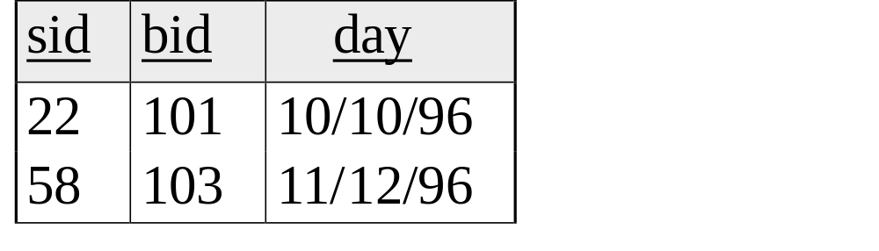
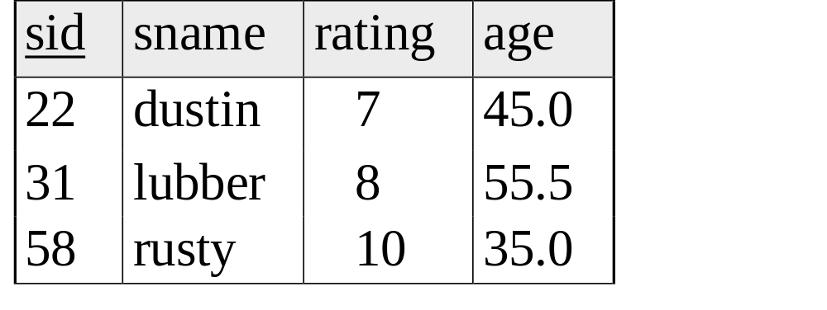
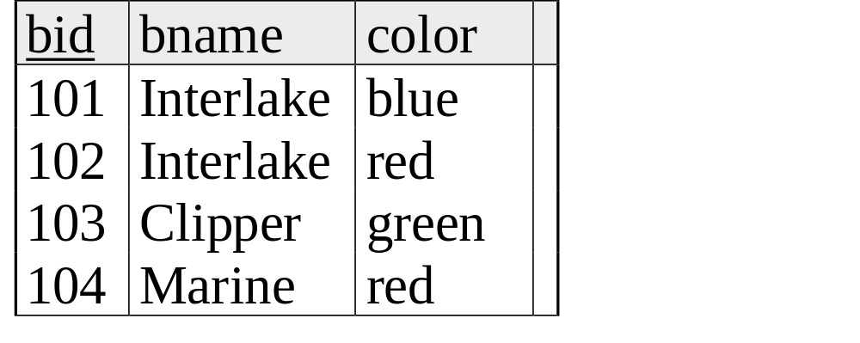
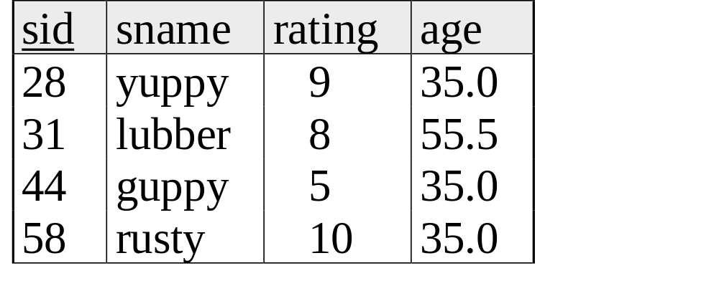
Example Instances
R1
Sailing Database:
Sailors, Boats, Reserves
S1
S2
Boats

Slide 7
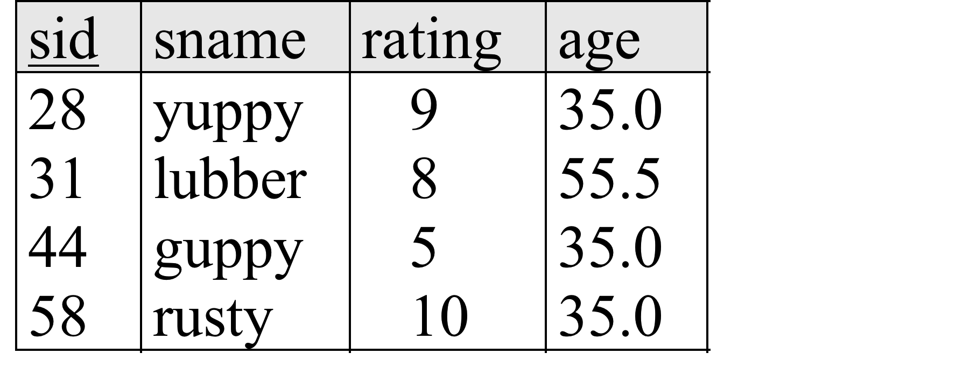
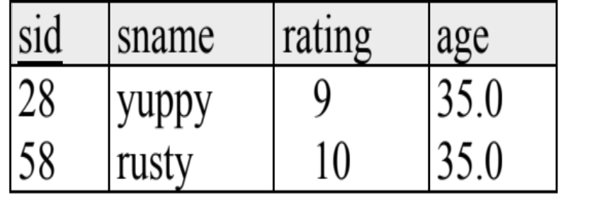
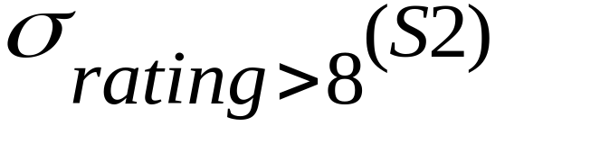

Selection (σ) – Horizontal Restriction
Selects rows that satisfy selection condition.
Result is a relation.
  Schema of result is same as that of the input relation.

Slide 8
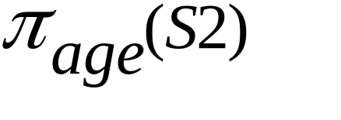
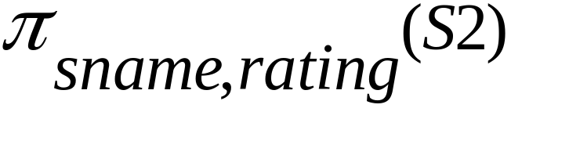
Projection – Vertical Restriction
Examples: ;
Retains only attributes that are in the “projection list”.
Schema of result:
  exactly the fields in the projection list, with the same names that they had in the input relation.
Projection operator has to eliminate duplicates (How do they arise? Why remove them?)
  Note: real systems typically don’t do duplicate elimination unless the user explicitly asks for it. (Why not?)

Slide 9
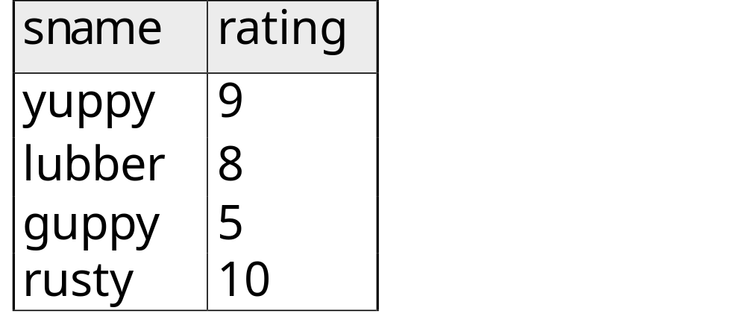
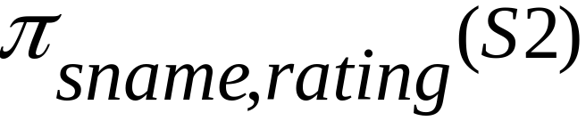
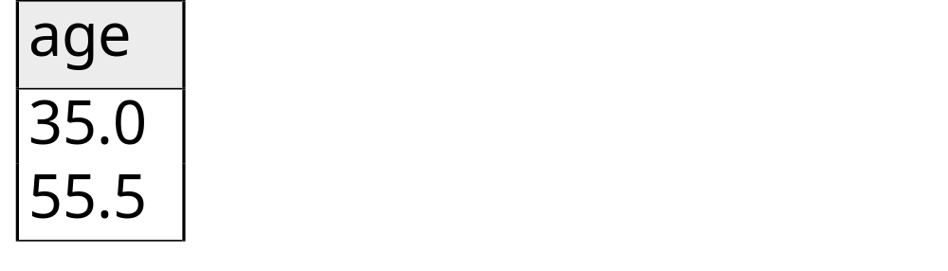
Projection
S2

Slide 10
Review: Relational Algebra: 5 Basic Operations
Selection ( ) Selects a subset of rows from relation (horizontal).
Projection ( ) Retains only wanted columns from relation (vertical).
Cross-product (x) Allows us to combine two relations.
Set-difference (–) Tuples in r1, but not in r2.
Union (∪ ) Tuples in r1 and/or in r2.
Since each operation returns a relation, operations can be composed! (Algebra is “closed”.)

Slide 11
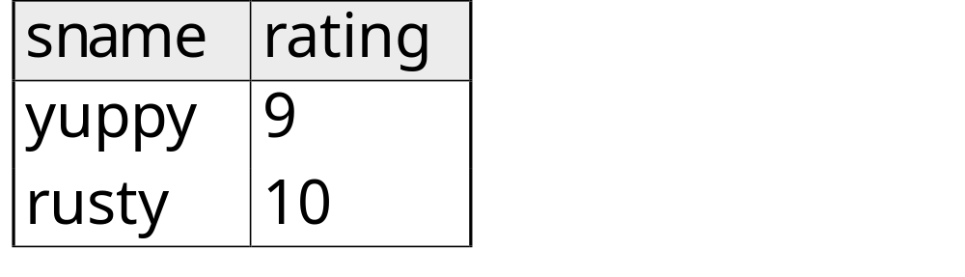
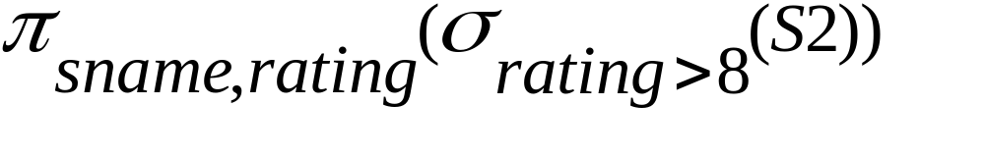
Nesting Operators
Result of a Relational Algebra Operator is a Relation, so…
Can use as input to another Relational Algebra Operator

Slide 12
Union and Set-Difference
All of these operations take two input relations, which must be union-compatible:
  Same number of fields.
  `Corresponding’ fields have the same type.
For which, if any, is duplicate elimination required?

Slide 13
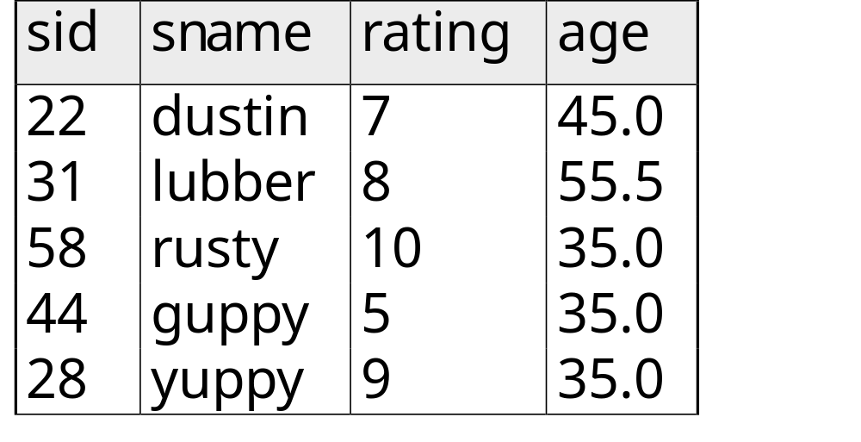
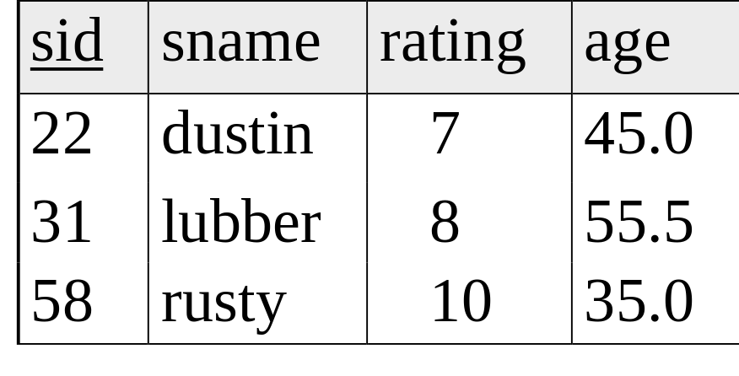

Union
S1
S2

Slide 14
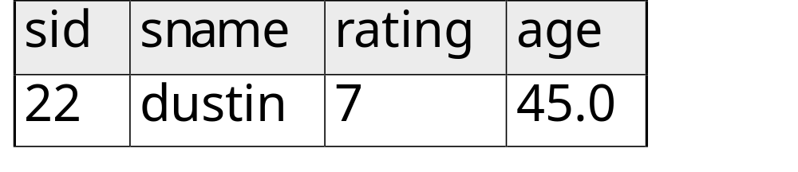

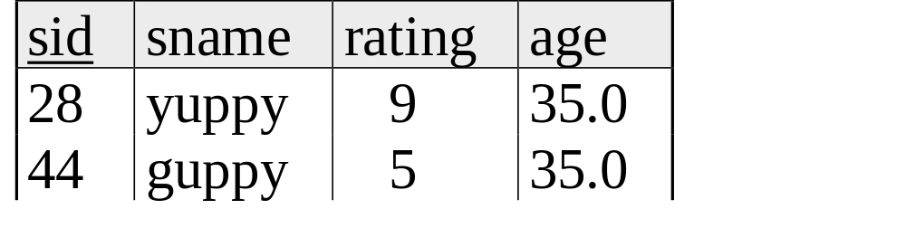
Set Difference
S1
S2 – S1
S2

Slide 15
Cross-Product
S1 x R1: Each row of S1 paired with each row of R1.
  Q: How many rows in the result?
Result schema has one field per field of S1 and R1, with field names `inherited’ if possible.
  May have a naming conflict: Both S1 and R1 have a field with the same name.
  In this case, can use the renaming operator:

Slide 16
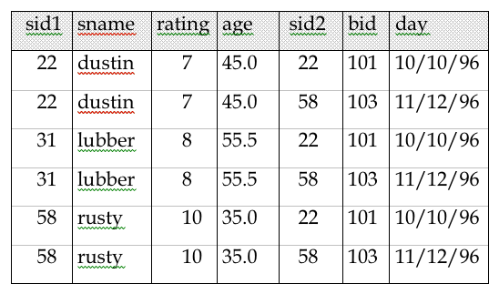
Cross Product Example
S1
R1

Slide 17
Compound Operator: Intersection
In addition to the 5 basic operators, there are several additional “Compound Operators”
  These add no computational power to the language, but are useful shorthands.
  Can be expressed solely with the basic ops.
Intersection takes two input relations, which must be union-compatible.
Q: How to express it using basic operators?
R ∩ S = R − (R − S)

Slide 18
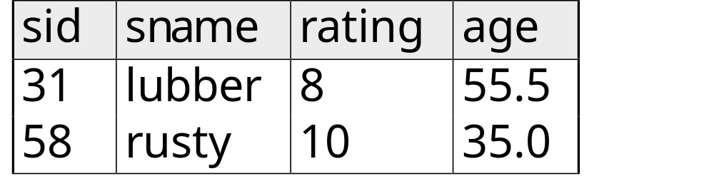

Intersection
S1
S2

Slide 19
Compound Operator: Join ( )
Joins are compound operators involving cross product, selection, and (sometimes) projection.
Most common type of join is a “natural join” (often just called “join”). R S conceptually is:
  Compute R X S
  Select rows where attributes that appear in both relations have equal values
  Project all unique attributes and one copy of each of the common ones.
Note: Usually done much more efficiently than this.
Useful for putting “normalized” relations back together.

Slide 20
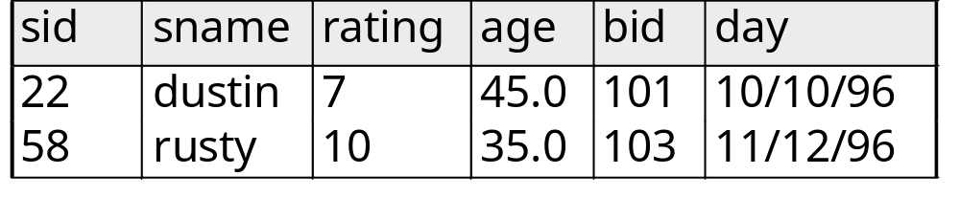
Natural Join Example
R1
S1
S1 R1 =

Slide 21

Other Types of Joins
Condition Join (or “theta-join”):
Result schema same as that of cross-product.
May have fewer tuples than cross-product.
Equi-Join: Special case: condition c contains only conjunction of equalities. Drop one of the two fields that have equality condition.
  Result schema: All fields of R followed by the fields in S do not appear in join condition (if the condition is only equality)

Slide 22
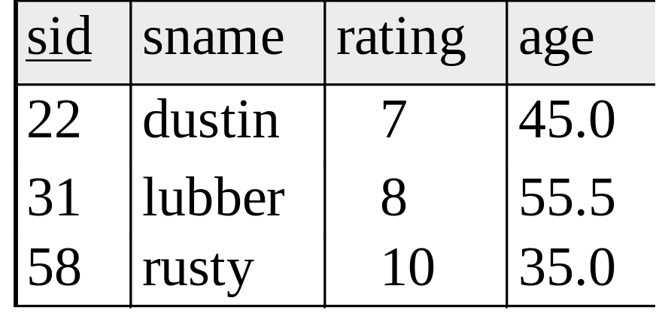
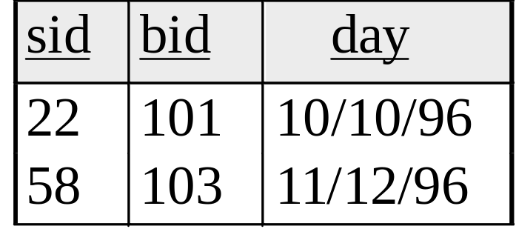
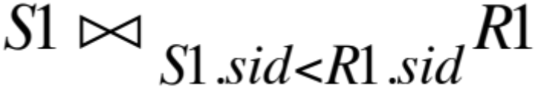
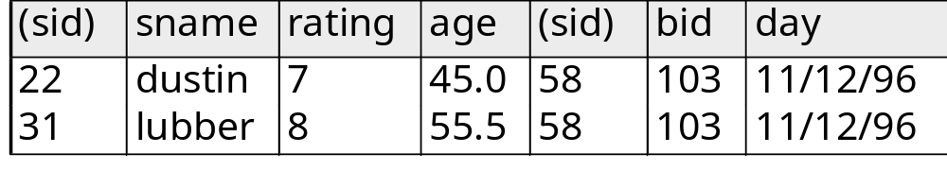
“Theta” Join Example
R1
S1
=

Slide 23
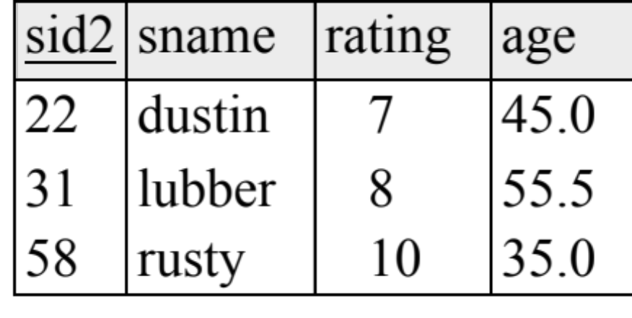
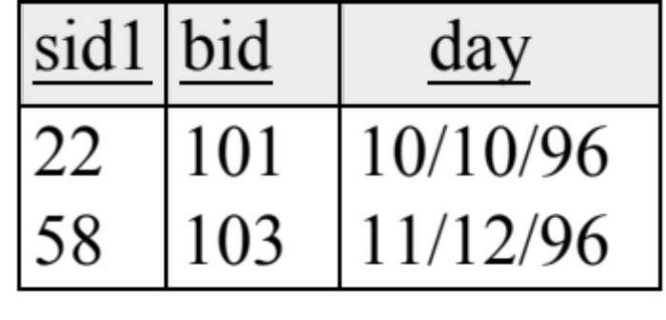
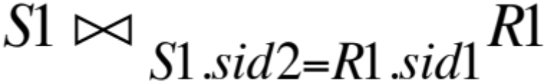
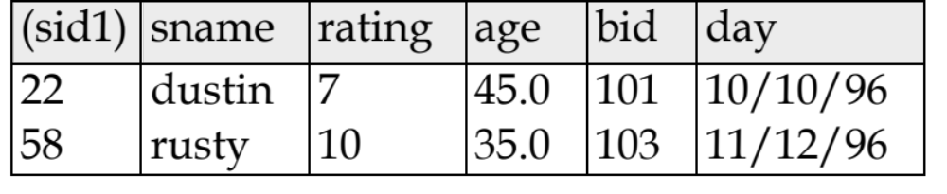
“Theta” Join Example
R1
S1
=

Slide 24
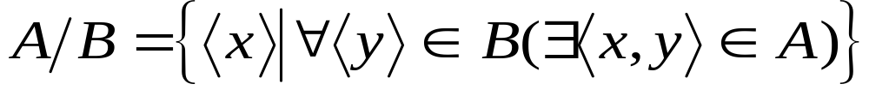
Compound Operator: Division
Useful for expressing “for all” queries like: Find sids of sailors who have reserved all boats.
For A/B attributes of B are subset of attrs of A.
  May need to “project” to make this happen.
E.g., let A have 2 fields, x and y; B have only field y:
  A/B contains an x tuple such that for every y tuple in B, there is an xy tuple in A.

Slide 25
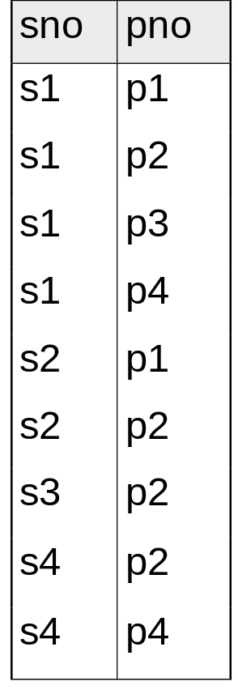
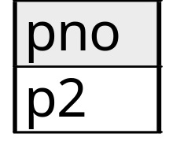
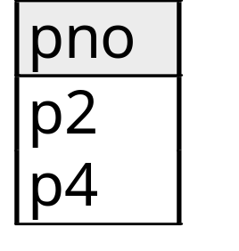
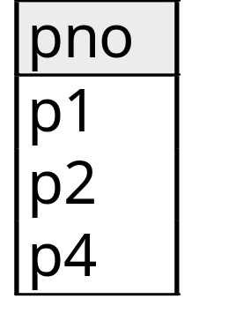
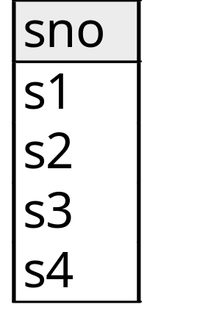
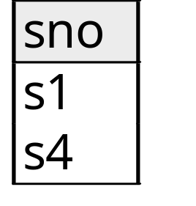
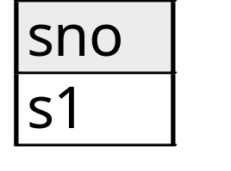
Examples of Division A/B
B1
B2
B3
A
A/B1
A/B2
A/B3
Note: For relation instances A and B, A/B is the largest
relation instance Q such that B x Q ⊆ A

Slide 26
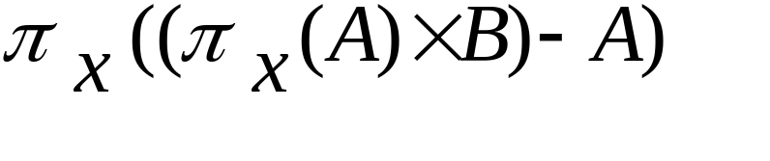
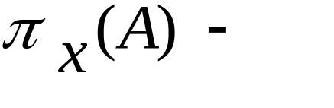
Expressing A/B Using Basic Operators
Division is not essential op; just a useful shorthand.
  (Also true of joins, but joins are so common that systems implement joins specially.)
Idea: For A/B, compute all x values that are not `disqualified’ by some y value in B.
  x value is disqualified if by attaching y value from B, we obtain an xy tuple that is not in A.
  Disqualified x values:
A/B:
Disqualified x values

Slide 27
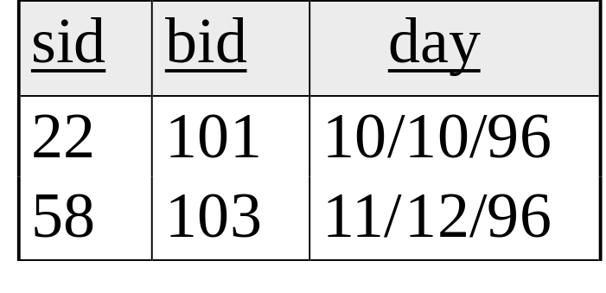
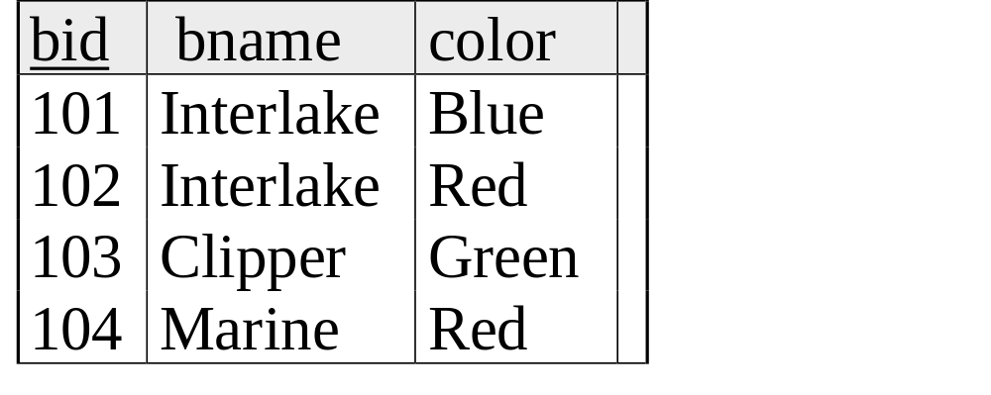
Examples
Reserves
Sailors
Boats

Slide 28
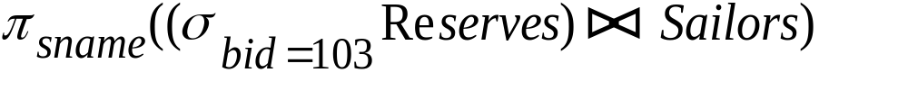
Find names of sailors who’ve reserved boat #103
Solution 1:
Solution 2:

Slide 29
Find names of sailors who’ve reserved a red boat
Information about boat color only available in Boats; so need an extra join:
A more efficient (???) solution:
A query optimizer can find this given the first solution!

Slide 30
Find names of sailors who’ve reserved a red or a green boat
Can identify all red or green boats, then find sailors who’ve reserved one of these boats:

Slide 31
Find sailors who’ve reserved a red and a green boat
Previous approach won’t work! Must identify sailors who’ve reserved red boats, sailors who’ve reserved green boats, then find the intersection (note that sid is a key for Sailors):

Slide 32
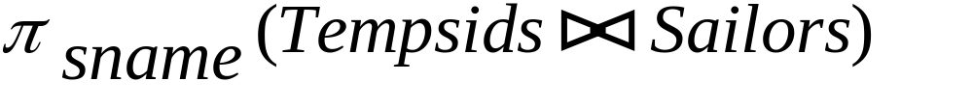
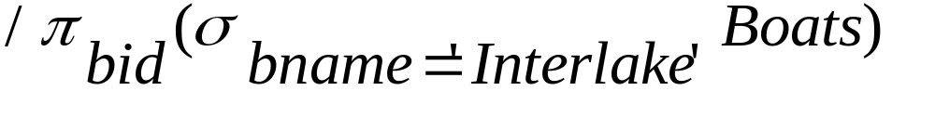
Find the names of sailors who’ve reserved all boats
Uses division; schemas of the input relations to / must be carefully chosen:
To find sailors who’ve reserved all ‘Interlake’ boats:
.....

Slide 33
More Queries
Find the color of boats reserved by “rusty”
Find the names of sailors who reserved at least two different boats

