Slide 1
109 Data Structure the 2nd Homework

Slide 2
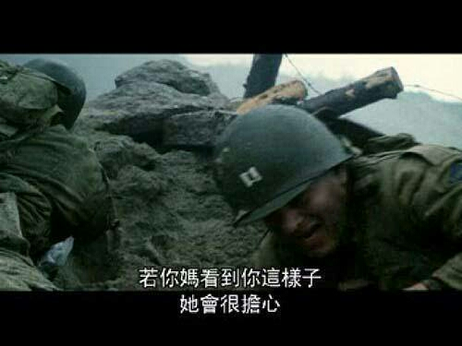
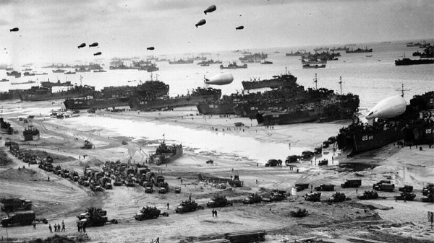
Operation Overlord (60%)
Operation Overlord was the codename for the Battle of Normandy.
On Tuesday, 6 June 1944, the Allies invaded Normandy, which was under German control at that time.
It was the largest seaborne invasion in history.
出自：搶救雷恩大兵 (1998)

Slide 3
Operation Overlord (60%)
The Allies successfully landed after paying a huge price.
From then on, the Allies needed to establish a secure lodgement from which to expend the beachhead to allow the buildup of a well-supplied force.
Assume that you were the commander during the war. Helping the Allies make a detailed plan was your job.

Slide 4
Operation Overlord (60%)
1) Set the Allies’ bases optimally (20%)
You think you may treat the Omaha Beach, which was the code name for one of the five sectors of the invasion, as a root.
The Allies may expand bases with a tree-like structure.
To simplify this problem, you may treat the tree-like structure as a binary tree.
Each base may guard its parent, itself, and its two child nodes.

Slide 5
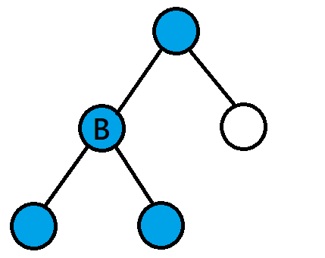
Operation Overlord (60%)
For example, you build a base in the node B, the blue nodes will be secured.
You need to build the least base while making sure every lodgements are secured.

Slide 6
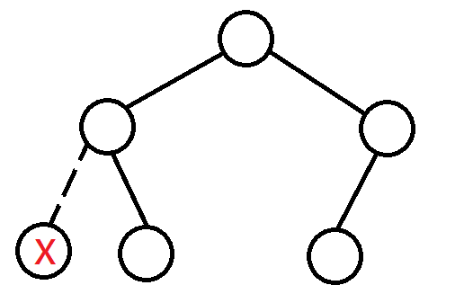
Operation Overlord (60%)
input: [0,0,0,null,0,0] (The X node doesn’t exist.)
output: 2
You may assume you can construct a valid tree with the input.

Slide 7
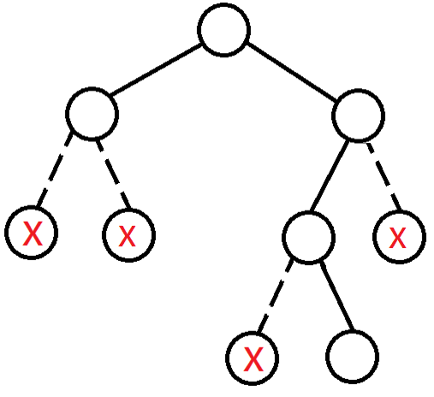
Operation Overlord (60%)
input: [0,0,0,null,null,0,null,null,0] (The X node doesn’t exist.)
output: 2

Slide 8
Operation Overlord (60%)
/* struct TreeNode {
int data;
struct TreeNode *left;
struct TreeNode *right;
};
*/
You SHOULDN’T modify the fields in TreeNode.
However, you CAN modify the values if you want.
You SHOULDN’T directly read the input as a string or an array.
Please build a tree stored the values and operate with that tree.
Traversing the tree and reconstructing it with an array is NOT allowed, either.

Slide 9
Operation Overlord (60%)
2) Set the Allies’ bases optimally - II (20%)
You first make a rough plan. However, the battlefield cannot be treated as such a simple scene.
You next consider the enemies. Some places may not be conquered so easily.
However, you may build up your base next to it and nibble them slowly.
What you need to do is to calculate how to pare down our expenses to a bare minimum.

Slide 10
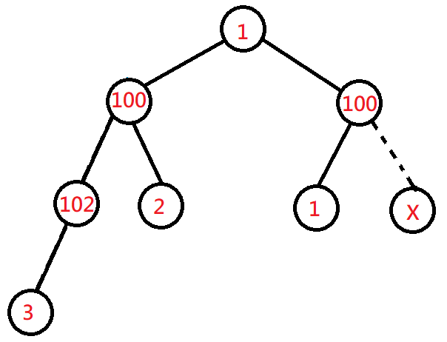
Operation Overlord (60%)
The data field stored in a TreeNode indicates the cost for building a base there.
input: [1,100,100,102,2,1,null,3] (The X node doesn’t exist.)
output: 7 (1+2+1+3)

Slide 11
Operation Overlord (60%)
For both of the problems:
The number of nodes in the tree is N.
0 <= N <= 15000
Time limit: 1 second per data.
1st problem
TreeNode.data = 0
2nd problem
0 <= TreeNode.data <= 1000

Slide 12
Operation Overlord (60%)
3) Spot the liars (20%)
Your army caught some prisoners of war. Most of them are still loyal to Germany. However, some of them WERE loyal to Germany.
Now, they point each other and say he/she is a liar. You need to figure out who is trying to tell the truth.

Slide 13
Operation Overlord (60%)
For each input:
Line 1: An integer N for the number of prisoners. (1 < N < 21)
Line 2: An integer M for the number of liars. (0 < M < N)
Next N lines: A string allegation indicates what the prisoner said.
An allegation is like: NO>NO>NO...=[T/L]
The number of “>” is less than 600.
You can translate the allegation by:
NO told that NO told me that NO...NO is telling the truth/lying.
The liars always lie, the others always tell the truth.
output: Who is/are the liar(s)?

Slide 14
Operation Overlord (60%)
For example:
3 (N)
1 (M)
0>1=T
1>2=L
2>0=L
output: 2
You may assume there’s only ONE answer in each case.

Slide 15
Operation Overlord (60%)
For example:
3
2
0>1>2>1>0>2=L
1>2>0=L
2>0>1>2=L
output: 0 1

Slide 16
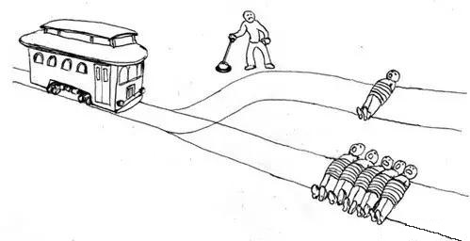
Trolley Problem (50%)
Trolley problem is a classical thought experiment in psychology. The basic version goes thus:
There are two tracks. There are 5 people tied up on one of both while there is 1 person tied up on the other.
A trolley is running straight for the 5-person one, You have two options:
Do nothing and allow the trolley to kill the five people on the main track.
Pull the lever, diverting the trolley onto the side track where it will kill one person.
Which is the more ethical option? Or, more simply: What is the right thing to do?

Slide 17
Trolley Problem (50%)
You got caught by The Jigsaw Killer. He wants to play a game. You have to make a choice.
Luckily, it is not such a hard problem to judge. There is always one track which is able to pass. Thus nobody will die.
You only need to choose the right one as soon as possible.

Slide 18
Trolley Problem (50%)
1) Build a doubly and circular linked list, which indicates the platforms of a trolley station. (10%)
There are 20 platforms.
You switch the platform you control with your joystick.
The last platform is connected to the first platform, creating a loop.
The target station of the platforms are initialized as “ “.
Commands:
>: Switch to the platform on the right.
<: Switch to the platform on the left.
+: Change the target station of the platform with “plus 1”.
-: Change the target station of the platform with “minus 1”.
The target station of the platforms can be: {(space), A, B, …, Z}.
The station after Z is space. The station after space is A.
Please treat “ “ as a valid input.
.: Trolley departs from the platform to the target station under control.

Slide 19
Trolley Problem (50%)
For example:
input:
output:
+
.
+
+
.
.
+
+
+
+
+
+
.
+
+
+
+
+
+
.
A
C
C
I
O
D
C
A
G
F
E
B
H
M
K
J
L
N
I
O

Slide 20
Trolley Problem (50%)
2) Try to optimize the process. (40%)
Time limit: 3 seconds per input.
After all the strings’ inputted are handled, I’ll sum up all your output strings’ length and compare with my algorithm.
You will get different grades if the sum of your lengths are:
0% : 400% longer than my algorithm.
10% : 100% longer than my algorithm.
20% : 10% longer than my algorithm.
30% : [-5% .. 10%] length of my algorithm.
40% : over 5% shorter than my algorithm.

Slide 21
Trolley Problem (50%)
EXPELLIARMUS
output: +++++.>---.--------.<.>----..---.>+.<+++++++++.-----.++++++++.--.
(The animation only demonstrates the part of “EXPELLIA”)
A
B
C
D
E
Z
Y
X
W
V
U
T
S
R
Q
P
O
N
M
L
K
J
I
A

Slide 22
Reminders
For all of the question, please read test.txt as input.
對於所有問題，請都讀test.txt作為input
If you can, please let me know how to change your I/O file name so that I can modify the path from test.txt to test1.txt, test2.txt, etc.
假如可以的話，讓我清楚知道從哪裡更改你I/O檔案的名稱，方便我可以從讀test.txt改成讀test1.txt, test2.txt，會改得比較快。
如果我看不懂，那我不會改你的code，一律讀test.txt。

Slide 23
Reminders
Only accept C
Deadline : 2020/11/16 23:59, please be on time.
File name : [student ID]_[question No.(1or2)]-[sub question No.(1,2,3)].[file name extension]
e.g. 7109056193_1-1.c
If there are more than 1 file for 1 question, please give a readme.txt for me and let me know the meaning of each file.
No need to give me the output, I’ll execute your program.
Zip all your files and hand in on the i-learning, the file name is [student ID]_homework2.
Plagiarism is prohibited.
Dev-C++ 5.11 is used for checking this homework.

