Slide 1

110 Data Structure Homework-2

Slide 2
Homework rules
Only accept C
Filename : [student ID]_[hw2]-[question number]
E.g. 4110012345_hw2-1.c
Zip all your files and hand in on the iLearning
Deadline 2021/11/16 23:59
Please add comments in your code
If any question, you can contact TA.
nchuds110＠gmail.com
Do not copy! 0 points for plagiarism!

Slide 3
Question 1. (35%)
Please use the following structure to implement a singly linked list.
typedef struct listNode *listPointer;
typedef struct listNode {
int data;
listPointer link;
}

Slide 4
The singly linked list must have the following functions：
add i : add the new node whose data field is i to the end of the list. (5%)
del i : delete the i-th node. (5%)
ins i j : insert the new node whose data field is j after the i-th node. (5%)
mul i j : the data field of the i-th to last node multiplies by j. (5%)
rev k : treat K data as a group and reverse them. (15%)
show : print out the data in the singly linked list.

Slide 5
Example
Initial list : empty
add 5
add 7
add 9
show
5 7 9

Slide 6
Example
Initial list : 5 7 9 7 9
del 2
show
5 9 7 9
Initial list : 5 7 9 7 9
del 0 / del 6 …
show
5 7 9 7 9
(No change! )

Slide 7
Example
Initial list: 1 2 3 4 5 7 8 9
(index: 1 2 3 4 5 6 7 8 )
ins 5 6
show
1 2 3 4 5 6 7 8 9

Slide 8
Example
Initial list: 1 2 3 4 5 6 7 8 9
mul 3 2
show
1 2 3 4 5 6 14 8 9

Slide 9
Example
Initial list: 1 2 3 4 5 6 7 8
rev 3
show
3 2 1 6 5 4 8 7
(最後一組數量雖不足3，但視為一組反轉)

Slide 10
Input & output
Read the file (input_1.txt)
The first line presents the initial list.
The second line contains an integer n indicates how many commands there are.
The next n rows are the commands.
Implement the functions in next slice, and write the result of “show” to the file (output_1.txt).

Slide 11
Example
(Input)
1 2 3 4 5 6
5
add 9
add 8
rev 3
del 1
show
(Output)
2 1 6 5 4 8 9

Slide 12
Question 2. (65%)
Overcooked is a well-known multiplayer cooperative game. Now you and your friends decided to play this game.
Today, our goal is to make as much money as possible.
In this scene, there is no need to wash the dishes.
There is a stove and a cutting table and only one meat/vegetables/fruits available on the stove/cutting table at the same time. (Please note this rule)
After all the ingredients are ready, the plate can be arranged. Then deliver meals to the guests and collect money from the guests.

Slide 13
Flow chart
煮
擺盤
Player2
切
工作
Player1
食譜
訂單
訂單完成/超時
賺錢
賠錢
S
F
C

Slide 14
Recipe
Read the file (recipes.txt) to let your program know how to cook.
For each dish, all the ingredients must be prepared and then arranging/decorating the food on the plate.
It takes time to cook meat, cut vegetables and fruits, and food presentation(擺盤).
Cooking time：
(1) 5 minutes for cooking something on the stove (fixed)
(2) 3 minutes for cutting something (fixed)
(3) The different recipe has the different time for food presentation : (1+other)

Slide 15
Recipe
[recipe_name] [s] [c] [others]
s : The ingredients that need to be cooked first on the stove.
c : The ingredients that need to be processed first on the cutting board.
others : The ingredients that do not require pre-processing.
The process of preparing each ingredient does not affect each other, only one ingredient can be processed at a time.
Food presentation must be done at one time and cannot be interrupted.

Slide 16
Recipe
[recipe_name] [s] [c] [others]
Example:
(1) hamburger beef lettuce,tomato bread
(If there are more than one kind of food ingredient , separate them with ",".)
(2) fruit_platter x peach,orange,grape x
(Use "x" to indicate that there is no such kind of ingredient.)
*紅色字才是擺盤時間
訂單完成所需時間：5*1 + 3*2 + (1+1)
訂單完成所需時間：5*0 + 3*3 + (1+0)

Slide 17
Input
Read the file (orders.txt)
In the first line, an integer n indicates how many orders there are.
The next n rows are the order data.
[order_ID] [recipe_name] [arrival] [deadline] [money] [punishment]
The “order_ID” is used to distinguish the meals of different guests.
(The range of order_ID is 0000~9999)

Slide 18
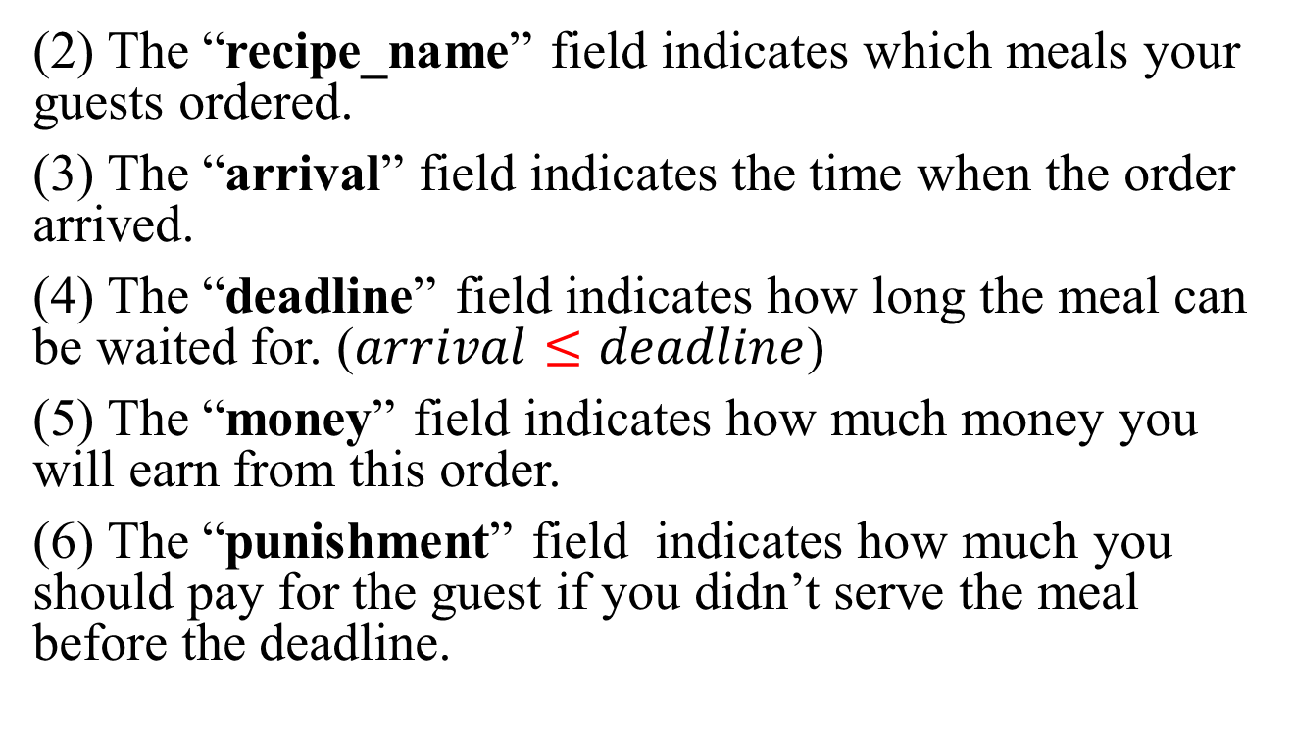
Input
(2) The “recipe_name” field indicates which meals your guests ordered.
(3) The “arrival” field indicates the time when the order arrived.
(4) The “deadline” field indicates how long the meal can be waited for. ($arrival≤deadline$)
(5) The “money” field indicates how much money you will earn from this order.
(6) The “punishment” field indicates how much you should pay for the guest if you didn’t serve the meal before the deadline.

Slide 19
Input
[order_ID] [recipe_name] [arrival] [deadline] [money] [punishment]
Example:
1001 hamburger 30 100 50 -100
1002 hamburger 0 20 40 -80
1003 fruit_platter 5 85 150 -300

Slide 20
Output
Output the work schedule of two players to players.txt in the order of time.
The first line uses an integer to indicate how many commands there are.
One line contains only one schedule.
Then use the scoring program to calculate the money earned by each classmates.
The scoring program will detect whether your sequence is legal. (whether the order completion time exceeds the deadline, orders added by yourself, etc.)

Slide 21
Output
[player_ID] [t] [order_ID] [command] [object]
[player_ID] indicates the player who executes this command.
[t] indicates the time when the player start to do this command.
order_ID indicates the order you are preparing for.
Three kind of commands :
(1) s + object: cooking “object” on the stove.
(2) c + object: cutting “object” on cutting board.
(3) f : food presentation.

Slide 22
Output
In players.txt
12
1 0 1002 s beef
2 0 1002 c lettuce
2 3 1002 c tomato
1 6 1003 c peach
2 6 1002 f
2 9 1003 c grape
1 12 1003 c orange
1 15 1003 f
1 30 1001 s beef
2 30 1001 c lettuce
2 33 1001 c tomato
1 36 1001 f

Slide 23
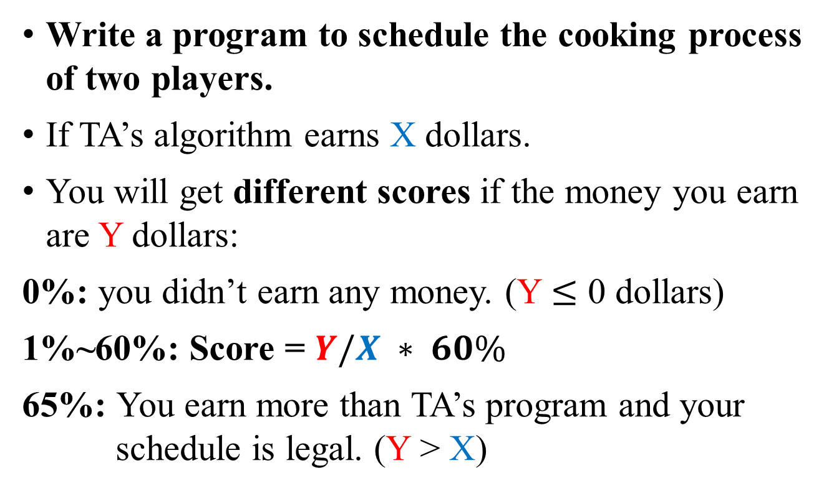
Scoring method
Write a program to schedule the cooking process of two players.
If TA’s algorithm earns X dollars.
You will get different scores if the money you earn are Y dollars:
0%: you didn’t earn any money. (Y $≤$ 0 dollars)
1%~60%: Score = $Y/X ∗ 60\%$
65%: You earn more than TA’s program and your schedule is legal. (Y > X)

