Slide 1
HW3 CNN exercise
TA

Slide 2
Outline
Task Introduction
Data Format
Requirements, Rules, Deadline and Policy

Slide 3
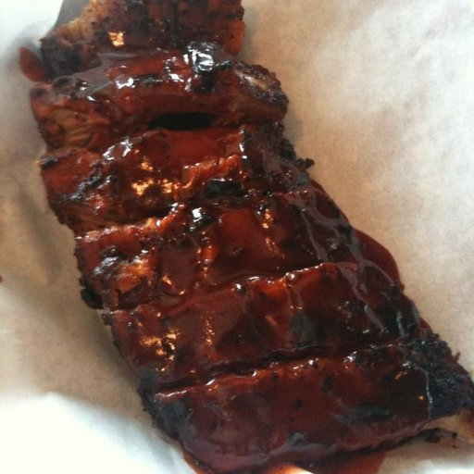
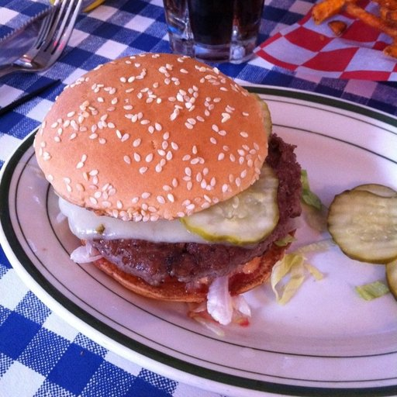
Task - Food Classification

Slide 4
Task - Food Classification
There are 11 type of food in our dataset collected on the internet.
Baby Back ribs, Bibimbap, Cheesecake, Chicken wings, Sandwiches, Cup cakes, Donuts, Dumplings, Edamame, Fried rice, Hamburger
Training set: 6600 pics
Validation set: 2200 pics
Testing set: 2200 pics

Slide 5
Data Format
Download and unzip the file from tronclass.
The file names in training and validation follow the format of [type]_[ID].jpg For example, 3_100.jpg means that the picture belongs to type 3.
The testing files have the format of [ID].jpg. List the prediction in order of number IDs into a csv file.

Slide 6
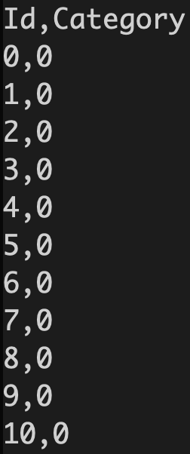
Submission format
Predict the data in the testing set
The output should be a csv file.
The headers are [ID, Category]
Split ID and Category with ‘,’

Slide 7
Requirements
Implement the model with CNN.
No additional training data.
Pre-trained model is forbidden (code CNN by yourself).
Don’t search for the test labels on the internet.
Notes:
能否使用pretrained model (e.g. VGG, ResNet)?

Slide 8
Policy
The result file should contain：
report.pdf
Python files
result.csv

Slide 9
Score - report.pdf
Explain your CNN model with structure, parameters, and accuracy.
Implement the CNN model again using similar parameters but with half CNN depth, and explain again.
Implement the DNN model with similar parameters and explain.
Tell us what you learnt in question 1-3
Try data normalization and data augmentation, tell us what’s the different with and without them.

