Slide 1
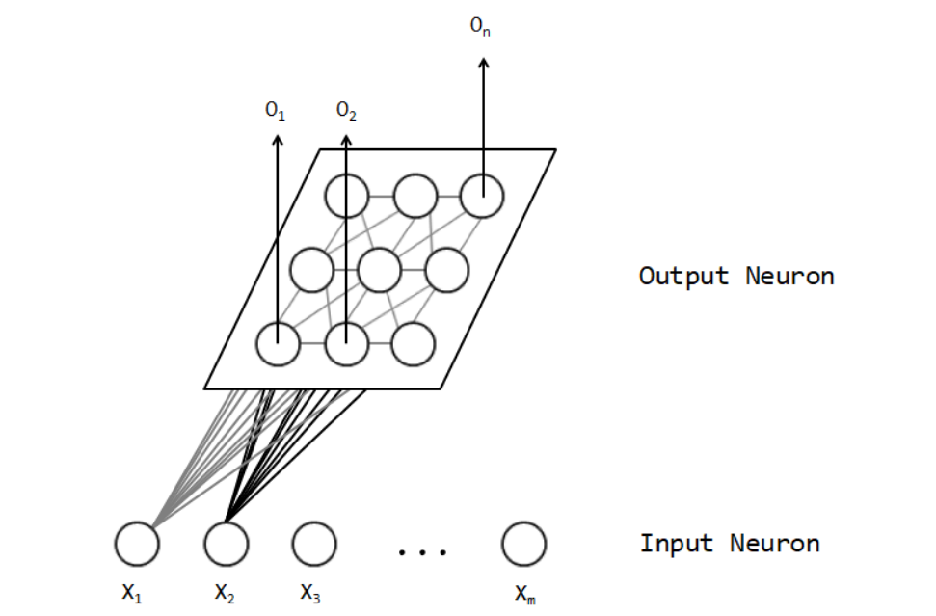
X1
X2
. . .
Xn
輸出層
輸入層

Slide 2
j
1 | 2 | 3
1 | 3 | 2
2 | 1 | 3
4 | 3 | 5
3 | 2 | 6
5 | 6 | 4
1
2
3
i
1
2
3

Slide 3
型態 | 組成 | 配置表示方式
Hot Clump | 𝑃𝑟(𝑋 ≥ 𝑥) < 0.05 | BB significant
Hot Only | 𝑃𝑟(𝑋 ≥ 𝑥) < 0.05 | -
Clump Only (H) | - | BB significant
Cold Clump | 𝑃𝑟(𝑋 ≤ 𝑥) < 0.05 | WW significant
Cold Only | 𝑃𝑟(𝑋 ≤ 𝑥) < 0.05 | -
Clump Only (C) | - | WW significant
Dispersed | - | BW significant
No clusters | - | -

