Slide 1
eki_ppyp/eki_iparkingnet
Collection
document
Data
Chat_room
member
Order serial
Member uniqueID
yyyyMMddHHmmss
yyyyMMddHHmmss
info
name
msg
from:uniqueID
msg
from:uniqueID
phone

Slide 2
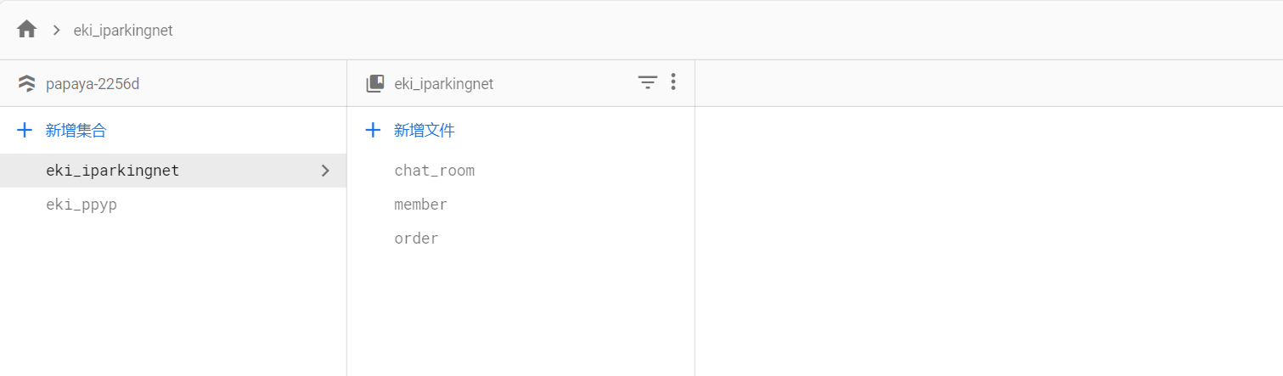
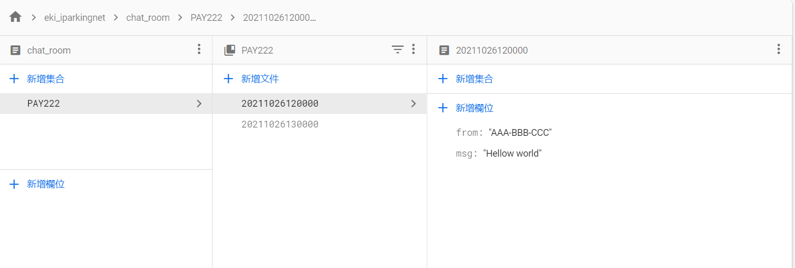

Slide 3
