Slide 1
Modeling Popularity with HIP: Understanding, Evaluating, and Delving into the Self-exciting process
COMP8880 – Network Science
He Weng (u7705421)
Based on the paper: "Expecting to be HIP: Hawkes Intensity Processes for Social Media Popularity"

Slide 2
Agenda
01 | Scenario & Motivation
02 | Problem Formulation
03 | Existing Method
04 | In-depth Analysis

Slide 3
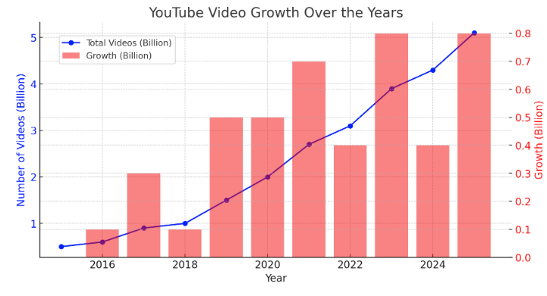
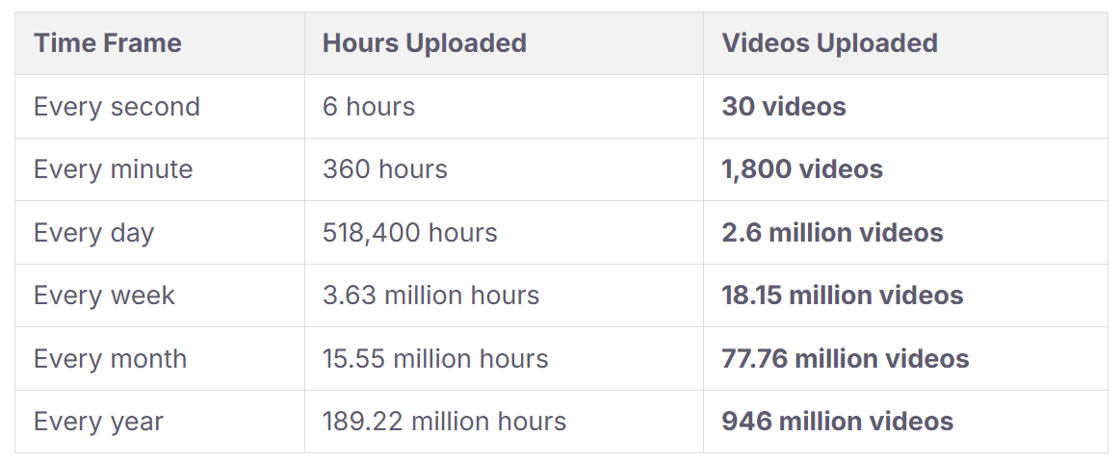

Scenario
A vast amount of online content emerges daily on streaming platforms.
For example, on YouTube:
YouTube currently has 2.49 billion users. Up from 2 billion users in 2019.
47% of all global internet users access YouTube monthly.
Just over a third of the world’s population access YouTube every month.
YouTube has 5.1 billion videos, making it the biggest video-sharing site.
Statistics Source:
https://backlinko.com/youtube-users
https://datareportal.com/reports/digital-2023-october-global-statshot
https://blog.youtube/news-and-events/youtube-music-premium-80-million-lyor-cohen/
https://seo.ai/blog/how-many-videos-are-on-youtube

Slide 4
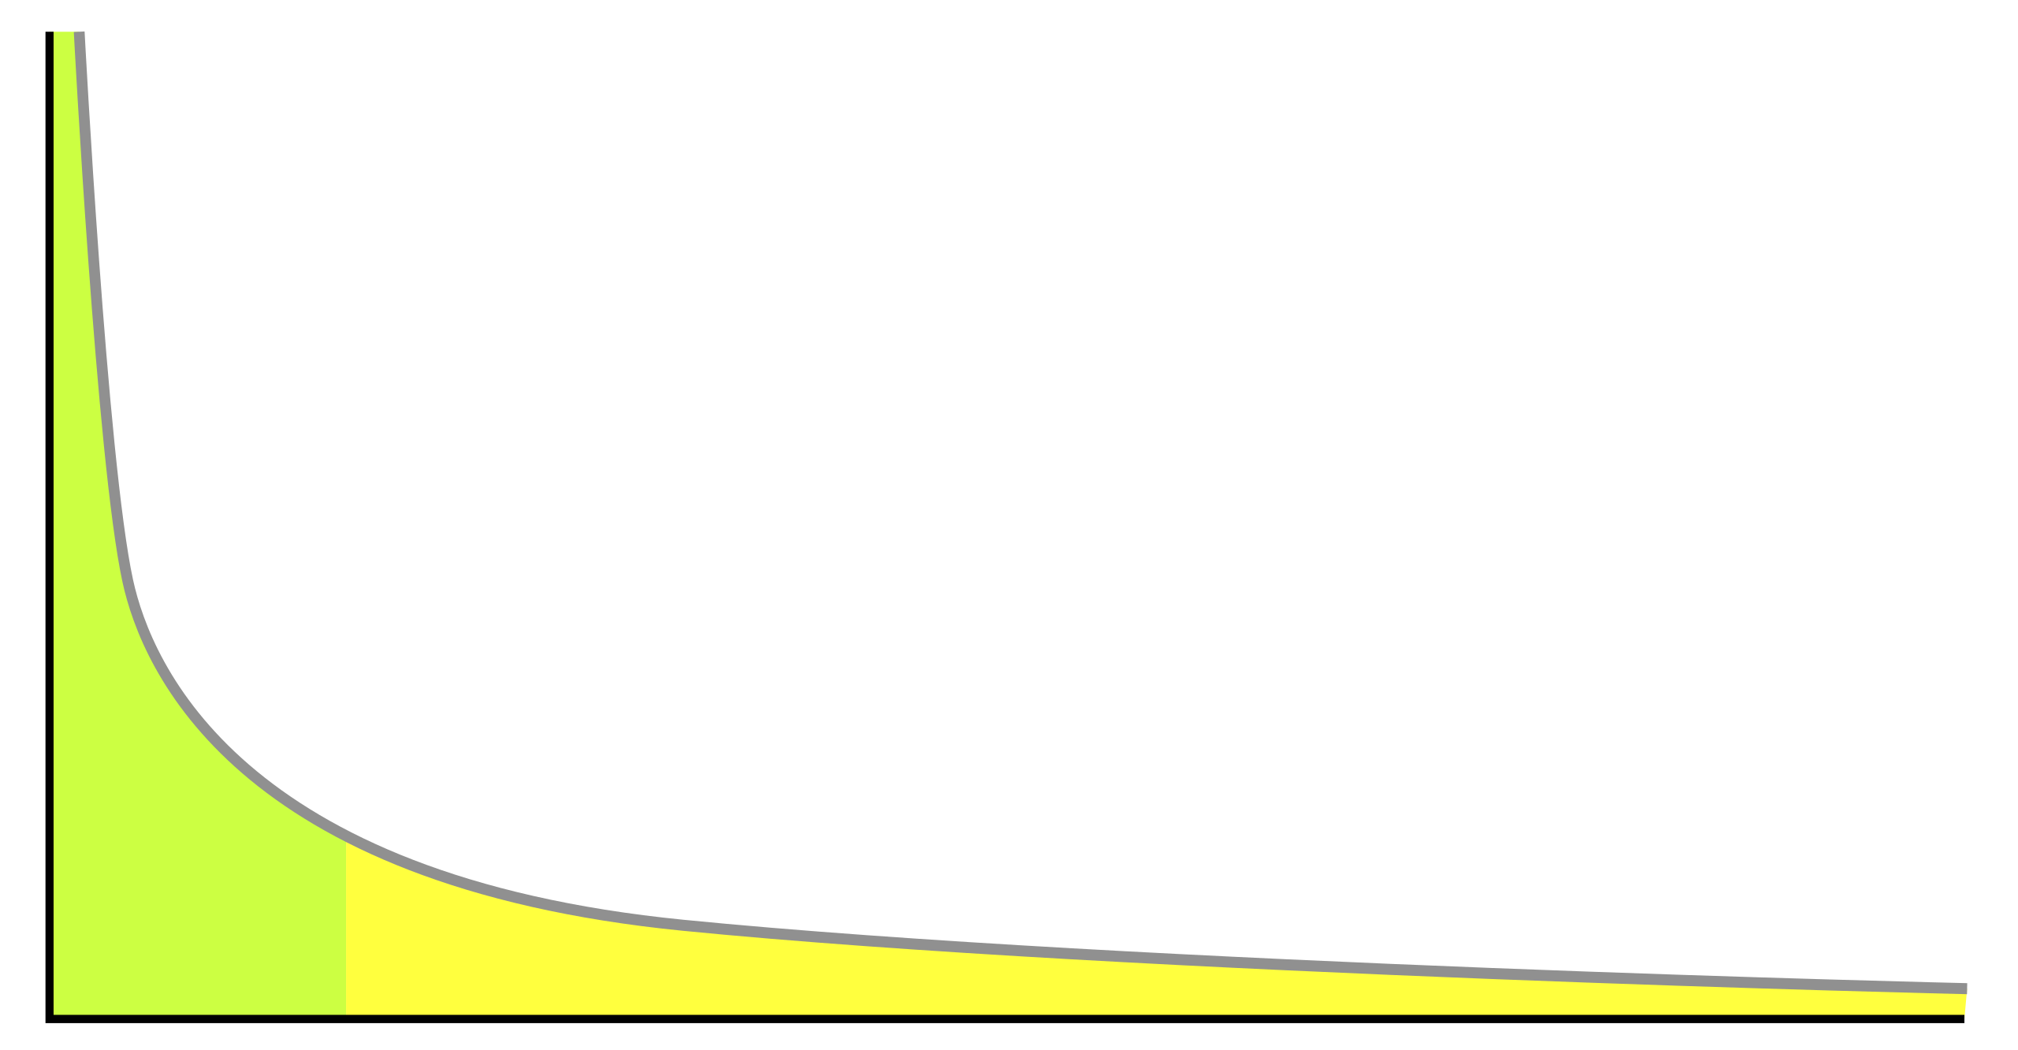
Long-tail
Motivation
Popularity
Time
The popularity of content refers to the degree to which digital items—such as videos, tweets, or blog posts—are viewed, clicked, or engaged with by users on platforms.
The temporal pattern for the content popularity often follows the long-tail distribution, where the popularity decays over time in the absence of external promotion.
In this work, the authors focus on two primary factors that drive the popularity trajectory of online content:
Extrinsic promotion：the amount of promotion from the outside world that the item receives, such as share and tweets.
Intrinsic factors：the content’s sensitivity to promotion and inherent virality.
The study aims to better understand and predict the temporal evolution of popularity.

Slide 5
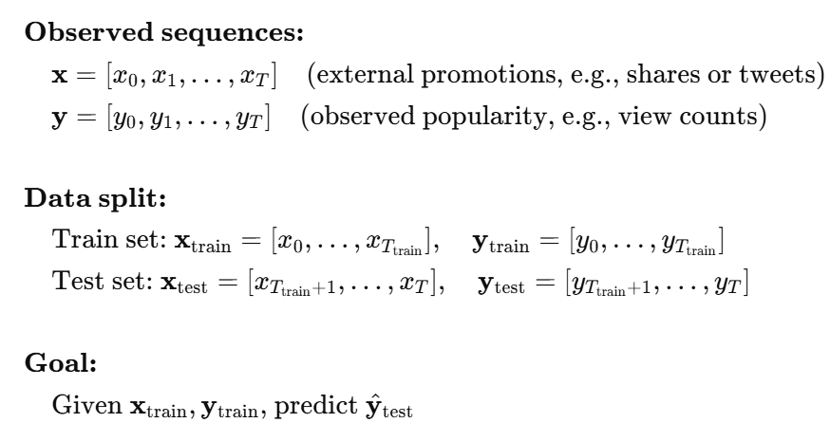
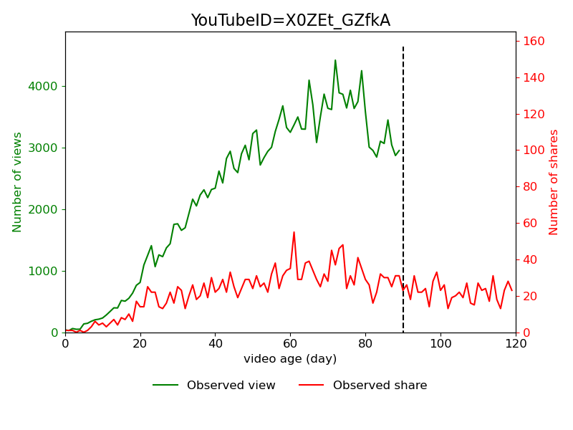

Problem Formulation
Train set
Test set
Regression Problem

Slide 6
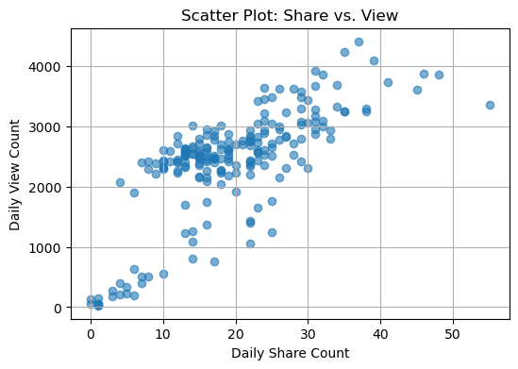
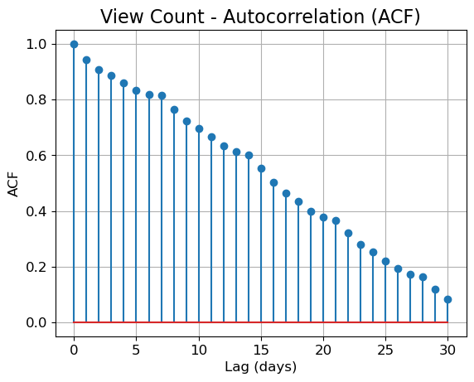
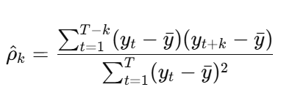
Assumption
User promotion positively drives item popularity：
External promotion (e.g., sharing) contribute positively to the item’s view count. These exogenous actions serve as external stimuli that trigger initial exposure and dissemination.
Past views exhibit a time-decaying, self-exciting influence：
Previous view events have a lasting impact on future popularity, reflecting the nature of self-exciting processes—where each past event increases the likelihood of future events, even at distant time intervals.
ACF:

Slide 7

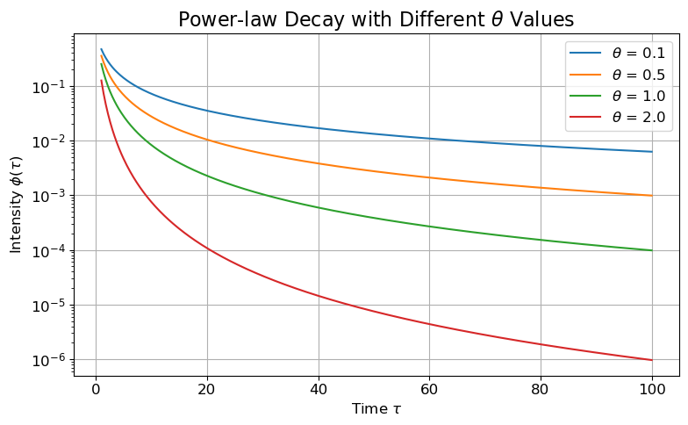

Methodology
Marked Hawkes Process （self-exciting point process）：
aggregation of past events’ impacts on triggering kernel
Event rate
The volume of external promotion
Scalar for video quality
power-law exponent for time decay impacts
(better than exponential kernel)
a nonlinear transformation on event magnitude under user influence
S. Mishra, M.-A. Rizoiu, and L. Xie. Feature Driven and Point Process Approaches for Popularity Prediction. In CIKM ’16, page 10, 2016.

Slide 8



Methodology
From Hawkes Process to Hawkes Intensity Process:
Consider the general distribution rather than a single event
Given：
Follows:
power-law！
Goal:

Slide 9
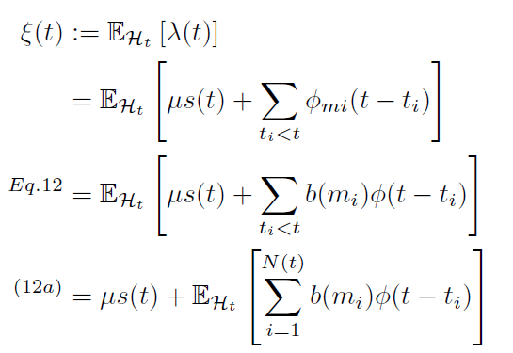
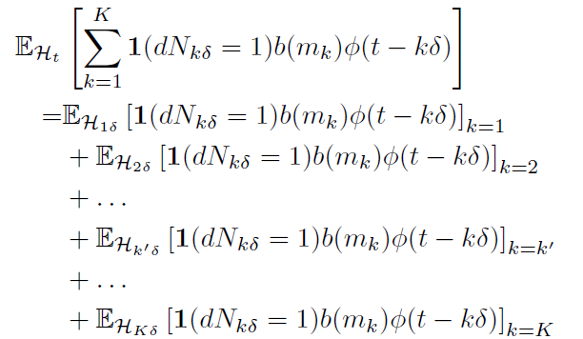
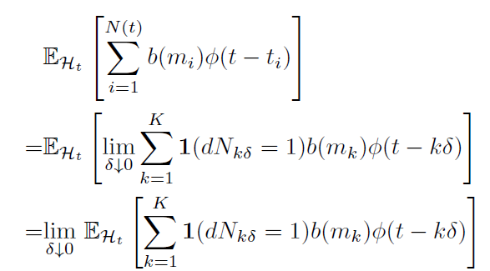
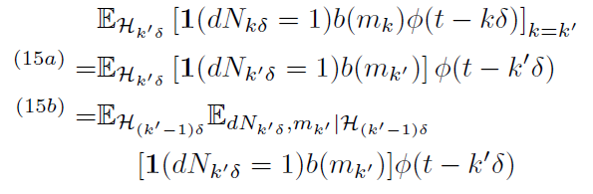
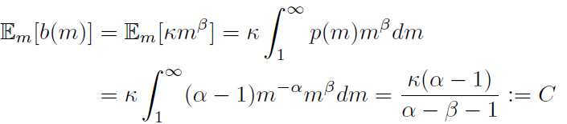
Methodology
Hawkes Intensity Process (integral equation)：

Slide 10
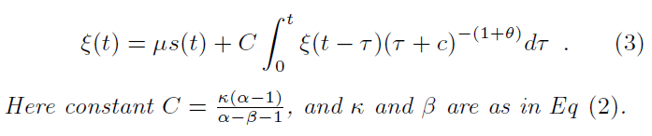
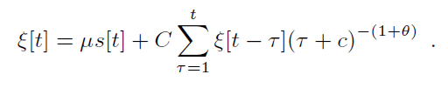

Methodology
Hawkes Intensity Process (integral equation)：
Hawkes Intensity Process (discretizing)：

Slide 11

Optimization
Goal:
Optimized by L-BFGS with analytical gradients and random restarts
Details of computing analytical gradients are shown in the Appendix of paper
"Expecting to be HIP: Hawkes Intensity Processes for Social Media Popularity"

Slide 12
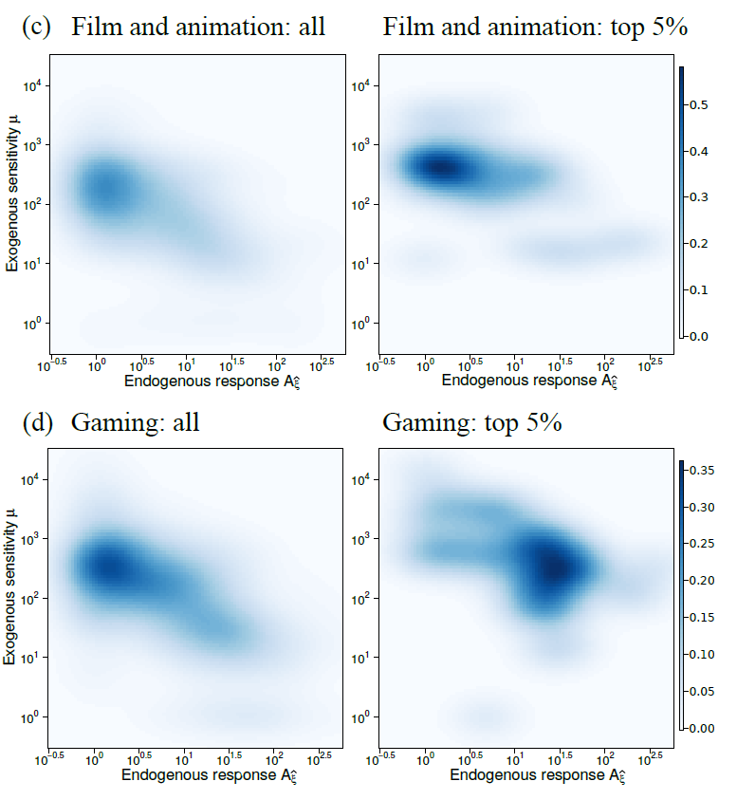


Advantages
Explicit modeling of exogenous and endogenous effects （Explainability）
Exogenous sensitivity
Endogenous response

Slide 13
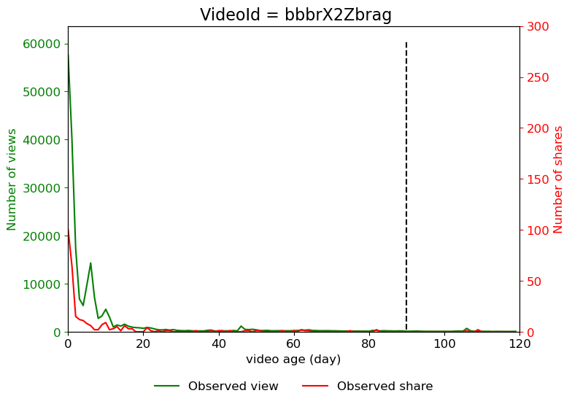
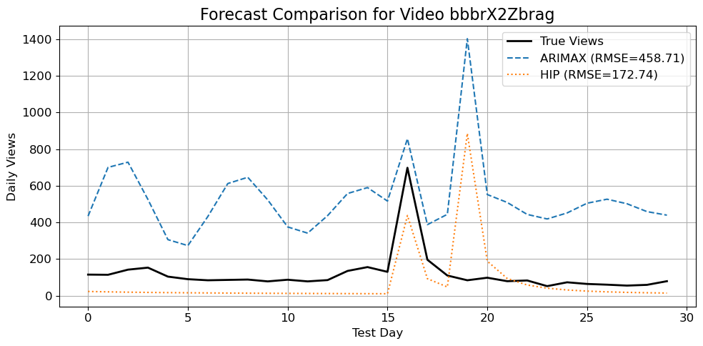
Advantages
Instance-wise modeling provide personalized and cold-start friendly method with outstanding metrics (RMSE)
Light-weight model, for each video there are only 6 parameters

Slide 14

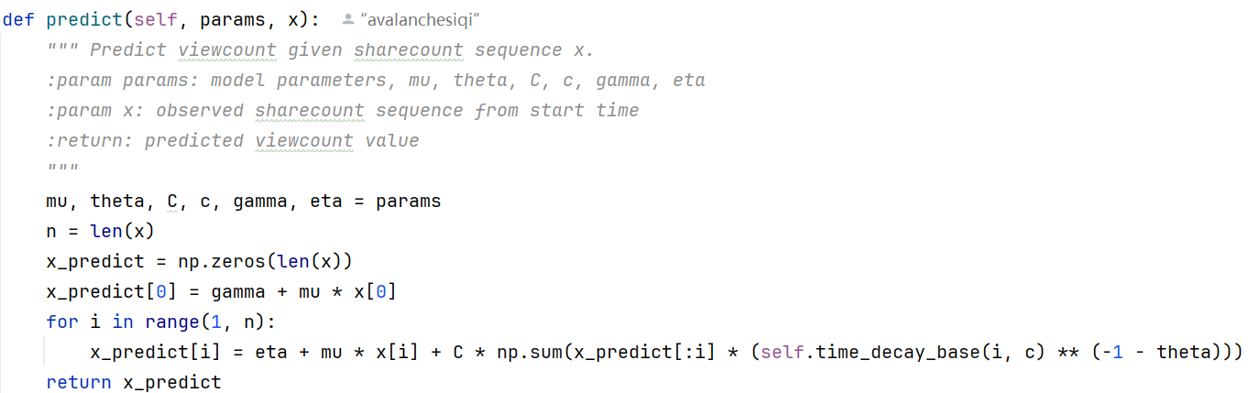
Advantages
Time complexity:

Slide 15
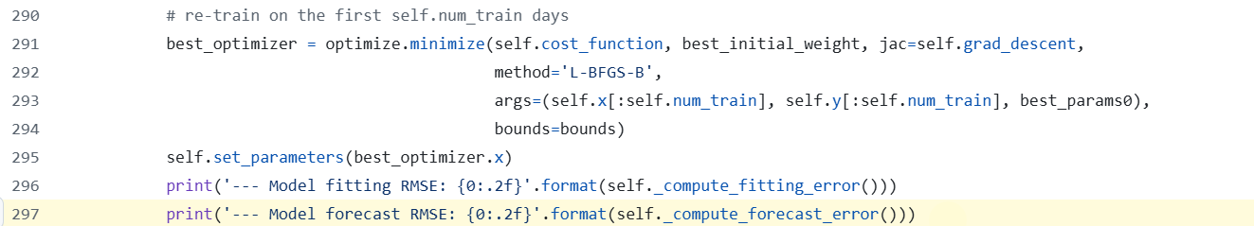
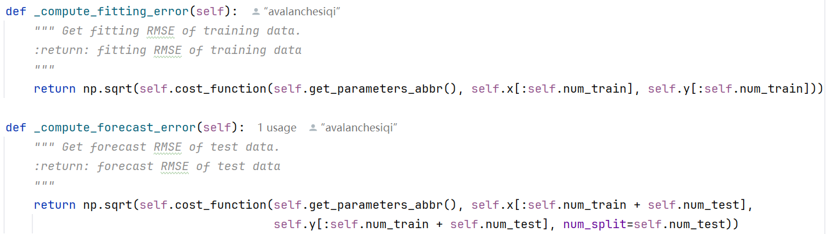
Limitations
Not exact calculation of RMSE method used in the code
Github Link：https://github.com/andrei-rizoiu/hip-popularity/blob/master/pyhip.py#L297

Slide 16
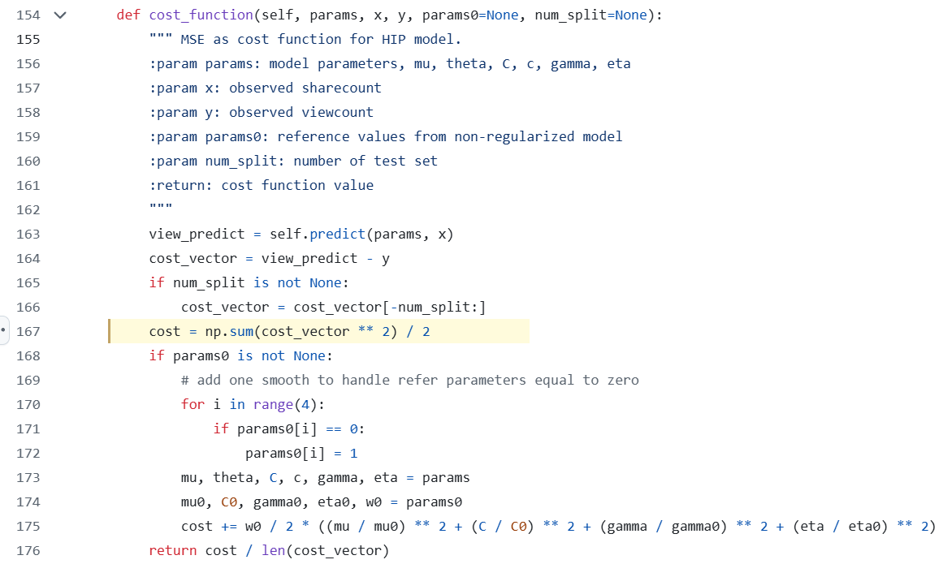
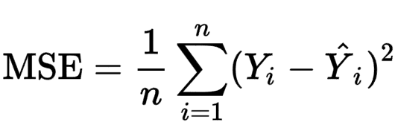
Limitations
Mismatch
Github Link：https://github.com/andrei-rizoiu/hip-popularity/blob/master/pyhip.py#L167C4-L167C44

Slide 17
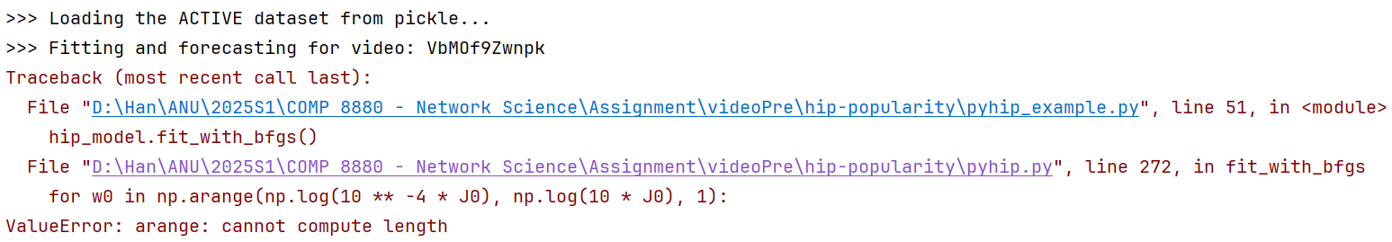
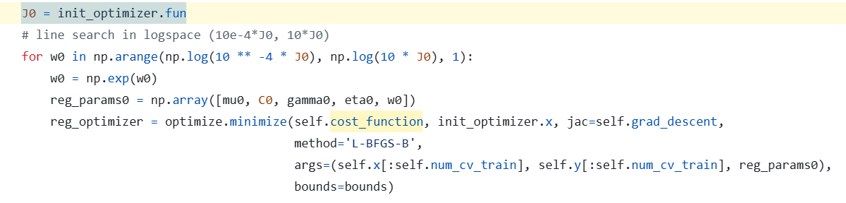
Limitations
Optimization can sometimes be unstable （Numerical underflow）
Github Link：https://github.com/andrei-rizoiu/hip-popularity/blob/master/pyhip.py#L270

Slide 18
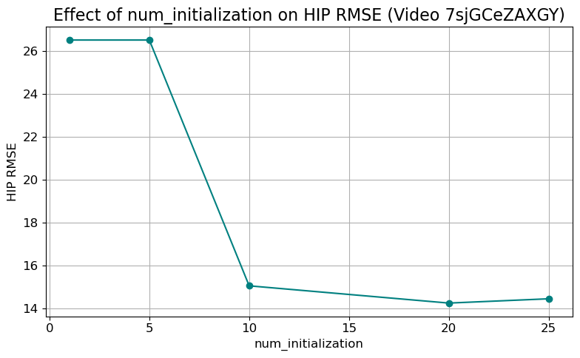
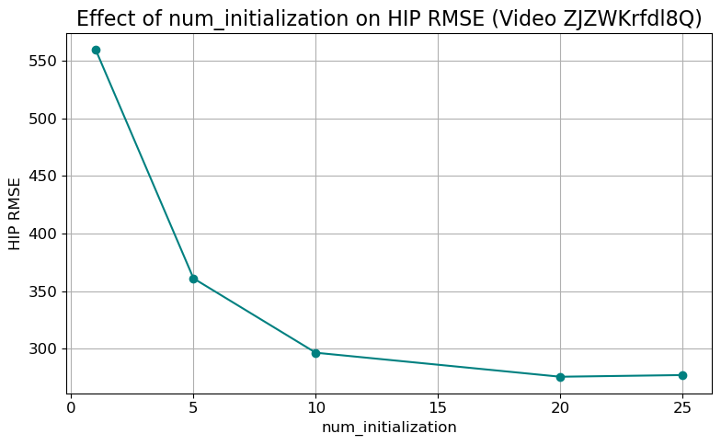
Limitations
HIP is sensitive and highly rely on initialization

Slide 19
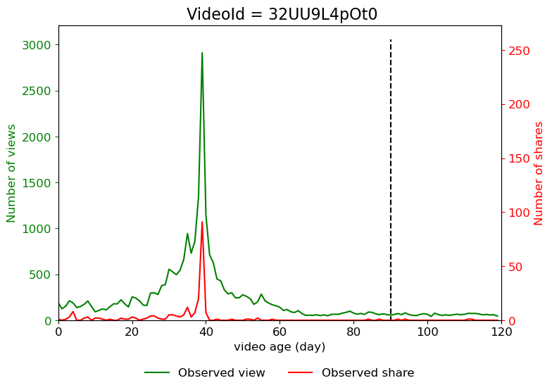
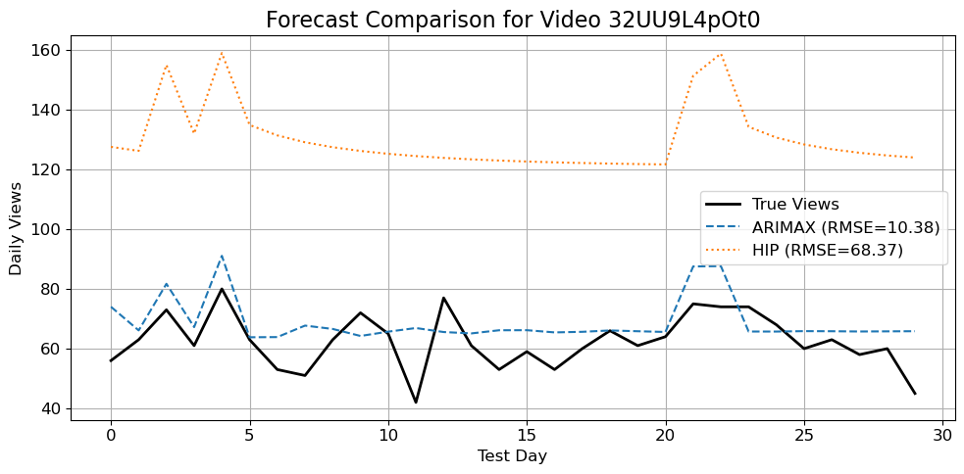
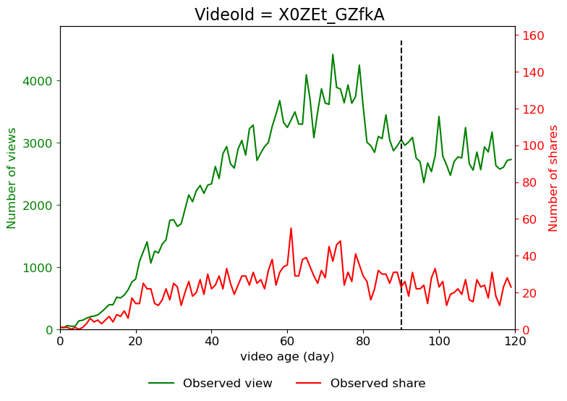
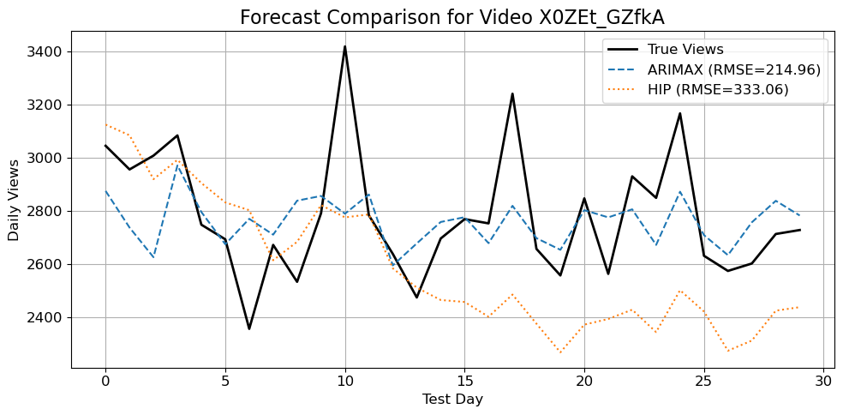
Limitations
Relatively high RMSE errors (compared to ARIMA on special case)

Slide 20
Thank you
Contact Us
He Weng
u7705421@any.edu.au
wenghe12345@gmail.com

Slide 21
Reference
Mishra, Swapnil, Marian-Andrei Rizoiu, and Lexing Xie. "Feature driven and point process approaches for popularity prediction." Proceedings of the 25th ACM international on conference on information and knowledge management. 2016.
Rizoiu, Marian-Andrei, et al. "Expecting to be hip: Hawkes intensity processes for social media popularity." Proceedings of the 26th international conference on world wide web. 2017.
Box G E P, Jenkins G M, Reinsel G C, et al. Time series analysis: forecasting and control[M]. John Wiley & Sons, 2015.
Github Link for HIP (official): https://github.com/andrei-rizoiu/hip-popularity
Github Link for my study: https://github.com/hahahaHan233/Study-HIP

