Slide 1
SmartCampus
Progress presentation
Learning support, campus facilities and administrative services
CSIT883 progress presentation
12 November 2026
SmartCampus progress 01 / 13
Notes:
Slide 1 — SmartCampus progress presentation — Cover — 0 seconds
Display while the group gets ready. Begin slide 2 without an additional cover speech.

Slide 2
Project Goals and Team Responsibilities
Rongkai Cheng / 50 seconds
Six connected modules now support saved, editable and traceable workflows.
Rongkai Cheng: study assistant and shared AI service
Dequn Shang: learning suggestions and support rules
Jun Yang: booking, fault reporting and system integration
Lexi Shu: maintenance, simulated energy and QA
Zheyuan Huai: requirements, scope and document pre-review
Shiran Yuan: service portal and shared user interface
Revised team responsibilities. All campus records and policies are fictional.
SmartCampus progress 02 / 13
Notes:
Slide 2 — Project Goals and Team Responsibilities — Rongkai Cheng — 50 seconds
SmartCampus connects learning, campus facilities and administrative services in one local application. Our enhanced prototype has six modules, each with a named owner. I handle the study assistant and shared AI adapter. Dequn handles learning plans, Jun handles bookings and integration, Lexi handles maintenance and testing, Zheyuan handles requirements, scope and material pre-review, and Shiran handles the portal and interface. Our focus is connected workflows that users can operate and revisit. The new version preserves previous records while adding conversations, plans, work histories and application versions. All accounts and campus records are fictional. I will show how the assistant now supports a continuing conversation instead of an isolated question.

Slide 3
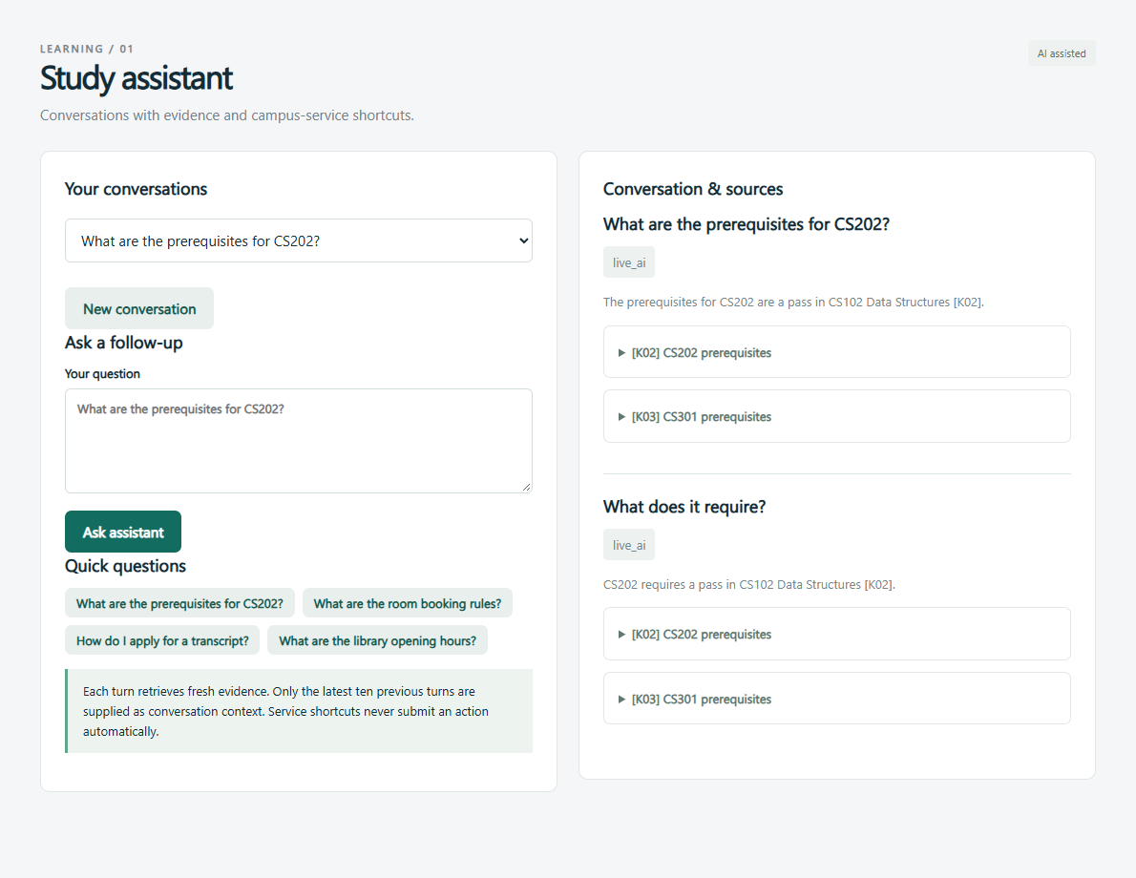
Study Assistant and Shared AI Service
Rongkai Cheng / 70 seconds
Current progress
Saved conversations, follow-up questions and expandable source excerpts.
Verified integration
Live DeepSeek calls and service shortcuts with explicit user actions.
Next action
Evaluate retrieval coverage and claim-level source support.
SmartCampus progress 03 / 13
Notes:
Slide 3 — Study Assistant and Shared AI Service — Rongkai Cheng — 70 seconds
Students can create a conversation, switch between saved conversations and continue after refreshing. Each turn retrieves fresh campus sources. The backend supplies at most ten previous turns as context, while treating the retrieved excerpts as evidence. Answers show source IDs and expandable original text. Questions about rooms or applications provide links to the relevant module, but do not perform actions automatically. The screenshot records an actual conversation. We have tested live DeepSeek connectivity; the new structured AI features use the same adapter. Remaining limitations include keyword retrieval and incomplete knowledge coverage. My next work is to evaluate follow-up questions, check whether individual claims match their cited excerpts and extend the knowledge base. A successful API call does not guarantee a correct answer. When evidence or AI is unavailable, the page shows a clear referral or fallback mode instead of inventing an academic rule.
Evidence: enhanced-screenshots/conversation-focus.png. All campus data is synthetic. The displayed AI mode is the actual recorded mode.

Slide 4
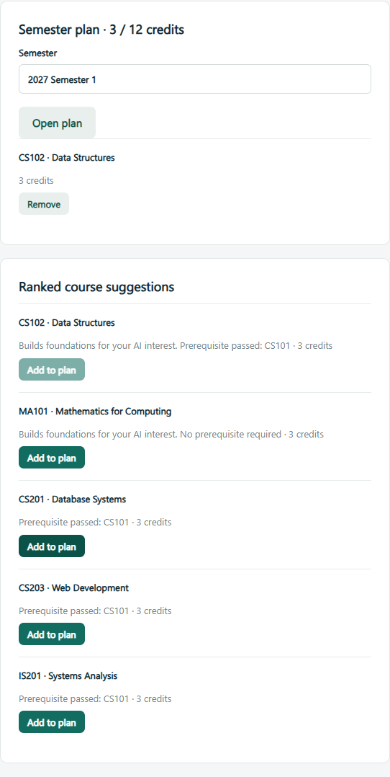
Interests, Suggestions and Semester Plans
Dequn Shang / 50 seconds
Interest-based rules
Save goals and rank eligible foundations for your chosen direction.
Saved plan
Add or remove courses and track a synthetic 12-credit limit.
Current result
Prerequisites and duplicate-course restrictions remain enforced.
SmartCampus progress 04 / 13
Notes:
Slide 4 — Learning Path and Support Rules — Dequn Shang — 50 seconds
The learning module now saves an interest direction, a learning goal and a semester plan. Course suggestions combine prerequisite eligibility with an explicit interest score. For an AI interest, eligible foundation courses can rank higher even before the advanced AI course becomes available. Students can add and remove courses, see credits and reopen the plan later. The demonstration uses three credits per seeded course and a twelve-credit semester limit. The backend rejects duplicates, passed courses and unmet prerequisites. The screenshot shows a saved plan. These are visible demonstration rules rather than a trained recommendation model. Learning goals are saved for context and do not automatically bypass eligibility checks.
Evidence: enhanced-screenshots/learning-focus.png. All campus data is synthetic. The displayed AI mode is the actual recorded mode.

Slide 5
Learning Progress, Problems and Next Steps
Dequn Shang / 70 seconds
Implemented and checked
Interest preferences, saved plans, prerequisite restrictions and credit limits.
Current limitations
Rule-based ranking over synthetic profiles. No timetable optimisation or trained risk model.
Next work
Broaden profiles and evaluate recommendations against the transparent rule baseline.
SmartCampus progress 05 / 13
Notes:
Slide 5 — Learning Progress, Problems and Next Steps — Dequn Shang — 70 seconds
The enhanced workflow connects personal preferences to ranked suggestions and a persistent plan. Low grades and attendance still produce explained reminders, now with a short action checklist. Tests cover saved preferences, prerequisite restrictions, duplicate selections, the credit limit and isolation between student accounts. The main limitation is that rule-based ranking captures only a small part of academic planning. It does not optimise schedules or predict outcomes, and the fictional records cannot support a credible trained risk model. My next steps are to add more varied profiles and explain how a student should balance interests against retaking failed foundations. We will evaluate future recommendation methods against the current transparent baseline. For this report, the result is a working, understandable planning tool whose restrictions we can reproduce, rather than a claim that we already have adaptive machine learning.

Slide 6
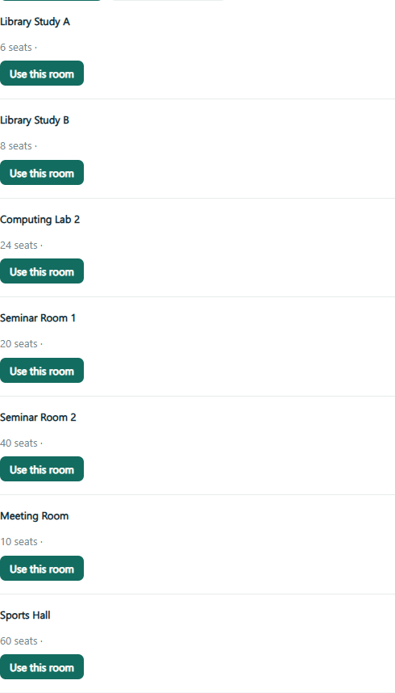
Room Search and Editable Reservations
Jun Yang / 50 seconds
Find a space
Filter by time, capacity, type and equipment; inspect the timetable.
Resolve conflicts
Choose an available alternative or modify your own reservation.
Keep a record
Cancelled bookings retain their reason and remain in history.
SmartCampus progress 06 / 13
Notes:
Slide 6 — Spaces, Bookings and Fault Reports — Jun Yang — 50 seconds
The booking page now filters spaces by time, capacity, type and equipment. Students can inspect the daily timetable, create a reservation and modify it later. If the slot conflicts, the server returns rooms that are available during that period. A failed modification preserves the existing booking. Cancellation records a reason and remains in the student's history. The screenshot shows a conflict with alternative choices. Reservation checks and updates use a database transaction, including when two requests arrive together. We also retain the two-hour limit and ownership checks. Fault reporting connects this page to maintenance, with category and priority fields that the student confirms.
Evidence: enhanced-screenshots/booking-focus.png. All campus data is synthetic. The displayed AI mode is the actual recorded mode.

Slide 7
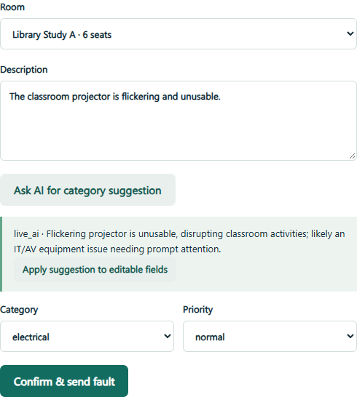
Fault Classification and Shared Integration
Jun Yang / 70 seconds
AI suggestion
DeepSeek suggests category and priority; the user confirms the report.
Preserved records
Versioned database migration retains earlier campus data.
Next action
Verify a second installation and coordinate shared interface changes.
SmartCampus progress 07 / 13
Notes:
Slide 7 — Integration Progress and Remaining Work — Jun Yang — 70 seconds
For a fault report, the student can request a DeepSeek classification suggestion and explicitly apply it to editable fields. They still confirm the form before the system creates a ticket. The screenshot shows that separation between suggestion and action. Integration now also includes persistent conversations, plans, ticket logs and application events. We upgraded the existing SQLite database through a versioned additive migration and preserved the earlier records. Tests exercise simultaneous booking modifications, data isolation and repeatable migrations, including a copy of the original database. Current integration limits include one-machine installation coverage and coordination around shared interfaces. My next work is to repeat setup on another computer, review module pull requests and keep schema changes compatible. AI classification remains advisory and can fail or be incorrect, so manual classification stays available and confirmed human values drive the actual ticket.
Evidence: enhanced-screenshots/classification-focus.png. All campus data is synthetic. The displayed AI mode is the actual recorded mode.

Slide 8
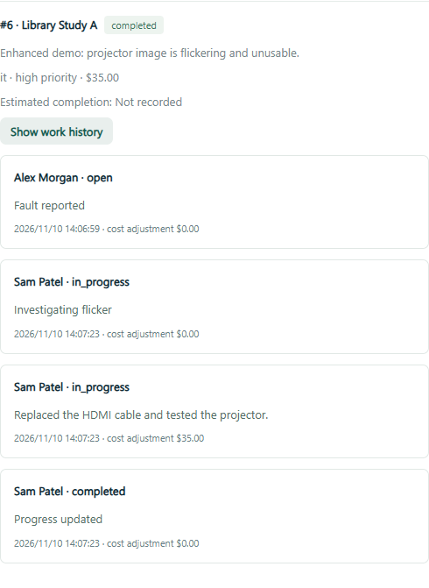
Maintenance Workflow and Energy Demonstration
Lexi Shu / 50 seconds
Repair history
Filter work, set an ETA, add notes and record expenses.
Evidence
The ticket keeps status changes and cost adjustments.
Energy boundaries
Filter persisted simulated readings by room and date. No real control.
SmartCampus progress 08 / 13
Notes:
Slide 8 — Maintenance Workflow and Energy Demonstration — Lexi Shu — 50 seconds
Maintenance now provides a filtered queue, category, priority, estimated completion and a timestamped work history. Staff can add a work note with an additional expense or update the recorded total cost with an adjustment entry. Tickets move from open to in progress and completed. Students can inspect their own reports, while staff actions stay restricted. The screenshot shows actual repair records from the browser demonstration. Energy readings are also filterable by room and date. They are stored synthetic values across seven seeded dates, so refreshing does not change the readings. The system still does not control real equipment or predict failures.
Evidence: enhanced-screenshots/maintenance-focus.png. All campus data is synthetic. The displayed AI mode is the actual recorded mode.

Slide 9
Verification, Problems and Next Steps
Lexi Shu / 70 seconds
Available local evidence
34 backend cases cover migration, isolation, file boundaries and connected workflows.
Checks still needed
Broader AI accuracy, a second physical computer and classroom-device rehearsal.
Next work
Keep a stable release and rehearse one new workflow per speaker within two minutes.
SmartCampus progress 09 / 13
Notes:
Slide 9 — Verification, Problems and Next Steps — Lexi Shu — 70 seconds
The expanded backend suite covers migrations, conversation isolation, course-plan restrictions, room filters, concurrent changes, maintenance histories, uploads and versioned applications. It also checks returned applications, notifications, resubmission and final decisions. Browser verification exercises the corresponding visible controls and real DeepSeek requests. The evidence distinguishes deterministic tests, mocked AI responses and actual model calls. The main remaining risks are broader model accuracy, installation portability and unfamiliar presentation equipment. PDF support is intentionally limited to text-based files, and energy data remains simulated. My next steps are to preserve a stable release, rerun relevant checks after changes and repeat the workflows on a teammate's computer. During rehearsal, each owner should show one new workflow within their two-minute slot. We will keep the recording as a backup, without adding an extra demonstration segment that would break the time limit.

Slide 10
System Requirements and Prototype Scope
Zheyuan Huai / 50 seconds
System Analyst and Document Pre-review Lead
Learning support
M1.1 Study assistant
M1.2 Learning path and support reminders
Facilities and resources
M2.1 Booking and fault reports
M2.2 Energy and maintenance
Administrative services
M3.1 Document pre-review
M3.2 Service portal and tracking
Acceptance focus: persistent operations, shared histories and validated AI integration.
Rules and simulated energy stay explicit. Live AI is connected; broader evaluation remains next.
SmartCampus progress 10 / 13
Notes:
Slide 10 — System Requirements and Prototype Scope — Zheyuan Huai — 50 seconds
My role is System Analyst and Document Pre-review Lead. I maintain the mapping between course requirements, the six modules and their acceptance conditions. This release expands usable workflows while preserving records across upgrades. The shared scope covers conversation history, saved study plans, editable bookings, repair logs and versioned applications with correction requests. We keep clear boundaries: learning suggestions use rules, energy data is synthetic and AI provides advice rather than approval. Real DeepSeek calls have been verified, but we still need broader accuracy evaluation and a second-machine check. My responsibility is to keep the scope baseline and report consistent with demonstrated behavior, and to prevent later features from appearing as already complete.

Slide 11
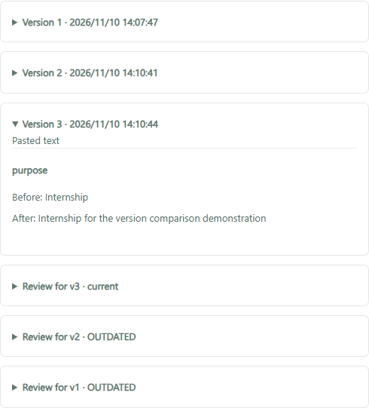
Material Upload, Evidence and Review Versions
Zheyuan Huai / 70 seconds
Material workflow
Upload TXT or text PDF; confirm selected AI-extracted fields.
Evidence and versions
Inspect findings and corrections; preserve outdated reviews by version.
Next evaluation
Test subtle contradictions. OCR and automatic approval remain out of scope.
SmartCampus progress 11 / 13
Notes:
Slide 11 — Intelligent Document Pre-review — Zheyuan Huai — 70 seconds
The pre-review module now starts with an application-specific checklist and a TXT or text-based PDF upload. Text extraction runs locally. Students can separately ask AI to suggest fields, inspect the supporting excerpts and explicitly apply selected values. The system then saves a draft and checks rules and possible text inconsistencies. Findings display their source, evidence and a suggested correction. Each actual edit creates a version, and each review remains attached to that version. Older results are labelled outdated instead of deleted. In the demonstration, the material first names S9999 instead of S1001; after correction we inspect the new version and review history. My next work is to evaluate more subtle contradictions and reduce unsupported findings. Scans and encrypted PDFs are rejected clearly, AI can still miss problems, and final staff decisions remain in Shiran's portal.
Evidence: enhanced-screenshots/versions-focus.png. All campus data is synthetic. The displayed AI mode is the actual recorded mode.

Slide 12
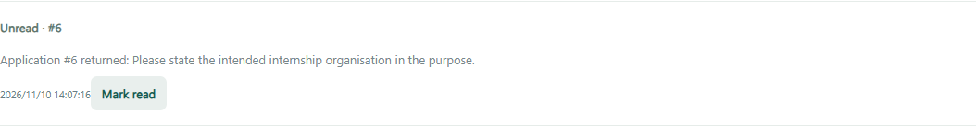
Correction Requests and In-app Notifications
Shiran Yuan / 50 seconds
Current progress
Search applications, read notifications and follow status changes.
Correction loop
Staff return a submission; students save a revision and resubmit.
Access boundary
Private student records and staff-only decision actions.
SmartCampus progress 12 / 13
Notes:
Slide 12 — Service Portal and Application Tracking — Shiran Yuan — 50 seconds
The portal now supports searching and filtering applications, processing timelines and in-app notifications with read status. Staff can return a submitted application with a correction request instead of immediately rejecting it. The student receives a notification, revises the application through pre-review and resubmits it. The same application ID connects the complete history. The screenshot shows the student's notification and current status. Backend role and ownership checks protect records throughout this process. The dashboard counts pending work and calculates average processing time for completed, recorded submission cycles. Imported records without original timestamps are not assigned invented processing durations.
Evidence: enhanced-screenshots/notification-focus.png. All campus data is synthetic. The displayed AI mode is the actual recorded mode.

Slide 13
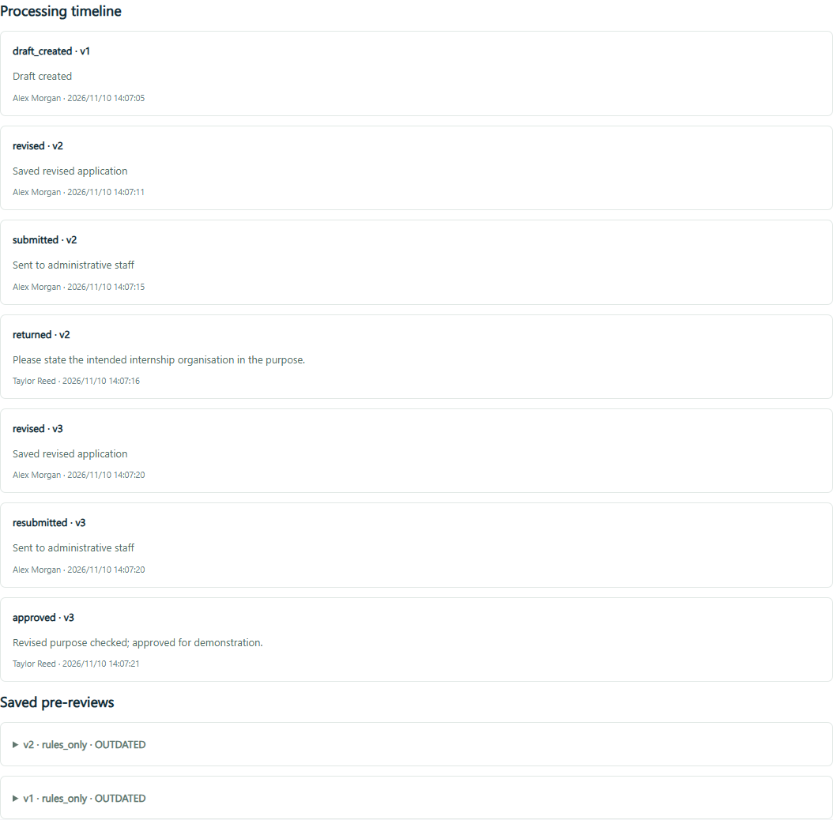
Processing Timeline and Delivery Plan
Shiran Yuan / 70 seconds
Connected evidence
Submission, return, revision, resubmission and approval share a timeline.
Current limitations
In-app updates after refresh. No emails or per-staff workload allocation.
Next action
Evaluate usability and rehearse the verified release on presentation equipment.
SmartCampus progress 13 / 13
Notes:
Slide 13 — Approval Evidence and Delivery Plan — Shiran Yuan — 70 seconds
This timeline shows submission, a staff correction request, a new student revision, resubmission and final approval. Notifications use actual application events and do not represent sent emails. The student can inspect the final explanation and earlier review versions after refreshing. Browser verification followed this complete loop. Remaining work includes more usability checks, richer staff workload assignment and external notification delivery. Our next priority is to rehearse the verified workflows on the presentation computer and keep progress claims aligned with the release. All six members retain their module responsibilities, while Zheyuan maintains the requirements and scope baseline. We will each use two minutes, including any short clicks or handover. The group leader submits the progress slides by 23:59 on 13 November. The current result is a connected local system with more complete user operations, alongside explicit limitations and a clear next development stage. Thank you.
Evidence: enhanced-screenshots/timeline-focus.png. All campus data is synthetic. The displayed AI mode is the actual recorded mode.

