Slide 1
SmartCampus
Progress presentation
Learning support, campus facilities and administrative services
CSIT883 progress presentation
12 November 2026
SmartCampus progress 01 / 13
Notes:
Slide 1 — SmartCampus progress presentation — Cover — 0 seconds
Display while the group gets ready. Rongkai begins slide 2 without a separate cover introduction. The submission deadline is an administrative reminder, not a separate discussion topic.

Slide 2
Project Goals and Team Responsibilities
Rongkai Cheng / 50 seconds
One local prototype connects learning, facilities and administration.
Rongkai Cheng: study assistant and shared AI service
Dequn Shang: learning suggestions and support rules
Jun Yang: booking, fault reporting and system integration
Lexi Shu: maintenance, simulated energy and QA
Zheyuan Huai: requirements, scope and document pre-review
Shiran Yuan: service portal and shared user interface
Revised team responsibilities. All campus records and policies are fictional.
SmartCampus progress 02 / 13
Notes:
Slide 2 — Project Goals and Team Responsibilities — Rongkai Cheng — 50 seconds
Good morning. SmartCampus connects learning support, campus facilities and administrative services for a fictional GlobalConnect University. Our current prototype has six modules, with one primary owner for each module. I am responsible for the study assistant and shared AI service. Dequn handles learning suggestions, Jun handles facilities and integration, Lexi handles maintenance and testing, Zheyuan handles requirements and document pre-review, and Shiran handles the service portal and interface. Our progress target is a working system with connected workflows. The screenshot shows the shared navigation. We use synthetic records and policies throughout this demonstration. I will now explain the learning assistant and the status of our AI integration.

Slide 3
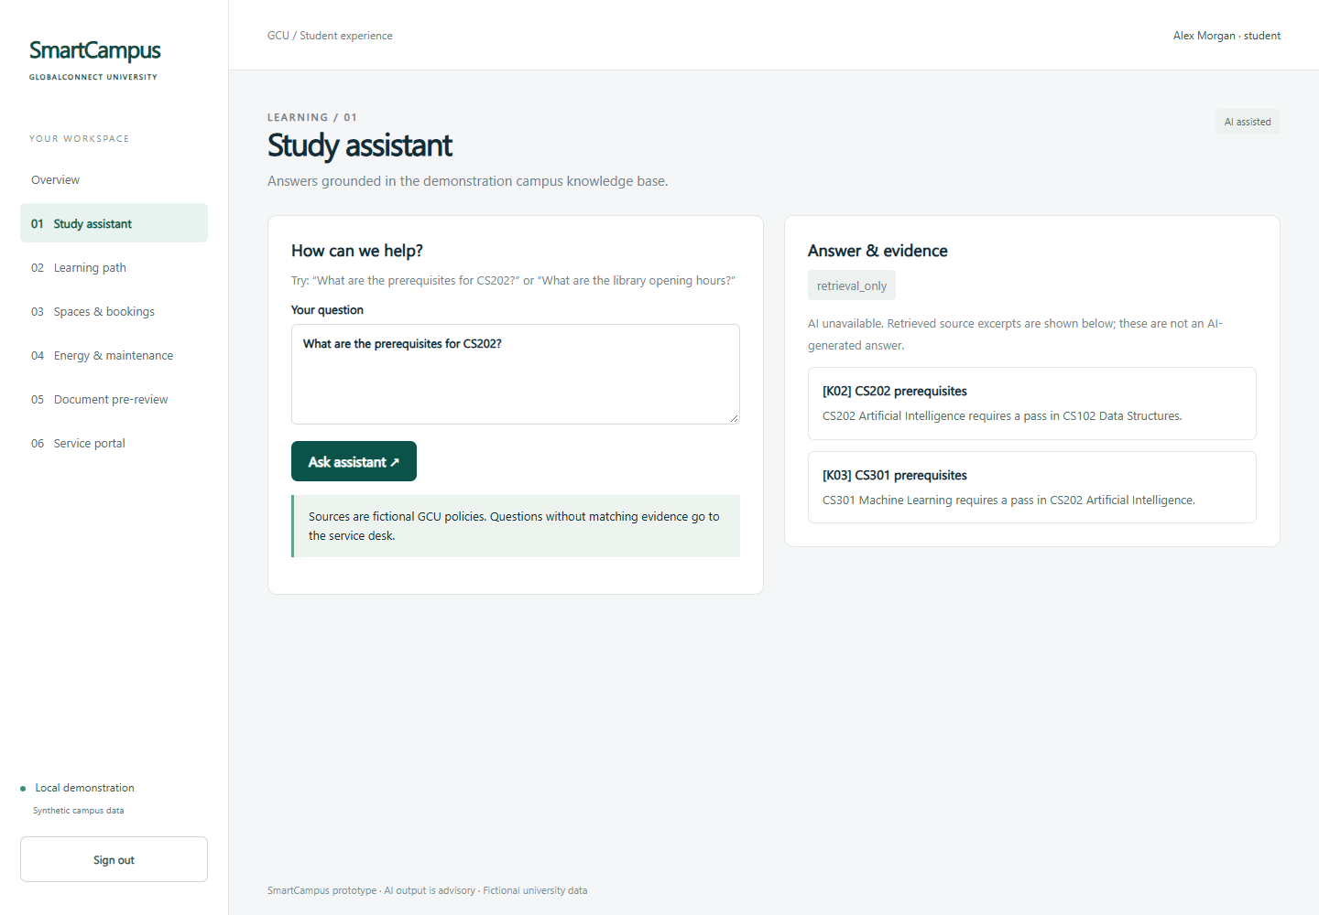
Study Assistant and Shared AI Service
Rongkai Cheng / 70 seconds
Current progress
Local retrieval and a shared DeepSeek adapter are implemented.
Current problem
Real model access and answer quality remain unverified.
Next action
Verify both AI features and evaluate cited answer support.
SmartCampus progress 03 / 13
Notes:
Slide 3 — Study Assistant and Shared AI Service — Rongkai Cheng — 70 seconds
The assistant first retrieves relevant material from fifteen local campus documents. It then sends the question and selected excerpts through one backend DeepSeek adapter. A generated answer must contain a matching source reference before the application presents it as an AI answer. Questions without matching evidence go to the service desk. If the API fails, the page shows retrieved excerpts and labels the mode clearly. The current screenshot is retrieval-only because live access has not been verified with a team key. Tests cover cited and uncited replies, timeouts, authentication failures and malformed responses using mocks. Those checks establish integration behavior, not model accuracy. My next steps are to verify both AI features with a real key, test ambiguous questions, and examine whether each generated claim is supported by its cited source. Local retrieval is still keyword based and needs broader evaluation.
Evidence: local browser capture deliverables/screenshots/03-assistant.png; synthetic data. No live AI verification implied.

Slide 4
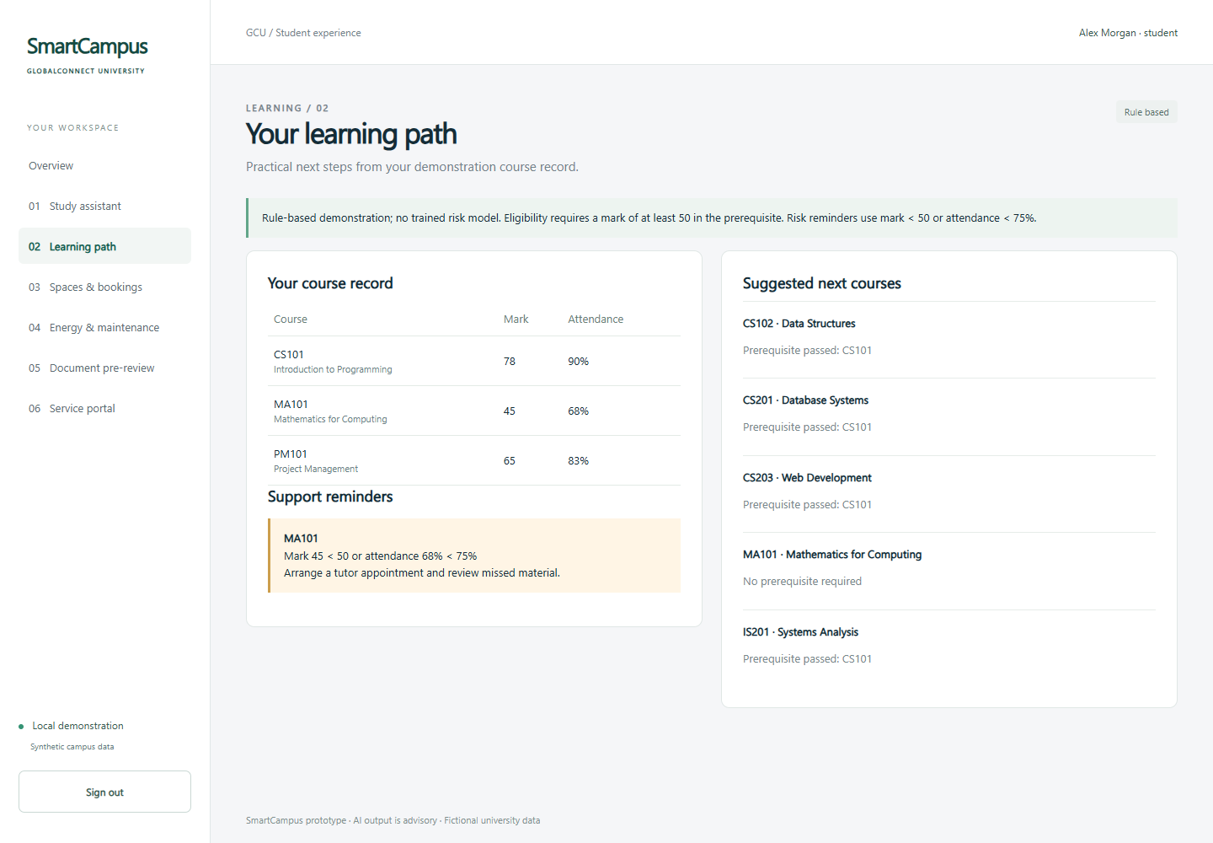
Learning Path and Support Rules
Dequn Shang / 50 seconds
Eligibility
Suggest courses when prerequisites have been passed.
Support reminder
Mark below 50 or attendance below 75% triggers an explanation.
Current result
Stored records drive the suggestions shown on the page.
SmartCampus progress 04 / 13
Notes:
Slide 4 — Learning Path and Support Rules — Dequn Shang — 50 seconds
My module uses course records to suggest eligible next courses and explain support reminders. The current implementation checks whether a student has passed a prerequisite with a mark of at least fifty. It excludes advanced courses when the prerequisite is missing. It also flags a mark below fifty or attendance below seventy-five percent. In this profile, Mathematics for Computing triggers a reminder, while the passed programming course opens several next-course choices. Each result includes the rule behind it. These are fictional demonstration thresholds, and the module does not use a trained prediction model. The screenshot shows the implemented course record, suggestions and reminder together.
Evidence: local browser capture deliverables/screenshots/04-learning.png; synthetic data. No live AI verification implied.

Slide 5
Learning Progress, Problems and Next Steps
Dequn Shang / 70 seconds
Implemented and locally checked
Prerequisite exclusions and low-performance reminders use explicit rules.
Current limitations
Small synthetic profiles. No trained risk model or interest-based course ranking.
Next work
Broaden profiles and boundary tests, then compare richer methods against the rules.
SmartCampus progress 05 / 13
Notes:
Slide 5 — Learning Progress, Problems and Next Steps — Dequn Shang — 70 seconds
The backend and page are connected, and the suggestions come from stored student records rather than fixed display text. Existing tests confirm that low performance produces a reminder and that unmet prerequisites exclude an advanced course. The main limitation is that eligibility is not the same as a personalised learning path. We currently do not rank by interests, balance a semester workload or use collaborative filtering. The data is small and synthetic, so it cannot support a credible trained risk model yet. My next work is to add more varied course profiles, check boundary cases and improve the explanation of retaking a failed course. After that, we can evaluate a recommendation method against these transparent rules. For the progress report, the acceptance condition is understandable, reproducible suggestions for each demonstration student, with the rule-based status visible rather than described as machine learning.

Slide 6
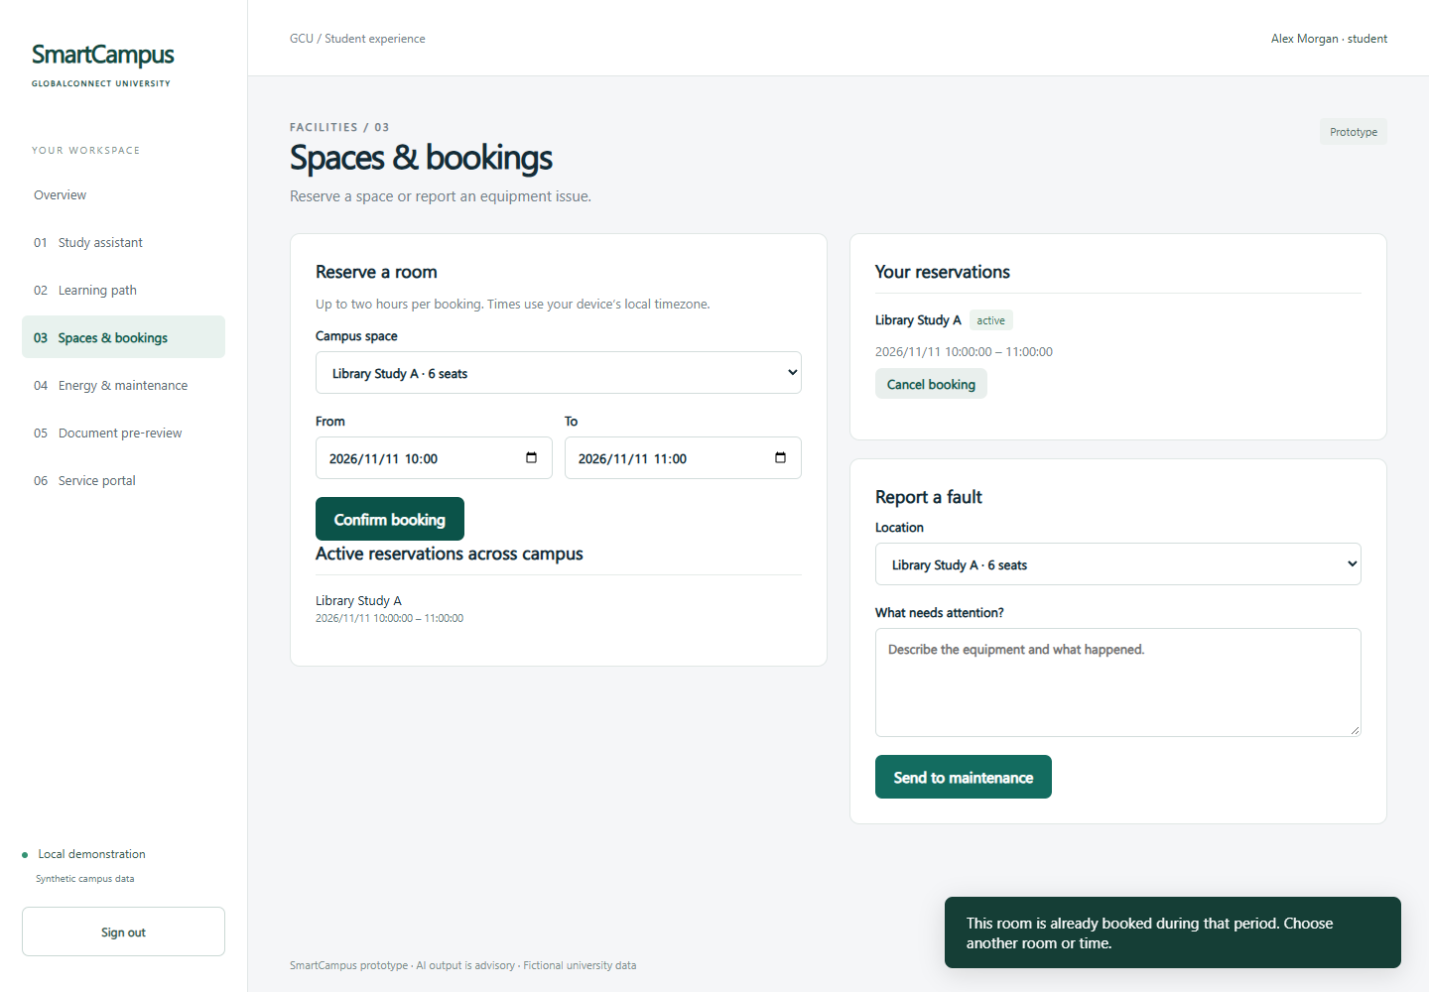
Spaces, Bookings and Fault Reports
Jun Yang / 50 seconds
Current progress
Reserve and cancel your own room slot, with overlap rejection.
Shared workflow
A fault report creates a ticket in the maintenance queue.
Scope boundary
No occupancy prediction or AI fault classification yet.
SmartCampus progress 06 / 13
Notes:
Slide 6 — Spaces, Bookings and Fault Reports — Jun Yang — 50 seconds
My facilities module supports room reservations, cancellation and equipment fault reports. Students choose a room and a future time slot of at most two hours. The server checks for overlapping active bookings before saving. In the screenshot, a second attempt at the same slot produces a conflict message. The overlap check and insertion share a database transaction, so simultaneous requests cannot both reserve the slot. Students can cancel only their own reservations. Fault reports create maintenance tickets that Lexi's module reads directly. The current implementation uses a common maintenance queue, without AI fault classification or occupancy prediction.
Evidence: local browser capture deliverables/screenshots/05-booking-conflict.png; synthetic data. No live AI verification implied.

Slide 7
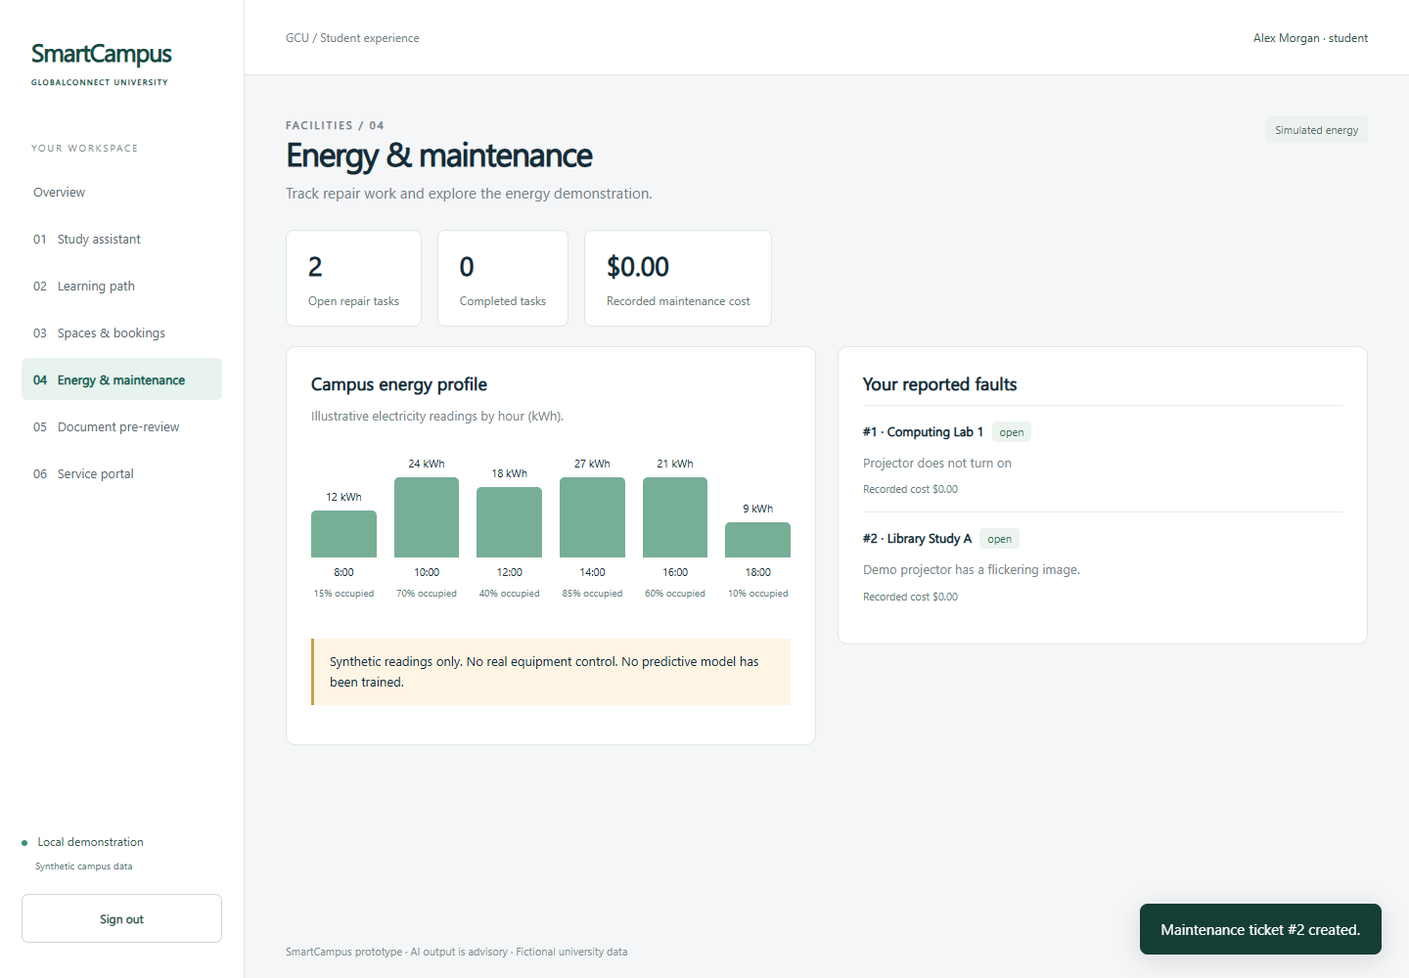
Integration Progress and Remaining Work
Jun Yang / 70 seconds
Verified connection
Fault intake and maintenance read the same saved tickets.
Current problem
Second-machine setup and the team repository are pending.
Next action
Verify installation, coordinate schema changes and merge by module.
SmartCampus progress 07 / 13
Notes:
Slide 7 — Integration Progress and Remaining Work — Jun Yang — 70 seconds
I also coordinate integration across the modules. The local application uses one FastAPI service, one SQLite database and shared session authentication. Each module has a separate router and browser page. The important integration result is that we share records across workflows: a fault becomes a maintenance ticket, and a reviewed application becomes an item in the service portal. Browser verification exercised these connected flows. An actual server restart also preserved a booking, an approved application and a completed repair. Current problems include limited installation coverage and coordination around shared database changes. We have checked only one physical computer, and the team repository still needs configuration. My next steps are to repeat setup on a teammate's machine, establish the module branches and pull-request checks, and maintain stable shared interfaces. Module owners should coordinate schema changes before merging them.
Evidence: local browser capture deliverables/screenshots/06-student-tickets.png; synthetic data. No live AI verification implied.

Slide 8
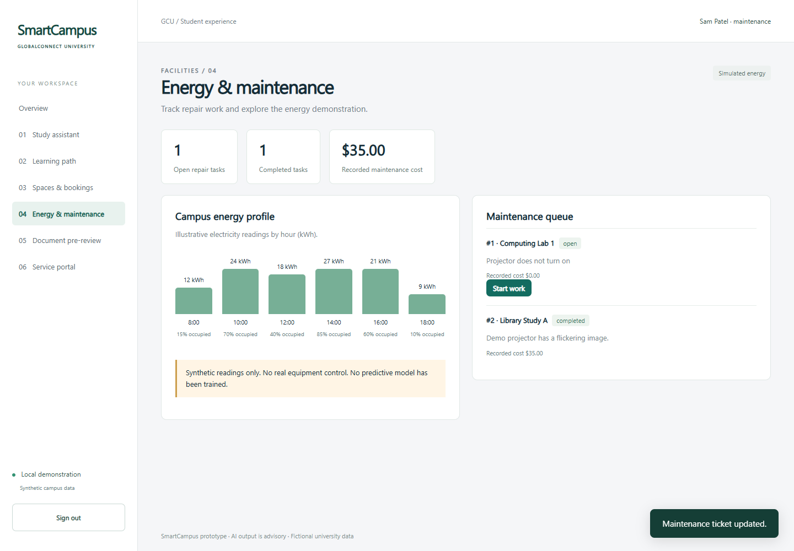
Maintenance Workflow and Energy Demonstration
Lexi Shu / 50 seconds
Current progress
Staff advance repair tickets and record the maintenance cost.
Current evidence
The queue shows open and completed work.
Scope boundary
Energy is simulated. No physical control or failure prediction.
SmartCampus progress 08 / 13
Notes:
Slide 8 — Maintenance Workflow and Energy Demonstration — Lexi Shu — 50 seconds
My module connects reported faults to repair work. Maintenance staff can advance a ticket from open to in progress and then completed, while recording a repair cost. Students can inspect their own reports but cannot perform staff updates. The screenshot shows an open issue and a completed repair. It also shows electricity readings with occupancy values. These readings are synthetic and the prototype does not control physical equipment. We have not implemented failure prediction. The current result is a persistent repair lifecycle and a clearly labelled energy demonstration, which are suitable for verifying the facility workflow before connecting real data.
Evidence: local browser capture deliverables/screenshots/10-maintenance.png; synthetic data. No live AI verification implied.

Slide 9
Verification, Problems and Next Steps
Lexi Shu / 70 seconds
Available local evidence
12 backend cases passed. Browser workflows and real server-restart persistence checked.
Checks still needed
Real DeepSeek service, a second computer and the classroom display remain unverified.
Next work
Recheck changes, record defects, freeze features and rehearse recovery within each slot.
SmartCampus progress 09 / 13
Notes:
Slide 9 — Verification, Problems and Next Steps — Lexi Shu — 70 seconds
I also coordinate quality assurance. The available local evidence includes twelve passing backend test cases and browser checks across the connected workflows. Tests cover login and ownership, concurrent booking conflicts, permitted ticket transitions, draft correction, staff decisions and AI adapter failures. The browser run recorded no unexpected page or console errors, and a mobile-width check found no horizontal overflow on the overview page. These results have limits. Mocked AI success does not establish that the external model is available or accurate. We still need a second-machine installation and classroom rehearsal. My next steps are to rerun the relevant checks after team changes, verify the permissions for each demonstration account, and record reproducible defects with expected and actual behavior. Before the presentation, we should freeze features, check the live AI connection and practice recovery using the existing offline recording.

Slide 10
System Requirements and Prototype Scope
Zheyuan Huai / 50 seconds
System Analyst and Document Pre-review Lead
Learning support
M1.1 Study assistant
M1.2 Learning path and support reminders
Facilities and resources
M2.1 Booking and fault reports
M2.2 Energy and maintenance
Administrative services
M3.1 Document pre-review
M3.2 Service portal and tracking
Acceptance focus: usable workflows, shared records and two AI integration paths.
Rules and simulated readings are explicit. Live AI verification and advanced features remain pending.
SmartCampus progress 10 / 13
Notes:
Slide 10 — System Requirements and Prototype Scope — Zheyuan Huai — 50 seconds
My revised role is System Analyst and Document Pre-review Lead. Alongside material pre-review, I am responsible for requirements analysis and scope management. The requirements baseline maps the three required subsystems to six modules and acceptance conditions. For this progress report, the scope prioritises usable workflows, shared records and two AI integration paths. We distinguish implemented business functions from rule-based recommendations and simulated energy readings. The AI adapters exist, but live service validation remains pending. Voice, trained predictive models, OCR and real equipment control are later work. My responsibility is to review and maintain this baseline as the team develops the system, so our progress claims remain aligned with what we can demonstrate.

Slide 11
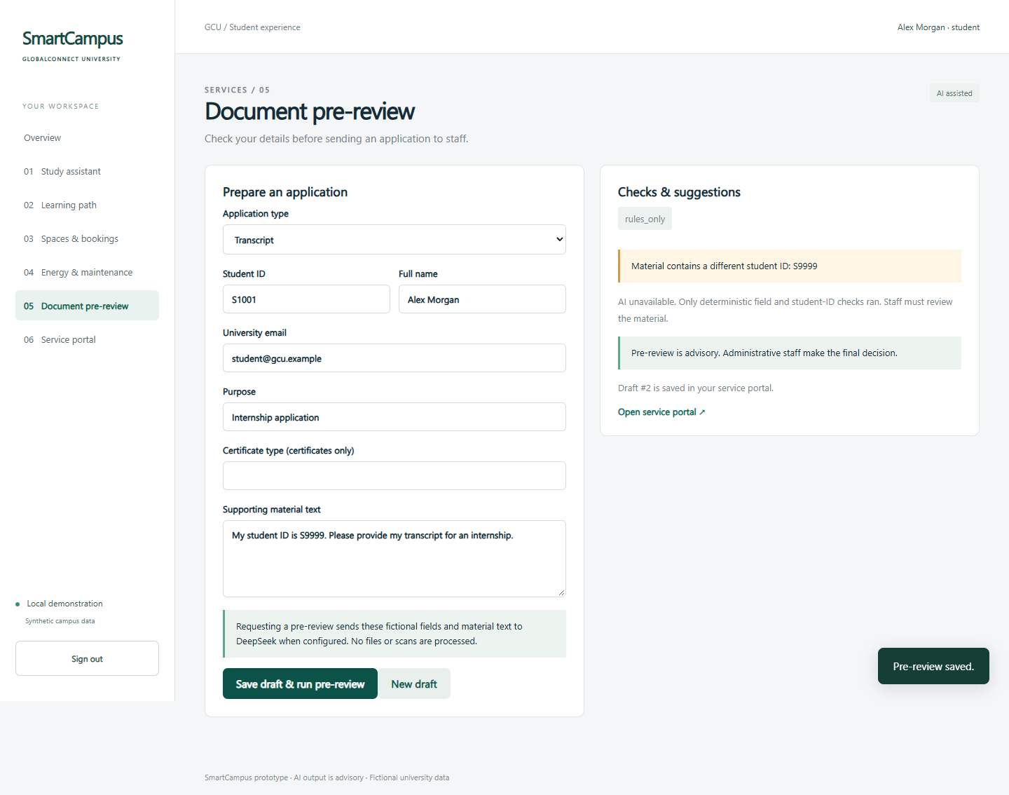
Intelligent Document Pre-review
Zheyuan Huai / 70 seconds
Implemented correction loop
Save draft, check rules, request AI analysis, correct and re-review.
Concrete evidence
Student S1001 versus material S9999: the rule flags the conflict.
Problem and next work
Verify live AI and test text contradictions. Staff retain approval.
SmartCampus progress 11 / 13
Notes:
Slide 11 — Intelligent Document Pre-review — Zheyuan Huai — 70 seconds
My module connects a saved application draft to rule checks, AI text analysis and a correction loop. Rules check required fields and whether identity details match the signed-in student. The supporting text can then go to DeepSeek for potential inconsistencies and evidence excerpts. In this example, the student is S1001 but the material says S9999, so the deterministic check reports the conflict. The screenshot shows rules-only mode. The interface and result storage are implemented, while a real AI call still needs verification. When a draft changes, old review records are cleared so they cannot be mistaken for current results. Students can correct and review again before submitting. Staff retain final approval through Shiran's portal. My next steps are to verify the API, add normal, missing-field and contradictory-text cases, and evaluate whether AI feedback identifies the actual problem with supporting evidence. We do not claim perfect detection or automatic approval.
Evidence: local browser capture deliverables/screenshots/07-review-issue.png; synthetic data. No live AI verification implied.

Slide 12
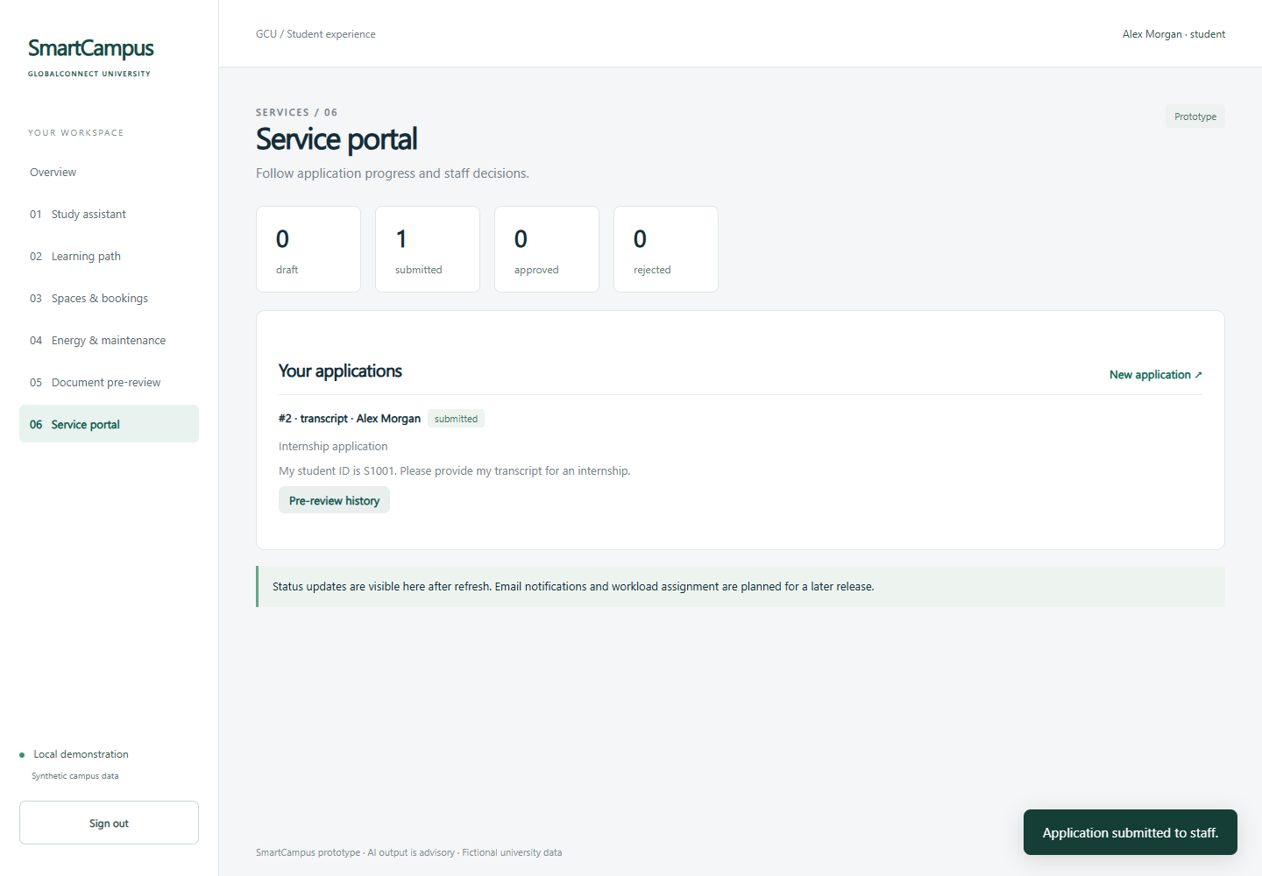
Service Portal and Application Tracking
Shiran Yuan / 50 seconds
Current progress
Students submit drafts and track their own applications.
Shared workflow
The portal reuses saved drafts and pre-review results.
Access boundary
Only administrative staff decide submitted applications.
SmartCampus progress 12 / 13
Notes:
Slide 12 — Service Portal and Application Tracking — Shiran Yuan — 50 seconds
My module gives students a common place to submit and track their applications. It reuses the drafts and saved pre-review results from Zheyuan's module. Students can edit a draft, inspect its review history and submit it after field validation. They see only their own records. Administrative staff see submitted applications and decide whether to approve or reject them with an explanation. This screenshot shows a submitted student application. The shared navigation and page styles connect the six modules, while backend permission checks enforce the role boundaries. The portal currently provides status counts rather than individual staff workload assignments.
Evidence: local browser capture deliverables/screenshots/09-submitted.png; synthetic data. No live AI verification implied.

Slide 13
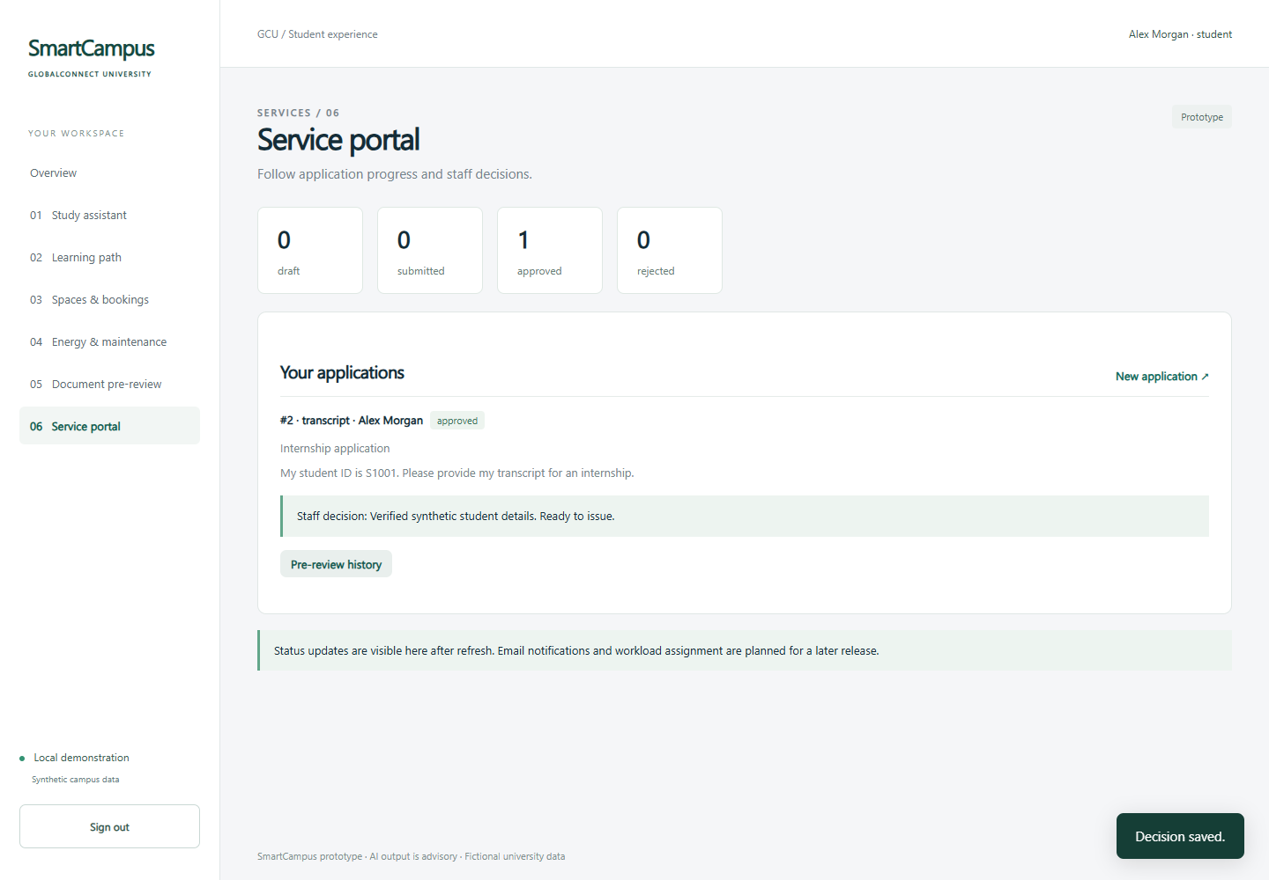
Approval Evidence and Delivery Plan
Shiran Yuan / 70 seconds
Current evidence
Students see the saved staff decision and explanation after refresh.
Current limitations
No email delivery or per-staff workload allocation.
Next action
Improve status clarity, test rejection cases and rehearse delivery.
SmartCampus progress 13 / 13
Notes:
Slide 13 — Approval Evidence and Delivery Plan — Shiran Yuan — 70 seconds
Here, the student can see the approved status and the staff explanation after refreshing the portal. Browser verification followed a corrected draft through submission, approval and the student's final view. This completes the administrative workflow without copying application data between modules. Current limitations include refresh-based status updates, no email delivery and no per-staff workload allocation. My next steps are to improve status clarity, add more rejection and empty-state examples, and test the page on the presentation computer. For final delivery, we will keep the current workflows stable before adding notifications or richer analytics. Each member will review their own module and prepare the corresponding report section. Our group leader will submit this progress deck to Moodle by 23:59 on 13 November. Today we have shown a functioning local prototype, the evidence behind our progress, and the work still needed. Thank you.
Evidence: local browser capture deliverables/screenshots/12-student-approved.png; synthetic data. No live AI verification implied.
Classroom presentation: 12 Nov 2026 during Tutorial. Group leader submits to Moodle by 23:59, 13 Nov 2026. Source: assignment screenshot supplied in this chat.

