Slide 1
HAV Architecture Design
Notes:
Do Duc Minh
1

Slide 2
Contents
Main Components
Back Office
Front Office
Deposit
Bond
Fund
IFA
Asset
Factoring
Price Board
HAV System Architecture

Slide 3
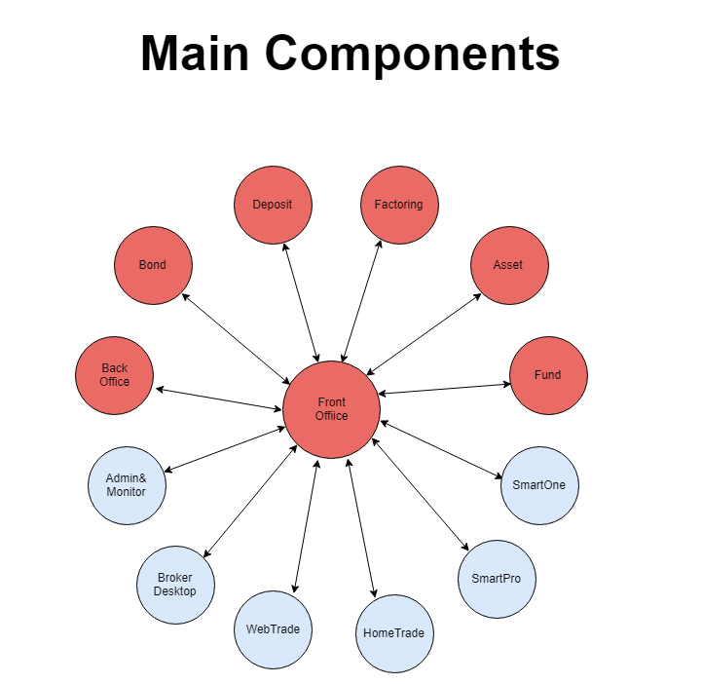

Slide 4
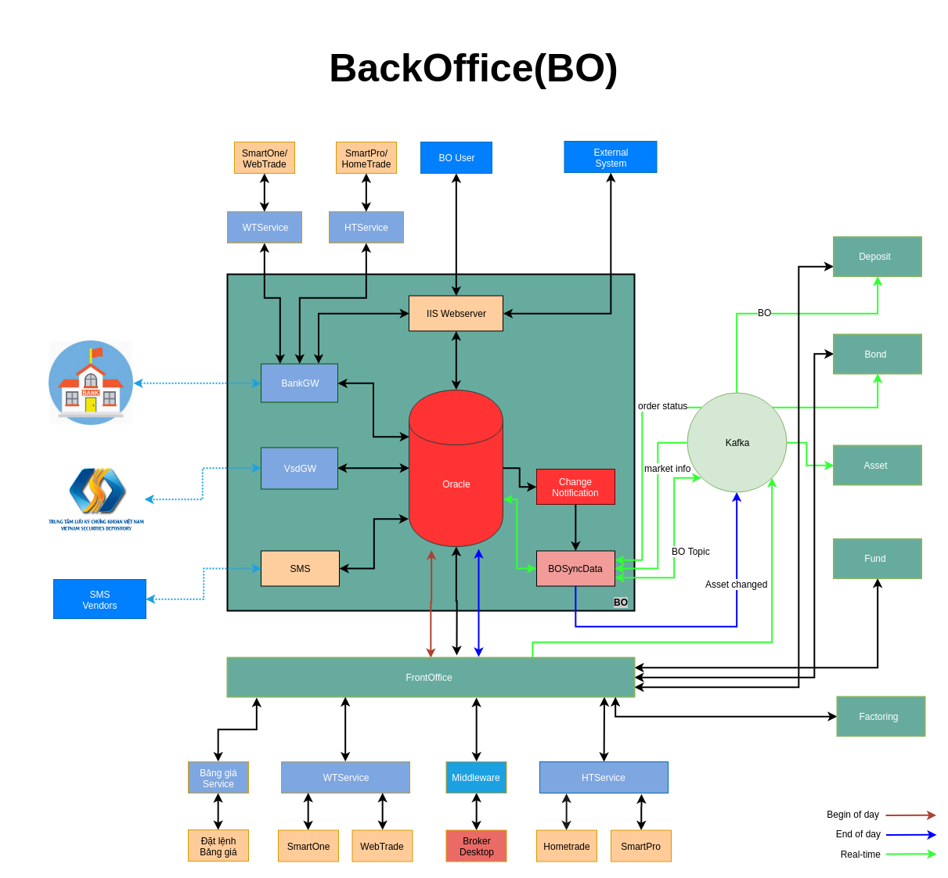

Slide 5
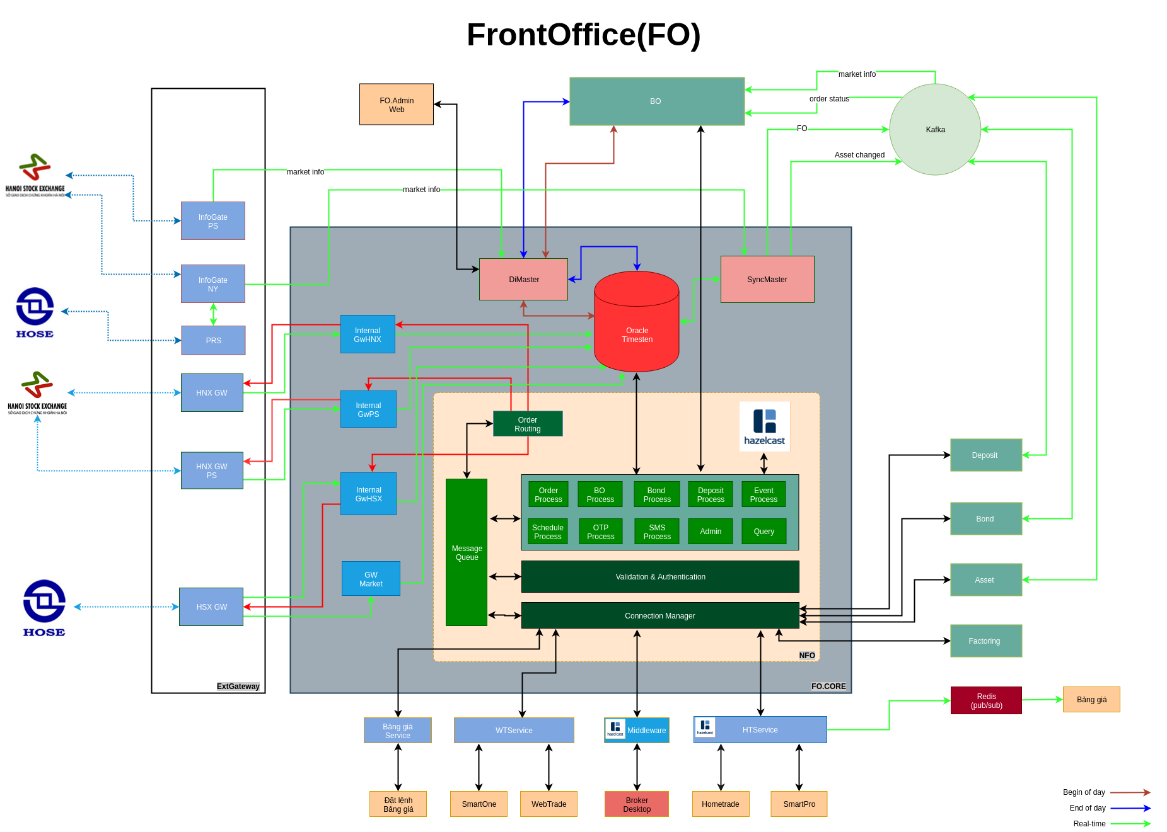

Slide 6
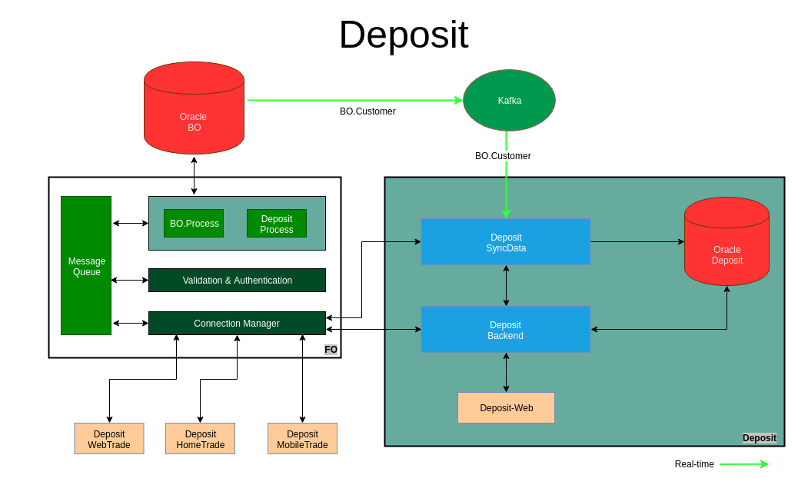

Slide 7
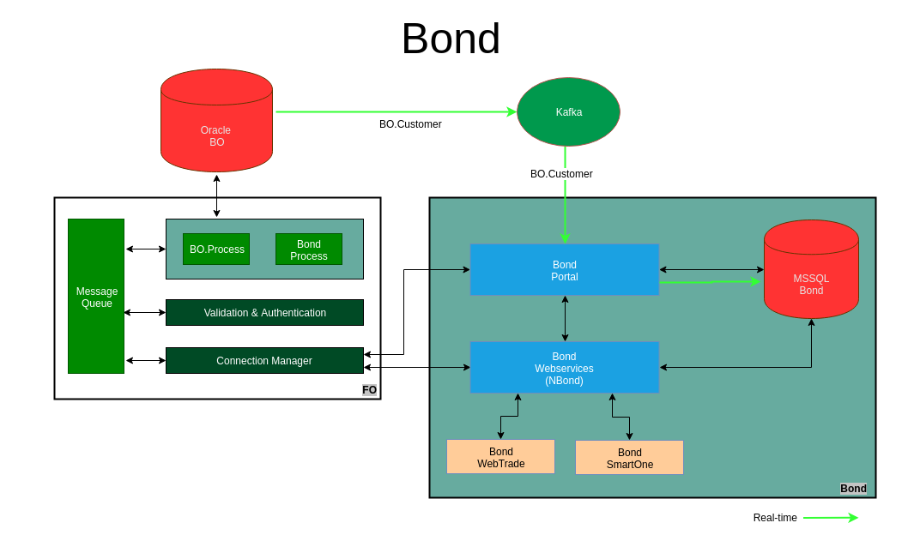

Slide 8
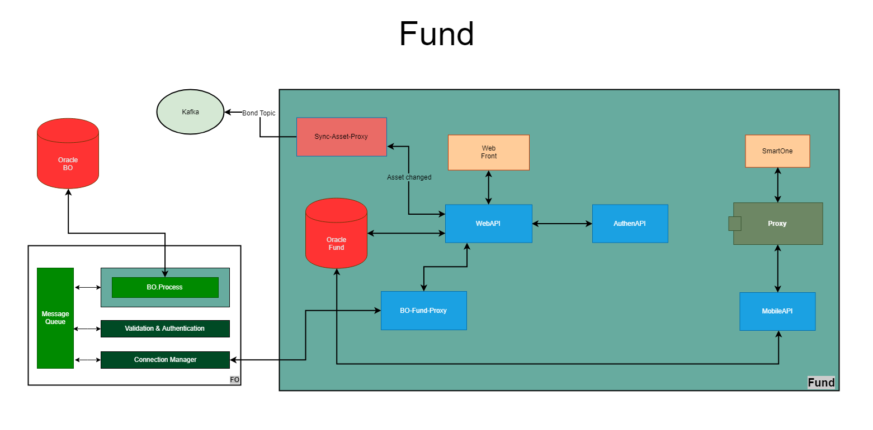

Slide 9
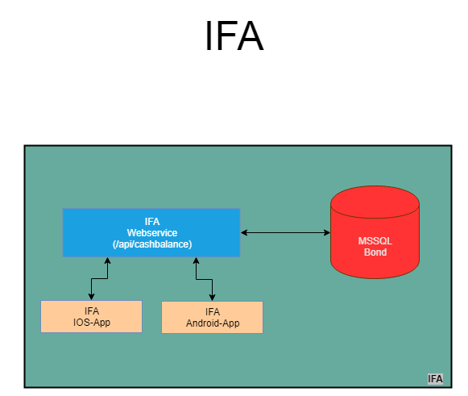

Slide 10
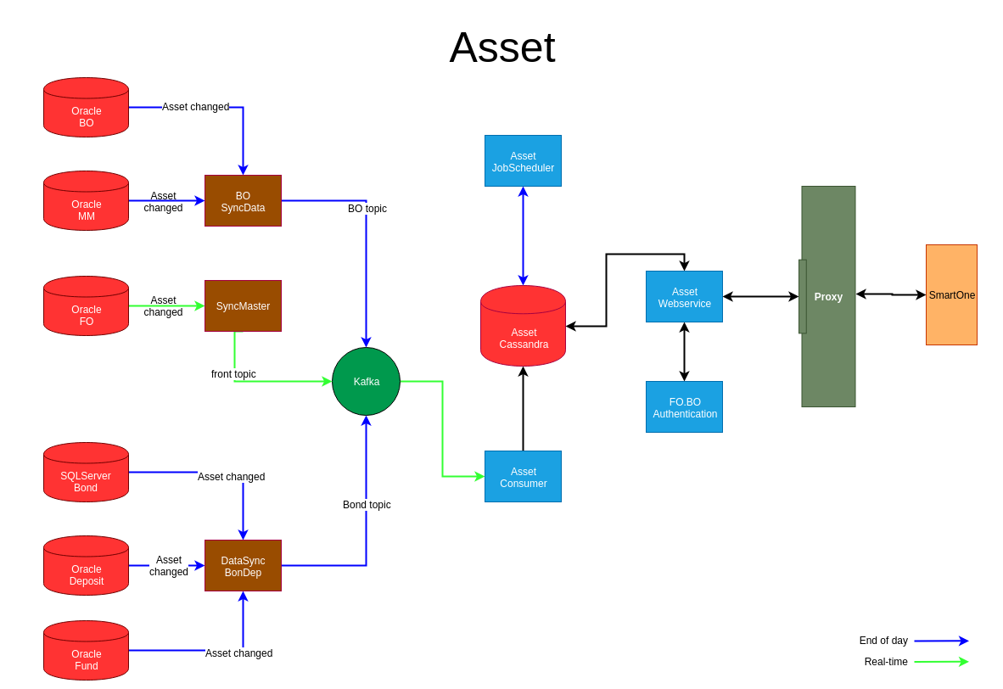

Slide 11
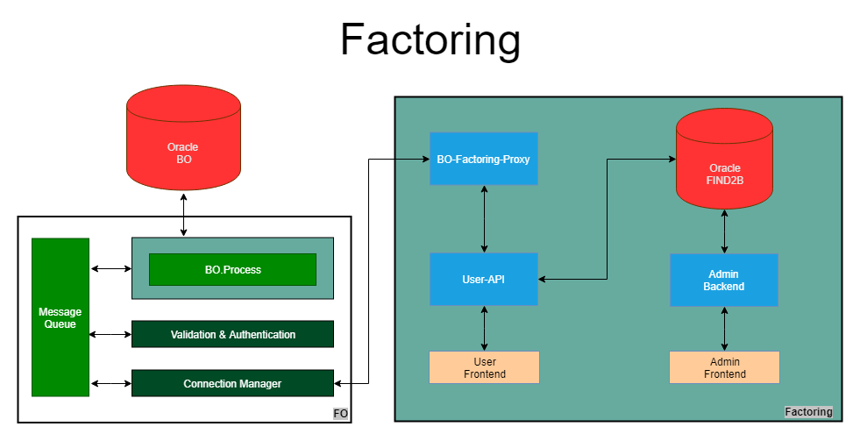

Slide 12
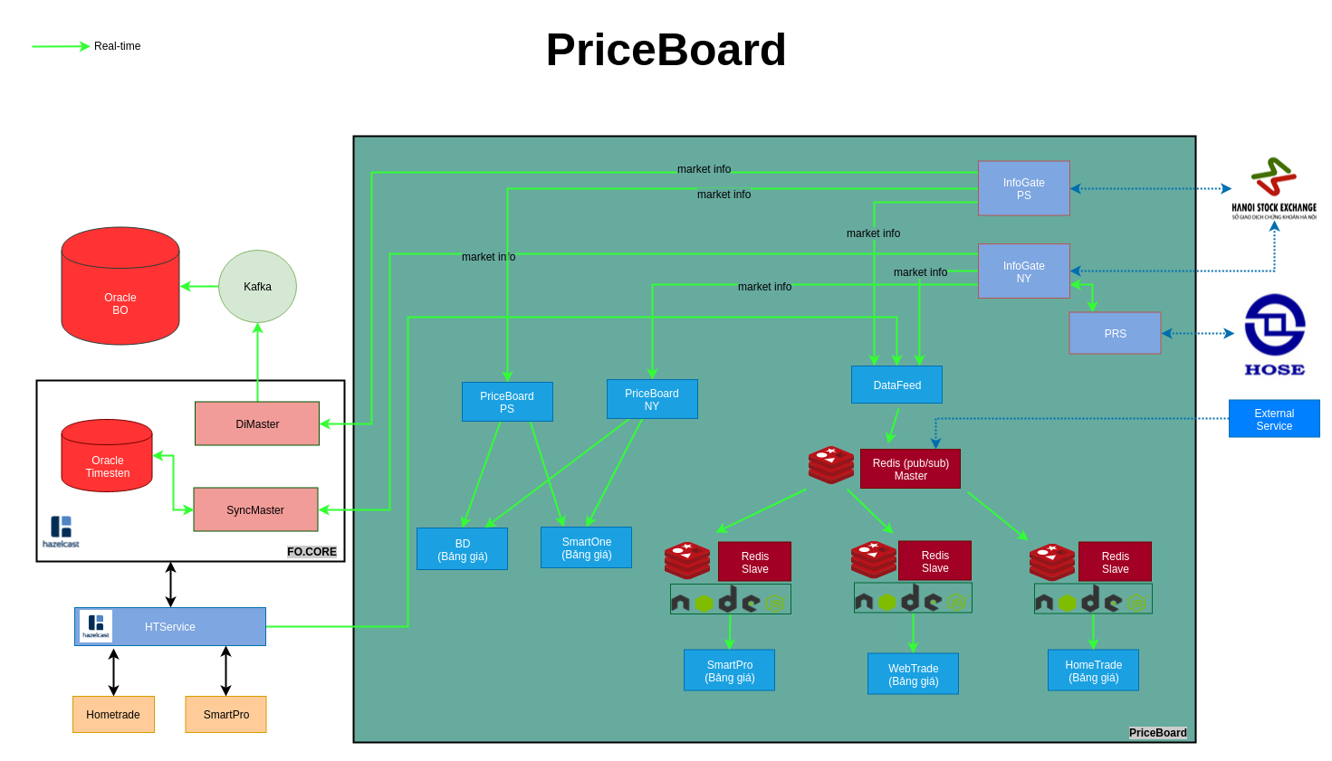

Slide 13
