Slide 1
Numerical Modeling of Control Rod Reactivity in the Kartini Research Reactor Using Differential Rod Worth Functions
Halim Hamadi

Slide 2
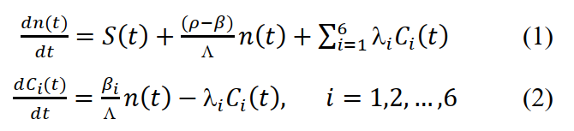
Kinematic Equations of the Kartini Reactor

Slide 3

Kinematic Equations of the Kartini Reactor
delete external neutron source term
the approach used:
Adding Thermal feedback term:

Slide 4
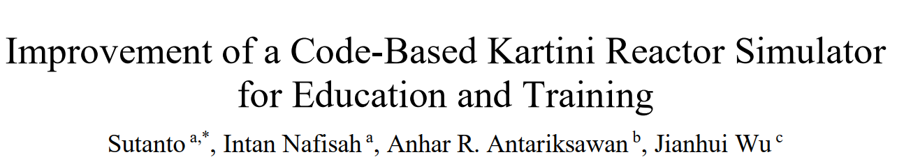
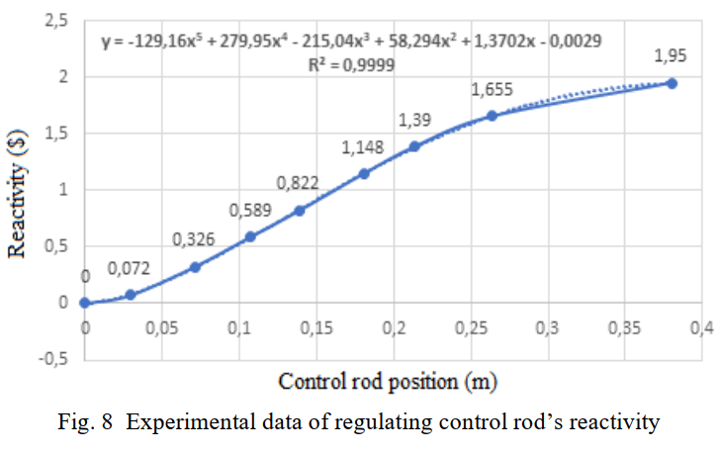
Reactivity Model with Control Rod Position
From paper

Slide 5
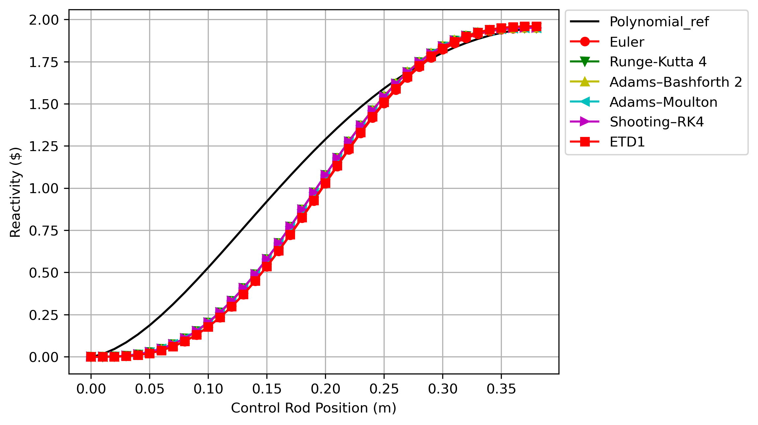

Reactivity Model Approach with Control Rod Position
Solve with some numerical method:
Euler
Runge-Kutta 4th orde
Adams Method (Adams-Bashforth 2 steps and Admas-Moulton)
Shooting ft RK4
Exponent Time Differencing (ETD)
Where x is stem position (from 0 to H);
H is control rod length;
$ρ_{total}$is total worth
ode_solve01.py
reference_function.py

Slide 6
Solve Kinematic Reactor Differential Equations
Solve the kinematic differential equation using some methods of solving differential equations
find the control rod speed (v) from the stored Kartini reactor operating data

Slide 7
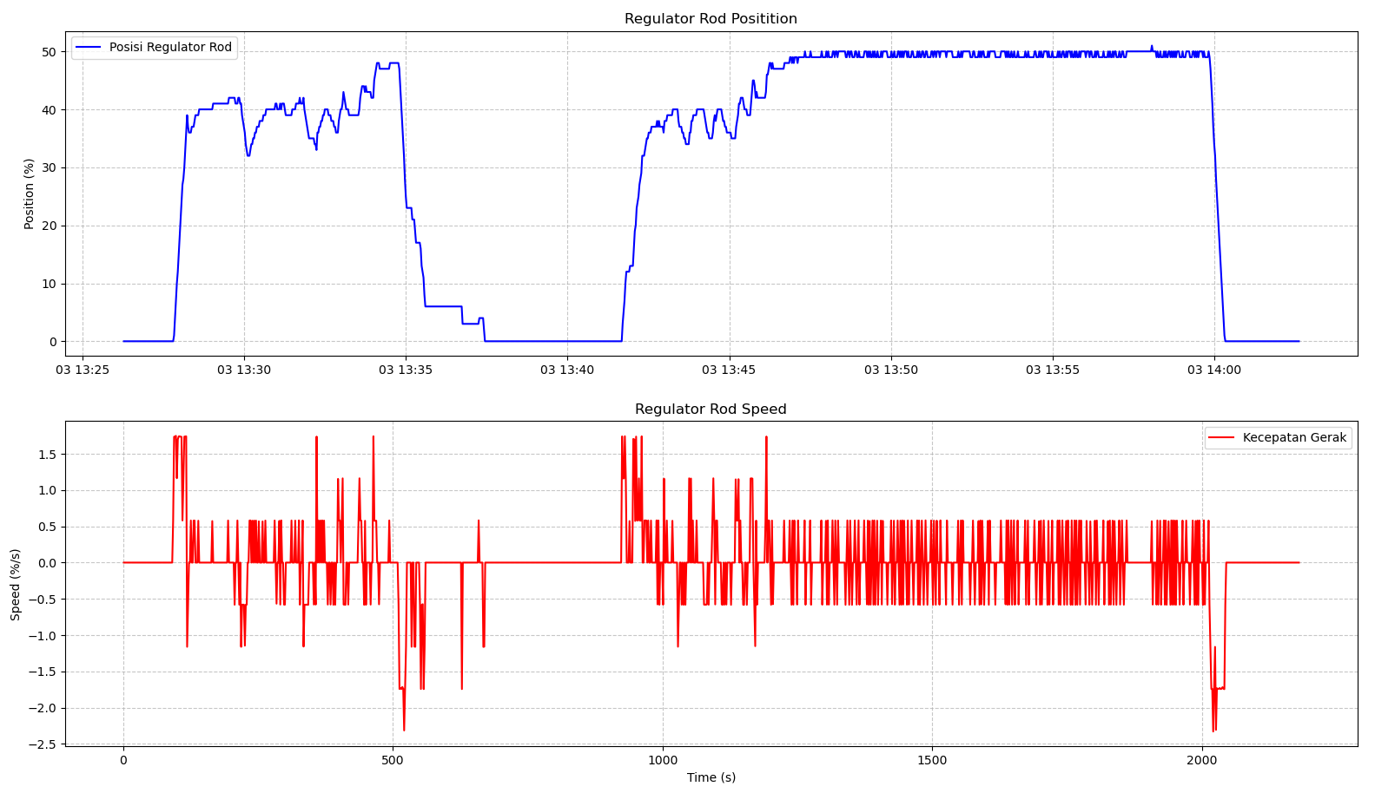
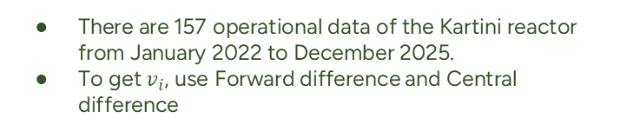
Speed Of The Control Rod Regulating The Kartini Reactor
There are 157 operational data of the Kartini reactor from January 2022 to December 2025.
To get $v_{i}$, use Forward difference and Central difference
Forward Difference:
Central Difference:

Slide 8
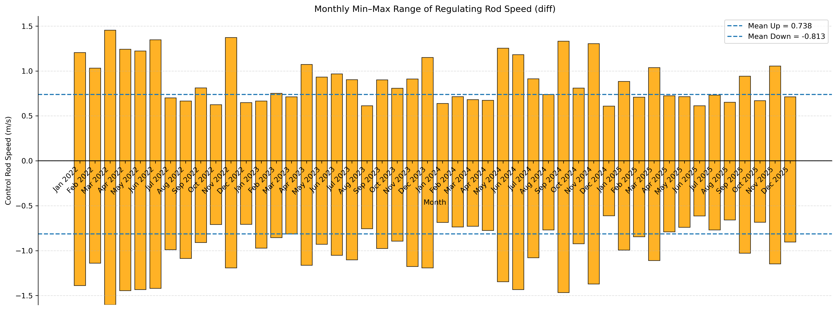
Speed Of The Control Rod Regulating The Kartini Reactor
From January 2022 to December 2025, the regulating rod mean speed using Forward diff is 0,738 when the regulating move from bottom to up, and -0,813 otherwise

Slide 9
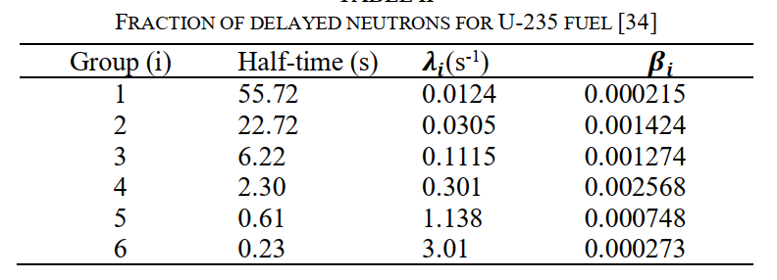
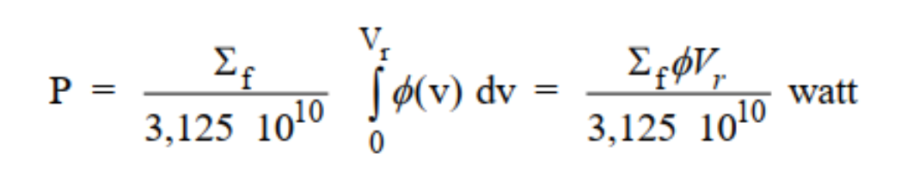
Solve Kinematic Reactor Differential Equations using Explicit Euler Method
All differential equations:
Variable Inputs:
The equation approach used:
The equation Explicit Euler:

Slide 10
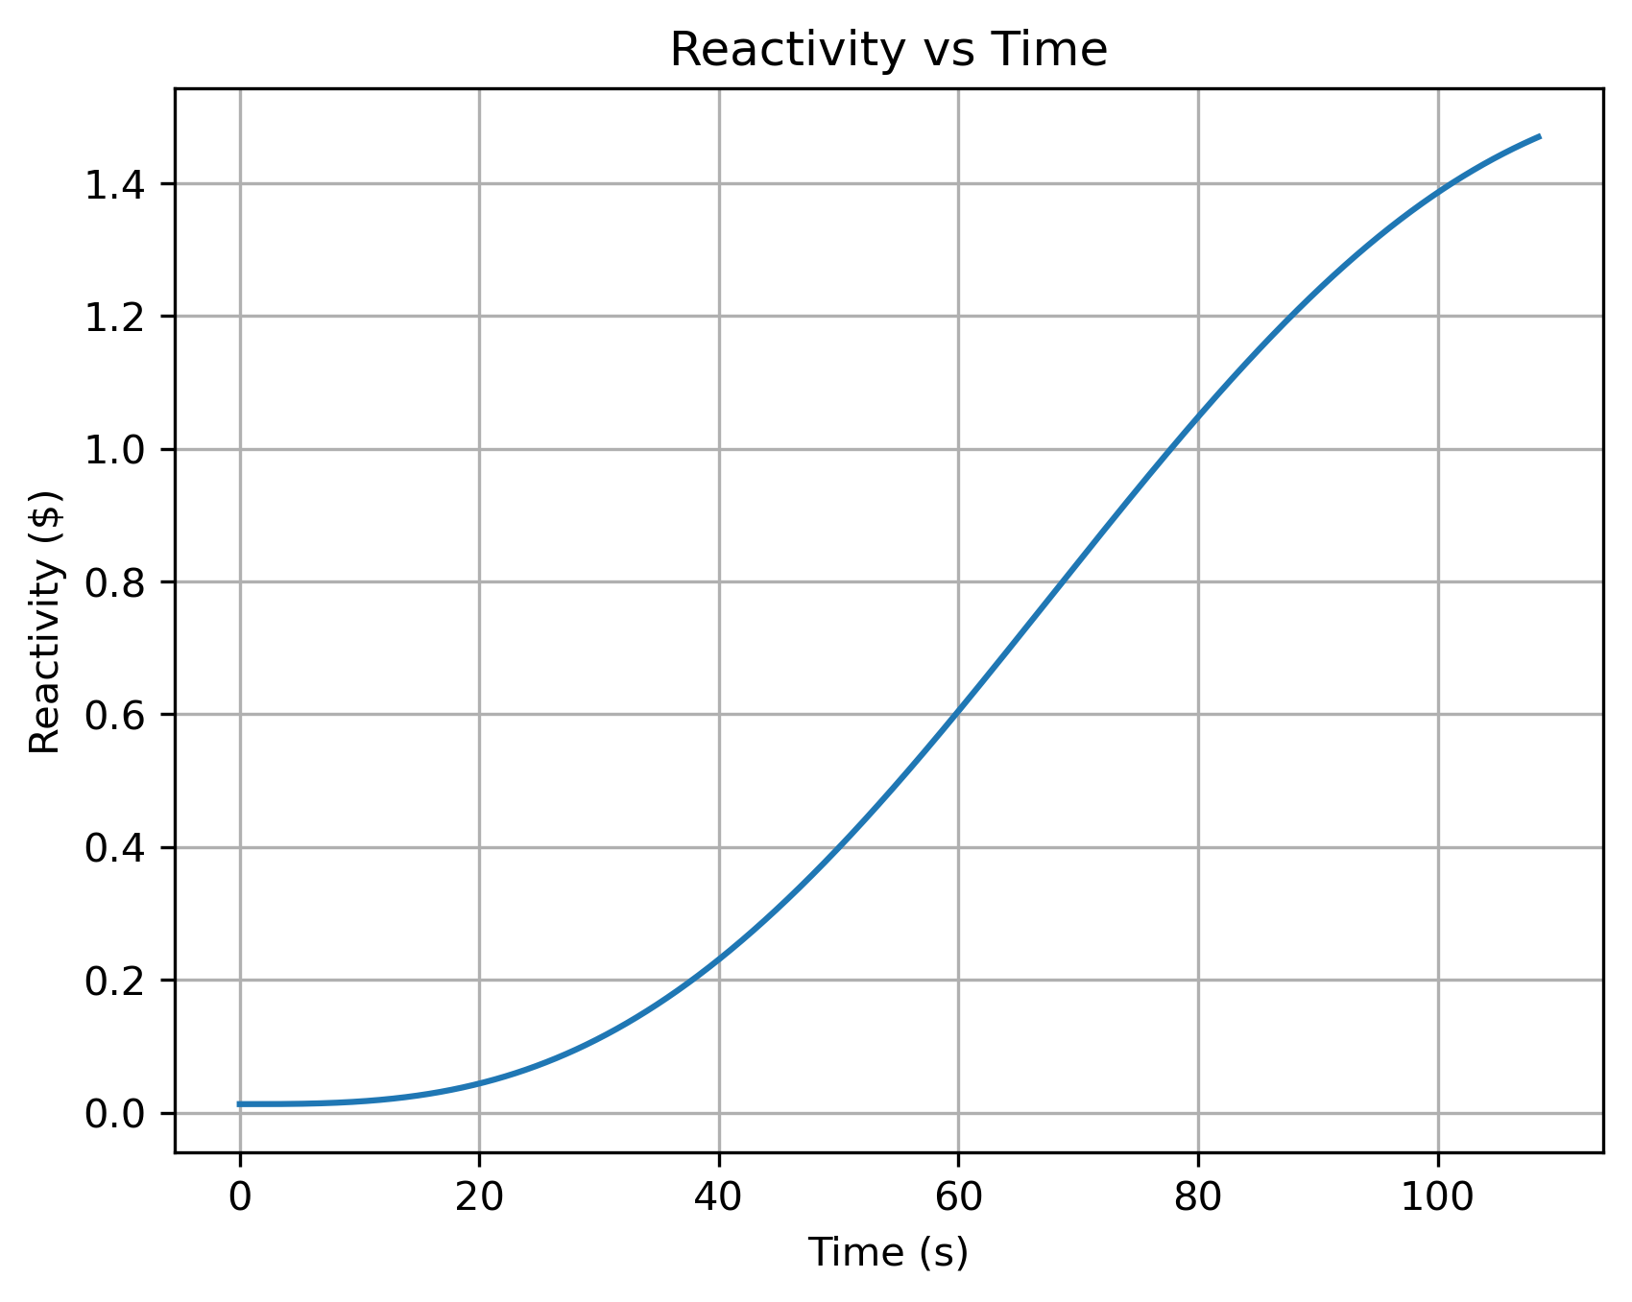
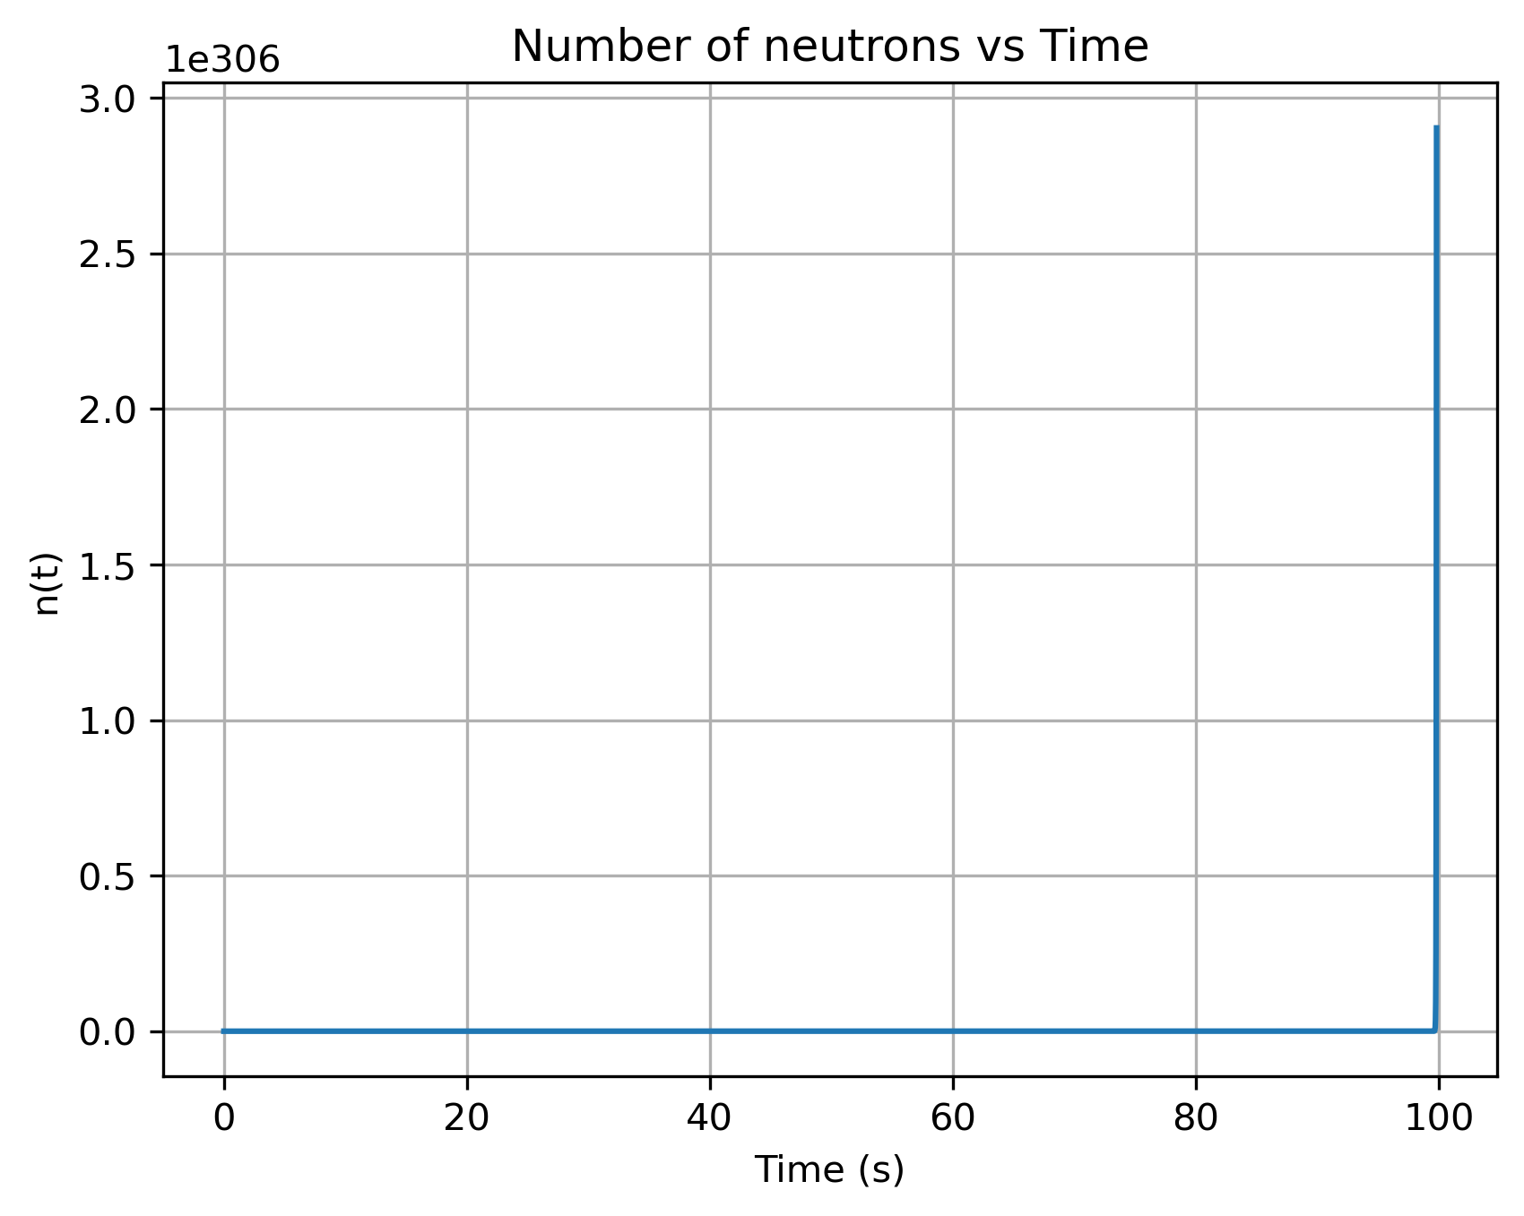
Solve Kinematic Reactor Differential Equations using Explicit Euler Method
Position = 80 %

Slide 11
Solve Kinematic Reactor Differential Equations using Explicit Euler Method with Temperature Feedback
All differential equations:
Variable Inputs:
The equation approach used:
Reactivity total:
Temperature Ordinary Differential Equation :
Notes:
ρrod​(t): reaktivitas dari batang (hasil model worth kamu, dalam absolut)
T(t): temperatur bahan bakar (atau temperatur efektif teras)
T0​: temperatur awal
a: konversi daya relatif → kenaikan suhu (K/s per unit n)
$b$: pendinginan ke lingkungan (1/s)

Slide 12
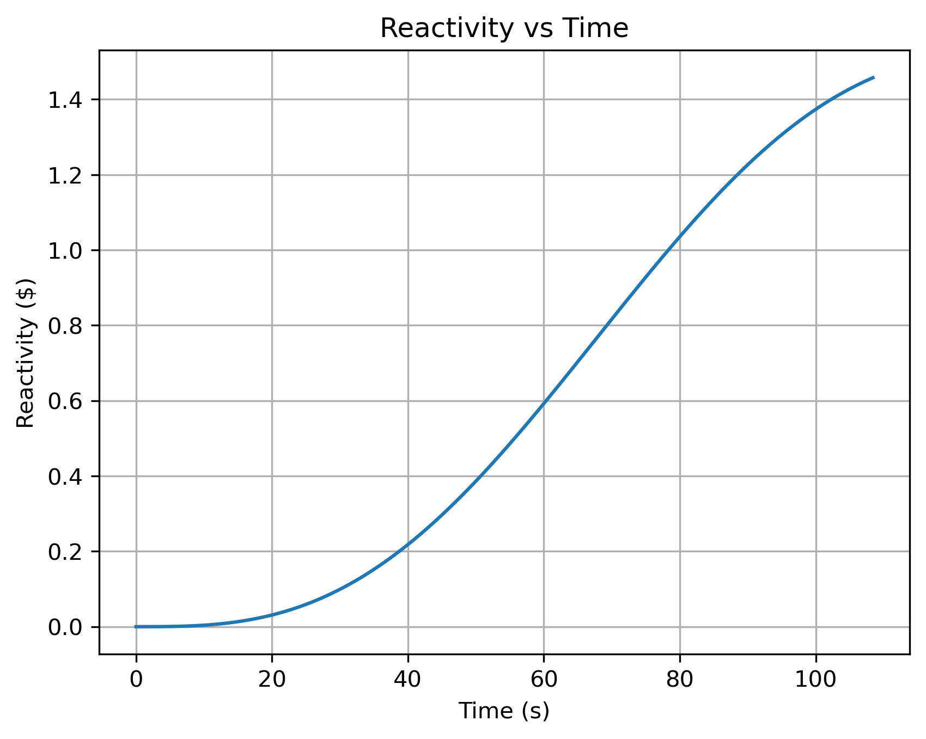
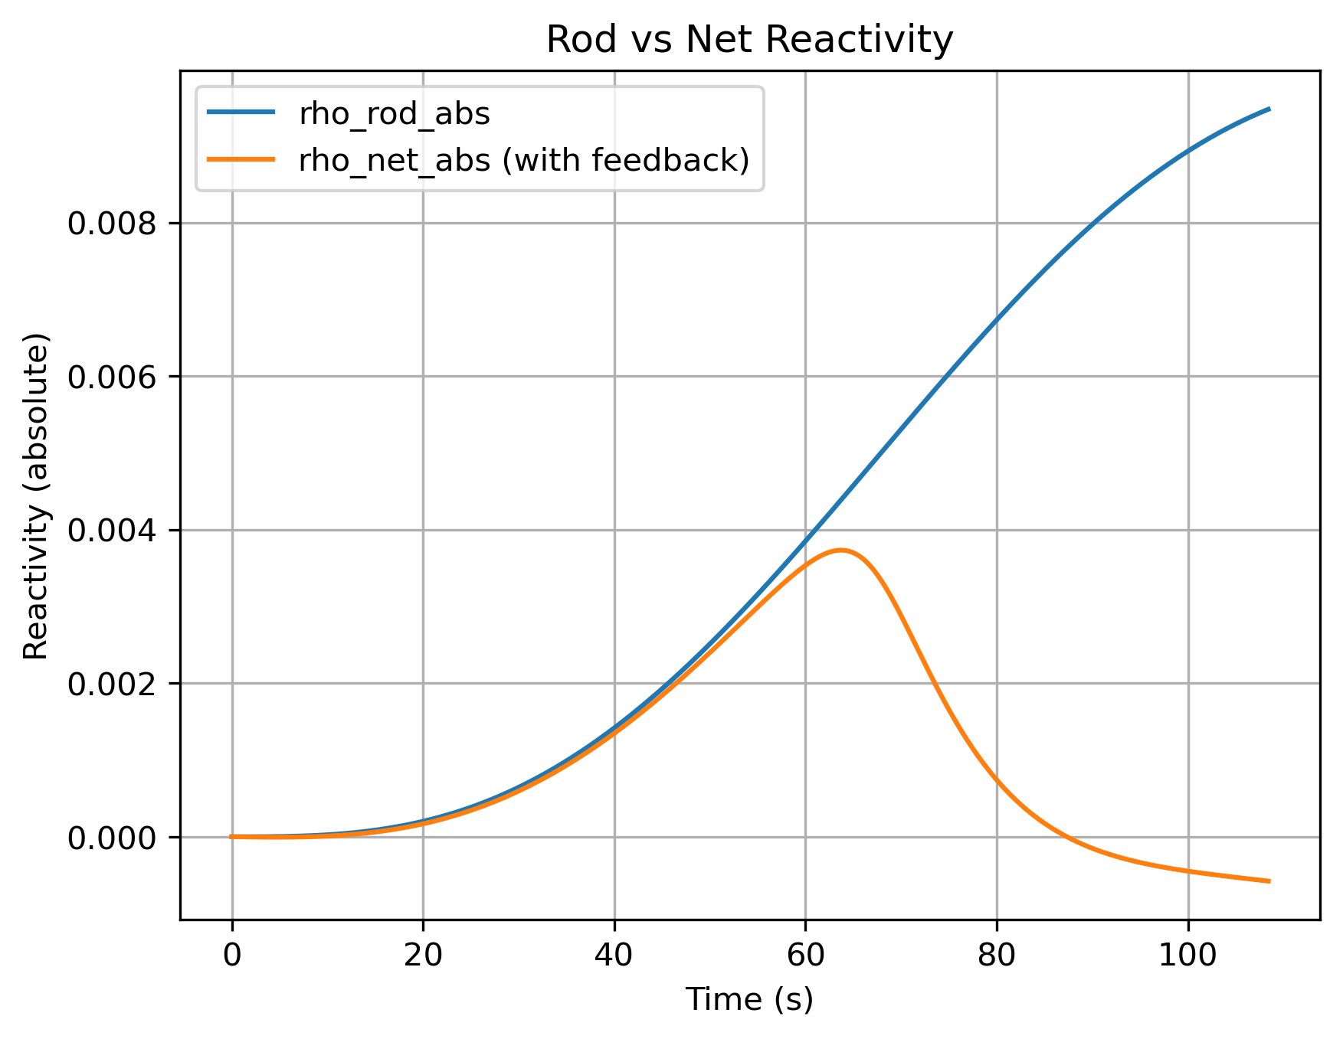
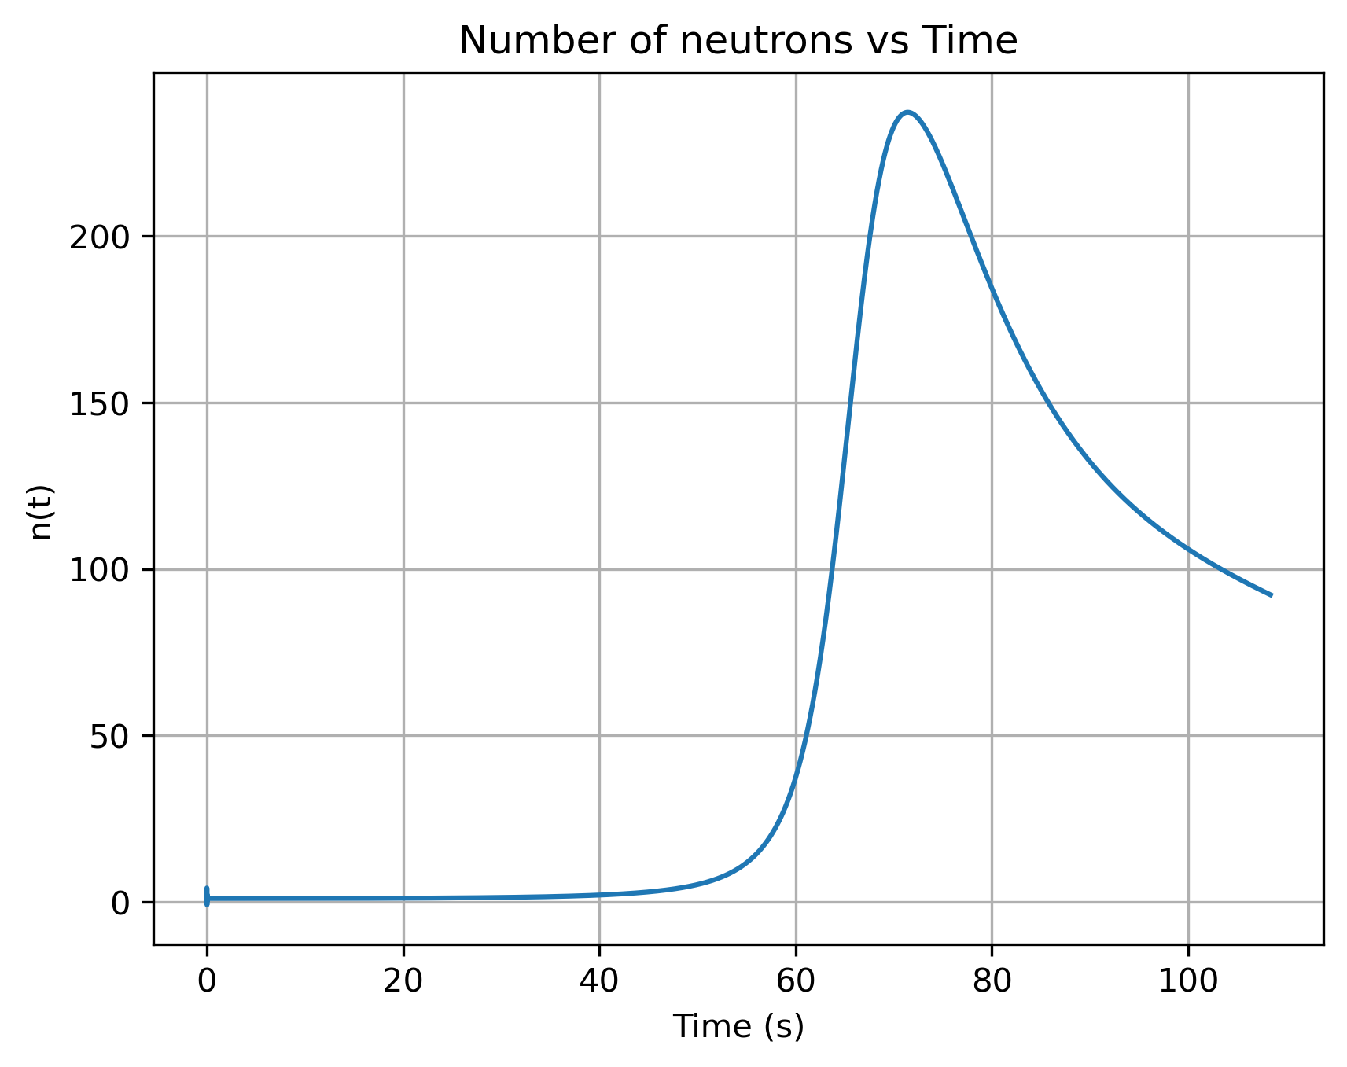
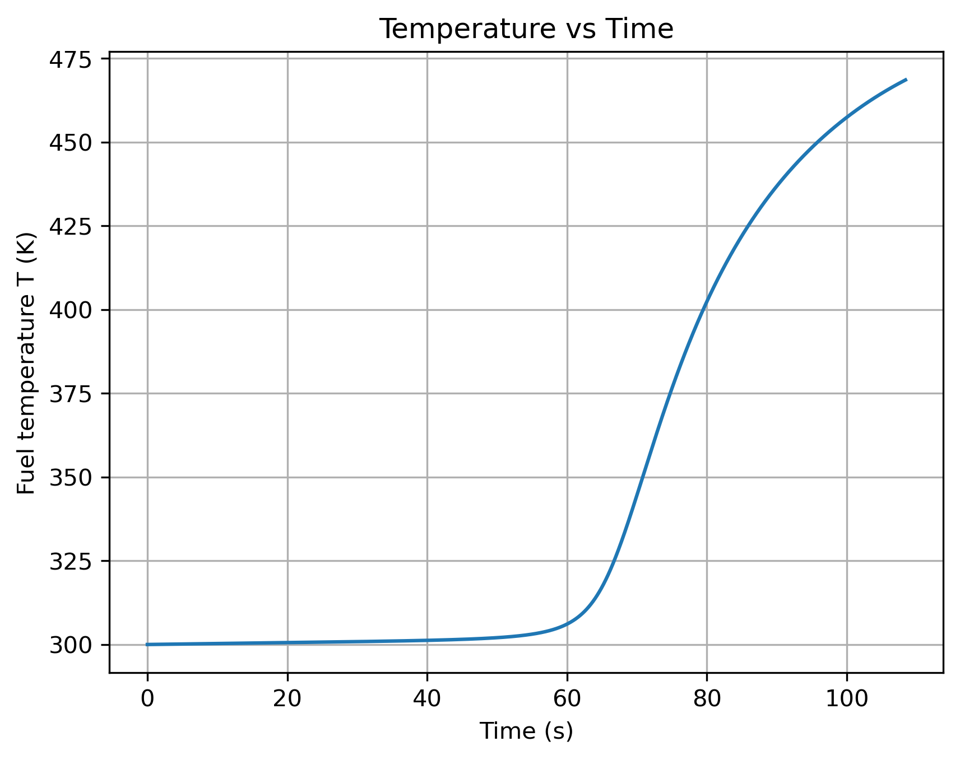
Solve Kinematic Reactor Differential Equations using Explicit Euler Method with Temperature Feedback

Slide 13
Solve Kinematic Reactor Differential Equations using Implicit Euler Method with Temperature Feedback
The equation Implicit Euler:

Slide 14
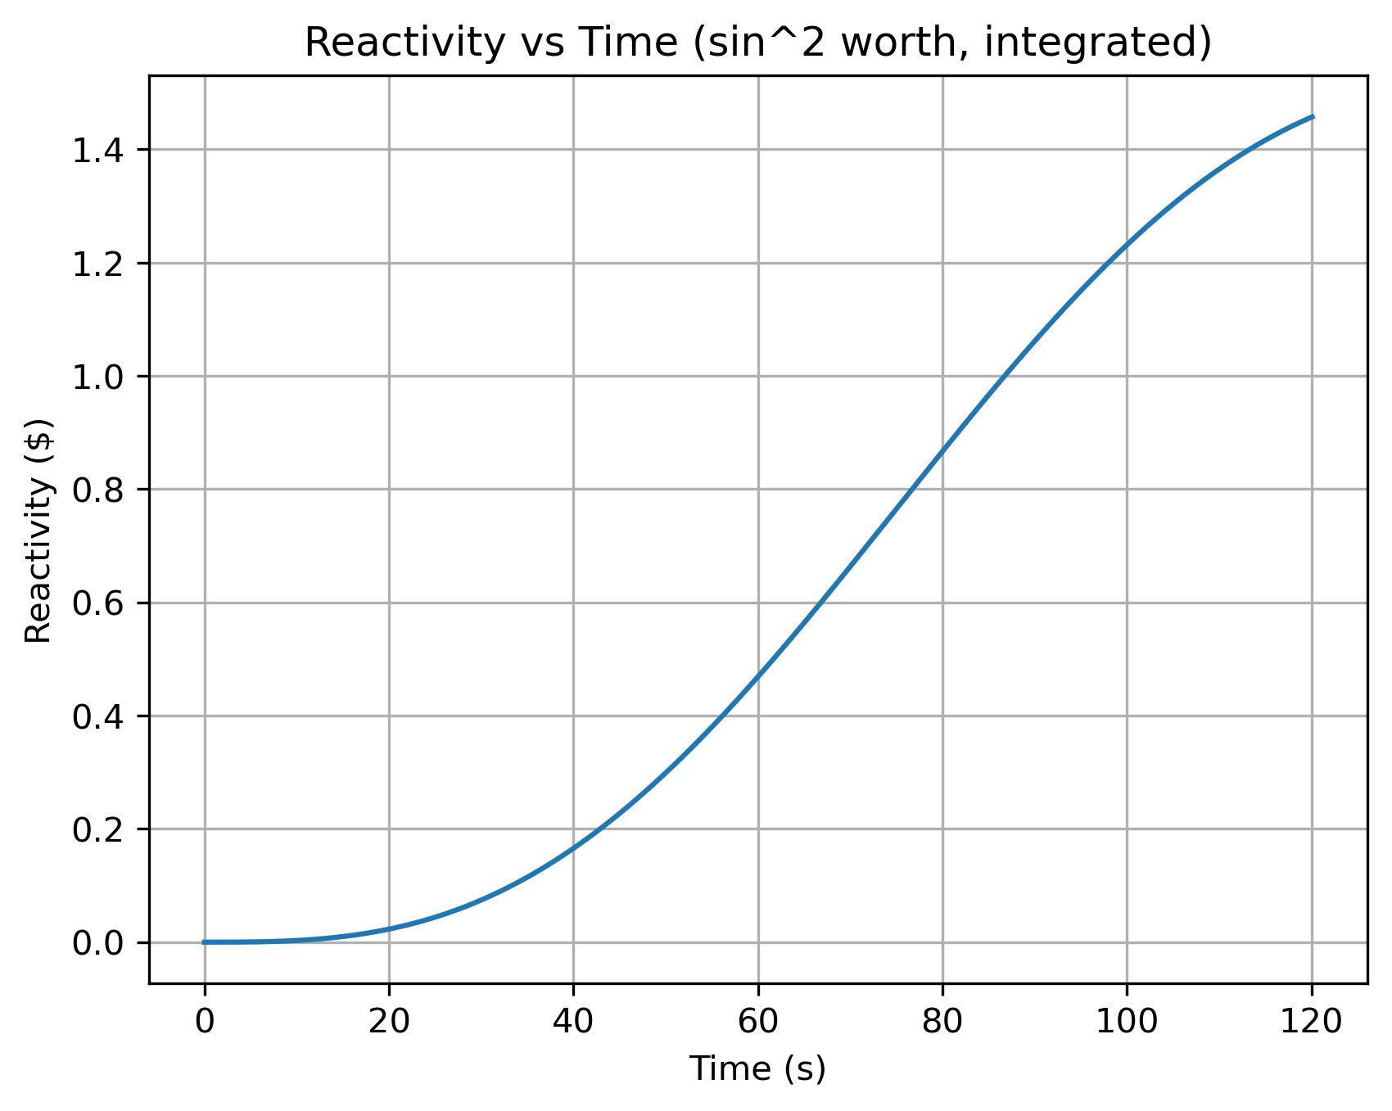
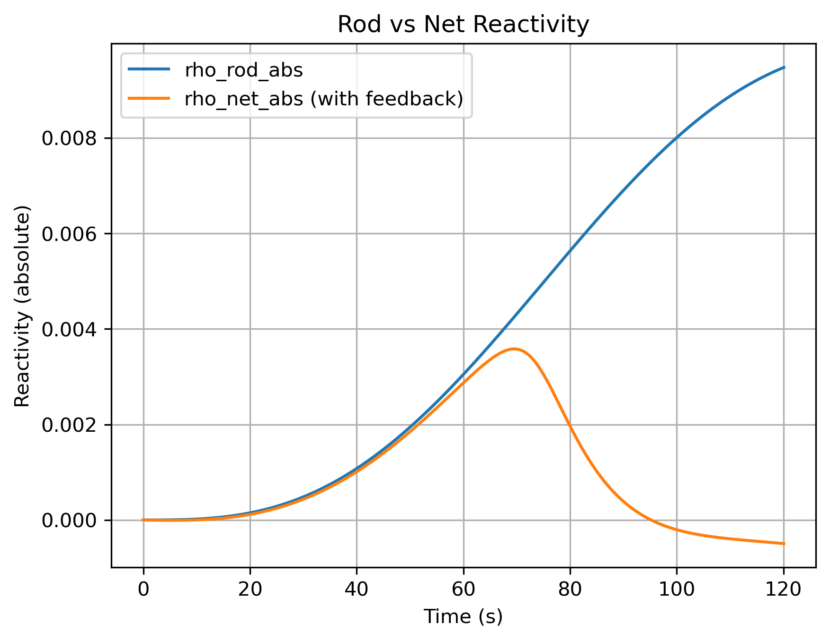
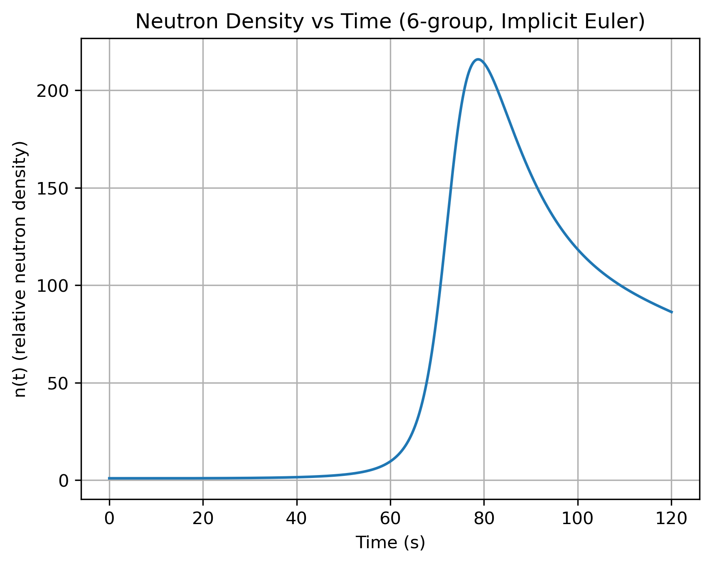
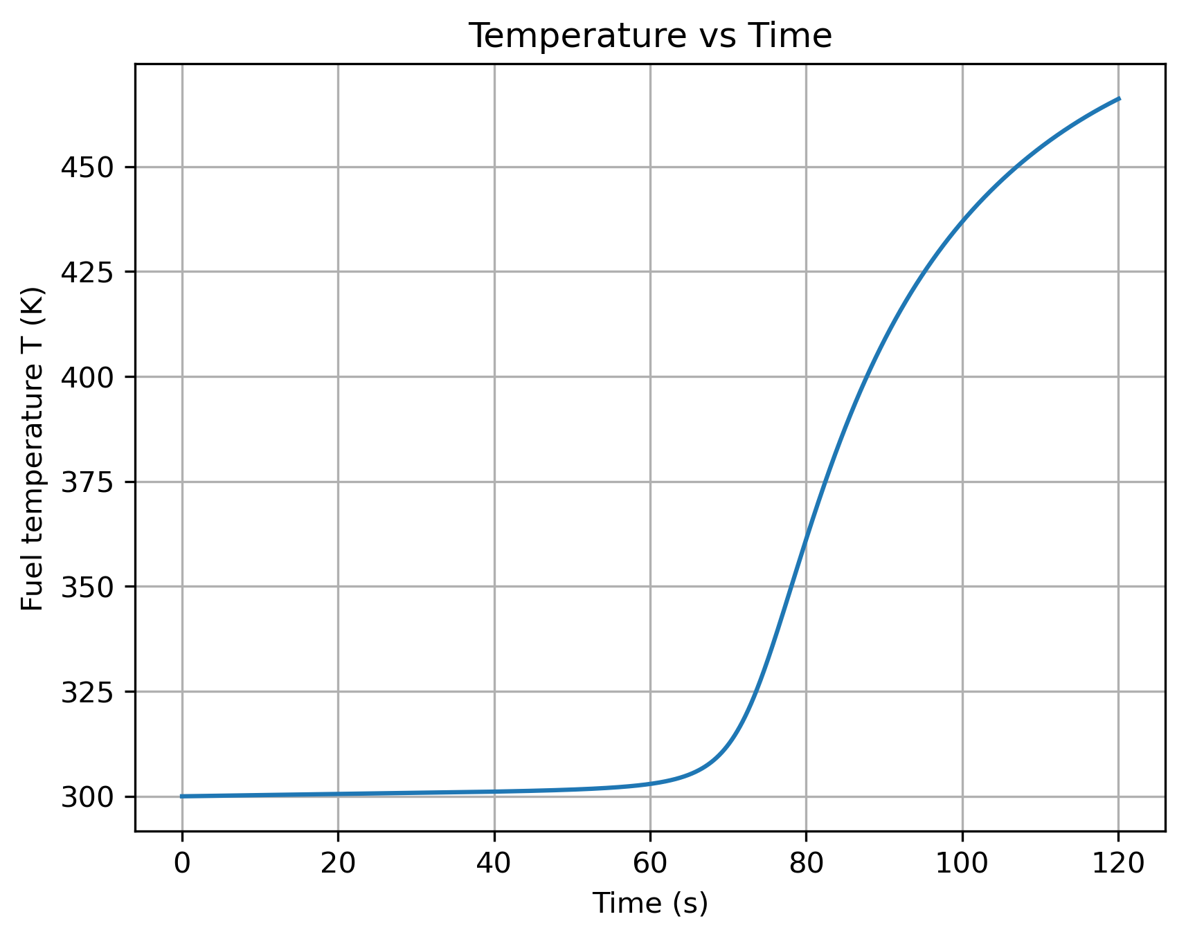
Solve Kinematic Reactor Differential Equations using Implicit Euler Method with Temperature Feedback

Slide 15
Solve Kinematic Reactor Differential Equations using Runge-Kutta 4th Method with Temperature Feedback
The equation Runge-Kutta 4th (RK4):

Slide 16
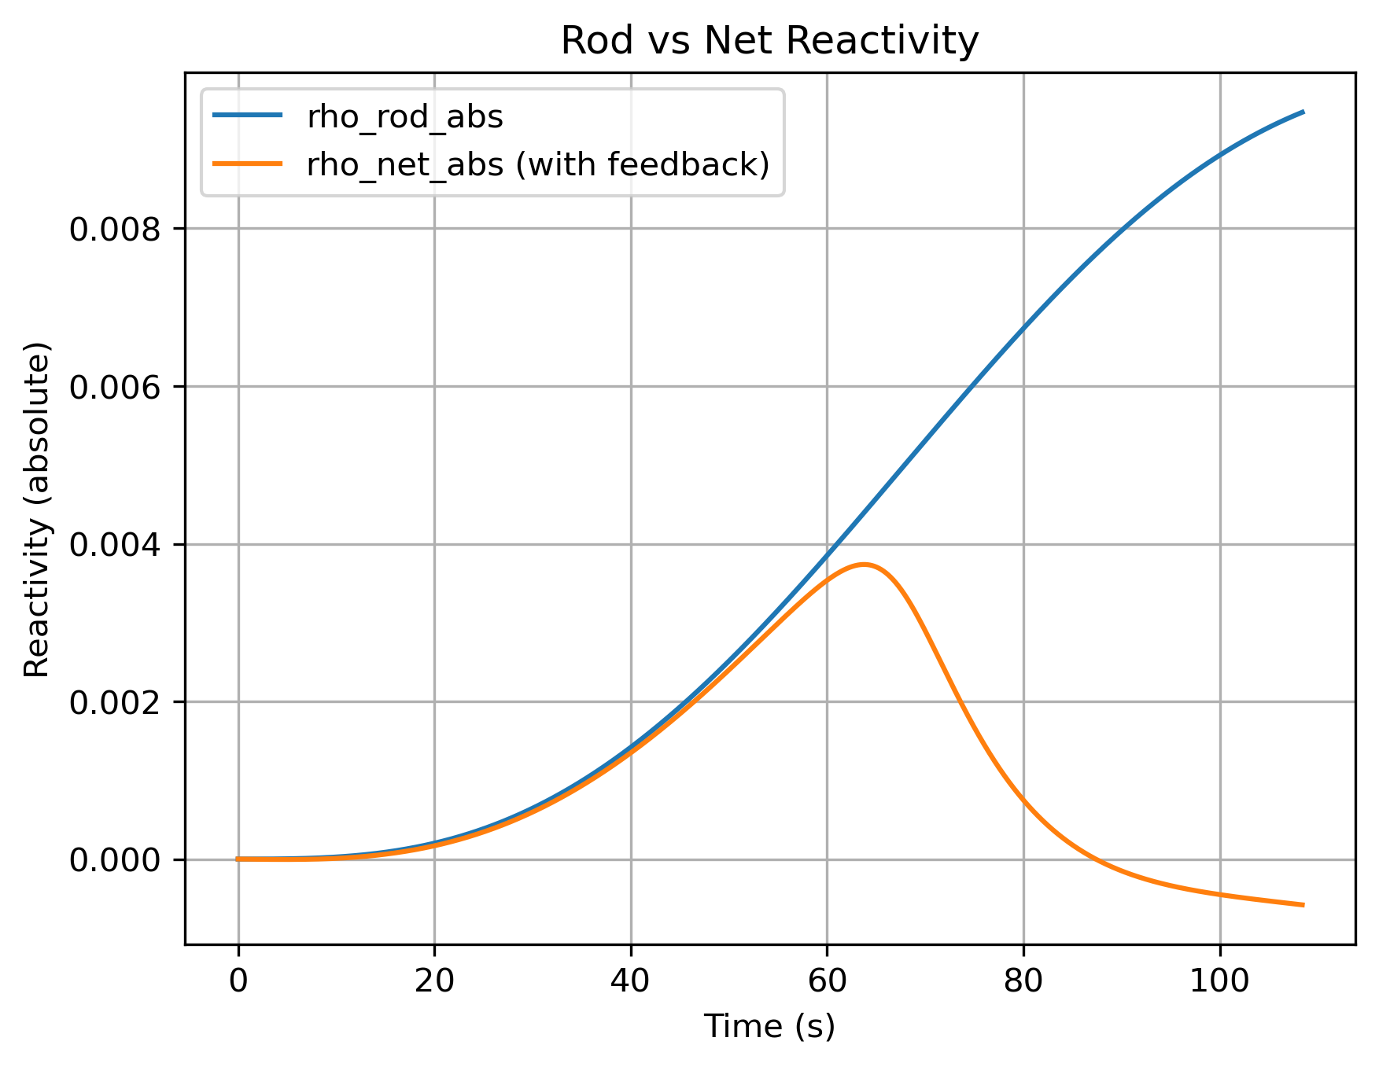
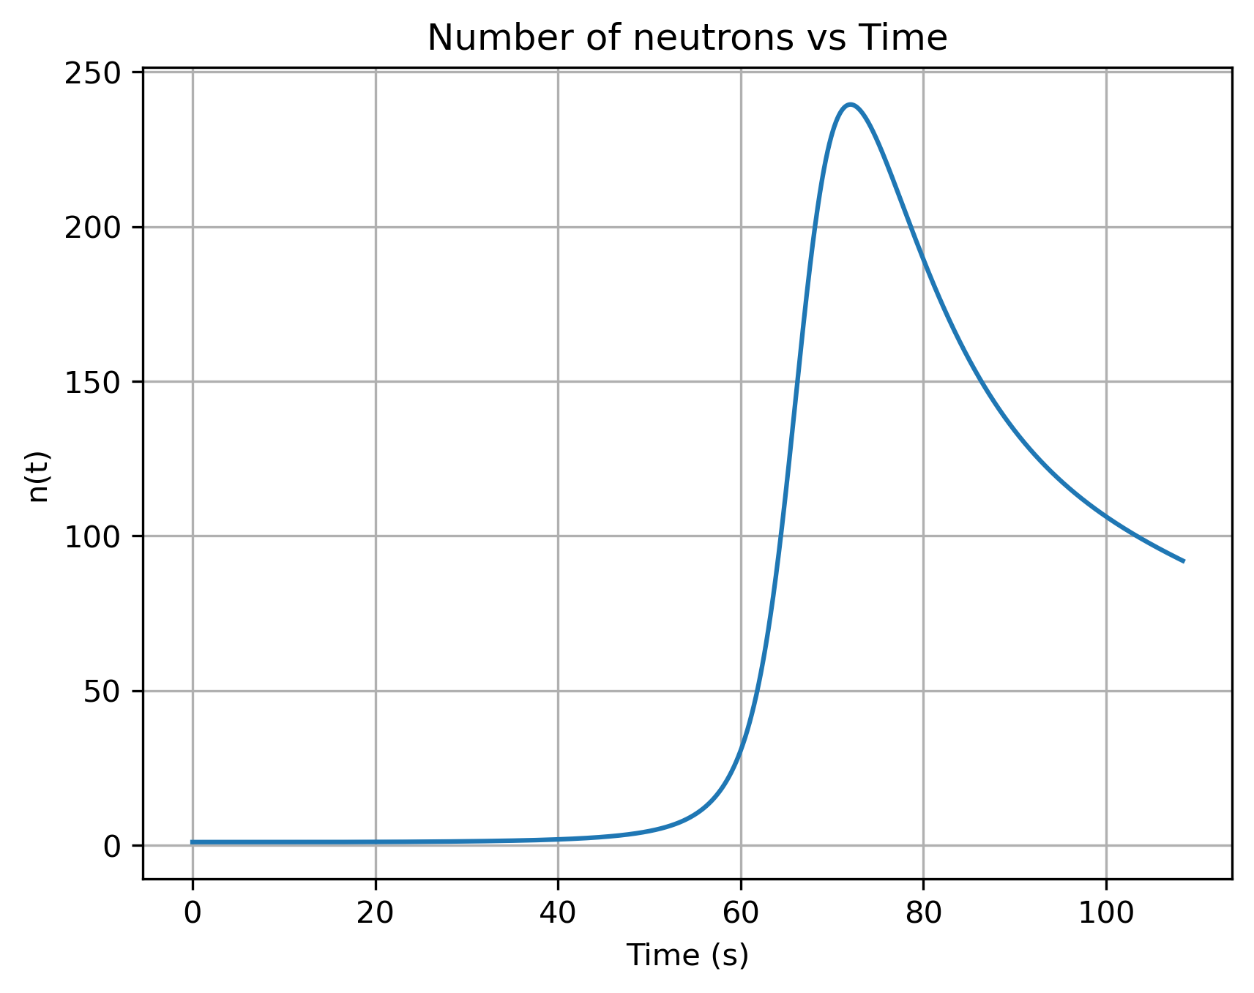

Solve Kinematic Reactor Differential Equations using Runge-Kutta 4th Method with Temperature Feedback

Slide 17
Solve Kinematic Reactor Differential Equations using Exponential Time Differencing (ETD) 1st Method with Temperature Feedback
The equation Runge-Kutta 4th (RK4):

Slide 18


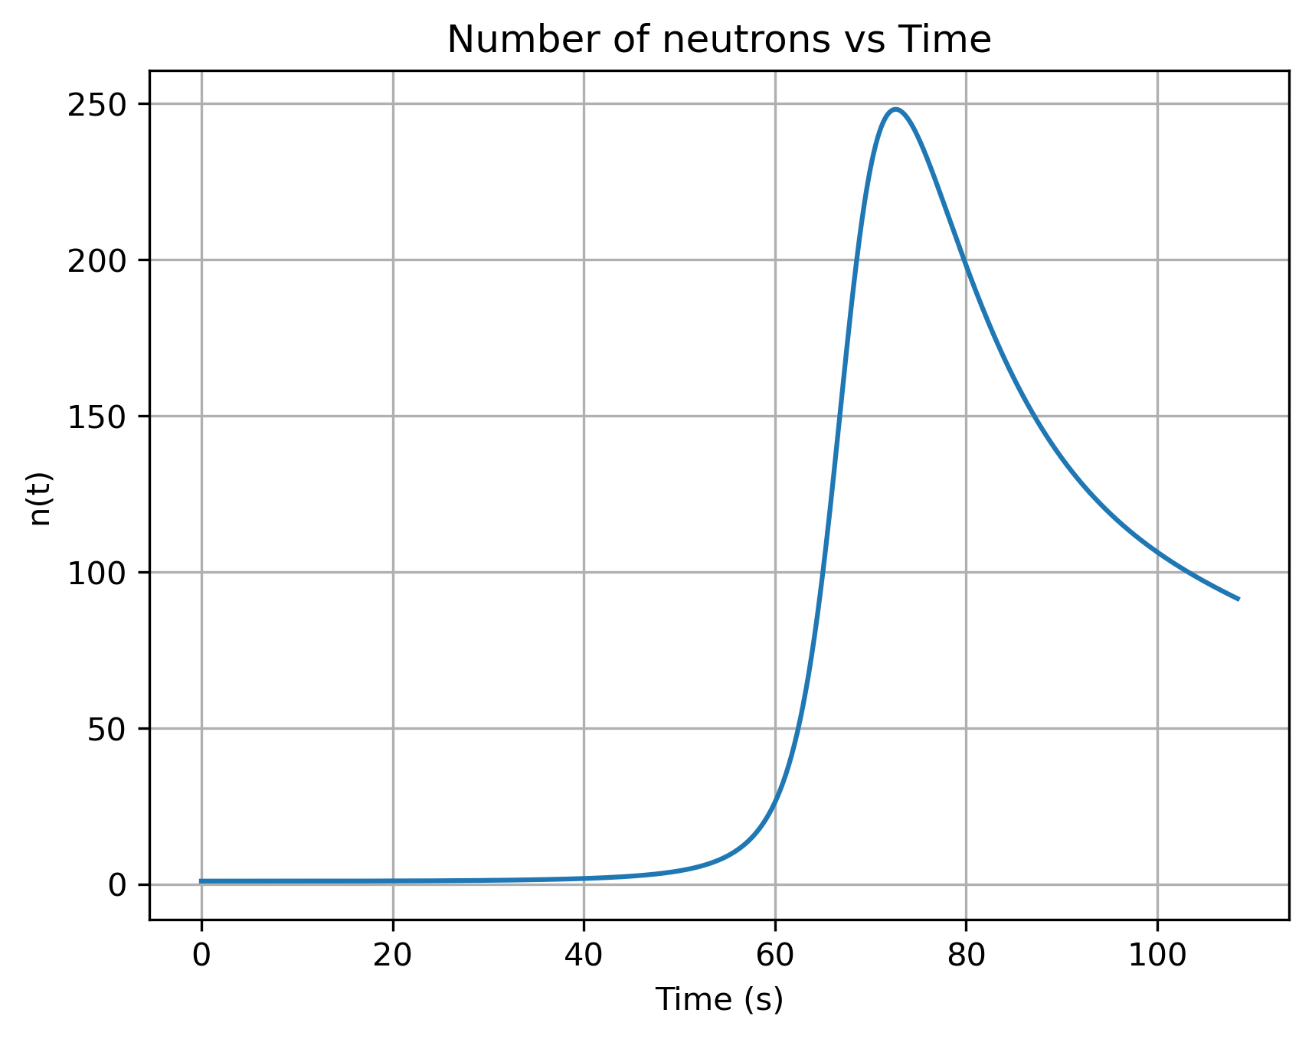
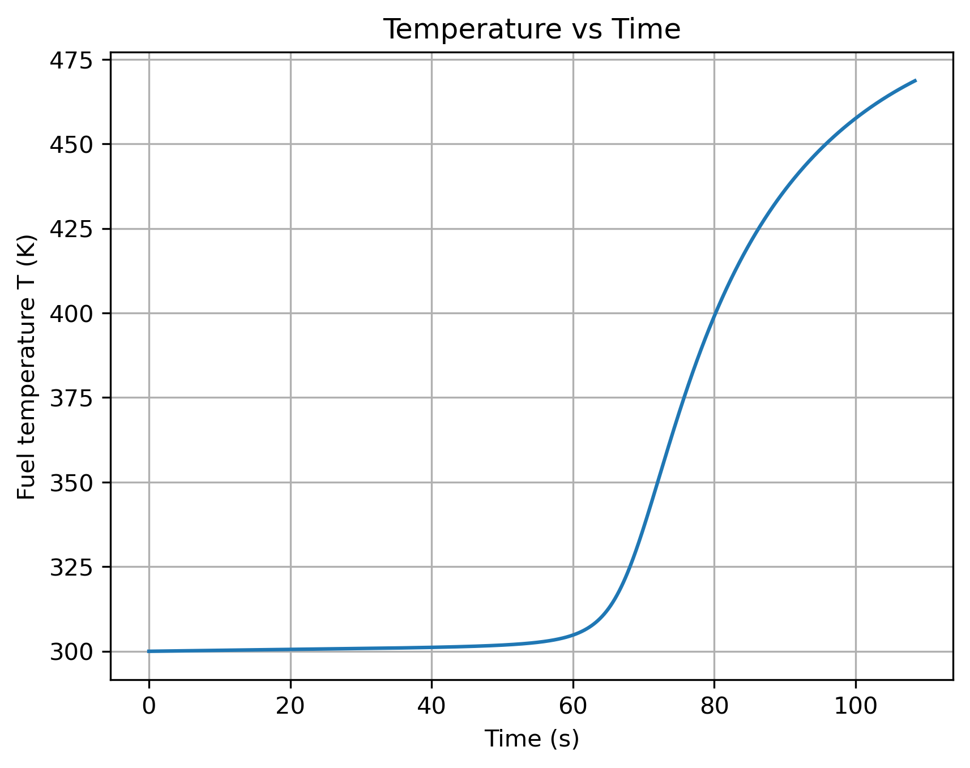
Solve Kinematic Reactor Differential Equations using Exponential Time Differencing (ETD) 1st Method with Temperature Feedback

Slide 19
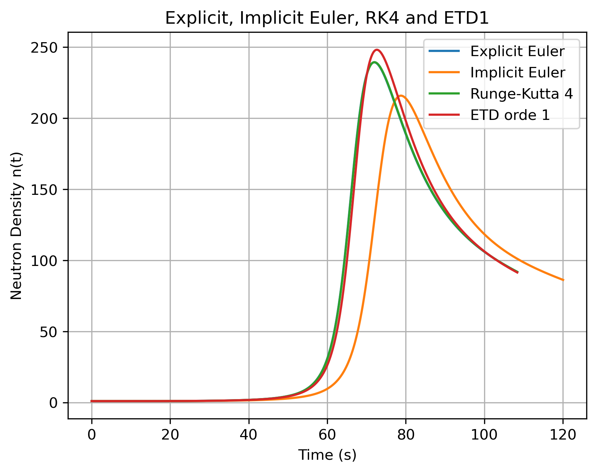
Compare all method in neutron density

Slide 20
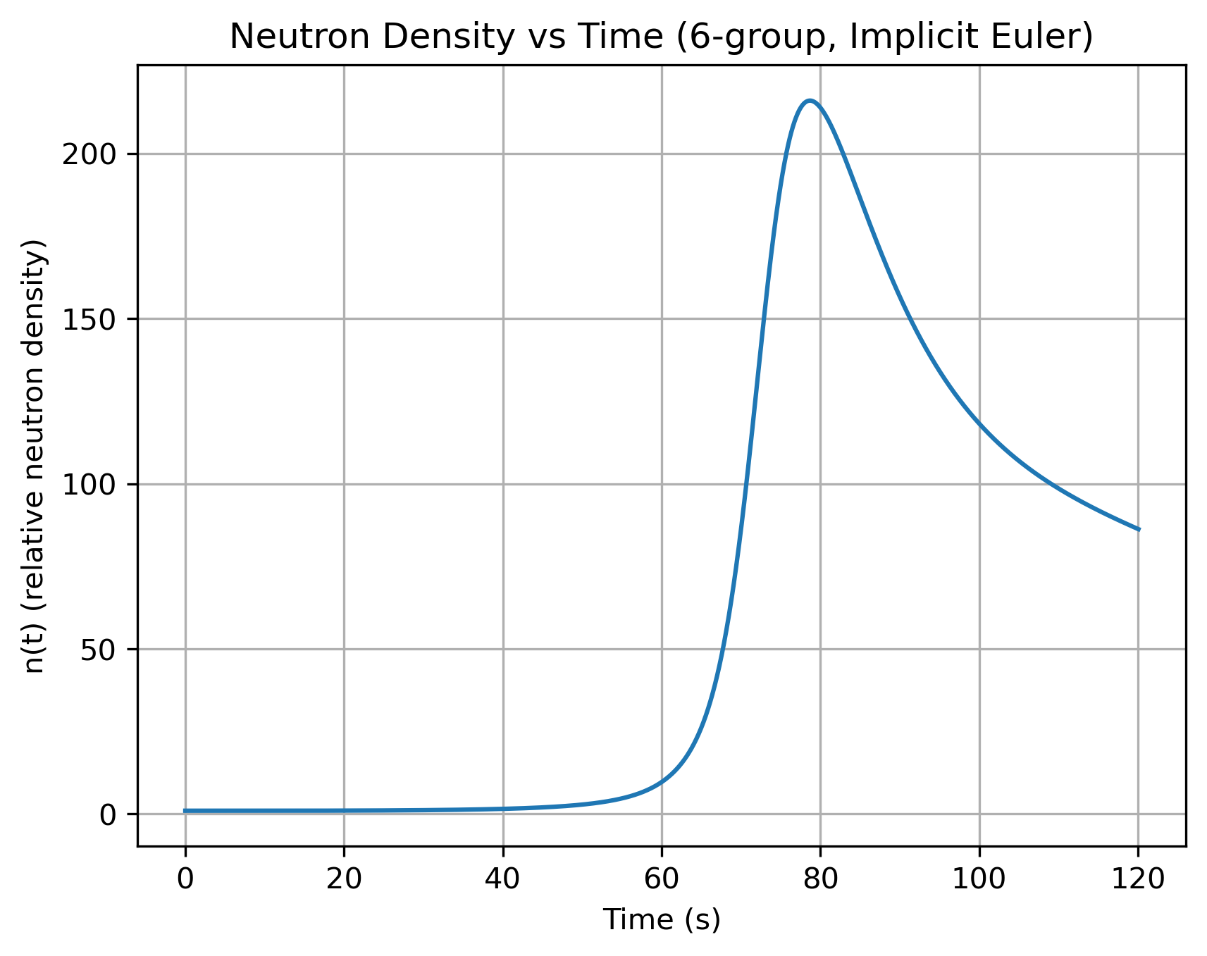
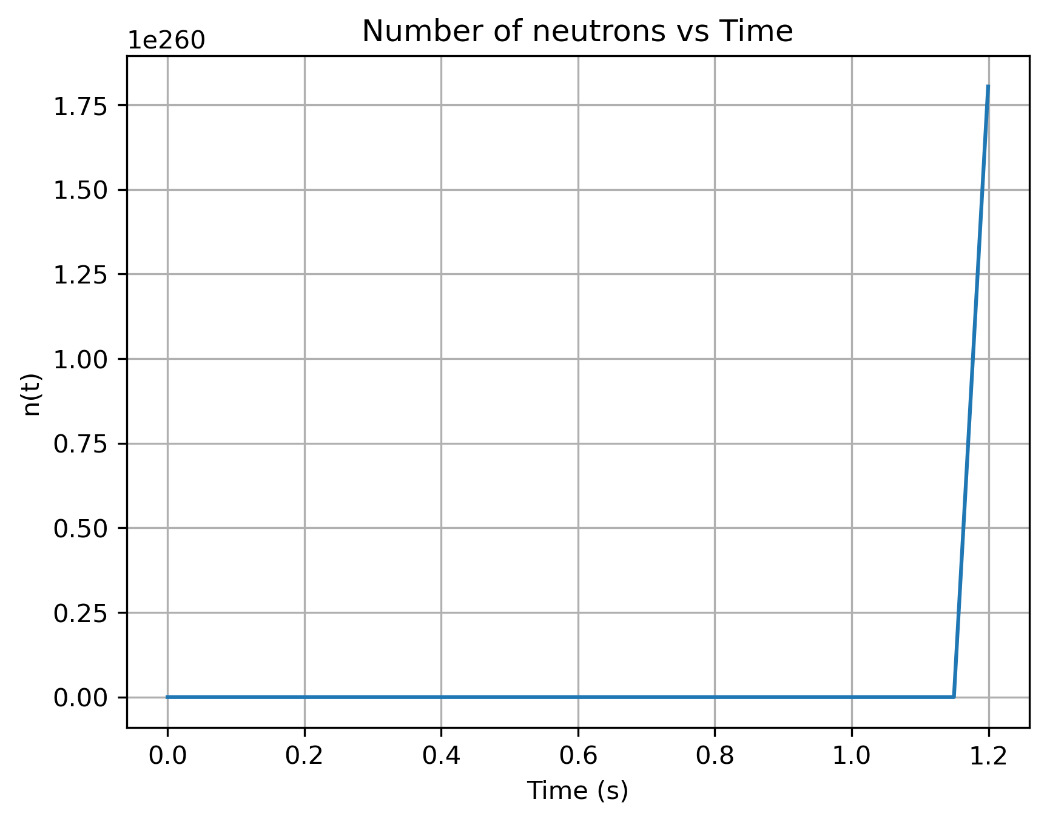
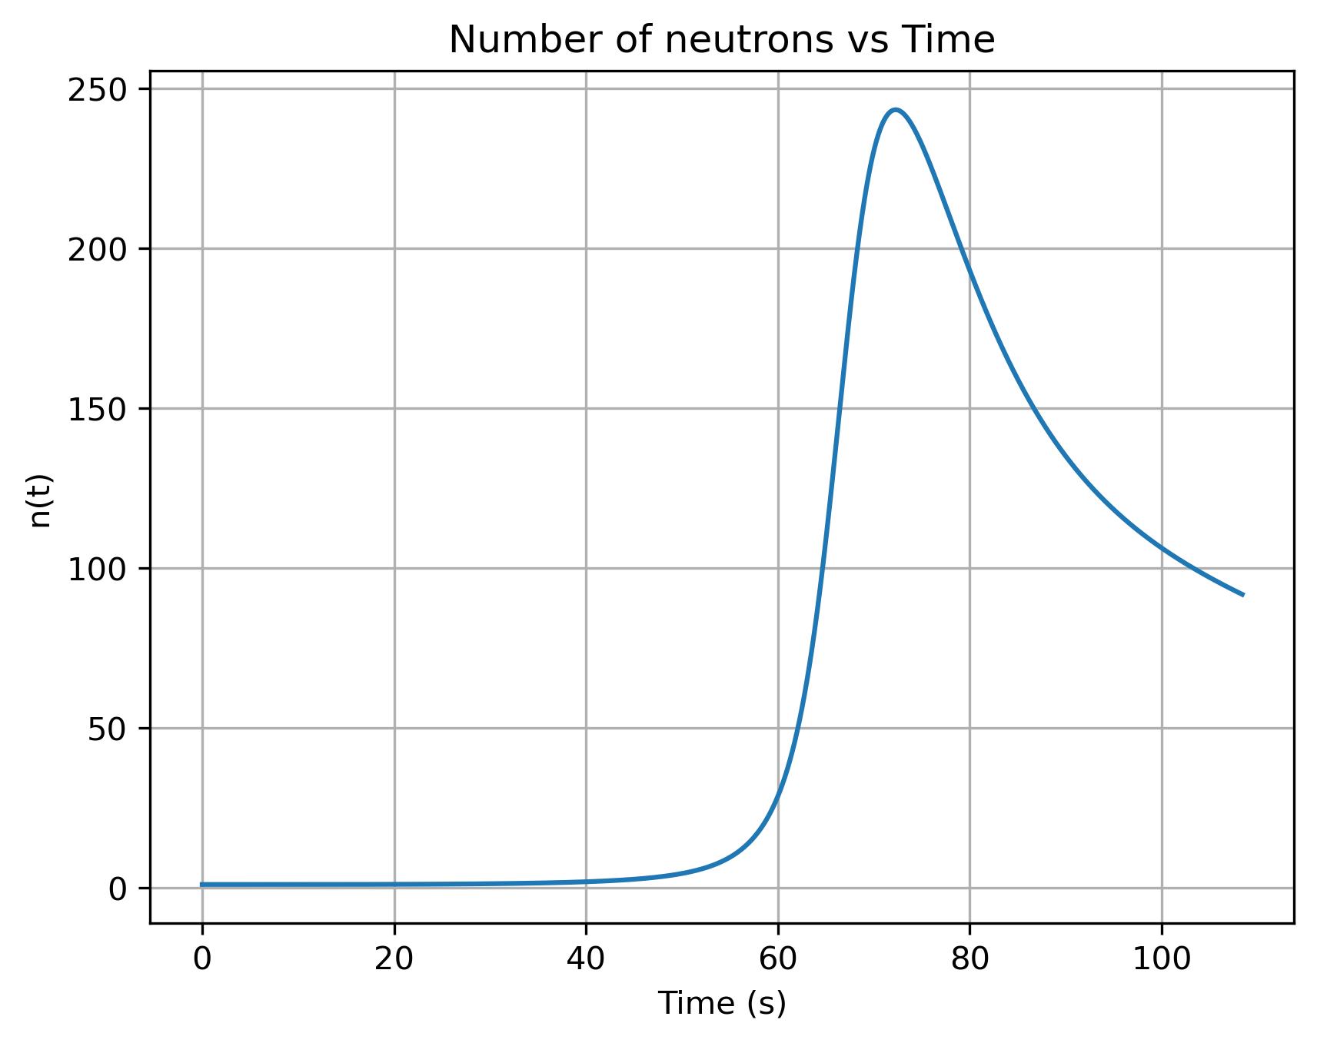
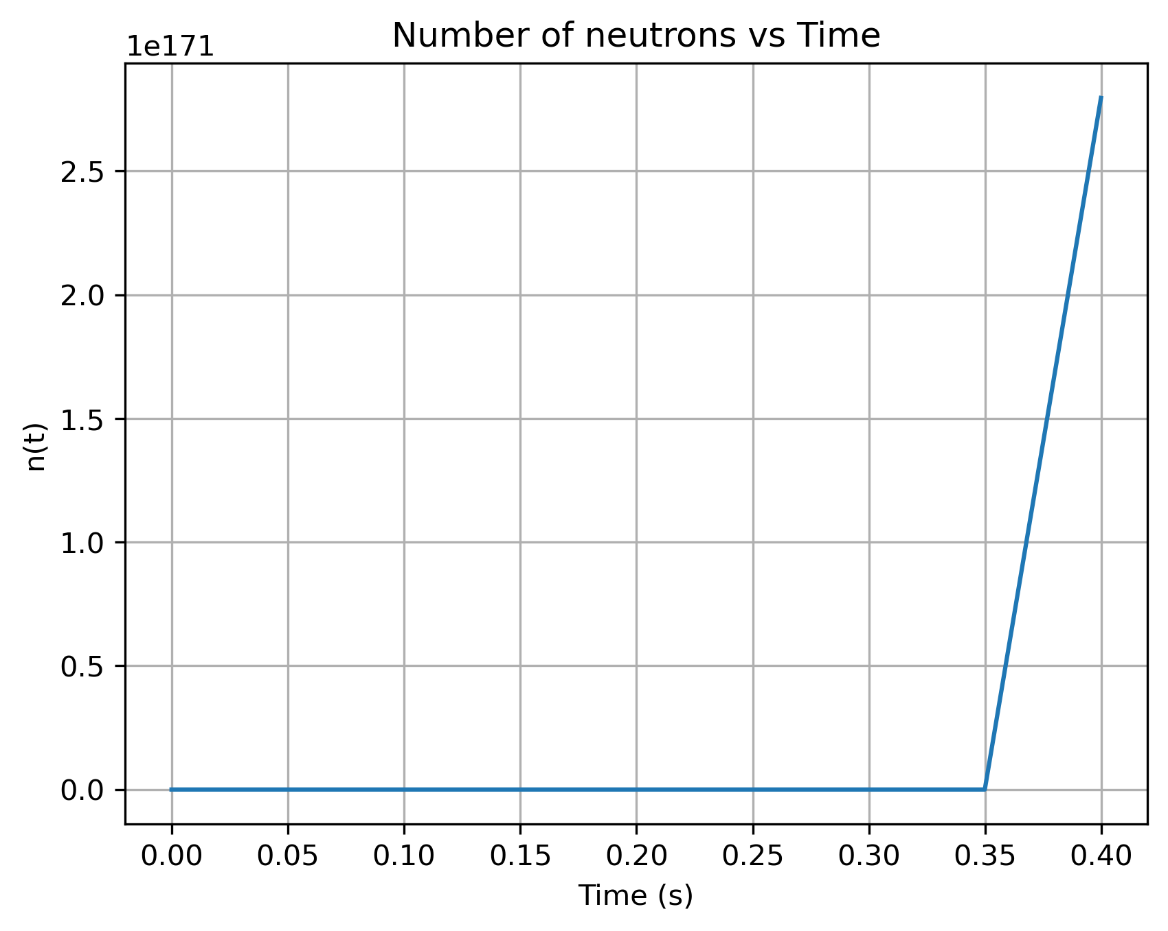
h=0.05
Implicit euler
Explicit euler
ETD1
RK4

