Slide 1
CAS CS 460/660
Introduction to Database Systems
File Organization
Slides from UC Berkeley

Slide 2
Context
Database app
Query Optimization
and Execution
Relational Operators
These layers
must consider
concurrency
control and
recovery
Access Methods
Buffer Management
Disk Space Management
Student Records stored on disk

Slide 3
Files of Records
Disk blocks are the interface for I/O, but…
Higher levels of DBMS operate on records, and files of records.
FILE: A collection of pages, each containing a number of records. The File API must support:
  insert/delete/modify record
  fetch a particular record (specified by record id)
  scan all records (possibly with some conditions on the records to be retrieved)
Typically: file page size = disk block size = buffer frame size

Slide 4
“MetaData” - System Catalogs
How to impose structure on all those bytes??
MetaData: “Data about Data”
For each relation:
  name, file location, file structure (e.g., Heap file)
  attribute name and type, for each attribute
  index name, for each index
  integrity constraints
For each index:
  structure (e.g., B+ tree) and search key fields
For each view: view name and definition
Plus statistics, authorization, buffer pool size, etc.
Notes:
Q: But how to store the catalogs????

Slide 5
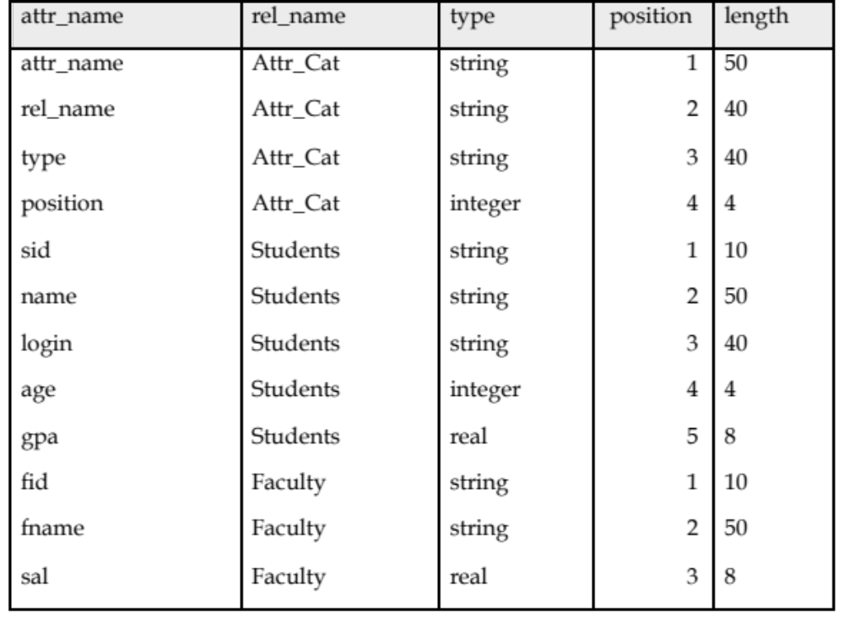
Catalogs are Stored as Relations!
Attr_Cat(attr_name, rel_name, type, position, length)

Slide 6

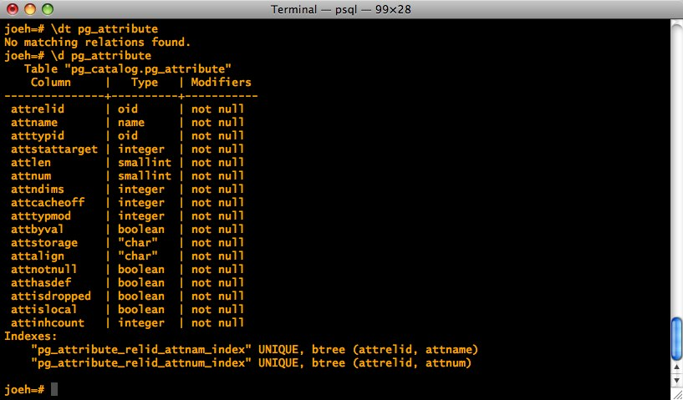
It’s a bit more complicated…

Slide 7
Record Formats: Fixed Length
F1
F2
F3
F4
L1
L2
L3
L4
Base address (B)
Address = B+L1+L2
Information about field types same for all records in a file; stored in system catalogs.
Finding i’th field done via arithmetic.

Slide 8
Record Formats:Variable Length
Two alternative formats (# fields is fixed):
F1 F2 F3 F4
$
$
$
$
Fields Delimited by Special Symbols
F1 F2 F3 F4
Array of Field Offsets
Second offers direct access to i’th field, efficient storage
of nulls (special don’t know value); some directory overhead.

Slide 9
How to Identify a Record?
The Relational Model doesn’t expose “pointers”, but that doesn’t mean that the DBMS doesn’t use them internally.
Q: Can we use memory addresses to permanently “point” to records?
Systems instead use a “Record ID” or “RecID”
Typically: Record ID = <page id, slot #>

Slide 10
Page Formats: Fixed Length Records
Slot 0
record
Slot 0
record
Slot 1
record
Slot 1
record
record
. . .
. . .
Free
Space
Slot N-1
record
record
Free
Space
Slot M-1
Slot M-1
record
N
1
0
0
1
. . .
1
0
1
M
number
of records
M-1 … 2 1 0
number
of slots
PACKED
UNPACKED, BITMAP
In first alternative, free space management requires record movement.
Changes RIds - may not be acceptable.

Slide 11
“Slotted Page” for Variable Length Records
Rid = <i,1>
Page i
Data
Area
Rid = <i,N-1>
Rid = <i,0>
Free Space
Offset
to start
of free
space
[28,16]
[4,20]
[64,28]
3
92
2 1 0
# slots
SLOT ARRAY
Slot contains: [offset (from start of page), length]
  both in bytes
Record id = <page id, slot #>
Page is full when data space and slot array meet.

Slide 12
Slotted Page (continued)
When need to allocate:
  If enough room in free space, use it and update free space pointer.
  Else, try to compact data area, if successful, use the freed space.
  Else, tell caller that page is full.
Advantages:
  Can move records around in page without changing their record ID
  Allows lazy space management within the page, with opportunity for clean up later

Slide 13
Slotted page (continued)
0 |  |  |  |  |  |  |  | 8 |  |  |  |  |  |  | 15
Pointer
to start
of free
space
 |  |  |  |  |  |  |  |  |  |  |  | 8 | 9 | 0 | 4 | 2 | 17
Slot directory
# of slots
What’s the biggest record you can add to the above page without compacting?
  Need 2 bytes for slot: [offset, length] plus record.

Slide 14
Slotted page (continued)
0 |  |  |  |  |  |  |  | 8 |  |  |  |  |  |  | 15
Pointer
to start
of free
space
 |  |  |  |  |  |  |  |  |  | 17 | 9 | 8 | 9 | 0 | 4 | 3 | X
Slot directory
# of slots
What’s the biggest record you can add to the above page without compacting?
  Need 2 bytes for slot: [offset, length] plus record.

Slide 15
Slotted page (continued)
0 |  |  |  |  |  |  |  | 8 |  |  |  |  |  |  | 15
Pointer
to start
of free
space
 |  |  |  |  |  |  |  |  |  |  |  | 8 | 9 | 0 | 4 | 2 | 17
Slot directory
# of slots
What’s the biggest record you can add to the above page with compacting?
  Need 2 bytes for slot: [offset, length] plus record.

Slide 16
Slotted page (continued)
0 |  |  |  |  |  |  |  | 8 |  |  |  |  |  |  | 15
Pointer
to start
of free
space
 |  |  |  |  |  |  |  |  |  | 13 | 13 | 4 | 9 | 0 | 4 | 3 | X
Slot directory
# of slots
What do you do if a record needs to move to a different page?
  Leave a special “tombstone” object in place of record, pointing to new page & slot.
    Record id remains unchanged
What if it needs to move again?
  Update the original tombstone – so one hop max.

Slide 17
So far we’ve organized:
Fields into Records (fixed and variable length)
Records into Pages (fixed and variable length)
Now we need to organize Pages into Files

Slide 18
Alternative File Organizations
Many alternatives exist, each good for some situations, and not so good in others:
Heap files: Unordered. Fine for file scan retrieving all records. Easy to maintain.
Sorted Files: Best for retrieval in search key order, or if only a `range’ of records is needed. Expensive to maintain.
Clustered Files (with Indexes): A compromise between the above two extremes.

Slide 19
Unordered (Heap) Files
Simplest file structure contains records in no particular order.
As file grows and shrinks, pages are allocated and de-allocated.
To support record level operations, we must:
  keep track of the pages in a file
  keep track of free space on pages
  keep track of the records on a page
Can organize as a list, as a directory, a tree, …

Slide 20
Heap File Implemented as a List
Data
Page
Data
Page
Data
Page
Full Pages
Header
Page
Data
Page
Data
Page
Data
Page
Pages with
Free Space
The Heap file name and header page id must be stored persistently.
  The catalog is a good place for this.
Each page contains 2 `pointers’ plus data.

Slide 21
Heap File Using a Page Directory
Data
Page 1
Header
Page
Data
Page 2
Data
Page N
DIRECTORY
The entry for a page can include the number of free bytes on the page.
The directory is a collection of pages; linked list implementation is just one alternative.

Slide 22
Cost Model for Analysis
Average-case analysis; based on several simplistic assumptions.
  Often called a “back of the envelope” calculation.
We ignore CPU costs, for simplicity:
  B: The number of data blocks
  R: Number of records per block
We simply count number of disk block I/O’s
  ignores gains of pre-fetching and sequential access; thus, even I/O cost is only loosely approximated.
Notes:
Good enough to show some overall trends!
Not always:

Slide 23
Some Assumptions in the Analysis
Single record insert and delete.
Equality selection - exactly one match (what if more or less???).
For Heap Files we’ll assume:
  Insert always appends to end of file.
  Delete just leaves free space in the page.
  Empty pages are not de-allocated.
  If using directory implementation assume directory is in-memory.

Slide 24
Average Case I/O Counts for Operations (B = # disk blocks in file)
 | Heap File | Sorted File | Clustered File
Scan all records
Equality Search (1 match)
Range Search
Insert
Delete
B
0.5 B
B
2
0.5 B+1

Slide 25
Sorted Files
Heap files are lazy on update - you end up paying on searches.
Sorted files eagerly maintain the file on update.
  The opposite choice in the trade-off
Let’s consider an extreme version
  No gaps allowed, pages fully packed always
  Q: How might you relax these assumptions?
Assumptions for our BotE Analysis:
  Files compacted after deletions.
  Searches are on sort key field(s).

Slide 26
Average Case I/O Counts for Operations (B = # disk blocks in file)
 | Heap File | Sorted File | Clustered File
Scan all records
Equality Search (1 match)
Range Search
Insert
Delete
B
0.5 B
B
2
0.5B+1
B
log₂ B (if on sort key) 0.5 B (otherwise)
(log₂ B) +
selectivity * B
(log₂B)+ B
Same cost as Insert

