Slide 1
Hybrid Optical/E-Band Correlated Channel Model
The structure of a data set
Location 0
Location 1
TSS
RSS
RFL
Channel
RFL
RSS
TSS
Radio Frequency Link
Free Space Optical
73.5 & 83.5 GHz
TSS
RSS
FSO
Channel
FSO
RSS
TSS
193.4 THz
Wind Direction
Wind Speed
Temperature
Humidity
Visibility
Particle Count
Rain Intensity
SYNOP Code
TSS:
RSS:
Transmit Signal Strength
Receive Signal Strength
Weather
P.1

Slide 2
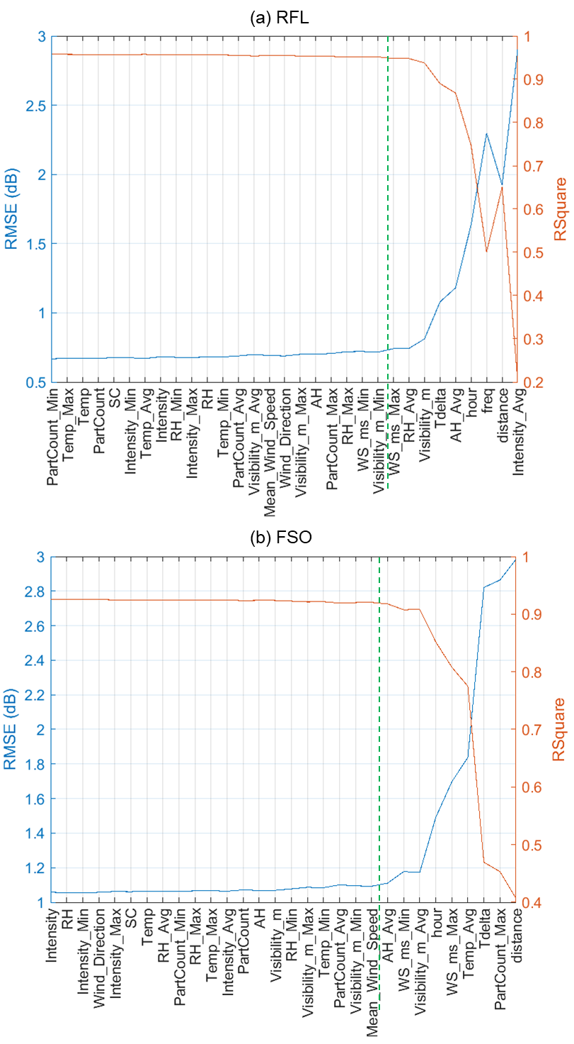
Models for Power Loss, i.e., (Transmit Signal Strength) – (Receive Signal Strength)
Constructed models using machine learning algorithms applied to empirical data
P.2

Slide 3
