Slide 1
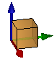
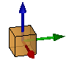
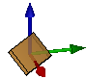
T_shift([-1 -1 -1])
T_rot('XYZ', pi/4 * [1 1 1])
geoBox([2 2 2])

Slide 2
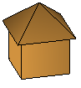
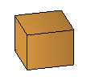
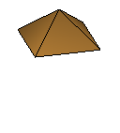
= combineGeometry( , )

Slide 3
box = createObject(geoBox([1 1 1]), 'FaceColor', [0 1 0]); % green cube
geo
intern: patch('Vertices', geo.f, 'Faces', geo.v, ...‚ 'FaceColor', [0 1 0]);

Slide 4
.place
.setMorpher
Object
.transform
T-Matrix
Morpher
Geometry
Lineare
Transformation
Lineare
Transformation
(nichtlineare)
Verformung
vertices
faces
(nichtlineare)
Verformung
patch('Vertices', , 'Faces', , …)
.morph

