Slide 1
Matlab Simulation Framework et al for Robotics
Fakulty of Electrical and computer Engineering Institut for Automation Engineering
Dresden, July 27, 2017

Slide 2
Motivation
Simulator Framework for testing of guidance algorithms
Requirements:
Simple time discret simulation in Matlab
Stand-alone (GUI) and scripted operation (non-GUI)
Easily reconfigurable system structure
Flexible visualization, easily adaptable
Clear separation of experiment data and simulator core functionality
Saves the timings of all simulation data
Replay (only vilualization without recalculation)
Video recording
Universal Version of 2D simulation framework by S. Horn
Dresden, July 27, 2017
Generic Matlab Simulation Framework
2

Slide 3
Hauptkomponenten
Matlab structure
system models (Blocks)
model-specific visualization code
parameters
Initial values
Main window
(possibly futher windows)
Framework
experiment independent
visualization
video tracking
Experiment Specification
Simulator
*.avi files
or
Evaluation
(extern)
Replay
Saved results
*.mat-files
Dresden, July 27, 2017
Generic Matlab Simulation Framework
3

Slide 4

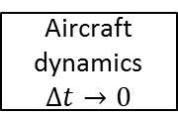






System Description
Model blocks
1 output, any number of input, any data format (Scalar, Matrices, Struct, …)  variable per calculation step (non-uniform output)
Sampling time $Δt$ (computing continuous blocks “if necessary“)
constant output
Trigger
Environment
$$Δt=∞$$
camera
$$Δt=T_{C A M}$$
Image processing
$$Δt=\text{< }\text{a} \text{u} \text{t} \text{o}\text{ >}$$
Map database
Example system:
Time continuous
navigation
$$Δt=n⋅T_{I M U}$$
Aircraft dynamics
$$Δt→0$$
IMU
$$Δt=T_{I M U}$$
Flight control
$$Δt=T_{C T R L}$$
Dresden, July 27, 2017
Generic Matlab Simulation Framework
4

Slide 5
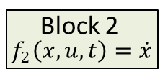
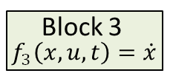


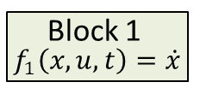
Abgrenzung zu Simulink
Architecture ofSimulink
Architektur of Matlab Simulation Framework
Simulink
Simulator Framework
Block 1
$$u$$
Block 1
$${ f}_{1}\left(x, u, t\right)=\dot{x}$$
Solver
Solver
state
Block 2
$$u$$
Block 2
$${ f}_{2}\left(x, u, t\right)=\dot{x}$$
central
State memory
Solver
state
$$u$$
Block 3
$${ f}_{3}\left(x, u, t\right)=\dot{x}$$
Block 3
Solver
state
Dresden, July 27, 2017
Generic Matlab Simulation Framework
5

Slide 6
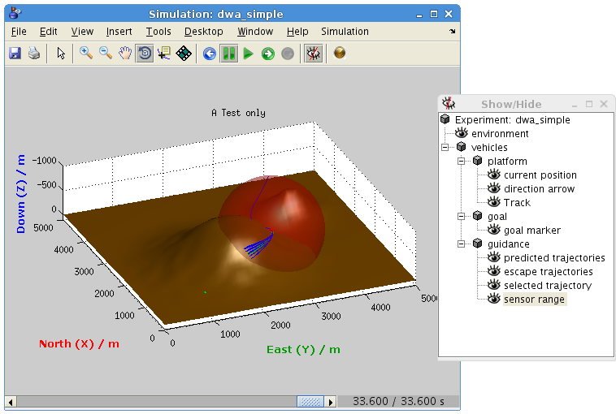

Stand-Alone GUI
Simulation control
…
Display further visualization window
Visualization area
Visualization elements
show/ hide
Timeline
Simulation time $t$
Dresden, July 27, 2017
Generic Matlab Simulation Framework
6

Slide 7
Experiment Description
Matlab strukture → hierarchic, object-oriented approach
function exp = experiment()
exp = experiment_base('dwa_simple'); % skeleton struct for experiment
exp.vehicle = struct( ... % blocks in nested structure
'platform', model_masspoint([4800, 4000, -150, -150 * pi / 180, 0]), ...
'goal', const_goal3d([500 1000 -250]), ...
'guidance', guidance_dwa());
exp.environment = env_heightmap('DEMs/two-hills_50x50.png');
exp.display.title = 'A Test only'; % configure visualization area
exp.display.settings = {'XLim', [0 5000], 'YLim', [0 5000], 'ZLim', [-1000 100]};
exp.display.view = [-112, 26];
exp.display.axis = 'equal';
exp.stop = stop_distance(500); % simulation finished?
exp.depends = {'*guidance'}; % tweak dependency analysis
end
Aufruf des Simulators:
simulate(experiment());
- oder -
simulate_unattended(experiment());
blocks
Special
fields
With GUI
Without GUI
Dresden, July 27, 2017
Generic Matlab Simulation Framework
7

Slide 8
Implementierung eines Blocks
function b = test_block()
b = block_base(1/10, {'input1'}, @process);
% Algorithm parameters
b.parameter = 1000;
b.parameter2 = 'abc';
function [state, out, debug] = process(block, t, state, in)
% Compute block state & outputs for time t
...
end
% visualization
b.graphicElements(1).draw = @visualize;
b.graphicElements(1).name = 'Graphic Object';
function handles = visualize(block, ax, handles, out, debug, state, in)
if isempty(handles)
% create visualization objects
handles = ...
end
% update visualization
set(handles, 'Property', value, ...
end
end
Block framework
Sampling time
Model propagation
A visualization element
Dresden, July 27, 2017
Generic Matlab Simulation Framework
8

Slide 9

Thanks for your attention!
Dresden, July 27, 2017
Generic Matlab Simulation Framework
9

