Slide 1
Haecksen Geekend
Git Workshop for Beginners
chjana

Slide 2
Be Ready!
Install Git:
  https://git-scm.com/book/en/v2/Getting-Started-Installing-Git
- for windows: https://tortoisegit.org/download/
Get your GitHub Account: https://github.com/join
Setup your Github ssh credential: https://docs.github.com/en/authentication/connecting-to-github-with-ssh/generating-a-new-ssh-key-and-adding-it-to-the-ssh-agent

Slide 3
Plan for today :-)
Part 1: UI, Command line interface, repo (40min)
Part 2: Staging and commits (20min)
Part 3: Syncing with the remote host (10min)
Part 4: Branch and merge (40min)
Many group activities, Interactive
The first personal repository at GitHub

Slide 4
Part 1: UI, Commands and Repo
Conceptual Understanding of Git
Examples of Basic Commands
Exercises

Slide 5
What is Git for?
Version Control
Collaboration
Workflow

Slide 6
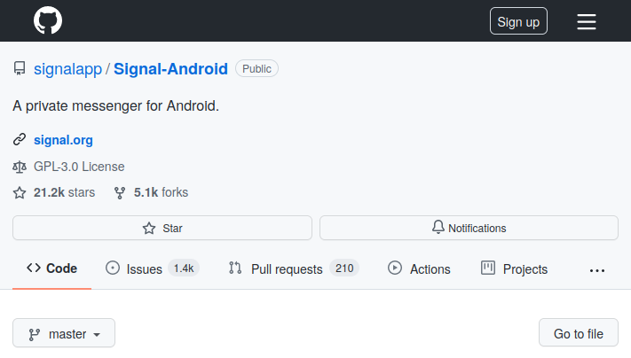
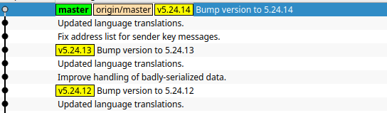
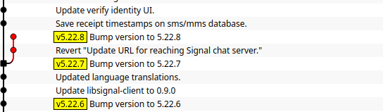
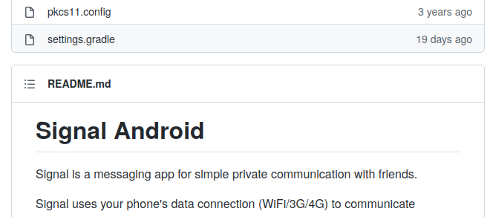
What can do with Git? - Repo

Slide 7
What can do with Git? - Hosting

Slide 8
What can we do with Git? - Commits

Slide 9
What can we do with Git? - Branch

Slide 10
What can we do with Git? - Tag

Slide 11
What can we do with Git? - and more

Slide 12
Part 1
Conceptual Understanding of Git
Examples of Basic Commands
Exercises

Slide 13
Cloning
git clone <repository_address>
To see the results, try
  ls
  Check out via git log or gui-clients
    https://git-scm.com/downloads/guis

Slide 14
Create New Repo
mkdir <directory_name>
git Init

Slide 15
Part 1
Conceptual Understanding of Git
Examples of Basic Commands
Exercises

Slide 16
Exercises
group-a. clone your favorite open source repository and check the history with a gui-client or git log
group-b. create your own repository and check out what happened in the directory by trying ls -al

Slide 17
Part 2: Staging, Commits
Conceptual Understanding of Git
Examples of Basic Commands
Exercises

Slide 18
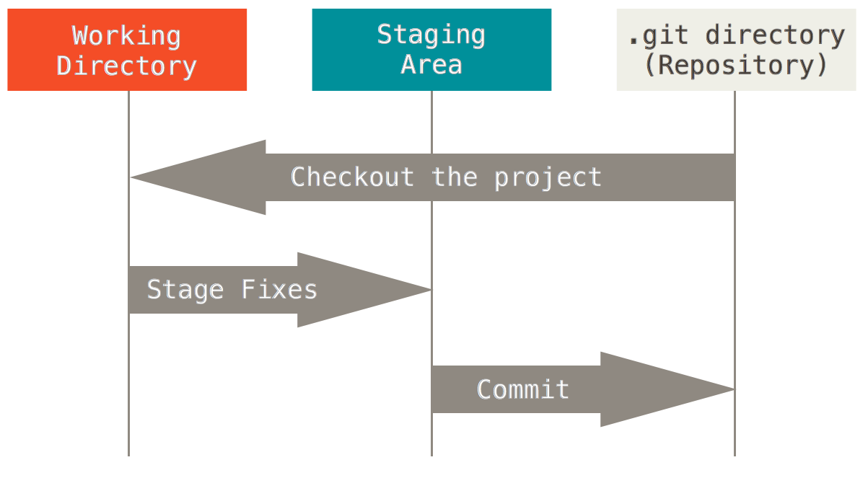
How can Git do this cool things?
Patches : difference of the codes
Commits with unique hashes
Stages

Slide 19
Part 2
Conceptual Understanding of Git
Examples of Basic Commands
Exercises

Slide 20
Commit – adding the history
From working directory to staging area
  git add <file>
  git add -p
From staging area to
repository
  git commit -m “<messages>”
  git commit –amend

Slide 21
Status check
git diff
git status

Slide 22
Part 2
Conceptual Understanding of Git
Examples of Basic Commands
Exercises

Slide 23
Git config for the first time user
git config --global user.name “John Doe”
git config --global user.email “john@doe.com”

Slide 24
Exercises
Each group in pair programming.
- Add a file named “Readme.md” of which has contents “### My first repo”.
- add the file into the stage
- commit the change
- check out the history

Slide 25
Part 3: Remote Host
Conceptual Understanding of Git
Examples of Basic Commands
Exercises

Slide 26


Hosting Services
GitHub
GitLab
Self hosting ...

Slide 27
Exercise Together
Create own repo at Github

Slide 28
Part 3
Conceptual Understanding of Git
Examples of Basic Commands
Exercises

Slide 29
Syncing with Remote
git push <remote> <branch>
git pull <remote> <branch>
git push / git push -u <remote> <branch>
git pull / git pull <remote> <branch>

Slide 30
Part 3
Conceptual Understanding of Git
Examples of Basic Commands
Exercises

Slide 31
Exercises
Each group in pair programming.
- push the new commit in the created repo to the created github remote

Slide 32
Part 4: Branching and Merging
Conceptual Understanding of Git
Examples of Basic Commands
Exercises

Slide 33
What can we do with Git? - Branch

Slide 34
Part 4
Conceptual Understanding of Git
Examples of Basic Commands
Exercises

Slide 35
Branch
git branch <new_branch>
git switch <other_branch>
git checkout -b <new_branch>
git branch
git branch –all

Slide 36
Part 4
Conceptual Understanding of Git
Examples of Basic Commands
Exercises

Slide 37
Group Challenge Exercises
Each group
  fork the repository hahey/geekend_gitworkshop
  clone the repository
  change the branch for the team
  edit the introduction of the participant list and commit
  push to the forked branch

Slide 38
Exercise Together
Send two pull requests to the repo hahey/geekend_gitworkshop
  One to the main branch
  One to the team branch

Slide 39
Demo
Code reviews in the pull requests
Merging Branch
Merge Conflicts
Looking up the command by git --help
Rebasing
Best Practice: a linear history

