Slide 1

老友智联
智能眼镜
Old Friend Smart Connect · Smart Glasses
汇报人：

Slide 2

目录
CONTENTS
1
2
3
4
The problem of social silos
AI smart glasses solution
Four core functions
User value and elderly-friendly design

Slide 3
Part 1
The problem of social silos

Slide 4

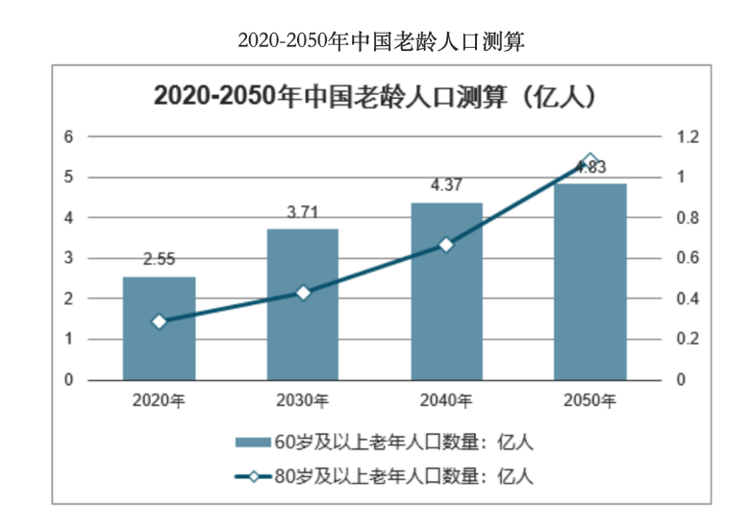
The ‘Isolation Moments’ of the Elderly: An Overlooked Social Crisis.
30
Living Alone, Feeling Lonely: A Stark Reality In China, over 10% of elderly people live alone. More alarmingly, nearly 80% of them connect with family less than once a week.
The Digital Divide Deepens Social Isolation Smartphones and social apps, originally meant to bring people closer, have become barriers:
Complex interfaces
Small text
Complicated steps Many seniors say: "I’m afraid to press the wrong button, so I don’t touch it."
Psychological Withdrawal Makes Socializing Harder Aging often comes with self-marginalization:
Fear of disturbing others
Fear of rejection
Wanting to speak, but not knowing how
Declining Social Life Hurts Mental and Physical Health Lack of social interaction greatly increases the risk of depression, anxiety, and cognitive decline (such as Alzheimer’s). According to The Lancet, loneliness is one of the independent risk factors for dementia in the elderly.
28
18
12
12

Slide 5

Digital Tools Don't Fit: Social Platforms That Miss the Elderly's Needs
Function Dimension | WeChat / Social Apps | Smart Devices Bought by Children | Our product: AI Smart Glasses
Interaction Mode | Requires initiating conversation | Passive; operated by family members | Voice-guided interaction, gentle wake-up prompts
Operation Complexity | Relatively high, with many functions | Infrequent use, low engagement | One-button start, automatic response
Learning Cost | High | Relies on others for maintenance | Zero learning curve, ready to use at startup
Social Motivation | Low; fear of rejection or disturbing others | Cannot be used independently | Topic suggestions, natural interaction
Elderly-Friendly Design | Weak | No personalized configuration | Custom fonts, voice, and personalized settings
Companionship | None | None | Virtual companion available daily
Active social mechanisms are not friendly to the elderly Mainstream social platforms (such as WeChat) emphasize "actively adding friends" and "initiating conversations", which can be a psychological burden for many elderly people: “I’m afraid of disturbing them.” “I don’t know what to say.” “My family is busy—I don’t dare to call.”
Complex app operations create a high barrier to use Social apps often have complicated interfaces and too many features. For elderly users with declining eyesight and finger dexterity: “The font is too small—I can’t read it.” “There are too many steps—too much tapping.” “My children installed the app but never taught me how to use it.”
Elderly people need a more natural and gentle companion-style interaction Compared to “having to tap, having to talk, having to initiate”, the elderly are more comfortable with an interaction style of “gentle guidance + natural cues + burden-free conversation” — this is exactly the starting point of our product design.

Slide 6
Part 2
AI smart glasses solution

Slide 7
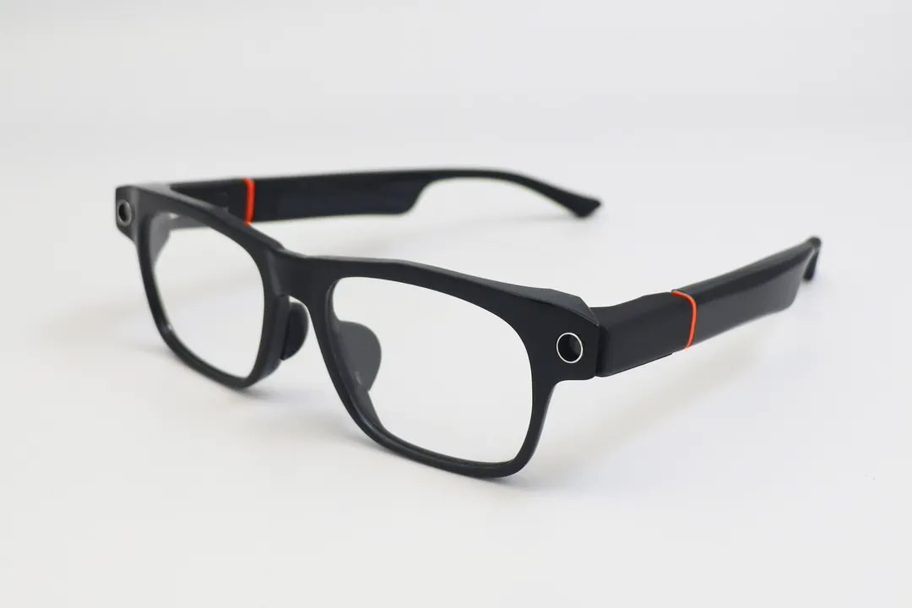
A pair of smart glasses that understand "companionship" makes social interaction occur naturally
Product Name: OldFriend Connect 👓 Product Overview: "OldFriend Connect" is an AI-powered social assistance smart glasses designed specifically for the elderly. It integrates AI semantic recognition, visual analysis, and localized voice prompts to create a natural and gentle interaction experience tailored for seniors. It requires no active operation from the user and does not force conversations; instead, it offers subtle reminders and natural guidance at appropriate moments—making socializing as effortless and natural as taking a walk.
Function Introduction
Function | Icon | Brief Description
🧠 AI context recognition | Brain + eye icon | Analyze the current scene (face recognition, location, time)
💬 Voice-guided social interaction | Sound wave icon | Prompt greetings and generate topic suggestions
📲 Information companionship | Mobile phone message icon | Family news reporting and guidance on responses
🔒 Safety reminder | Warning shield icon | Call fraud detection, voice reminder
VS
Product picture

Slide 8
Part 3
Four core functions

Slide 9
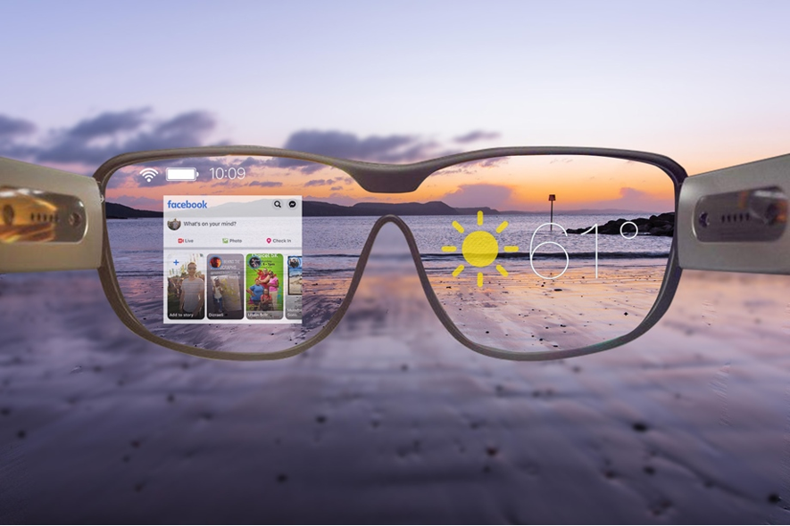
Function 1: AI ice-breaking topic generation
Many elderly people want to socialize but don’t know how to start a conversation. Our smart glasses automatically generate natural conversation openers by real-time sensing the environment—such as location, face recognition, and weather information—lowering the barrier to engaging in dialogue.
🌤 Context Awareness + Semantic Generation: When the glasses detect that the user is in the park and recognize neighbor Aunt Zhang, it prompts: “Today’s weather is nice, Aunt Zhang is here. Would you like to take a walk together?”
🧠 Interest Profile Supports Conversation Continuation: Based on past interactions, it suggests “neighborhood topic packs” like “Balcony gardening tips” and “Square dance music recommendations” to keep the conversation going.

Slide 10
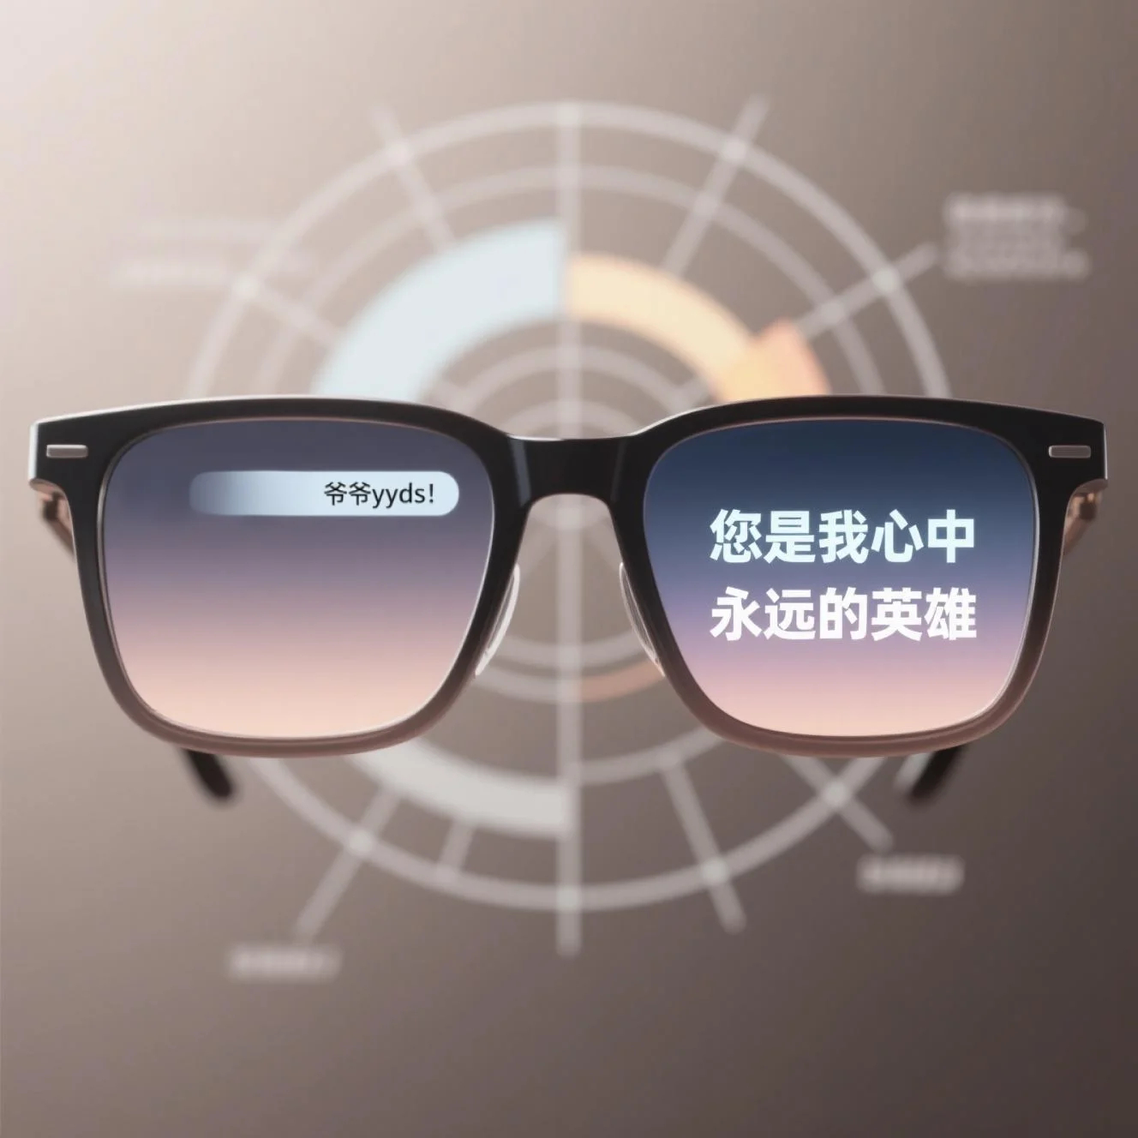
Function 2: Intergenerational Translation Engine
Intergenerational communication often stalls due to “not understanding” or “not expressing clearly.” This product features a semantic reconstruction engine tailored for the elderly, enabling two-way “translation”:
👵 Elderly Expression → Modern Simplified Version: When an older person says, “I’ll write you a letter,” the suggestion is replaced with, “Would you prefer to listen to a voice message?”
👦 Youthful Tone → Emotional Softening: When a grandson sends “Grandpa yyds!” it is transformed into, “Grandpa, you will always be my hero in my heart!”
🧠 Technical Foundation: Emotional recognition combined with senior-friendly language training reduces misunderstandings and strengthens family bonds.

Slide 11
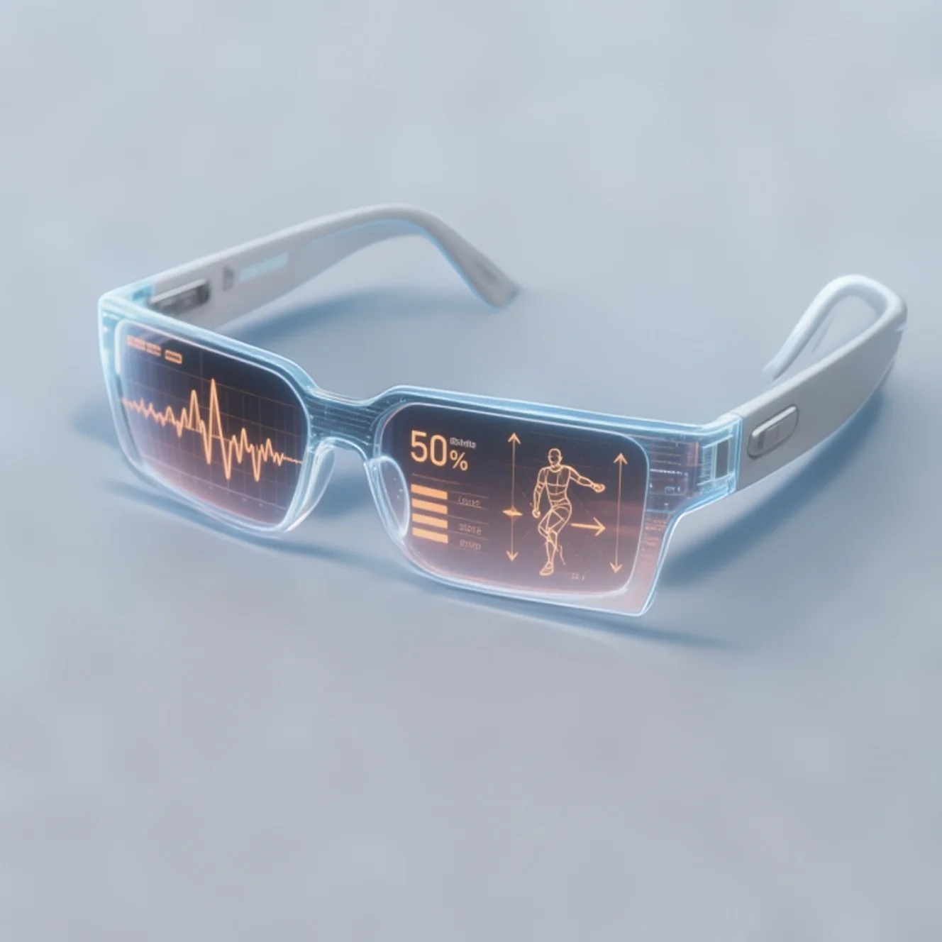
Function 3: Virtual Activity Companion
Let the glasses be your “virtual friend,” naturally joining social interactions within your familiar daily rhythm:
🎤 AI Chorus Simulator: Supports seniors practicing old songs, with AI providing harmony accompaniment and pitch guidance: “You’re singing with so much feeling! Would you like to invite Old Zhao to practice together?”
🧘 Tai Chi / Square Dance Practice Assistant: Uses cameras on the temple arms to capture movements and gives voice prompts for rhythm and posture correction.
⭐ Social Task Incentives: Set goals like: “Call a friend today to earn the ‘Heartwarming Star’ badge” → enhancing social initiative.

Slide 12
Function 4: Anti-Fraud Guardian
Elderly people are often targets of telecom fraud. This feature uses multiple AI technologies as a shield to identify potential risks in real time:
🎙 Voiceprint Recognition: When a caller claims, “I’m your son, transfer money quickly,” the system detects a voiceprint mismatch and automatically displays a warning: “Identity anomaly.”
🔍 Keyword Monitoring + Semantic Analysis: If high-risk words like “transfer,” “prize,” or “guaranteed investment” appear during calls or voice messages, the AI proactively intervenes, issuing a “risk alert” and suggests confirming with family members.
🔐 User-Friendly Mechanism: Users can call their children or customer support with one click to get human assistance.

Slide 13
Part 4
User value and elderly-friendly design

Slide 14

User value and elderly-friendly design
Enable natural interaction
It helps users interact smoothly without complicated operations.
Fraud detection in calls
It identifies suspicious calls and warns users.
Voice-guided social prompts
Auto family message updates
It offers voice suggestions to start or continue conversations.
It informs users of family messages and helps reply.

Slide 15
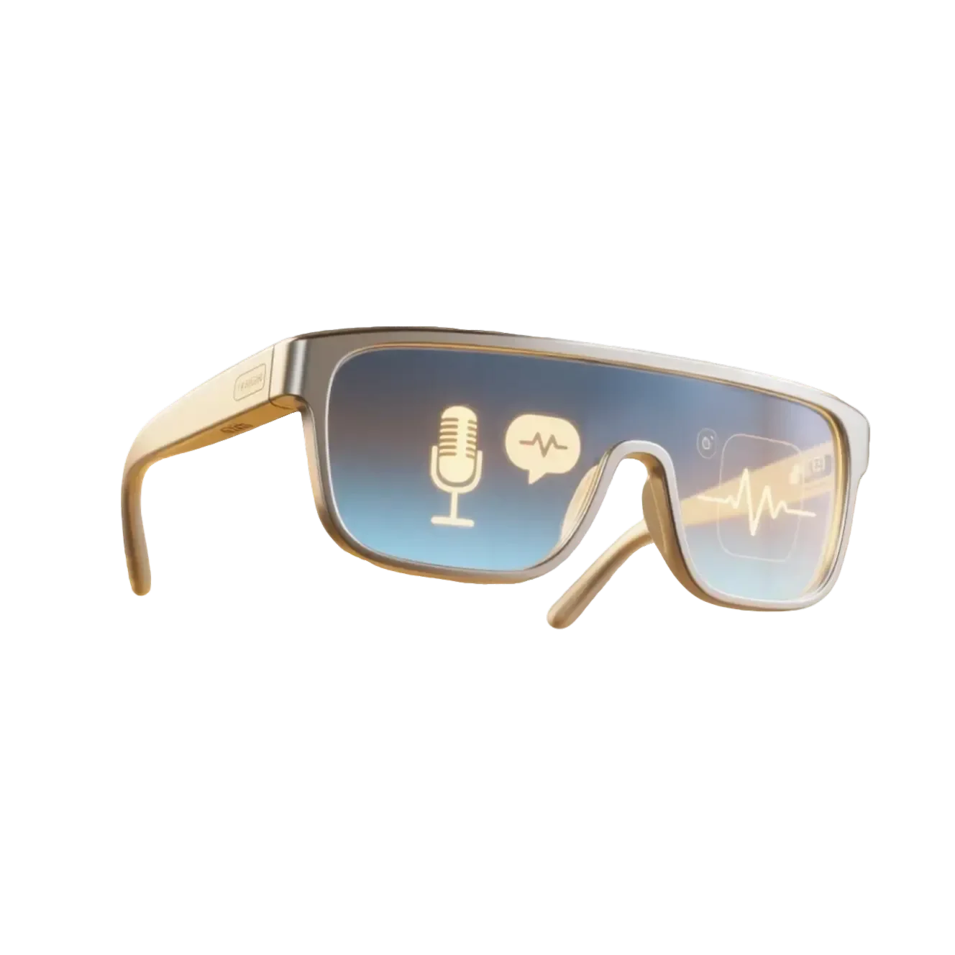
User value and elderly-friendly design
No forced active operation
Users don't need to actively operate it.
Gentle, natural reminders
Reminders are given in a soft and natural way.

Slide 16
THANK YOU
FOR WATCHING

