Slide 1

Sales Forecast of Retail Clothing Products
By: Haroon Ahmed

Slide 2
Presentation Outline
1. Business Objectives
2. Preprocessing
3. Exploratory Data Analysis
4. Model Selection
5. Conclusion

Slide 3
BUSINESS OBJECTIVE

Slide 4
Accurate estimation of Future Sales
Workflow Management
Cash Flow management
Resource Allocation
Understand Sales cycle
Provide offers to boost sales during dull periods
Tap market opportunity
Benchmarking against competitors

Slide 5
PREPROCESSING
Regression

Slide 6

Preprocessing Steps - I
Weather Data
Macroeconomic Data
Data merge from Excel sheets for different years.
Aggregation of yearly data based on months
Concatenation of 6 years data
Feature Engineer: Weather Events column
Drop unwanted features
Generate Month and year column from Year-Month Column
Drop Feature like PartyInPower, Advertising Expenses
Standardization of Data

Slide 7

Preprocessing Steps - II
Events-Holiday Data
Train Data
Extract Month from MonthDate Column
Dummify DayCategory feature
Aggregate data based on Year and Month
Generate “HolidaysInAMonth” Feature by summation
Merge Weather, Events-Holiday, Macroeconomic
Drop Feature: Women Category
Fill missing values using mean
Divide the Dataset into train and test

Slide 8
PREPROCESSING
Time Series

Slide 9
Preprocessing Steps
Train Data
Split the Dataset based on Product Category
Central Imputation for missing data

Slide 10
EXPLORATORY DATA ANALYSIS
Regression

Slide 11
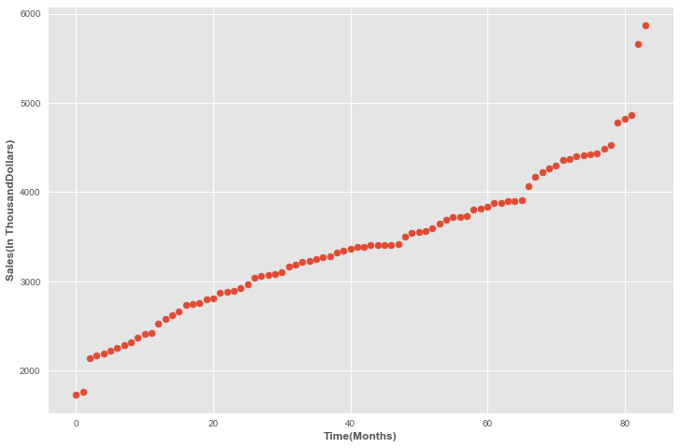
Sales
Sales(in Thousand Dollars) over the last six years

Slide 12
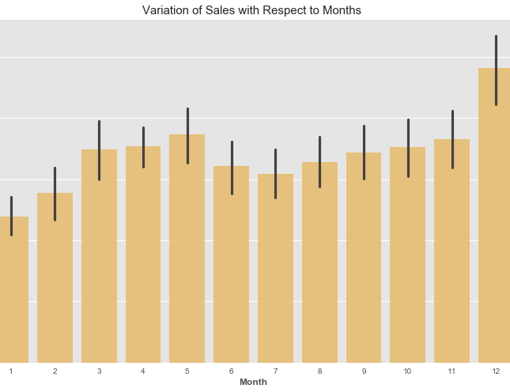
Sales Cycle
Sales tend to spike in months of December followed by a period of dull in January, February before picking themselves up.

Slide 13
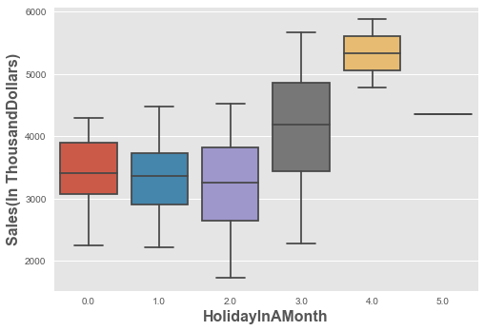
Holidays & Sales
AS apparent from the plot, sales tend to pick in the months with more holidays

Slide 14
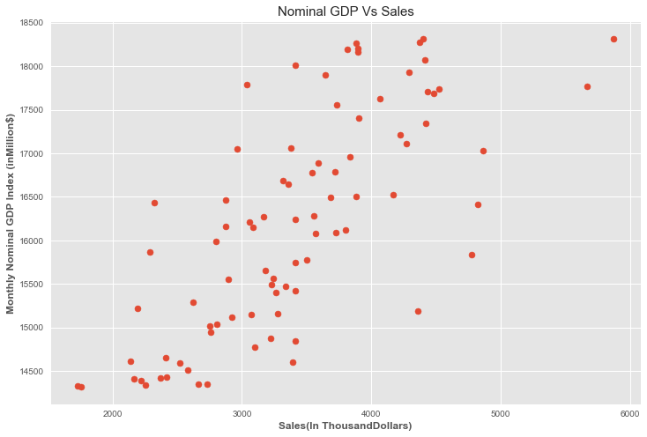
Strong Correlation between nominal GDP and Sales

Slide 15
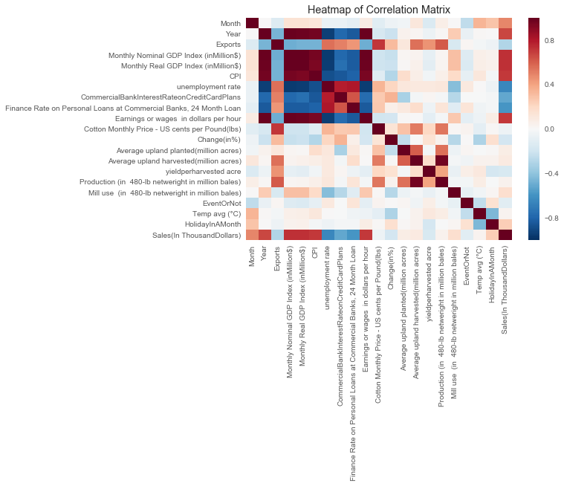
Correlation Plot

Slide 16
EXPLORATORY DATA ANALYSIS
Time Series

Slide 17
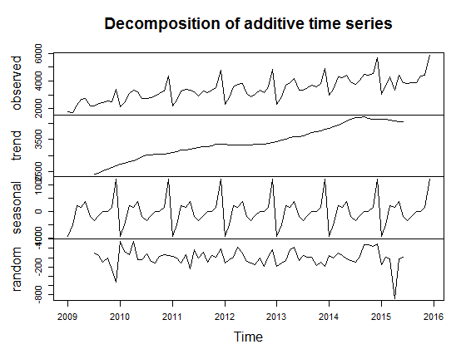
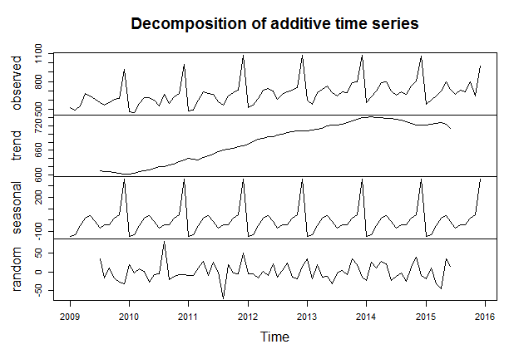
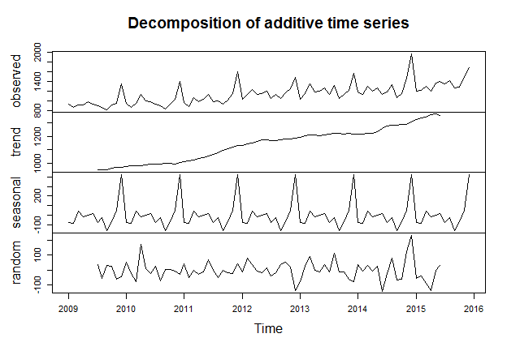
Time Series Plots of Each Category
Women
Men
Other

Slide 18
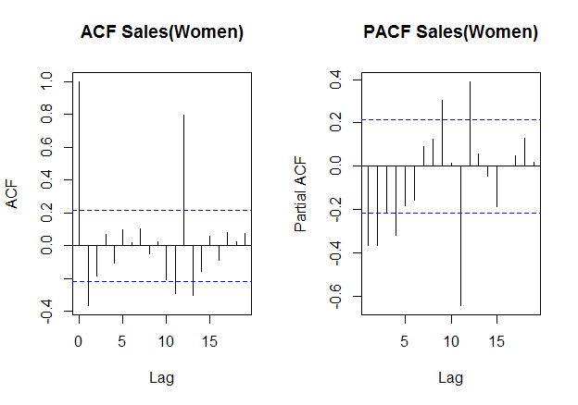
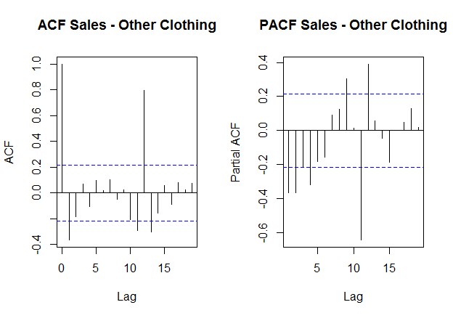
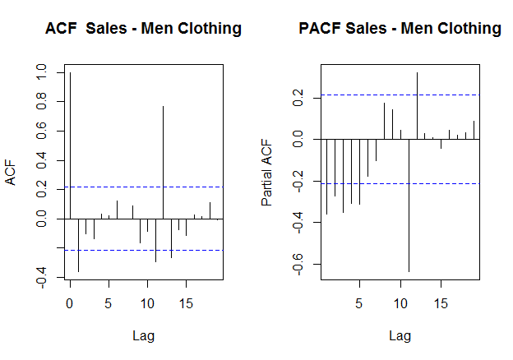
ACF & PACF Plots of Product Categories

Slide 19
MODEL SELECTION
Regression

Slide 20

Best Model Selection
Optimal Model Selection
Linear Regression
Decision Tree
Support Vector Machines
Adaboost
Random Forest
Gradient Boosting
Perceptron
Stacked Model

Slide 21

Evaluation/Results

Slide 22
Evaluation
Ml Models | Train Score | Test (MAPE)
Linear Regression | 80.4% | 25.21%
SVM (Linear kernel) | 66.6% | 16.61%
Gradient Boosting Regression | 86.4% | 6.93%
Decision Tree Regression | 88.6% | 10.78%
Random Forest Regression | 92.4% | 10.31%
Adaboost Regression | 97.09% | 9.53%
Gradient Boosting with Grid Search | 99.8% | 16.63%
Stacked Model (Ridge, Adaboost, RF, DT, GBR) | 100% | 17.72%

Slide 23
MODEL SELECTION
Time Series

Slide 24
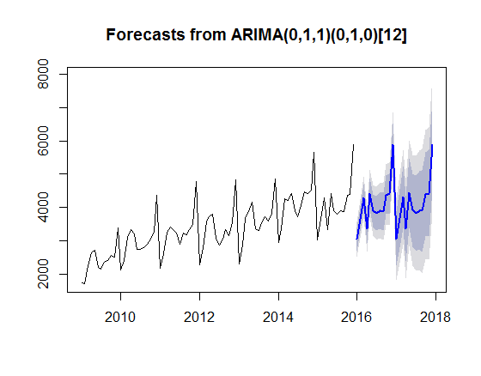
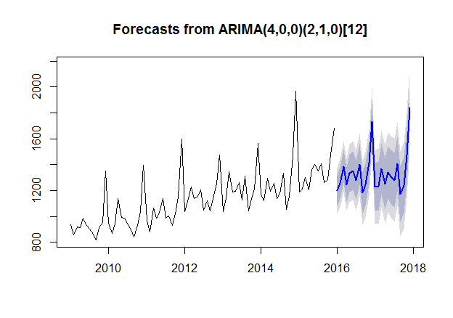
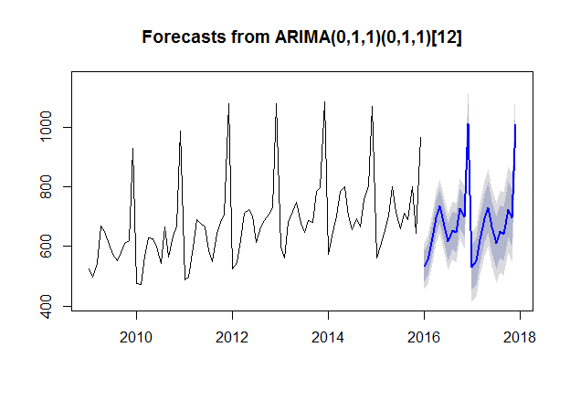
Forecasts From ARIMA Model
Women
Other
Men

Slide 25
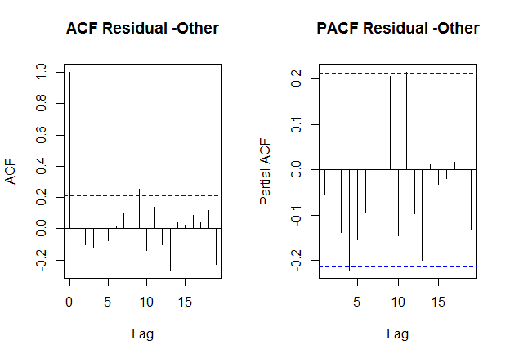
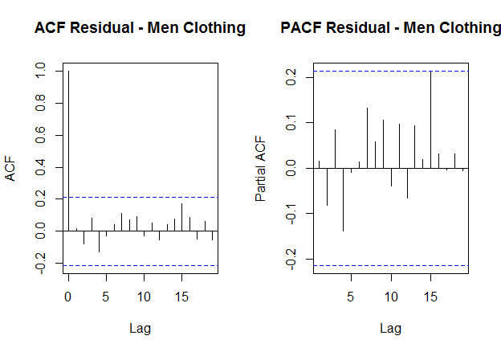
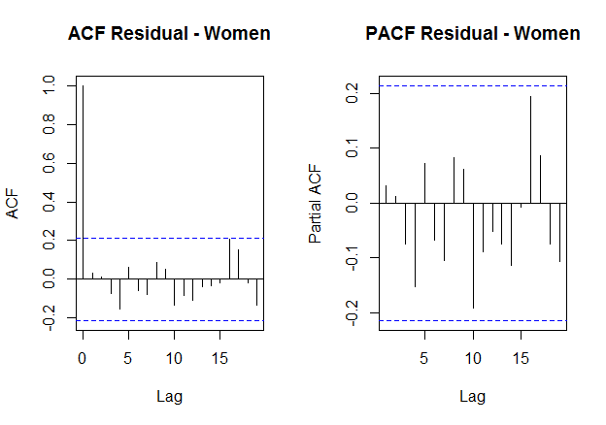
ACF & PACF Plots of Residuals

Slide 26
Evaluation/Results

Slide 27
Evaluation
Ml Models | Test (MAPE)
ARIMA Model | 8.45%
ETS | 8.45%

Slide 28
Conclusion
Regression

Slide 29
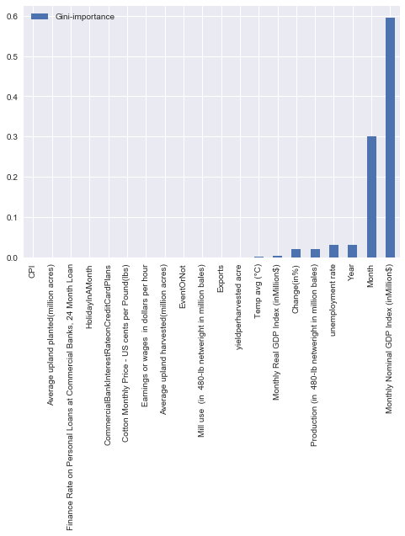
Decision Tree
Important Features

Slide 30
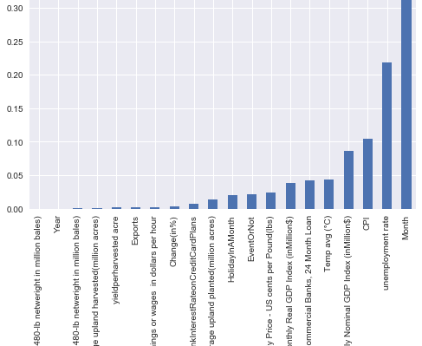
Adaboost
Important Features

Slide 31
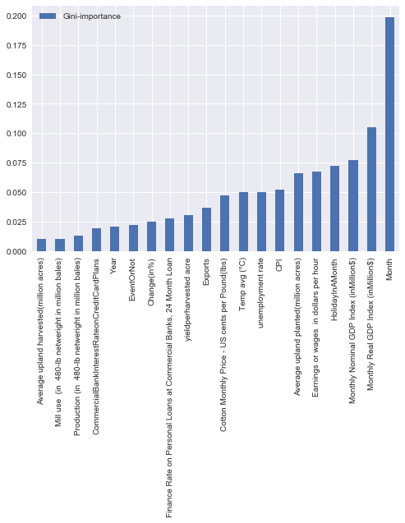
Random Forest
Important Features

Slide 32
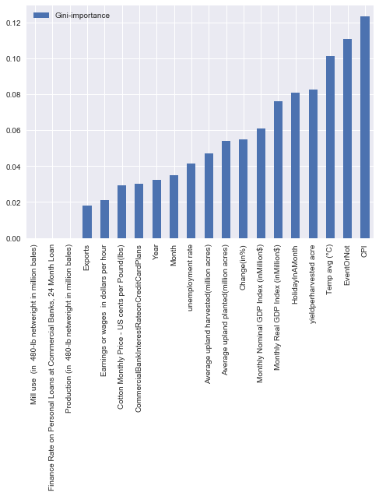
Gradient Boost
Important Features

