Slide 1

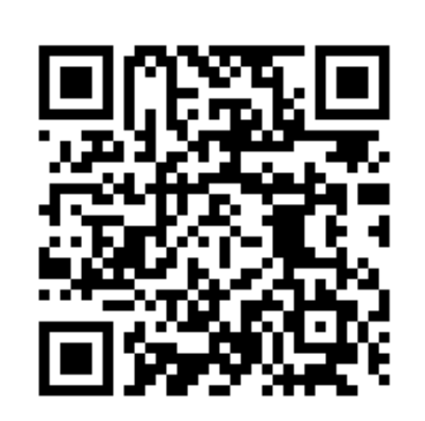
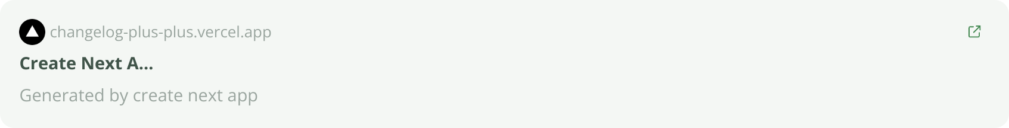
changelog++
Aida, Daksh, Hahnbee, Marcella, Zach

Slide 2

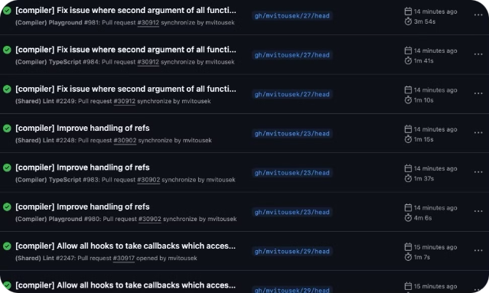
The Problem
1
Time Sink
Manual changelog creation wastes precious dev time
2
Inconsistency
Updates lack standardization across teams & stakeholders
3
Developer Visibility
Lack of visibility into the work developers are doing

Slide 3

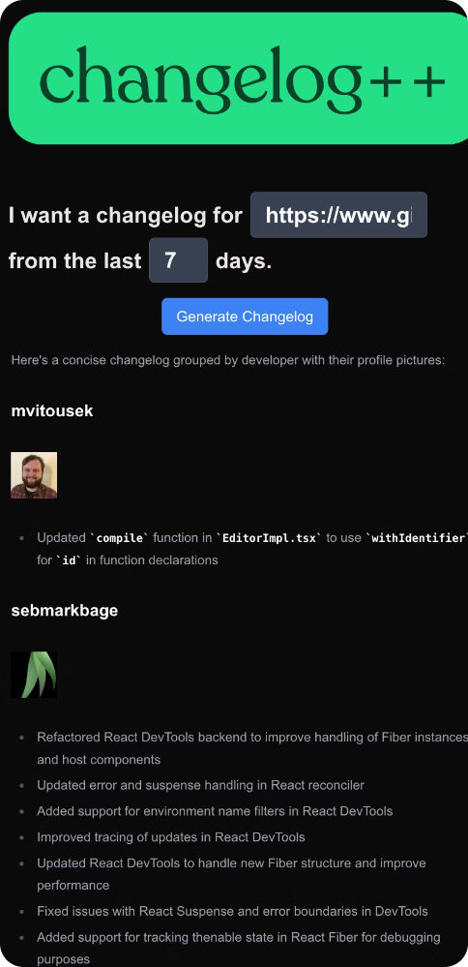
Our Solution
Automate
Extract changes directly from Git repositories
Summarize
AI-powered categorization and content generation

Slide 4
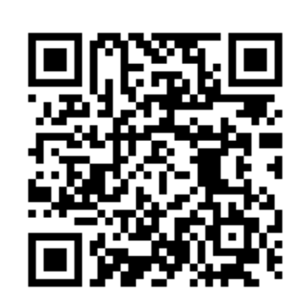
Live Demo + How it works
How it works
1. Input Repo - Provide GitHub URL for analysis
2. Extract Changes - Pull recent Git commits automatically
3. AI Magic - Claude API summarizes and categorizes updates
4. Generate Content - Create Markdown changelog and optional formats

