Slide 1
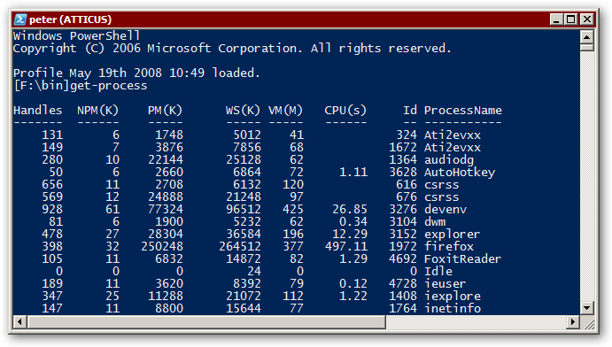
Azure VM-Lab with PowerShell
Presentation for the Singapore Azure User Group 27. April 2017
Peter Hahndorf Solution Architect Hahndorf Consulting https://peter.hahndorf.eu

Slide 2
Agenda
Intro
Setting up the client
Using templates to create VMs
Using scripts to simplify template usage
Remove VM after we are done
Compare with local Hyper-V

Slide 3
Setting up the client
Get PowerShell Azure Modules
Using PowerShell Gallery
Install-Module AzureRM
Install-AzureRM
Using a local repository
Using xcopy
Login
Open a PowerShell session and log into your Azure account.
Login-AzureRmAccount

Slide 4
Using Templates to create VMs
Using the portal to create a new template
Customize it
Run-Template

Slide 5
Using scripts to simplify template usage
Use a custom script to create parameter files
Using custom scripts to quickly set create new VMs from scratch. A single one:
New-AzLabVM -MachineId 1 -ssd

Slide 6
Remove VM after we are done
Templates don’t help
Need to use custom script:
Before DSC was around I created many custom scripts to set up servers.
Remove-AzlabVm.ps1 –MachineId 1

Slide 7
Compare with local Hyper-V
New-vLab –count 5 –os 2016Core
Using parent disks of sysprepped OS VHDs
Insert setup PowerShell script to perform common tasks for new machines.

Slide 8

Questions?
About Me
Peter Hahndorf Technical Fellow / World Traveller Hahndorf Consulting My blog, open source projects and other tech stuff: https://peter.hahndorf.eu/tech/ For more about my travels: https://peter.hahndorf.eu/trip/
Contact me at: https://www.twee.net/contact/

