Slide 1
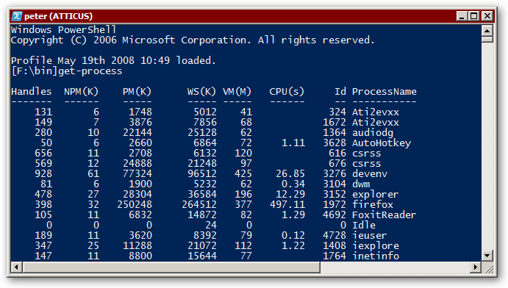
Creating a portable virtual server lab
Presentation for the Singapore PowerShell User Group 8. April 2017
Peter Hahndorf Solution Architect Hahndorf Consulting https://peter.hahndorf.eu

Slide 2
Agenda
Intro
The host
Creating new VMs
Using custom scripts
DSC Resources
Using DSC push and pull configurations
Alternatives

Slide 3
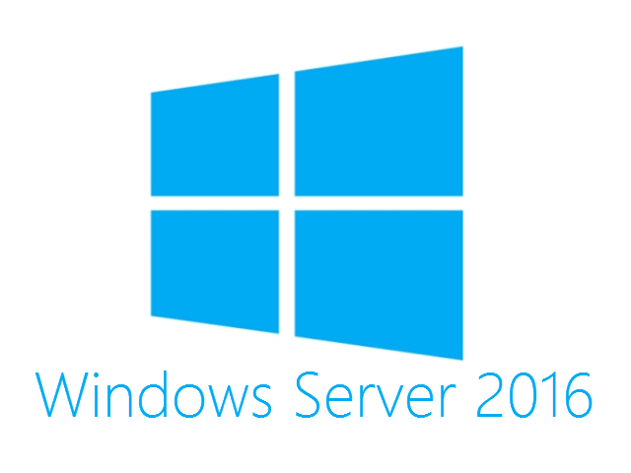
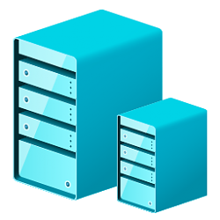
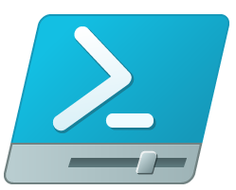



Technologies leveraged
Hyper-V
IIS
My Scripts
Active Directory

Slide 4
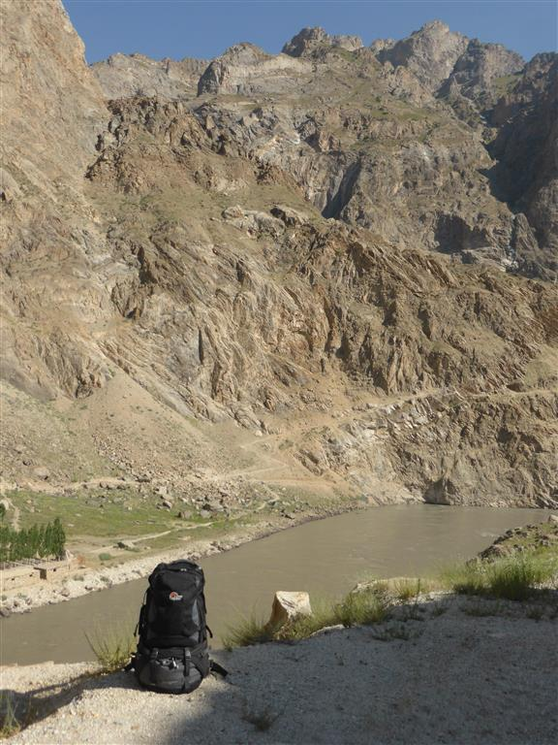
Motivation
I quit my day job in London in 2005 and started travelling No Laptop to work with (too heavy) USB drive to store photos on Often no network connectivity Still needed to get some work done Secure way to connect to servers and online banking

Slide 5
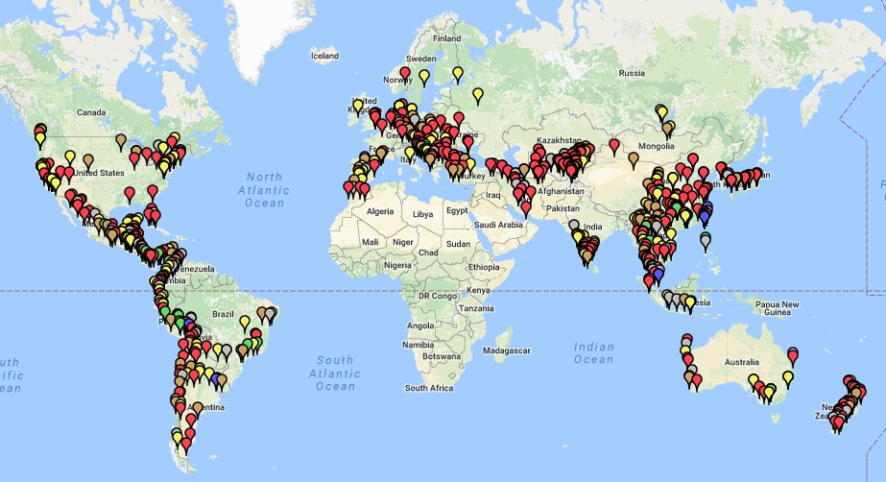
Around the world

Slide 6
The host
Software
Host OS: Windows Server 2016 To Go
Boots from an external USB 3 drive.
Hardware
We can use any normal SATA SSD drive and an USB-3 adapter or connect the drive internally via SATA.
The host PC needs to have a 64bit CPU with Hyper-V support, the more memory the better.
New Installation
Using a PowerShell script and a blank disk I create the host OS in about an hour.
I use a 180 day trial version of Windows server, because this is just a trial.

Slide 7
Using Profiles
Posh Profiles
Using a command line interface to start my Windows programs since the early 1990s, now using PowerShell profiles.
ex, um, dm, vm, ev, ser, n, ise, apps, fire, hosts, iis
Word, vs, sql, su, fm, excel, pdf, code

Slide 8
Creating new VMs
Hyper-V and Hyper-Cmdlets
Using custom scripts to quickly set create new VMs from scratch. A single one:
New-LabVM -id 1 -os 2016GUI
or several
New-vLab -count 5 -os 2016Core
I can also control them all with single commands
Start-vLab.ps1
Save-vLab.ps1
CheckPoint-vLab.ps1
Remove-LabVM.ps1 -ids 1,2,5

Slide 9
Using custom scripts
Automate common tasks
Before DSC was around I created many custom scripts to set up servers.
Setup-OS.ps1
Setup-iis.ps1 -role -hacon
Setup-DemoWebServer.ps1 -iis -sites 5
Setup-AD.ps1 -prepare -forest -SiteName Singapore
Mysore Project
I created scripts to completely automate the setup of my productions servers: Web-Server, web-sites, SQL-Server, database restore, custom apps and services. certificates, security settings.

Slide 10
Desired State Configuration
What is PowerShell DSC?
You define the desired configuration of your servers in configuration files using a PowerShell like syntax.
Configuration MyServer {
Node Localhost {
File BinFolder
{
Ensure = "Present"
Type = "Directory"
DestinationPath = "C:\bin"
}
}
}

Slide 11
DSC Resources
DSC is using resources to be configured to define the state of the server.
Get-DscResource | Select Name
Included in Windows (23)
Out of the box in Windows, the newer the OS, the more resources you will have.
DSC Resource Kit
Many more resources, now open source but strongly controlled by the Microsoft PowerShell team
Community Resources
Even more resource written by the community, before writing your own, Bing around a bit.

Slide 12
Using DSC locally
Using the push mode
We create a DSC configuration and execute it manually on a local or different server.

Slide 13
Using a DSC Pull Server
Server Setup
Using a web server (SMB share is possible)
Installing the pull server components
Providing configurations to be distributed
Client Setup
Tell the LC about the pull server
Sit back and relaxed

Slide 14
Alternatives to DSC
chef.io
puppet.com
powershellgallery.com/packages/Carbon/
Using your own scripts
How to choose?

Slide 15
Authoring DSC Resources
Need your own resources?
There are still some things you can not do with the existing DSC resources, so you can/have to write your own. But this is a topic for a another day.

Slide 16
Things DSC can't do!
Even though there are many resources available, for some things there may not be any.
Make sure things are NOT there.
There is a Script resource, which allows you to write custom PowerShell code into the DSC process.

Slide 17

Questions?
About Me
Peter Hahndorf Solution Architect / World Traveller Hahndorf Consulting My blog, open source projects and other tech stuff: https://peter.hahndorf.eu/tech/ For more about my travels: https://peter.hahndorf.eu/trip/
Contact me at: https://www.twee.net/contact/

