Slide 1
Contributing factors to win a superbowl

Slide 2
Overview
Financial
Big market vs small market
Proximity of salary cap
Average player salary
Average team salaries
Geographic impact
Travel distances
Injuries Domes vs outdoor
Score changes dome vs outdoor
Offensive stats
Completion %
Rushing yards
Defensive stats
# sacks
# icps

Slide 3
Definitions
Dead Money: refers to salary cap money a team is spending on a player no longer with the team
Active Money: refers to the salary cap money spent for active players

Slide 4
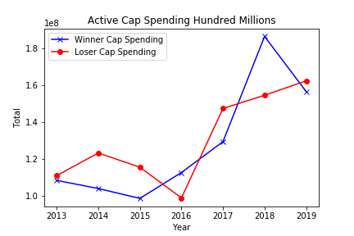
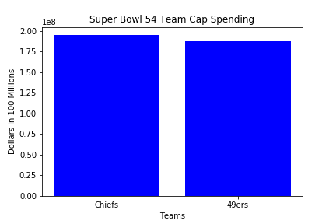
Total Cap spending
Advantage 49ers

Slide 5
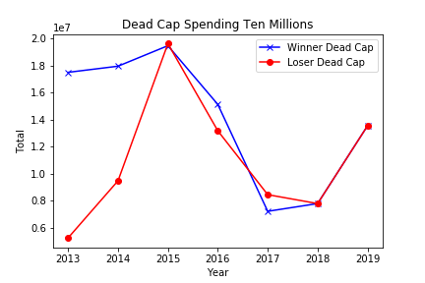
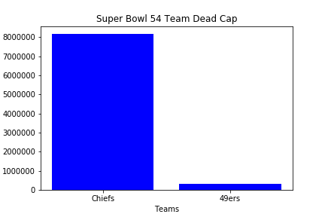
Dead cap spending comparison
Advantage Chiefs

Slide 6
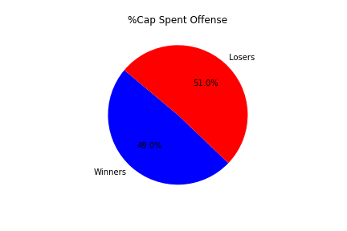
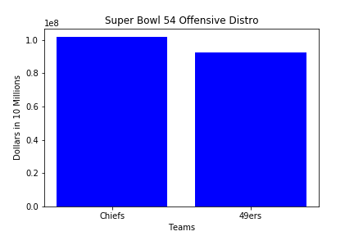
Offensive spending comparison
Advantage 49ers

Slide 7

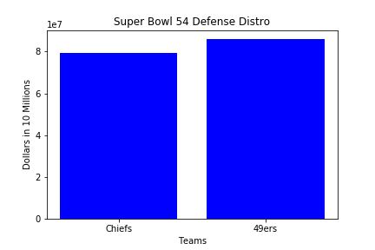
Defensive spending comparison
Advantage Chiefs

Slide 8
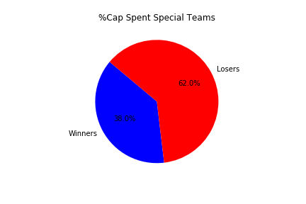
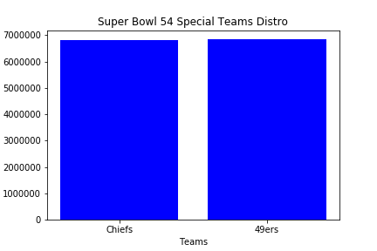
Special Teams spending comparison
Advantage None

