Slide 1
winning a superbowl: Historical Overview
Jennifer Garnett, Chris Ladymon, Harper Hahn

Slide 2
*We are not responsible for any money loss that may occur* *We are not promoting/encouraging betting/gambling behavior*
Colorado Gambling Hotline: 1-800-522-4700

Slide 3
Motivation & Summary
Hypothesis
Geographic
Teams who win travel the least
Gameplay
Highest seasonal stats have higher chance of winning
Financial
Due to salary caps, finances don’t impact outcome
Motivation
Relevant
Current Event
Imminent

Slide 4
Methods
Pandas
Jupyter Notebook
Matplotlib
SciPy
Gmaps
Excel
GeoPy
NFL Statistic Websites
https://www.spotrac.com/
Data.World
https://www.statista.com/statistics/193556/operating-income-of-national-football-league-teams-in-2010/

Slide 5
Geographical Data

Slide 6
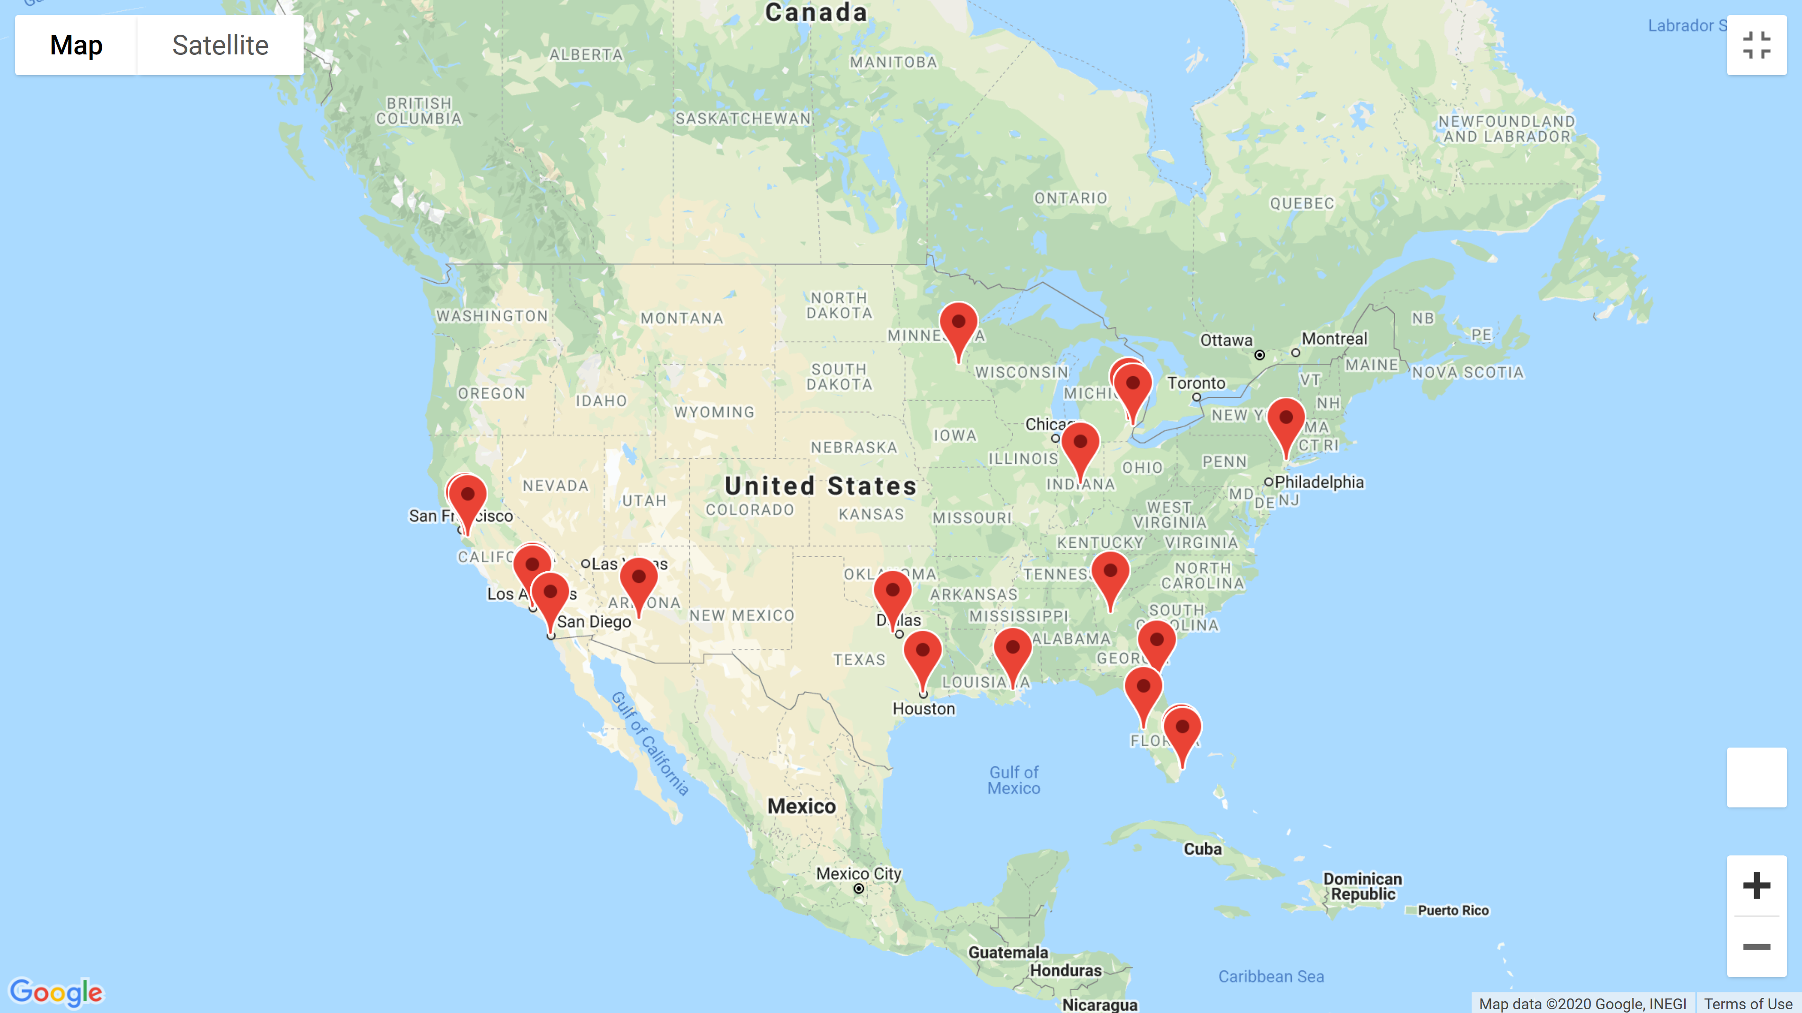

Slide 7
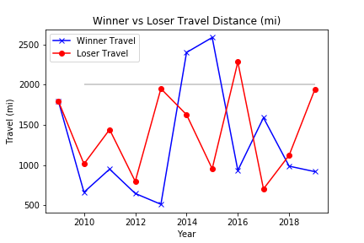
Distance Traveled: Who travels the greatest distance?
Advantage Chiefs

Slide 8
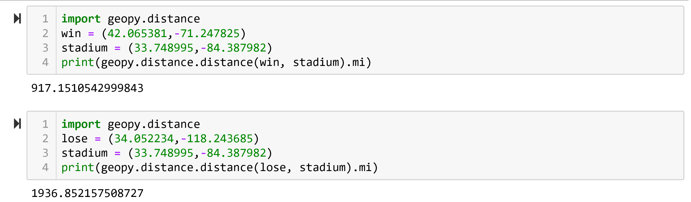

Slide 9
Gameplay Stats

Slide 10
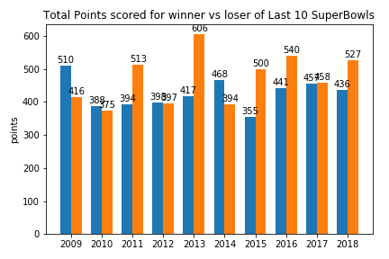
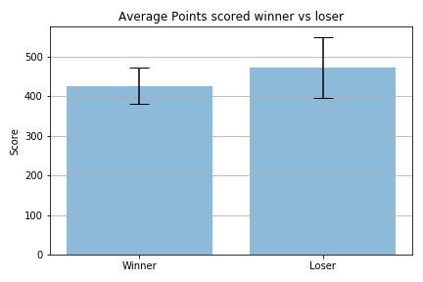
Total Points scored throughout the season before the superbowl
Advantage Chiefs

Slide 11
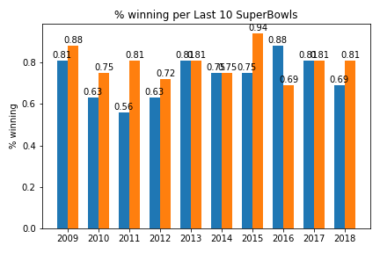
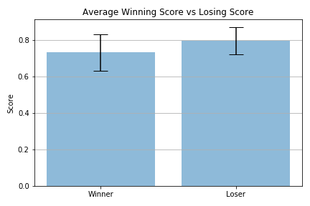
Season win loss record
Advantage Chiefs

Slide 12
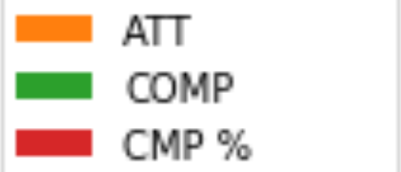
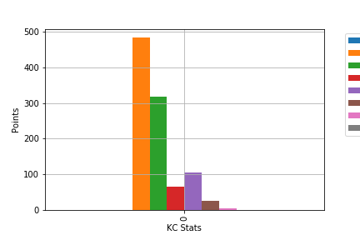
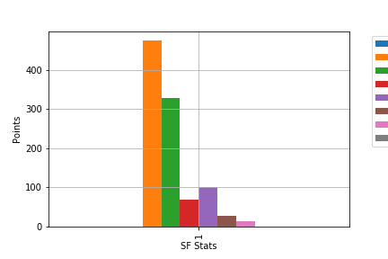
Chiefs vs 49ers: Passing
Advantage None

Slide 13
Financial Data

Slide 14
Definitions
Dead Money
refers to salary cap money a team is spending on a player no longer with the team
Active Money
refers to the salary cap money spent for active players

Slide 15
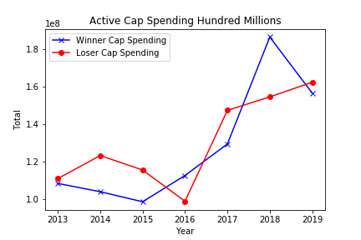
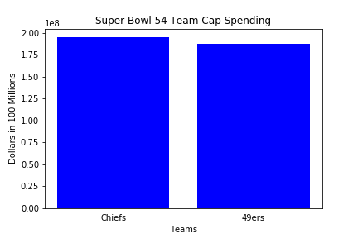
ACTIVE CAP SPENDING
Advantage 49ers

Slide 16
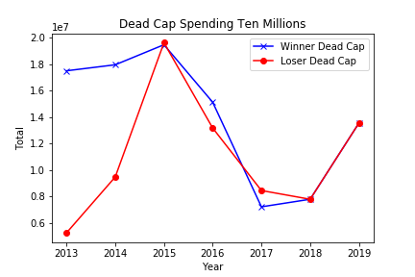
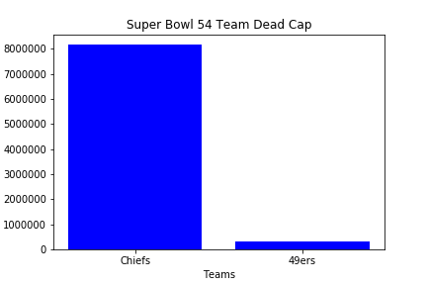
Dead cap spending comparison
Advantage None

Slide 17
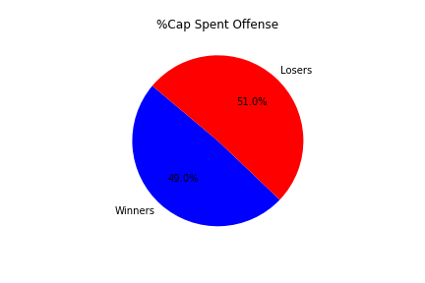
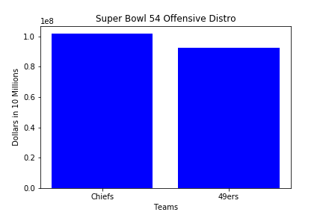
Offensive spending comparison
Advantage 49ers

Slide 18
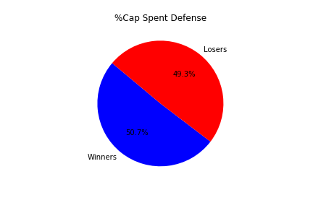
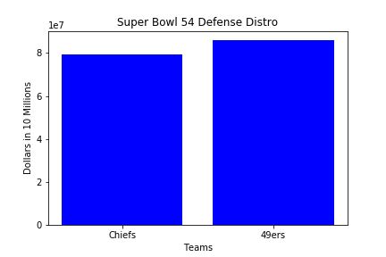
Defensive spending comparison
Advantage 49ers

Slide 19
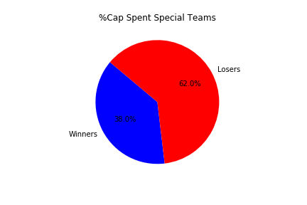
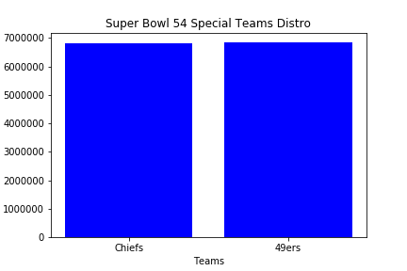
Special Teams spending comparison
Advantage Chiefs

Slide 20

Summary
Geography
Distance travel does impact outcome
Statistics
Seasonal statistics impact outcome
Winner tends to have lower stats
Financials
A wash since the salary caps starting in 1994
Team who spends the least on Special Teams wins
Prediction
Based on adding up the advantages when comparing the current teams to pass performance we pick the:
Chiefs

