Slide 1
Contributing factors to win a superbowl

Slide 2
Overview
Financial
Big market vs small market
Proximity of salary cap
Average player salary
Average team salaries
Geographic impact
Travel distances
Injuries Domes vs outdoor
Score changes dome vs outdoor
Offensive stats
Completion %
Rushing yards
Defensive stats
# sacks
# icps

Slide 3
Definitions
Dead Money: refers to salary cap money a team is spending on a player no longer with the team
Active Money: refers to the salary cap money spent for active players

Slide 4
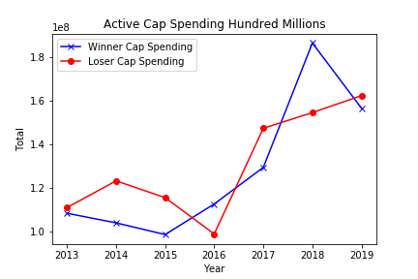
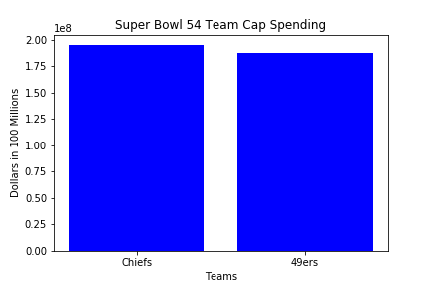
Total Cap spending
Advantage 49ers

Slide 5
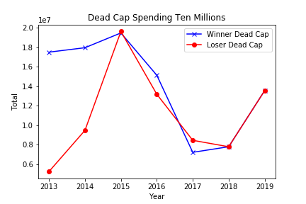
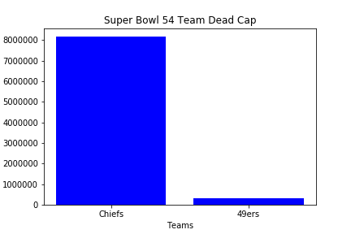
Dead cap spending comparison
Advantage Chiefs

Slide 6
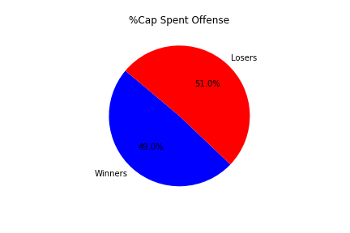
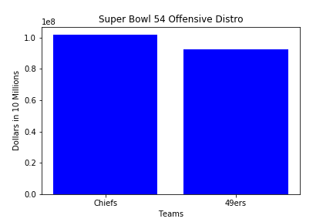
Offensive spending comparison

Slide 7
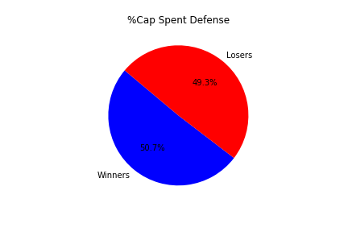
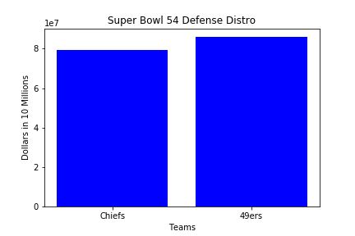
Defensive spending comparison

Slide 8
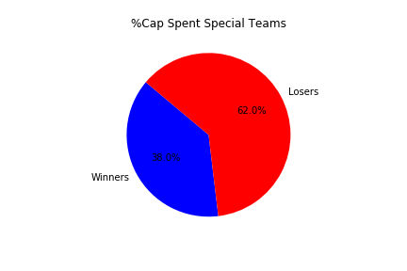
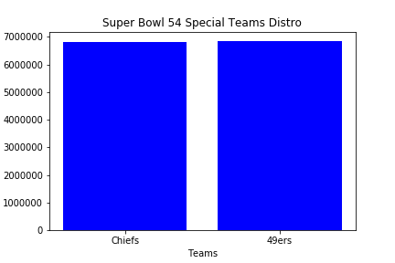
Special Teams spending comparison

Slide 9
Summary
Geography
Where the Super Bowls have been held over the last decade
NFL requires a dome or an ave temp of >=50 degrees
xxxxxxx
Statistics
Stats XXX tend to trend for the winner
Xxxxxxx
xxxxxx
Financials
Basically a wash since the salary caps starting in 1994
If there is any trend it is that the team who spends the least on Special Teams win
Prediction
Based on adding up the advantages when comparing the current teams to pass performance we pick the:
Put team here

