Slide 1
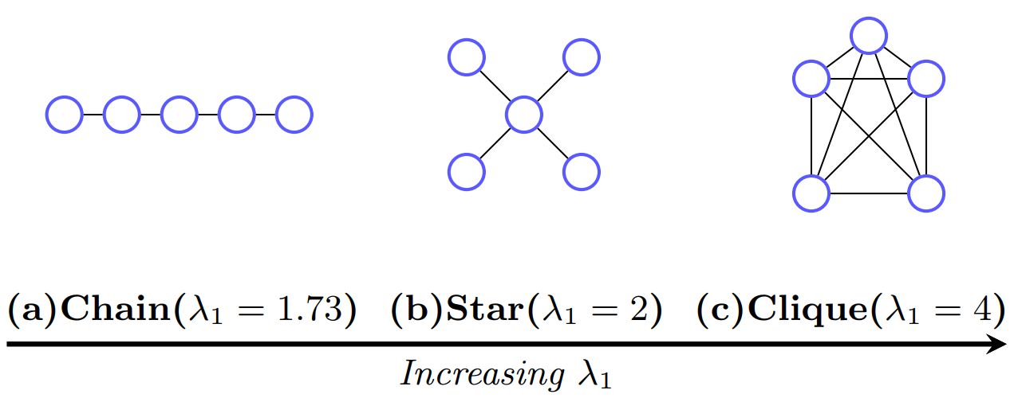

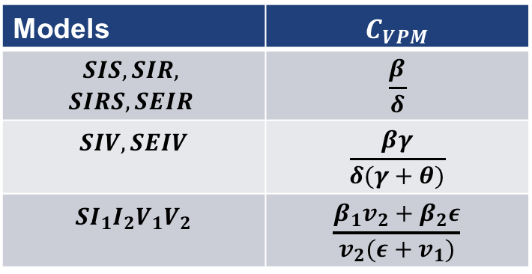
Cascades & Spectra
Effective strength of a virus $s=C_{VPM}λ_{1}$ with tipping point at $s=1$
Research Questions: How is the virus strength influenced by graph topology? What are the typical topological structures? How well does the model respond to manipulation of data?
Models | $$C_{VPM}$$
$$SIS,SIR,$$ $$SIRS, SEIR$$ | $$\frac{β}{δ}$$
$$SIV, SEIV$$ | $$\frac{βγ}{δ(γ+θ)}$$
$$SI_{1}I_{2}V_{1}V_{2}$$ | $$\frac{β_{1}v_{2}+β_{2}ε}{v_{2}(ε+v_{1})}$$
Sources: B. Aditya Prakash, D. Chakrabarti, N. Valler, M. Faloutsos, C. Faloutsos (2012), Threshold Conditions for Arbitrary Cascade Models on Arbitrary Networks. Knowledge and Information Systems manuscript No. KAIS-12-3483R1
Severin Jäger, Thomas Hahn, Yannick Schubert

