Slide 2

Particle Swarm Optimization for Capacitated Vehicle Routing Problem
Lecturers : Prof. Michel Toulouse
Group member : Hoang Hong Ha - 20212306M

Slide 3
Outline
I. Introduction
II. Problem: Capacitated vehicle routing problem
III. Particle Swarm Optimization
IV. Implementation
V. Experiment result
VI. Conclusion

Slide 4
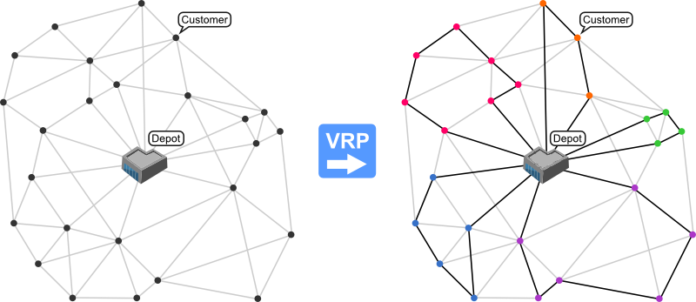
I. Introduction
The vehicle routing problem (VRP) is a combinatorial optimization and integer programming problem which asks "What is the optimal set of routes for a fleet of vehicles to traverse to deliver to a given set of customers?".
VRP will solve the problem in which a set of routes for a fleet of delivery vehicles based at one or several depots must be determined for several customers
Several variations of the VRP such as Multiple Depot VRP (MDVRP), Split Delivery VRP (SDVRP), and Dynamic VRP (DVRP)
If a constraint is given on the capacity of every vehicle, the problem is known as capacitated vehicle routing problem (CVRP).

Slide 5
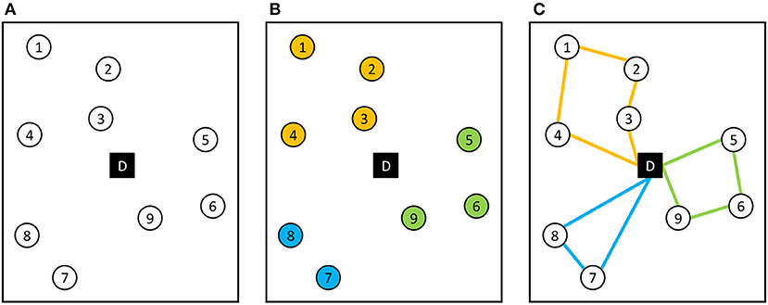
II. Problem: Capacitated vehicle routing problem
Capacitated Vehicle Routing Problem (CVRP) is a set of N customers with determined demands which must be served from a common depot by a fleet of delivery vehicles that has a constraint on their capacity
The CVRP aims are to find a set of minimum total cost routes for a fleet of capacitated vehicles based at a single depot, to serve a set of customers under the following constraints:
Each route begins and ends at the depot.
Each customer is visited exactly once.
The total demand for each route does not exceed the capacity of the vehicle.

Slide 6
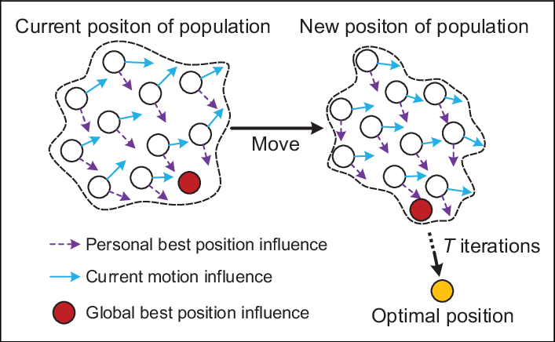
III. Particle Swarm Optimization
Particle swarm optimization (PSO) is a computational method that optimizes a problem by iteratively trying to improve a candidate solution with about a given measure of quality.
PSO is initialized with a group of random particles (solutions) and then searches for optima by updating generations.

Slide 7
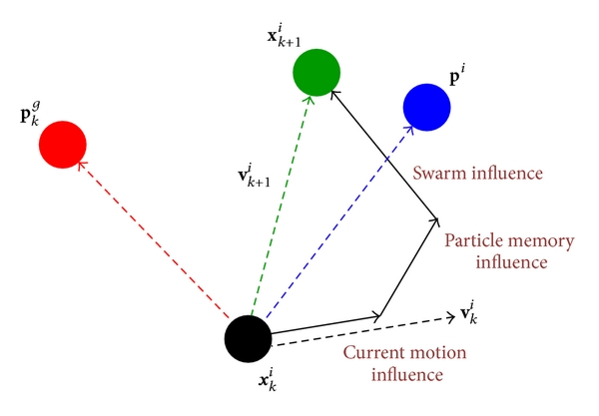

III. Particle Swarm Optimization
This compromise is formalized by the following equations :
$$v_{i}^{t+1}=w∗v_{i}^{t}+c_{1}∗α∗(p_{i}−x_{i})+c_{2}∗β∗(p_{glob}−x_{i})$$
$$x_{i}^{t+1}=x_{i}^{t}+v_{i}^{t+1}$$

Slide 8
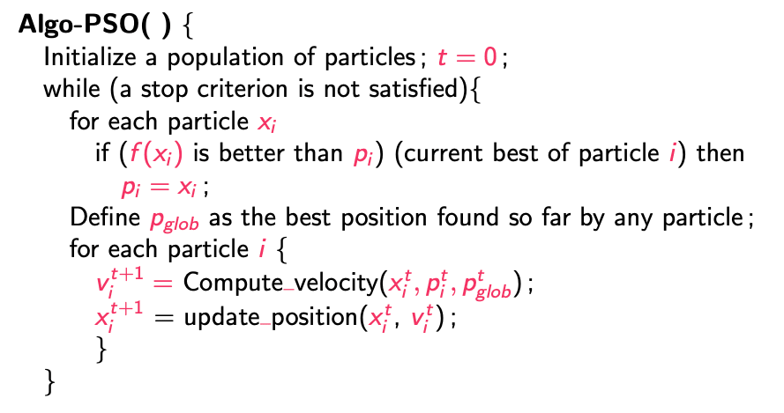
III. Particle Swarm Optimization
Pseudocode of PSO

Slide 9
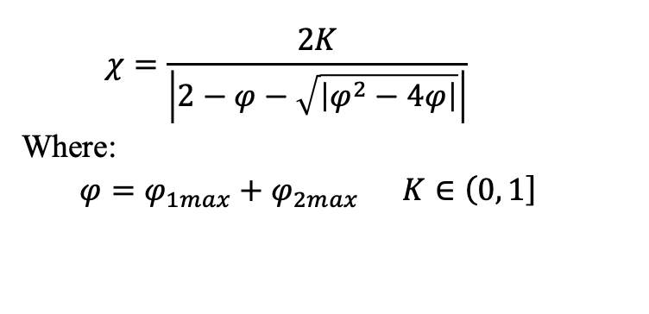
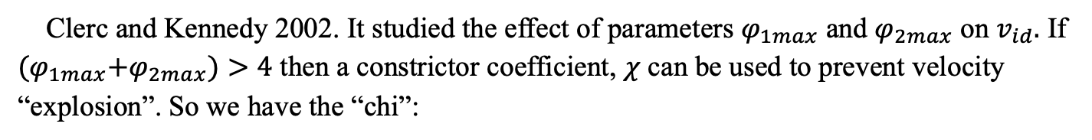
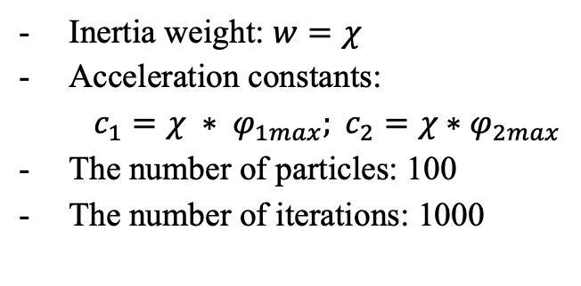
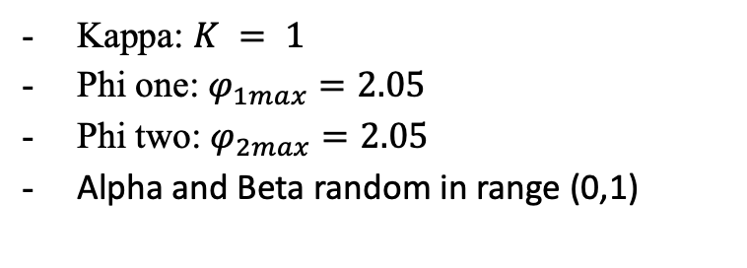
IV. Implementation
The parameter settings
Clerc and Kennedy 2002. It studied the effect of parameters $φ_{1max}$ and $φ_{2max}$ on $v_{id}.$ If ${(φ}_{1max}+φ_{2max})>4$ then a constrictor coefficient, $χ$ can be used to prevent velocity “explosion”. So we have the “chi”:
$$χ=\frac{2Κ}{\left|2−φ−\sqrt{\left|φ^{2}−4φ\right|}\right|}$$
Where:
$${φ=φ}_{1max}+φ_{2max} K∈\left(0,\left.1\right]\right.$$
The parameters for PSO are set as follows:
Kappa: $K = 1$
Phi one: $φ_{1max}=2.05$
Phi two: $φ_{2max}=2.05$
Alpha and Beta random in range (0,1)
Inertia weight: $w=χ$
Acceleration constants:
$c_{1}=χ ∗ φ_{1max}; c_{2}=χ∗φ_{2max}$
The number of particles: 100
The number of iterations: 1000

Slide 10
IV. Implementation
The datasets
The benchmark problems consist of six sets as follow: seventy-four instances (sets A, B and P) from [4], eleven instances (set E) from [5], three instances (set F) from [6], five instances (set M) from [7]. All the problem instances were downloaded from the site http://vrp.atd-lab.inf.puc-rio.br.

Slide 11
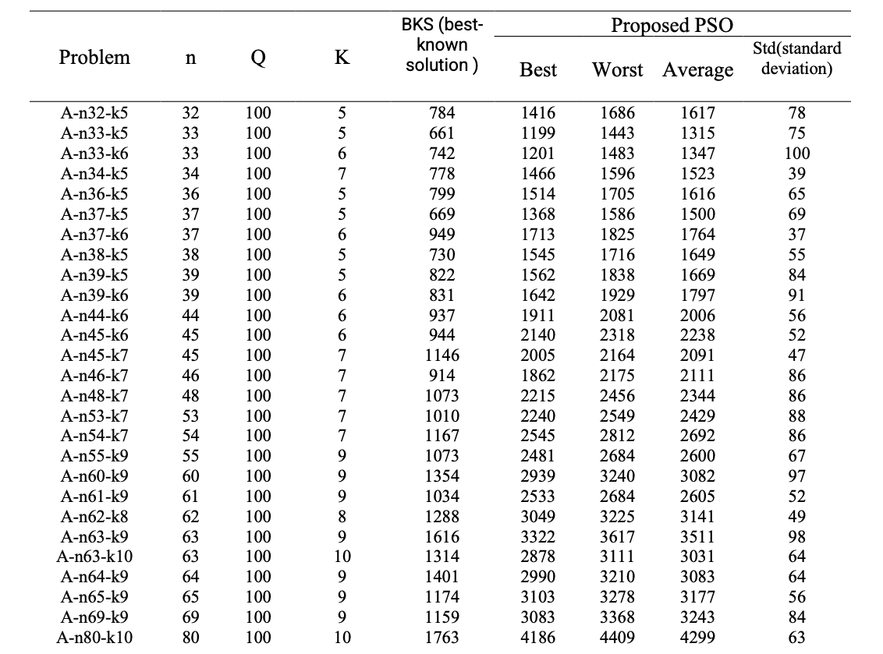
V. Experiment result
Computational results for the problem set A.

Slide 12
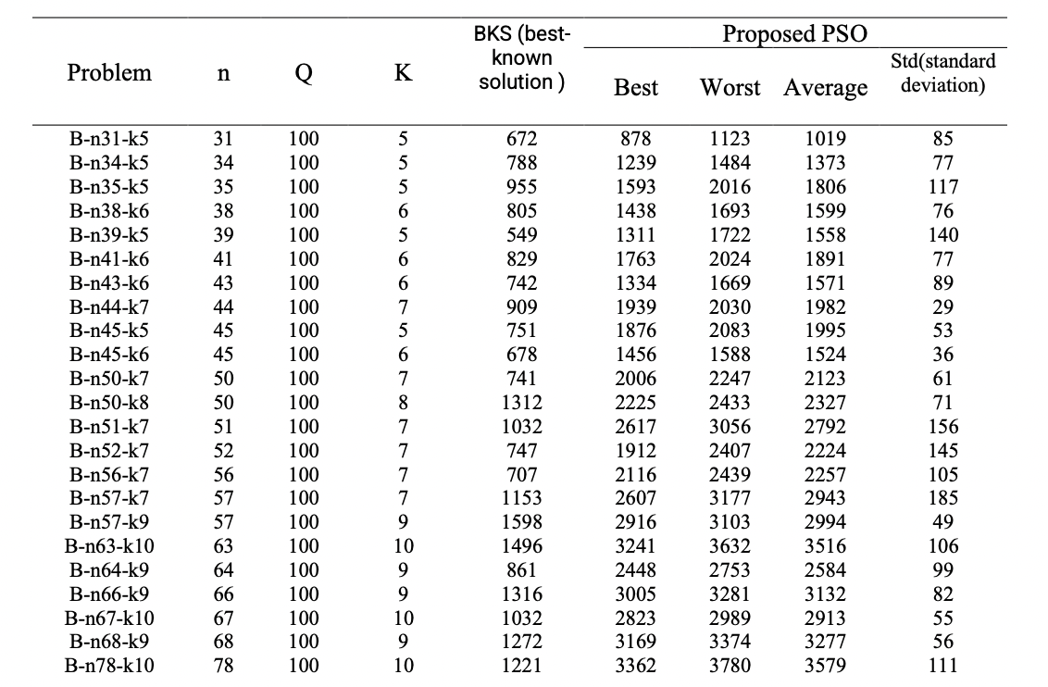
V. Experiment result
Computational results for the problem set B.

Slide 13
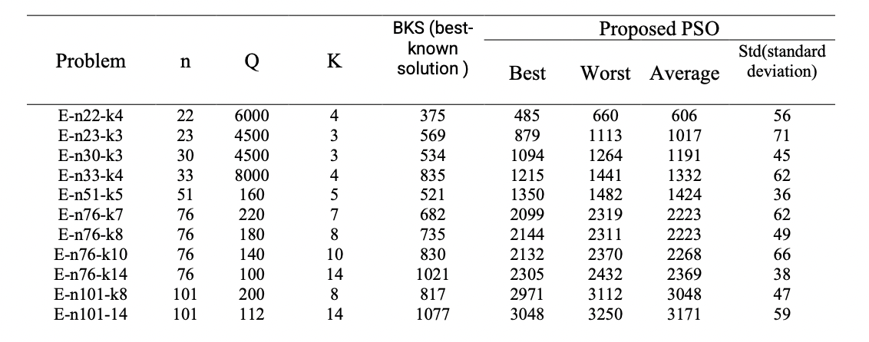
V. Experiment result
Computational results for the problem set E.

Slide 14
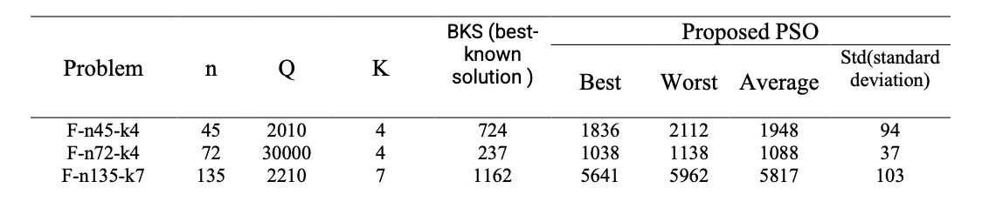
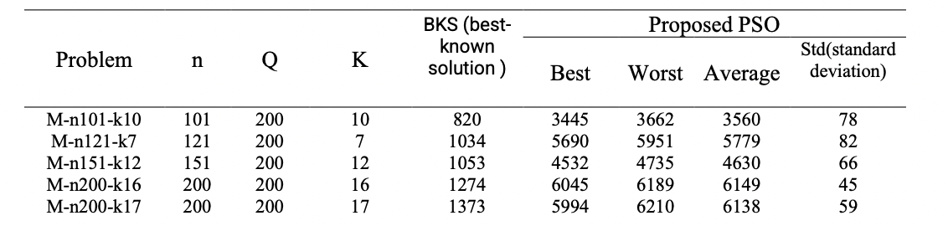
V. Experiment result
Computational results for the problem set F.
Computational results for the problem set M.

Slide 15
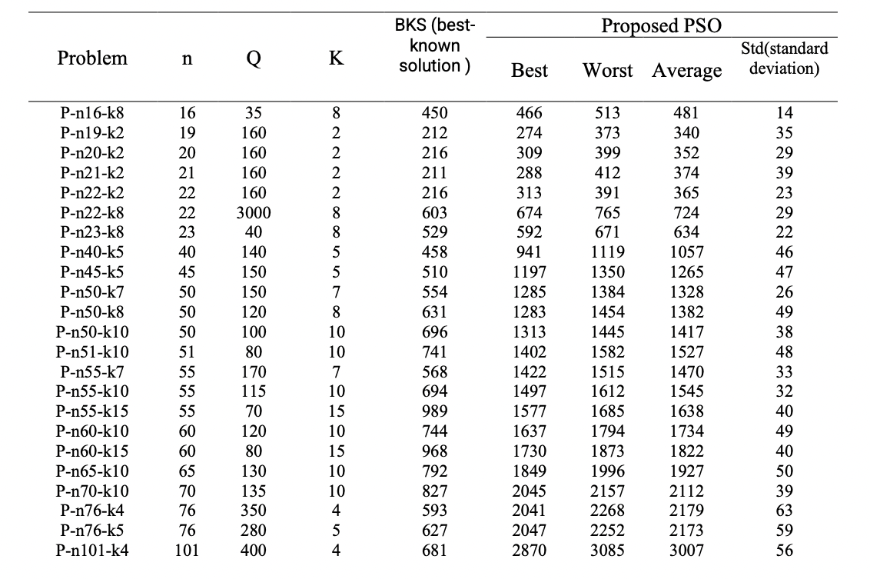
V. Experiment result
Computational results for the problem set P.

Slide 16
VI. Conclusion
We have implemented the algorithm and run it through the six sets of data.
So, the result given received are not good.
In future work, we will find some approaches in a way that performs well on large benchmarks too.

Slide 17
THANK YOU !

