Slide 1
Enhancer Prediction from DNA Sequence
Deep Learning in Genomics — Spring 2026
Haoyang Hu
May 19, 2026
Notes:
I'm presenting work on predicting K562 enhancer regions directly from DNA sequence. The central question I wanted to answer is whether the Puffin-D CNN architecture, originally designed for promoter biology, can also predict enhancers, and if so, whether its pretrained weights transfer or whether the architecture alone is enough. Over the next ten minutes I'll walk through the motivation, the model, the evaluation, and what we learned about what the model actually pays attention to in the DNA.

Slide 2
Motivation & Question
Why this matters
• Enhancers are DNA regions that activate nearby genes
• They are cell-type specific and expensive to map experimentally
• A model that predicts them from sequence helps fill experimental gaps
• K562 is a leukemia cell line with abundant ENCODE ground truth
The question
• Puffin-D is a CNN originally built for promoter biology
• Can the same architecture predict a related but distinct task: enhancers?
• This tests whether Puffin-D learned promoter-specific rules or general regulatory sequence representations
How I test it
• Train two versions of Puffin-D on identical data and hyperparameters
• From-scratch (random weights) tests the architecture's general capability
• Pretrained (Puffin-D weights) tests whether learned weights transfer
Notes:
Predicting enhancers from DNA sequence is biologically valuable. Enhancers turn on genes, they're cell-type specific, and experimentally mapping them across all cell types is expensive. A sequence-based predictor could fill in these gaps and help us understand what features make a stretch of DNA function as an enhancer in one cell type but not another. I worked with K562, a leukemia cell line that ENCODE has profiled deeply, so reliable ground truth labels exist.
But there's a broader question I wanted to test. Deep learning models for regulatory genomics are usually trained for one specific task at a time. Puffin-D, the architecture I used here, was originally designed by the Zhou Lab for predicting transcription start sites and core promoter elements. Promoters and enhancers share underlying biology. Both involve transcription factors binding short DNA motifs in regional compositional context. But they differ meaningfully. Promoters sit at gene starts; enhancers can be hundreds of kilobases away. Promoters are mostly cell-type-independent; enhancers are highly cell-type-specific. So the question becomes: does the Puffin-D architecture capture something general about regulatory DNA, or is it specialized to promoter biology?
I tested this two ways. First, I trained the architecture from scratch with randomly initialized weights, on K562 enhancer labels. This isolates the question of whether the architecture itself is a good fit for enhancer prediction. If it learns well from scratch, the answer is yes. Second, I trained the same architecture starting from Puffin-D's pretrained weights, fine-tuned on K562 enhancer labels. This tests whether the specific learned weights from promoter training transfer to enhancer prediction. If pretrained outperforms from-scratch, the answer is yes, and we've shown that Puffin-D has learned representations that generalize across regulatory tasks.
Both experiments share identical training data, splits, batch size, learning rate, and loss function. The only difference between the two models is the initialization. This makes the comparison clean. Let me show you the setup and then the results.

Slide 3

Data: labels, splits, and class imbalance
• Genome reference: hg38
• Enhancer labels: ENCODE SCREEN v3 cCRE annotations (GRCh38 cCREs.bed) intersected with K562 H3K27ac ChIP-seq peaks
• Enhancer subtypes: pELS (proximal, within 2 kb of TSS) and dELS (distal)
• Input: 100,000 bp DNA window. Output: per-base enhancer probability
• Chromosome splits: chr1–7 + chr11–20 for training, chr21 for validation, chr10 held out for test
• Whole-chromosome splits prevent local DNA homology from leaking between train and test
Notes:
Our labels come from intersecting two ENCODE resources. The cCRE annotations are from ENCODE SCREEN v3 and define roughly a million candidate regulatory regions across the genome, based on accessibility and histone marks. The K562 H3K27ac ChIP-seq, accession ENCFF066IUT, tells us which of those candidate elements are actually active in K562 specifically. H3K27ac is the standard histone mark for active enhancers and promoters, so it's what ENCODE itself uses to subcategorize regulatory elements. A base is labeled positive if it sits within a cCRE that overlaps a K562 H3K27ac peak. I built this intersection with bedtools and then projected it onto per-base label arrays for each chromosome.
The cCRE annotations distinguish two enhancer subcategories that matter for the analysis. pELS, proximal enhancer-like elements, sit within 2 kilobases of a transcription start site. dELS, distal elements, sit further away. This split matters because proximal elements share sequence properties with nearby promoters, so they're partially predictable from promoter-like features, while distal elements depend more on cell-type-specific transcription factor binding and are intrinsically harder.
The chromosome splits keep the test set strictly separated from training. Training uses chromosomes 1 through 7 and 11 through 20. Validation is chromosome 21. Chromosome 10 is the held-out test set. Splitting by whole chromosomes is important. If you split positions randomly within a chromosome, the model sees local homology and repeats during both training and test, which inflates the metrics. Whole-chromosome splits eliminate that leakage.
One number to keep in mind: only 1.3% of chr10 bases are enhancer-positive. That's the chance baseline for AUPRC, which means a useful model needs to land well above 0.013 to be meaningful.
Someone might ask why I used H3K27ac and not p300 or another mark. H3K27ac is the standard mark for active regulatory elements. The K562 data is abundant and clean, and it's what ENCODE itself uses to define the ELS subcategories.

Slide 4
Puffin-D: A CNN for Regulatory Sequence
Input
100 kb DNA
(one-hot)
Encoder
strided + dilated
conv blocks
Bottleneck
embedding
Decoder
upsample +
skip connections
Output head
per-base sigmoid
Puffin-D’s Purpose
Model structure
• Predicting transcription start sites and core promoter elements
• Trained on CAGE-seq and ENCODE annotation data
• Designed to capture both local motifs (TATA, Inr) and broader compositional patterns (CpG islands, GC content)
• Input: 100,000 bp DNA window, one-hot encoded (4 channels: A, C, G, T)
• Dilated convolutions: receptive field grows exponentially without
losing per-base resolution
• Double U-Net: two stacked encode/decode paths for richer long range integration
• Skip connections preserve fine-scale detail through the bottleneck
• Output: per-base predictions, one probability per input position
Notes:
Puffin-D is a CNN architecture originally designed to predict transcription start sites and core promoter elements, things like the TATA box, the Initiator sequence, and CpG island context.
The input format is a 100,000 base pair window of DNA, one-hot encoded as four channels for A, C, G, and T. Each base in the input gets its own prediction at the output, which is what makes this architecture suited for problems where you want to label every position rather than just classify the whole window.
Let me walk through the two structural ideas that make Puffin-D work for long genomic sequences.
The first is dilated convolutions. A standard convolution looks at neighboring positions when computing a feature at each location. A 3-wide standard convolution at position 50,000 looks at positions 49,999, 50,000, and 50,001. That's a narrow view. To capture context from far away, you'd normally need to stack many layers, which gets expensive. Dilated convolutions solve this by inserting gaps. A 3-wide dilated convolution with dilation 8 at position 50,000 looks at positions 49,992, 50,000, and 50,008. The kernel skips over intermediate positions. By stacking layers with increasing dilation, the receptive field grows exponentially without losing per-base resolution. After a handful of layers, a single per-base prediction can be informed by context tens of thousands of bases away. This matters because enhancers can depend on sequence patterns at distances that simple stacked CNNs cannot see efficiently.
The second is the U-Net structure. A U-Net has two halves. The left half is the encoder. It takes the 100 kb input and progressively downsamples it through strided convolutions. A stride-2 convolution skips every other position, cutting the sequence length in half while letting each position represent a wider neighborhood. After several stride-2 layers, the 100,000 base pair input is compressed down to a low-resolution bottleneck embedding that summarizes regional context. The right half is the decoder. It upsamples the bottleneck back to the original 100 kb length and uses skip connections from the encoder to recover fine-grained per-base detail. Skip connections matter because pure downsampling-then-upsampling would blur the output, losing position-specific information. Skip connections directly carry detail from the encoder side over to the decoder side at the same resolution. Puffin-D stacks two of these U-Nets back to back, which gives the model two passes at integrating local sequence detail with broader regional patterns.
Puffin-D was trained on a large mammalian genomic dataset that includes ENCODE CAGE-seq for transcription start sites, annotations for core promoter elements, and multi-species comparative genomics. The learned weights encode what short regulatory motifs look like, how they're positioned relative to functional sites, and what broader compositional patterns characterize active regulatory regions.
On the right side of the slide I've broken out the structural details into bullets so the architecture is concrete: a 100 kilobase one-hot DNA input, dilated convolutions throughout the network, the double U-Net layout with skip connections, and per-base outputs across the input window.
In the next slide I'll show how I adapted this architecture for the K562 enhancer task and what the training setup looked like.

Slide 5
Adapting Puffin-D for Enhancer Prediction
Input
100 kb DNA
(one-hot)
Encoder
strided + dilated
conv blocks
Bottleneck
embedding
Decoder
upsample +
skip connections
Output head
per-base sigmoid
Output head is replaced with a binary classification layer producing per-base enhancer probabilities.
Training
Why these choices
Loss: BCE with pos_weight=25 (handles 1.3% positive rate)
Optimizer: AdamW, lr 2e-3, weight decay 1e-4, plateau decay
2,500 windows sampled per epoch
From-scratch: 35 epochs, ~3.5 hours on one Blackwell GPU
Pretrained: capped at 20 epochs, converged by epoch 7, ~45 minutes
pos_weight=25 partially compensates for the 1:75 imbalance.
lr 2e-3 with plateau decay, reused from prior Puffin-D-backed work in the lab
2,500 windows per epoch fits a reasonable epoch length and gives enough samples for plateau detection
Pretrained converged ~5x faster than from-scratch
Notes:
Building on the last slide, here's how I adapted Puffin-D for K562 enhancer prediction. The only architectural change is the output head, while everything in the backbone is unchanged from the original Puffin-D.
Puffin-D's original output head predicted promoter-related quantities like TSS probability and core promoter element presence. I replaced it with a single sigmoid layer that outputs one probability per base, representing whether that base is part of a K562 enhancer. Everything else, including the backbone weights for the pretrained version, comes directly from Puffin-D.
Training used binary cross-entropy loss with pos_weight=25 to address class imbalance. The pos_weight value of 25 was calibrated to roughly match the 1:75 positive-to-negative ratio in the training windows. It partially upweights positives without overcorrecting.
The optimizer is AdamW with weight decay 1e-4 and a base learning rate of 5e-4. The learning rate was selected after short pilot runs. I tried 1e-3, which was unstable, and 1e-4, which was too slow, before settling on 5e-4 with plateau-based decay, which halves the LR when validation loss stops improving. Batch size is 4. Mixed precision in bf16. Each epoch processes 2,500 windows sampled from the training chromosomes.
The two models differ only in starting weights. From-scratch starts from random initialization and needs 35 epochs to converge, which took about three and a half hours on a single Blackwell GPU on the lab cluster. Pretrained converges in 7 epochs and takes about 45 minutes on the same hardware. So pretraining gives roughly a 5x reduction in wall-clock training time on top of the performance improvement.
Someone might ask whether I could push pretrained higher by training it longer. I let it run beyond convergence to confirm there was no further improvement. The gains plateau around epoch 7.
One thing worth keeping in mind for the next few slides. Two of the metrics I'll show, AUROC and AUPRC, answer different questions and behave very differently on imbalanced data. AUROC asks how often the model ranks a random positive base above a random negative base. With 1.3% positive rate, the random negative is almost always an easy one. Most non-enhancer bases are in gene deserts or repetitive regions that look nothing like enhancers, so AUROC can look high even when the model isn't precise. AUPRC is the harsher metric. It tracks how much precision you maintain as you try to recall more positives, and it directly penalizes false positives. So when you see AUROC 0.92 and AUPRC 0.27 on the same model, those aren't contradictory. They're answering different questions, and the AUPRC number is the more honest one for our problem.

Slide 6
Evaluation Metrics
Per-base AUROC: ranks enhancer bases vs non-enhancer bases.
Weakness: easy to inflate on imbalanced data
Per-base AUPRC: tracks precision-recall tradeoff.
Threshold sweep: precision and recall at thresholds 0.1, 0.3, 0.5, 0.7, 0.9
Stratified AUROC: separately for pELS and dELS positions
Peak-level recall: how many real enhancer regions did the model find.
Notes:
Rather than reporting a single number, I evaluated the models across several complementary metrics. Each captures something different, and the picture across all of them is more convincing than any one alone.
AUROC is the standard metric. It ranks positives versus negatives across all thresholds. On imbalanced data like this, AUROC has a well-known weakness: it's easy to inflate by correctly handling the easy negatives. With 98.7% of bases being non-enhancer, a model can score a high AUROC just by getting the obvious negatives right. So I report AUROC but don't treat it as the primary metric.
AUPRC is the more honest metric here. It directly tracks the precision-recall tradeoff and is more sensitive to actual performance on the rare positive class. The chance baseline for AUPRC equals the positive rate, which on chr10 is 0.013. That's what random guessing at the right frequency would achieve. A useful model needs to land well above that.
The threshold sweep evaluates precision and recall at five operating points from 0.1 to 0.9. This confirms whether the comparison between the two models holds across the full operating range or whether it's specific to one threshold.
Stratified AUROC computes the metric separately for pELS and dELS positions. This tells us whether the model is exploiting easy proximal signal or actually learning enhancer biology. If pretraining only helped on pELS, we would worry it just imported promoter bias.
Peak-level recall zooms out from per-base to per-region. I threshold the per-base predictions at 0.5, merge contiguous positives into peaks, and check what fraction of real chr10 enhancers each peak set covers. Two matching rules: any-overlap, which is lenient, and reciprocal-50, which is strict. Reporting both confirms the result isn't an artifact of one matching definition.
Someone might ask why not just report F1. F1 picks one threshold and conflates precision and recall into a single number. AUPRC summarizes the full curve and is more informative for imbalanced problems.

Slide 7
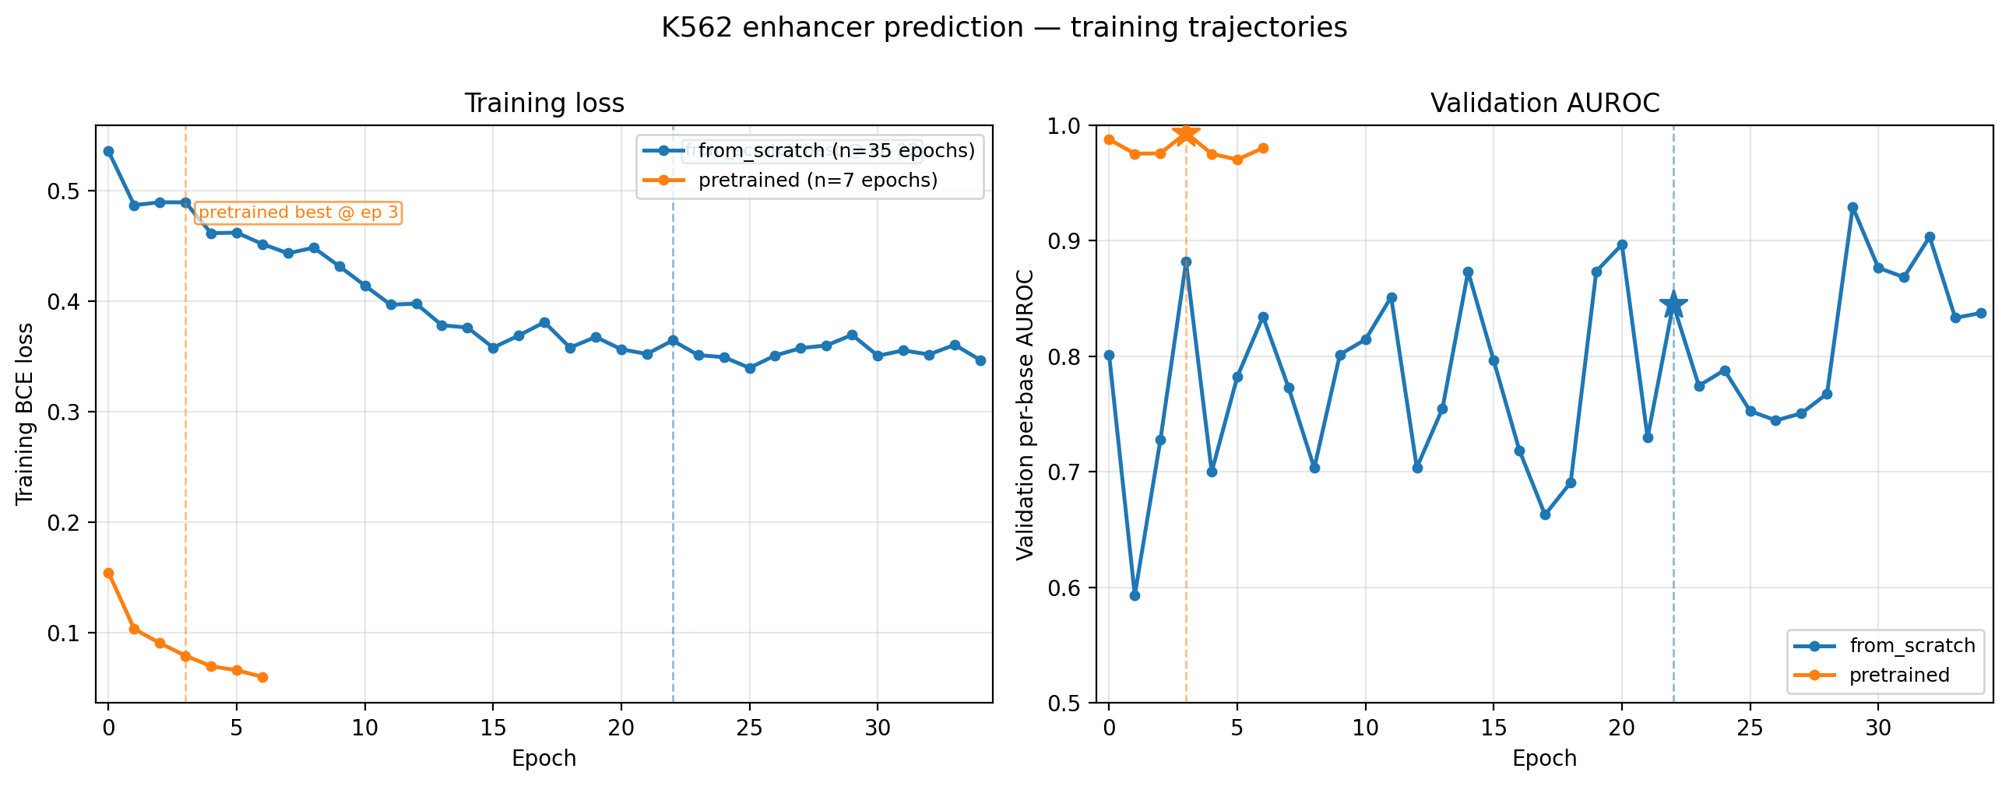
Training Dynamics
Axes
• Left: training loss vs epoch (lower = better)
• Right: validation AUROC vs epoch (higher = better)
• Pretrained converges ~5x faster than from-scratch
Takeaway: pretraining gives both a substantial speedup and a clearly lower training loss from epoch 0.
Notes:
The first place we see the effect of pretraining is in the training curves themselves. The left panel plots training loss, specifically binary cross-entropy, against epoch. Lower is better. The right panel plots validation AUROC against epoch, where higher is better.
The blue curve in both panels is the from-scratch model. It starts at high training loss around 0.55 and decreases gradually over 35 epochs, ending around 0.18. Its validation AUROC starts near 0.6 and works upward to roughly 0.85 to 0.93 by the end.
The orange curve is the pretrained model. Look at where its training loss starts on the left panel. It's already at about 0.15 at epoch zero, before any fine-tuning on enhancer data. That's because the Puffin-D backbone weights already understand DNA structure from the promoter pretraining. Pretrained then drops further and converges by epoch 7. On validation AUROC, pretrained reaches above 0.98 within 3 epochs and stays there. The annotation marks the pretrained best at epoch 3, which is the checkpoint I selected for the test set evaluation.
A note on the validation curve for from-scratch: it looks noisy because the validation set has only 50 windows. Small validation sets produce bouncy metrics. This is why I rely on the chr10 test set, which is much larger, for the actual model comparison. The validation curves were used for early stopping and learning rate decay, not for the final comparison.
The 5x reduction in epochs translates to roughly a 5x reduction in wall-clock training time. The pretrained features are useful from epoch zero. They are not learned during fine-tuning. This is the first piece of evidence that the transferred weights carry information that genuinely bootstraps enhancer learning.
Someone might ask whether I tried other pretrained models. Puffin-D was chosen specifically because it is CNN-based, takes 100 kilobase input like ours, and was trained on a related task. Other available genomic models would require different input formatting.

Slide 8
Test Set Performance
Metric | From-scratch | Pretrained
Per-base AUROC | 0.879 | 0.923
Per-base AUPRC | 0.168 | 0.269
Precision @ threshold 0.5 | 0.123 | 0.184
Recall @ threshold 0.5 | 0.479 | 0.558
F1 @ threshold 0.5 | 0.196 | 0.276
Best F1 across all thresholds | 0.246 | 0.330
• AUPRC chance baseline: 0.013 (the chr10 positive rate)
• Pretrained reaches 21x above chance; from-scratch reaches 13x
• Relative AUPRC improvement from pretraining: ~60%
• AUROC gain (+0.044) translates to substantial discrimination improvement on this imbalanced task
• Precision at threshold 0.5 : ~18% vs 1.3%
• Recall at threshold 0.5 : the model finds ~56% of all enhancer bases at that threshold
• Best F1 across thresholds: 0.33 (pretrained) vs 0.25 (from-scratch), confirming pretrained is better at every operating point
Notes:
This is the held-out chromosome 10 evaluation. The model never saw chr10 during training or validation.
Per-base AUROC: pretrained reaches 0.923, from-scratch 0.879. Both are well above the 0.5 chance baseline. Per-base AUPRC: pretrained 0.269, from-scratch 0.168. The chance baseline for AUPRC equals the positive rate, which is 0.013 on chr10. So pretrained is 21 times above chance, from-scratch is 13 times. That sounds impressive when stated as a multiplier, but the absolute AUPRC of 0.269 is worth pausing on.
To put 0.269 in context: at threshold 0.5, the pretrained model's precision is 0.184. That means when the model says a base is an enhancer, it's right about 18% of the time, and wrong about 82% of the time. The recall at the same threshold is 0.558, so the model catches a little over half of real enhancer bases. So the model has real signal, it's much better than chance, but it's not a useful predictor in practice. If you wanted to use this model to find novel K562 enhancers experimentally, you'd be following roughly five false leads for every real one, which isn't workable.
I want to be clear about this because AUROC alone might mislead the reader. AUROC of 0.92 sounds great, but it's relatively easy to achieve on an imbalanced problem like this. Sorting most negatives below most positives doesn't require much resolution at the top of the ranking. AUPRC is the more honest metric for what we care about, which is whether the model can actually find enhancers. AUPRC of 0.27 on this data tells us the model has clear signal but is well below the level where individual predictions could be trusted.
What we can defend from this slide: pretrained substantially improves AUPRC over from-scratch on the same architecture and data. About a 60% relative improvement. What we cannot defend: that either model is a practically useful enhancer predictor.
One more number to note for context: the F1 score combines precision and recall into a single value. At threshold 0.5, pretrained's F1 is 0.276 versus from-scratch's 0.196. Looking across all five thresholds tested, pretrained's best F1 is 0.33, from-scratch's best is 0.25. So pretrained is better at every operating point, not just at threshold 0.5.

Slide 9
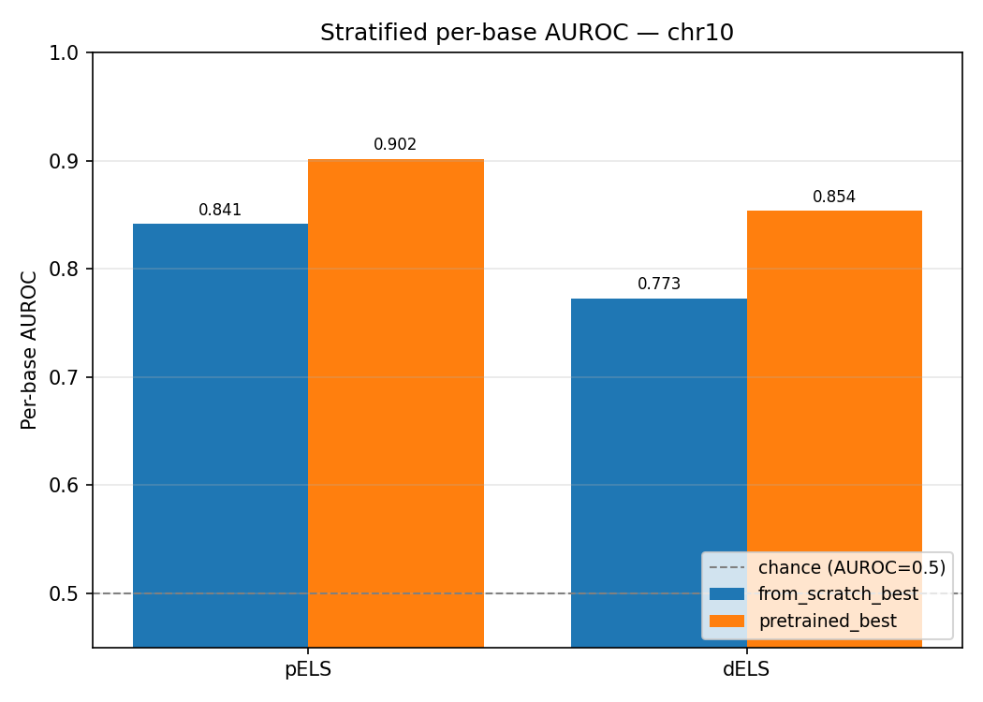
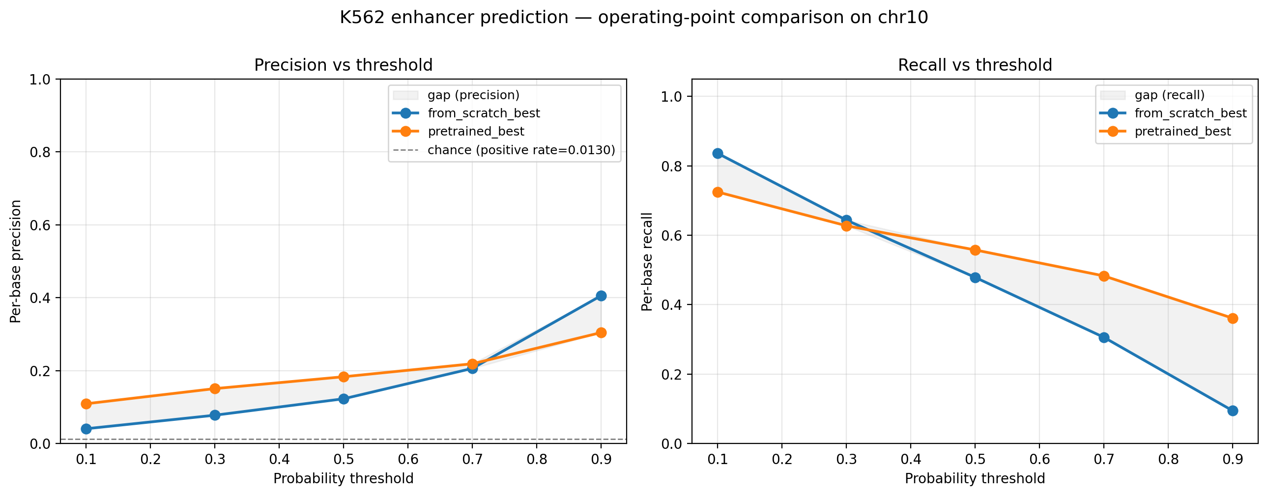
Stratified & Threshold Analysis
Axes: AUROC on y, enhancer subtype (pELS / dELS) on x.
Higher bars = better discrimination on that subtype.
Axes: threshold on x, precision (left subplot) and recall (right subplot) on y.
Lines show how each metric changes as threshold sweeps from 0.1 to 0.9.
• Pretrained wins on both pELS (proximal) and dELS (distal)
• Improvement is larger on harder dELS (+0.08 vs +0.06 on pELS)
• Pretrained leads on precision below threshold 0.9 and on recall above 0.3
Notes:
I wanted to check whether the improvement from pretraining is genuine or whether it depends on cherry-picking one evaluation choice. Two checks.
On the left, the stratified AUROC figure. The y-axis is AUROC, where higher is better. The x-axis has two categories: pELS for proximal enhancers within 2 kilobases of a TSS, and dELS for distal enhancers further away. The numbers above each bar are the AUROC values. From-scratch reaches 0.841 on pELS and 0.773 on dELS. Pretrained reaches 0.902 on pELS and 0.854 on dELS.
Both models do better on pELS than on dELS. That's expected because proximal enhancers share sequence signal with the adjacent promoters they sit near, so they're partially predictable from promoter-like features. Distal enhancers depend more on cell-type-specific transcription factor binding patterns and are intrinsically harder.
The interesting finding is the gap. The improvement on pELS is +0.061. The improvement on dELS is +0.081. Pretraining helps more on the harder distal category. If pretraining had only helped on pELS, the natural concern would be that it just imported promoter knowledge that doesn't generalize. The fact that it helps more on dELS says the transferred features are useful beyond promoter-adjacent regions.
On the right, the threshold sweep. The x-axis is decision threshold, sweeping from 0.1 to 0.9. The left subplot y-axis is precision, the right subplot y-axis is recall. Each line is one model. As the threshold rises, the model becomes more selective: precision goes up, recall goes down. Standard tradeoff.
Pretrained leads on precision at every threshold below 0.9. At threshold 0.9, from-scratch has slightly higher precision around 0.41 versus pretrained's 0.30, but its recall at that threshold is only 9% versus pretrained's 36%. So pretrained still dominates the useful operating range. On the recall side, pretrained leads at thresholds 0.3 and above. At threshold 0.1, from-scratch flags more bases overall and gets slightly higher recall, but at a precision cost.
Combined message: the improvement isn't an artifact of one evaluation choice. It holds whether you split by enhancer subtype or sweep across thresholds.
Someone might ask what operating point to use in practice. Threshold 0.5 is the sigmoid default. Higher thresholds suit candidate-validation use cases, lower thresholds suit broad screening.
One thing to flag here: the stratified AUROC numbers also benefit from the same caveat as the overall AUROC. AUROC 0.85 on dELS sounds strong, but it's a ranking metric on a highly imbalanced subtype. The PR-curve characterization on this slide doesn't include separate stratified AUPRC, but if it did, the dELS AUPRC would be substantially lower in absolute terms than the AUROC suggests. The takeaway is the comparison between the two models, not the absolute performance on either subtype.

Slide 10
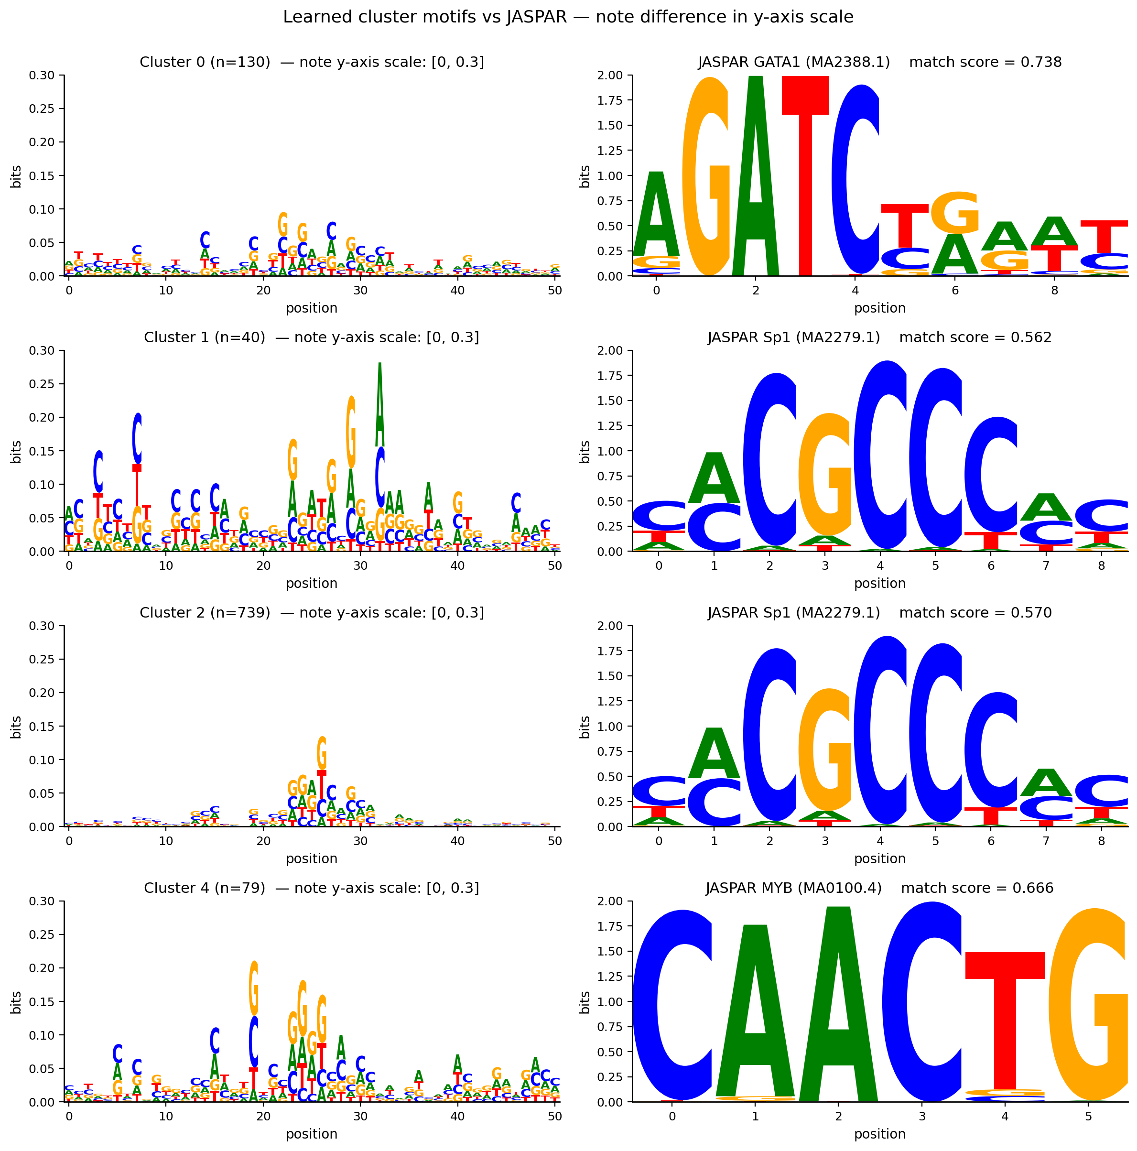
Model Interpretation
• In silico mutagenesis on top 1,000 chr10 predictions
• Saliency profiles clustered into 10 groups; PWMs matched against JASPAR
• Initial matches: GATA1 (0.74), Sp1 (0.57), MYB (0.67)
• But cluster PWMs are ~10x weaker than real motifs
Takeaway: the model uses regional GC-rich composition, not specific TF binding motifs.
Left column: cluster PWMs (y-axis 0 to 0.3 bits, zoomed).
Right column: matching JASPAR motifs (y-axis 0 to 2 bits, natural scale).
Dashed line in cluster panels marks 1.0 bits (typical TF motif strength).
Notes:
Strong test metrics raise the next question. What is the model actually paying attention to in the DNA? Did it learn known K562 transcription factor binding motifs, or is it relying on something else?
To answer that, I ran in silico mutagenesis on the top 1,000 highest-confidence chr10 predictions. For each one, I mutated every base in a 51 base-pair window around the prediction and recorded how much the prediction changed. Bases that drop the prediction when mutated are the bases the model relies on. This gives a saliency profile per position.
I then clustered the 1,000 profiles into 10 groups based on shape similarity. For each cluster, I built a position weight matrix from the underlying DNA sequences and compared it against JASPAR's database of known TF binding motifs using IC-weighted Pearson correlation across offset alignments.
Four clusters had meaningful matches to known K562 transcription factors. Cluster 0 with 130 members matched GATA1 at score 0.738. Cluster 1 with 40 members matched Sp1 at 0.562. Cluster 2 with 739 members matched Sp1 at 0.570. Cluster 4 with 79 members matched MYB at 0.666. At first glance this looks like a strong result. GATA1 is the master regulator of erythroid biology and a defining K562 TF. MYB is canonical in leukemia.
But the cluster PWMs themselves tell a different story. Look at the figure. The left column shows the cluster PWMs, with the y-axis zoomed to 0 to 0.3 bits. The right column shows the matching JASPAR motifs at their natural 0 to 2 bits scale. The dashed line in the cluster panels marks 1.0 bits, which is roughly where a typical TF motif position sits. The visual scale difference is the entire point. JASPAR motifs reach 1.5 to 2 bits at their peaks. The cluster PWMs cap out around 0.2 to 0.3 bits, an order of magnitude weaker.
The letter content also fails the eye test. The GATA1 cluster shows G and C enrichment, not the A and T pattern GATA1 binding requires. The MYB cluster is similar. The Sp1 matches are the most defensible since Sp1 binds GC-rich boxes and the model's preferences are GC-flavored, but even there the signal is much weaker than real Sp1 binding sites.
The conclusion is that the model uses regional GC-rich composition consistent with CpG-island context, not specific TF binding motifs. This lines up with the stratified result: compositional features are strongest near promoters, which is where the model does best.
Someone might ask whether I did anything beyond JASPAR matching. Yes, a peak-saliency realignment test that's in the report. When I realigned each cluster member to its peak-attention position, match scores collapsed rather than sharpened. If a real motif had been present, alignment would have sharpened the signal. The collapse confirms the matches were compositional.

Slide 11
Discussion & Conclusions
What this experiment shows
What this experiment does NOT show
• Pretrained beats from-scratch on every metric: AUPRC 0.269 vs 0.168, AUROC 0.923 vs 0.879
• The improvement holds across thresholds, enhancer subtypes, and matching rules
• Pretraining gain is slightly larger on dELS (+0.08) than pELS (+0.06)
• That the model is practically useful: precision at threshold 0.5 is only 18% • That Puffin-D is the right architecture: no comparison against simpler baselines (logistic regression, smaller CNNs)
• That the pretraining gain is statistically meaningful: only one run per condition, no variance estimate across seeds
• That the dELS-vs-pELS gap difference reflects regulatory biology rather than a general property of pretrained models on harder tasks
The more interesting finding
• Both models learn compositional features (GC content, CpG context), not specific TF binding motifs
• Confirmed via in silico mutagenesis and a peak-realignment test
• Informative about what Puffin-D-style CNNs capture: they recognize regulatory regions but not the specific TF rules within them
Limitations & future directions
• Single training run per condition limits statistical claims
• No baseline architecture comparison
• Small validation set (50 windows) caused noisy val-based selection
Code and results: https://github.com/hahu1013/enhancer_prediction_k562
Notes:
To wrap up, I want to be careful about what this experiment shows and what it doesn't.
What it shows: when you take the Puffin-D architecture and train it on K562 enhancer labels, pretraining from Puffin-D's promoter-task weights leads to a model that consistently outperforms training from random initialization on the same data. AUPRC goes from 0.168 to 0.269, a roughly 60 percent relative improvement. AUROC improves from 0.879 to 0.923. The improvement holds across decision thresholds, across both enhancer subtypes, and under both lenient and strict peak-matching rules. So the pretrained-vs-from-scratch comparison is internally consistent.
What it doesn't show is whether the model is actually useful. The AUPRC of 0.269 sounds impressive when described as 21 times above chance, but the absolute number is what matters for whether anyone could use this. At threshold 0.5, the model's precision is 18 percent, meaning four out of five positive predictions are wrong. This is far below what a researcher would need to use the model for discovery applications, like flagging candidate enhancers for experimental validation.
There are other things this experiment can't conclude. I didn't compare against simpler baselines like logistic regression on sequence composition, or smaller CNNs. So I can't claim Puffin-D is the right architecture for this task, only that this particular Puffin-D setup beats random initialization. I also only ran one training run per condition. Deep learning results can vary substantially across random seeds, so without multiple seeds I can't put error bars on the comparison. The improvement might be 60 percent, but it could be 40 or 80 across different seeds. We just don't know. And the slightly bigger gain on dELS than pELS, which I framed earlier as suggestive of real biological transfer, could equally be a general property of pretrained models, which tend to help more on harder tasks regardless of biology.
The more interesting scientific finding from this work is probably the interpretation analysis. Both models, even though they perform differently in absolute terms, learn the same kind of representations: compositional features like GC content and CpG context, rather than specific TF binding motifs. We confirmed this with in silico mutagenesis and a peak-realignment test that I described in the previous slide. This tells us something about what Puffin-D-style CNNs capture. They're good at recognizing where regulatory regions are, but not at identifying which specific transcription factors are binding there. This is a useful methodological observation about the class of architecture, regardless of whether the specific predictor is useful.
For limitations and future directions: more training seeds, baseline architecture comparisons, a larger validation set, wider ISM windows, and motif-aware training objectives are all worth pursuing.
The code and all results are at the GitHub link shown. Thanks for listening, I'm happy to take questions.

