Slide 1
AlexNet Backpropagation
하현숙

Slide 2
Backpropagation

Slide 3
























Forward
$$W_{11}^{2}$$
$$W_{11}^{3}$$
$$x_{1}$$
$$b_{1}$$
$$b_{1}$$
$$z_{1}$$
$$a_{1}^{3}, y_{1}$$
$$E_{1}$$
$$W_{21}^{2}$$
$$W_{21}^{3}$$
$$W_{12}^{2}$$
$$W_{12}^{3}$$
$$x_{2}$$
$$b_{2}$$
$$b_{2}$$
$$z_{2}$$
$$a_{2}^{3}{, y}_{1}$$
$$E_{2}$$
$$W_{22}^{2}$$
$$W_{22}^{3}$$
Input Layer
Hidden Layer
Output Layer
$$\begin{matrix}W_{11} & W_{12} \\ W_{21} & W_{22}\end{matrix}$$
$$\begin{matrix}b_{1} \\ b_{2}\end{matrix}$$
$$\begin{matrix}W_{11} & W_{12} \\ W_{21} & W_{22}\end{matrix}$$
$$\begin{matrix}b_{1} \\ b_{2}\end{matrix}$$
학습의 목표

Slide 4






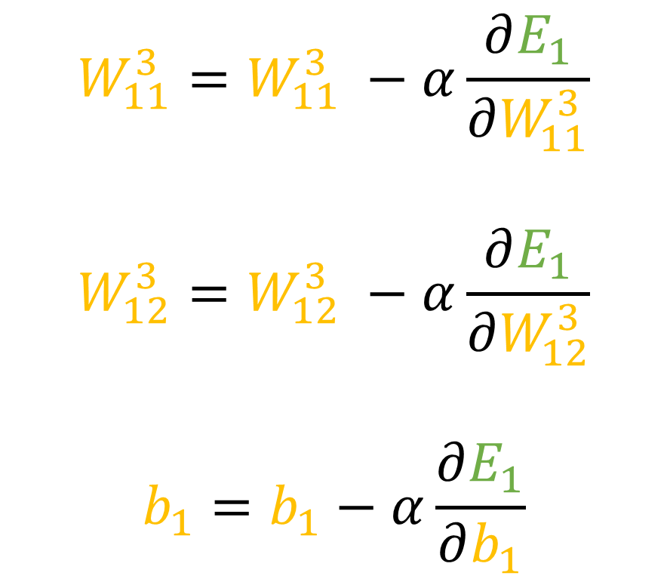






Backpropagation
$$W_{11}^{3}=W_{11}^{3} −α\frac{∂E_{1}}{∂W_{11}^{3}}$$
$$W_{12}^{3}=W_{12}^{3} −α\frac{∂E_{1}}{∂W_{12}^{3}}$$
$$b_{1}=b_{1}−α\frac{∂E_{1}}{∂b_{1}}$$
$$W_{11}^{3}$$
$$b_{1}$$
$$z_{1}$$
$$a_{1}^{3}$$
$$E_{1}$$
$$W_{21}^{3}$$
$$W_{12}^{3}$$
$$b_{2}$$
$$z_{2}$$
$$a_{2}^{3}$$
$$E_{2}$$
$$W_{22}^{3}$$
Output Layer

Slide 5


















Backpropagation
$$W_{11}^{2}$$
$$W_{11}^{3}$$
$$b_{1}$$
$$b_{1}$$
$$z_{1}$$
$$a_{1}^{3}, y_{1}$$
$$E_{1}$$
$$W_{21}^{2}$$
$$W_{21}^{3}$$
$$W_{12}^{2}$$
$$W_{12}^{3}$$
$$b_{2}$$
$$b_{2}$$
$$z_{2}$$
$$a_{2}^{3}{, y}_{1}$$
$$E_{2}$$
$$W_{22}^{2}$$
$$W_{22}^{3}$$
Hidden Layer
Output Layer

Slide 6
Convolution NN

Slide 7
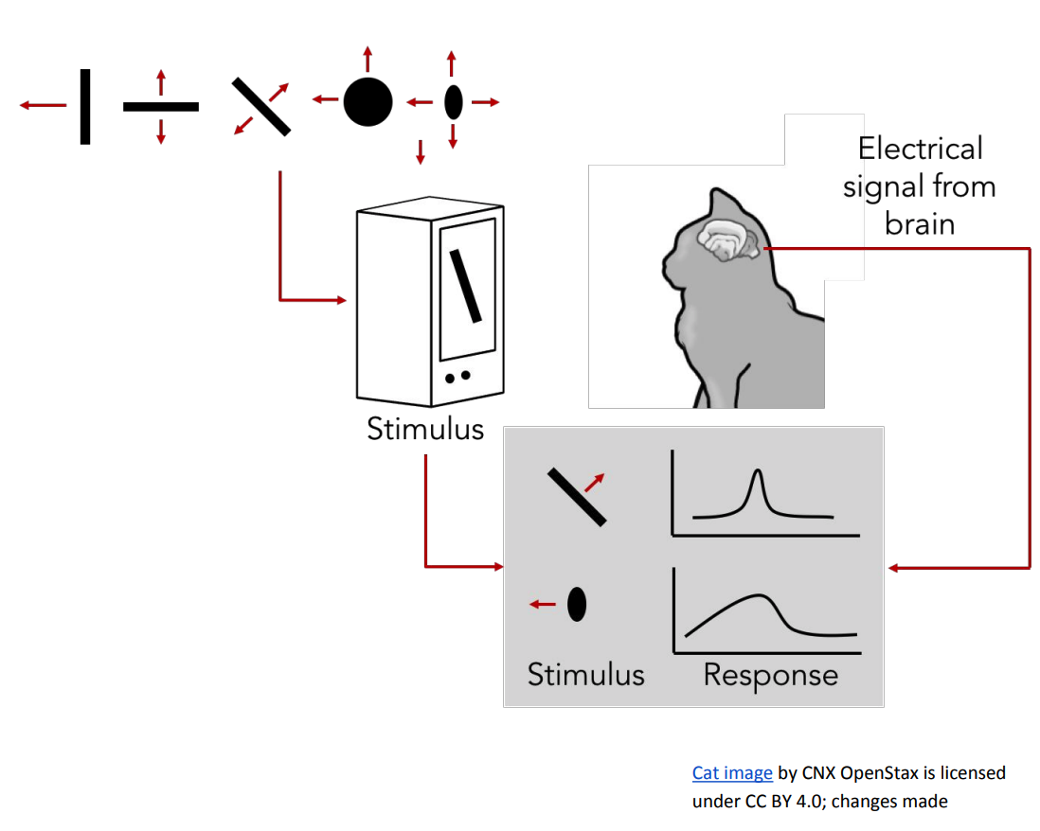
Convolution Neural Network

Slide 8
Convolution Neural Network
Input
Layer
Convolution
Layer
Fully-
Connected Layer
Output
Layer
Conv
ReLu
Pooling

Slide 9
Convolution
Filter or Kernel
입력 데이터의 특징(feature)을 추출하는 역할을 수행
1 | 2 | 3 | 0
0 | 1 | 2 | 3
3 | 0 | 1 | 2
2 | 3 | 0 | 1
2 | 0 | 1
0 | 1 | 2
1 | 0 | 2
15
=
+
*
Input
Filter(W)
연산 결과
Bias
많은 Filter를 사용하여 Convolution 층들을 만듦

Slide 10
Pooling Layer (sampling)
Overfitting을 방지하기 위한 Pooling
Notes:
https://zzsza.github.io/data/2018/05/14/cs231n-cnn/

Slide 11
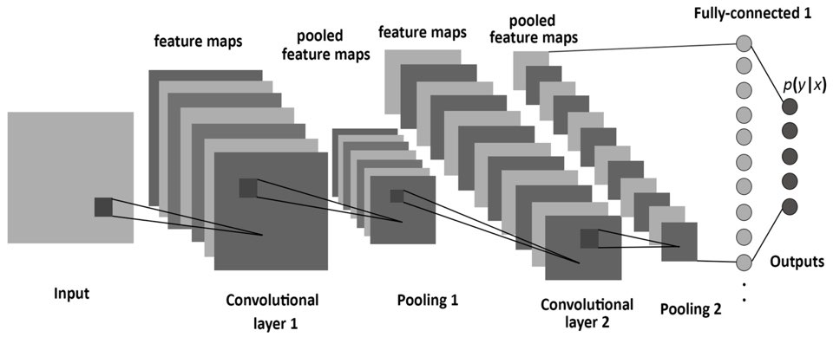
Convolution Neural Network

