Slide 1
Analysis of Algorithms CS 477/677
Instructor: Monica Nicolescu
Lecture 1

Slide 2
General Information
Instructor: Dr. Monica Nicolescu
E-mail: monica@cse.unr.edu
Office hours: Wed 12:30-2pm,
Thu: 10am-11am, 1-1:30pm
Office: SEM 239
Teaching assistant: Tawfiq Cowdhury
E-mail: mtawfiqc@nevada.unr.edu
Office hours: Tue: 12 pm– 1:00pm, Wed: 10-11am
Office: SEM 246
Class webpage:
http://www.cse.unr.edu/~monica/Courses/CS477-677/index.html

Slide 3
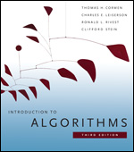
Class Policy
Grading
9-10 homeworks (40%)
Extra-credit
Programming component
Mid-term exam (25%)
Closed books, closed notes
Final exam (30%)
Closed books, closed notes
Attendance and class participation (5%)
Extra-credit
Late homework
10% penalty for each day of delay, up to 3 days
Introduction to Algorithms,
Thomas H. Cormen, Charles E. Leiserson, Ronald L. Rivest and Clifford Stein

Slide 4
Homework Submission
Typed covered page:
your name
the section you are in: CS477 or CS677
homework number
Handwriting is good for the rest of the homework, but write legibly
Staple pages together
Homework due at the beginning of the class, late after that

Slide 5
Academic Dishonesty
“Cheating, plagiarism or otherwise obtaining grades under false pretenses” constitute academic dishonesty according to the code of this university. Academic dishonesty will not be tolerated and penalties can include canceling a student’s enrollment without a grade, giving an F for the course or for the assignment. For more details, see the University of Nevada, Reno General Catalog.
Do not do this!

Slide 6
Why Study Algorithms?
Necessary in any computer programming problem
Improve algorithm efficiency: run faster, process more data, do something that would otherwise be impossible
Solve problems of significantly large size
Technology only improves things by a constant factor
Compare algorithms
Algorithms as a field of study
Learn about a standard set of algorithms
New discoveries arise
Numerous application areas
Learn techniques of algorithm design and analysis

Slide 7
Applications
Multimedia
CD player, DVD, MP3, JPG, DivX, HDTV
Internet
Packet routing, data retrieval (Google)
Communication
Cell-phones, e-commerce
Computers
Circuit layout, file systems
Science
Human genome
Transportation
Airline crew scheduling, UPS deliveries

Slide 8
Roadmap
Different problems
Sorting
Searching
String processing
Graph problems
Geometric problems
Numerical problems
Different design paradigms
Divide-and-conquer
Incremental
Dynamic programming
Greedy algorithms
Randomized/probabilistic

Slide 9
Analyzing Algorithms
Predict the amount of resources required:
memory: how much space is needed?
computational time: how fast the algorithm runs?
FACT: running time grows with the size of the input
Input size (number of elements in the input)
Size of an array, polynomial degree, # of elements in a matrix, # of bits in the binary representation of the input, vertices and edges in a graph
Def: Running time = the number of primitive operations (steps) executed before termination
Arithmetic operations (+, -, *), data movement, control, decision making (if, while), comparison

Slide 10
Algorithm Efficiency vs. Speed
E.g.: sorting n numbers
Friend’s computer = 10⁹ instructions/second
Friend’s algorithm = 2n² instructions
Your computer = 10⁷ instructions/second
Your algorithm = 50nlgn instructions
Your friend =
You =
Sort 10⁶ numbers!
20 times better!!

Slide 11
Algorithm Analysis: Example
Alg.: MIN (a[1], …, a[n])
m ← a[1];
for i ← 2 to n
if a[i] < m
then m ← a[i];
Running time:
the number of primitive operations (steps) executed before termination
T(n) =1 [first step] + (n) [for loop] + (n-1) [if condition] +
(n-1) [the assignment in then] = 3n - 1
Order (rate) of growth:
The leading term of the formula
Expresses the asymptotic behavior of the algorithm

Slide 12
Typical Running Time Functions
1 (constant running time):
Instructions are executed once or a few times
logN (logarithmic)
A big problem is solved by cutting the original problem in smaller sizes, by a constant fraction at each step
N (linear)
A small amount of processing is done on each input element
N logN
A problem is solved by dividing it into smaller problems, solving them independently and combining the solution

Slide 13
Typical Running Time Functions
N² (quadratic)
Typical for algorithms that process all pairs of data items (double nested loops)
N³ (cubic)
Processing of triples of data (triple nested loops)
N^{K} (polynomial)
2^{N} (exponential)
Few exponential algorithms are appropriate for practical use

Slide 14
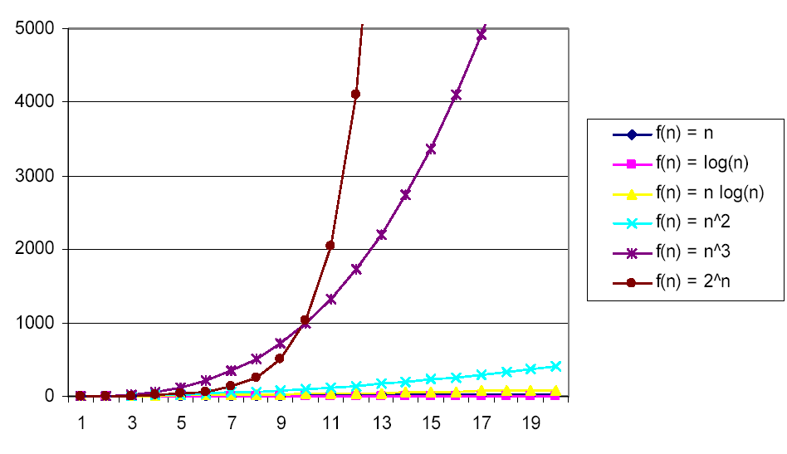
Why Faster Algorithms?

Slide 15
Asymptotic Notations
A way to describe behavior of functions in the limit
Abstracts away low-order terms and constant factors
How we indicate running times of algorithms
Describe the running time of an algorithm as n grows to ∞
O notation:
𝝮 notation:
Θ notation:
asymptotic “less than and equal”: f(n) “≤” g(n)
asymptotic “greater than and equal”: f(n) “≥” g(n)
asymptotic “equality”: f(n) “=” g(n)

Slide 16
Asymptotic Notations - Examples
Θ notation
n²/2 – n/2
(6n³ + 1)lgn/(n + 1)
n vs. n²
𝝮 notation
n³ vs. n²
n vs. logn
n vs. n²
= Θ(n²)
= Θ(n²lgn)
n ≠ Θ(n²)
O notation
2n² vs. n³
n² vs. n²
n³ vs. nlogn
n³ = 𝝮(n²)
2n² = O(n³)
n = 𝝮(logn)
n² = O(n²)
n ≠ 𝝮(n²)
n³ ≠ O(nlgn)

Slide 17
Mathematical Induction
Used to prove a sequence of statements (S(1), S(2), … S(n)) indexed by positive integers. S(n):
Proof:
Basis step: prove that the statement is true for n = 1
Inductive step: assume that S(n) is true and prove that S(n+1) is true for all n ≥ 1
The key to proving mathematical induction is to find case n “within” case n+1

Slide 18
Recursive Algorithms
Binary search: for an ordered array A, finds if x is in the array A[lo…hi]
Alg.: BINARY-SEARCH (A, lo, hi, x)
if (lo > hi)
return FALSE
mid ← ⎣(lo+hi)/2⎦
if x = A[mid]
return TRUE
if ( x < A[mid] )
BINARY-SEARCH (A, lo, mid-1, x)
if ( x > A[mid] )
BINARY-SEARCH (A, mid+1, hi, x)
1
2
3
4
5
6
7
8
2
3
5
7
9
10
11
12
mid
lo
hi

Slide 19
Recurrences
Def.: Recurrence = an equation or inequality that describes a function in terms of its value on smaller inputs, and one or more base cases
E.g.: T(n) = T(n-1) + n
Useful for analyzing recurrent algorithms
Methods for solving recurrences
Iteration method
Substitution method
Recursion tree method
Master method

Slide 20
Sorting – Analysis of Running Time
Iterative methods:
Insertion sort
Bubble sort
Selection sort
2, 3, 4, 5, 6, 7, 8, 9, 10, J, Q, K, A
Divide and conquer
Merge sort
Quicksort
Non-comparison methods
Counting sort
Radix sort
Bucket sort

Slide 21
Types of Analysis
Worst case
Provides an upper bound on running time
An absolute guarantee that the algorithm would not run longer, no matter what the inputs are
Best case
Input is the one for which the algorithm runs the fastest
Average case
Provides a prediction about the running time
Assumes that the input is random
(e.g. cards reversely ordered)
(e.g., cards already ordered)
(general case)

Slide 22
Specialized Data Structures
Problem:
Keeping track of customer account information at a bank or flight reservations
This applications requires fast search, insert/delete, sort
Solution: binary search trees
If y is in left subtree of x,
then key [y] ≤ key [x]
If y is in right subtree of x,
then key [y] ≥ key [x]
Red-black trees, interval trees, OS-trees
parent
L
R
key
data
Left child
Right child
15
6
18
3
7
17
20
2
4
13
9

Slide 23
Dynamic Programming
An algorithm design technique (like divide and conquer)
Richard Bellman, optimizing decision processes
Applicable to problems with overlapping subproblems
E.g.: Fibonacci numbers:
Recurrence: F(n) = F(n-1) + F(n-2)
Boundary conditions: F(1) = 0, F(2) = 1
Compute: F(5) = 3, F(3) = 1, F(4) = 2
Solution: store the solutions to subproblems in a table
Applications:
Assembly line scheduling, matrix chain multiplication, longest common sequence of two strings, 0-1 Knapsack problem

Slide 24
Greedy Algorithms
Problem
Schedule the largest possible set of non-overlapping activities for SEM 234
 | Start | End | Activity
1 | 8:00am | 9:15am | Numerical methods class
2 | 8:30am | 10:30am | Movie presentation (refreshments served)
3 | 9:20am | 11:00am | Data structures class
4 | 10:00am | noon | Programming club mtg. (Pizza provided)
5 | 11:30am | 1:00pm | Computer graphics class
6 | 1:05pm | 2:15pm | Analysis of algorithms class
7 | 2:30pm | 3:00pm | Computer security class
8 | noon | 4:00pm | Computer games contest (refreshments served)
9 | 4:00pm | 5:30pm | Operating systems class
✓
✓
✓
✓
✓
✓

Slide 25
Greedy Algorithms
Similar to dynamic programming, but simpler approach
Also used for optimization problems
Idea: When we have a choice to make, make the one that looks best right now
Make a locally optimal choice in hope of getting a globally optimal solution
Greedy algorithms don’t always yield an optimal solution
Applications:
Activity selection, fractional knapsack, Huffman codes

Slide 26
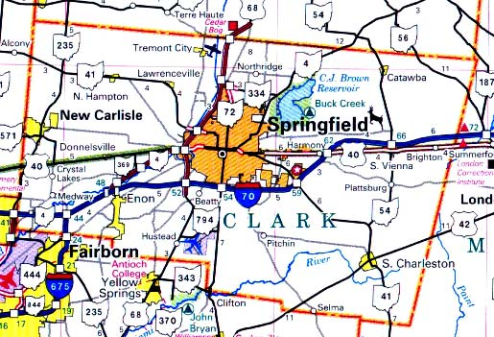
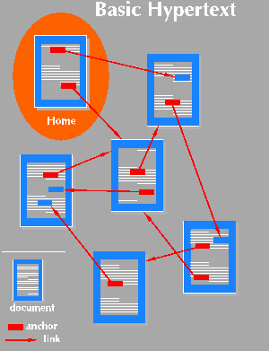

Graphs
Applications that involve not only a set of items, but also the connections between them
Maps
Schedules
Computer networks
Hypertext
Circuits

Slide 27
Searching in Graphs
Graph searching = systematically follow the edges of the graph so as to visit the vertices of the graph
Two basic graph methods:
Breadth-first search
Depth-first search
The difference between them is in the order in which they explore the unvisited edges of the graph
Graph algorithms are typically elaborations of the basic graph-searching algorithms
u
v
w
x
y
z

Slide 28

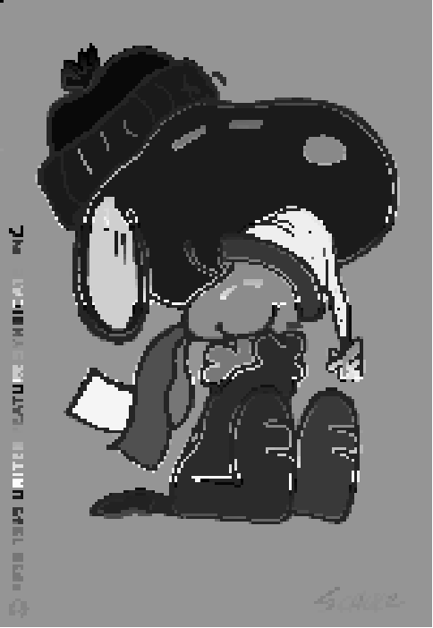
Strongly Connected Components
Read in a 2D image and find regions of pixels that have the same color
Original
Labeled

Slide 29
Minimum Spanning Trees
A connected, undirected graph:
Vertices = houses, Edges = roads
A weight w(u, v) on each edge (u, v) ∈ E
Find T ⊆ E such that:
T connects all vertices
w(T) = Σ_{(u,v)∈T} w(u, v) is
minimized
b
8
c
7
d
4
9
2
a
11
i
4
14
e
8
7
6
10
h
g
f
1
2
Algorithms: Kruskal and Prim

Slide 30
Shortest Path Problems
Input:
Directed graph G = (V, E)
Weight function w : E → R
Weight of path p = ⟨v₀, v₁, . . . , v_{k}⟩
Shortest-path weight from u to v:
δ(u, v) = min w(p) : u v if there exists a path from u to v
∞ otherwise
6
3
4
2
1
2
7
5
3
6
p

Slide 31
Variants of Shortest Paths
Single-source shortest path (Bellman-Ford, DAG shortest paths, Disjkstra)
G = (V, E) ⇒ find a shortest path from a given source vertex s to each vertex v ∈ V
Single-destination shortest path
Find a shortest path to a given destination vertex t from each vertex v
Reverse the direction of each edge ⇒ single-source
Single-pair shortest path
Find a shortest path from u to v for given vertices u and v
Solve the single-source problem
All-pairs shortest-paths (Matrix multiplication, Floyd-Warshall)
Find a shortest path from u to v for every pair of vertices u and v

Slide 32
Number Theoretic Algorithms
Secured communication: RSA public-key cryptosystem
Easy to find large primes
Hard to factor the product of large primes
Secure Message
eavesdropper
Bob
Alice
Authenticated Message

Slide 33
NP-Completeness
Not all problems can be solved in polynomial time
Some problems cannot be solved by any computer no matter how much time is provided (Turing’s Halting problem) – such problems are called undecidable
Some problems can be solved but not in O(n^{k})
Can we tell if a problem can be solved?
NP, NP-complete, NP-hard
Approximation algorithms

Slide 34
Readings
Chapter 1
Appendix A

