Slide 1
Analysis of Algorithms CS 477/677
Instructor: Monica Nicolescu
Lecture 10

Slide 2
How Fast Can We Sort?
Insertion sort, Bubble Sort, Selection Sort
Merge sort
Quicksort
What is common to all these algorithms?
These algorithms sort by making comparisons between the input elements
To sort n elements, comparison sorts must make 𝝮(nlgn) comparisons in the worst case
Θ(n²)
Θ(nlgn)
Θ(nlgn)

Slide 3
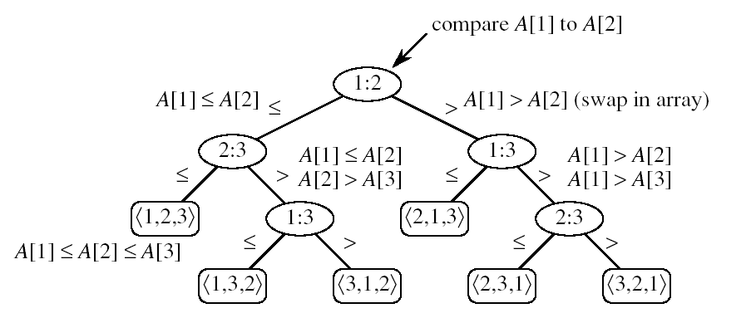
Decision Tree Model
Represents the comparisons made by a sorting algorithm on an input of a given size: models all possible execution traces
Control, data movement, other operations are ignored
Count only the comparisons
Decision tree for insertion sort on three elements:
one execution trace
node
leaf:

Slide 4

Decision Tree Model
All permutations on n elements must appear as one of the leaves in the decision tree
Worst-case number of comparisons
the length of the longest path from the root to a leaf
the height of the decision tree
n! permutations

Slide 5
Decision Tree Model
Goal: finding a lower bound on the running time on any comparison sort algorithm
find a lower bound on the heights of all decision trees for all algorithms

Slide 6
Lemma
Any binary tree of height h has at most
Proof: induction on h
Basis: h = 0 ⇒ tree has one node, which is a leaf
2^{h} = 1
Inductive step: assume true for h-1
Extend the height of the tree with one more level
Each leaf becomes parent to two new leaves
No. of leaves for tree of height h =
= 2 ×(no. of leaves for tree of height h-1)
≤ 2 ×2^{h-1}
= 2^{h}
2^{h} leaves

Slide 7
Lower Bound for Comparison Sorts
Theorem: Any comparison sort algorithm requires 𝝮(nlgn) comparisons in the worst case.
Proof: How many leaves does the tree have?
At least n! (each of the n! permutations of the input appears as some leaf) ⇒ n! ≤ l
At most 2^{h} leaves
⇒ n! ≤ l ≤ 2^{h}
⇒ h ≥ lg(n!) = 𝝮(nlgn)
h
leaves l
We can beat the 𝝮(nlgn) running time if we use other operations than comparisons!

Slide 8
Counting Sort
Assumption:
The elements to be sorted are integers in the range 0 to k
Idea:
Determine for each input element x, the number of elements smaller than x
Place element x into its correct position in the output array
1
2
3
4
5
6
7
8
0
1
2
3
4
5
A
2
5
3
0
2
3
0
3
C
2
2
4
7
7
8
1
2
3
4
5
6
7
8
B
0
0
2
2
3
3
3
5

Slide 9
COUNTING-SORT
1
j
n
A
Alg.: COUNTING-SORT(A, B, n, k)
for i ← 0 to k
do C[ i ] ← 0
for j ← 1 to n
do C[A[ j ]] ← C[A[ j ]] + 1
C[i] contains the number of elements equal to i
for i ← 1 to k
do C[ i ] ← C[ i ] + C[i -1]
C[i] contains the number of elements ≤ i
for j ← n downto 1
do B[C[A[ j ]]] ← A[ j ]
C[A[ j ]] ← C[A[ j ]] - 1
0
k
C
1
n
B

Slide 10
Example
1
2
3
4
5
6
7
8
0
1
2
3
4
5
A
2
5
3
0
2
3
0
3
C
2
2
4
7
7
8
0
1
2
3
4
5
C
2
0
2
3
0
1
1
2
3
4
5
6
7
8
1
2
3
4
5
6
7
8
B
3
B
0
3
0
1
2
3
4
5
0
1
2
3
4
5
C
2
2
4
6
7
8
C
1
2
4
6
7
8
1
2
3
4
5
6
7
8
1
2
3
4
5
6
7
8
B
0
3
3
B
0
2
3
3
0
1
2
3
4
5
0
1
2
3
4
5
C
1
2
4
5
7
8
C
1
2
3
5
7
8

Slide 11
Example (cont.)
1
2
3
4
5
6
7
8
A
2
5
3
0
2
3
0
3
1
2
3
4
5
6
7
8
1
2
3
4
5
6
7
8
B
0
0
2
3
3
B
0
0
2
3
3
3
5
0
1
2
3
4
5
0
1
2
3
4
5
C
0
2
3
5
7
8
C
0
2
3
4
7
7
1
2
3
4
5
6
7
8
1
2
3
4
5
6
7
8
B
0
0
2
3
3
3
B
0
0
2
2
3
3
3
5
0
1
2
3
4
5
C
0
2
3
4
7
8

Slide 12
Analysis of Counting Sort
Alg.: COUNTING-SORT(A, B, n, k)
for i ← 0 to k
do C[ i ] ← 0
for j ← 1 to n
do C[A[ j ]] ← C[A[ j ]] + 1
C[i] contains the number of elements equal to i
for i ← 1 to k
do C[ i ] ← C[ i ] + C[i -1]
C[i] contains the number of elements ≤ i
for j ← n downto 1
do B[C[A[ j ]]] ← A[ j ]
C[A[ j ]] ← C[A[ j ]] - 1
Θ(k)
Θ(n)
Θ(k)
Θ(n)
Overall time: Θ(n + k)

Slide 13
Analysis of Counting Sort
Overall time: Θ(n + k)
In practice we use COUNTING sort when k = O(n)
⇒ running time is Θ(n)
Counting sort is stable
Numbers with the same value appear in the same order in the output array
Important when additional data is carried around with the sorted keys

Slide 14

Radix Sort
Considers keys as numbers in a base-k number
A d-digit number will occupy a field of d columns
Sorting looks at one column at a time
For a d digit number, sort the least significant digit first
Continue sorting on the next least significant digit, until all digits have been sorted
Requires only d passes through the list

Slide 15

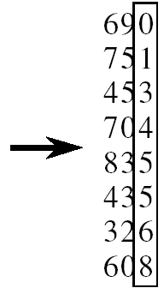
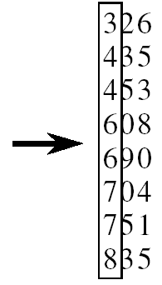
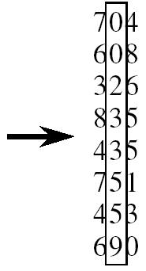
RADIX-SORT
Alg.: RADIX-SORT(A, d)
for i ← 1 to d
do use a stable sort to sort array A on digit i
1 is the lowest order digit, d is the highest-order digit

Slide 16
Analysis of Radix Sort
Given n numbers of d digits each, where each digit may take up to k possible values, RADIX-SORT correctly sorts the numbers in Θ(d(n+k))
One pass of sorting per digit takes Θ(n+k) assuming that we use counting sort
There are d passes (for each digit)

Slide 17
Correctness of Radix sort
We use induction on the number d of passes through the digits
Basis: If d = 1, there’s only one digit, trivial
Inductive step: assume digits 1, 2, . . . , d-1 are sorted
Now sort on the d-th digit
If a_{d} < b_{d}, sort will put a before b: correct
a < b regardless of the low-order digits
If a_{d} > b_{d}, sort will put a after b: correct
a > b regardless of the low-order digits
If a_{d} = b_{d}, sort will leave a and b in the
same order and a and b are already sorted
on the low-order d-1 digits

Slide 18
Bucket Sort
Assumption:
the input is generated by a random process that distributes elements uniformly over [0, 1)
Idea:
Divide [0, 1) into n equal-sized buckets
Distribute the n input values into the buckets
Sort each bucket
Go through the buckets in order, listing elements in each one
Input: A[1 . . n], where 0 ≤ A[i] < 1 for all i
Output: elements in A sorted
Auxiliary array: B[0 . . n - 1] of linked lists, each list initially empty

Slide 19
BUCKET-SORT
Alg.: BUCKET-SORT(A, n)
for i ← 1 to n
do insert A[i] into list B[⎣nA[i]⎦]
for i ← 0 to n - 1
do sort list B[i] with insertion sort
concatenate lists B[0], B[1], . . . , B[n -1] together in order
return the concatenated lists

Slide 20
Example - Bucket Sort
1
.78
.17
.39
.26
.72
.94
.21
.12
.23
.68
0
/
2
1
.17
.12 /
3
2
.26
.21
.23 /
4
3
.39 /
5
4
/
6
5
/
7
6
.68 /
8
7
.78
.72 /
9
8
/
10
9
.94 /

Slide 21
Example - Bucket Sort
.12
.17
.21
.23
.26
.39
.68
.72
.78
.94 /
0
/
1
.12
.17 /
2
.21
.23
.26 /
3
.39 /
4
/
5
/
6
.68 /
7
.72
.78 /
Concatenate the lists from
0 to n – 1 together, in order
8
/
9
.94 /

Slide 22
Correctness of Bucket Sort
Consider two elements A[i], A[ j]
Assume without loss of generality that A[i] ≤ A[j]
Then ⎣nA[i]⎦ ≤ ⎣nA[j]⎦
A[i] belongs to the same group as A[j] or to a group with a lower index than that of A[j]
If A[i], A[j] belong to the same bucket:
insertion sort puts them in the proper order
If A[i], A[j] are put in different buckets:
concatenation of the lists puts them in the proper order

Slide 23
Analysis of Bucket Sort
Alg.: BUCKET-SORT(A, n)
for i ← 1 to n
do insert A[i] into list B[⎣nA[i]⎦]
for i ← 0 to n - 1
do sort list B[i] with insertion sort
concatenate lists B[0], B[1], . . . , B[n -1] together in order
return the concatenated lists
𝝤(n)
Θ(n)
𝝤(n)
Θ(n)

Slide 24
Conclusion
Any comparison sort will take at least nlgn to sort an array of n numbers
We can achieve a better running time for sorting if we can make certain assumptions on the input data:
Counting sort: each of the n input elements is an integer in the range 0 to k
Radix sort: the elements in the input are integers represented with d digits
Bucket sort: the numbers in the input are uniformly distributed over the interval [0, 1)

Slide 25
A Job Scheduling Application
Job scheduling
The key is the priority of the jobs in the queue
The job with the highest priority needs to be executed next
Operations
Insert, remove maximum
Data structures
Priority queues
Ordered array/list, unordered array/list

Slide 26
PQ Implementations & Cost
Worst-case asymptotic costs for a PQ with N items
Insert
Remove max
ordered array
N
1
ordered list
N
1
unordered array
1
N
unordered list
1
N
Can we implement both operations efficiently?

Slide 27
Background on Trees
Def: Binary tree = structure composed of a finite set of nodes that either:
Contains no nodes, or
Is composed of three disjoint sets of nodes: a root node, a left subtree and a right subtree
4
root
Left subtree
Right subtree
1
3
2
16
9
10
14
8

Slide 28
Special Types of Trees
Def: Full binary tree = a binary tree in which each node is either a leaf or has degree (number of children) exactly 2.
Def: Complete binary tree = a binary tree in which all leaves have the same depth and all internal nodes have degree 2.
4
1
3
2
16
9
10
14
8
7
12
Full binary tree
4
1
3
2
16
9
10
Complete binary tree

Slide 29
Readings
Chapter 8

