Slide 1
Analysis of Algorithms CS 477/677
Instructor: Monica Nicolescu
Lecture 11

Slide 2
A Job Scheduling Application
Job scheduling
The key is the priority of the jobs in the queue
The job with the highest priority needs to be executed next
Operations
Insert, remove maximum
Data structures
Priority queues
Ordered array/list, unordered array/list

Slide 3
The Heap Data Structure
Def: A heap is a nearly complete binary tree with the following two properties:
Structural property: all levels are full, except possibly the last one, which is filled from left to right
Order (heap) property: for any node x
Parent(x) ≥ x
8
It doesn’t matter that 4 in level 1 is smaller than 5 in level 2
7
4
5
2
Heap

Slide 4
Definitions
Height of a node = the number of edges on a longest simple path from the node down to a leaf
Depth of a node = the length of a path from the root to the node
Height of tree = height of root node
= ⎣lgn⎦, for a heap of n elements
4
Height of root = 3
1
3
Height of (2)= 1
2
16
9
10
Depth of (10)= 2
14
8

Slide 5
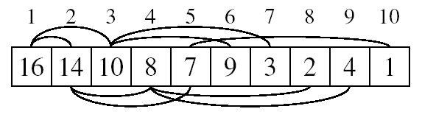
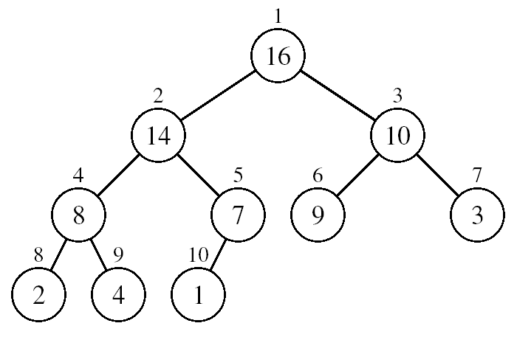
Array Representation of Heaps
A heap can be stored as an array A.
Root of tree is A[1]
Left child of A[i] = A[2i]
Right child of A[i] = A[2i + 1]
Parent of A[i] = A[ ⎣i/2⎦]
Heapsize[A] ≤ length[A]
The elements in the subarray A[(⎣n/2⎦ + 1) .. n] are leaves
The root is the maximum element of the heap

Slide 6
Heap Types
Max-heaps (largest element at root), have the max-heap property:
for all nodes i, excluding the root:
A[PARENT(i)] ≥ A[i]
Min-heaps (smallest element at root), have the min-heap property:
for all nodes i, excluding the root:
A[PARENT(i)] ≤ A[i]

Slide 7
Operations on Heaps
Maintain the max-heap property
MAX-HEAPIFY
Create a max-heap from an unordered array
BUILD-MAX-HEAP
Sort an array in place
HEAPSORT
Priority queue operations

Slide 8
Operations on Priority Queues
Max-priority queues support the following operations:
INSERT(S, x): inserts element x into set S
EXTRACT-MAX(S): removes and returns element of S with largest key
MAXIMUM(S): returns element of S with largest key
INCREASE-KEY(S, x, k): increases value of element x’s key to k (assume k ≥ current key value at x)

Slide 9
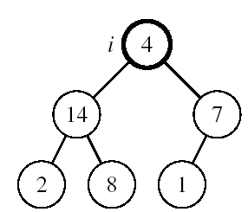
Maintaining the Heap Property
Suppose a node is smaller than a child
Left and Right subtrees of i are max-heaps
Invariant:
the heap condition is violated only at that node
To eliminate the violation:
Exchange with larger child
Move down the tree
Continue until node is not smaller than children

Slide 10
Maintaining the Heap Property
Alg: MAX-HEAPIFY(A, i, n)
l ← LEFT(i)
r ← RIGHT(i)
if l ≤ n and A[l] > A[i]
then largest ←l
else largest ←i
if r ≤ n and A[r] > A[largest]
then largest ←r
if largest ≠ i
then exchange A[i] ⟺ A[largest]
MAX-HEAPIFY(A, largest, n)
Assumptions:
Left and Right subtrees of i are max-heaps
A[i] may be smaller than its children

Slide 11
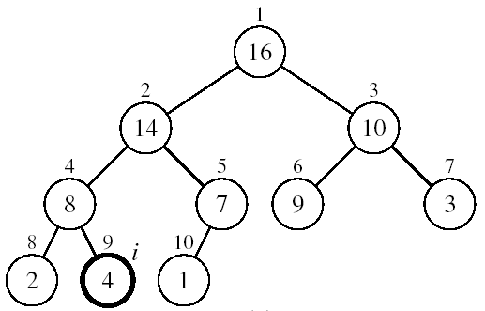
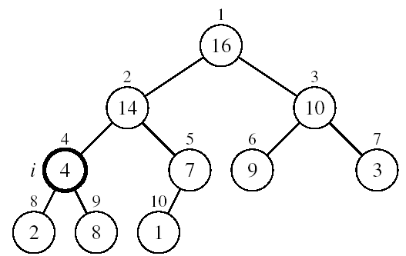
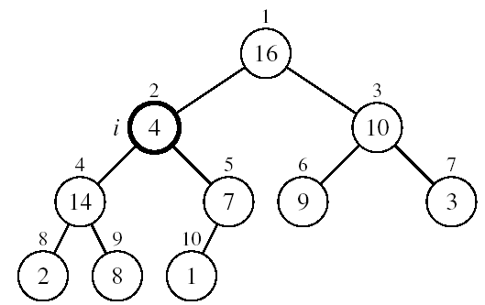
Example
MAX-HEAPIFY(A, 2, 10)
A[2] ⟷ A[4]
A[2] violates the heap property
A[4] violates the heap property
A[4] ⟷ A[9]
Heap property restored

Slide 12
MAX-HEAPIFY Running Time
Intuitively:
A heap is an almost complete binary tree ⇒ must process O(lgn) levels, with constant work at each level
Running time of MAX-HEAPIFY is O(lgn)
Can be written in terms of the height of the heap, as being O(h)
Since the height of the heap is ⎣lgn⎦

Slide 13
Building a Heap
Convert an array A[1 … n] into a max-heap (n = length[A])
The elements in the subarray A[(⎣n/2⎦+1) .. n] are leaves
Apply MAX-HEAPIFY on elements between 1 and ⎣n/2⎦
Alg: BUILD-MAX-HEAP(A)
n = length[A]
for i ← ⎣n/2⎦ downto 1
do MAX-HEAPIFY(A, i, n)
1
4
2
3
1
3
4
5
6
7
2
16
9
10
8
9
10
14
8
7
A:
4 | 1 | 3 | 2 | 16 | 9 | 10 | 14 | 8 | 7

Slide 14
Example: A
4 | 1 | 3 | 2 | 16 | 9 | 10 | 14 | 8 | 7
i = 5
i = 4
i = 3
1
1
1
4
4
4
2
3
2
3
2
3
1
3
1
3
1
3
4
5
6
7
4
5
6
7
4
5
6
7
2
16
9
10
2
16
9
10
14
16
9
10
8
9
10
8
9
10
8
9
10
14
8
7
14
8
7
2
8
7
i = 2
i = 1
1
1
1
4
4
16
2
3
2
3
2
3
1
10
16
10
14
10
4
5
6
7
4
5
6
7
4
5
6
7
14
16
9
3
14
7
9
3
8
7
9
3
8
9
10
8
9
10
8
9
10
2
8
7
2
8
1
2
4
1

Slide 15
Correctness of BUILD-MAX-HEAP
Loop invariant:
At the start of each iteration of the for loop, each node i + 1, i + 2,…, n is the root of a max-heap
Initialization:
i = ⎣n/2⎦: Nodes ⎣n/2⎦ + 1, ⎣n/2⎦ + 2, …, n are leaves ⇒ they are the root of trivial max-heaps
1
4
2
3
1
3
4
5
6
7
2
16
9
10
8
9
10
14
8
7

Slide 16
Correctness of BUILD-MAX-HEAP
Maintenance:
MAX-HEAPIFY makes node i a max-heap root and preserves the property that nodes i + 1, i + 2, …, n are roots of max-heaps
Decrementing i in the for loop reestablishes the loop invariant
Termination:
i = 0 ⇒ each node 1, 2, …, n is the root of a max-heap (by the loop invariant)
1
4
2
3
1
3
4
5
6
7
2
16
9
10
8
9
10
14
8
7

Slide 17
Running Time of BUILD MAX HEAP
Alg: BUILD-MAX-HEAP(A)
n = length[A]
for i ← ⎣n/2⎦ downto 1
do MAX-HEAPIFY(A, i, n)
O(n)
O(lgn)
⇒ It would seem that running time is O(nlgn)
This is not an asymptotically tight upper bound

Slide 18
Running Time of BUILD MAX HEAP
HEAPIFY takes O(h) ⇒ the cost of HEAPIFY on a node i is proportional to the height of the node i in the tree
Height
Level
No. of nodes
h₀ = 3 (⎣lgn⎦)
i = 0
2⁰
h₁ = 2
i = 1
2¹
h₂ = 1
i = 2
2²
h₃ = 0
i = 3 (⎣lgn⎦)
2³
h_{i} = h – i height of the heap rooted at level i
n_{i} = 2^{i} number of nodes at level i

Slide 19
Running Time of BUILD MAX HEAP
Cost of HEAPIFY at level i × number of nodes at that level
Replace the values of n_{i} and h_{i} computed before
Multiply by 2^{h} both at the numerator and denominator
and write 2^{i} as
Change variables: k = h - i
The sum above is smaller than the sum of all elements to ∞
and h = lgn
The sum above is smaller than 2
Running time of BUILD-MAX-HEAP: T(n) = O(n)

Slide 20
Operations on Priority Queues
Max-priority queues support the following operations:
INSERT(S, x): inserts element x into set S
EXTRACT-MAX(S): removes and returns element of S with largest key
MAXIMUM(S): returns element of S with largest key
INCREASE-KEY(S, x, k): increases value of element x’s key to k (assume k ≥ current key value at x)

Slide 21
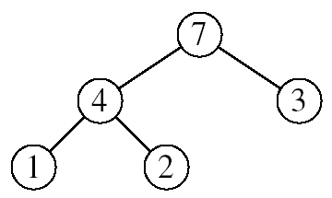
HEAP-MAXIMUM
Goal:
Return the largest element of the heap
Alg: HEAP-MAXIMUM(A)
return A[1]
Running time: O(1)
Heap A:
Heap-Maximum(A) returns 7

Slide 22
HEAP-EXTRACT-MAX
Goal:
Extract the largest element of the heap (i.e., return the max value and also remove that element from the heap
Idea:
Exchange the root element with the last
Decrease the size of the heap by 1 element
Call MAX-HEAPIFY on the new root, on a heap of size n-1
Heap A:
Root is the largest element

Slide 23
HEAP-EXTRACT-MAX
Alg: HEAP-EXTRACT-MAX(A, n)
if n < 1
then error “heap underflow”
max ← A[1]
A[1] ← A[n]
MAX-HEAPIFY(A, 1, n-1) remakes heap
return max
Running time: O(lgn)

Slide 24
Example: HEAP-EXTRACT-MAX
16
1
14
10
max = 16
14
10
8
7
9
3
8
7
9
3
2
4
1
2
4
Heap size decreased with 1
14
Call MAX-HEAPIFY(A, 1, n-1)
8
10
4
7
9
3
2
1

Slide 25
HEAP-INCREASE-KEY
Goal:
Increases the key of an element i in the heap
Idea:
Increment the key of A[i] to its new value
If the max-heap property does not hold anymore: traverse a path toward the root to find the proper place for the newly increased key
16
14
10
8
i
7
9
3
Key [i] ← 15
2
4
1

Slide 26
HEAP-INCREASE-KEY
Alg: HEAP-INCREASE-KEY(A, i, key)
if key < A[i]
then error “new key is smaller than current key”
A[i] ← key
while i > 1 and A[PARENT(i)] < A[i]
do exchange A[i] ⟺ A[PARENT(i)]
i ← PARENT(i)
Running time: O(lgn)
16
14
10
8
i
7
9
3
2
4
1
Key [i] ← 15

Slide 27
Example: HEAP-INCREASE-KEY
16
16
14
10
14
10
8
i
7
9
3
8
i
7
9
3
2
4
1
2
15
1
Key [i ] ← 15
16
16
i
14
10
15
10
i
15
7
9
3
14
7
9
3
2
8
1
2
8
1

Slide 28
MAX-HEAP-INSERT
Goal:
Inserts a new element into a max-heap
Idea:
Expand the max-heap with a new element whose key is -∞
Calls HEAP-INCREASE-KEY to set the key of the new node to its correct value and maintain the max-heap property
16
14
10
8
7
9
3
2
4
1
-∞
16
14
10
8
7
9
3
2
4
1
15

Slide 29
MAX-HEAP-INSERT
Alg: MAX-HEAP-INSERT(A, key, n)
heap-size[A] ← n + 1
A[n + 1] ← - ∞
HEAP-INCREASE-KEY(A, n + 1, key)
16
14
10
8
7
9
3
2
4
1
-∞
Running time: O(lgn)

Slide 30
Example: MAX-HEAP-INSERT
Insert value 15:
- Start by inserting -∞
Increase the key to 15
Call HEAP-INCREASE-KEY on A[11] = 15
16
16
14
10
14
10
8
7
9
3
8
7
9
3
2
4
1
-∞
2
4
1
15
The restored heap containing
the newly added element
16
16
14
10
15
10
8
15
9
3
8
14
9
3
2
4
1
7
2
4
1
7

Slide 31
Summary
We can perform the following operations on heaps:
MAX-HEAPIFY O(lgn)
BUILD-MAX-HEAP O(n)
HEAP-SORT O(nlgn)
MAX-HEAP-INSERT O(lgn)
HEAP-EXTRACT-MAX O(lgn)
HEAP-INCREASE-KEY O(lgn)
HEAP-MAXIMUM O(1)

Slide 32
Binary Search Trees
Tree representation:
A linked data structure in which each node is an object
Node representation:
Key field
Satellite data
Left: pointer to left child
Right: pointer to right child
p: pointer to parent (p [root [T]] = NIL)
Satisfies the binary search tree property
parent
L
R
key
data
Left child
Right child

Slide 33
Binary Search Tree Example
Binary search tree property:
If y is in left subtree of x,
then key [y] ≤ key [x]
If y is in right subtree of x,
then key [y] ≥ key [x]
5
3
7
2
5
9

Slide 34
Binary Search Trees
Support many dynamic set operations
SEARCH, MINIMUM, MAXIMUM, PREDECESSOR, SUCCESSOR, INSERT, DELETE
Running time of basic operations on binary search trees
On average: Θ(lgn)
The expected height of the tree is lgn
In the worst case: Θ(n)
The tree is a linear chain of n nodes

Slide 35
Red-Black Trees
“Balanced” binary trees guarantee an O(lgn) running time on the basic dynamic-set operations
Red-black tree
Binary tree with an additional attribute for its nodes: color which can be red or black
Constrains the way nodes can be colored on any path from the root to a leaf
Ensures that no path is more than twice as long as another ⇒ the tree is balanced
The nodes inherit all the other attributes from the binary-search trees: key, left, right, p

Slide 36
Red-Black Trees Properties
Every node is either red or black
The root is black
Every leaf (NIL) is black
If a node is red, then both its children are black
No two red nodes in a row on a simple path from the root to a leaf
For each node, all paths from the node to descendant leaves contain the same number of black nodes

Slide 37
Example: RED-BLACK TREE
26
17
41
NIL
NIL
30
47
38
NIL
50
NIL
NIL
NIL
NIL
NIL
For convenience we use a sentinel NIL[T] to represent all the NIL nodes at the leafs
NIL[T] has the same fields as an ordinary node
Color[NIL[T]] = BLACK
The other fields may be set to arbitrary values

Slide 38
Black-Height of a Node
h = 4
bh = 2
26
h = 1
bh = 1
h = 3
bh = 2
17
41
NIL
NIL
h = 2
bh = 1
h = 2
bh = 1
30
47
h = 1
bh = 1
38
50
h = 1
bh = 1
NIL
NIL
NIL
NIL
NIL
NIL
Height of a node: the number of edges in a longest path to a leaf
Black-height of a node x: bh(x) is the number of black nodes (including NIL) on a path from x to leaf, not counting x

Slide 39
Readings
Chapter 6, 7, 8

