Slide 1
Analysis of Algorithms CS 477/677
Instructor: Monica Nicolescu
Lecture 12

Slide 2
Red-Black Trees
“Balanced” binary trees guarantee an O(lgn) running time on the basic dynamic-set operations
Red-black tree
Binary tree with an additional attribute for its nodes: color which can be red or black
Constrains the way nodes can be colored on any path from the root to a leaf
Ensures that no path is more than twice as long as another ⇒ the tree is balanced
The nodes inherit all the other attributes from the binary-search trees: key, left, right, p

Slide 3
Red-Black Trees Properties
Every node is either red or black
The root is black
Every leaf (NIL) is black
If a node is red, then both its children are black
No two red nodes in a row on a simple path from the root to a leaf
For each node, all paths from the node to descendant leaves contain the same number of black nodes

Slide 4
Black-Height of a Node
h = 4
bh = 2
26
h = 1
bh = 1
h = 3
bh = 2
17
41
NIL
NIL
h = 2
bh = 1
h = 2
bh = 1
30
47
h = 1
bh = 1
38
50
h = 1
bh = 1
NIL
NIL
NIL
NIL
NIL
NIL
Height of a node: the number of edges in a longest path to a leaf
Black-height of a node x: bh(x) is the number of black nodes (including NIL) on a path from x to leaf, not counting x

Slide 5
Properties of Red-Black Trees
Claim
Any node with height h has black-height ≥ h/2
Proof
By property 4, there are at most h/2 red nodes on the path from the node to a leaf
Hence at least h/2 are black
26
17
41
Property 4: if a node is red then both its children are black
30
47
38
50

Slide 6
Properties of Red-Black Trees
Claim
The subtree rooted at any node x contains at least 2^{bh(x)} - 1 internal nodes
Proof: By induction on height of x
Basis: height[x] = 0 ⇒
x is a leaf (NIL[T]) ⇒
bh(x) = 0 ⇒
# of internal nodes: 2⁰ - 1 = 0
x
NIL

Slide 7
Properties of Red-Black Trees
Inductive step:
Let height(x) = h and bh(x) = b
Any child y of x has:
bh (y) =
bh (y) =
b (if the child is red), or
b - 1 (if the child is black)
26
17
41
30
47
38
50

Slide 8
Properties of Red-Black Trees
Want to prove:
The subtree rooted at any node x contains at least 2^{bh(x)} - 1 internal nodes
Assume true for children of x:
Their subtrees contain at least 2^{bh(x) - 1} – 1 internal nodes
The subtree rooted at x contains at least:
(2^{bh(x) - 1} – 1) + (2^{bh(x) - 1} – 1) + 1 =
2 · (2^{bh(x) - 1} - 1) + 1 =
2^{bh(x)} - 1 internal nodes
x
l
r

Slide 9
Properties of Red-Black Trees
Lemma: A red-black tree with n internal nodes has height at most 2lg(n + 1).
Proof:
n
Add 1 to all sides and then take logs:
n + 1 ≥ 2^{b} ≥ 2^{h/2}
lg(n + 1) ≥ h/2 ⇒
h ≤ 2 lg(n + 1)
height(root) = h
root
bh(root) = b
≥ 2^{b} - 1
≥ 2^{h/2} - 1
l
r
number n
of internal
nodes
since b ≥ h/2

Slide 10
Operations on Red-Black Trees
The non-modifying binary-search tree operations MINIMUM, MAXIMUM, SUCCESSOR, PREDECESSOR, and SEARCH run in O(h) time
They take O(lgn) time on red-black trees
What about TREE-INSERT and TREE-DELETE?
They will still run in O(lgn)
We have to guarantee that the modified tree will still be a red-black tree

Slide 11
INSERT
INSERT: what color to make the new node?
Red? Let’s insert 35!
Property 4: if a node is red, then both its children are black
Black? Let’s insert 14!
Property 5: all paths from a node to its leaves contain the same number of black nodes
26
17
41
30
47
38
50

Slide 12
DELETE
26
17
41
DELETE: what color was the
node that was removed? Red?
Every node is either red or black
The root is black
Every leaf (NIL) is black
If a node is red, then both its children are black
For each node, all paths from the node to descendant leaves contain the same number of black nodes
30
47
38
50
OK!
OK!
OK!
OK! Does not change
any black heights
OK! Does not create
two red nodes in a row

Slide 13
DELETE
26
17
41
DELETE: what color was the
node that was removed? Black?
Every node is either red or black
The root is black
Every leaf (NIL) is black
If a node is red, then both its children are black
For each node, all paths from the node to descendant leaves contain the same number of black nodes
30
47
38
50
OK!
Not OK! If removing the root and the child that replaces it is red
OK!
Not OK! Could change the
black heights of some nodes
Not OK! Could create
two red nodes in a row

Slide 14
Rotations
Operations for restructuring the tree after insert and delete operations on red-black trees
Rotations take a red-black tree and a node within the tree and:
Together with some node re-coloring they help restore the red-black tree property
Change some of the pointer structure
Do not change the binary-search tree property
Two types of rotations:
Left & right rotations

Slide 15
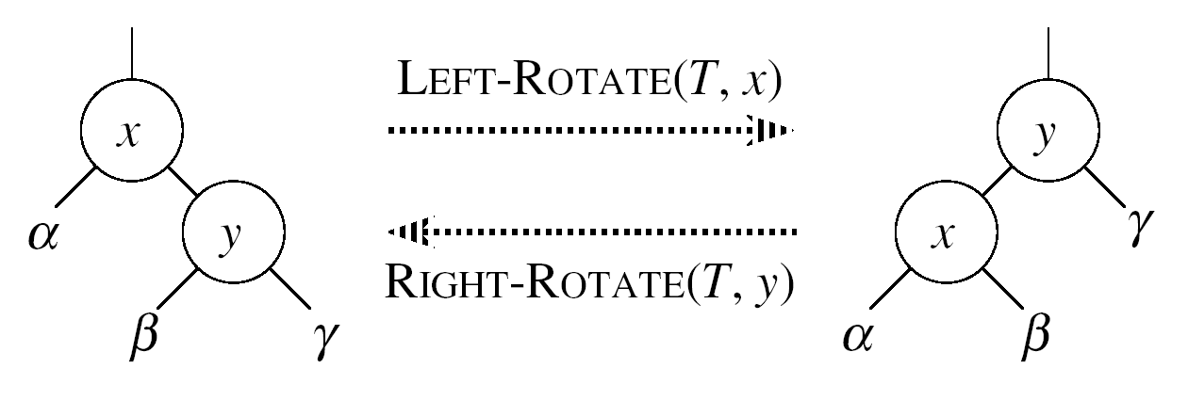
Left Rotations
Assumption for a left rotation on a node x:
The right child of x (y) is not NIL
Idea:
Pivots around the link from x to y
Makes y the new root of the subtree
x becomes y’s left child
y’s left child becomes x’s right child

Slide 16
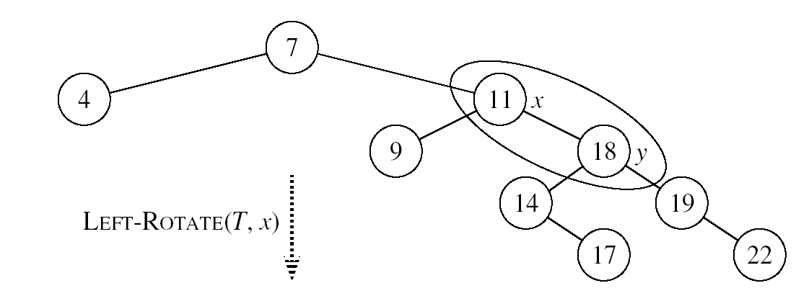
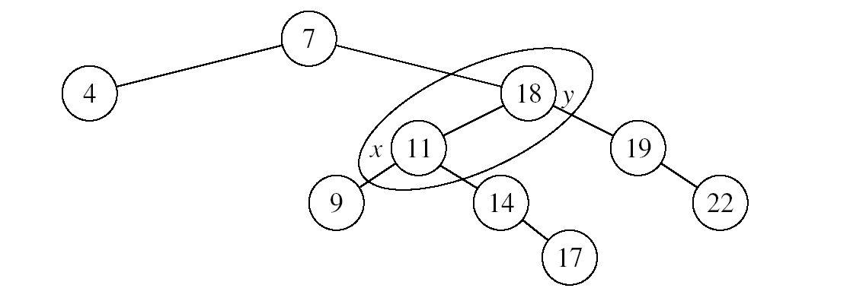
Example: LEFT-ROTATE

Slide 17
LEFT-ROTATE(T, x)
y ← right[x] ►Set y
right[x] ← left[y] ► y’s left subtree becomes x’s right subtree
if left[y] ≠ NIL
then p[left[y]] ← x ► Set the parent relation from left[y] to x
p[y] ← p[x] ► The parent of x becomes the parent of y
if p[x] = NIL
then root[T] ← y
else if x = left[p[x]]
then left[p[x]] ← y
else right[p[x]] ← y
left[y] ← x ► Put x on y’s left
p[x] ← y ► y becomes x’s parent

Slide 18
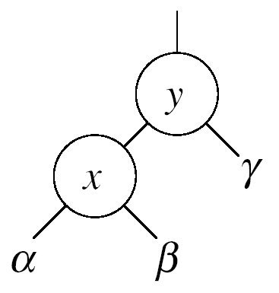
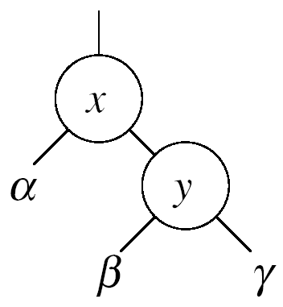


Right Rotations
Assumption for a right rotation on a node x:
The left child of y (x) is not NIL
Idea:
Pivots around the link from y to x
Makes x the new root of the subtree
y becomes x’s right child
x’s right child becomes y’s left child

Slide 19
Insertion
Goal:
Insert a new node z into a red-black tree
Idea:
Insert node z into the tree as for an ordinary binary search tree
Color the node red
Restore the red-black tree properties
Use an auxiliary procedure RB-INSERT-FIXUP

Slide 20
RB-INSERT(T, z)
26
17
41
30
47
Initialize nodes x and y
Throughout the algorithm y points
to the parent of x
y ← NIL
x ← root[T]
while x ≠ NIL
do y ← x
if key[z] < key[x]
then x ← left[x]
else x ← right[x]
p[z] ← y
38
50
Go down the tree until
reaching a leaf
At that point y is the
parent of the node to be
inserted
Sets the parent of z to be y

Slide 21
RB-INSERT(T, z)
26
17
41
if y = NIL
then root[T] ← z
else if key[z] < key[y]
then left[y] ← z
else right[y] ← z
left[z] ← NIL
right[z] ← NIL
color[z] ← RED
RB-INSERT-FIXUP(T, z)
30
47
The tree was empty:
set the new node to be the root
38
50
Otherwise, set z to be the left or right child of y, depending on whether the inserted node is smaller or larger than y’s key
Set the fields of the newly added node
Fix any inconsistencies that could have
been introduced by adding this new red
node

Slide 22
RB Properties Affected by Insert
OK!
Every node is either red or black
The root is black
Every leaf (NIL) is black
If a node is red, then both its children are black
For each node, all paths
from the node to descendant
leaves contain the same number
of black nodes
If z is the root
⇒ not OK
OK!
If p(z) is red ⇒ not OK
z and p(z) are both red
OK!
26
17
41
38
47
50

Slide 23
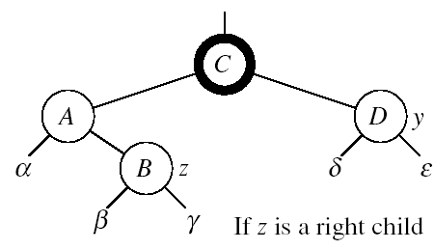
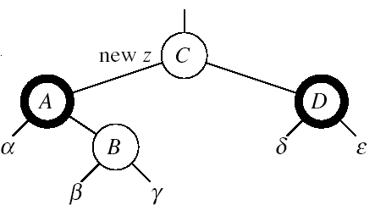

RB-INSERT-FIXUP – Case 1
z’s “uncle” (y) is red
Idea: (z is a right child)
p[p[z]] (z’s grandparent) must be black: z and p[z] are both red
Color p[z] black
Color y black
Color p[p[z]] red
Push the red node up the tree
Make z = p[p[z]]

Slide 24
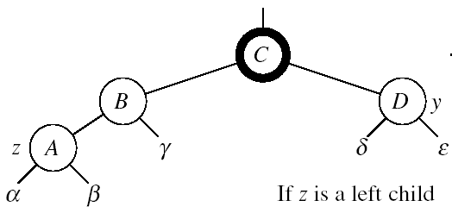
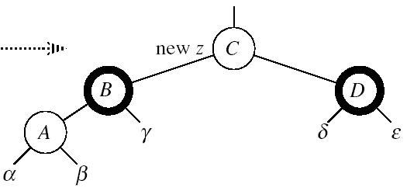

RB-INSERT-FIXUP – Case 1
z’s “uncle” (y) is red
Idea: (z is a left child)
p[p[z]] (z’s grandparent) must be black: z and p[z] are both red
color[p[z]] ← black
color[y] ← black
color p[p[z]] ← red
z = p[p[z]]
Push the red node up the tree
Case1

Slide 25
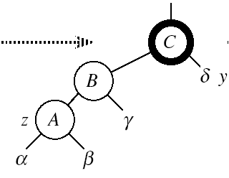

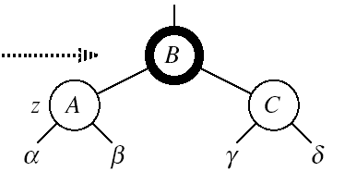
RB-INSERT-FIXUP – Case 3
Case 3:
z’s “uncle” (y) is black
z is a left child
Idea:
color[p[z]] ← black
color[p[p[z]]] ← red
RIGHT-ROTATE(T, p[p[z]])
No longer have 2 reds in a row
p[z] is now black
Case3
Case 3

Slide 26
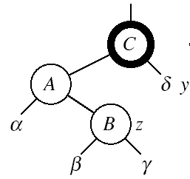
RB-INSERT-FIXUP – Case 2
Case 2:
z’s “uncle” (y) is black
z is a right child
Idea:
z ← p[z]
LEFT-ROTATE(T, z)
⇒ now z is a left child, and both z and p[z] are red ⇒ case 3
Case2
Case 2
Case 3

Slide 27
RB-INSERT-FIXUP(T, z)
while color[p[z]] = RED
do if p[z] = left[p[p[z]]]
then y ← right[p[p[z]]]
if color[y] = RED
then Case1
else if z = right[p[z]]
then Case2
Case3
else (same as then clause with “right” and “left” exchanged)
color[root[T]] ← BLACK
The while loop repeats only when
case1 is executed: O(lgn) times
Set the value of x’s “uncle”
We just inserted the root, or
the red node reached the root

Slide 28
Example
Insert 4
11
Case 1
11
Case 2
2
14
2
14
y
1
7
7
z
15
1
15
5
8
y
5
8
z and p[z] are both red
z’s uncle y is red
z and p[z] are both red
z’s uncle y is black
z is a right child
z
4
4
11
7
Case 3
z
7
14
y
2
11
z
2
8
15
1
5
8
14
1
5
z and p[z] are red
z’s uncle y is black
z is a left child
4
15
4

Slide 29
Analysis of RB-INSERT
Inserting the new element into the tree O(lgn)
RB-INSERT-FIXUP
The while loop repeats only if CASE 1 is executed
The number of times the while loop can be executed is O(lgn)
Total running time of RB-INSERT: O(lgn)

Slide 30
Red-Black Trees - Summary
Operations on red-black trees:
SEARCH O(h)
PREDECESSOR O(h)
SUCCESOR O(h)
MINIMUM O(h)
MAXIMUM O(h)
INSERT O(h)
DELETE O(h)
Red-black trees guarantee that the height of the tree will be O(lgn)

Slide 31
Augmenting Data Structures
Let’s look at two new problems:
Dynamic order statistic
Interval search
It is unusual to have to design all-new data structures from scratch
Typically: store additional information in an already known data structure
The augmented data structure can support new operations
We need to correctly maintain the new information without loss of efficiency

Slide 32
Dynamic Order Statistics
Def.: the i-th order statistic of a set of n elements, where i ∈ {1, 2, …, n} is the element with the i-th smallest key.
We can retrieve an order statistic from an unordered set:
Using:
In:
We will show that:
With red-black trees we can achieve this in O(lgn)
Finding the rank of an element takes also O(lgn)
RANDOMIZED-SELECT
O(n) time

Slide 33
Order-Statistic Tree
Def.: Order-statistic tree: a red-black tree with additional information stored in each node
Node representation:
Usual fields: key[x], color[x], p[x], left[x], right[x]
Additional field: size[x] that contains the number of (internal) nodes in the subtree rooted at x (including x itself)
For any internal node of the tree:
size[x] =
size[left[x]] + size[right[x]] + 1

Slide 34
Readings
Chapters 14, 15

